Slide 1
WebSage: AI-Powered Web Scraping and Semantic Analysis Framework for Product Insights and Decision Support

Slide 2
ABSTRACT:
WebSage is an intelligent AI-powered web scraping tool designed to extract, analyze, and present product information from websites in a structured and meaningful way. Unlike traditional scrapers that only provide raw data, WebSage integrates web scraping, multi-language semantic analysis, and data visualization into a single platform. Using BeautifulSoup and Requests, the system collects product details such as prices, descriptions, and features. The Gemini API enables multi-language semantic search and natural language question answering, allowing users to query products in simple conversational language across different languages. The extracted data is further analyzed and visualized through Matplotlib, Seaborn, and Plotly, offering insights like price trends, feature comparisons, and brand analysis. A user-friendly interface built with Streamlit makes the tool accessible to both technical and non-technical users. WebSage is designed to support businesses, researchers, and consumers by providing real-time, scalable, and actionable insights for smarter decision-making.

Slide 3
Understand Web Scraping & Define System Scope
Activities Performed
Collected and reviewed research papers and technical articles on modern web-scraping techniques.
Analysed use cases such as e-commerce product extraction, news aggregation, and academic data collection.
Defined the scope of the project “WebSage”—focus on product-related websites and semantic search capability.
Literature / Journals Studied
1)Web Data Extraction, Applications and Techniques: A Survey
https://www.researchgate.net/publication/228095933_Web_Data_Extraction_Applications_and_Techniques_A_Survey
2) Fields of Gold: Scraping Web Data for Marketing Insights
https://journals.sagepub.com/doi/10.1177/00222429221100750
3) Intelligent Semantic Search for Academic Journals Using AI and NLP Techniques
https://www.researchgate.net/publication/391435093_Intelligent_Semantic_Search_for_Academic_Journals_Using_AI_and_NLP_Techniques

Slide 4
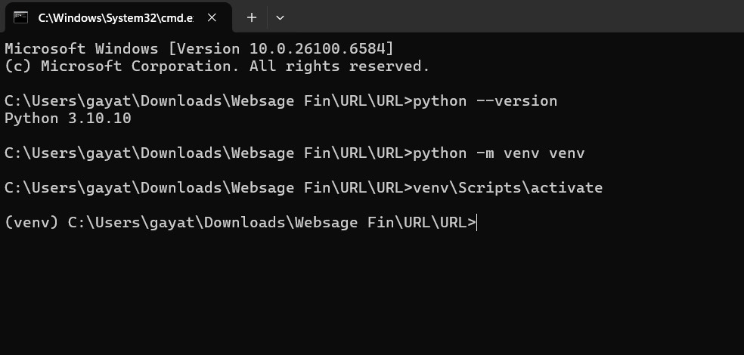
Development Environment Setup
Installed Python 3.x and required packages:
beautifulsoup4, requests, streamlit, openai, pandas, numpy.
Created a virtual environment to keep project dependencies isolated.
python -m venv venv
Activated the virtual environment
.\venv\Scripts\activate
Configured VS Code:
Installed Python extension.

Slide 5
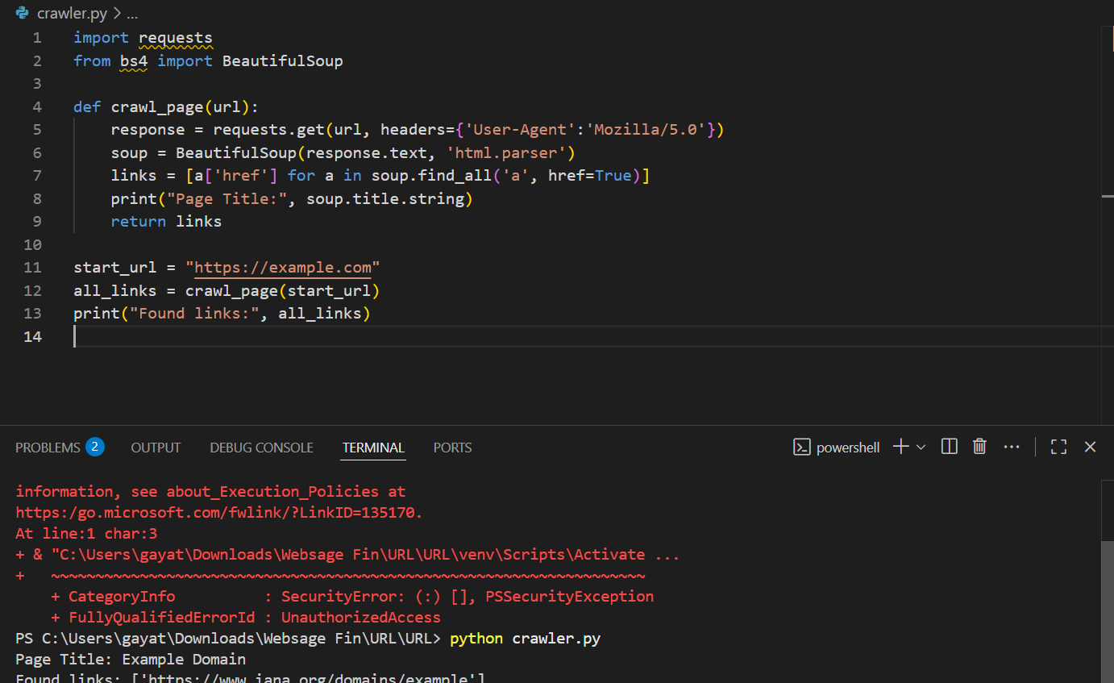
Implement HTML Crawler with BeautifulSoup
Built a basic HTML crawler using Python.
Imported requests and BeautifulSoup to fetch and parse web pages.
Wrote a function to send HTTP GET requests to target URLs.
Parsed HTML responses to extract <title> and <a> link elements.
Stored extracted links in a list for later use.
Tested the crawler on https://example.com and successfully printed the page title and links.

Slide 6
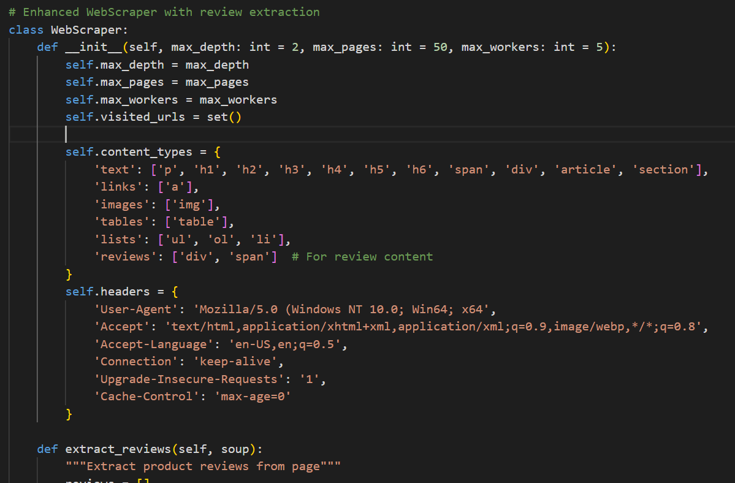
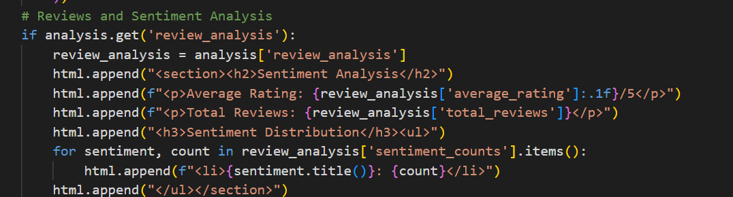
Enable recursive crawling and page navigation.
the HTML crawler was enhanced to support recursive crawling, allowing it to follow links found on a page to gather more data automatically. Logic for page navigation was implemented to handle multiple pages of a website, ensuring comprehensive data collection. The crawler was tested on sample sites to verify that it could extract links and traverse pages correctly.

Slide 7
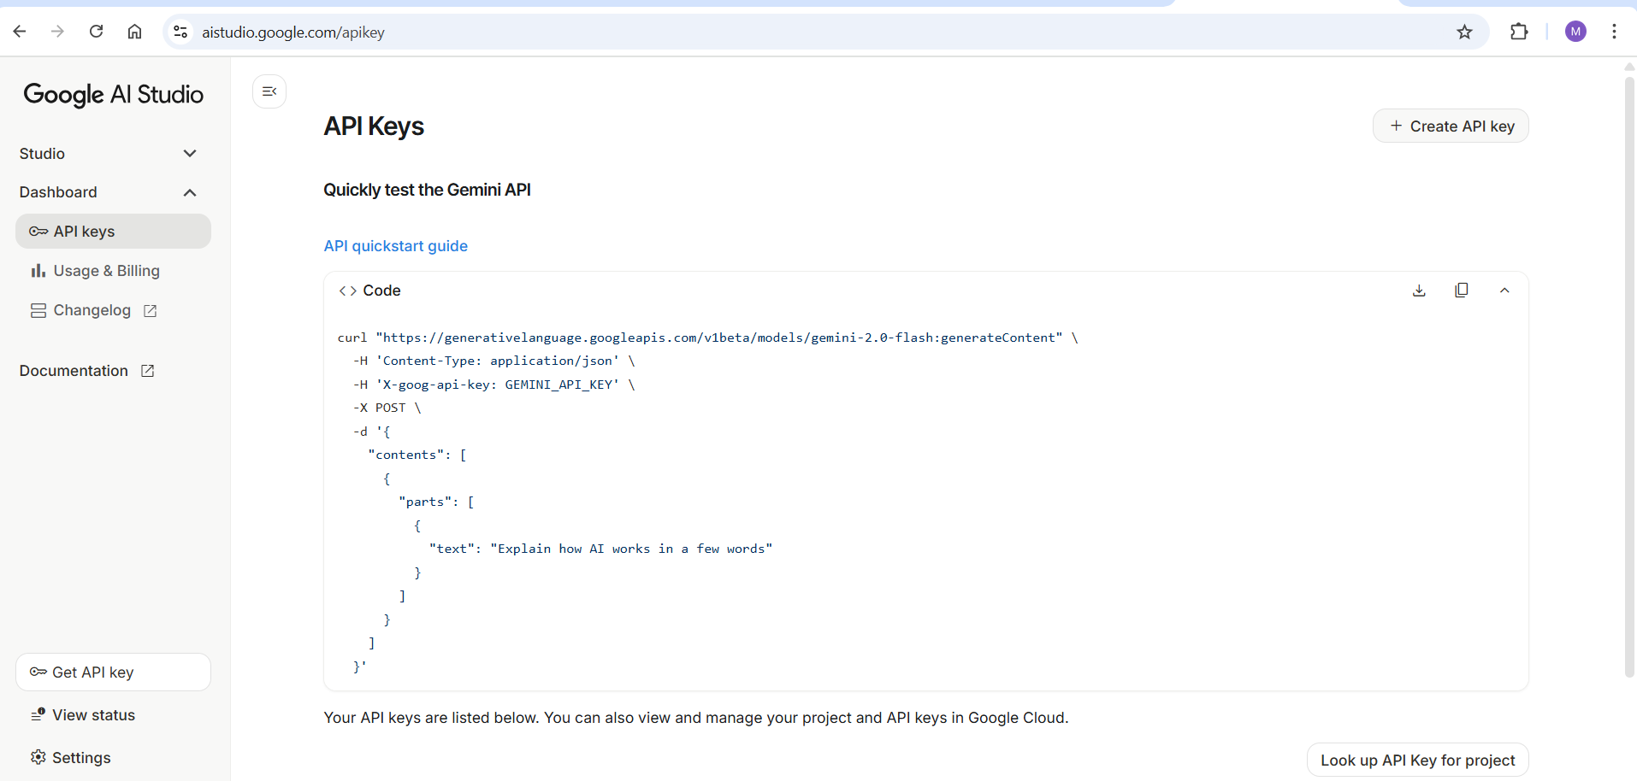
Gemini API Key Generation
Gemini embeddings convert text into numerical vectors that capture the semantic meaning of the content. They represent similar texts with closer vectors, allowing efficient semantic search and similarity analysis. In this project, they are used to represent scraped data for tasks like search and question-answering.
Created an API key from the Gemini/OpenAI dashboard to access embeddings.
Logged into OpenAI/Gemini account.
Navigated to API keys section.
Clicked “Generate New Key”.
Copied the key securely

Slide 8
Develop semantic search and question-answering module
A semantic search module was developed to retrieve relevant information from the scraped data using the Gemini embeddings. A question-answering feature was implemented, allowing users to input queries and receive contextually accurate answers. The module was tested with sample queries to ensure correct and meaningful results.
Users can enter natural language queries in the query tab of the dashboard.
WebSage uses Gemini AI embeddings to perform semantic search on the scraped product data.
The system matches the query with relevant products and displays the results in a table or visualization.
Example queries for a single website:
“What are the features of this smartphone?”
Example queries for two websites comparison:
“Compare budget laptops from both websites.”
“Which smartphone has better features and price?”

Slide 9
Design Streamlit interface and integrate search.
The Streamlit interface is the front-end of WebSage where users interact with the system.
It is user-friendly, interactive, and web-based, allowing users to:
Login/Signup – Access the system securely.
Single Website Tab – Enter a website link and ask queries for detailed product information.
Two Websites Tab – Enter two website links for comparison and semantic summarization.
Dashboard – View scraped data tables, query results, and visual insights (charts, summaries).

Slide 10
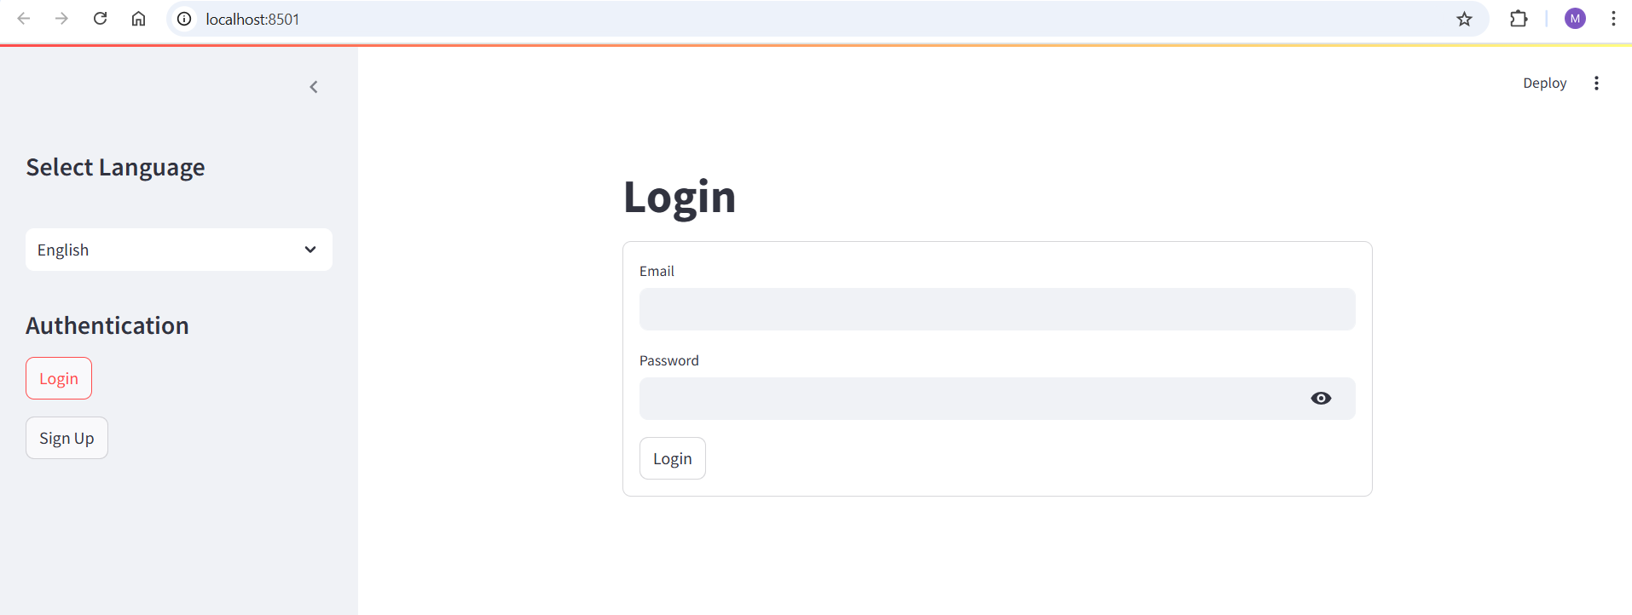
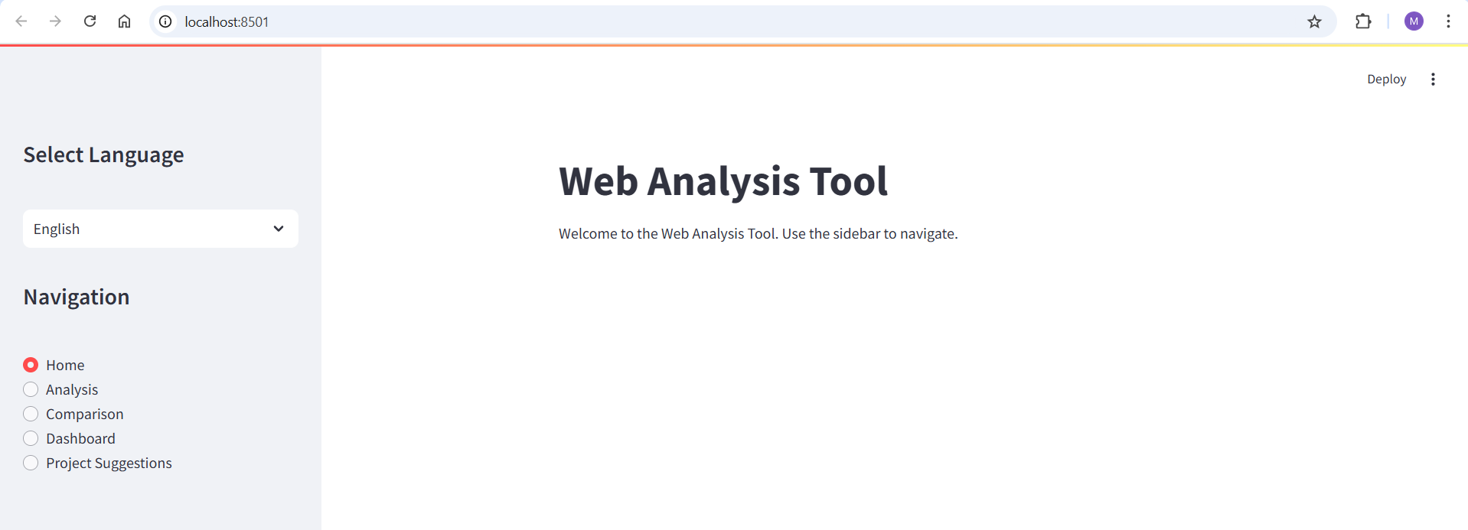

Slide 11
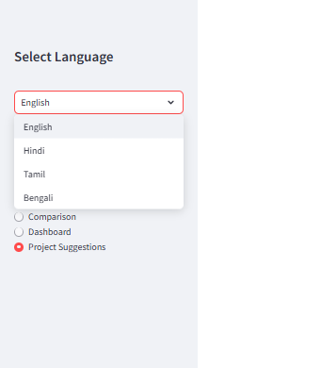
Multi-Language Support

Slide 12
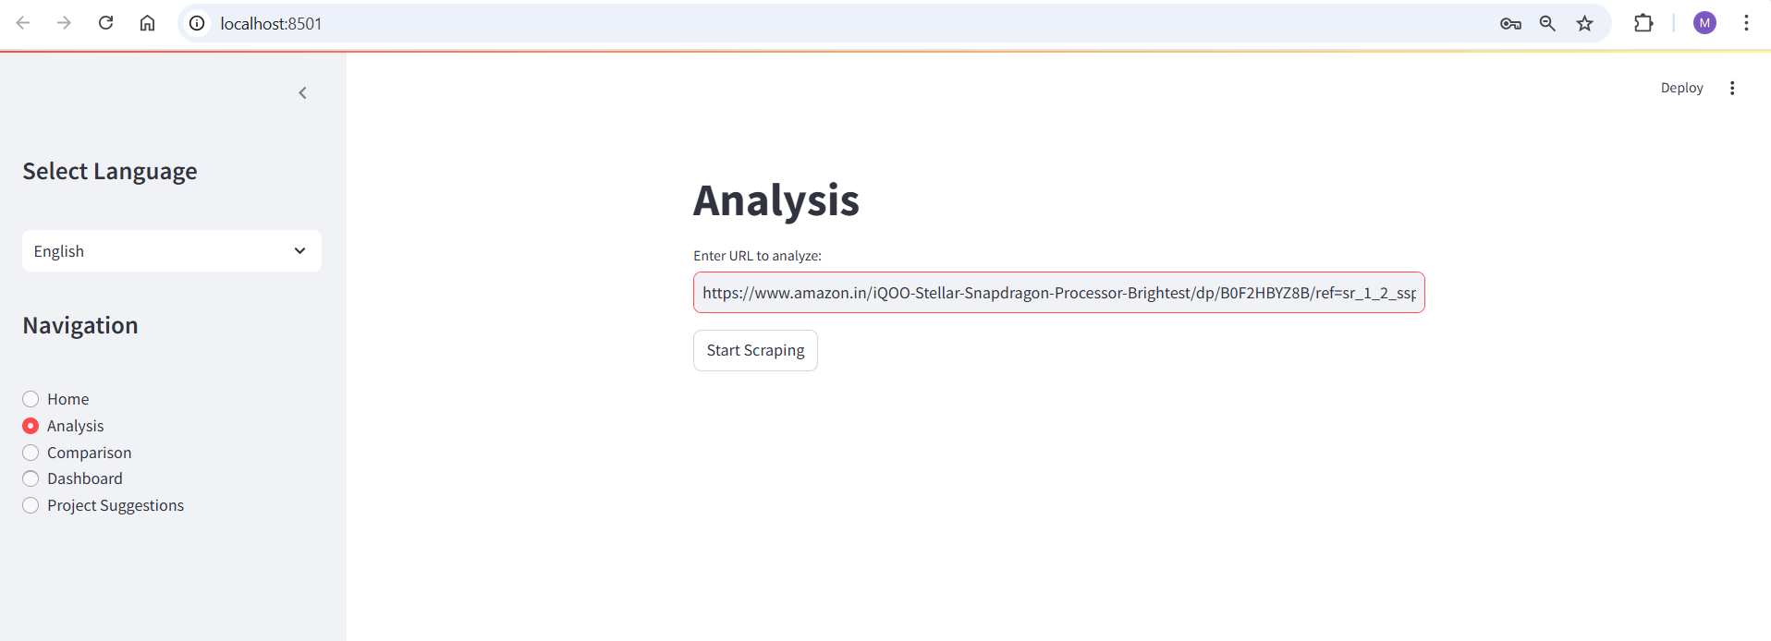
Single Website Product Scraping and Query
The user enters a single e-commerce website link in the dashboard.
WebSage scrapes product details like name, price, features, and reviews from that website only.
In the query tab, the user can ask for detailed information or analysis of products from that website.

Slide 13
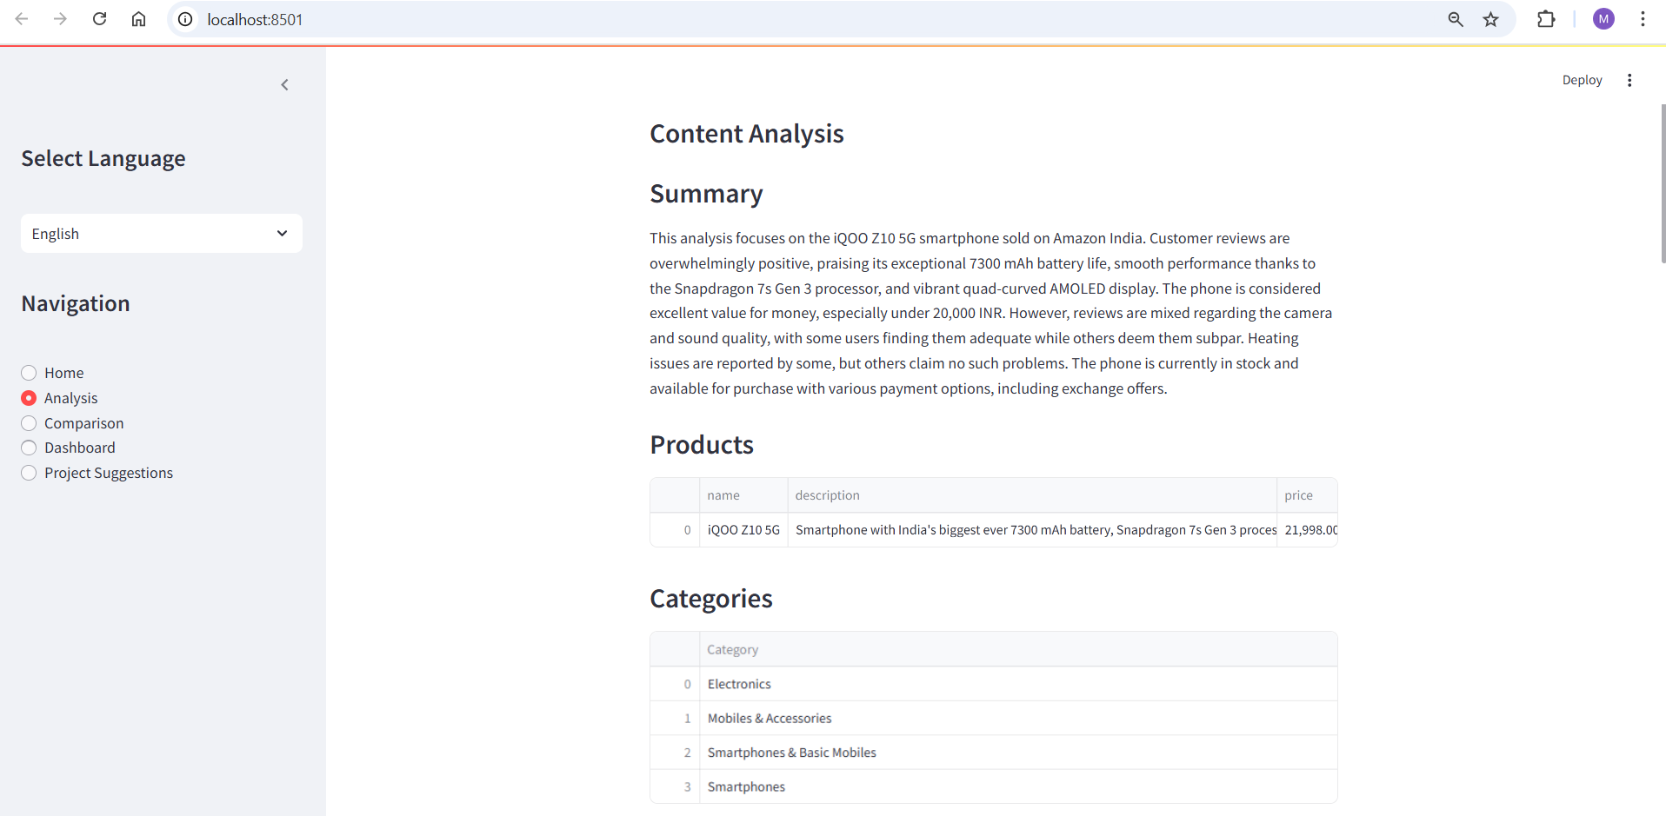

Slide 14
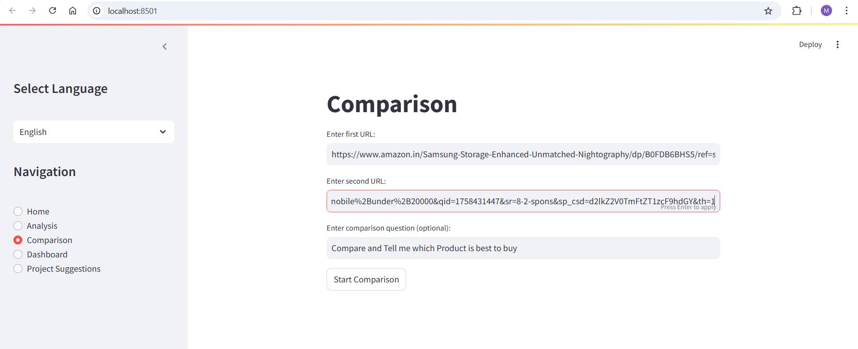
Scrape Two Websites (For Comparison)
The user provides links for two e-commerce websites in the dashboard.
WebSage scrapes product details from both websites, including:
Product name, Price, Features, Reviews
After scraping, the system compares products side by side using the scraped data.

Slide 15
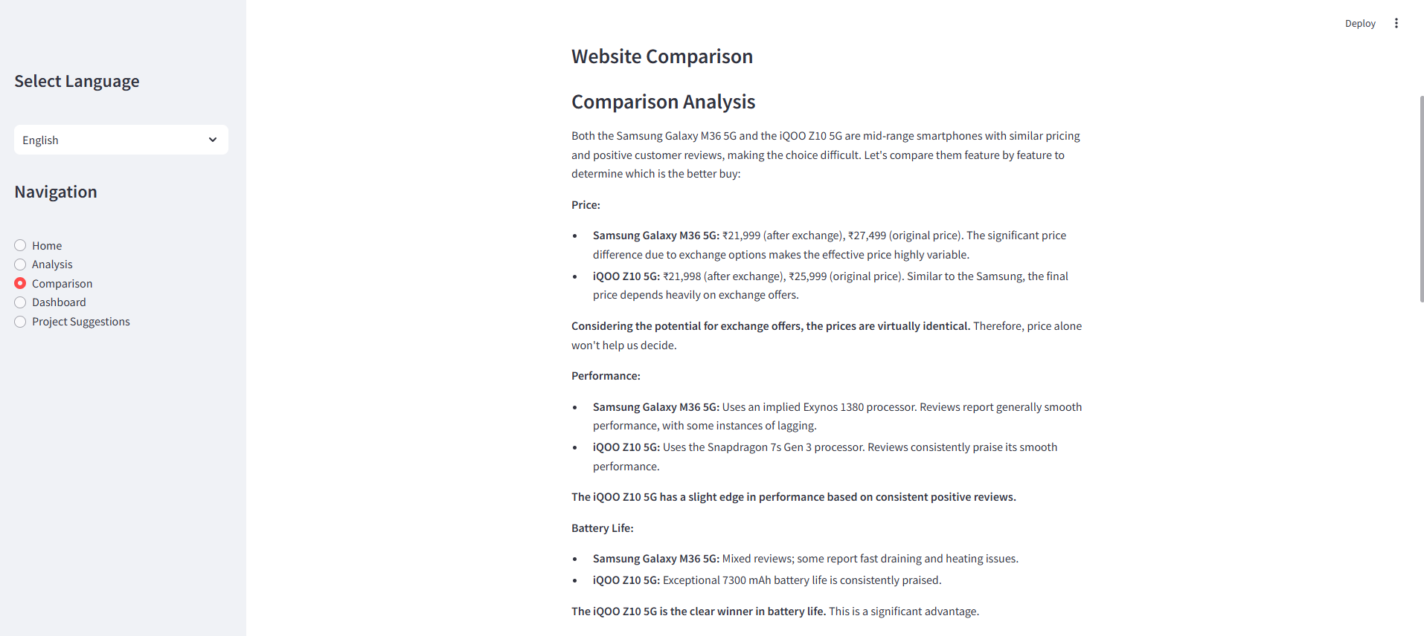
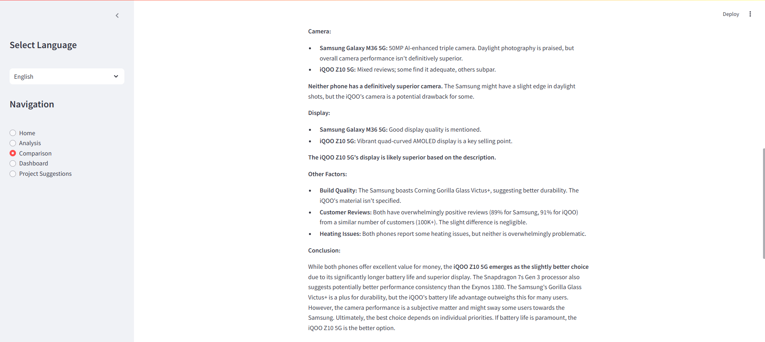

Slide 16
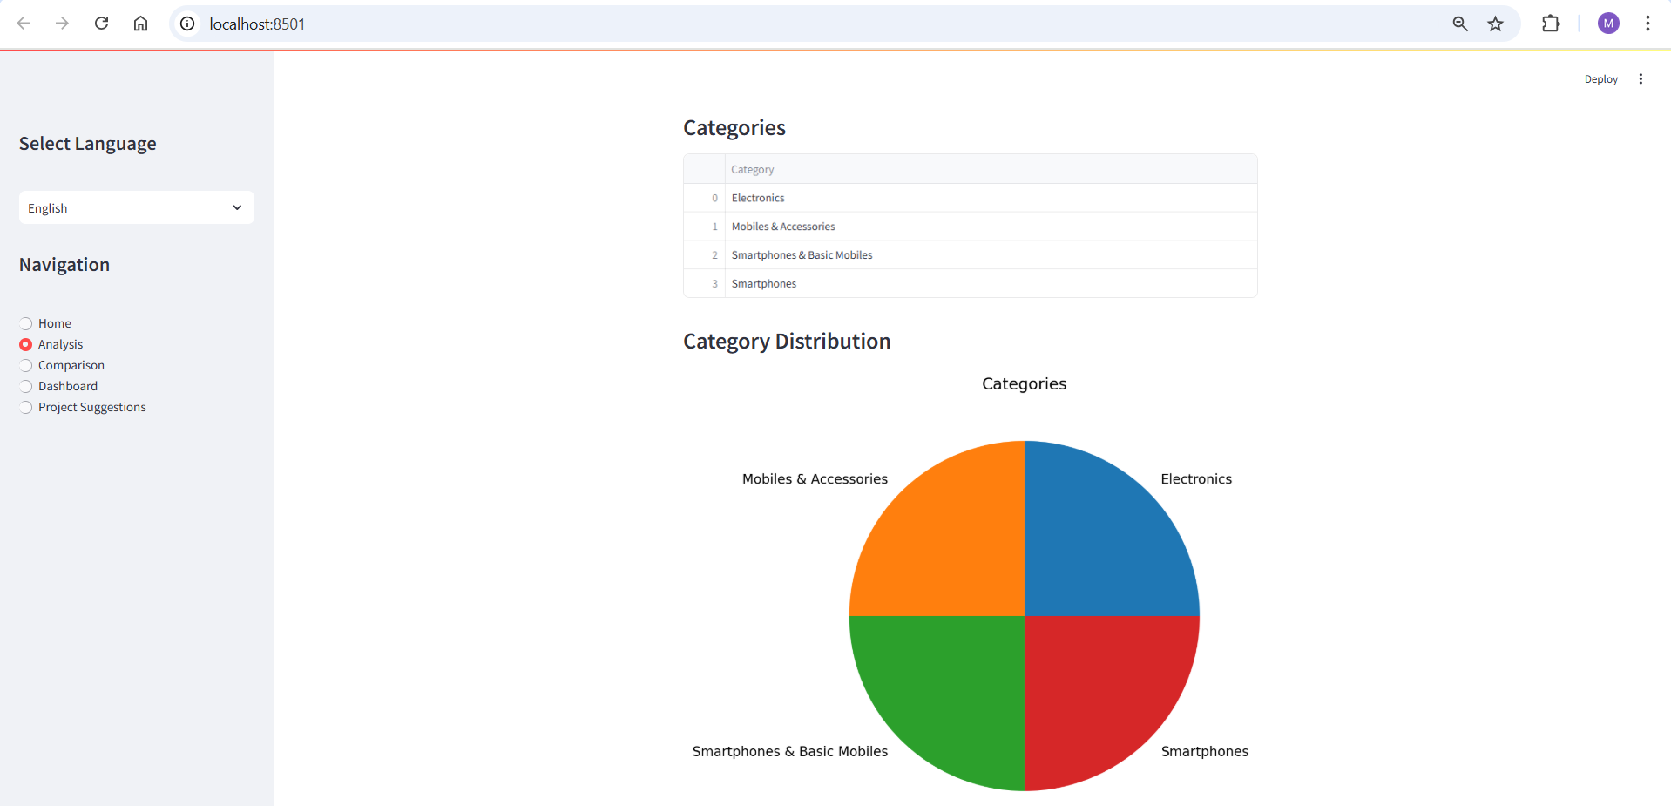
Week-14 : Visualize Data
After scraping and processing product data, WebSage provides visual insights to help users analyze the information quickly.

Slide 17
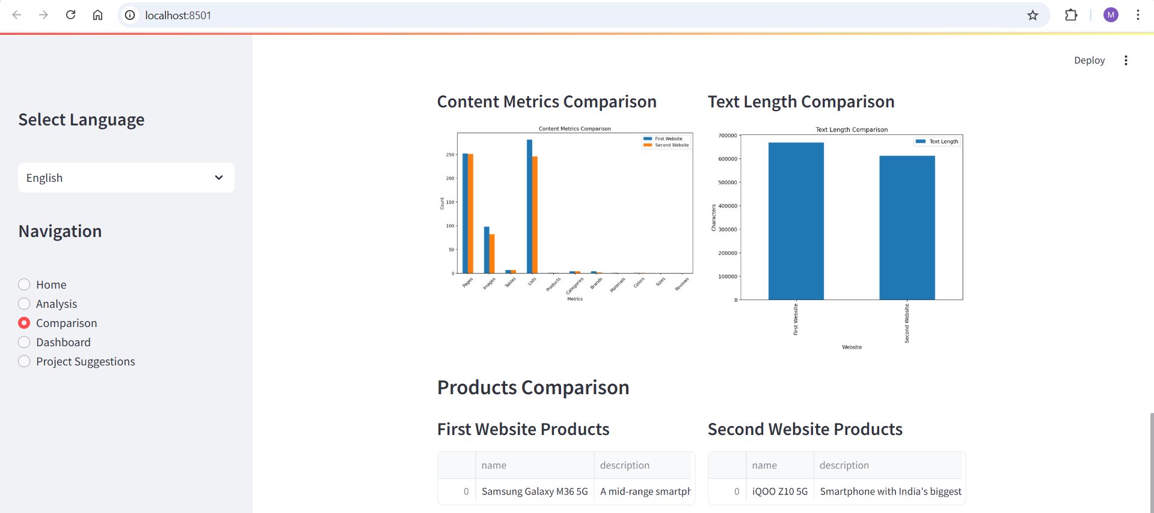

Slide 18
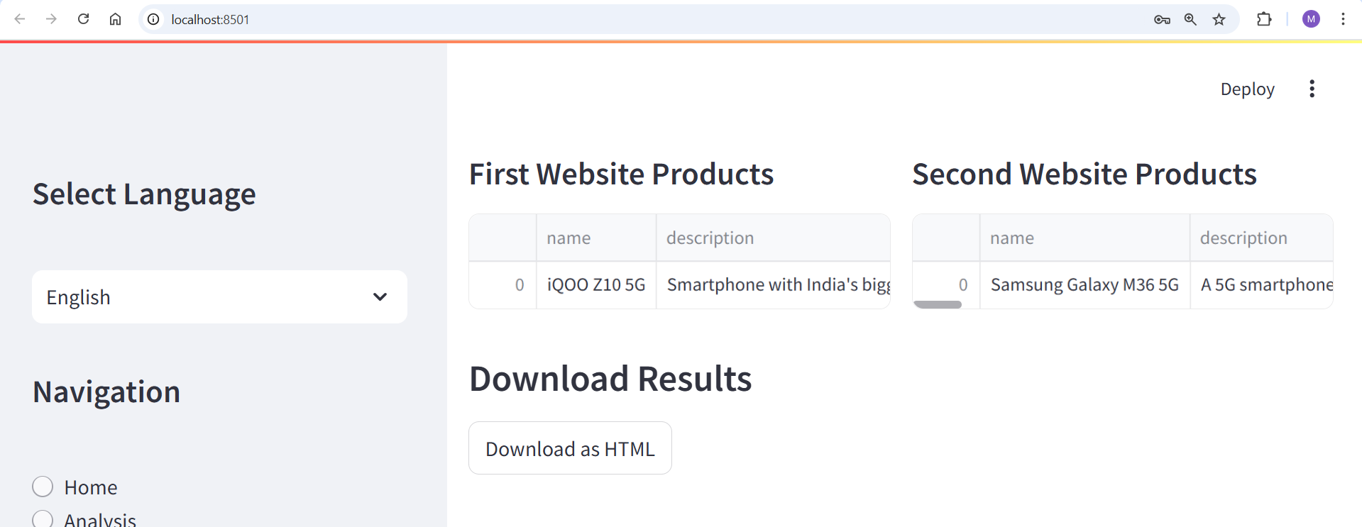
HTML Download Report

Slide 19
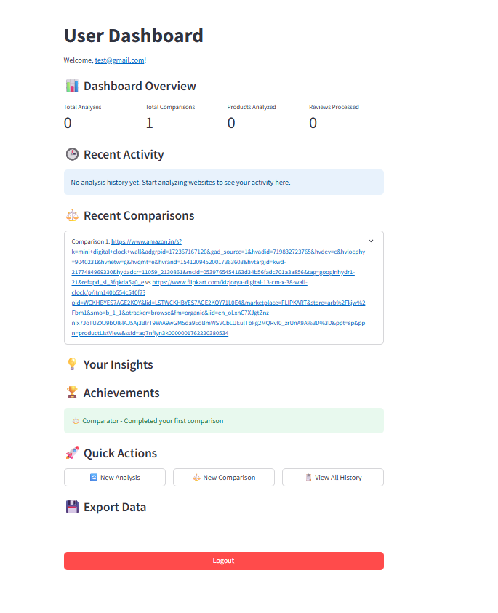
User Dashboard Interface

Slide 20
Thank You!

