Slide 1
MEDICINAL IMPORTANCE OF FLAVOR MOLECULES
A presentation by:
Group 24
Gayatri Panda- PhD19206
Aayushi Mittal – PhD19203

Slide 2
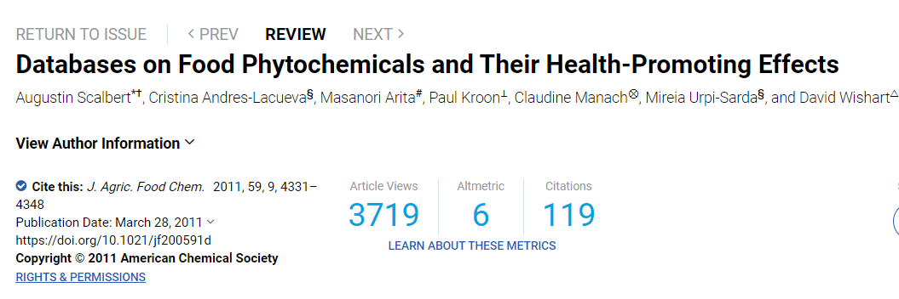
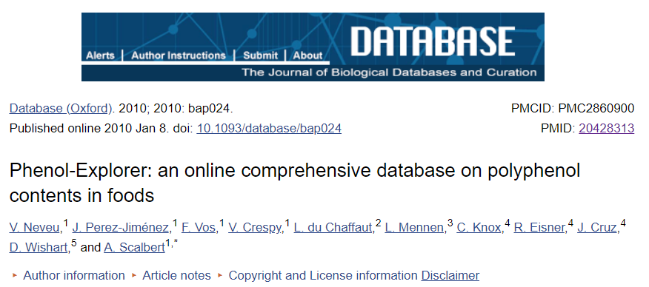
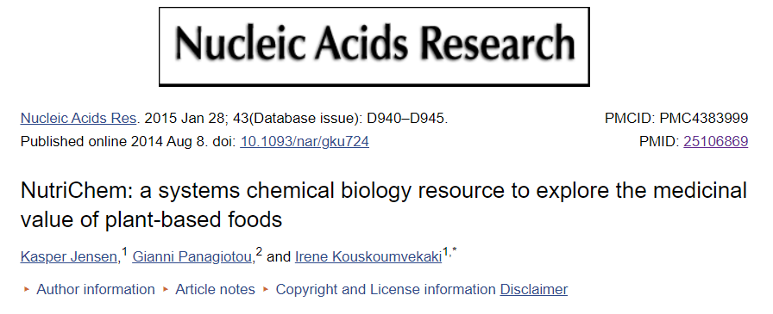
MOTIVATION
EXISTING DATABASES
Existing databases that associate chemical molecules with health/disease focus on a specific class of chemical molecules (phytochemicals)
None looks into bioactivity aspect of molecules.
Flavor-Db: Comprehensive resource of flavor molecules (representing their molecular features, flavor profiles and details of natural source) +Bioactivity
OBJECTIVE
Bioactivity (Pharmacological aspect)- Ability of a molecule to show its defined molecular effect on binding to a target protein .
Find out the bioactivity of flavor molecules, i.e ability to bind to the target site.
Differentiate active (binding) compounds from the inactive (non-binding) ones
Drug likeness of flavor molecules(depends of Lipinski’s Descriptors).
Structural Similarity Analysis of active and inactive flavor molecules
Notes:
we thought of adding medicinal value to the flavor molecules in Flavor Db. Add a value to this resource.
- Evaluation of the effects on health of phytochemicals and in facilitating the exploitation of nutrigenomic data-
- Phenol-Explorer : A comprehensive web-based database on polyphenol( polyphenols, one of the major classes of phytochemicals) content in foods.
-NutriChem: database generated by text mining of 21 million MEDLINE abstracts for information that links plant-based foods with their small molecule components and human disease phenotypes

Slide 3
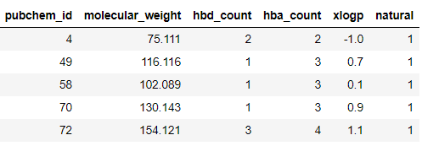
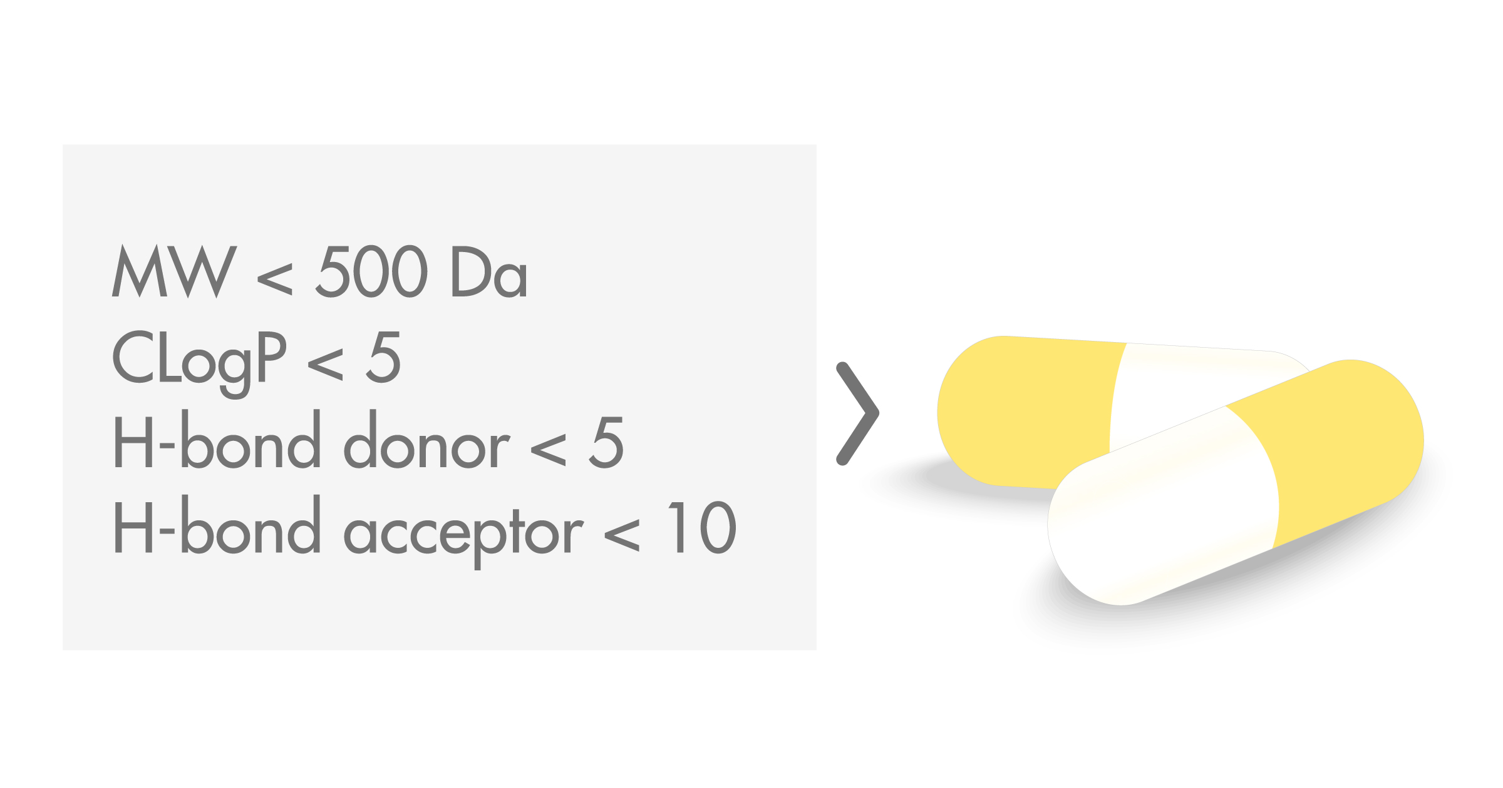
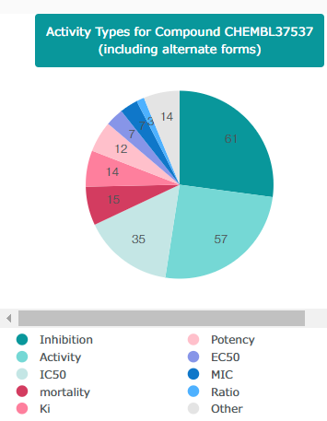
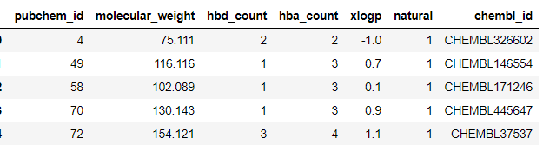
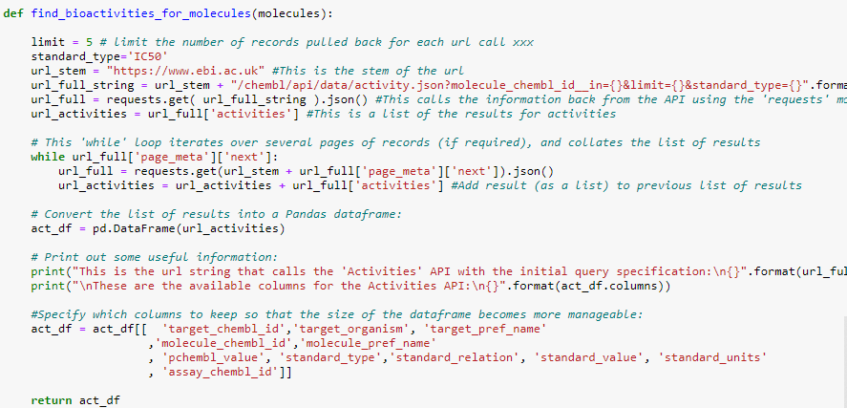
Data Collection (Bioactivity Data Extraction)
Lipinski’s Rule of 5( Drug-like properties)
Complete Dataset- 25595 X 5
Natural Molecules- 2254 X 5
Pubchem CIDs converted to ChEMBL ids (PubChem Identifier Exchange Service)
https://pubchem.ncbi.nlm.nih.gov/idexchange/idexchange.cgi
ChEMBL is a manually curated
database of bioactive molecules with drug-like properties.
Python Function for scraping bioactivity data
1145 X 6
URL- https://www.ebi.ac.uk/chembl/api/data/activity.json?molecule_chembl_id__in={}&limit={}&standard_type={}".format(molecules,limit,standard_type).
Limit- No. of records for each url/ID (5)
Standard Bioactivity type – IC50
Standard units – nM
Notes:
A molecule has higher chances to be successful as oral drug (like tablets, capsules, emulsions, suspensions etc) if it satisfies Lipinski's 'rule of 5’
Standard value is the potency of the drug , lower the number better the potency.
The conc. of drug required to cause 50% of inhibition of target protein(target chembl id).
IC50-(widely used for bioactivity differentiation, to maintain the uniformity of the dataset also to reduce the scraping time)

Slide 4
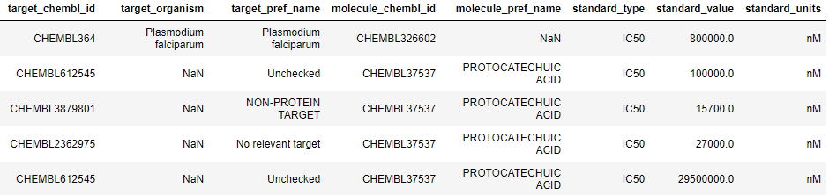

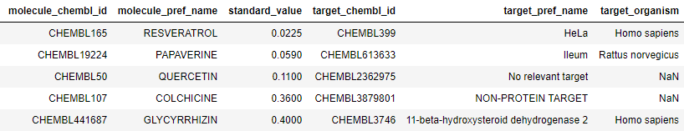
Data Processing ( Bioactivity Data Extraction)
Standard Value(IC50)-
Conc. of molecule required for 50% inhibition of the target protein.
Lower value better potency better bioactivity
6553 X 8
Sorted Data in ascending order. Kept first record for each id.
365 X 6

Slide 5
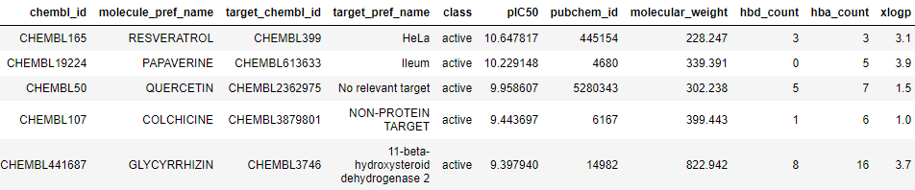
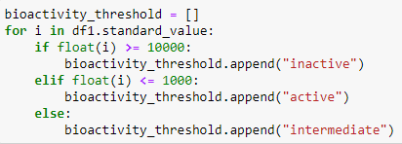
Classification of Compounds on the basis of bioactivity
Labelling compounds
Standard value < 1000 nM = Active
Standard value > 10,000 nM = Inactive
Standard value between 1,000 and 10,000 nM = Intermediate
IC50 to pIC50 (365 ids)
For a uniform distribution of IC50 value
nM to M →- log10(IC50).
IC50 converted to the negative logarithmic scale which is essentially -log10(IC50).
Chemical Space Analysis Data
Compounds belonging to intermediate class were removed.
Merged with base data columns
(297 ids left)
297 X 11

Slide 6
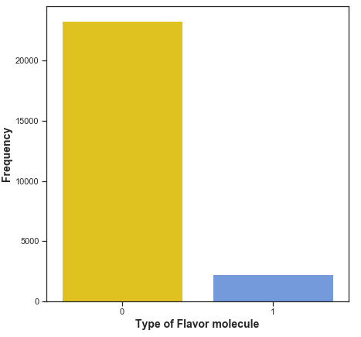
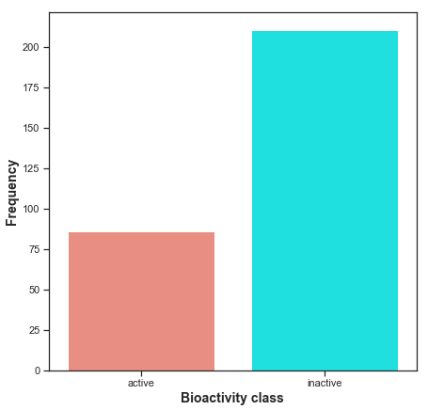
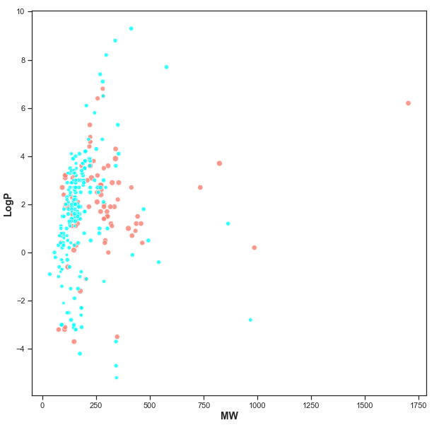
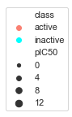
Exploratory Data Analysis
Frequency Plot (Synthetic & Natural Flavor molecules)
Frequency Plot (Active & Inactive Natural molecules)
Scatter Plot of MW vs LogP (Active & Inactive Natural molecules)
Synthetic
Natural
It can be seen that the two bioactivity classes are spanning similar chemical spaces as evident by the scatter plot of MW vs LogP

Slide 7
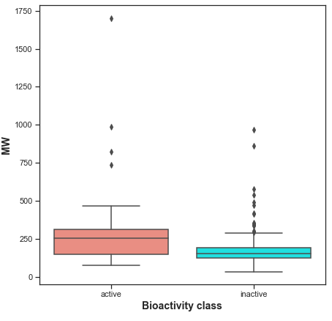
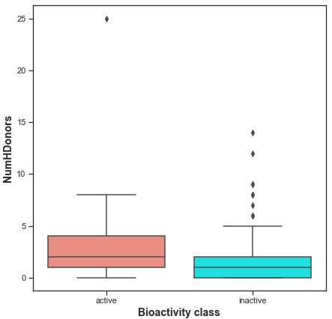
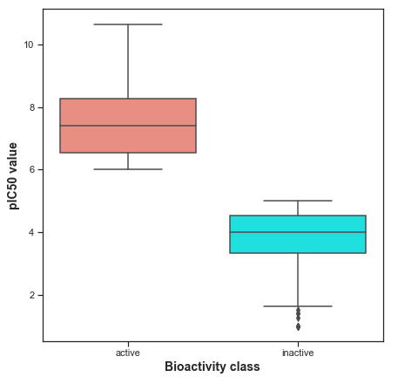
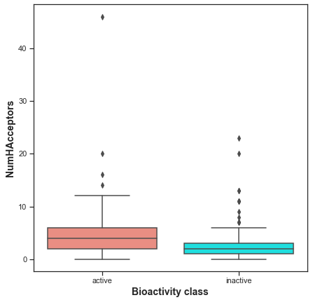
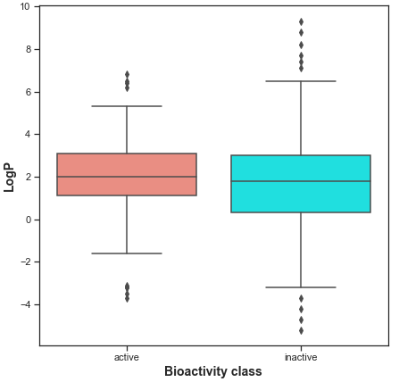
Box Plot using Lipinski’s Descriptors (Active & Inactive Natural molecules)
Both the classes almost satisfy the drug-like properties.
Box Plot of pIC50 values, the actives and inactives displayed statistically significant difference, which is to be expected since threshold values (IC50 < 1,000 nM = Actives while IC50 > 10,000 nM = Inactives, corresponding to pIC50 > 6 = Actives and pIC50 < 5 = Inactives) were used to define actives and Inactives.

Slide 8
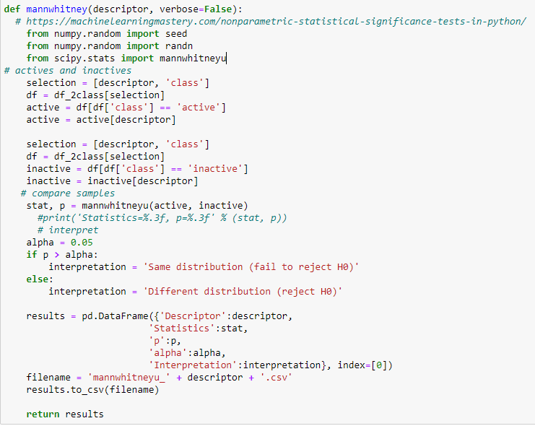
Statistical analysis | Mann-Whitney U Test
Descriptor | Statistics | P-value | Alpha (significance level) | Interpretation
pIC50 | 0.0 | 6.087553e-42 | 0.05 | Different distribution (reject H0)
molecular_weight | 5254.5 | 6.436918e-09 | 0.05 | Different distribution (reject H0
xlogp | 8217.5 | 0.10134 | 0.05 | Same distribution (fail to reject H0)
hbd_count | 5945.5 | 6.722676e-07 | 0.05 | Different distribution (reject H0)
hba_count | 5616.0 | 7.643777e-08 | 0.05 | Different distribution (reject H0)
p <= alpha: reject H0, different distribution.
p > alpha: fail to reject H0, same distribution
Non-parametric tests are used when the distribution of data is not known.
Null Hypothesis assumption: Samples are drawn from population with same distribution.
P-value is used to interpret the result.
Mann–Whitney U test was used to determine if there is a significant difference between the two Groups active/ inactive groups or not.
Overall, there is a significant difference between Active and inactive flavor molecules for most of the molecular properties.
The only molecular property for which there is no statistical difference is xlogP.
Notes:
How your code works ?
When the data doesn’t follow a normal distribution we resort to non-parametric test.
The null hypothesis of these tests is often the assumption that both samples were drawn from a population with the same distribution, and therefore the same population parameters, such as mean or median. Tests also return a p-value that can be used to interpret the result of the test.
The p-value can be interpreted in the context of a chosen significance level called alpha. A common value for alpha is 5% or 0.05. If the p-value is below the significance level, then the test says there is enough evidence to reject the null hypothesis and that the samples were likely drawn from populations with differing distributions.
p <= alpha: reject H0, different distribution.
p > alpha: fail to reject H0, same distribution.

Slide 9
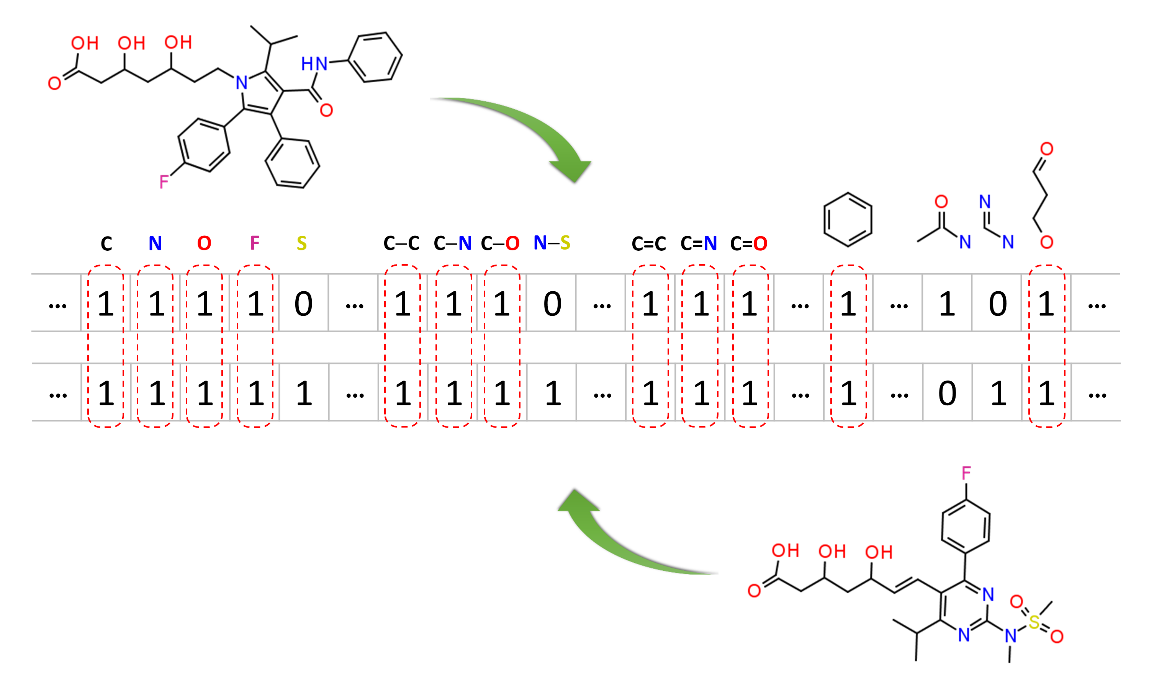
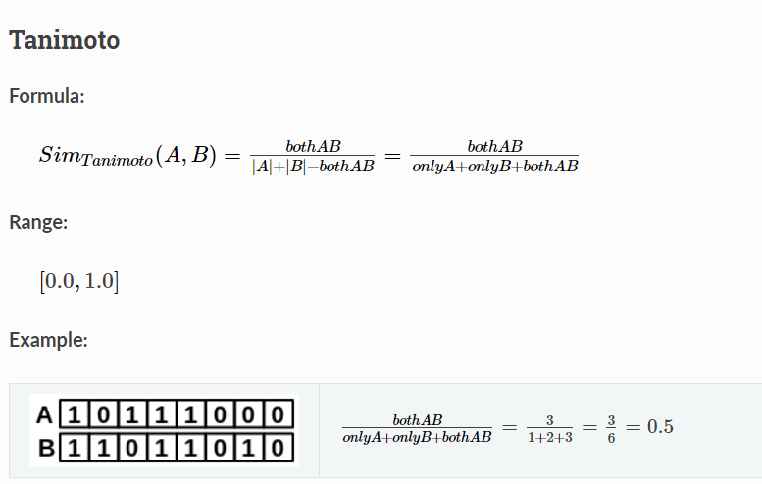
Molecular similarity of flavor molecules
Structurally similar molecules are likely to have similar biological and physicochemical properties (commonly called the similarity principle).
2-D similarity methods use so-called molecular fingerprints. Molecular fingerprints are a way of encoding the structure of a molecule as a series of bits/binary string (0 or 1). These bits represent the presence or absence of particular patterns or substructures
The molecular fingerprints of two molecules are compared and similarity coefficient or score is calculated , the underlying ideas are the same as each other: if the two fingerprints have 1’s at the same position, it means that both compounds have the same fragment, and if the molecules share more common fragments, they are considered to be more similar.
PubChem uses its own fingerprint called PubChem subgraph fingerprints. The PubChem fingerprint encodes molecular fragments information with 881 binary digits.
PaDEL-Descriptor - A software to calculate molecular descriptors and fingerprints . Similarity method used in work is Tanimoto score (rdkit package). It ranges from 0 (for no similarity) to 1 (for identical molecules)
Notes:
More same bits, more same fragmenrs and more similar two molecules

Slide 10
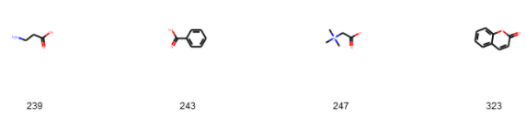
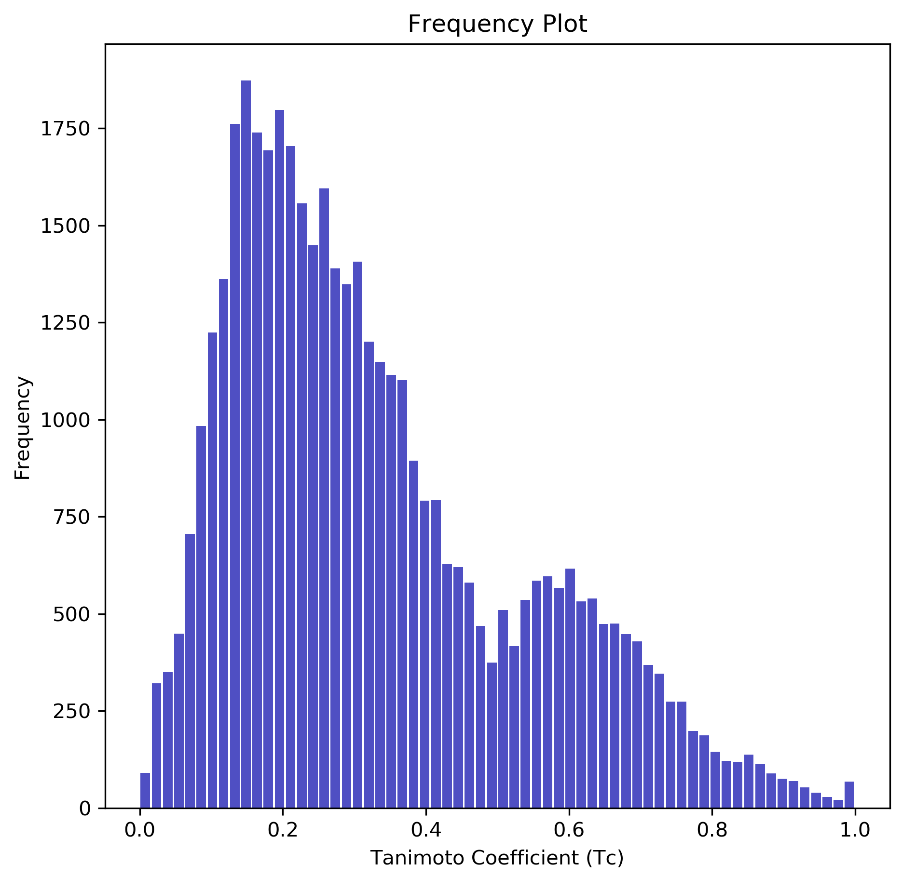
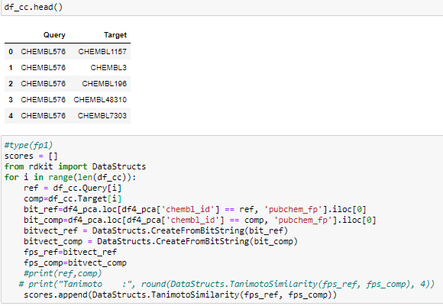
Method I for Molecular Similarity Calculation
PubChem Identifier Exchange Service (I/P- CIDs to get SMILES )
PaDel Descriptor – Calculate Pubchem Fps(I/P- SMILES) to bitvectors
Tanimoto Similarity Measure used for Pairwise- Similarity of molecules (I/P- Bit vectors of a 2 mols)
Result
43956 molecules pairs(297)
Python code for Tc calculation
Average Tc: 0.330

Slide 11
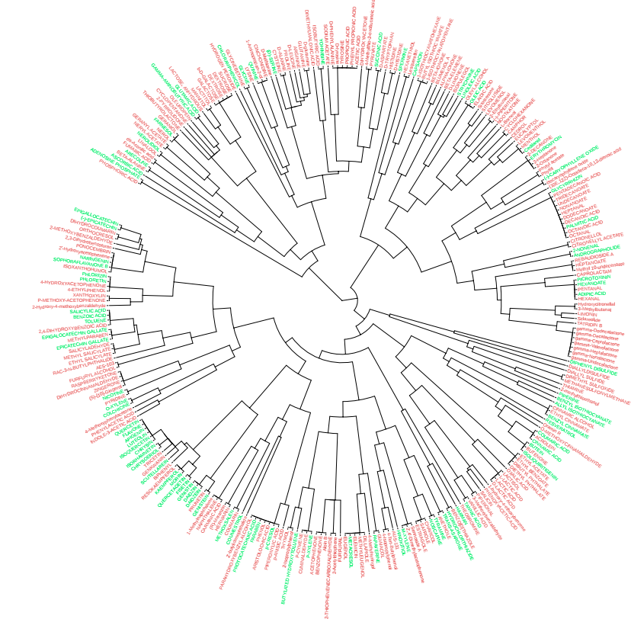
Method II for Molecular Similarity Calculation
Maximum common substructure (MCS) problem is a graph-based similarity concept that is defined as the largest substructure (sub-graph) shared among two compounds.
Identifies MCSs among compounds containing atom and/or bond mismatches.
Can pinpoint the common and unique features in their structures
Simpson index: the number of non-hydrogen atoms in the MCS divided by the number of non-hydrogen atoms found in the smaller one of its two source compounds.
Active
Inactive

