Slide 1
Secure Authenticated Key Management Protocol for Cloud Computing Environments
Presented By:Neha Kumavat
Gayatri Puri
Mayuri Kulkarni

Slide 2
Contents
Introduction
Software and Hardware Requirements
Advantages
System Architecture
Implementation and Flow Diagram
Conclusion

Slide 3

Introduction
We develop a java application to Secure users documents with key authentication
Through this project users can easily access and upload their cloud file securely.

Slide 4
SOFTWARE and HARDWARE REQUIREMENTS
Operating system : Windows 10.
Coding Language : JAVA.
Tool : NetBeans 8.2
Database : MYSQL
System : Pentium i3 Processor
Hard Disk : 500 GB.
Input Devices : Keyboard, Mouse
Ram : 2 GB

Slide 5
Advantages
It prevent malicious attackers posing as server to obtain the users information
We propose a dynamic revocable three-factor mutual authentication and key agreement protocol
Reliable security and relatively higher execution efficiency
Computation cost of our scheme is lowest is related existing protocol

Slide 6
Implementation
Users Registration Phase
QR Code Generation
Malicious User Revocation
User Apply For Revocation
Cloud Server

Slide 7
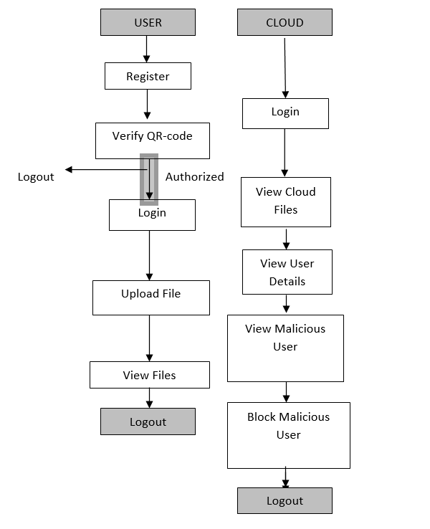
Workflow

Slide 8
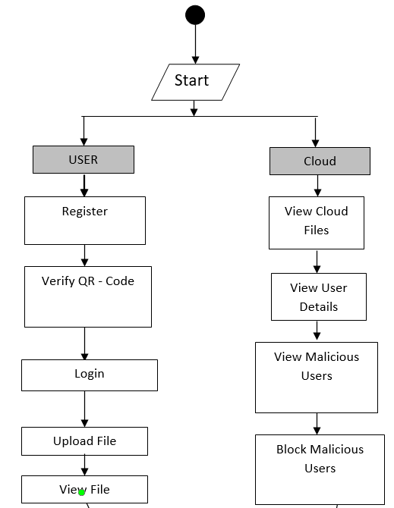
Activity Diagram

Slide 9
Conclusion
To resist the exhaustion of password attack on the two-factor MAKA protocols, a large number of three-factor MAKA protocols have been proposed. However, almost all three factor. In order to achieve more flexible user management and higher security, this paper proposes a new three-factor MAKA protocol that supports dynamic revocation and provides formal proof. The security shows that our protocol achieves the security properties of requirements from multi-server environments. On the other hand, through the comprehensive analysis of performance, our protocol doesn’t sacrifice efficiency while improving the function. On the contrary, the proposed protocol has great advantages in terms of the total computation time.

Slide 10


