Slide 1
Docker Assignment
By Gayatri
(1624)

Slide 2
Create a Jenkins pipeline to deploy application present at: -
https://github.com/gayatrisingh31/node-hello

Slide 3
Screenshot of Creating Instance of EC2 Management Tools.

Slide 4
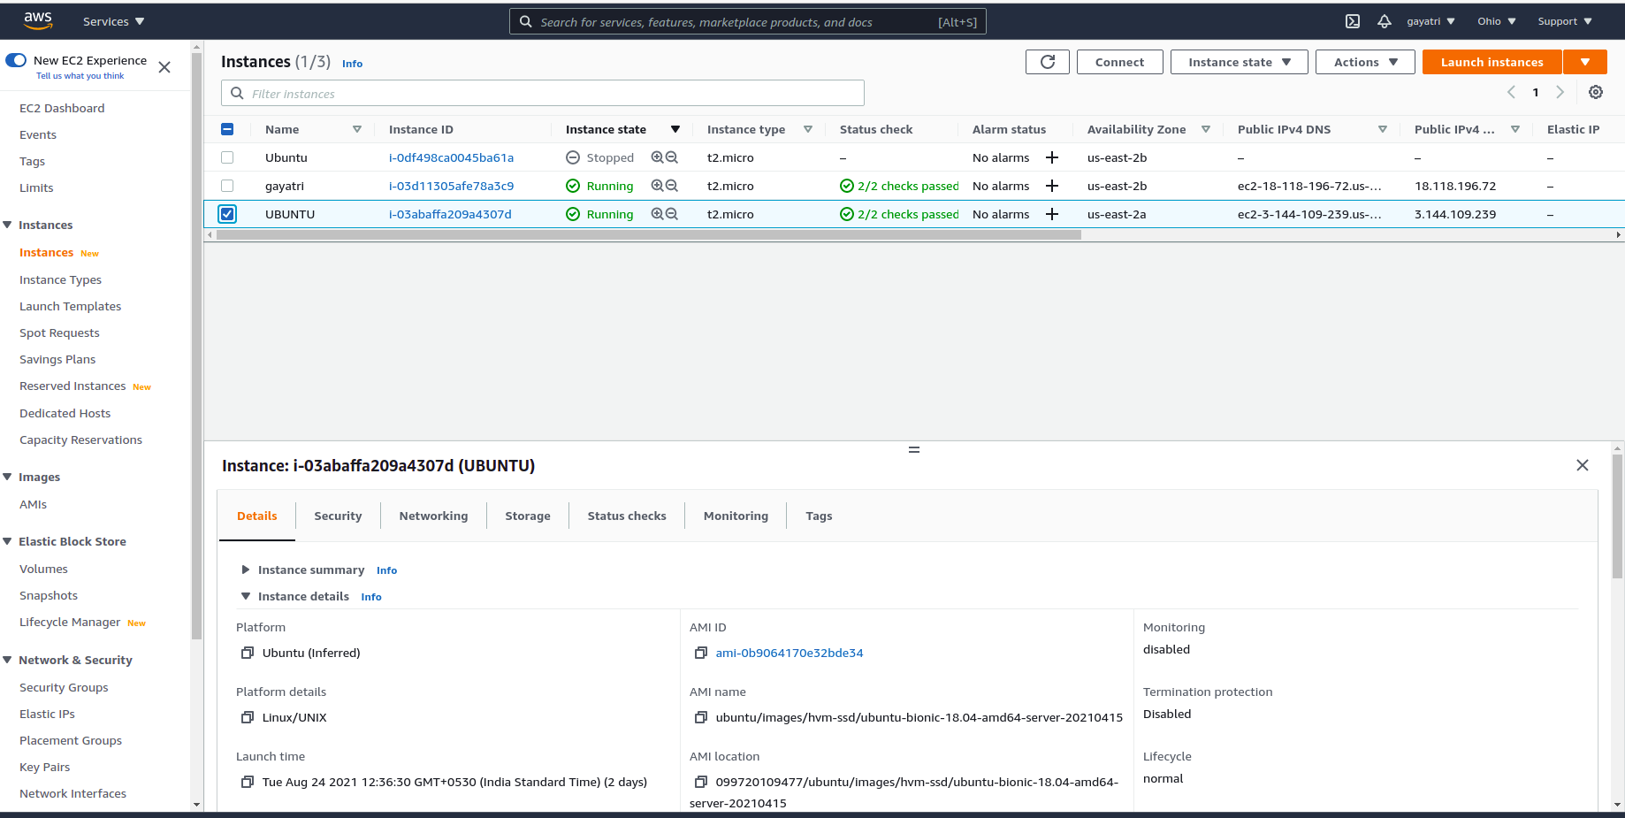

Slide 5
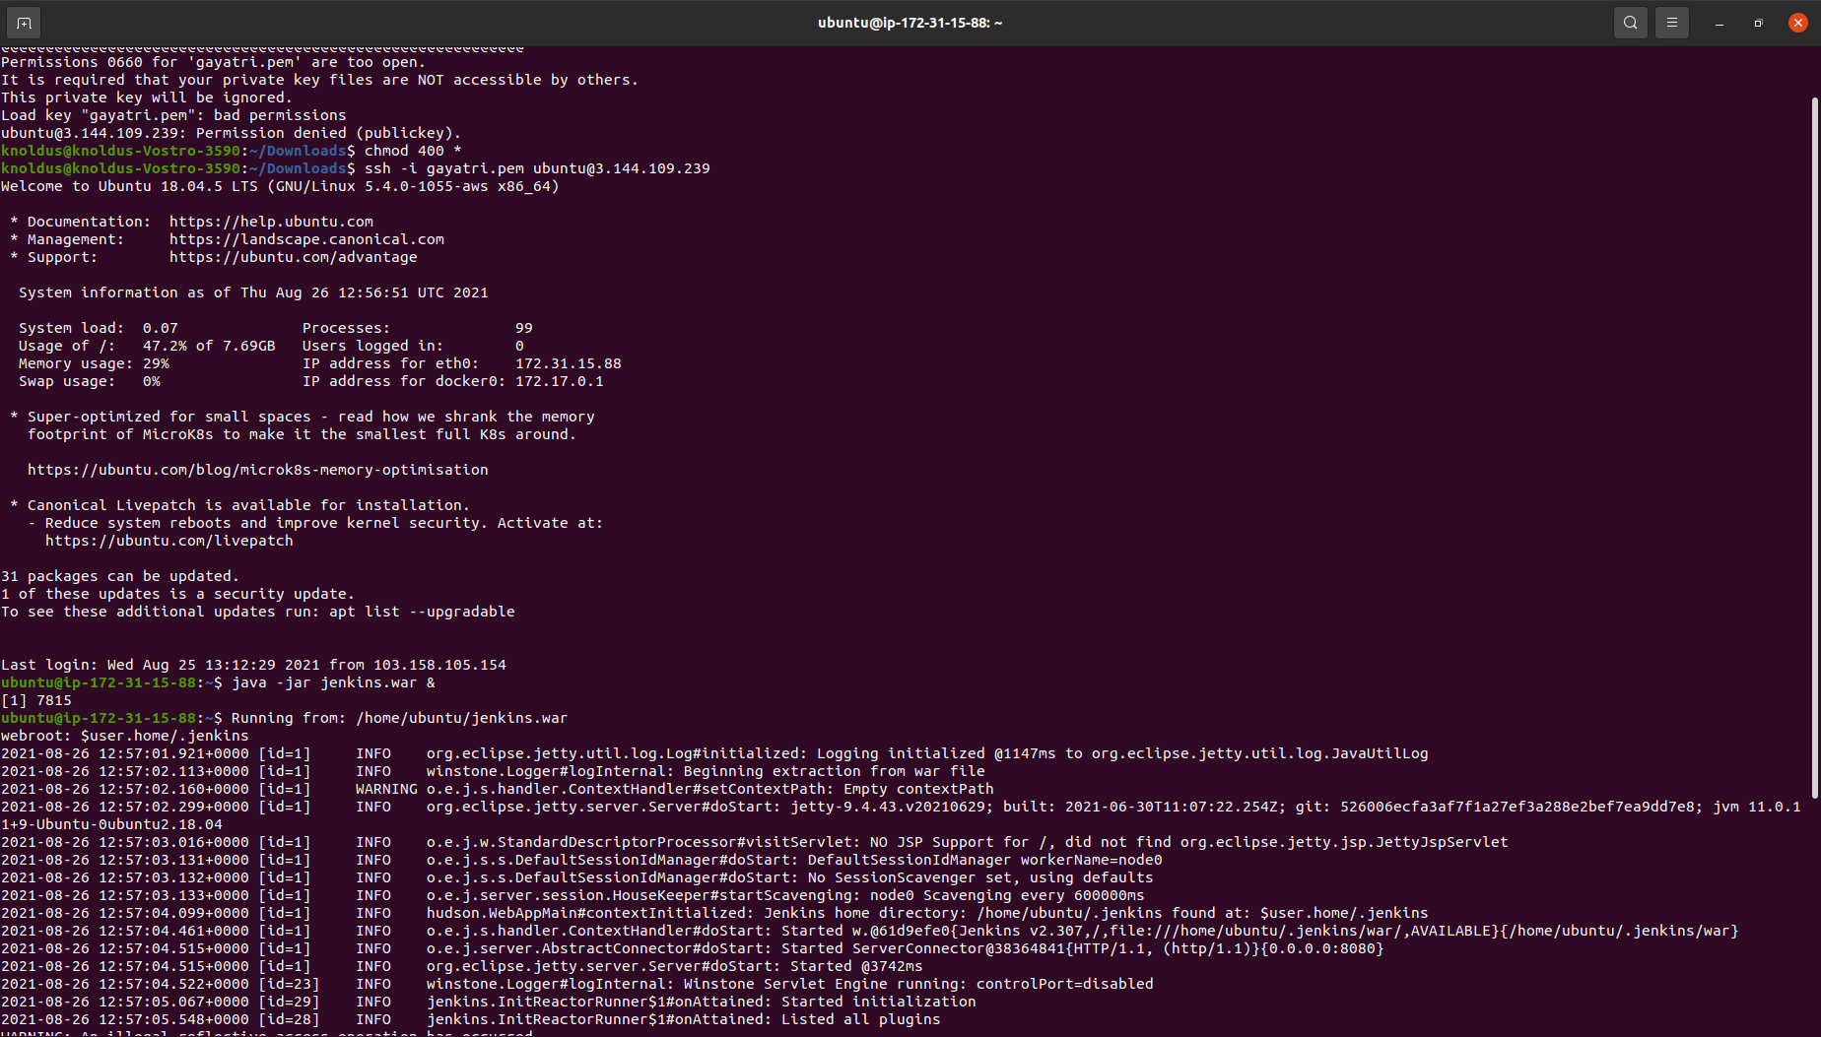

Slide 6
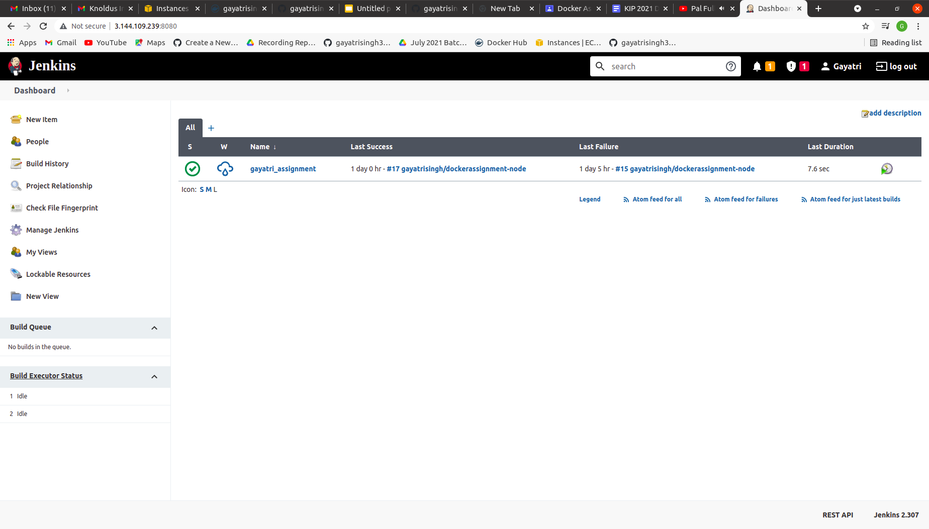
Create a Jenkins pipeline to deploy application present at: -https://github.com/gayatrisingh31/node-hello

Slide 7
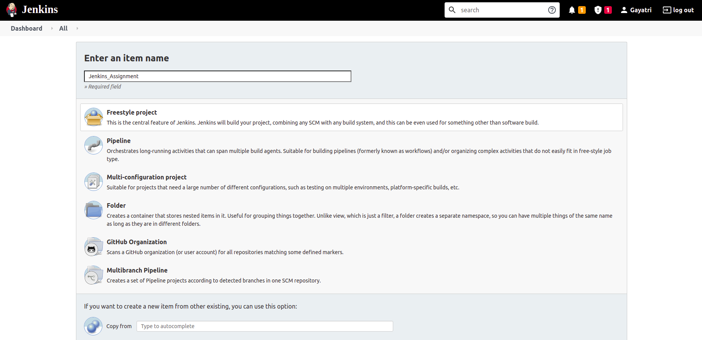
Create a Jenkins pipeline to deploy application present at: -https://github.com/gayatrisingh31/node-hello

Slide 8
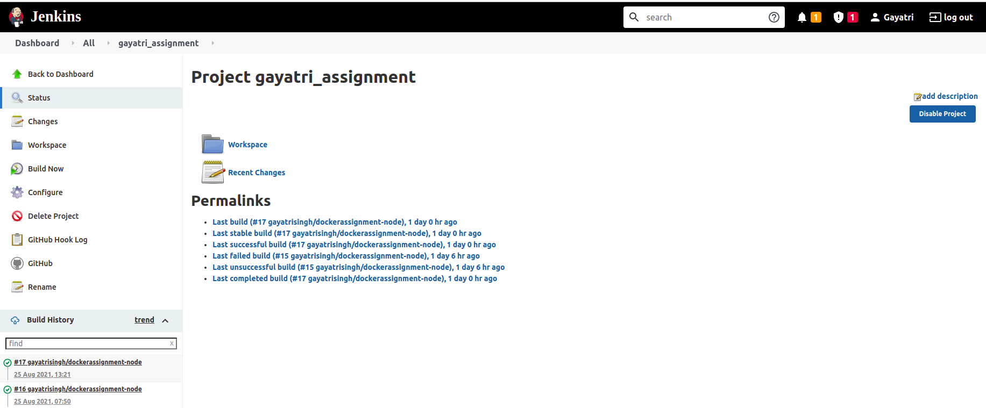
Configuring the jenkins Pipeline.

Slide 9
2. Required command to run the application and the ports being used are present in the Github repository.

Slide 10
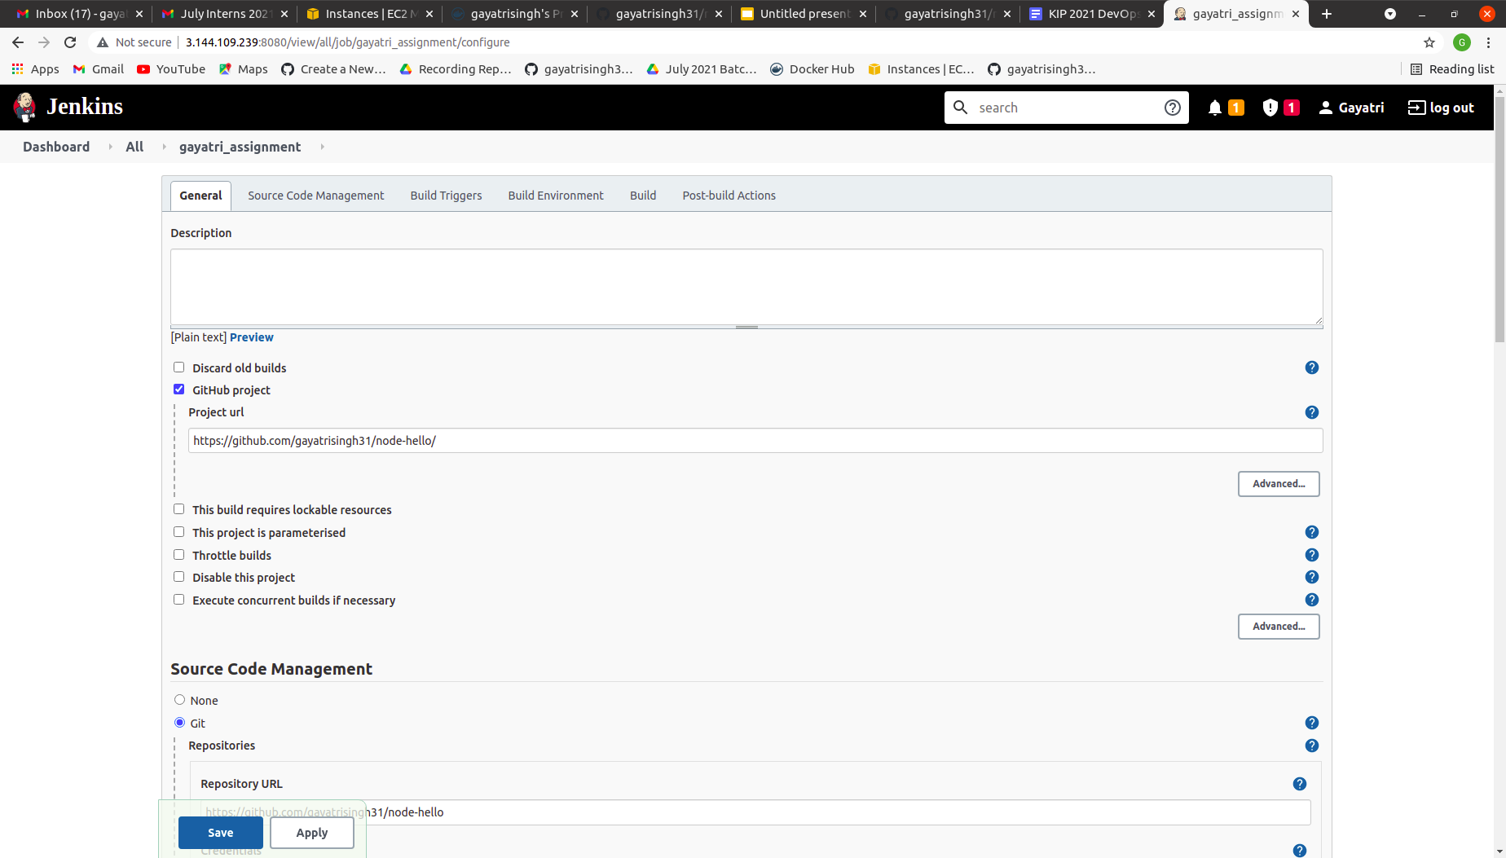
Configuring steps of the jenkins.

Slide 11
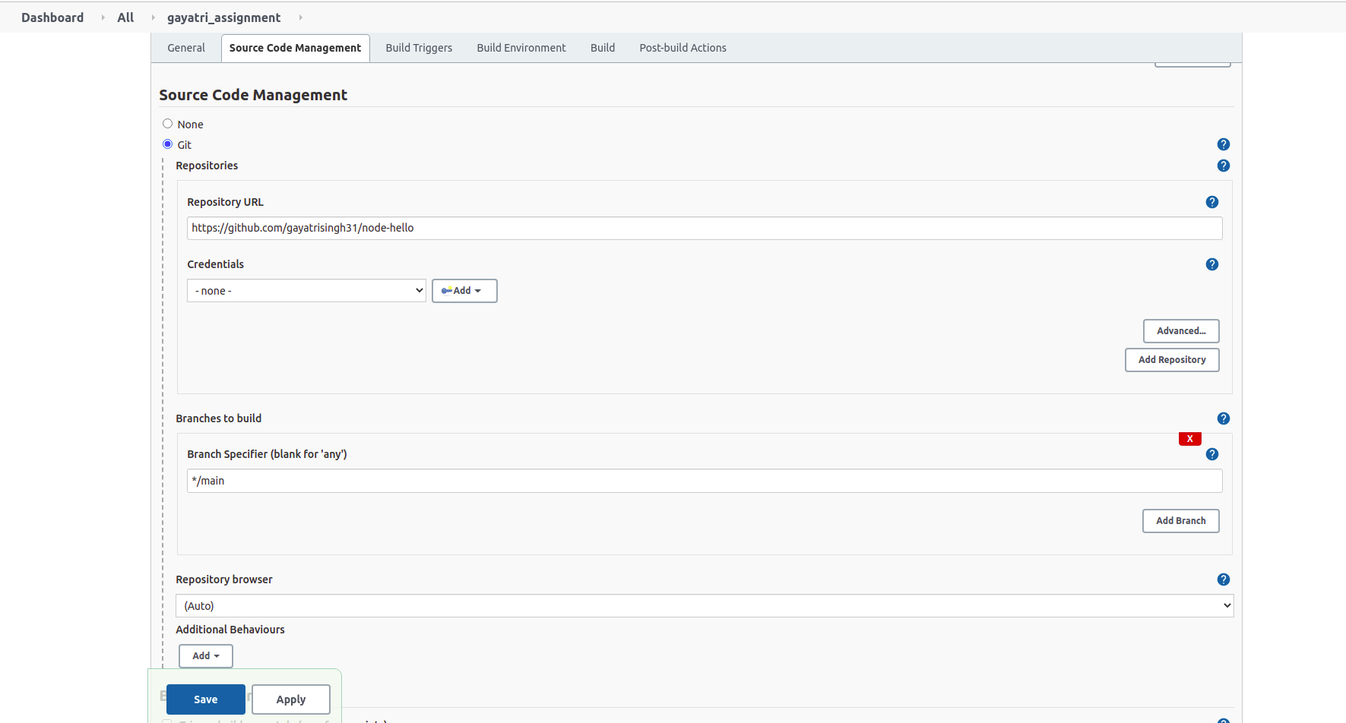
Configuring steps of the jenkins.

Slide 12
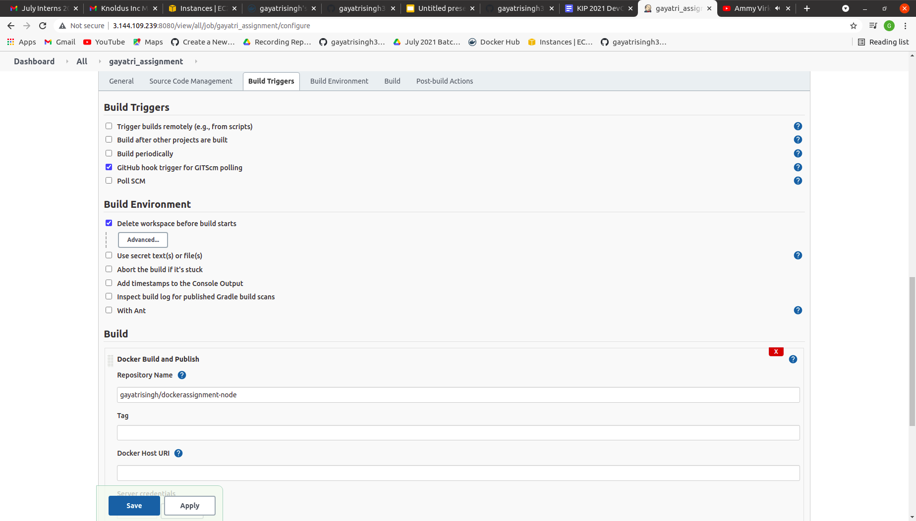
Configuring steps of the jenkins.

Slide 13
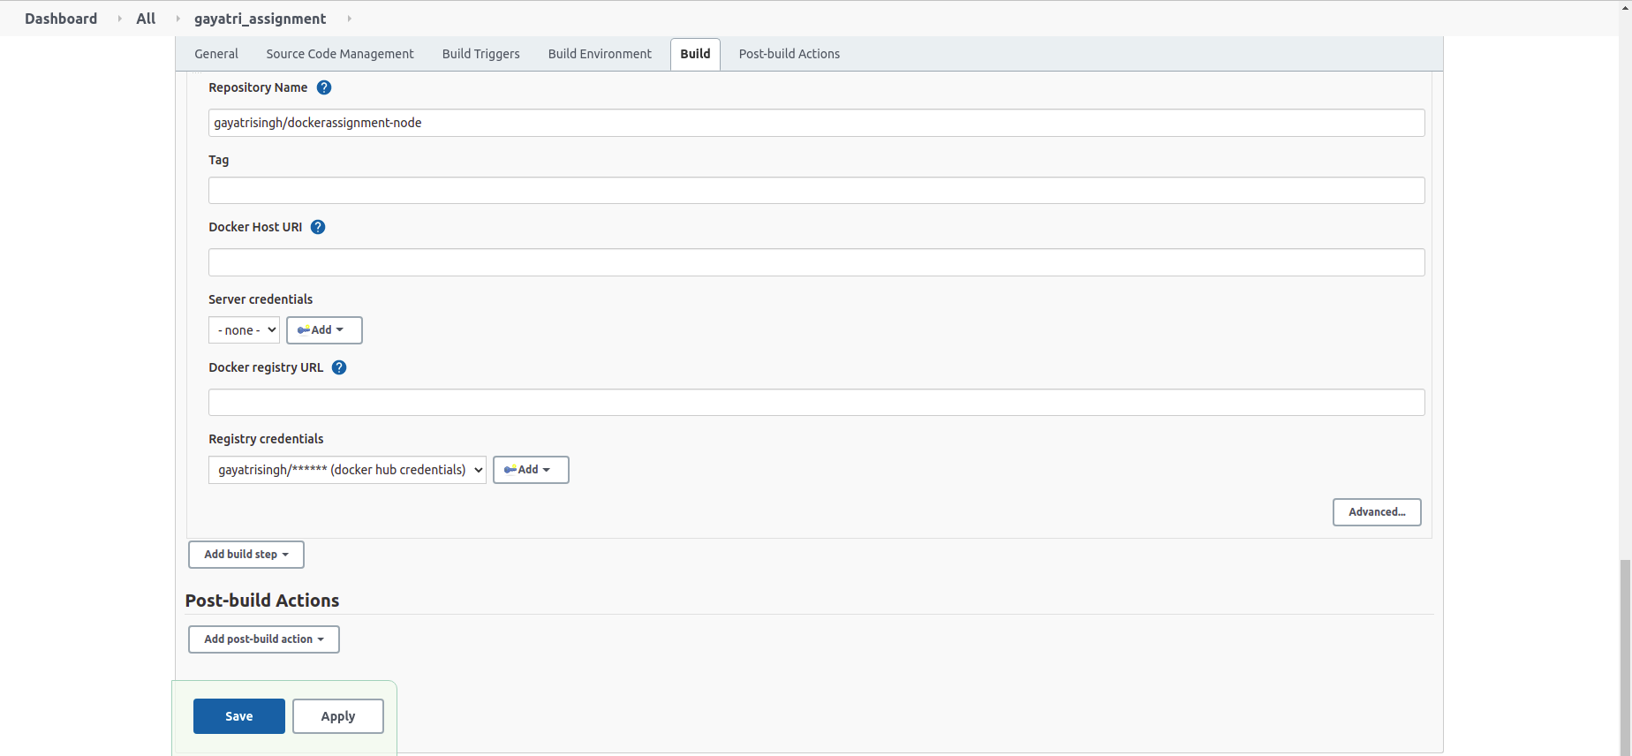
Configuring steps of the jenkins.

Slide 14
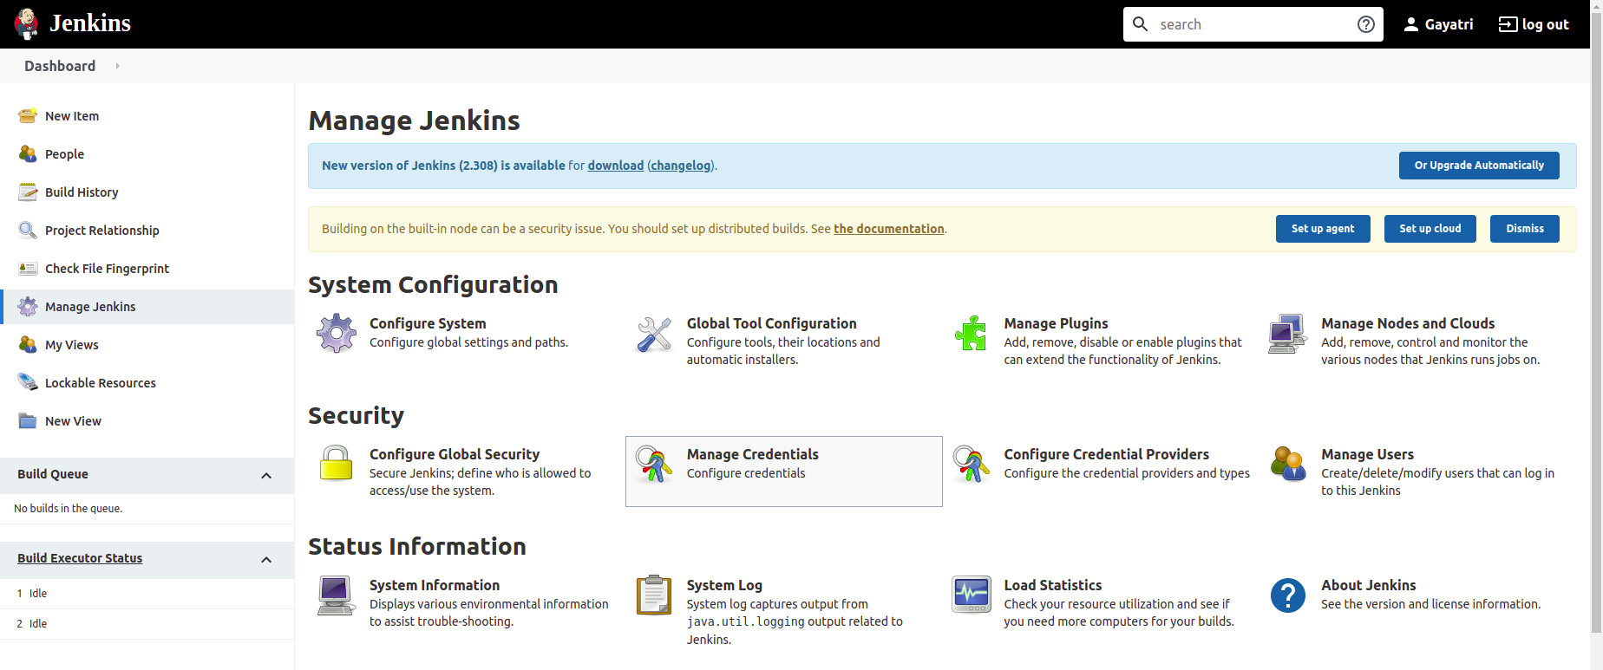
Installation of Jenkins Plugins

Slide 15
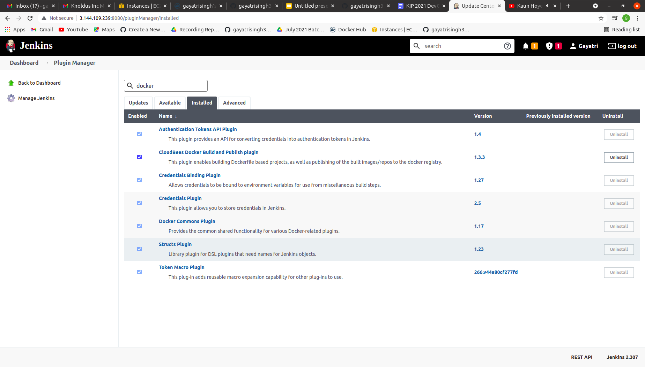

Slide 16
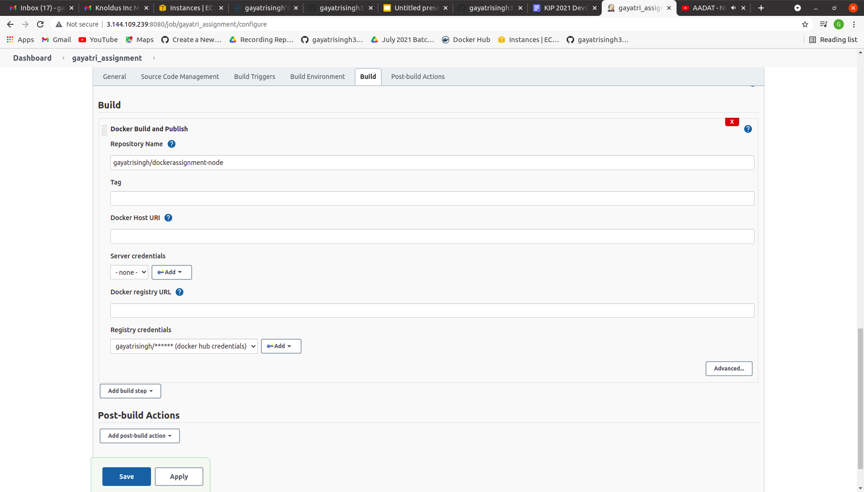
Adding NodeJs in the Jenkins Pipeline

Slide 17
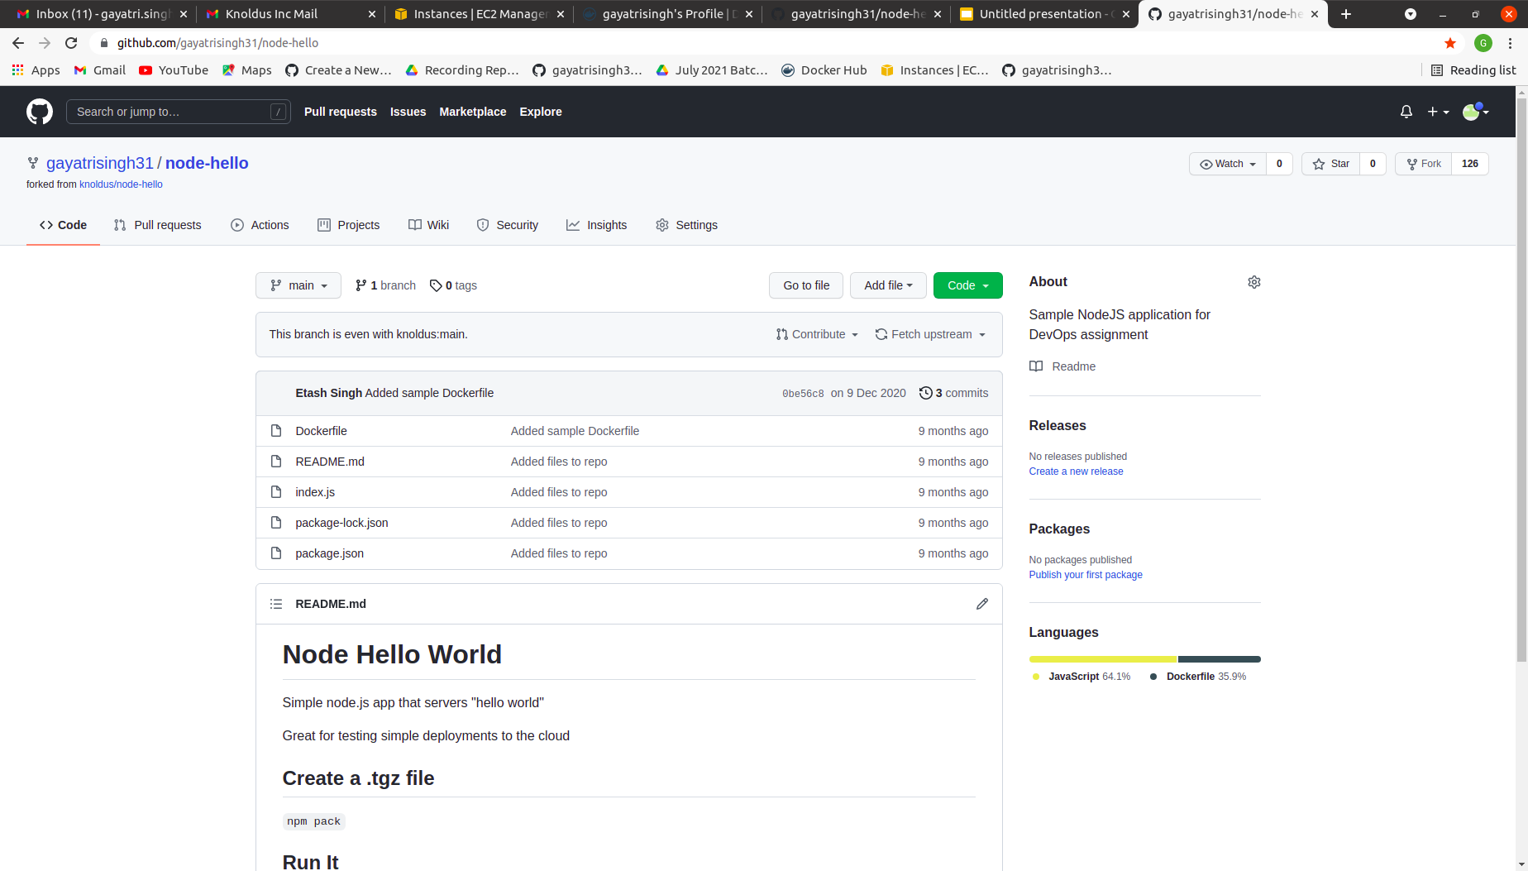
Github Repository

Slide 18
3. The application should be containerized and should be running on docker.

Slide 19
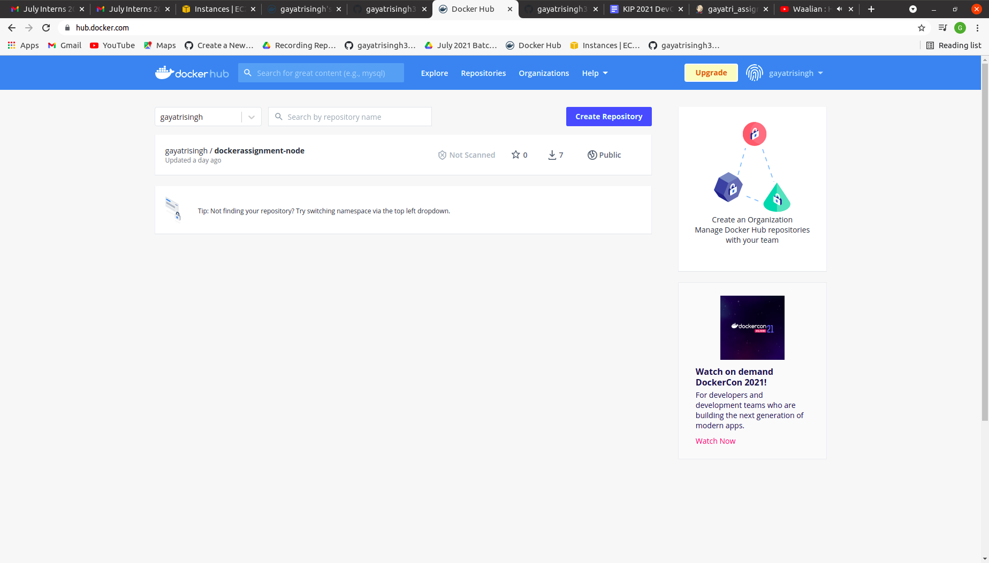
Creating a Docker Hub account and container

Slide 20
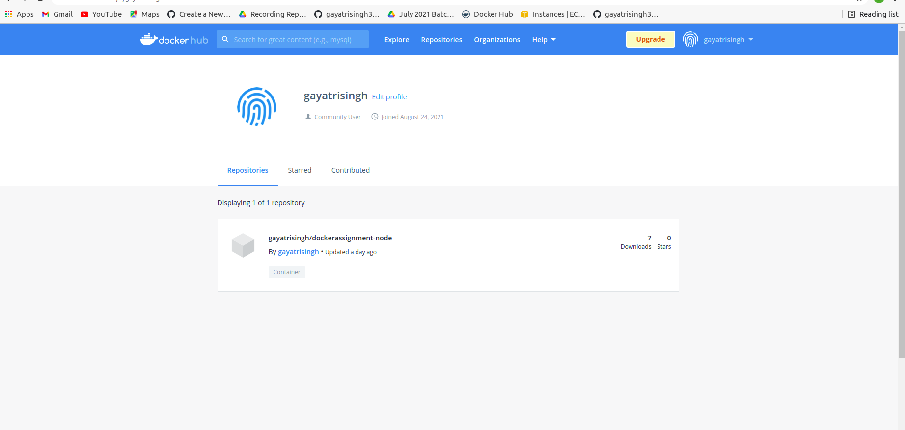

Slide 21
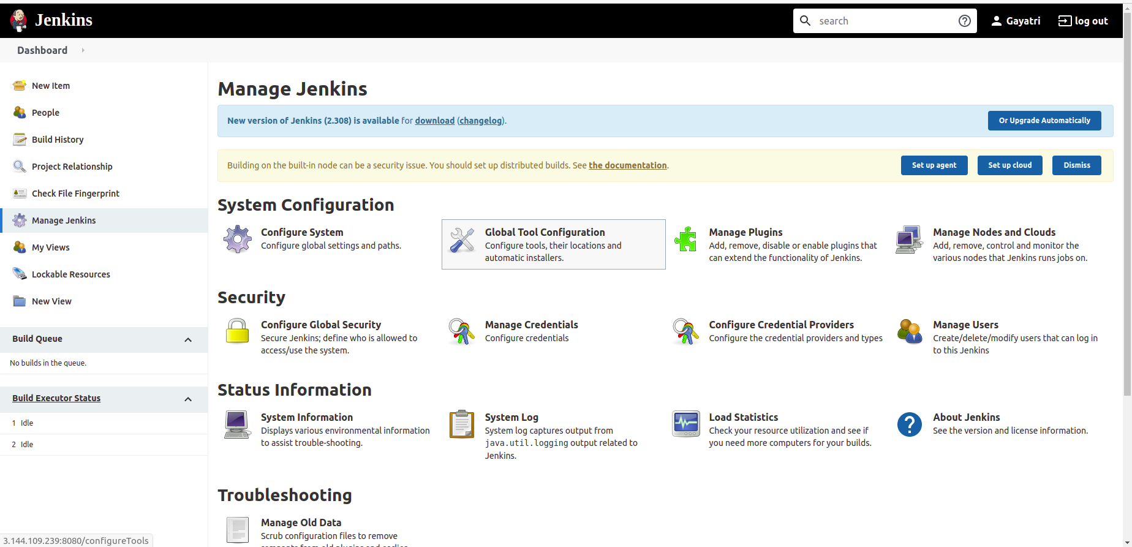
7. Implement use of Global Tools Configuration to use Node JS effectively

Slide 22
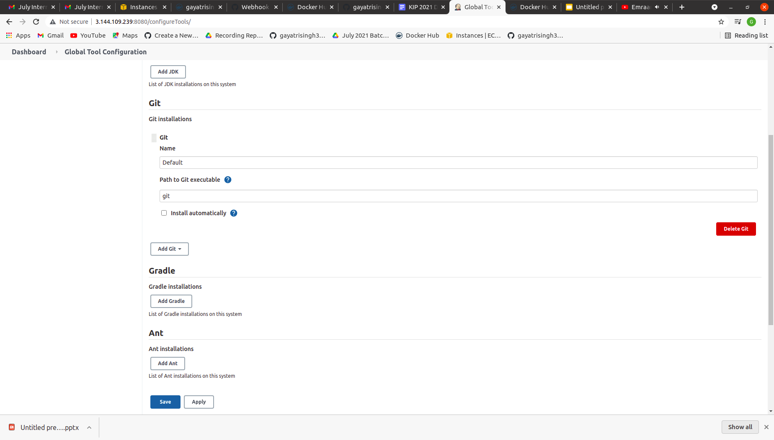

Slide 23
8. Requirements:
Jenkins should be set up on a Cloud Virtual Machine and not from the local system
Any commits to the ‘main’ branch should trigger the job on Jenkins and start the build process
Use Github webhooks to trigger builds
The first part of the Jenkins job should be creating the package
The second part of the Jenkins job will be to send the package to another VM and run it there

Slide 24
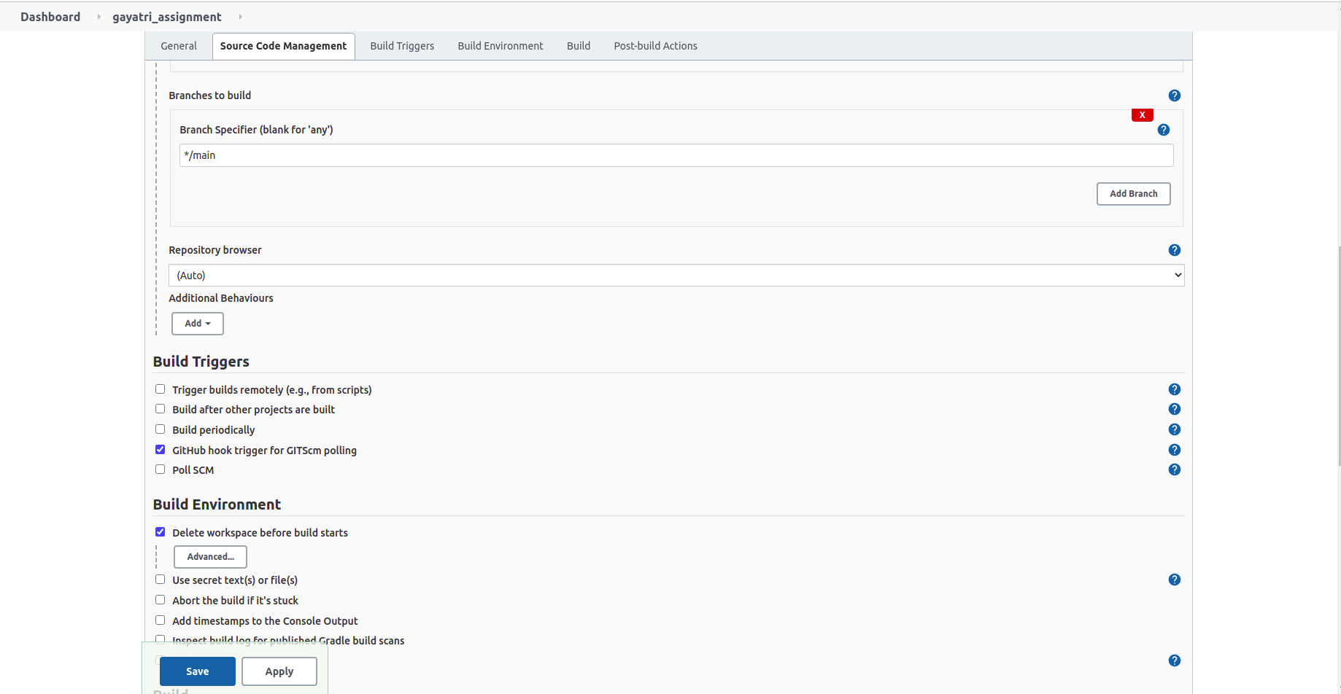

Slide 25
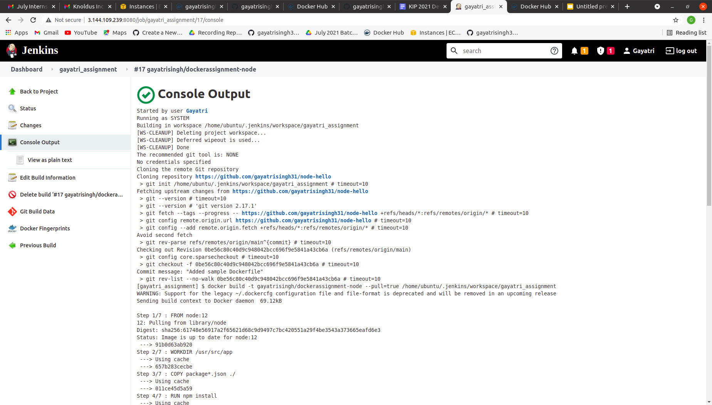

Slide 26
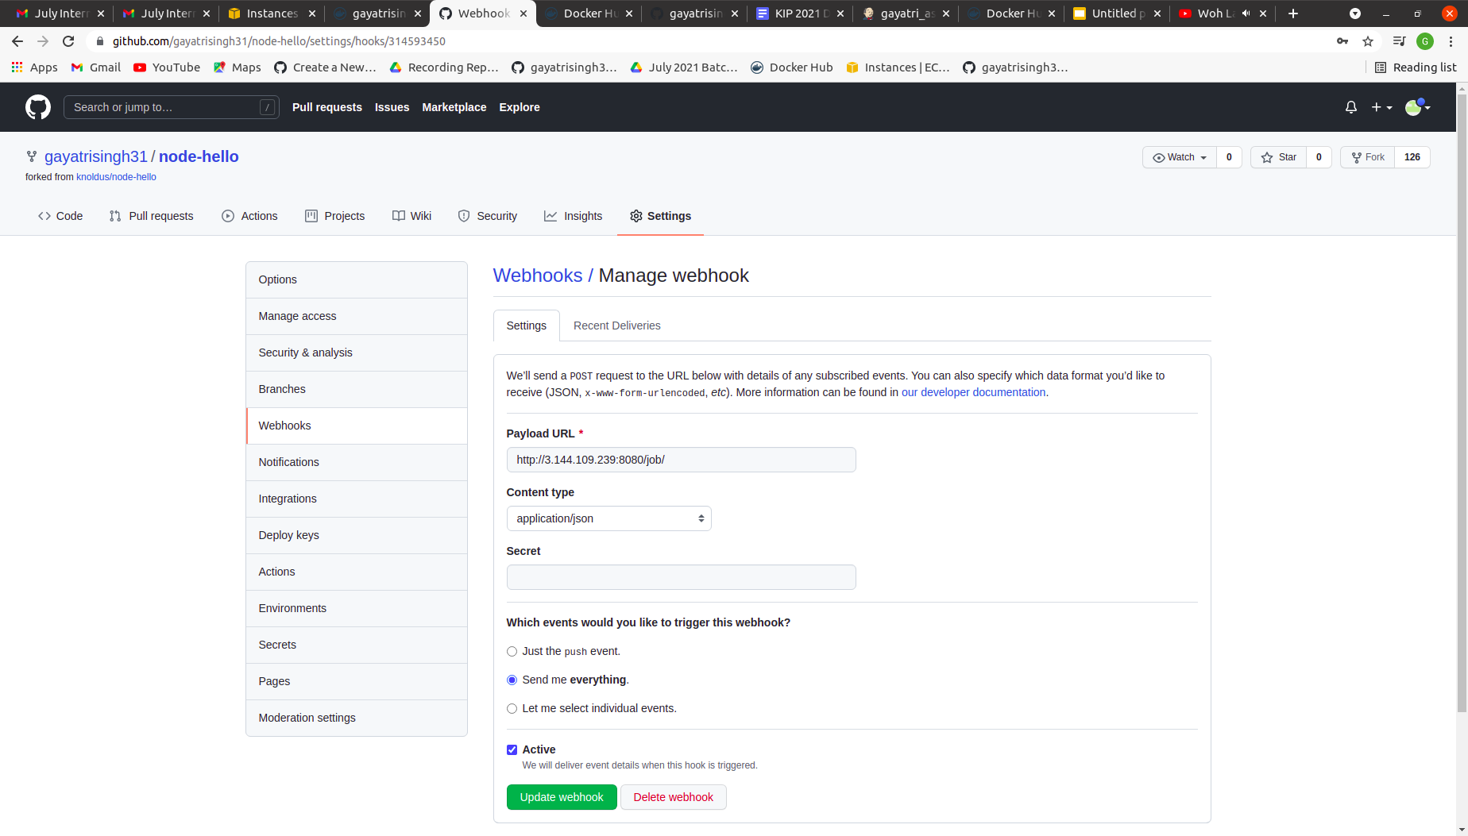
Screenshot of webhooks/Manage webhook

Slide 27
9. The validations can be performed by hitting endpoints: <VM_IP>:3000 or <VM_IP>:3001

Slide 28
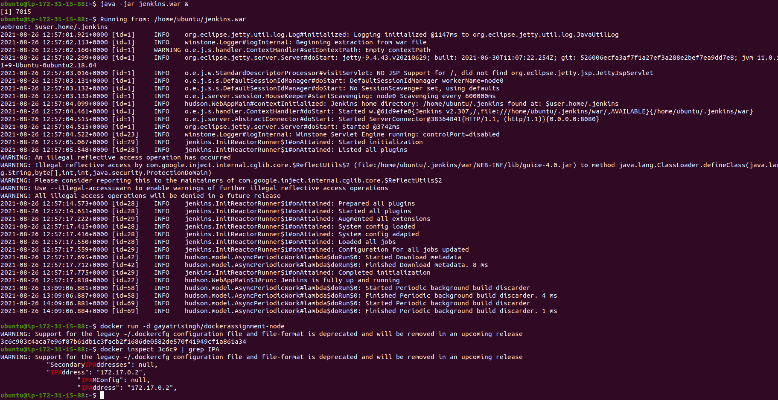
Command of validation

Slide 29
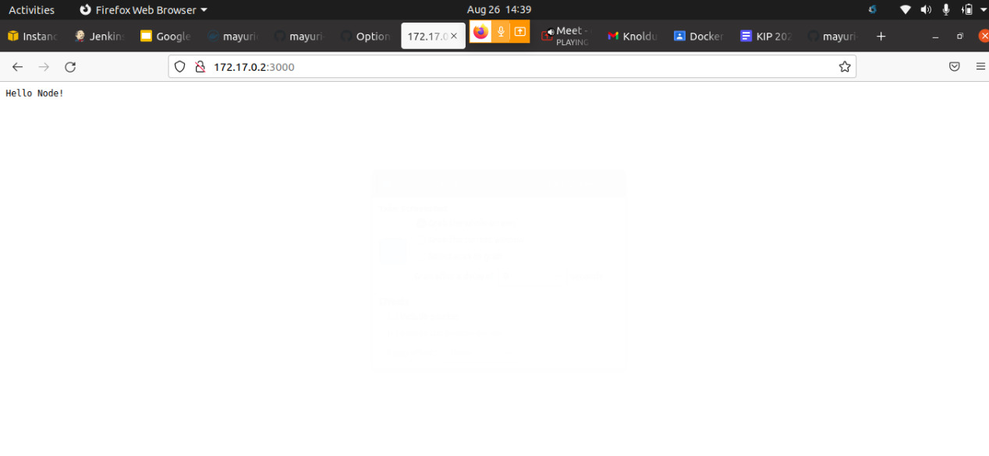
Validation of <VM_IP>:3000 Port

Slide 30
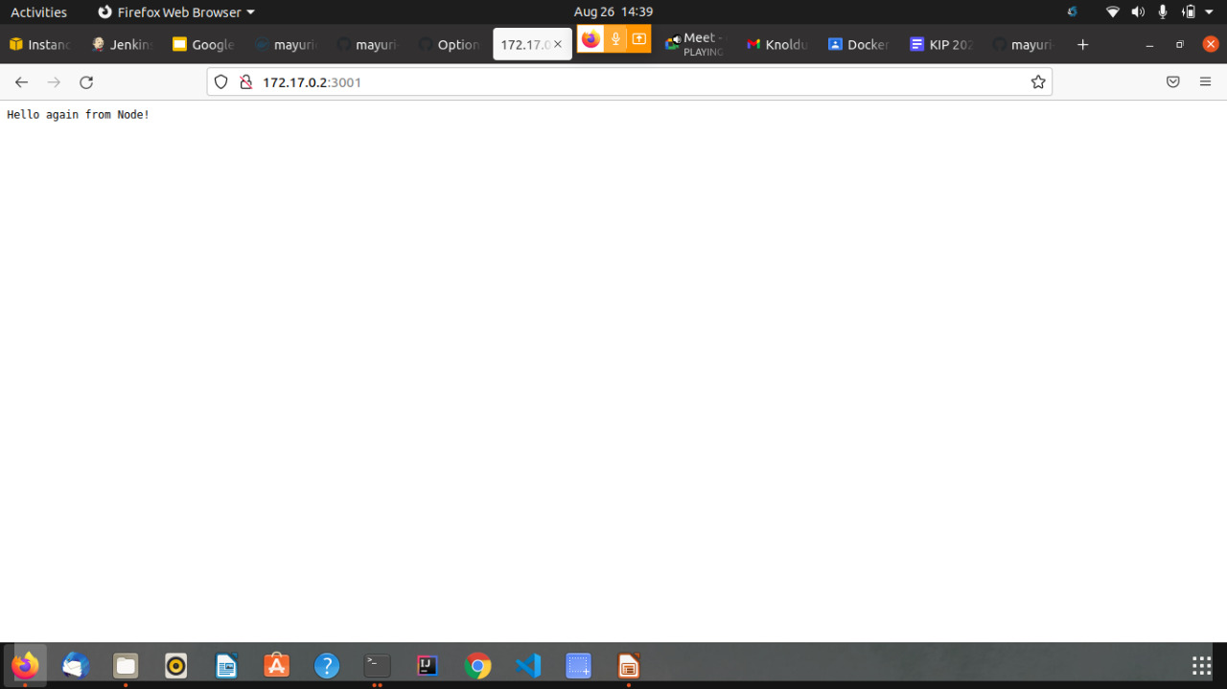
Validation of <VM_IP>:3000 Port

Slide 31
Thank You

