Slide 1
Data Structures and Algorithms -3 (25CS2103E) Smart Recipe Discovery System Using Ingredients & Keywords
2520030032-A.AMULYA
2520030600-CH.GAYATRI SRI HARSHITA
2520030154-P.BHAVANA MANASWINI
Under the Esteemed Guidance of
Dr. V. Sireesha
Professor, Department of CSE

Slide 2
Contents
Abstract
Introduction
Literature survey
Problem Statement and Objectives
Hardware and Software requirements
Results
Conclusion
Future Scope

Slide 3
Abstract
In today’s fast-paced lifestyle, deciding what to cook using the ingredients available at home has become a common challenge. Most existing recipe platforms require users to search by exact dish names, which is often inconvenient and time-consuming. This limitation leads to inefficient use of ingredients, increased food wastage, and difficulty in making quick cooking decisions.
The Smart Recipe Discovery System addresses this problem by enabling users to search for recipes based on available ingredients or simple keywords. The system processes user inputs to generate relevant and filtered recipe suggestions, along with options based on cuisine, preparation time, and dietary preferences. By simplifying the search process and improving accessibility, the system helps users save time, reduce wastage, and make smarter everyday cooking choices.

Slide 4
Introduction
Recipe discovery can be challenging when users have ingredients available at home but are unsure what to prepare. Traditional recipe platforms often require users to search for a specific dish name, which can be inconvenient and time-consuming when they do not already know what they want to cook. This may result in inefficient use of available ingredients, increased food wastage, and difficulty in making quick cooking decisions.
The Smart Recipe Discovery System addresses this problem by allowing users to search for recipes using the ingredients they already have or through simple keywords. The system identifies relevant recipes and helps users explore different meal options without manually browsing through a large collection. It aims to make recipe discovery faster and more convenient while encouraging better utilization of available ingredients, reducing wastage, and simplifying everyday meal planning.

Slide 5
Literature Survey
Existing approach | Limitation | Proposed approach
Dish-name based recipe search | User must already know what dish they want | Search using available ingredients
Manual browsing through recipes | Time-consuming | Relevant recipes suggested automatically
Basic recipe search | Limited personalization | Filters based on cuisine, time, difficulty and diet
Searching individual recipes | Difficult to utilize leftover ingredients | Ingredient-based discovery helps reduce wastage

Slide 6
Problem Statement and Objectives
Many users face difficulty in identifying suitable recipes using the ingredients available at home. Existing recipe platforms primarily rely on searching by dish names, making it inconvenient for users who are unsure of what to cook.
This leads to:
Inefficient use of available ingredients
Increased food wastage
Time-consuming browsing and decision-making
Lack of personalized recommendations
There is a need for an intelligent system that simplifies recipe discovery based on real-time user needs.

Slide 7
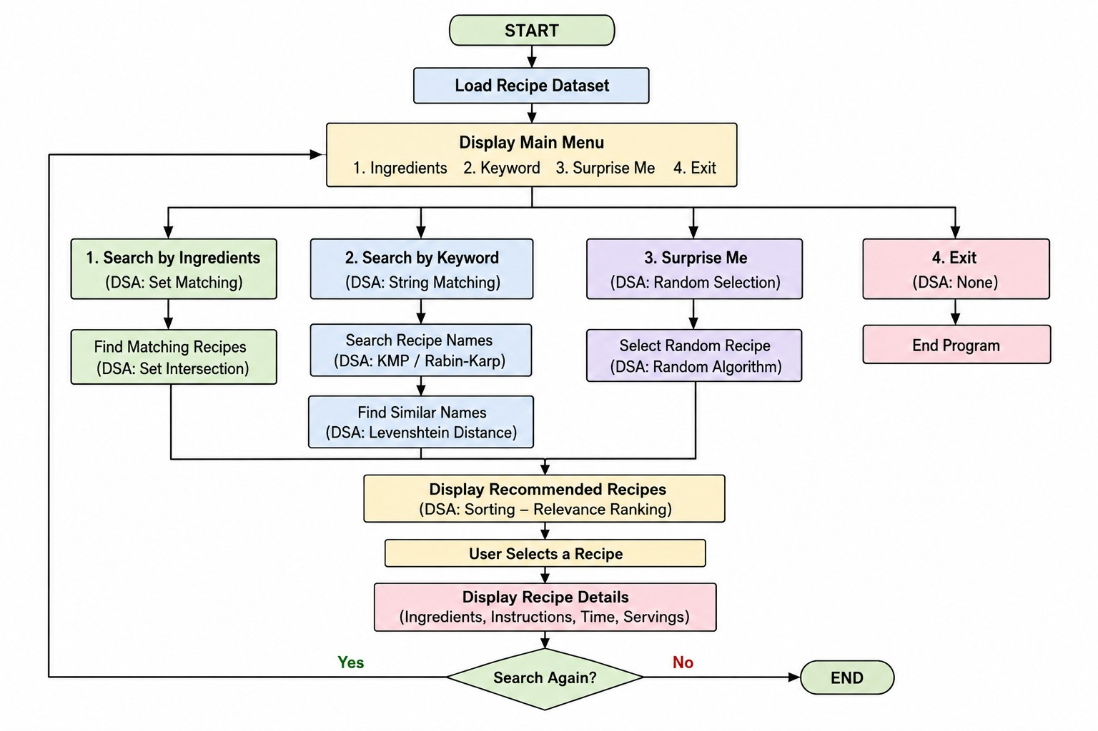
Flow Chart

Slide 8
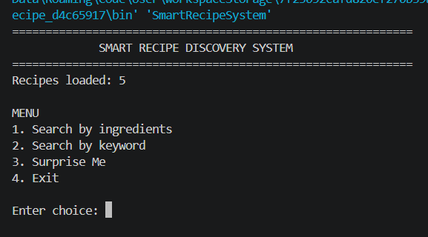
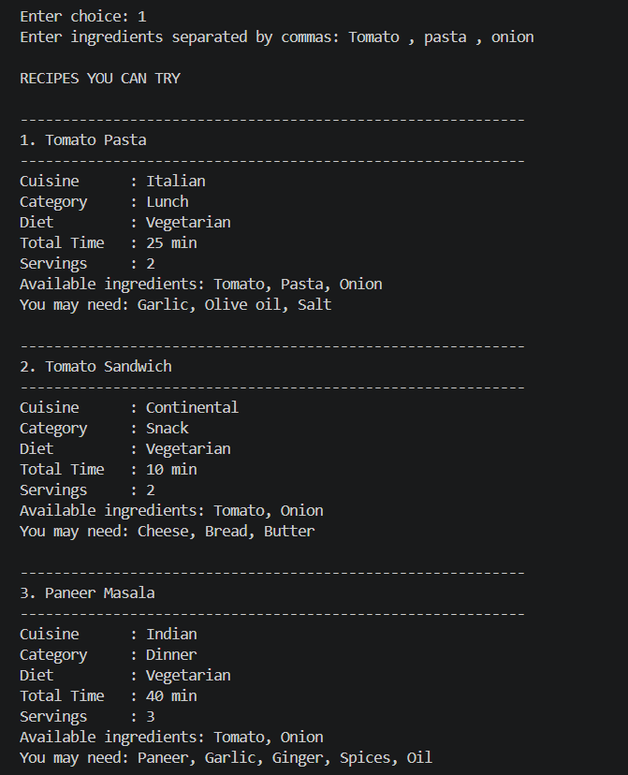
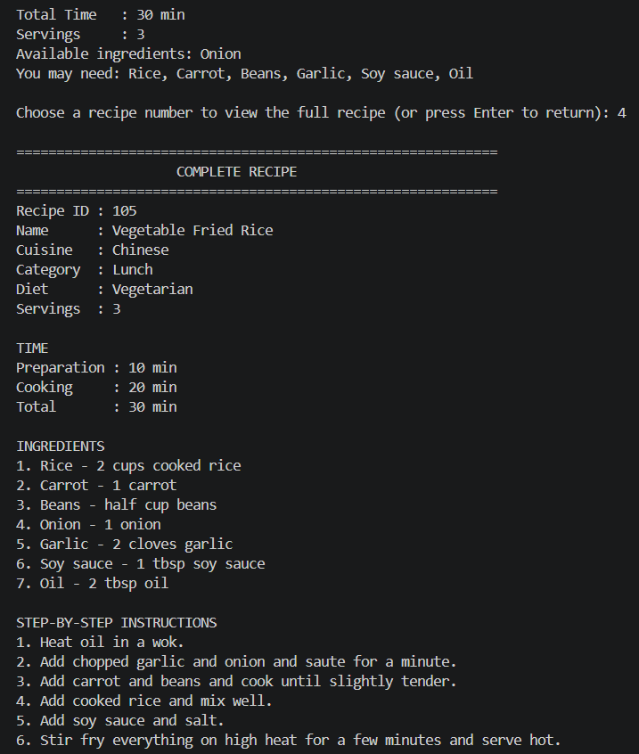
Results

Slide 9
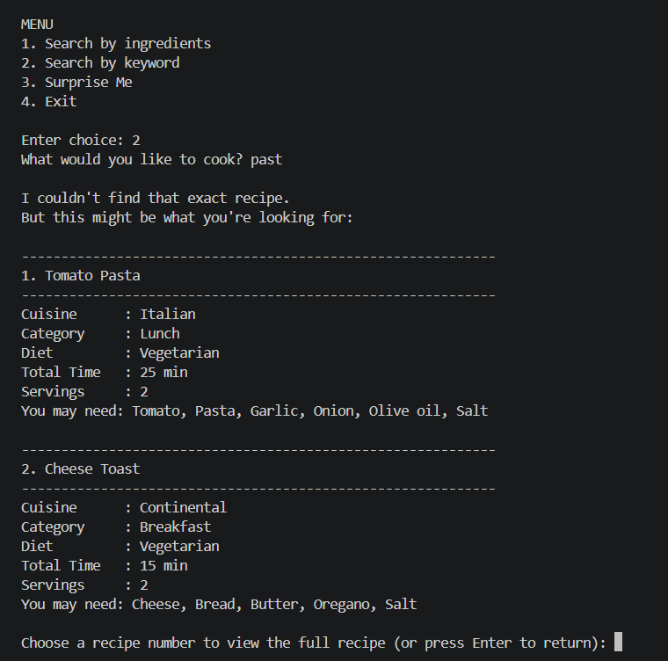
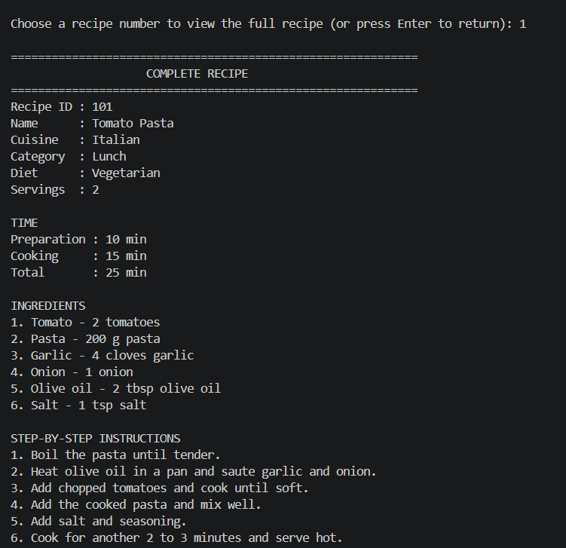

Slide 10
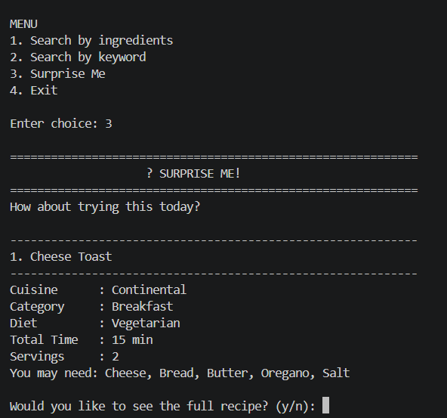
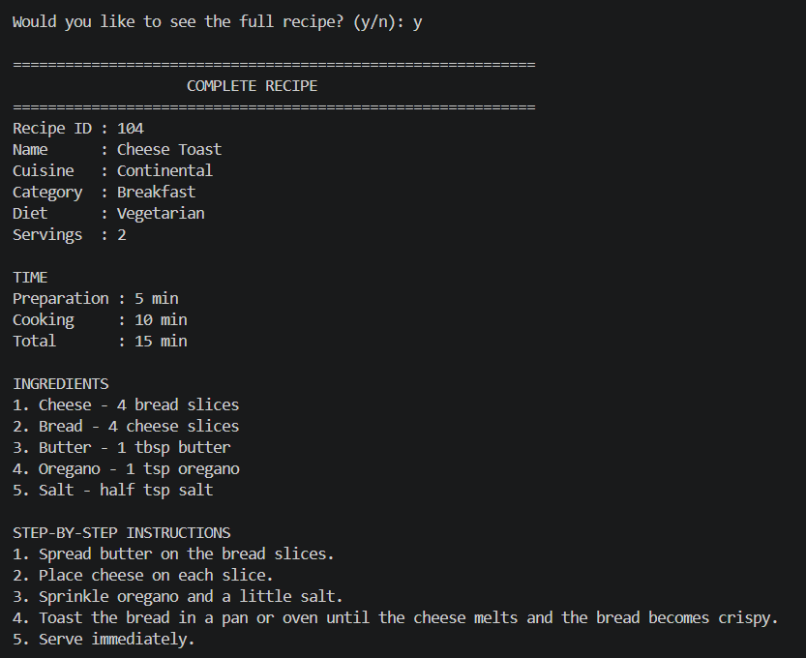
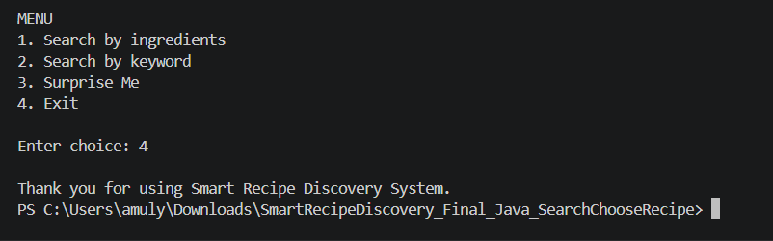

Slide 11
Hardware and Software requirements
Hardware Requirements
Laptop/Desktop
Minimum 4 GB RAM
Sufficient storage for the recipe dataset
Keyboard/monitor for user interaction
Software Requirements
Programming Language: Java
IDE: VS Code / IntelliJ IDEA / Eclipse
Data Source: Recipe dataset / text or CSV files
DSA: Java implementations of searching and similarity algorithms

Slide 12
Conclusion
In conclusion, the Smart Recipe Discovery System Using Ingredients and Keywords is designed to make the process of finding suitable recipes easier, faster, and more efficient. Instead of requiring users to search for exact dish names, the system allows them to discover recipes based on the ingredients available at home or simple keywords. With features such as ingredient-based search, keyword-based search, smart filtering, auto-suggestions, personalized recommendations, favorite recipe saving, and step-by-step cooking instructions, the system provides a more convenient and user-friendly experience.
The proposed system can help users make better use of available ingredients, reduce food wastage, save time in deciding what to cook, and explore recipes according to their preferences. By combining intelligent search and personalized features, the project aims to provide a practical, scalable, and efficient solution for everyday cooking needs. Overall, the Smart Recipe Discovery System enhances the cooking experience by making recipe discovery smarter, more accessible, and more convenient for users.

Slide 13
Future Scope
In the future, the Smart Recipe Discovery System Using Ingredients and Keywords can be enhanced with more advanced and intelligent features. The system can include AI-based personalized recipe recommendations by analyzing users’ preferences, search history, and favorite recipes. It can also support image-based ingredient recognition, allowing users to upload a picture of available ingredients and receive suitable recipe suggestions.
Further improvements can include voice-based search, meal planning, nutrition and calorie information, shopping list generation, and integration with grocery delivery services. The system can also provide more accurate recommendations by considering dietary preferences and cooking time. These enhancements can make the platform more intelligent, interactive, scalable, and useful for everyday cooking needs.

Slide 14
Thank you

