Slide 1
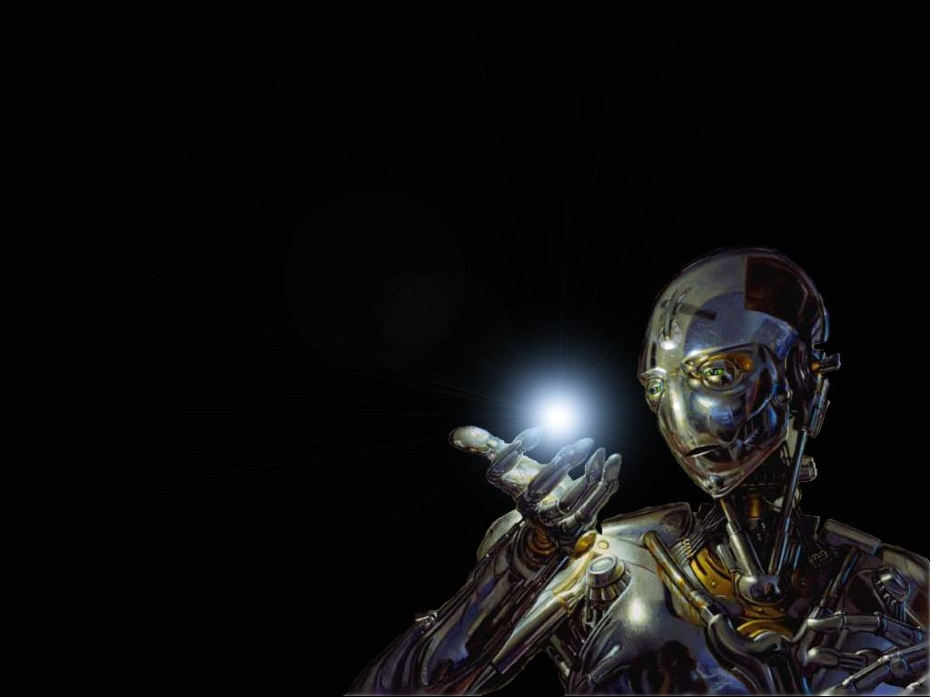
ARTIFICIAL INTELLIGENCE

Slide 2
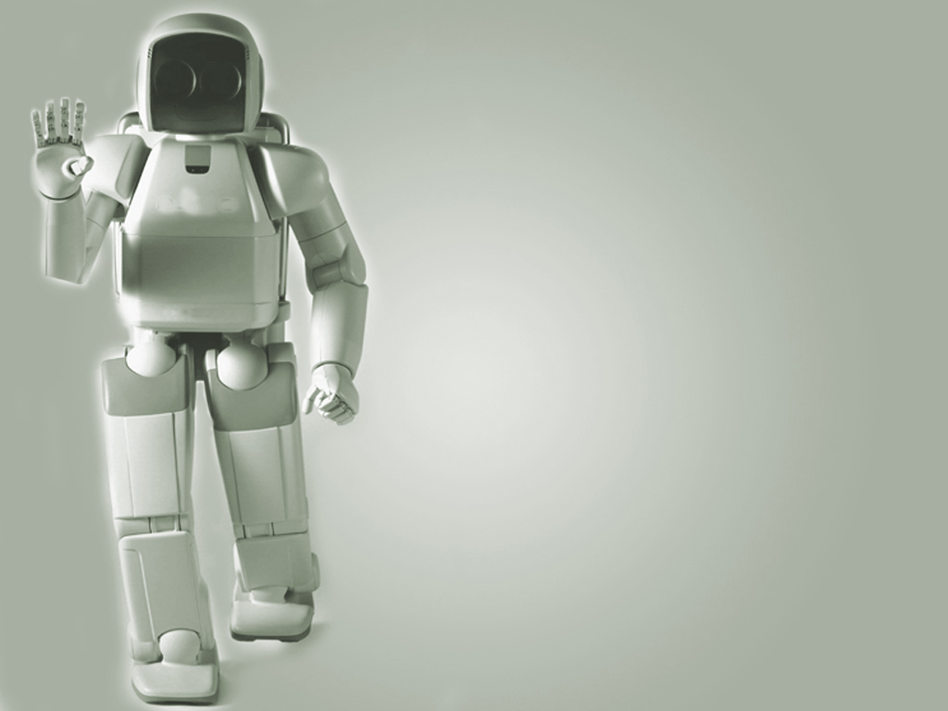
“AI is the study of techniques for solving exponentially hard problems in polynomial time by exploiting knowledge about the problem domain.“ - Elaine Rich

Slide 3
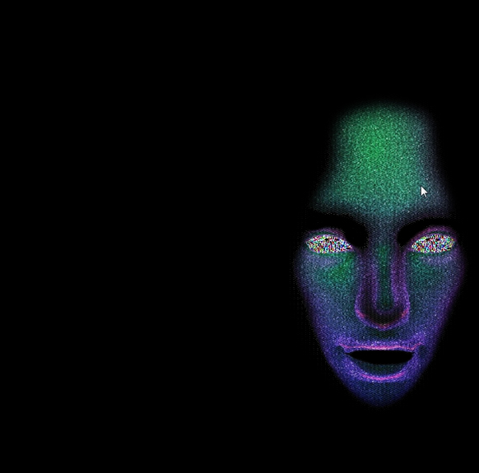
History of artificial intelligence
Although artificial intelligence as an independent field of study is relatively new, it has some roots in the past. We can say that it started 2,400 years ago when the Greek philosopher Aristotle invented the concept of logical reasoning. The effort to finalize the language of logic continued with Leibniz and Newton. George Boole developed Boolean algebra in the nineteenth century (Appendix E) that laid the foundation of computer circuits. However, the main idea of a thinking machine came from Alan Turing, who proposed the Turing test. The term “artificial intelligence” was first coined by John McCarthy in 1956.

Slide 4
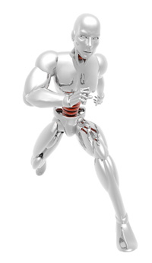
We end up with four possible goals:
Systems that think like humans (focus on reasoning and human framework)
Systems that think rationally (focus on reasoning and a general concept of intelligence)
Systems that act like humans (focus on behavior and human framework)
Systems that act rationally (focus on behavior and a general concept of intelligence)

Slide 5
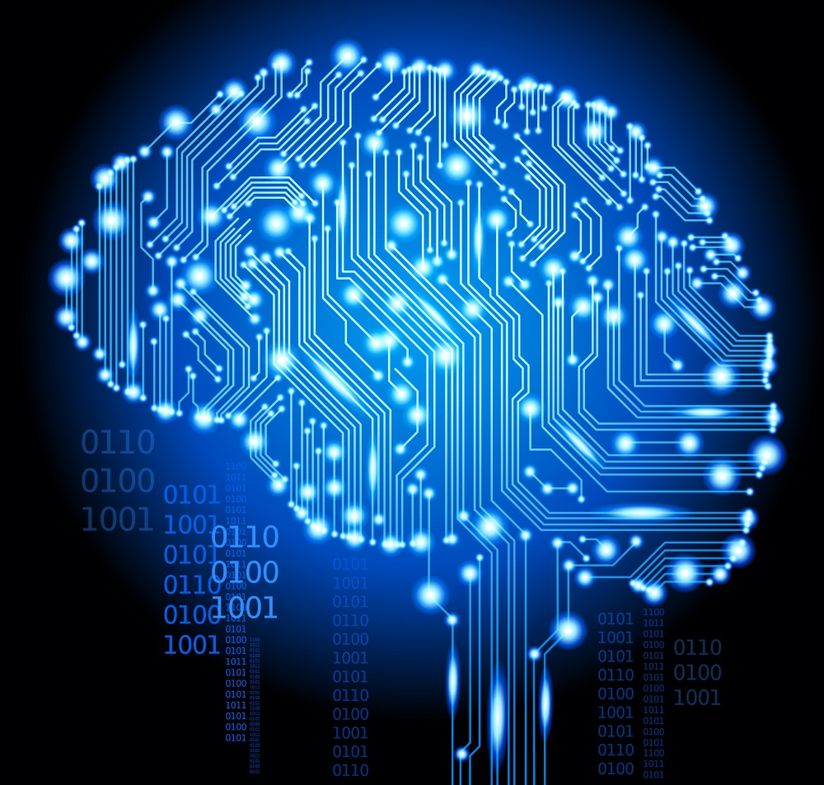
Computers were solving word problems in algebra, proving logical theorems and speaking English. By the middle of the 1960s, research in the U.S. was heavily funded by the Department of Defense and laboratories had been established around the world. AI's founders were profoundly optimistic about the future of the new field: Herbert Simon predicted that "machines will be capable, within twenty years, of doing any work a man can do" and Marvin Minsky agreed, writing that "within a generation ... the problem of creating 'artificial intelligence' will substantially be solved".

Slide 6
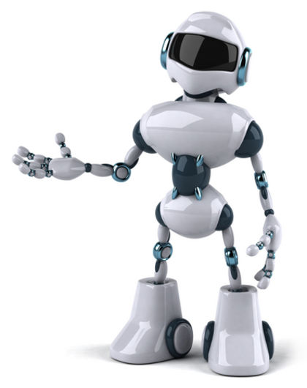

Intelligent agents
Intelligent agents can be divided into two broad categories: software agents and physical agents.

Slide 7
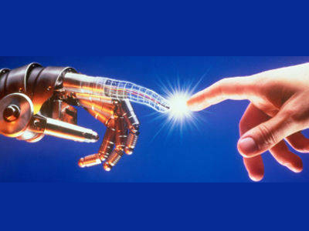
Software agents : A software agent is a set of programs that are designed to do particular tasks. They works with limitation.
Physical agents : A physical agent (robot) is a programmable system that can be used to perform a variety of tasks. Simple robots can be used in manufacturing to do routine jobs such as assembling, welding, or painting. Some organizations use mobile robots that do routine delivery jobs such as distributing mail or correspondence to different rooms.

Slide 8
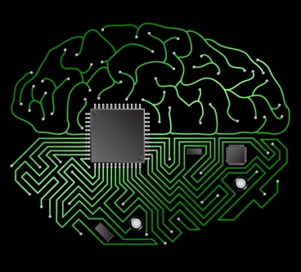
Applications of AI :
Game playing : Most games are played using a well-defined set of rules, this makes it easy to generate the search space and frees the researcher from many of the ambiguities and complexities inherent in less structured problems.
Automated Reasoning & Theorem Proving : Theorem proffers function as intelligent assistants , letting human perform the more demanding tasks of decomposing a large problem into sub problems and devising heuristics for searching the space of possible proofs.
Expert Systems : Expert knowledge is a combination of a theoretical understanding of the problem and a collection of heuristic problem solving rules that experience has shown to be effective in the domain , expert system are constructed by obtaining this knowledge from a human expert and coding it into a form that a computer may apply to similar problems .

Slide 9
Applications of AI :
Natural Language Understanding & Semantic Modeling : One of the long-standing goals of artificial intelligence is the creation of programs that are capable of understanding human language, Not only does the ability to understand natural language seem to be one of the most fundamental aspects of human intelligence, but also it successful automation would have an incredible impact on the usability and effectiveness of computer them selves.
Planning & Robotics : Planning is an important aspect of the effort to design Robots that perform their task with some degree of flexibility and responsiveness to the outside world, Briefly, Planning assumes a Robot that is capable of performing certain atomic actions, It attempts to find a sequence of those action that will accomplish some higher-level task such as moving a cross an obstacle-filled room.
Machine Learning : The ability to learn is one of the most important components of intelligent behavior; an expert system may perform extensive and costly computations to solve a problem.

Slide 10
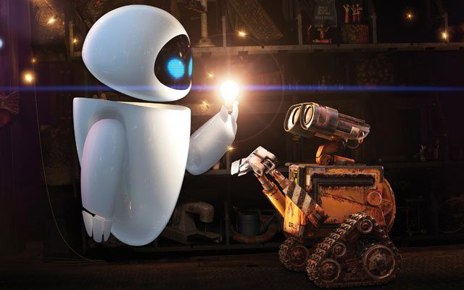
Knowledge : is the symbolic representation of aspect of some named universe of discourse.
Data : is the symbolic representation of simple aspects of some named universe of discourse.
Information : the useful contents of knowledge

Slide 11
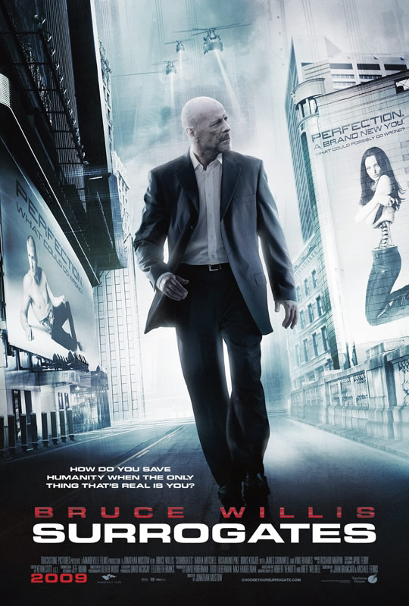
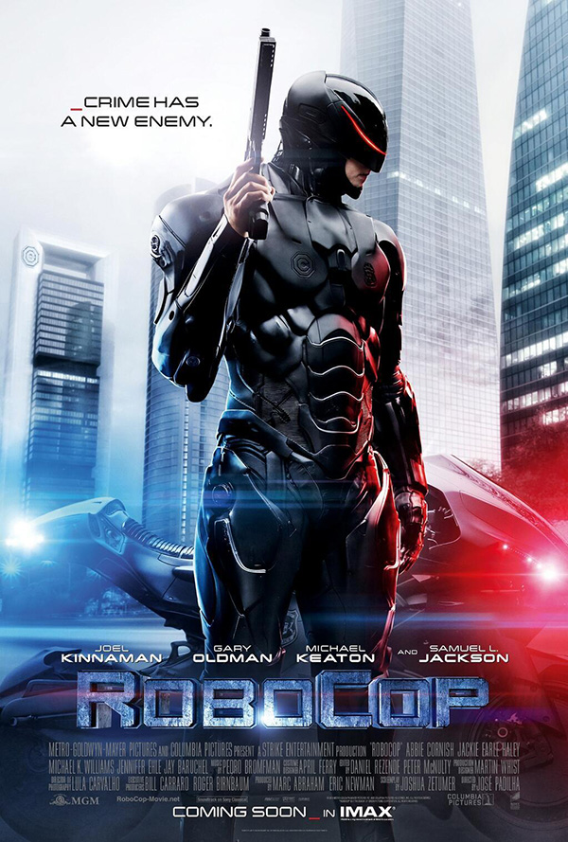
Many Hollywood movies come with the future technology, that technology we can see in our future. Have a look some of them….
In this movie people to purchase remote controlled humanoid robots through which they interact with society.
Alex (Robocop) at first rejects his current condition upon seeing that his original body now consists of only lungs, throat, head and right hand when the armor and Cybernetic components are fully removed, but he is convinced by Norton to be strong for his wife and son.
These fit, attractive, remotely controlled robots ultimately assume their life roles, enabling people to experience life vicariously from the comfort and safety of their own homes.
He had loose his body parts in a car bomb blast. Alex has him outfitted with the cybernetic body and software.

Slide 12

The robots are coming to steal our jobs

Slide 13
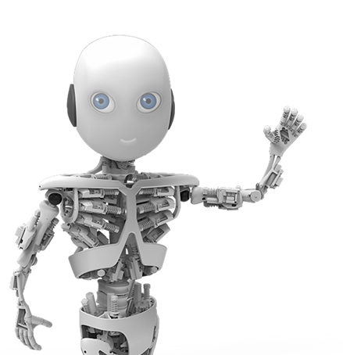
Thank You

