Slide 1
Learning Management Systems
A Case Study on Moodle
Education 4.0 – Role of Educational Technologies
Gayatri Venugopal
Symbiosis Institute of Computer Studies and Research
Symbiosis International (Deemed University)
July 15, 2021

Slide 2
Overview
Education 4.0
Learning Management Systems
About Moodle
Using Moodle for Implementing the Components of Education 4.0
Using Moodle as a Student
Using Moodle as a Facilitator and an Administrator
        July 15 2021, Education 4.0 – Role of Educational Technologies © 2021 Gayatri Venugopal

Slide 3

The Challenge!
Source: Engaging learners in Moodle | Helen Foster, Mary Cooch | MoodleMoot Global 2020 (YouTube)
        Education 4.0 – Role of Educational Technologies © 2021 Gayatri Venugopal

Slide 4


The Competition
Sources: https://www.onaplatterofgold.com/apply-social-media-in-daily-life/, https://www.businessinsider.in/tech/news/ott-platforms-hotstar-netflix-and-even-news-content-providers-will-now-be-regulated-by-the-ib-ministry/articleshow/79166864.cms
        Education 4.0 – Role of Educational Technologies © 2021 Gayatri Venugopal

Slide 5
Education 4.0
Personalised Learning
Complex Problem Solving
Critical Thinking
Creativity
Remote
Learning
Collaboration
Formative Assessments
Data Analysis
Cognitive Flexibility
Emotional Intelligence
Project Based Learning
        Education 4.0 – Role of Educational Technologies © 2021 Gayatri Venugopal

Slide 6
Learning Management System
Used for delivering educational courses including training programmes
Blended and remote learning
Learning facilitated by instructor
Courses, content sharing, user roles, transparent assessment, feedback, rewards, analytics
Moodle, Canvas, Edmodo, Blackboard
        July 15 2021, Education 4.0 – Role of Educational Technologies © 2021 Gayatri Venugopal

Slide 7


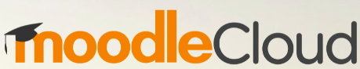
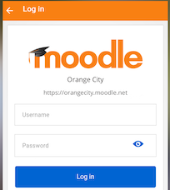



Modular Object Oriented Dynamic Learning Environment
Open Source, GNU GPL
Moodle 1.0 in 2002, Moodle 3.11 in 2021
Statistics
Martin Dougiamas
Sources: https://moodle.com/, https://download.moodle.org/mobile, https://moodlecloud.com/, https://moodle.org/
        July 15 2021, Education 4.0 – Role of Educational Technologies © 2021 Gayatri Venugopal

Slide 8
Moodle Cloud
Course Page: https://gayatrivenugopal.moodlecloud.com/course/view.php?id=5
Overview of features
  Content sharing (24 x 7 access)
  Assignments (formative assignments, project based learning)
  Quiz and display of results (data analysis)
  Competencies and learning plan (personalised learning)
  Workshop (peer assessment)
  Feedback (survey, in-class activities)
  Forum (discussion and collaboration)
  Attendance
        July 15 2021, Education 4.0 – Role of Educational Technologies © 2021 Gayatri Venugopal

