Slide 1

CONNECT Forward
Lexical Simplification of Hindi Text
Gayatri Venugopal
Twitter: @speakingg3
https://gayatrivenugopal.wordpress.com
gayatrivenugopal3@gmail.com
https://github.com/gayatrivenugopal/wwcode-connectforward

Slide 2

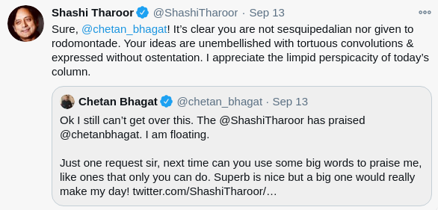
Text Simplification...Why?
Sources
https://twitter.com/shashitharoor/status/1305097520981225472?lang=en
https://twitter.com/shashitharoor/status/861608665517895680?lang=en

Slide 3
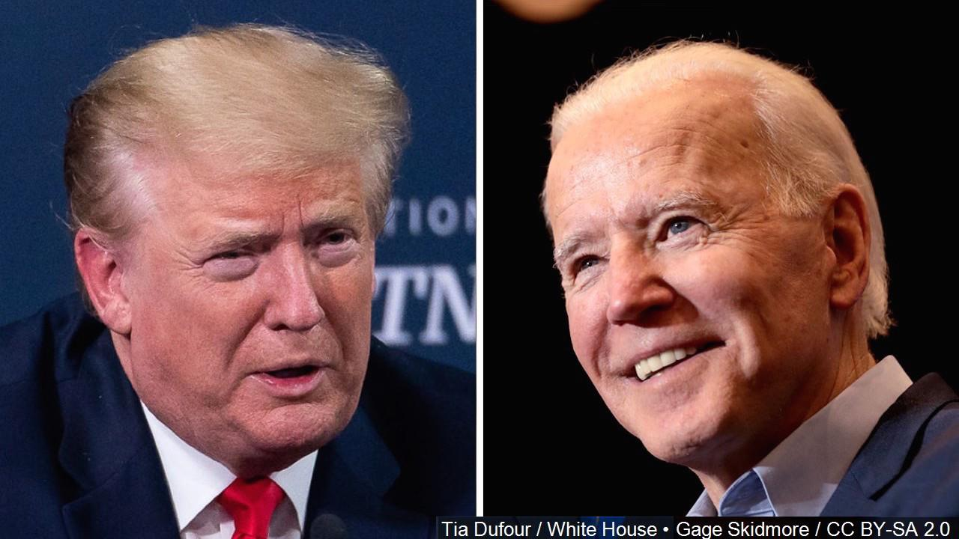
Nomination Acceptance Speeches
Flesch Reading Ease (100% = simple) | 60% | 72.3%
Length | 6944 words | 3196 words
Sources
https://www.bloombergquint.com/gadfly/biden-and-trump-nomination-speeches-are-two-clashing-word-clouds

Slide 4
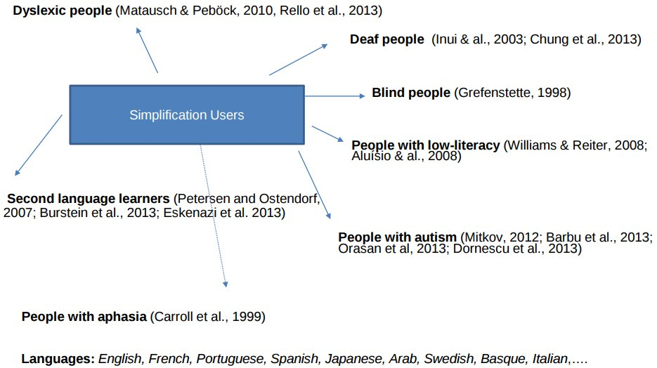
Text Simplification and its Applications
Sources
https://zenodo.org/record/2593329#.XIzyaayYW02 presented at the Department of Information and Communication Technologies, Universitat Pompeu Fabra, in the context of the María de Maeztu data-driven knowledge extraction strategic research program (MDM-2015-0502), by Horacio Saggion and Sanja Štajner in 2019.

Slide 5
Lexical Simplification Pipeline
Complex Sentence
The cat perched on the mat
Simplified Sentence
The cat sat on the mat.
Complex Word Identification
The cat perched on the mat
Substitution Raking
#1: sat, #2: rested
Substitution Generation
perched: rested, sat, roosted
Substitution Selection
perched: rested, sat, roosted
Sources
Paetzold, G. (2015, June). Reliable lexical simplification for non-native speakers. In Proceedings of the 2015 Conference of the North American Chapter of the Association for Computational Linguistics: Student Research Workshop (pp. 9-16).
Adaptation of the pipeline proposed by Shardlow, M. (2014, May). Out in the Open: Finding and Categorising Errors in the Lexical Simplification Pipeline. In LREC (pp. 1583-1590).

Slide 6
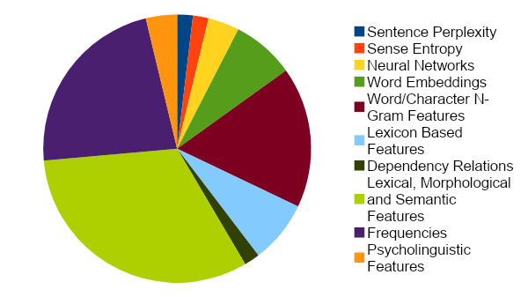
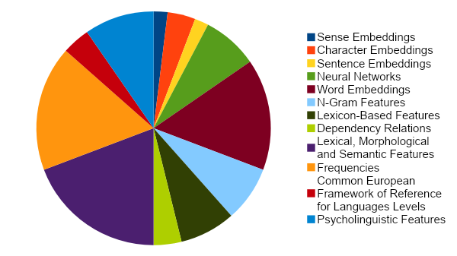
SemEval Shared Tasks
Summary of features employed in CWI Shared Tasks 2016
Summary of features employed in CWI Shared Tasks 2018
Sources
Paetzold, G., & Specia, L. (2016, June). Semeval 2016 task 11: Complex word identification. In Proceedings of the 10th International Workshop on Semantic Evaluation (SemEval-2016) (pp. 560-569); Muhie Yimam, S., Biemann, C., Malmasi, S., Paetzold, G. H., Specia, L., Štajner, S., ... & Zampieri, M. (2018). A Report on the Complex Word Identification Shared Task 2018. arXiv, arXiv-1804.

Slide 7
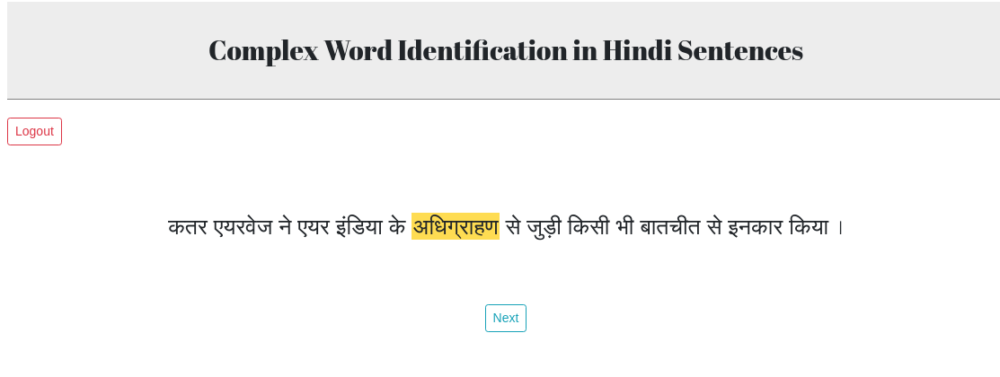
Task 1 - Annotation
Screens designed by Kumar Ashwin (https://krash.dev)

Slide 8
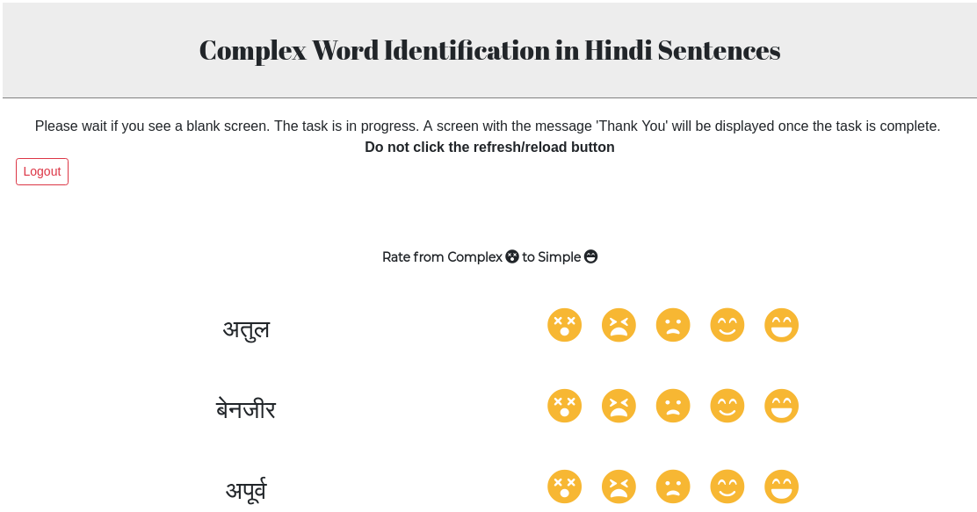
Task 2 - Rating
Screens designed by Kumar Ashwin (https://krash.dev)

Slide 9
S.No. | Source | Unique Word Count | Unique Lemma Count | Domain
1 | Language Resource#1 | 145,507 | 117,309 | Aesthetics
2 | Language Resource#2 | 21,335 | 17,159 | Entertainment
3 | Language Resource#3 | 119,313 | 102,201 | Not available
4 | Language Resource#4 | 2,330 | 1,851 | Varied domains
5 | Language Resource#5 | 21,826 | 18,220 | Tourism
6 | Language Resource#6 | 39,351 | 32,074 | Agriculture and Entertainment
7 | Language Resource#7 | 35,018 | 28,645 | Agriculture, Entertainment, Politics and Public, Administration, Sports, Religion, Literature, Aesthetics, Economy
8 | Language Resource#8 | 20,430 | 16,673 | Health
9 | Language Resource#9 | 5,322,602 | 4,579,200 | News

Slide 10
Data Description
Number of words ranked by participants | 68,107
Number of unique words ranked by participants | 18,186
Number of unique words annotated by at least two participants | 12,111
Number of unique words ranked by at least two participants and that are present in our corpus | 7,315

Slide 11
Features, Classifiers and Evaluation Metrics
Features | length, number of syllables, frequency of the lemma of the word, number of consonants, number of vowels, number of consonant conjuncts, number of synsets, number of synonyms, number of hypernyms and the number of hyponyms
Classifiers | decision tree, support vector classifier, nearest centroid classifier, random forest, extra trees, ada boost, gradient boosting and XG boost
Evaluation Metrics | AUC Scores
Created a stopword list: https://github.com/gayatrivenugopal/hindi-corpus-stoplemmas
Normalised feature values
We used soft voting classification and random search hyperparameter tuning of the models. Receiver Operating Characteristic (ROC) scores were used to tune the models.

Slide 12
Model | AUC Score
Ada | 0.776
Tuned Ada | 0.781
Extra Trees | 0.760
Tuned Extra Trees | 0.762
Gradient Boosting | 0.783
Tuned Gradient Boosting | 0.755
Random Forest | 0.770
Tuned Random Forest | 0.785
XGBoost | 0.785
Tuned XGBoost | 0.782
Soft Voting | 0.790

Slide 13
Ongoing and Future Work
Analysis of user data
Hyperparameter tuning using Grid Search
Adding fasttext embeddings as a feature for classification
Treating the task as a token classification task – using data from Task 1
Word sense disambiguation
Synonym selection and substitution

Slide 14
Language Resources
Language Resource#1: Aesthetics Corpus
Language Resource#2: The Open Parallel Corpus (n.d.). Retrieved July 12, 2019, from http://opus.nlpl.eu/.
Language Resource#3: CFILT Hindi Corpus (n.d.). Retrieved July 15, 2019, from https://www.cfilt.iitb.ac.in/Downloads.html.
Language Resource#4: Kunchukuttan, A., Mehta, P. & Bhattacharyya, P. (2018). The IIT Bombay English-Hindi Parallel Corpus. Language Resources and
Evaluation Conference.
Language Resource#5: English-Hindi Tourism Text Corpus – EILMT (October, 2016). EILMT Consortia, CDAC Pune. Retrieved July 15, 2019, from http://www.tdil-dc.in.
Language Resource#6: Hindi-English Agriculture & Entertainment Text Corpus ILCI-II (May, 2017). ILCI Consortium, JNU. Retrieved July 15, 2019, from http://www.tdil-dc.in.
Language Resource#7: Hindi Monolingual Text Corpus ILCI-II (June, 2017). ILCI-II, JNU. Retrieved July 15, 2019, from http://www.tdil-dc.in.
Language Resource#8: Hindi-English Health Text Corpus-ILCI (April, 2012). ILCI Consortium, JNU. Retrieved July 15, 2019, from http://www.tdil-dc.in
Language Resource#9: Kunchukuttan, A., Kakwani, D., Golla, S., Bhattacharyya, A., Khapra, M. M., & Kumar, P. (2020). AI4Bharat-IndicNLP Corpus: Monolingual Corpora and Word Embeddings for Indic Languages. arXiv preprint arXiv:2005.00085.

Slide 15

Gayatri Venugopal
Twitter: @speakingg3
https://gayatrivenugopal.wordpress.com
gayatrivenugopal3@gmail.com
https://github.com/gayatrivenugopal/wwcode-connectforward

