Slide 1
Top CVEs and Mitigation

Slide 2
#6 Information Exposure
Examples
Many well-known cloud hacks
Krebs webcam-based DNS-reflection attack
Everyday mistakes
Linux history command
Leaky logs
Key exposures
Default passwords and misconfiguration

Slide 3
#5 Out of Bounds Read, Path Traversal
Example: Heartbleed, ZipSlip
A user is allowed to overwrite arbitrary paths or environment variables
A reusable resource allows users to read previous inputs
History
Reused buffers

Slide 4
#4 Improper input validation
Logical, programmatic mistakes
Scenario:
A bank transaction interface allows users to input negative values
An application protocol confuses control information with data

Slide 5
#3 Uncontrolled resource allocation
Examples: reflected DDoS attacks / protocol flaws, unprotected database endpoints
Uncontrolled access to:
Thread allocation
Expensive database queries
Cpu, filesystem resources

Slide 6
#2 Cross Site Scripting, CSRF
Examples: abundant
Javascript code injection
Exploiting the browser’s trust model
Stored XSS: forums comments
Reflected: Sent and subsequently returned by a server

Slide 7
#1 Buffer overflow
Structured, whitebox attacks
Components: Research→“shellcode”→drop
Mitigation:
Compile time: ASLR, DEP, NX, stack ‘canary’
...But most can be bypassed.
Run time: defined process capabilities
...Easily bypassed if proc running as root
Process scanning (also a means of attack!)

Slide 8
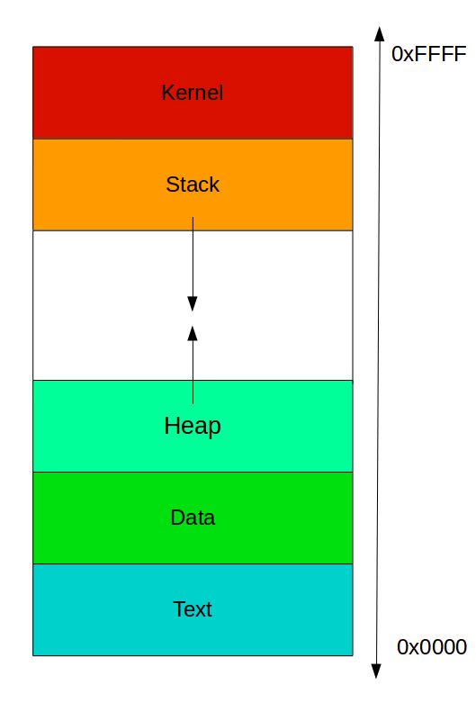
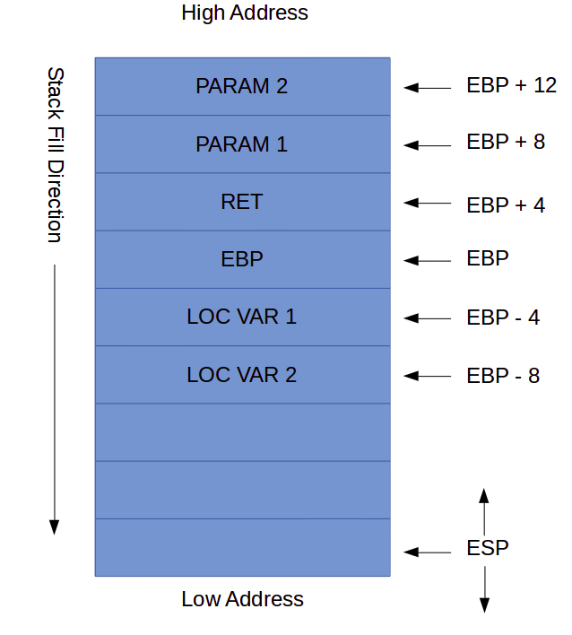
Process memory layout

Slide 9
Almost Famous
SQL Injection
Improper deserialization techniques
HTTP smuggling
Don’t be fooled: taxonomies are useful for common language--but I doubt attackers use them!

Slide 10

Best Practices
Sanitize all user inputs
Run with least-privilege
Clean code, code reviews
Scanning: code and runtime scans.
Shame!!!
Just kidding--we’re all human. Security should be talked of openly as a quality issue, not spookily

Slide 11
Sources
MITRE CVE list:
https://cwe.mitre.org/top25/archive/2019/2019_cwe_top25.html
Super simple buffer overflow lab:
https://payatu.com/understanding-stack-based-buffer-overflow
Burp Suite web vulnerability info:
https://portswigger.net/web-security
MITRE ATT&CK framework:
https://attack.mitre.org/matrices/enterprise/

