Slide 1
how do electric?
a hyperspeed uptake with minimal vocab/math on electricity by Josh Beaker

Slide 2
Atoms Exist
“Nothing exists except atoms and space, everything else is opinion.”
- Democritus

Slide 3
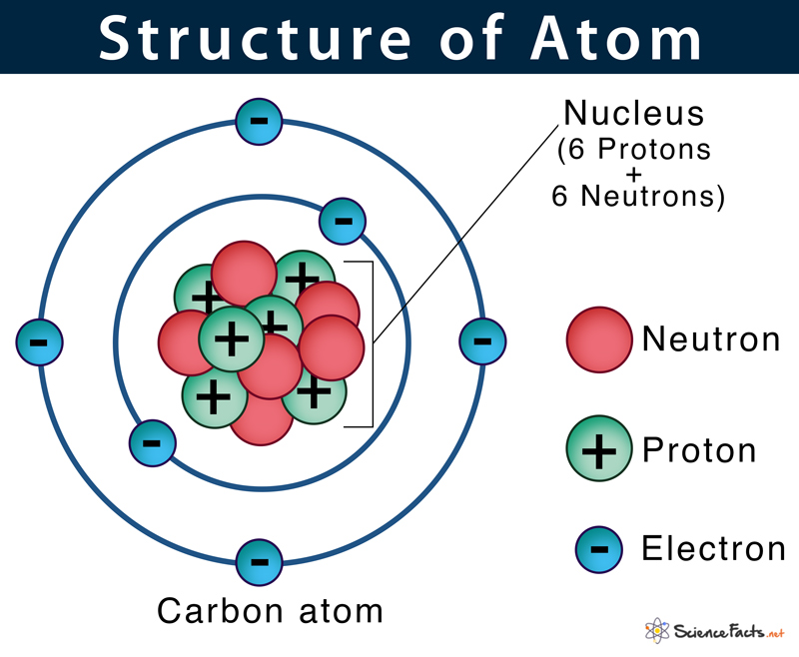
Protons Neutrons and Electrons but mostly just electrons
proton and electrons repel each other
image from https://www.sciencefacts.net/atom-2.html

Slide 4
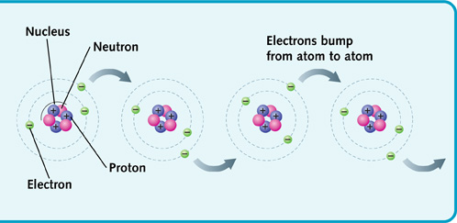
Electrons (Can) Jump Around Atoms can hold a different amount of electrons, depending on the type of atom sometimes electrons can bounce around between atoms

Slide 5
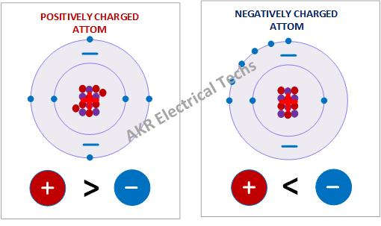
Electric Charge The positive or negative inbalance of protons and electrons is “charge”.

Slide 6
Quick Review
Atoms exist and are made of protons neutrons and electrons
Electrons can jump around from atom to atom (with some restriction that is determined by the type of atom and some other factors)
Electric charge is an inbalance of protons (+) and electrons (-)
A positive charge is more protons than electrons
A negative charge is more electrons than protons
Positive charges repel other positively charged atoms
Negative charges repel other negatively charged atoms
Positive and negatively charged atoms are attracted to each other so that the can exchange electrons

Slide 7
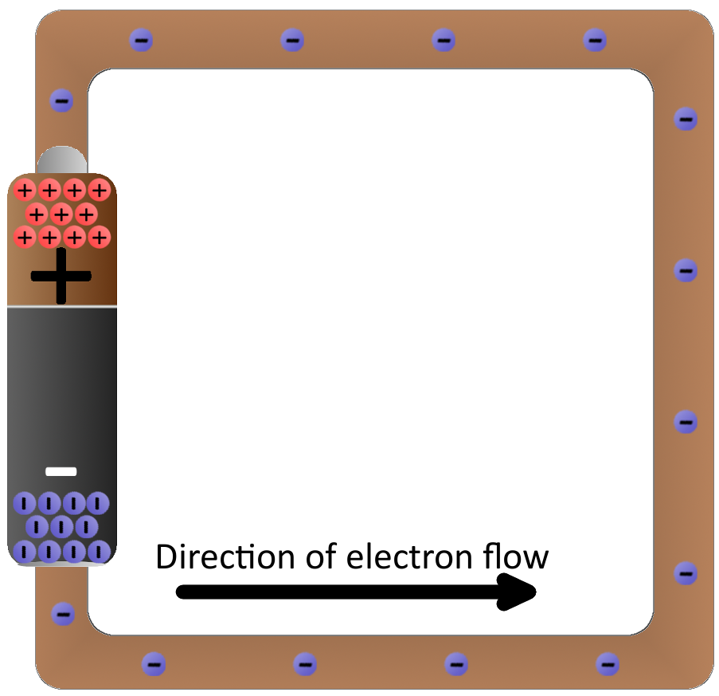
The Flow of Electricity This flow of electricity is known as direct current or DC
A battery (sometimes) has 2 compartments, one holds atoms with positive charge (more protons), and the other holds atoms with negative charge (more electrons)
When the two ends are connected by a WIRE made of atoms that electrons can jump around on, electrons are repelled from the negatively charged atoms in one compartment along the WIRE to the positively charged atoms in the other compartment

Slide 8
Example
Electrons flow from the negative part of the battery to the positive part of the battery when there is a complete route.
Electrons do not flow at all if there is not a path from the negatively charge part of the battery to something with a positive charge
When the electrons flow through the lightbulb they provide power and the bulb is lit. The act of lighting the bulb takes some energy from the flow of electrons.

Slide 9
What about the type of electricity found in our homes?
In our houses, wall sockets do not provide DC current, despite most of our devices using DC current. This is why devices need a power brick or adapter.
This is another type of electricity that can travel along wires and it is known as AC or alternating current
An AC current is not created by the difference in charge of two locations
An AC current is the continuous reversal of the flow of electrons, this is why it is called “Alternating” current

Slide 10
How is that possible?
AC current can transfer energy without a displacement of electrons by manipulating the charge of electrons back and forth
The transfer of energy by reversing the flow of electrons repeatedly is just as valid of a method as allowing them to flow through the circuit in one direction.
Great interactive example https://javalab.org/en/dc_and_ac_en/

Slide 11
What creates AC?
You might have noticed we did not discuss what can generate a current that alternates in this way.
The key lies in something called electromagnetic forces.
Understanding electromagnetic forces is the key to understanding how radio waves work.
To be continued...

