Slide 1


COMPUTER PROGRAMMING
BY
FATOUMATA BA
MALICK DIEDJOU SOW

Slide 2
PLAN
Introduction
Different Types of Programming Languages
Different Programming Languages and Their Uses
Why is Computer Programming Important
What are the benefits of computer programming
How can computer programming or coding help the world ?
Jobs after learning computer programming
Conclusion

Slide 3
introduction
Programming is a process of designing and writing computer programs that make the workings of a computer more efficient. It is a form of communication that uses symbols to represent instructions for making a machine do what you want.
It also allows people to solve practical problems by breaking them down into a series of logical steps, called algorithms or programs. Application developers can use any number of programming languages to write applications.

Slide 4
Different Types of Programming Languages ?
The programming language can be categorized into various types. They are mentioned below.
1. High-Level Programming Language.
2. Middle-Level Programming Language.
3. Low-Level Programming Language.

Slide 5
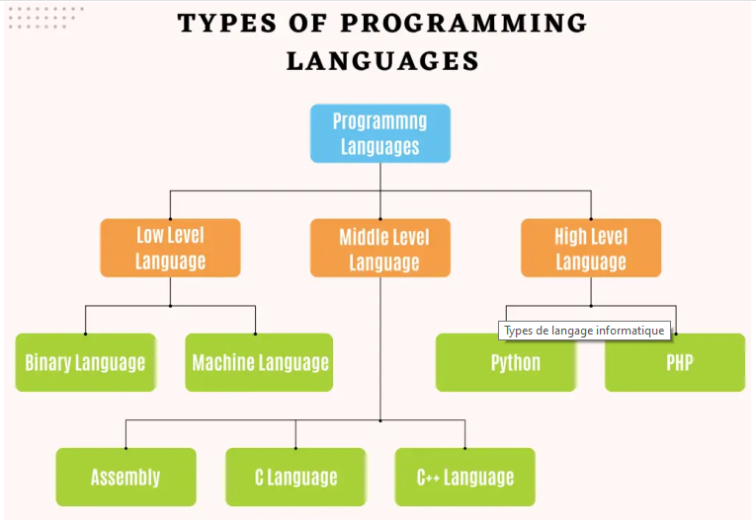

Slide 6
Different Programming Languages and Their Uses
1 | C | Device Drivers and Operating System
2 | C++ | Games, Video, and Picture Editing Software.
3 | Python | Artificial Intelligence and Machine learning
4 | PHP | Application Development, Software.
5 | .NET | Desktop Software and Application Software.

Slide 7
6 | JAVA | Company Application Development
7 | JavaScript | Rich Interactive Web Applications
8 | Jquery | It is a framework of javascript used to add extra functionality to webpages.
9 | SQL | Database Management

Slide 8
Why is Computer Programming Important?
Computers and the internet have completely changed the way we live our lives and interact with the world around us. It allows us to connect with people on the other side of the globe in an instant. Programming has changed the way we shop, travel, learn, and work. They are an essential part of our everyday lives.

Slide 9
What are the benefits of computer programming ?
Computer programming can be used to create innovative and functional software computer programmer might design a program that analyzes data from medical tests to determine the presence of a particular disease. The program could be used to help doctors diagnose the disease more easily and accurately
Computers can also be programmed to perform specific tasks using mathematical algorithms and logic. Computer programmers can create programs that use these algorithms to carry out tasks such as sorting data or calculating the results of complex equations.

Slide 10
It can also be used to create websites, games, and other digital content. In this way, computer programs make it possible for people to access a wide range of entertainment and information online. In addition to creating new content, computer programmers can also help improve existing software and applications. They can add new features and options to existing programs to improve the usability and quality of these programs. For example, a programmer could update an existing gaming app to make it easier to use on a smartphone

Slide 11
How can computer programming or coding help the world ?
Improve Healthcare
It can improve healthcare through the use of technology. Coding skills can help healthcare organizations develop apps and other tools that can help manage medical records and improve patient care.

Slide 12
Encourage economic growth
Programming can help fuel our economy. Coding abilities may be utilized to create apps that assist people in finding a job. These apps will assist job seekers in discovering employment possibilities across a variety of sectors, including tech, healthcare, media, entertainment, and education.

Slide 13
Discover the environment we live in
Programming helps us learn about the world around us. It pertains to the development of apps that allow users to travel around the world and discover intriguing facts about a variety of subjects.
By comparing images of different plants and animals to a database of pictures of similar species, developers can create apps that let users recognize various types of plants and animals.

Slide 14
Jobs after learning computer programming
Computer Programmer
In today’s digital world, computer skills are a must if you want to get a job. Programming experience is a plus. As a computer programmer,
you can work in a variety of industries including banking, finance, healthcare, and retail.

Slide 15
Software Development Engineer
A software development engineer works in a technical environment to design and develop computer software for a variety of platforms. Requirements vary depending on the employer, but employers generally look for a degree in computer science or software engineering

Slide 16
Cloud Architect
The cloud architect helps design and create cloud-based solutions for clients. This person should be well-versed in cloud computing concepts and have strong problem-solving abilities. Responsibilities may include analyzing requirements, creating cloud architectures, and designing solutions to meet client requirements.

Slide 17
Conclusion
Programming is important for a variety of reasons. It helps us automate tasks, create new technologies, and develop more efficient systems. With the ever-growing importance of technology in our world, learning to program is becoming more and more essential.

