Slide 1
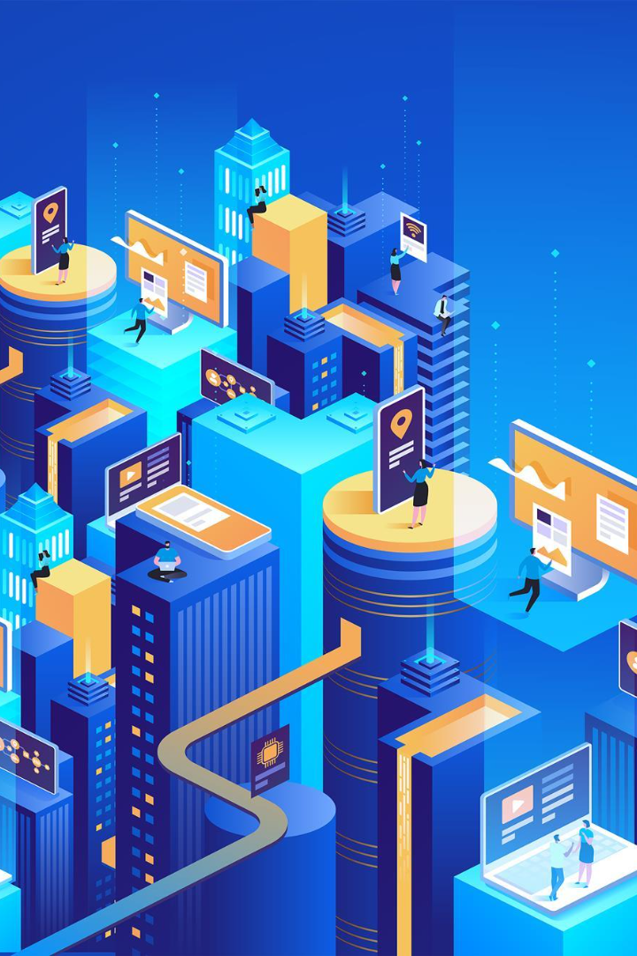

The Internet of Things (IoT), advantages and disadvantages
The Internet of Things (IoT) is the network of interconnected devices, allowing them to communicate and share data. Let's explore its advantages and disadvantages.
Exhibitor
Abdou Lahad WADE
Abdoulaye GAYE

Slide 2
Motivation
The Internet of Things (IoT) is a booming technology that enables the connection and communication between various physical objects via the internet. This interconnection offers numerous opportunities and benefits, which explains why it has garnered so much interest and motivation.
One of the primary motivations behind IoT is the potential to make our daily lives more convenient and efficient. Through IoT, we can automate and control various aspects of our environment, such as household appliances, security systems, lighting, and more. This allows us to save time, conserve energy, and enhance our quality of life.
Another significant aspect of the motivation behind IoT is its potential to transform industries and businesses. By enabling real-time data collection and analysis, IoT provides opportunities for process optimization, informed decision-making, and the development of new business models. This can lead to improved operational efficiency, cost reduction, and enhanced customer satisfaction.
Lastly, the motivation behind IoT also rests on its ability to enhance our understanding of the world around us. Through large-scale data collection and data analysis, IoT can contribute to better resource management, increased environmental monitoring, and data-driven decision-making. This can have a positive impact on environmental sustainability and natural resource management.

Slide 3

Definition of the Internet of Things (IoT)
The Internet of Things (IoT) is the concept of connecting everyday objects and devices to the internet, enabling them to send and receive data and interact with each other.

Slide 4
Advantages of the IoT
Increased efficiency and productivity
Improved decision-making
Enhanced communication and connectivity
The IoT enables automation and real-time tracking, leading to improved efficiency and productivity in various industries, such as manufacturing and logistics.
With IoT-enabled devices collecting vast amounts of data, businesses can make more informed decisions based on accurate and up-to-date information.
IoT devices facilitate seamless communication and connectivity between devices, allowing for smoother interactions and better coordination.

Slide 5

Disadvantages of the IoT
1
Security and privacy concerns
2
Complexity and integration challenges
The vast network of connected devices poses security risks, as hackers can potentially breach systems and access sensitive information.
Implementing and integrating IoT systems can be complex and challenging, requiring expertise in various domains, such as hardware, software, and data management.
3
Cost implications
Adopting IoT technologies often involves significant financial investments in infrastructure, equipment, and maintenance, making it a potential barrier for smaller businesses.

Slide 6
Conclusion and future prospects of the IoT
Despite its challenges, the IoT has immense potential to revolutionize industries and improve our daily lives. As technology advances and security measures strengthen, the IoT's impact will continue to grow.

