Slide 1

AUTOMATED INTELLIGENT WASTE MANAGEMENT SYSTEM IN SMART CITIES:ENHANCED RECYCLING FACILITIES
By
G.KRISHNA PRIYA (21BF1A3352)
A.GAYATHRI (21BF1A3301)
B.SRIKANTH REDDY (21BF1A3328)
K.NITHYA SANTHOSH (21BF1A3363)
Under the guidance of
Dr. A.REVATHI
Associate Professor
DEPARTMENT OF COMPUTER SCIENCE AND ENGINEERING (AI & ML)
SRI VENKATESWARA COLLEGE OF ENGINEERING
(Autonomous)
Karakambadi Road, Tirupati-517507
2021-2025

Slide 2
OUTLINE
Abstract
Introduction
Problem Statement
Existing system
Disadvantages
Proposed system
Advantages
System Requirements
Modules
UML Diagrams
Implementation
Testing phase
Output screens
Future Scope
References

Slide 3
ABSTRACT
With rapid urbanization, waste generation has become a significant issue, necessitating efficient waste management for a cleaner and healthier environment. The proposed system employs object recognition to classify waste without requiring prior tagging, aligning with current user habits. A deep Convolutional Neural Network (CNN) is trained to recognize and classify biodegradable and non-biodegradable waste items using image analysis. Pixel optimization techniques are used to visualize the features learned by the CNN model, enhancing classification accuracy.

Slide 4
INTRODUCTION
Traditional object detection struggled with issues like diversity in morphology and background, making urban trash detection challenging. Recent advancements in CNNs, especially region-based methods, have improved accuracy in object detection tasks. This study introduces a model that detects street trash in real-time, trained on labeled images categorized into six size-based folders, enhancing detection accuracy for objects like plastic bottles. The model's performance is optimized using a fine-tuning strategy with a pre-trained SSD MobileNet V1, leveraging transfer learning on urban scene images with and without trash.

Slide 5
PROBLEM STATEMENT
Urban trash monitoring and cleanliness assessment are often manual, time-consuming, and prone to human error, affecting sanitation quality. Unlike pedestrians and vehicles, trash lacks clear definitions, leading to subjective judgment and inconsistent detection results in varying situations. The accuracy of trash detection is influenced by the diversity of scenes in which trash appears. With the rise of smart cities, there is a need for automated urban trash detection to address growing waste problems. The focus is on using convolutional neural networks (CNNs) for automatic garbage classification, categorizing items into recycling types like metal, paper, and plastic.

Slide 6
EXISTING SYSTEM
The current garbage classification system is manual, requiring workers to visually inspect and sort waste into categories like paper, plastic, metal, and organic, making it time-consuming and labor-intensive. Manual sorting is prone to errors, inconsistencies, and poses hazards for workers handling potentially harmful materials. Automated waste sorting systems have been introduced but are often expensive, complex, and require regular maintenance. While some automated systems use computer vision and machine learning, they are limited in accurately classifying a wide variety of waste types.

Slide 7
DISADVANTAGES
Time-consuming and labor-intensive.
Inaccurate sorting
Hazardous working conditions.
Limited scalability

Slide 8
PROPOSED SYSTEM
The proposed system uses CNN algorithms to process images and classify them based on their pixel data, with Max-pooling used for colorization. The system focuses on separating biodegradable and non-biodegradable elements from waste. The goal is to create an application that can automatically detect and classify waste as biodegradable or non-biodegradable. The application analyzes images of waste to estimate the proportion of biodegradable and non-biodegradable content, generating results based on this analysis.

Slide 9
ADVANTAGES
Accurate Classification, the system is designed to accurately classify waste items as either biodegradable or non-biodegradable, which is critical for effective waste management and recycling. Efficient and Scalable: The proposed system uses deep learning algorithms which are highly efficient and scalable, allowing it to process large amounts of waste data quickly and accurately.

Slide 10
SYSTEM REQUIREMENTS
Hardware Requirements :
Processor : Intel Core to Dual 1.8GHZ RAM : 1GB or more
Hard disk : 20 GB or more

Slide 11
SOFTWARE REQUIREMENTS
Operating System : Windows XP/7/8/10
Programming language : Python
Python IDE : VS CODE

Slide 12
MODULES
Input
Pre-processing
Classification
Output
Feedback and Optimization

Slide 13
MODULES
Input Module:
A camera captures images of waste items for processing.
Sensors can optionally gather additional data like weight and material composition.
Pre-processing Module:
Enhances image quality by removing noise and normalizing data.
Resizes images to ensure consistency for model input.

Slide 14
MODULES
Classification Module:
A deep CNN processes the images and classifies waste into categories (organic, plastic, metal, glass, paper).
Incorporates structured data for better accuracy.
Output Module:
Displays the classification results in real-time.
Directs the waste to appropriate bins or storage units for recycling or disposal.

Slide 15
MODULES
Feedback and Optimization Module:
Monitors system performance and refines the CNN model using new data.
Uses pixel optimization to continuously enhance feature extraction and classification accuracy.

Slide 16
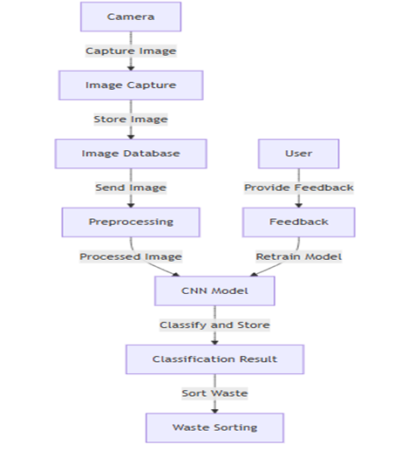
UML DIAGRAMS:
DATA FLOW DIAGRAM:
Fig.:1.1- Machine Learning Dataflow

Slide 17
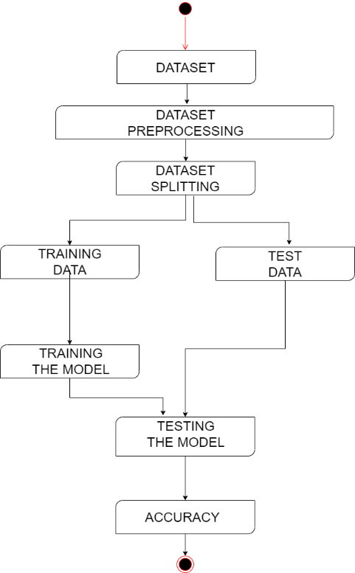
UML DIAGRAMS:
STATE DIAGRAM
Fig.:1.1- Machine Learning Workflow

Slide 18
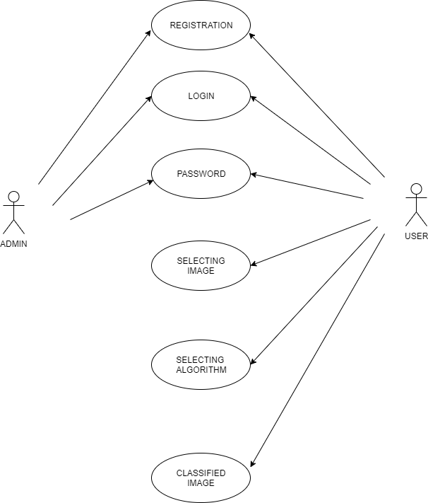
UML DIAGRAMS:
USECASE DIAGRAM
Fig.1.2:- Machine Learning Use Case Diagram

Slide 19
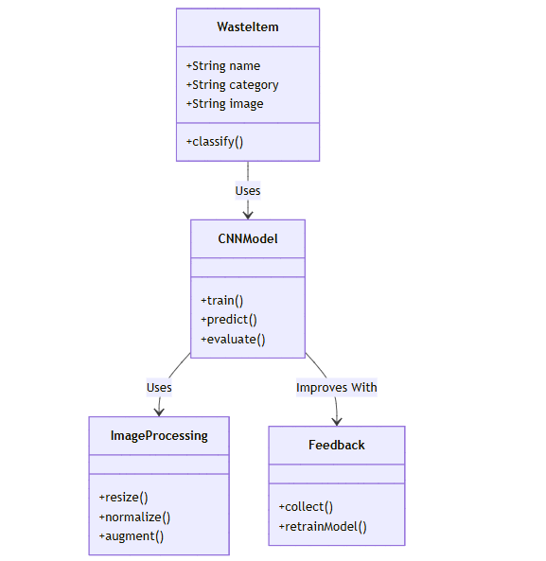
UML DIAGRAMS:
CLASS DIAGRAM
Fig.1.3:- User to the system class diagram

Slide 20
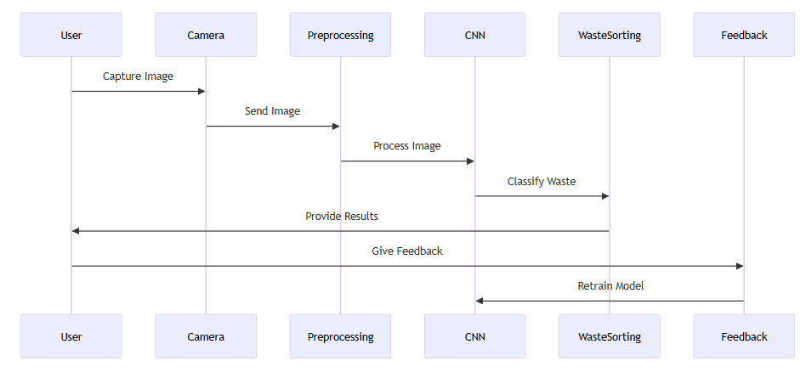
UML DIAGRAMS:
SEQUENCE DIAGRAM
Fig.1.4:- Sequence Diagram for Data Collection to Prediction

Slide 21
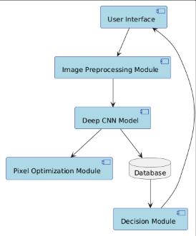
UML DIAGRAMS:
COMPONENT DIAGRAM
Fig.1.5:- Component Diagram for Deep Learning-Based Image Processing System

Slide 22
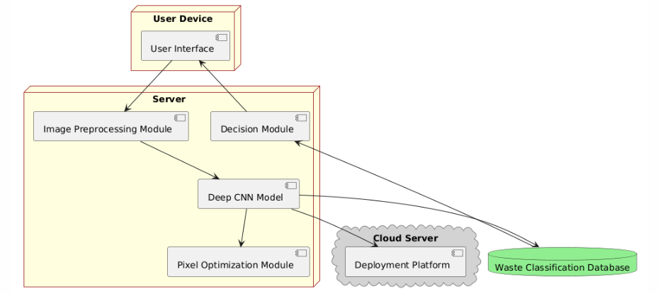
UML DIAGRAMS
DEPLOYMENT DIAGRAM
Fig.1.6:- Deep Learning-Based Waste Classification Deployment diagram

Slide 23
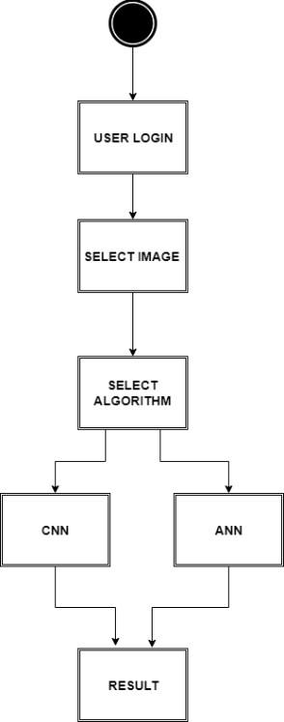
UML DIAGRAMS:
ACTIVITY DIAGRAM
Fig.1.7:- User Interaction Flow for Waste Classification System

Slide 24
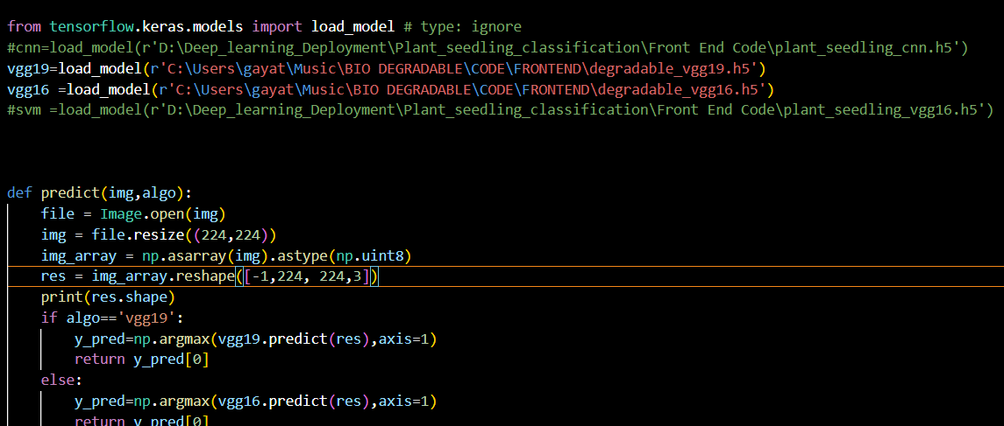
IMPLEMENTATION
Img1: Image Prediction Function Using VGG

Slide 25
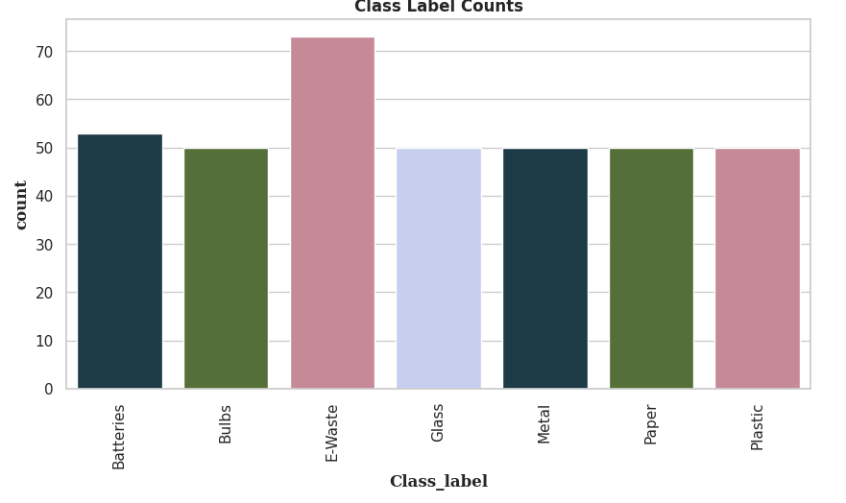
IMPLEMENTATION
Img2: Class Labels of WASTE MANAGEMENT SYSTEM

Slide 26
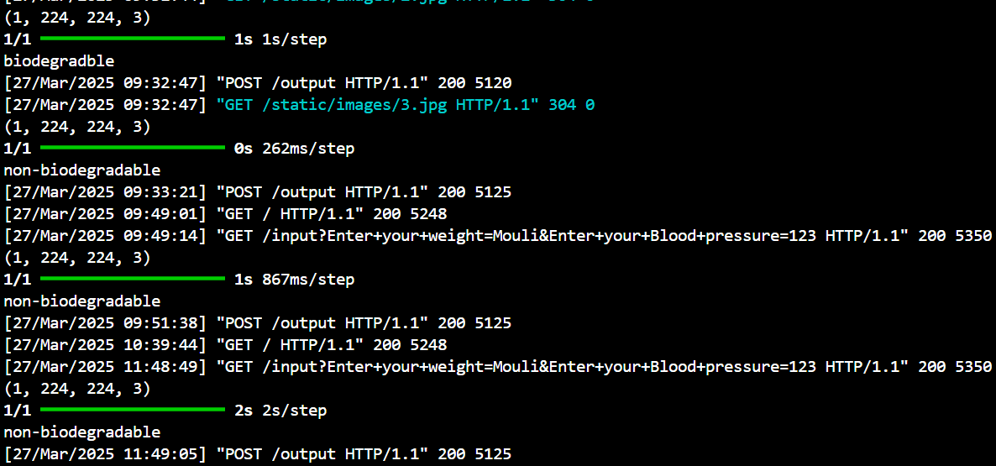
TESTING
Img3 :Backend API Tests

Slide 27
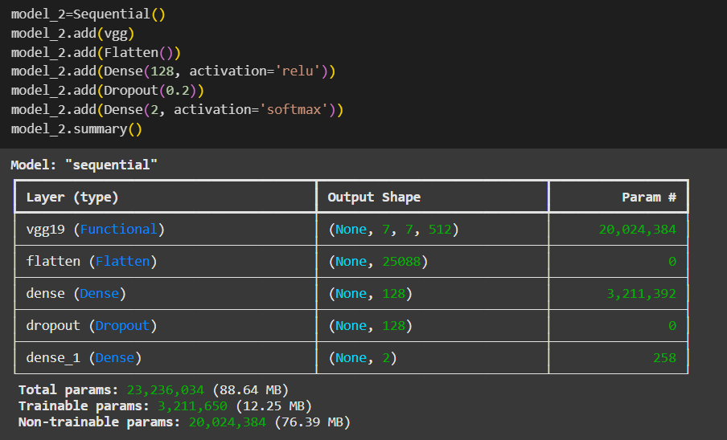
TESTING
Img4 : Model Tests

Slide 28
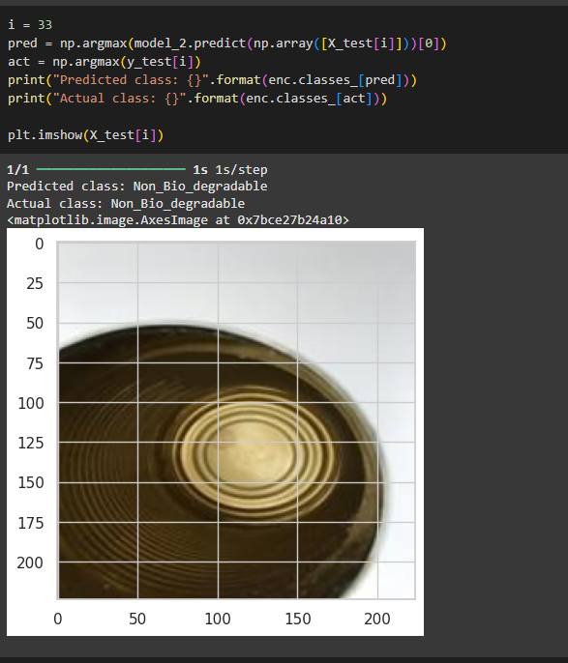
TESTING
Img5 : Model testing on samples

Slide 29
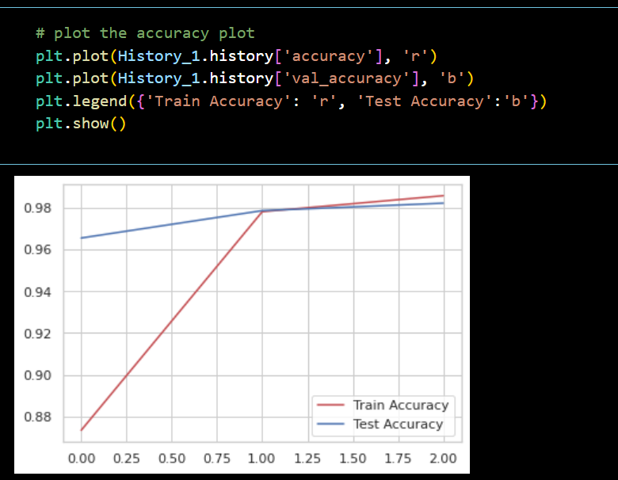
TESTING
Img6: Accuracy plot of WASTE MANAGEMENT SYSTEM

Slide 30
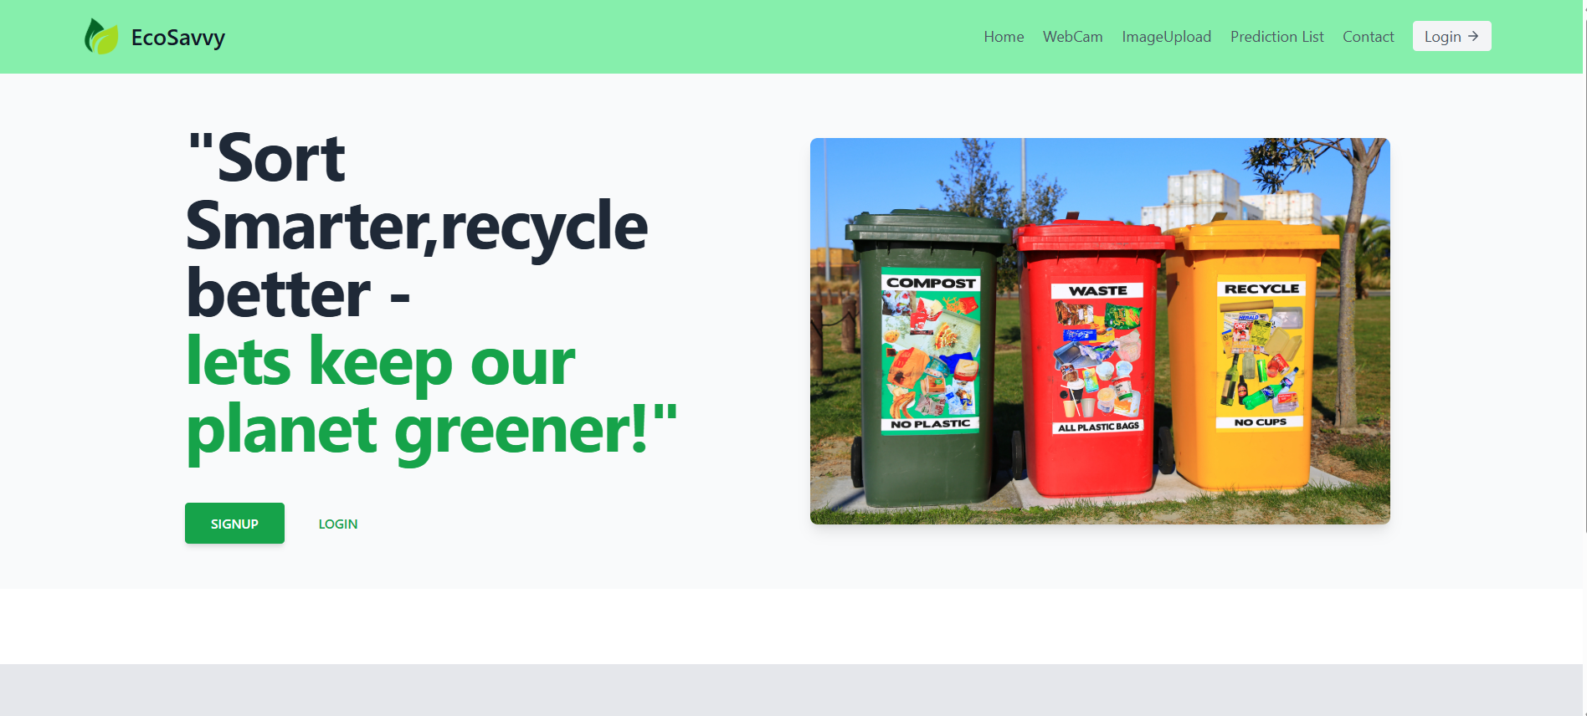
OUTPUT SCREENS
Img5: Home Page of WASTE MANAGEMENT SYSTEM

Slide 31
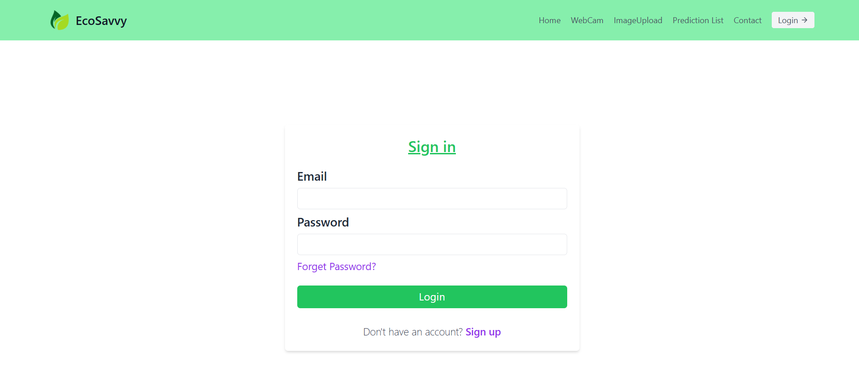
OUTPUT SCREENS
Img7: Sign in Page of WASTE MANAGEMENT SYSTEM

Slide 32
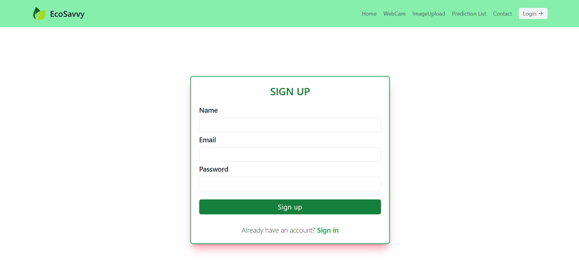
OUTPUT SCREENS
Img8: Sign Up Page of WASTE MANAGEMENT SYSTEM

Slide 33
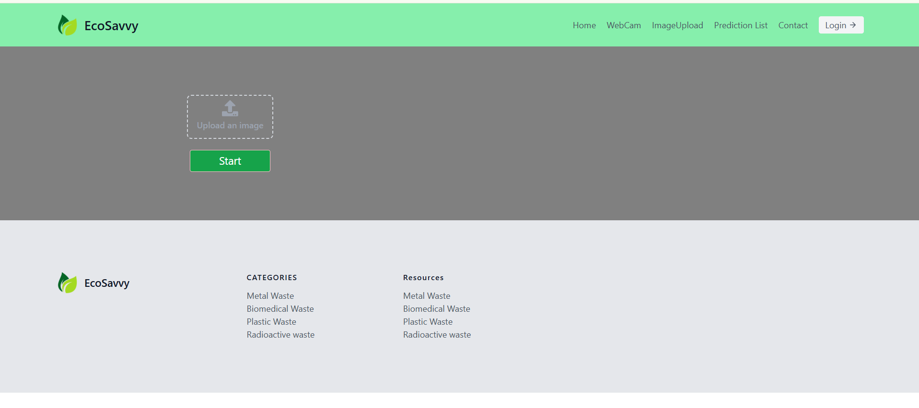
OUTPUT SCREENS
Img9: Image uplad Page of WASTE MANAGEMENT SYSTEM

Slide 34
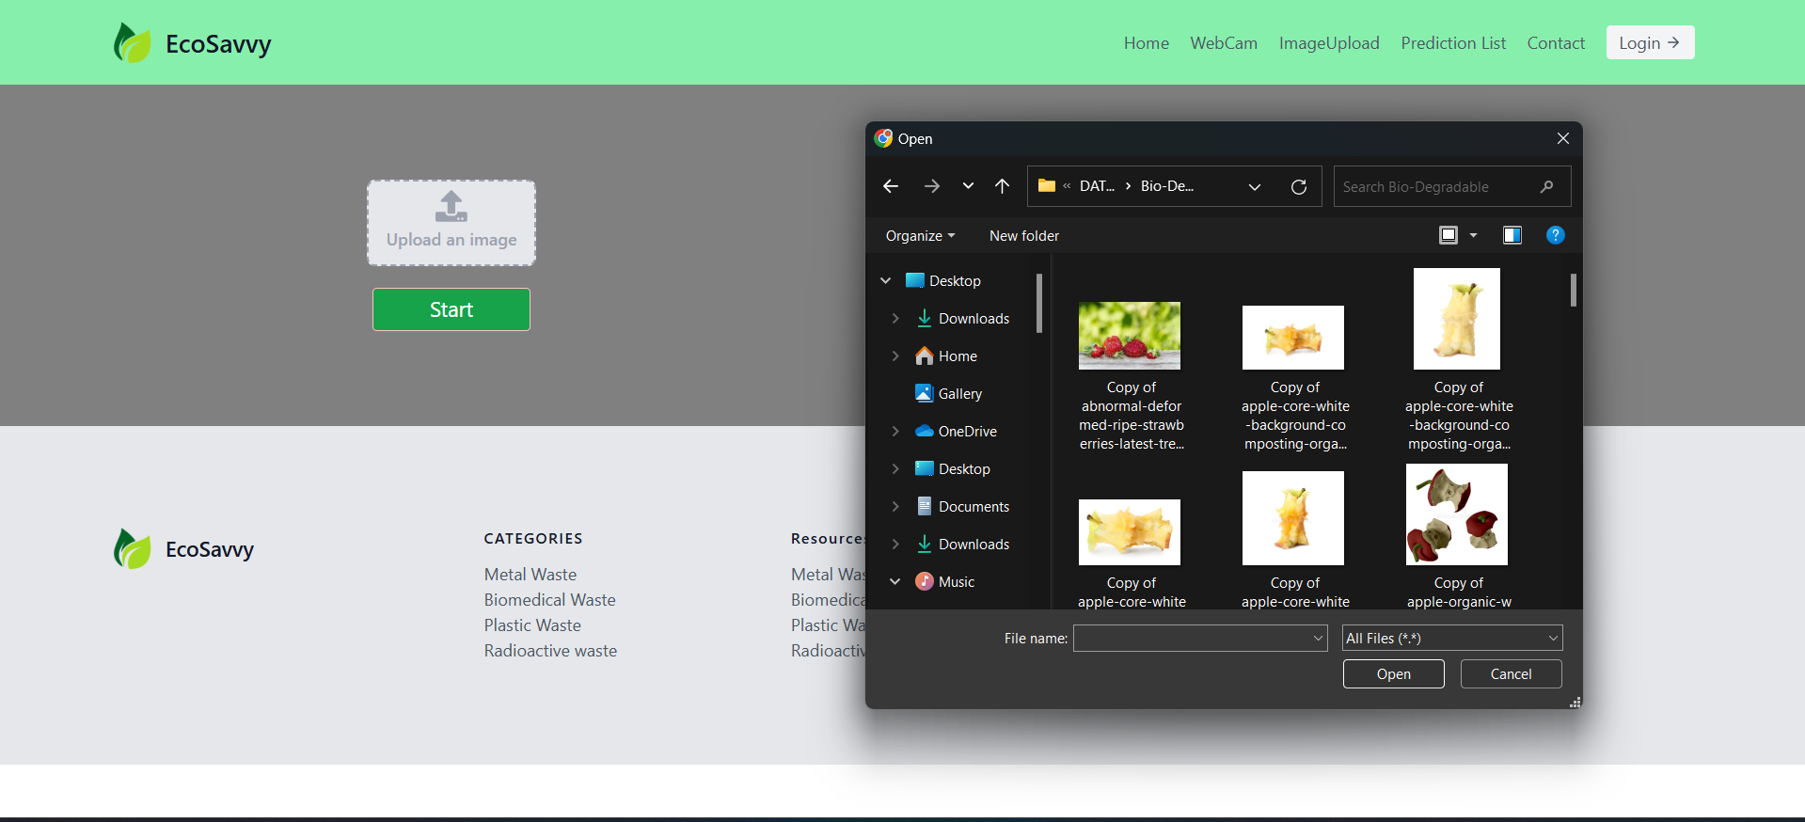
OUTPUT SCREENS
Img10: uploading image into WASTE MANAGEMENT SYSTEM

Slide 35
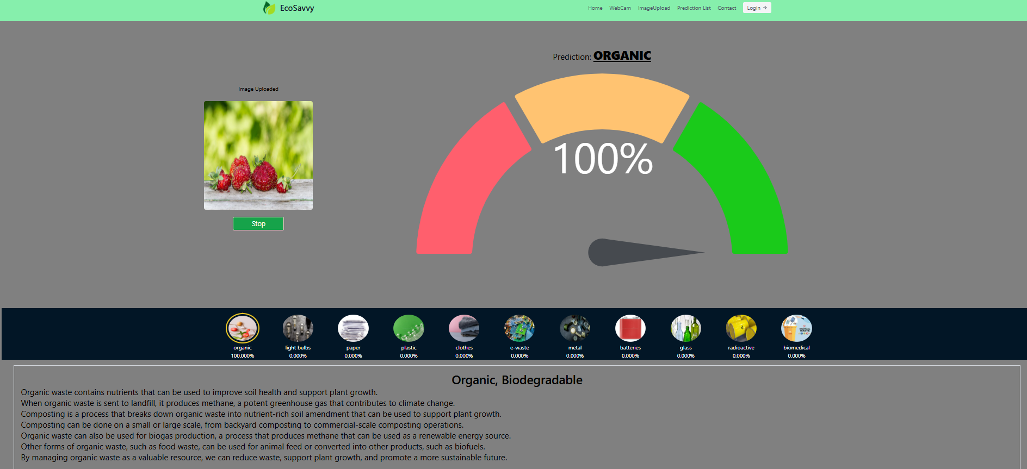
OUTPUT SCREENS
Img11: Prediction of WASTE MANAGEMENT SYSTEM

Slide 36
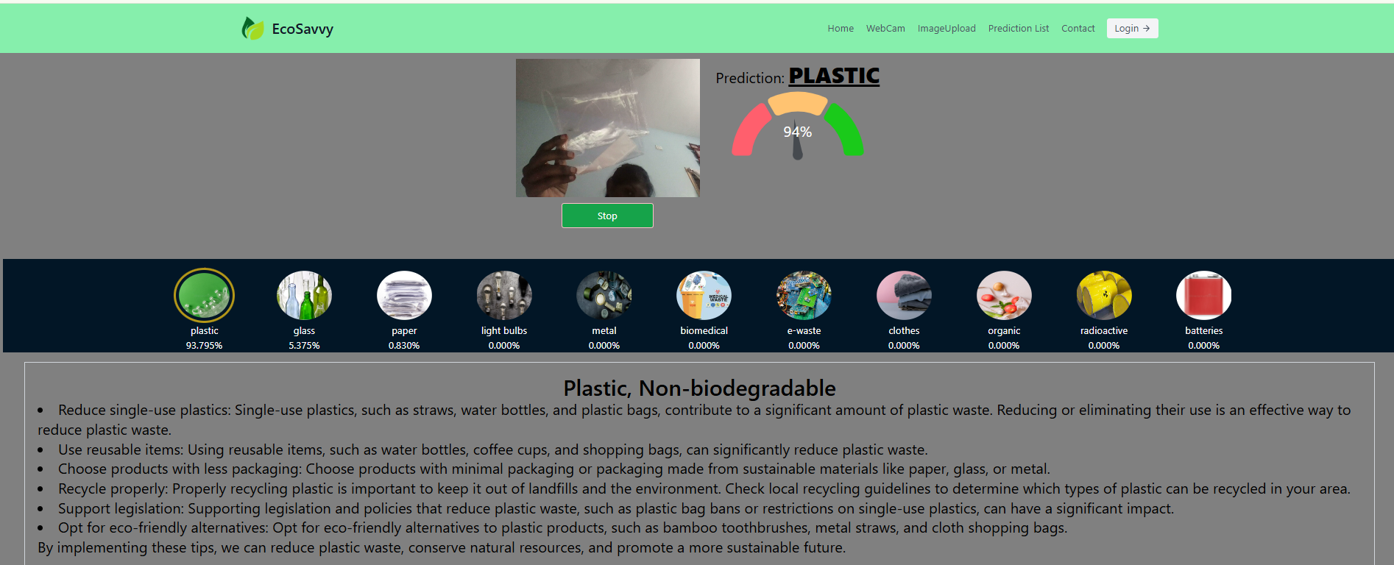
OUTPUT SCREENS
Img12: Live detection of WASTE MANAGEMENT SYSTEM

Slide 37
FUTURE SCOPE
The future scope of the project in terms of software involves several advanced modifications. First, the model's accuracy can be significantly improved by training it with a larger and more diverse dataset, allowing it to classify waste more accurately across various categories. Additionally, more complex and efficient models such as Vision Transformers could replace VGG16 and VGG19, offering better accuracy and faster processing.
Furthermore, developing a mobile application for waste classification will make the project accessible to a wider audience. The app could be built using Flutter or React Native for cross-platform compatibility, allowing both Android and iOS users to benefit from it. Lastly, improving the user interface (UI) by adding drag-and-drop image uploads, displaying confidence scores, and providing detailed statistics will make the application more user-friendly and informative.
In terms of hardware, the project has immense potential for expansion. One major application is the development of smart waste bins equipped with cameras and servo motors. These bins could automatically classify and sort waste into different compartments based on the image classification output, streamlining waste management processes.
Additionally, the project can be scaled for industrial-level automation by integrating it with conveyor belt systems in waste management plants. Real-time waste classification could trigger robotic arms to segregate waste into appropriate sections, reducing manual labor and increasing efficiency.
The project can also be used in IoT-based waste management systems, where smart bins send real-time data about waste levels to cloud servers. This would allow municipalities to optimize waste collection routes, saving time and resources. Drone integration is another innovative application where drones equipped with cameras could scan and classify waste in large outdoor areas, making it useful for environmental cleanup operations.

Slide 38
REFERENCES
World Bank, “Trends in Solid Waste Management”, Datatopics.worldbank.org, 2019. [Online]. Available:https://datatopics.worldbank.org/what-a-waste/trends-in-solid-waste-management.html [Accessed: 17-Jun-2020].
Wikipedia Contributors, “Convolutional Neural Network”, Wikipedia, [Online]. Available: https://en.wikipedia.org/wiki/Convolutional_neural_network [Accessed: 7-Jun-2020].
Yann Glouche, Paul Couderc, “A Smart Waste Management with Self-Describing Objects”, The Second International Conference on Smart Systems, Devices and Technologies (SMART’13), IARIA, June 2013, Rome, Italy. [Online]. Available: https://hal.inria.fr/hal-00924270/document [Accessed: 20- Jun-2020].
Fetulhak Abdurahman, Sileshi Aweke, Chera Assefa, “Automated Garbage Monitoring System Using Arduino”, IOSR Journal of Computer Engineering (IOSR-JCE), Vol. 20, No.1, Jan-Feb 2018.
Kannan G. S., Kumar S. S., R. R., M. B., “Automatic Garbage Separation Robot Using Image Processing Technique”, International Journal of Scientific and Research Publications, Vol. 6, No. 4, Apr 2016, pp. 326–328. [Online]. Available: http://www.ijsrp.org/research-paper-0416.php?rp=P525265 [Accessed: 20-Feb-2020].
Abdulrahman Alkandari, “Trash Basket Sensor Notification Using Arduino with Android Application”, 2018. [Online]. Available: https://www.researchgate.net/publication/324138992 [Accessed: 10-Jun-2020].
Nagaraju Urlagunta, “Smart Dustbin for Economic Growth”, 2017. [Online]. Available: https://www.researchgate.net/publication/316700582 [Accessed: 10-Feb-2020].
A. Gitz-Johansen, et al., “A Practical Delivery Route Planning System”, 2019 20th IEEE International Conference on Mobile Data Management (MDM), Hong Kong, 2019, pp. 349–350. [Online]. Available: https://ieeexplore.ieee.org/document/8788747 [Accessed: 20-Apr-2020].

Slide 39


