Slide 1
Controller Area Network

Slide 2
Contents
Why CAN?
CAN Introduction
CAN Frame Format
CAN Bus Access
CAN Data Protection

Slide 3
Why CAN?
Motivation
Bus Networking
Communication Model
Three Layer Model
Architecture of Serial Bus System

Slide 4
Motivation
The recent history of the automobile is characterized by intensive electronification.
Over the course of time, electronic functions found their way into the automobile that could not be implemented without highly active data exchange between electronic ECUs.
Electronic systems were requiring more and more intensive networking to implement them, which drove wiring expense sky high.
A way out of this dilemma soon appeared in the form of bit-serial exchange of data via a communication channel (Bus) jointly used by a number of electronic control units.

Slide 5
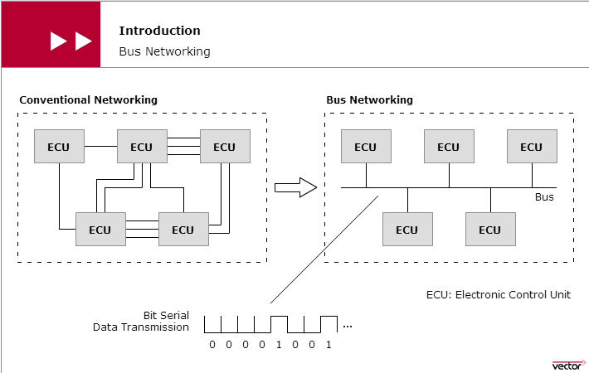
Bus Networking

Slide 6
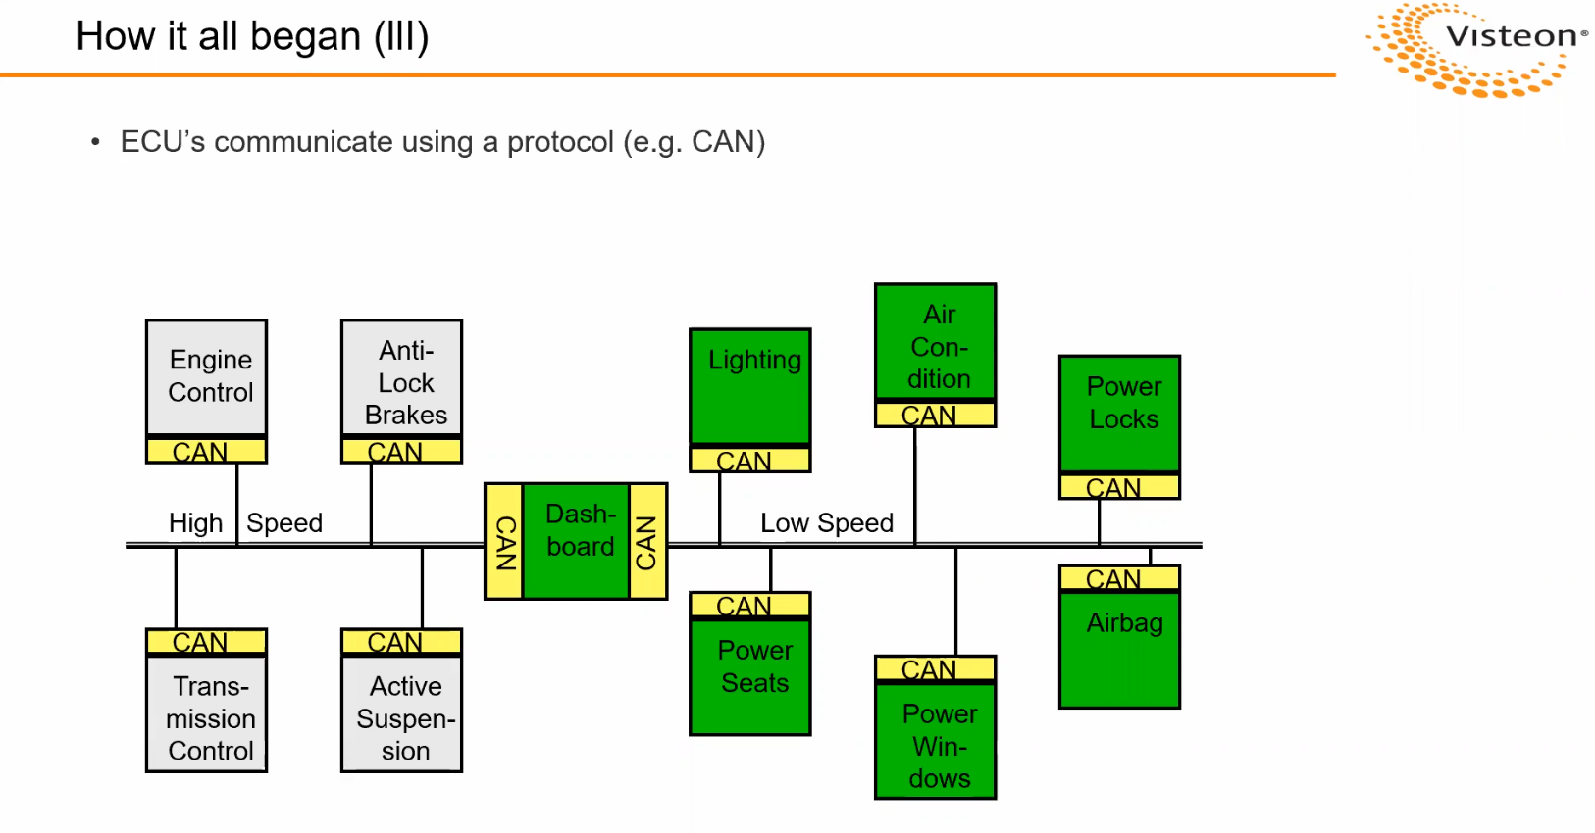

Slide 7
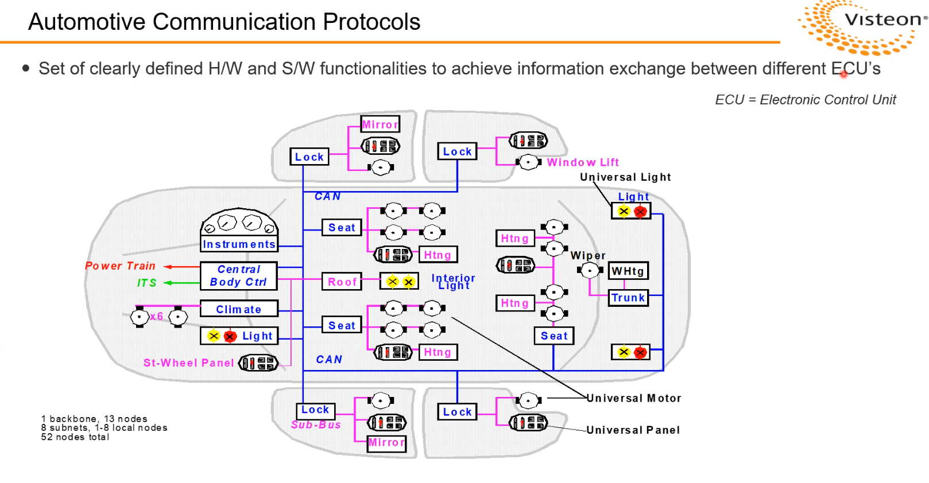

Slide 8
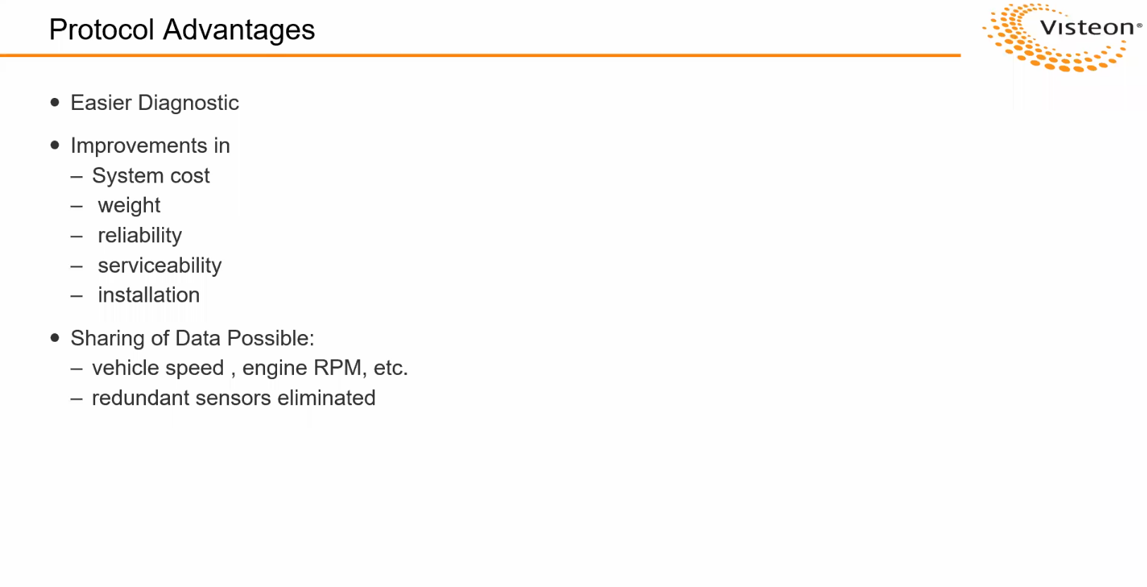

Slide 9
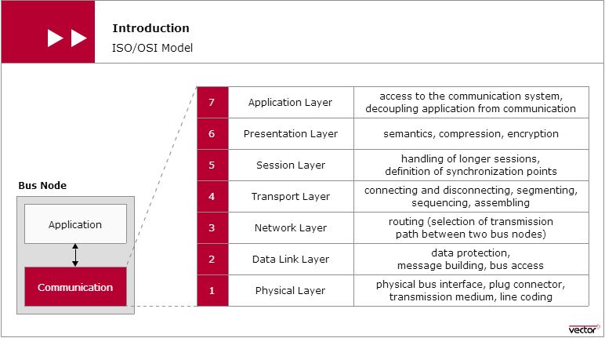
Communication Model/OSI Model
The OSI communication model (Open System Interconnection) published by ISO (International Standardization Organization) in 1983 is a reference architecture for implementing CAN communication.

Slide 10
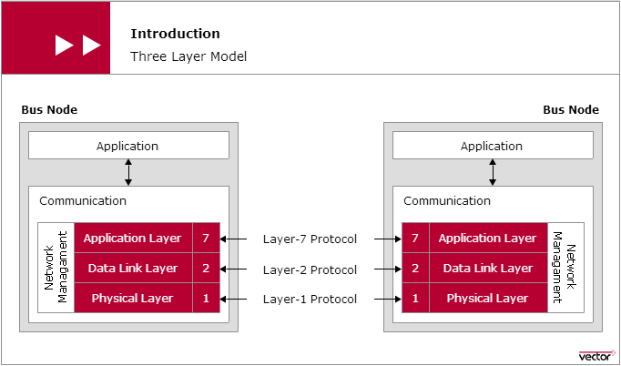
Three Layer Model
For data exchange between electronic control units in the motor vehicle, not all of the communication functions, defined in the ISO/OSI model, are necessary.
Essentially, only the two lowermost layers are relevant to serial data communication in the motor vehicle. These layers are the Data Link Layer and the Physical Layer.

Slide 11
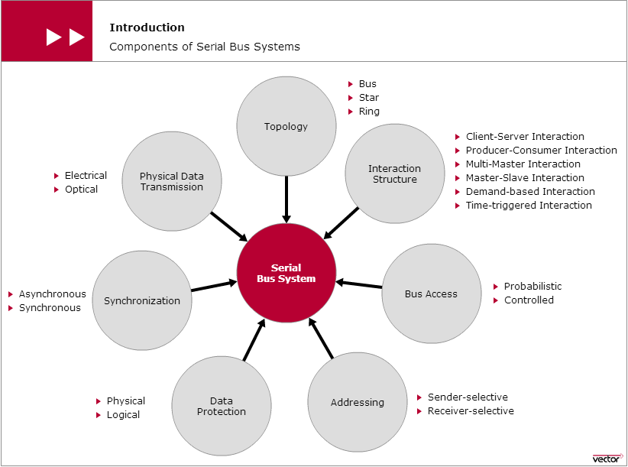
Architecture of Serial Bus System

Slide 12
CAN Introduction
CAN Standard
CAN Network
CAN Communication Principle
CAN Bus Levels

Slide 13
CAN Standard
CAN has been standardized since 1993 and is available as an ISO standard (International Standardization Organization): ISO 11898.
While it initially consisted of three parts, today it has five parts.
The first part describes the event-driven communication protocol.
A time-triggered extension can be found in the fourth part.
The second and third parts cover information on the bus interface and physical data transmission: A distinction is made here between the High-Speed variant (data rates up to 1 MBit/s) and Low-Speed variant (data rates up to 125 KBit/s).
The fifth part describes the behavior of a CAN node in the High-Speed network in “Low Power Mode”.
A maximum network extension of about 40 meters is allowed. At the ends of the CAN network, bus termination resistors contribute to preventing transient phenomena (reflections).

Slide 14
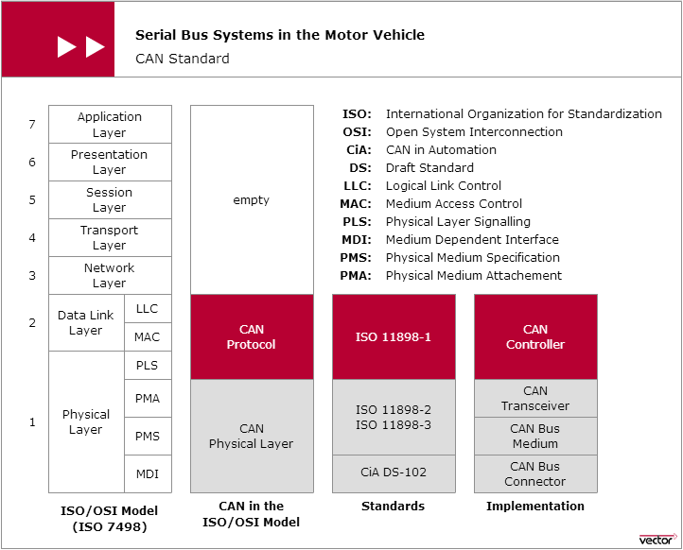
CAN Standard (Continued)

Slide 15
CAN Network
A CAN network is a system network made up of CAN nodes (electronic control units with a CAN interface), which exchange data with one another over their individual CAN interfaces and a transmission medium (CAN bus) that interconnects all of the CAN interfaces.
A CAN interface is made up of two parts: the communication software and communication hardware.
While the communication software is made up of higher level communication services, the fundamental communication functions are implemented in hardware.
The CAN controller provides for uniform handling of the CAN communication protocols.
The CAN transceiver serves to interface the CAN controller to the CAN bus.
The transmission medium that is generally used is a twisted pair line.
The symmetrical signal transmission that occurs over this line is very insensitive to external interference.

Slide 16
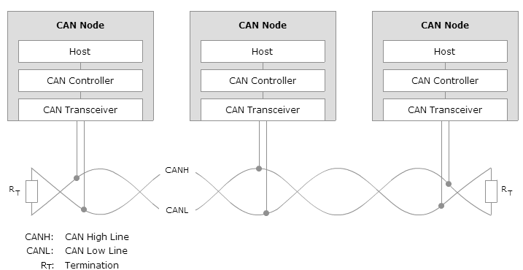
CAN Network Diagram

Slide 17
CAN Communication Principle
In a CAN network, the transmitted data frames and their sequence are not a function of the progression of time, rather they depend on the occurrence of special events.
In principle, each CAN node is authorized to access the CAN bus immediately after an event occurs. In conjunction with the relatively short message length of a maximum of 130 bits in standard format, and the high data transmission rate of up to 1 MBit/s, the method enables quick reactions to asynchronous processes.
This is an important prerequisite for real-time data transmission capability in the low milliseconds range, which is primarily demanded by applications in the powertrain and chassis areas.
To guarantee real-time communication despite random bus access, bus access is based on the CSMA/CA method (Carrier Sense Multiple Access/Collision Avoidance).
First, the CSMA/CA method ensures that CAN nodes wishing to send do not access the CAN bus until it is available.
Second, in simultaneous bus accesses occur, the CSMA/CA method ensures that the CAN node with the highest priority data frame prevails.

Slide 18
CAN Communication Principle
The CAN communication protocol is a carrier-sense, multiple-access protocol with collision detection and arbitration on message priority (CSMA/CD+AMP).
CSMA means that each node on a bus must wait for a prescribed period of inactivity before attempting to send a message.
CD+AMP means that collisions are resolved through a bit-wise arbitration, based on a preprogrammed priority of each message in the identifier field of a message. The higher priority identifier always wins bus access.
That is, the last logic high in the identifier keeps on transmitting because it is the highest priority. Since every node on a bus takes part in writing every bit "as it is being written," an arbitrating node knows if it placed the logic-high bit on the bus.

Slide 19
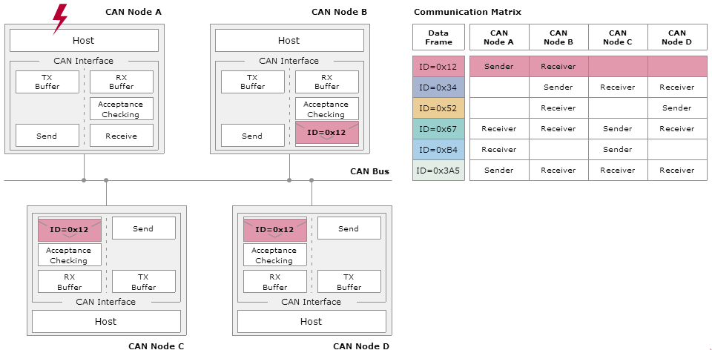
CAN Communication Principle

Slide 20
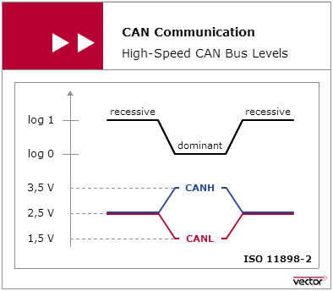
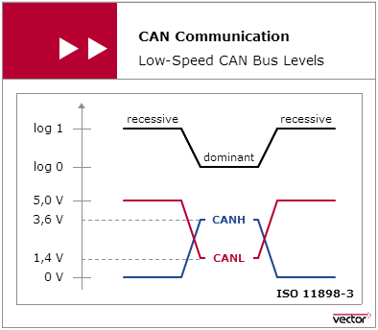
CAN Bus Levels
ISO 11898-2 High Speed CAN assigns logical “1” to a typical differential voltage of 0 Volt. The logical “0” is assigned with a typical differential voltage of 2 Volt.
ISO 11898-3 Low Speed CAN assigns a typical differential voltage of 5 Volt to logical “1”, and a typical differential voltage of 2 Volt corresponds to logical “0”.

Slide 21
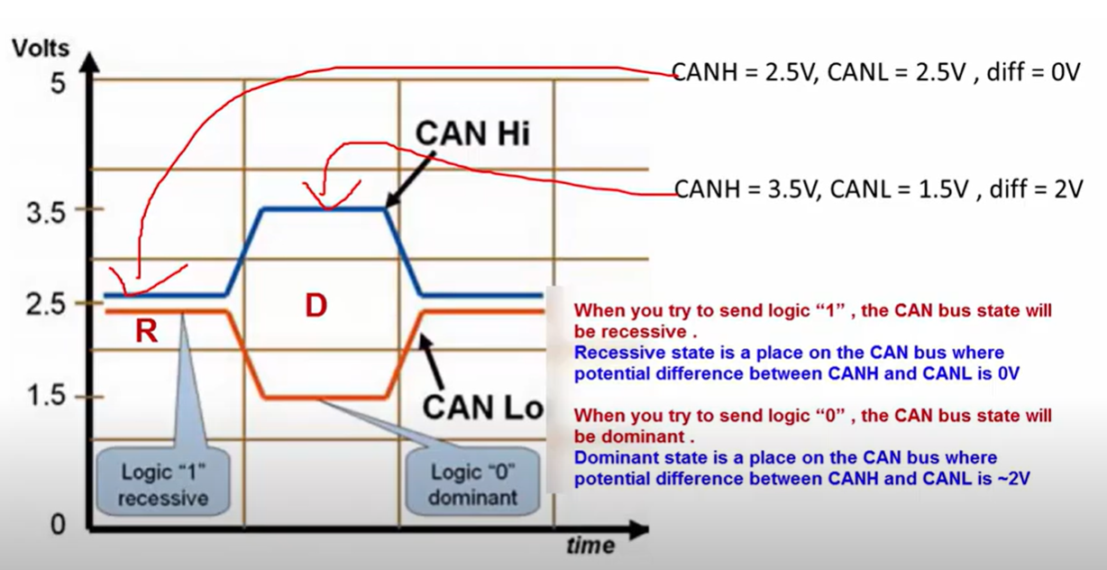
CAN Bus Levels

Slide 22
CAN Frames Format
CAN Data Frame – carries the actual node information
CAN Remote Frame – requests for the particular CAN Message ID information
CAN Error Frame – indicates error has occurred in data
CAN Standard and Extended Frame
CAN Frame – Acknowledgement
CAN Frame – Bit Stuffing

Slide 23
Type and Role of Each Frame

Slide 24
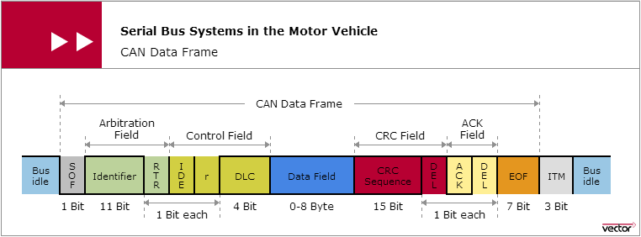
CAN Data Frame
Transmission of a data frame begins with a start symbol (Start of Frame: SOF). It is used by the CAN nodes to synchronize to the sender.
During transmission, the CAN nodes maintain accurate timing by evaluating each edge transition and adjusting their clocks as necessary.
The bit stuffing method guarantees that an edge transition occurs after five homogeneous bits at most.
An end symbol (End Of Frame: EOF) marks the end of a data frame.

Slide 25
CAN Data Transmission
Data in the CAN network is transmitted using message frames, the so-called CAN data frame.
Each data frame is identified by an identifier. In standard format it is made up of 11 bits, in extended format it is 29 bits.
The ISO-11898:2003 Standard, with the standard 11-bit identifier, provides for signaling rates from 125 kbps to 1 Mbps. The standard was later amended with the “extended” 29-bit identifier. The standard 11-bit identifier field provides for 2^11, or 2048 different message identifiers, whereas the extended 29-bit identifier provides for 2^29, or 537 million identifiers.
RTR –The single remote transmission request (RTR) bit is dominant when information is required from another node. RTR helps to identify whether it is a Data or Remote Frame.

Slide 26
CAN Data Transmission
IDE – A dominant single identifier extension (IDE) bit means that a standard CAN identifier with no extension is being transmitted.
R0 – Reserved bit (for possible use by future standard amendment).
DLC - Indicate the length of data in the data field.The precise number of useful bytes is indicated by the DLC (Data Length Code).
Data field - Useful data up to eight bytes in length can be transmitted in the data field of a data frame.
Every data frame is available for receiving by every CAN node (broadcasting).
CRC - The useful data is protected by the CRC method (Cyclic Redundancy Check): The sender appends a checksum (CRC sequence) to the useful data, which is evaluated by the receiver by applying the CRC algorithm.
ACK - Depending on the result of the evaluation, the receiver acknowledges either positively or negatively in the ACK slot that follows the CRC sequence.
Intermission Field (ITM) - The ITM is a printf type instrumentation output.

Slide 27
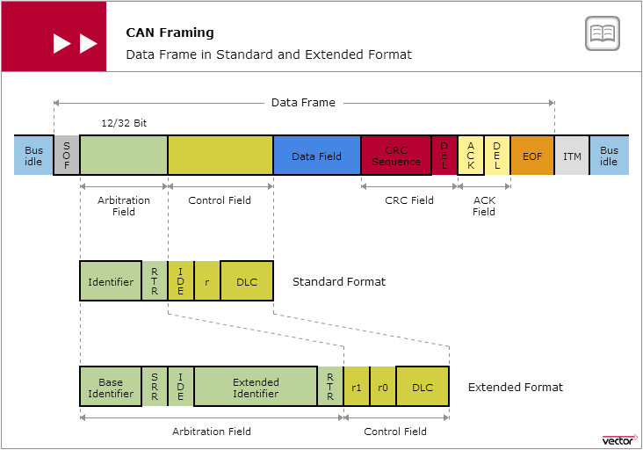
Standard and Extended Frame

Slide 28
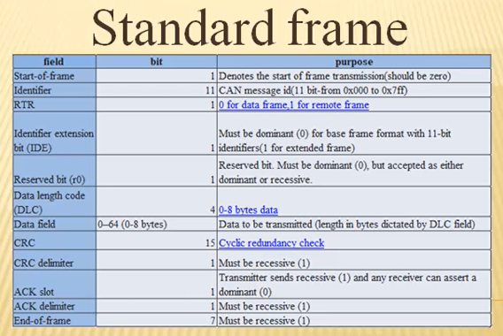

Slide 29
Standard and Extended Frame
SRR–The substitute remote request (SRR) bit replaces the RTR bit in the standard message location
as a placeholder in the extended format.
IDE– A recessive bit in the identifier extension (IDE) indicates that more identifier bits follow. The 18-bit
extension follows IDE.
r1– Following the RTR and r0 bits, an additional reserve bit has been included ahead of the DLC bit.
With the use of a recessive SRR plus a recessive IDE bit, it is guaranteed that standard message frames (11-bit identifier) will always have higher priority than extended message frames (29-bit identifier).

Slide 30
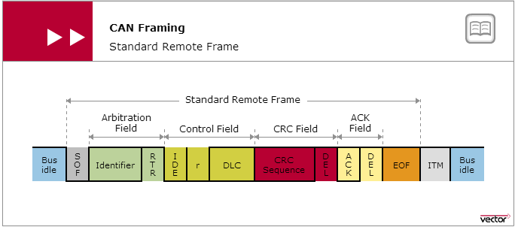
Remote Frame and Error Frame
The intended purpose of the remote frame is to solicit the transmission of data from another node.
The remote frame is similar to the data frame, with two important differences.
First, this type of message is explicitly marked as a remote frame by a recessive RTR bit in the arbitration field, and secondly, there is no data.

Slide 31
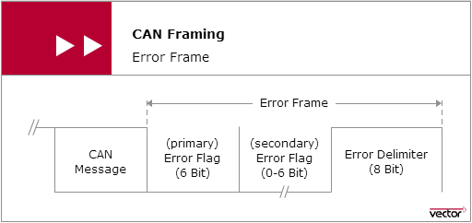
Remote Frame and Error Frame
Error flag can be either active-error flag or passive- error flag.
Active error flag consists of six consecutive dominant bits.
Passive error flag consists of six consecutive recessive bits.
The error delimiter consists of eight recessive bits.
The error frame is a special message that violates the formatting rules of a CAN message.
It is transmitted when a node detects an error in a message, and causes all other nodes in the network to send an error frame as well.
The original transmitter then automatically retransmits the message. error frames.

Slide 32
Overload Frame
The overload frame is mentioned for completeness. It is similar to the error frame with regard to the
format, and it is transmitted by a node that becomes too busy. It is primarily used to provide for an extra delay between messages.

Slide 33
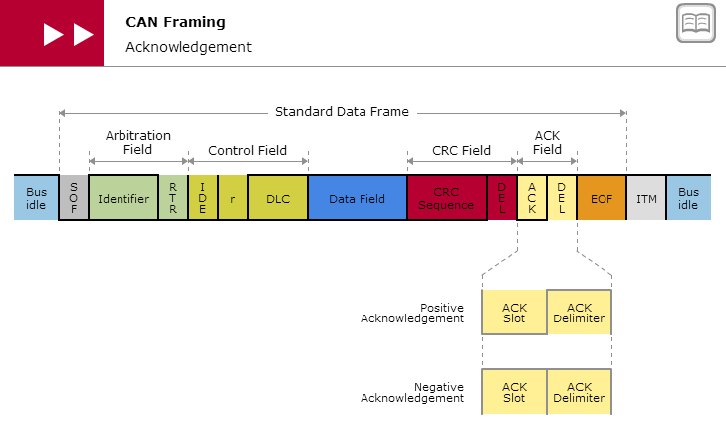
CAN Framing - Acknowledgement
While transmitting the CAN message ACK bit is made recessive by the node.
When the node receives the message successfully the ACK bit is made dominant by the receiving node, and it re-transmits the node of the bus.
The transmitter receives the frame and check for the ACK bit, if the bit is dominant then the frame has been sent successfully and there is no need to re-transmit the message.

Slide 34
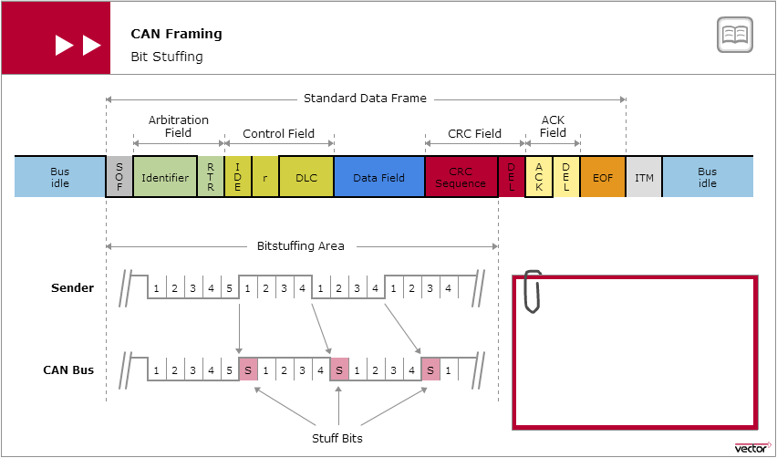
CAN Framing – Bit Stuffing
Used for the purpose of Re-synchronization as CAN bus is a synchronous network, where all receiving modules synchronize to the data coming from a transmitting module.

Slide 35
CAN Bus Access
Bus Access in CAN Network
Bitwise Bus Arbitration
Prioritization

Slide 36
CAN Bus Access
ISO 11898-1 defines a multi-master architecture to assure high availability and event-driven data transmission.
Each node in the CAN network has the right to access the CAN bus without requiring permission and without prior coordination with other CAN nodes.
Although bus access based on an event-driven approach enables very quick reactions to events, there is the inherent risk that several CAN nodes might want to access the CAN bus at the same time, which would lead to undesirable overlaps of data on the CAN bus.
To preserve the communication system’s real-time capability, ISO 11898-1 provides for a bus access that guarantees nondestructive data transport. The so-called CSMA/CA (Carrier Sense Multiple Access with Collision Avoidance) method is used here.
The CSMA/CA method ensures that CAN nodes wishing to send do not access the CAN bus until it is available.
In case of simultaneous bus access, the CSMA/CA method based on bitwise bus arbitration ensures that the highest priority CAN message among the CAN nodes prevails.
In principle, the higher the priority of a CAN message the sooner it can be transmitted on the CAN bus. In case of poor system design, low priority CAN messages even run the risk of never being transmitted.

Slide 37
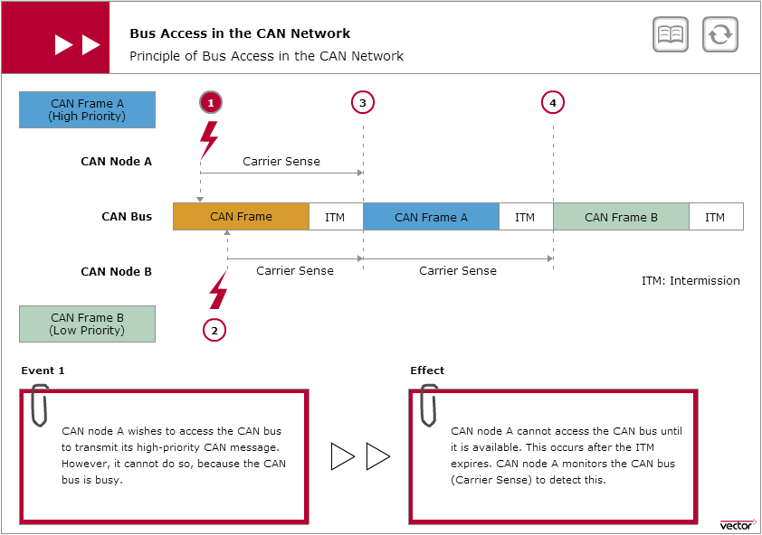
Bus Access in the CAN network

Slide 38
Bitwise Bus Arbitration
The CAN protocol allows simultaneous bus access from different nodes. When two or more nodes attempts to send message at the same time collision will occur.
If more than one node is accessing the bus, an arbitration is required.
The bus access method used in CAN is non-destructive bitwise arbitration called carrier sense multiple access with collision detection and arbitration on message priority (CSMA/CD+ AMP).
When the bus is in idle state, several nodes can start transmission of a frame.
Every node reads back, bit by bit, from the bus during complete message and compares the transmitted bit value with the received bit value.

Slide 39
Bitwise Bus Arbitration
The key component of the bus access method defined by ISO 11898-1 is bitwise bus arbitration. It prevents collisions from occurring despite simultaneous bus access.
After network-wide synchronization, all CAN nodes wishing to send place their identifier of the CAN message bitwise onto the CAN bus, from most significant to least significant bit.
In this process, the wired-AND bus logic upon which the CAN network is based ensures that a clear and distinct bus level results on the bus.
At the end of the arbitration phase, the CAN node transmitting the CAN message with the lowest ID gets authorization to send. CAN nodes with lower priority messages switch to the receiving state, later they access the CAN bus for another sending attempt as soon as it is available again.

Slide 40
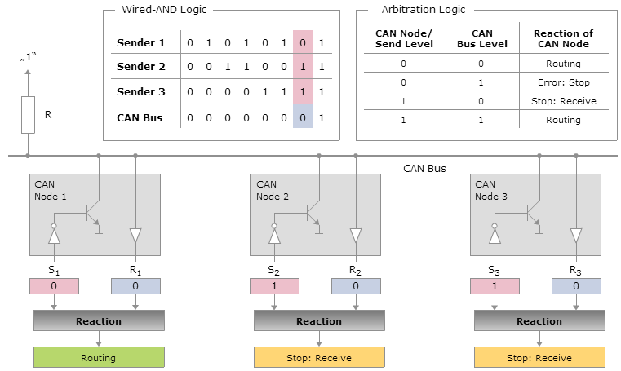
Wired AND Logic and Arbitration Logic

Slide 41
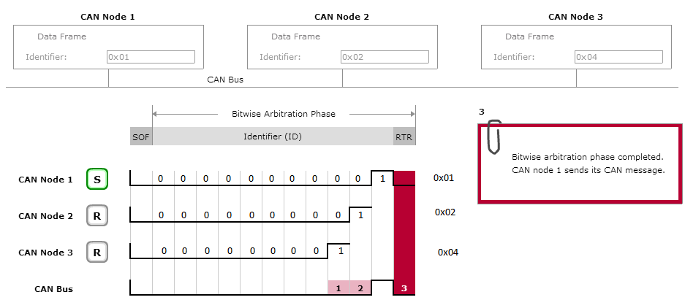
Example – Bitwise Bus Arbitration

Slide 42
Prioritization
The priorities of the CAN messages are decisive in obtaining bus access in the CAN network. They are encoded via the identifier which is transmitted bitwise from the most significant to the least significant bit.
Wired-AND bus logic and arbitration logic ensure that the priority of the CAN message increases with decreasing identifier value: The smaller an identifier is, the higher the priority of the CAN message.
If the bus load is not too high, this type of random, nondestructive and priority-controlled bus access provides for fair and very quick bus access.
Nonetheless, it must be taken into account that increasing bus load primarily causes delays in lower-priority CAN messages to grow.
This could impair the real-time capability of the CAN communication system. Therefore, in designing the system the priorities of CAN messages should be derived from the urgency of the signals they will transport.

Slide 43
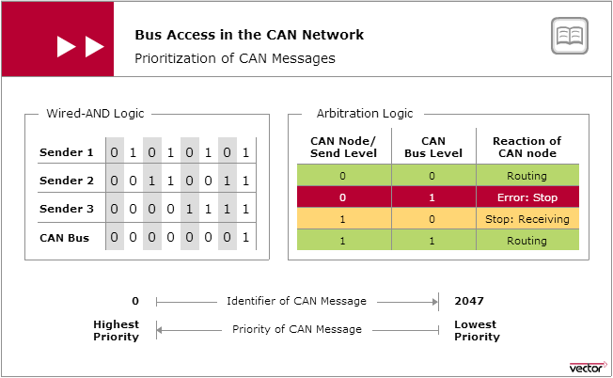
Prioritization of CAN Message

Slide 44
CAN Data Protection
Physical Error Protection
Logical Error Detection
Logical Error Handling
Error Tracking

Slide 45
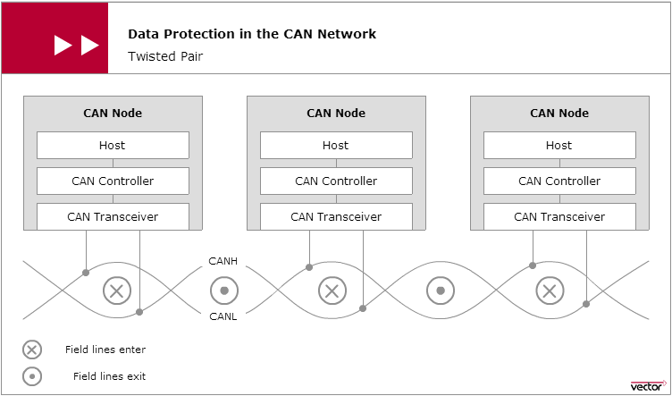
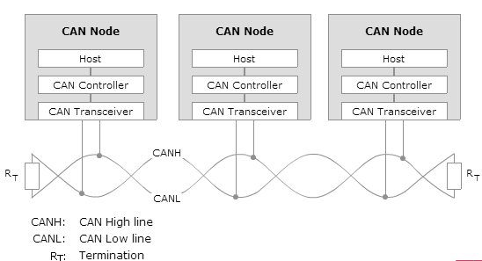
CAN Data Protection
Twisted Pair
Termination

Slide 46
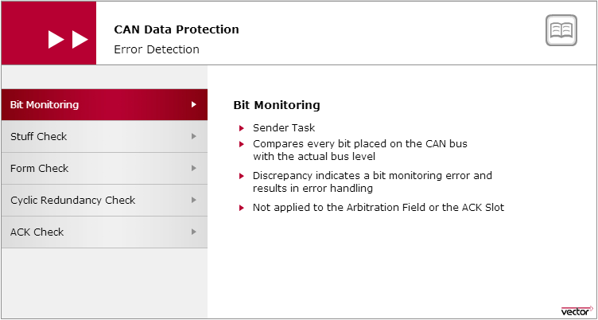
Logical Error Detection- Bit Monitoring
To detect corrupted messages, the CAN protocol defines five mechanisms: bit monitoring, monitoring of the message format (Form Check), monitoring of the bit coding (Stuff Check), evaluation of the acknowledgement (ACK Check) and verifying the checksum (Cyclic Redundancy Check).

Slide 47
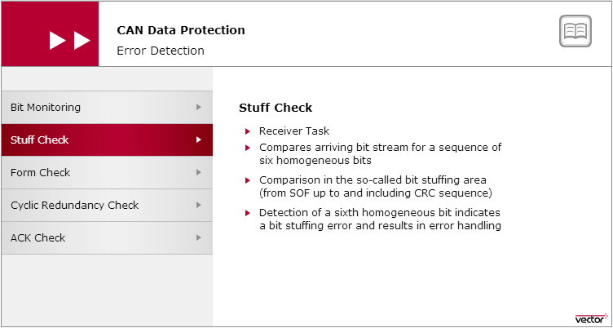
Logical Error Detection- Stuff Check
The stuff check serves to check the bit stream. The CAN protocol specifies that the sender must transmit a complementary bit after five homogeneous bits — for synchronization purposes. There is a stuffing error if more than five homogeneous contiguous bits are received.

Slide 48
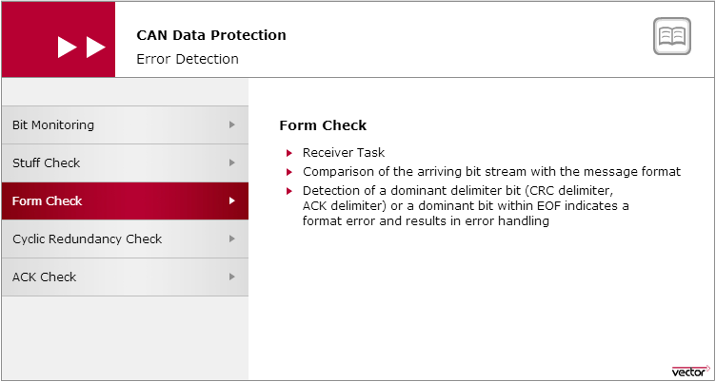
Logical Error Detection- Form Check
The form check serves to check the format of a CAN message. Each CAN message always exhibits the same bit sequences at certain positions. They are the CRC delimiter, ACK delimiter and EOF. Senders always transmit these message components recessively. A format error exists if a receiver detects a dominant bus level within one of these message components in the Form Check.

Slide 49
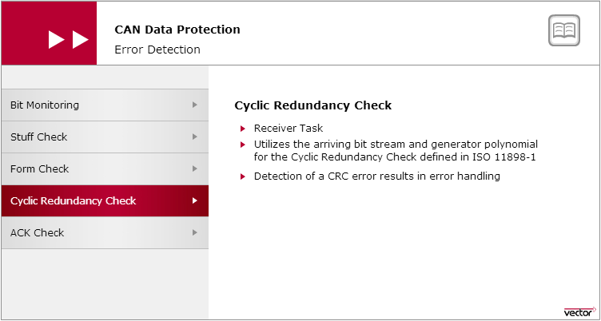
Logical Error Detection- CRC Check
In the cyclic redundancy check (CRC) the polynomial R(x) associated with the arriving data or remote frame should equal a multiple of the generator polynomial G(x) specified by ISO 11898-1. If this is not the case (CRC error), then the data or remote frame was corrupted during its transmission.

Slide 50
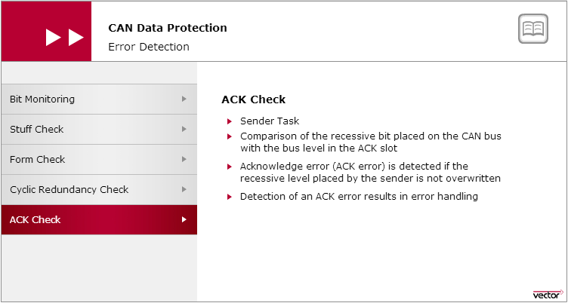
Logical Error Detection- ACK Check

Slide 51
Logical Error Handling
The CAN protocol prescribes that if the error-detecting CAN node is experiencing a local disturbance, it must inform all CAN nodes connected to the CAN network.
The error-detecting CAN node transmits an error signal (error flag) for this purpose, which is made up of six dominant bits. This is an intentional violation of the bit stuffing rule, and it generates a bit stuffing error.
Transmission of an error flag ensures that all other CAN nodes will also transmit an error flag (secondary error flag) and thereby also terminate the regular data transmission just like the sender of the primary error flag.
Transmission of an error flag is always terminated by an error delimiter. This consists of eight recessive bits.

Slide 52
Error Tracking
To assure network-wide data consistency, each node in a CAN network has the right to terminate any CAN message interpreted as faulty. This also applies to a CAN node that erroneously interprets correct CAN messages as faulty.
To prevent jamming up the transmission medium, the CAN protocol specifies error tracking that allows CAN nodes to distinguish between occasionally occurring disturbances and persistent ones.
Consequently, each CAN controller has a TEC (Transmit Error Counter) and a REC (Receive Error Counter). In case of successful transmission of a data or remote frame, the relevant error counter is decremented (TEC=TEC-1; REC=REC-1).
Detection and subsequent transmission of a error flag causes the relevant error counter to be incremented according to certain rules.
For the sender the following rule applies: TEC=TEC+8.
Error-detecting receivers initially increment their REC by one unit (REC=REC+1).
For the error causing receiver: REC=REC+8.

Slide 53
Error Tracking
Error Active | Depending on the specific error count, a CAN controller handles switching of the error state. After the start, a CAN controller assumes the normal state Error Active. In this state, the CAN controller sends six dominant bits (active error flag) after detecting an error. When a limit is exceeded (TEC>127; REC>127), the CAN controllers switch over to the “Error Passive” state.
Error Passive | CAN controllers in the Error Passive state can only indicate a detected error by sending six homogeneous recessive bits. This prevents the error-detecting receivers from globalizing detected errors. In addition, when sending two consecutive data or remote frames, CAN controllers that are in the “Error Passive” state must wait the “Suspend Transmission Time” (8 bits).
Bus Off | If a CAN controller fails or if there are extreme accumulations of errors, a state transition is made to the Bus Off state. The CAN controller disconnects from the CAN bus. The Bus-Off state can only be exited by intervention of the host (with a mandatory waiting time of 128 x 11 bits) or by a hardware reset.

Slide 54
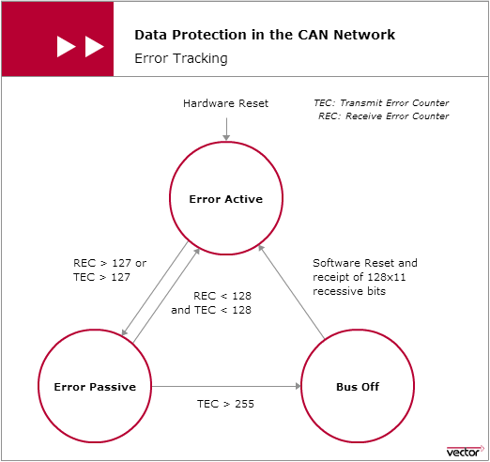
Error Tracking

Slide 55
Thank you

