Slide 1
Visteon Pune – Validation
Controller Area Network– May 2016
Presented by Tarun Bharani
tbharani@visteon.com

Slide 2
Contents
Why CAN?
CAN Introduction
CAN Frame Format
CAN Bus Access
CAN Data Protection

Slide 3
Why CAN?
Motivation
Bus Networking
Communication Model
Three Layer Model
Architecture of Serial Bus System

Slide 4
Motivation
The recent history of the automobile is characterized by intensive electronification.
Over the course of time, electronic functions found their way into the automobile that could not be implemented without highly active data exchange between electronic ECUs.
Electronic systems were requiring more and more intensive networking to implement them, which drove wiring expense sky high.
A way out of this dilemma soon appeared in the form of bit-serial exchange of data via a communication channel (Bus) jointly used by a number of electronic control units.

Slide 5
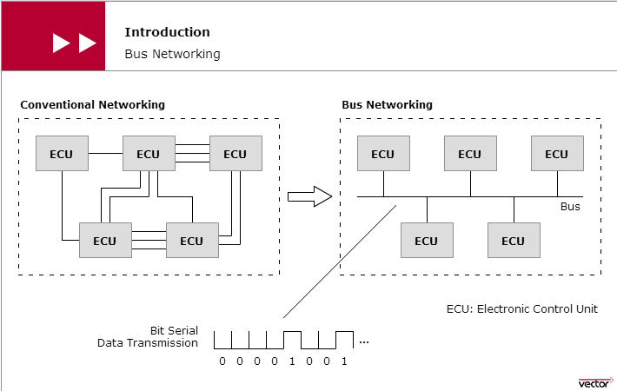
Bus Networking

Slide 6
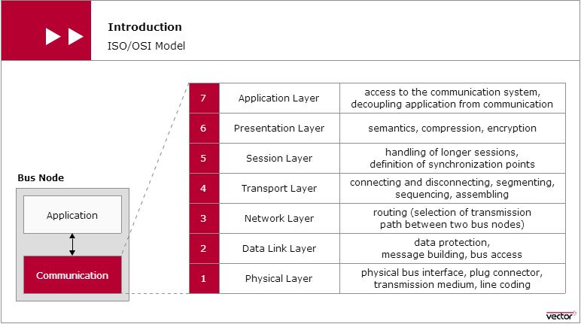
Communication Model/OSI Model
The OSI communication model (Open System Interconnection) published by ISO (International Standardization Organization) in 1983 is a reference architecture for implementing CAN communication.

Slide 7
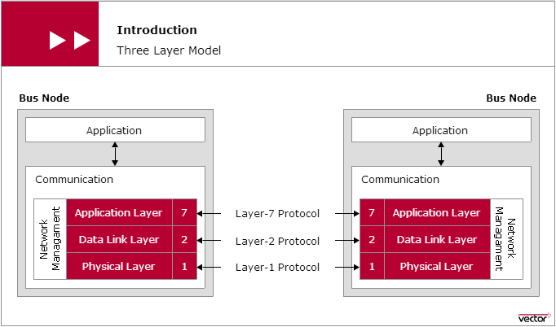
Three Layer Model
For data exchange between electronic control units in the motor vehicle, not all of the communication functions, defined in the ISO/OSI model, are necessary.
Essentially, only the two lowermost layers are relevant to serial data communication in the motor vehicle. These layers are the Data Link Layer and the Physical Layer.

Slide 8
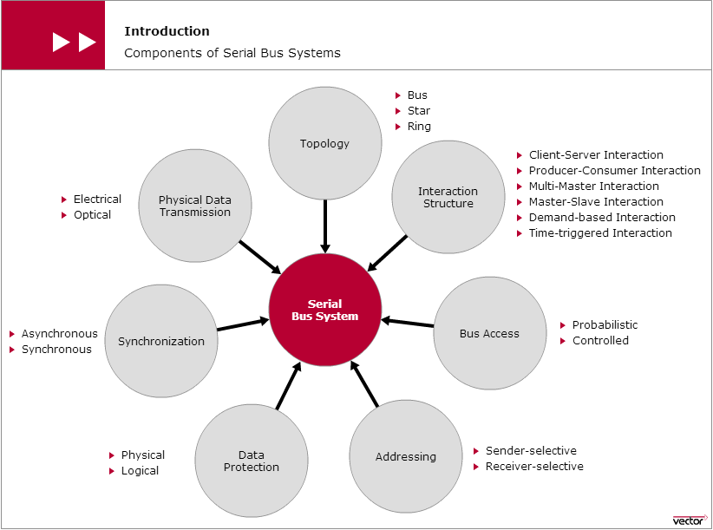
Architecture of Serial Bus System

Slide 9
CAN Introduction
CAN Standard
CAN Network
CAN Communication Principle
CAN Bus Levels

Slide 10
CAN Standard
CAN has been standardized since 1993 and is available as an ISO standard (International Standardization Organization): ISO 11898.
While it initially consisted of three parts, today it has five parts.
The first part describes the event-driven communication protocol.
A time-triggered extension can be found in the fourth part.
The second and third parts cover information on the bus interface and physical data transmission: A distinction is made here between the High-Speed variant (data rates up to 1 MBit/s) and Low-Speed variant (data rates up to 125 KBit/s).
The fifth part describes the behavior of a CAN node in the High-Speed network in “Low Power Mode”.
A maximum network extension of about 40 meters is allowed. At the ends of the CAN network, bus termination resistors contribute to preventing transient phenomena (reflections).

Slide 11
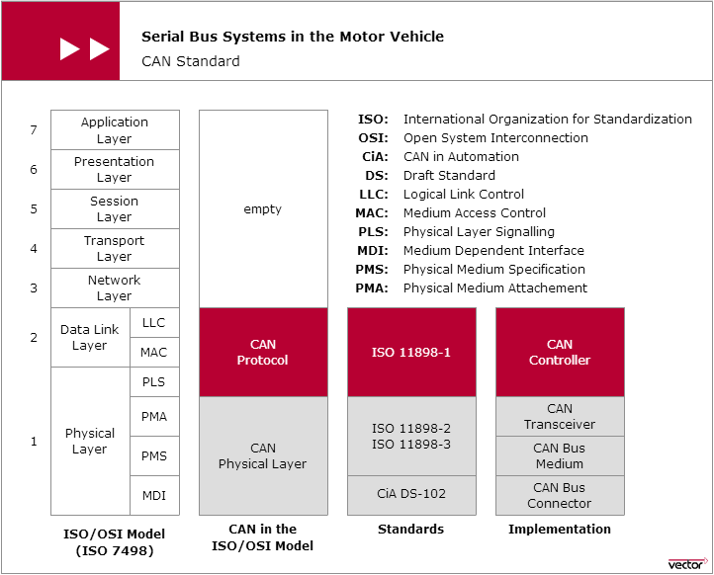
CAN Standard (Continued)

Slide 12
CAN Network
A CAN network is a system network made up of CAN nodes (electronic control units with a CAN interface), which exchange data with one another over their individual CAN interfaces and a transmission medium (CAN bus) that interconnects all of the CAN interfaces.
A CAN interface is made up of two parts: the communication software and communication hardware.
While the communication software is made up of higher level communication services, the fundamental communication functions are implemented in hardware.
The CAN controller provides for uniform handling of the CAN communication protocols.
The CAN transceiver serves to interface the CAN controller to the CAN bus.
The transmission medium that is generally used is a twisted pair line.
The symmetrical signal transmission that occurs over this line is very insensitive to external interference.

Slide 13
Architecture
1) can is a multi-master serial bus standard for connecting electronic control units also known as nodes.
2) two or more nodes are required on the can network to communicate.
3) all nodes are connected to each other through a two wire bus. THE WIRES ARE A TWISTED PAIR WITH A 120 ohm TERMINATING RESISTOR.
4) this bus uses differential wired-and signals. Two signals, can high (canh) and can low (canl) are either driven to a "dominant" state with canh > canl, or not driven and pulled by passive resistors to a "recessive" state with canh <= canl.
5) a o data bit encodes a dominant state, while a 1 data bit encodes a recessive state, supporting a wired-and convention, which gives nodes with lower id numbers priority on the bus

Slide 14
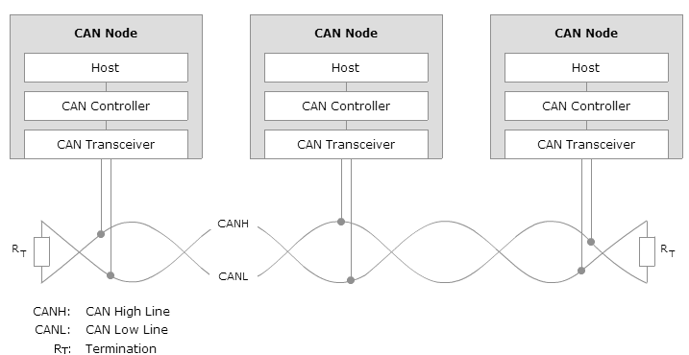
CAN Network Diagram

Slide 15
CAN Communication Principle
In a CAN network, the transmitted data frames and their sequence are not a function of the progression of time, rather they depend on the occurrence of special events.
In principle, each CAN node is authorized to access the CAN bus immediately after an event occurs. In conjunction with the relatively short message length of a maximum of 130 bits in standard format, and the high data transmission rate of up to 1 MBit/s, the method enables quick reactions to asynchronous processes.
This is an important prerequisite for real-time data transmission capability in the low milliseconds range, which is primarily demanded by applications in the powertrain and chassis areas.
To guarantee real-time communication despite random bus access, bus access is based on the CSMA/CA method (Carrier Sense Multiple Access/Collision Avoidance).
First, the CSMA/CA method ensures that CAN nodes wishing to send do not access the CAN bus until it is available.
Second, in simultaneous bus accesses occur, the CSMA/CA method ensures that the CAN node with the highest priority data frame prevails.

Slide 16
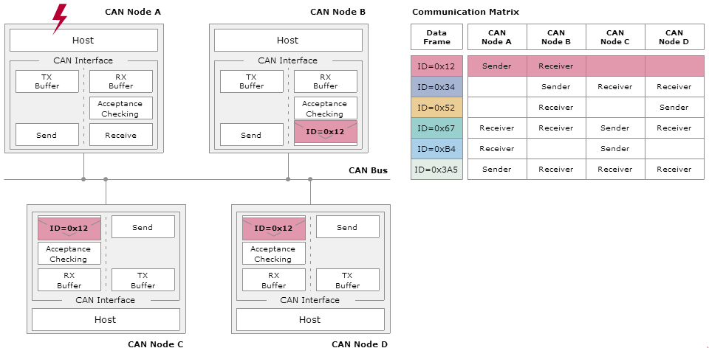
CAN Communication Principle

Slide 17
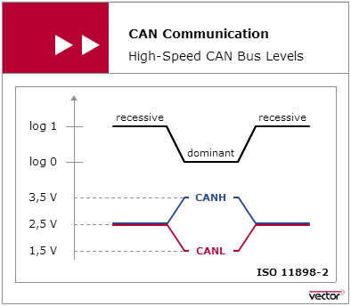
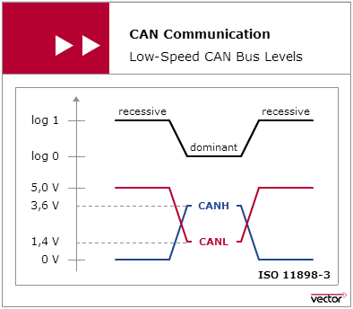
CAN Bus Levels
ISO 11898-2 High Speed CAN assigns logical “1” to a typical differential voltage of 0 Volt. The logical “0” is assigned with a typical differential voltage of 2 Volt.
ISO 11898-3 Low Speed CAN assigns a typical differential voltage of 5 Volt to logical “1”, and a typical differential voltage of 2 Volt corresponds to logical “0”.

Slide 18
CAN Frames Format
CAN Data Frame
CAN Remote Frame
CAN Error Frame
CAN Standard and Extended Frame
CAN Frame – Acknowledgement
CAN Frame – Bit Stuffing

Slide 19
Type and Role of Each Frame

Slide 20
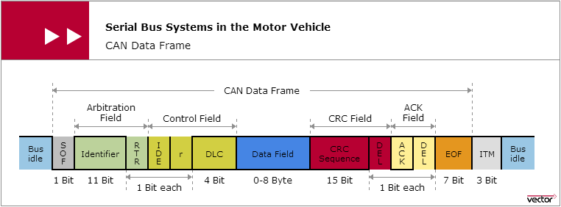
CAN Data Frame
Transmission of a data frame begins with a start symbol (Start of Frame: SOF). It is used by the CAN nodes to synchronize to the sender.
During transmission, the CAN nodes maintain accurate timing by evaluating each edge transition and adjusting their clocks as necessary.
The bit stuffing method guarantees that an edge transition occurs after five homogeneous bits at most.
An end symbol (End Of Frame: EOF) marks the end of a data frame.

Slide 21
CAN Data Transmission
Data in the CAN network is transmitted using message frames, the so-called CAN data frame.
Useful data up to eight bytes in length can be transmitted in the data field of a data frame.
The precise number of useful bytes is indicated by the DLC (Data Length Code).
Every data frame is available for receiving by every CAN node (broadcasting).
The useful data is protected by the CRC method (Cyclic Redundancy Check): The sender appends a checksum (CRC sequence) to the useful data, which is evaluated by the receiver by applying the CRC algorithm.
Depending on the result of the evaluation, the receiver acknowledges either positively or negatively in the ACK slot that follows the CRC sequence.
Each data frame is identified by an identifier. In standard format it is made up of 11 bits, in extended format it is 29 bits.

Slide 22
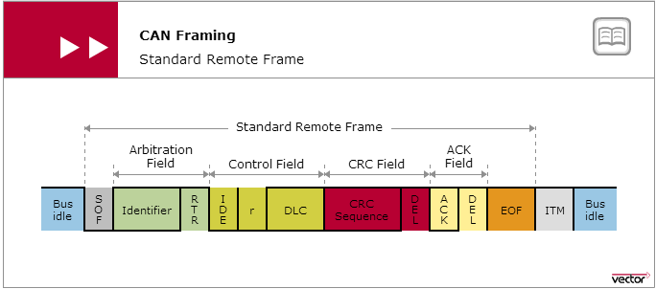
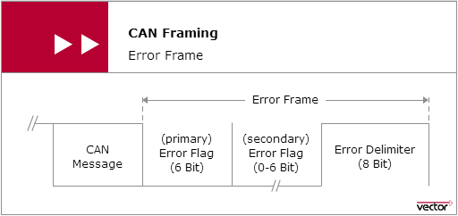
Remote Frame and Error Frame

Slide 23
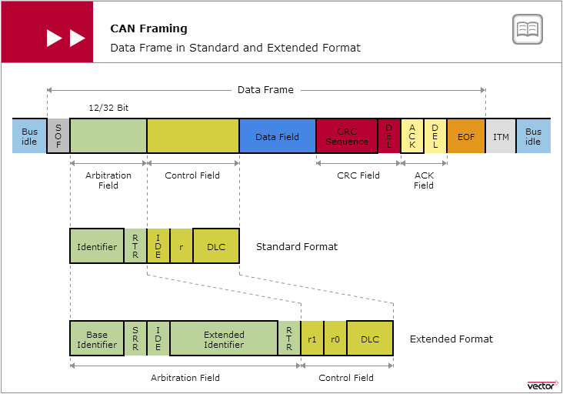
Standard and Extended Frame

Slide 24
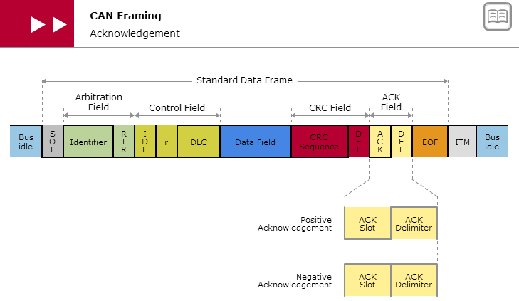
CAN Framing - Acknowledgement

Slide 25
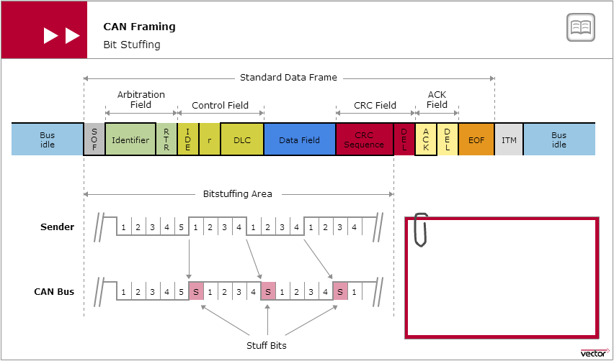
CAN Framing – Bit Stuffing
Used for the purpose of Re-synchronization as CAN bus is a synchronous network, where all receiving modules synchronize to the data coming from a transmitting module.

Slide 26
CAN Bus Access
Bus Access in CAN Network
Bitwise Bus Arbitration
Prioritization

Slide 27
CAN Bus Access
ISO 11898-1 defines a multi-master architecture to assure high availability and event-driven data transmission.
Each node in the CAN network has the right to access the CAN bus without requiring permission and without prior coordination with other CAN nodes.
Although bus access based on an event-driven approach enables very quick reactions to events, there is the inherent risk that several CAN nodes might want to access the CAN bus at the same time, which would lead to undesirable overlaps of data on the CAN bus.
To preserve the communication system’s real-time capability, ISO 11898-1 provides for a bus access that guarantees nondestructive data transport. The so-called CSMA/CA (Carrier Sense Multiple Access with Collision Avoidance) method is used here.
The CSMA/CA method ensures that CAN nodes wishing to send do not access the CAN bus until it is available.
In case of simultaneous bus access, the CSMA/CA method based on bitwise bus arbitration ensures that the highest priority CAN message among the CAN nodes prevails.
In principle, the higher the priority of a CAN message the sooner it can be transmitted on the CAN bus. In case of poor system design, low priority CAN messages even run the risk of never being transmitted.

Slide 28
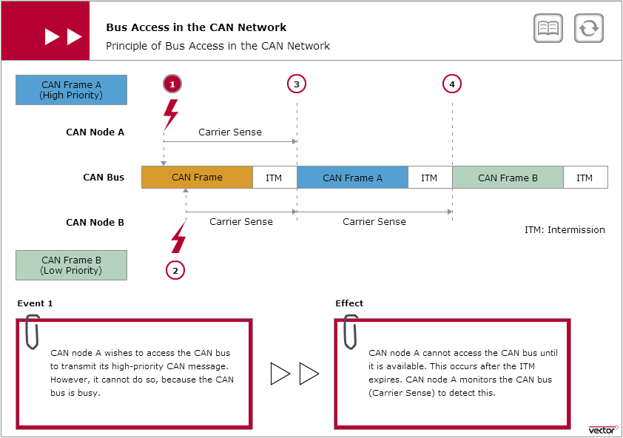
Bus Access in the CAN network

Slide 29
Bitwise Bus Arbitration
The key component of the bus access method defined by ISO 11898-1 is bitwise bus arbitration. It prevents collisions from occurring despite simultaneous bus access.
After network-wide synchronization, all CAN nodes wishing to send place their identifier of the CAN message bitwise onto the CAN bus, from most significant to least significant bit.
In this process, the wired-AND bus logic upon which the CAN network is based ensures that a clear and distinct bus level results on the bus.
At the end of the arbitration phase, the CAN node transmitting the CAN message with the lowest ID gets authorization to send. CAN nodes with lower priority messages switch to the receiving state, later they access the CAN bus for another sending attempt as soon as it is available again.

Slide 30
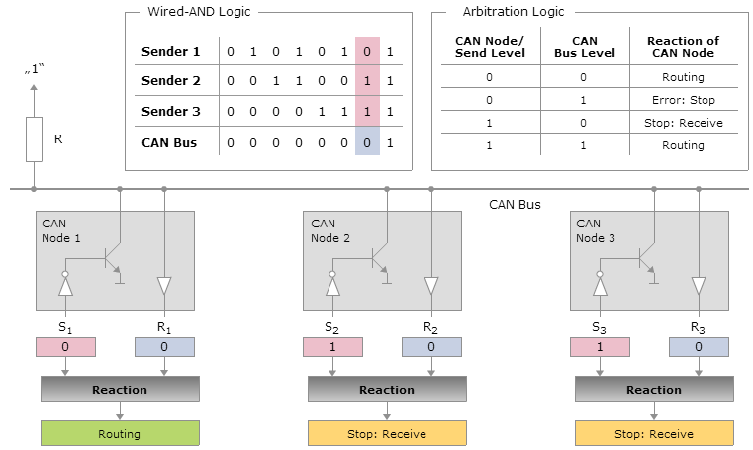
Wired AND Logic and Arbitration Logic

Slide 31
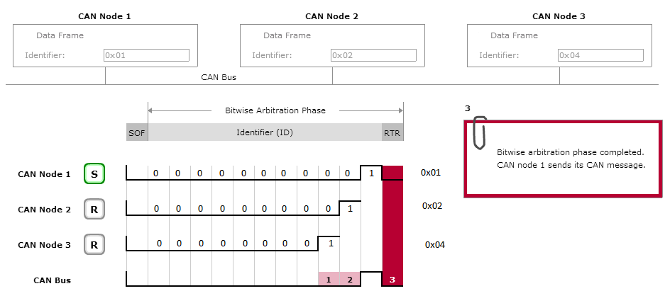
Example – Bitwise Bus Arbitration

Slide 32
Prioritization
The priorities of the CAN messages are decisive in obtaining bus access in the CAN network. They are encoded via the identifier which is transmitted bitwise from the most significant to the least significant bit.
Wired-AND bus logic and arbitration logic ensure that the priority of the CAN message increases with decreasing identifier value: The smaller an identifier is, the higher the priority of the CAN message.
If the bus load is not too high, this type of random, nondestructive and priority-controlled bus access provides for fair and very quick bus access.
Nonetheless, it must be taken into account that increasing bus load primarily causes delays in lower-priority CAN messages to grow.
This could impair the real-time capability of the CAN communication system. Therefore, in designing the system the priorities of CAN messages should be derived from the urgency of the signals they will transport.

Slide 33
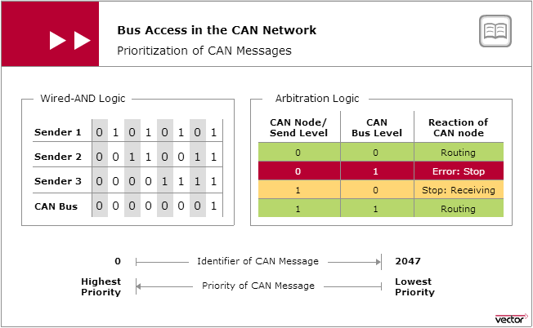
Prioritization of CAN Message

Slide 34
CAN Data Protection
Physical Error Protection
Logical Error Detection
Logical Error Handling
Error Tracking

Slide 35
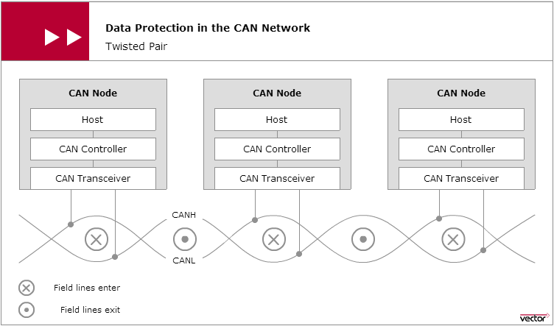
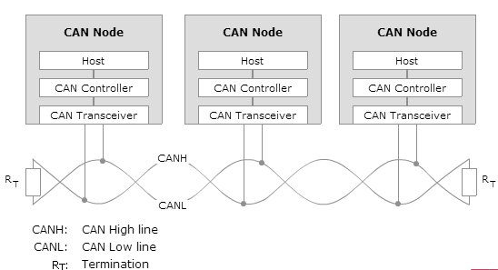
CAN Data Protection
Twisted Pair
Termination

Slide 36
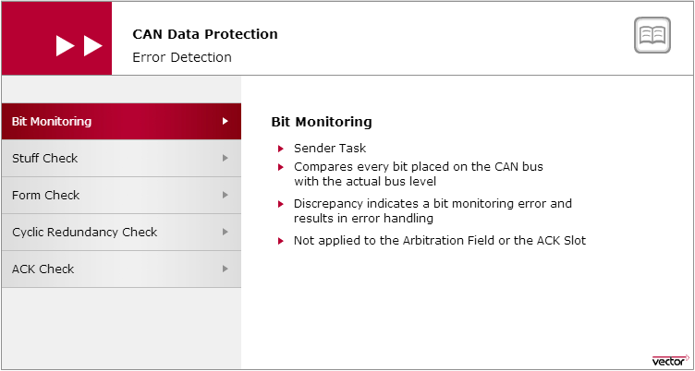
Logical Error Detection- Bit Monitoring
To detect corrupted messages, the CAN protocol defines five mechanisms: bit monitoring, monitoring of the message format (Form Check), monitoring of the bit coding (Stuff Check), evaluation of the acknowledgement (ACK Check) and verifying the checksum (Cyclic Redundancy Check).

Slide 37
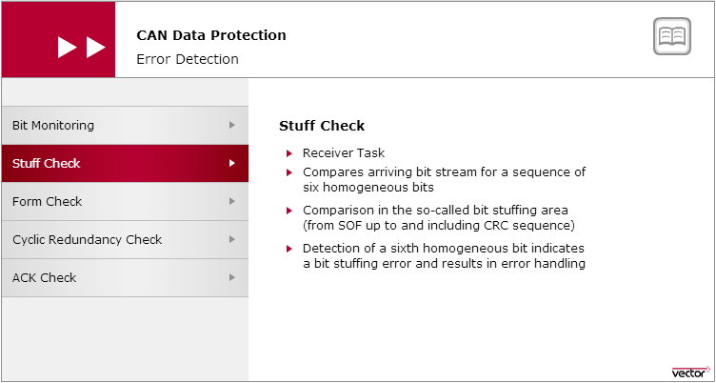
Logical Error Detection- Stuff Check
The stuff check serves to check the bit stream. The CAN protocol specifies that the sender must transmit a complementary bit after five homogeneous bits — for synchronization purposes. There is a stuffing error if more than five homogeneous contiguous bits are received.

Slide 38
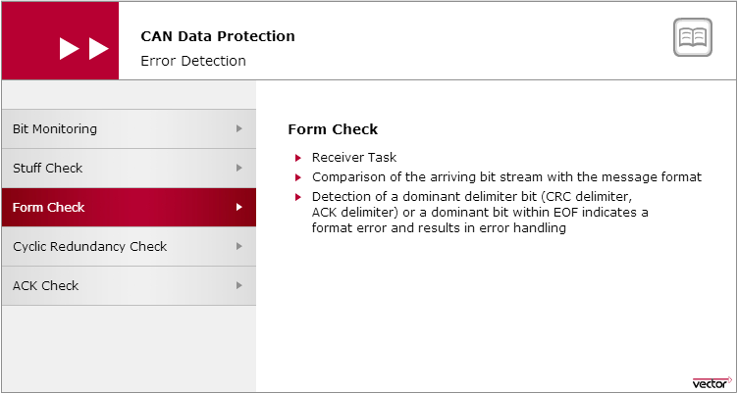
Logical Error Detection- Form Check
The form check serves to check the format of a CAN message. Each CAN message always exhibits the same bit sequences at certain positions. They are the CRC delimiter, ACK delimiter and EOF. Senders always transmit these message components recessively. A format error exists if a receiver detects a dominant bus level within one of these message components in the Form Check.

Slide 39
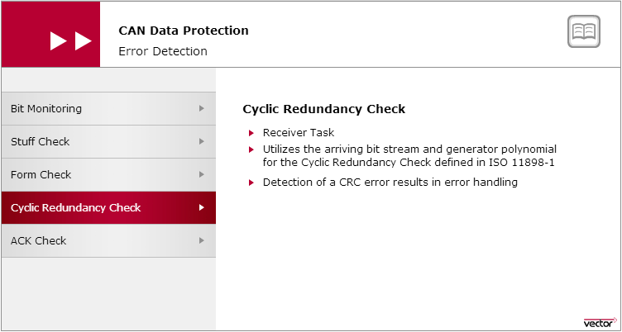
Logical Error Detection- CRC Check
In the cyclic redundancy check (CRC) the polynomial R(x) associated with the arriving data or remote frame should equal a multiple of the generator polynomial G(x) specified by ISO 11898-1. If this is not the case (CRC error), then the data or remote frame was corrupted during its transmission.

Slide 40
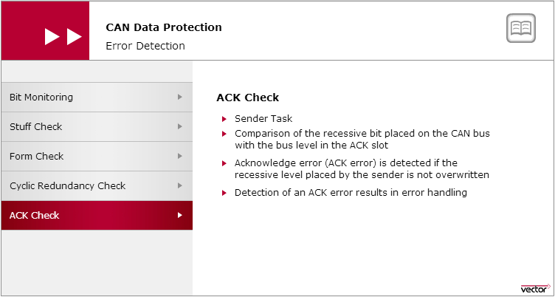
Logical Error Detection- ACK Check

Slide 41
Logical Error Handling
The CAN protocol prescribes that if the error-detecting CAN node is experiencing a local disturbance, it must inform all CAN nodes connected to the CAN network.
The error-detecting CAN node transmits an error signal (error flag) for this purpose, which is made up of six dominant bits. This is an intentional violation of the bit stuffing rule, and it generates a bit stuffing error.
Transmission of an error flag ensures that all other CAN nodes will also transmit an error flag (secondary error flag) and thereby also terminate the regular data transmission just like the sender of the primary error flag.
Transmission of an error flag is always terminated by an error delimiter. This consists of eight recessive bits.

Slide 42
Error Tracking
To assure network-wide data consistency, each node in a CAN network has the right to terminate any CAN message interpreted as faulty. This also applies to a CAN node that erroneously interprets correct CAN messages as faulty.
To prevent jamming up the transmission medium, the CAN protocol specifies error tracking that allows CAN nodes to distinguish between occasionally occurring disturbances and persistent ones.
Consequently, each CAN controller has a TEC (Transmit Error Counter) and a REC (Receive Error Counter). In case of successful transmission of a data or remote frame, the relevant error counter is decremented (TEC=TEC-1; REC=REC-1).
Detection and subsequent transmission of a error flag causes the relevant error counter to be incremented according to certain rules.
For the sender the following rule applies: TEC=TEC+8.
Error-detecting receivers initially increment their REC by one unit (REC=REC+1).
For the error causing receiver: REC=REC+8.

Slide 43
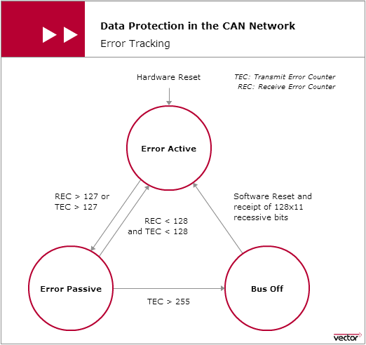
Error Tracking

Slide 44
Queries?

Slide 45
Thank you

