Slide 1
Bellabeat Activity Analysis
Insights from Smart Device Usage Patterns
By: Kayla Gaymon
Purpose: Introduce the case study and set context.

Slide 2
Project Purpose & Scenario
Content:
Bellabeat wants to understand how women use smart devices.
Fitbit data is used as a proxy for Bellabeat users.
Goal: Identify activity patterns to improve Bellabeat’s product strategy.
Assumption: Fitbit users behave similarly to Bellabeat users.

Slide 3
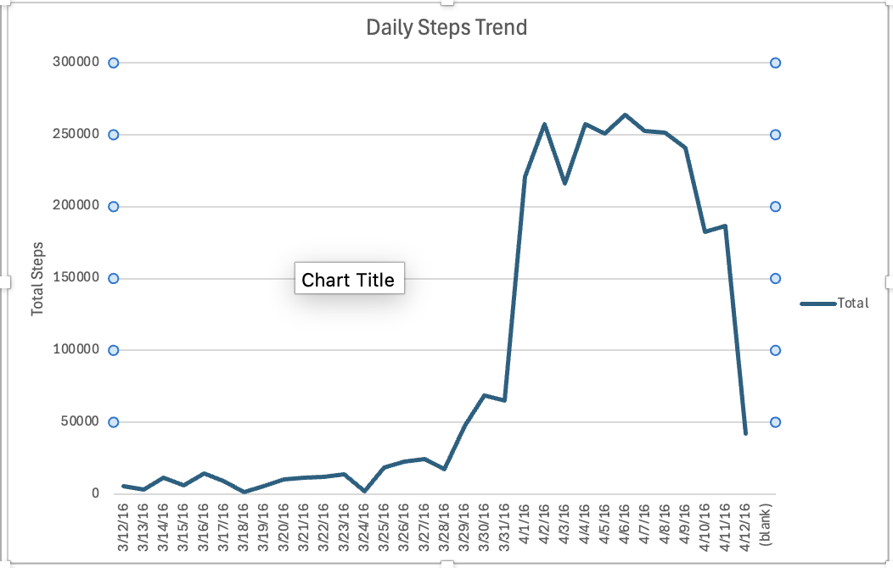
Daily Steps Trend
Users averaged ~6,500 steps/day
Daily step counts fluctuated significantly
Most days fell below the 10,000‑step guideline
Indicates moderate activity overall
Only a few days showed high movement spikes

Slide 4
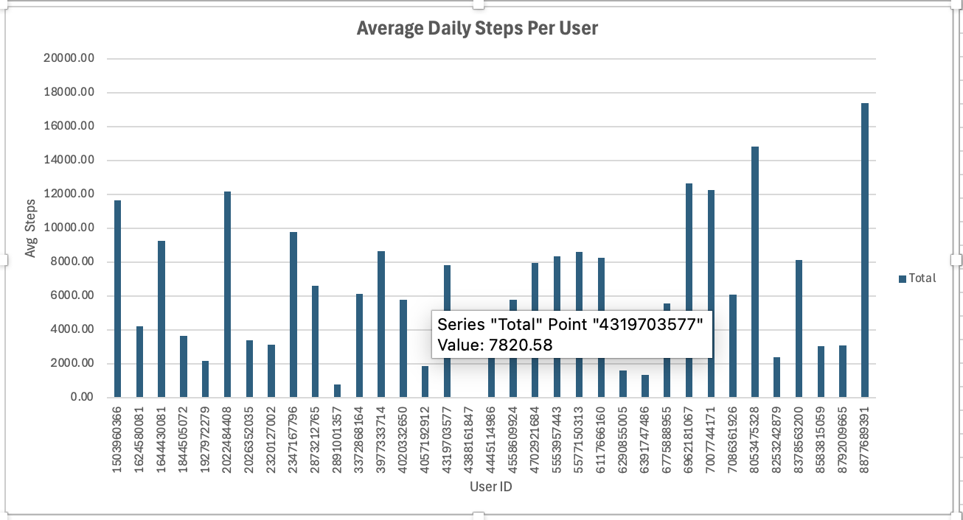
Average Daily Steps Per User
Activity levels vary widely across users
Some users averaged under 1,000 steps/day
Some averaged over 17,000 steps/day
Shows inconsistent device usage or lifestyle differences
Bellabeat users likely have diverse movement habits

Slide 5
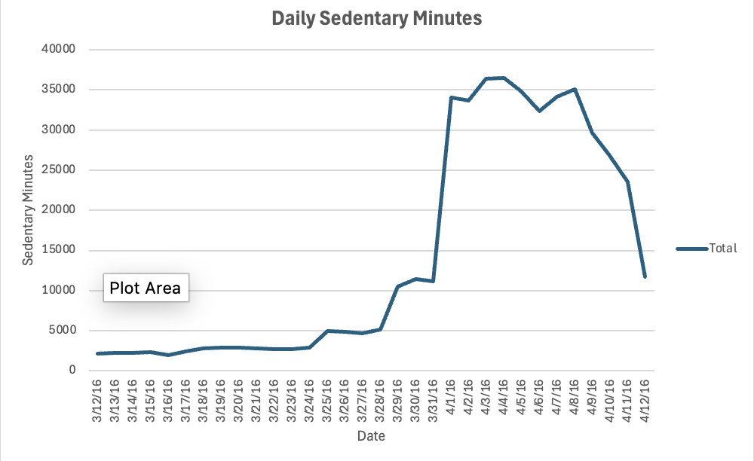
Daily Sedentary Minutes
Users spent ~18–19 hours/day sedentary
Sedentary minutes increased over the period, with later days much higher than earlier days
When compared with daily steps (Slide 3), some higher‑step days still show high sedentary minutes
Users take short movement breaks, not sustained activity
Bellabeat could encourage more consistent movement throughout the day

Slide 6
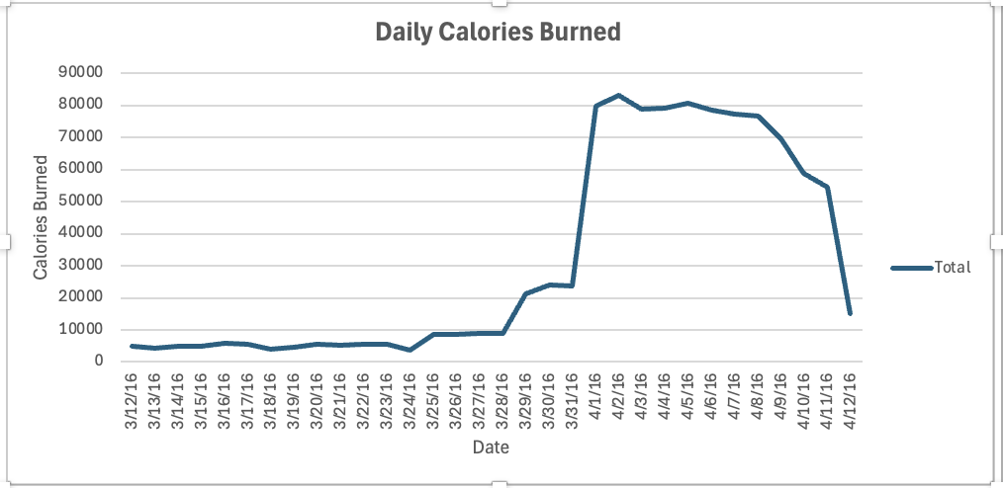
Daily Calories Burned
Calorie burn follows movement patterns
Higher step days generally show higher calorie burn (This comes from comparing Slide 3 + Slide 6.)
Some days show high calories with lower steps (This indicates intensity—running, workouts, etc.)
Calorie burn varies more than steps, suggesting intensity differences (Calories fluctuate more than steps.)
Intensity influences calorie burn more than step count alone (This is supported by your scatter plot in Slide 7.)

Slide 7
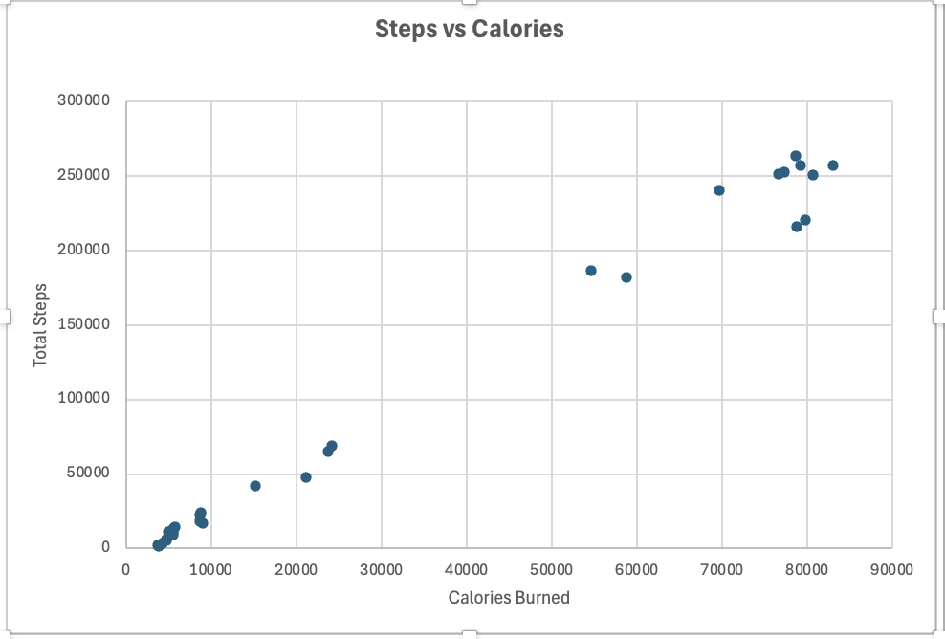
Correlation Between Steps and Calories
Positive relationship with intensity effects
More steps generally lead to more calories burned
Some points show high calories with fewer steps → higher‑intensity activity
Some points show many steps with moderate calories → lower‑intensity walking
Intensity influences calorie burn more than step count alone

Slide 8
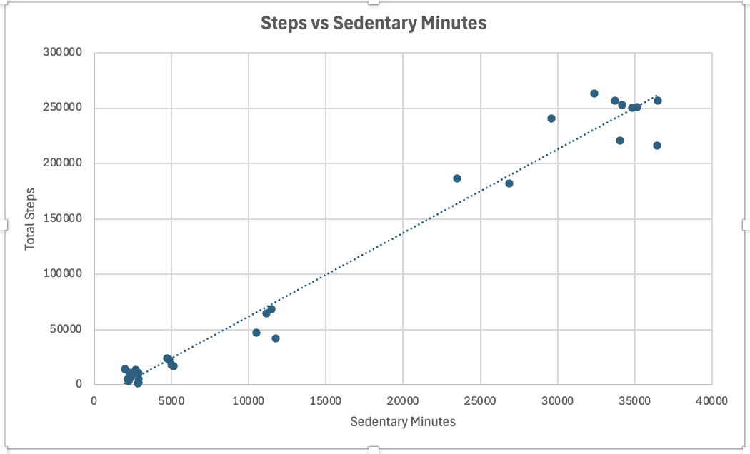
Steps vs Sedentary Minutes
Sedentary minutes and steps vary independently across users
Sedentary minutes and steps both increase over time, reflecting higher overall device usage.
High sedentary totals do not necessarily correspond to low step totals in this aggregated dataset.
Some days show high sedentary minutes alongside high step counts, indicating mixed activity patterns across users.
Sedentary minutes and steps appear to vary independently when summed across all users.

Slide 9
Summary of Key Findings
Insights from Daily Activity, Sedentary Time, and Calorie Trends
Summary of Findings
Recommendations for Bellabeat
Next Steps for Bellabeat
Users averaged ~6,500 steps/day, indicating moderate overall activity
Daily steps varied widely, showing inconsistent movement patterns across users
Sedentary minutes increased significantly over time, reflecting higher overall device usage
Steps and sedentary minutes varied independently, suggesting mixed activity levels across users
Calories generally increased with steps, but intensity differences created variation
Scatter plots show intensity affects calorie burn beyond step count alone
Encourage more consistent daily movement through reminders, nudges, and micro‑goals
Highlight intensity‑based insights (e.g., workout types, effort zones) to improve calorie understanding
Develop features that reduce sedentary time, such as posture alerts or movement streaks
Personalize activity suggestions based on user patterns (low‑step days, high‑sedentary days, etc.)
Promote balanced daily routines by combining step goals with sedentary‑time reduction goals
Analyze individual user patterns instead of aggregated totals to refine recommendations
Segment users by activity level (low, moderate, high) for targeted coaching
Incorporate heart‑rate or intensity data to improve calorie accuracy
Test new features (movement streaks, intensity badges, sedentary alerts) with a pilot group
Use insights to enhance marketing by highlighting how Bellabeat supports daily wellness habits

