Slide 1
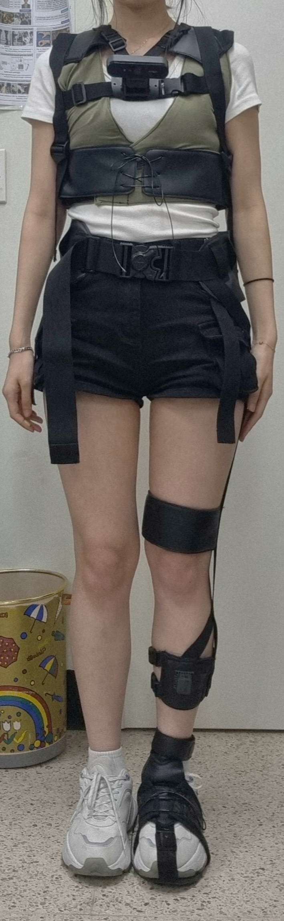
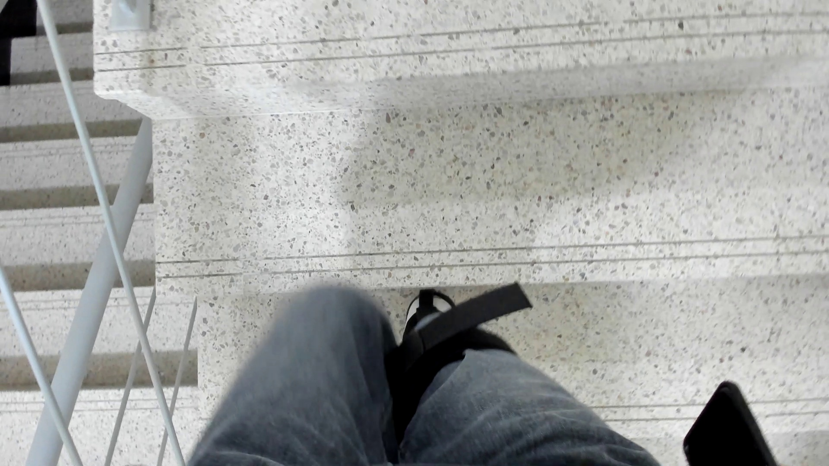
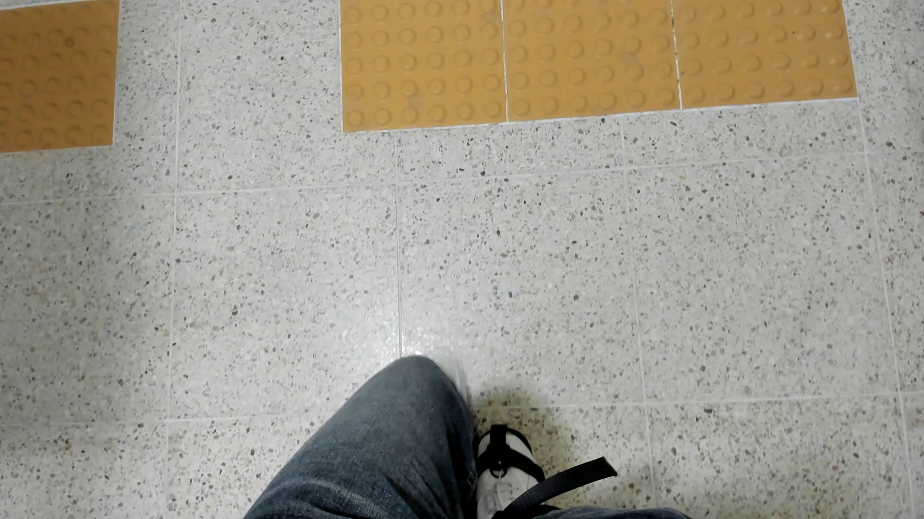
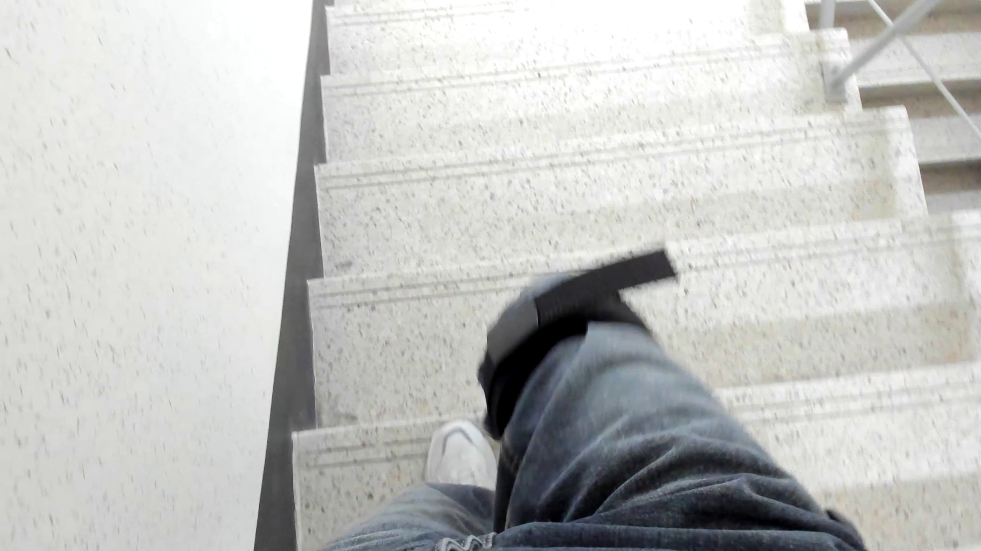
(A)
(B)
IC
IC prev
camera
IC
IC next
LG
LG
DC
DC prev
DC
DC next

Slide 2
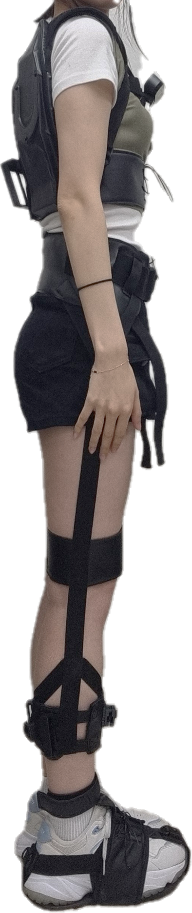
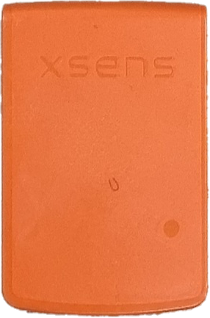
(A)
(B)
Exosuit
Camera
LG
IC
Medial
gastrocnemius
(MG)
Tibialis anterior
(TA)
DC
Inertial sensor

Slide 3
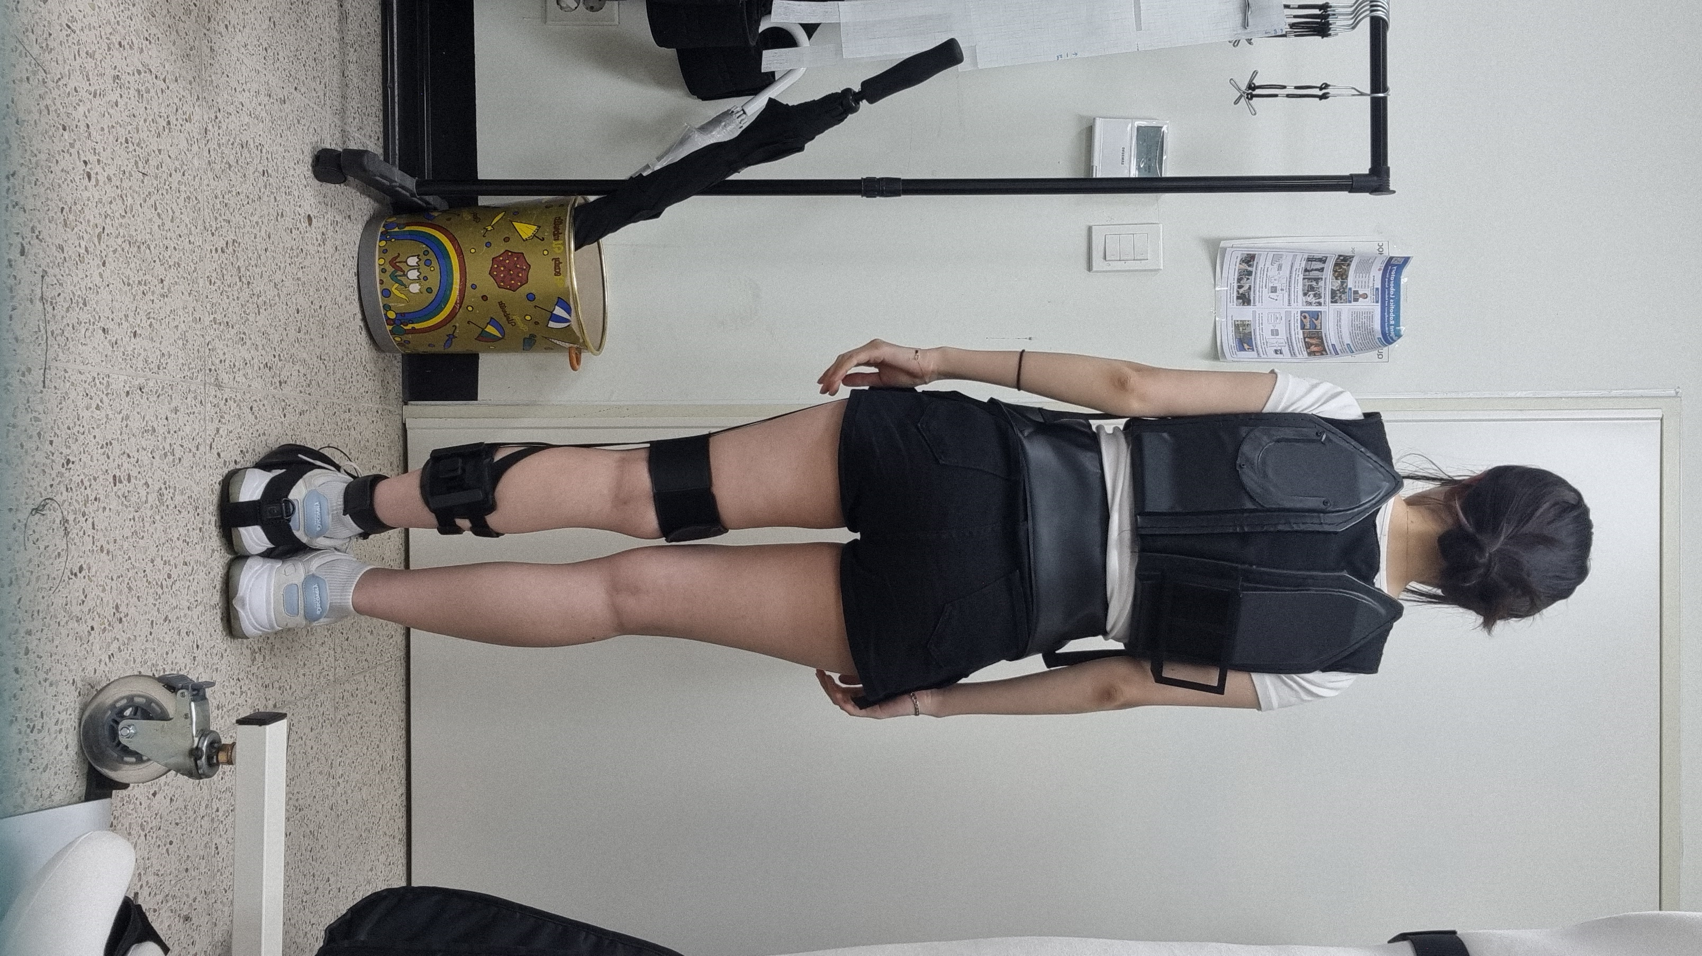
Tibialis Anterior
(TA)
Medial
Gastrocnemius
(MG)

Slide 4
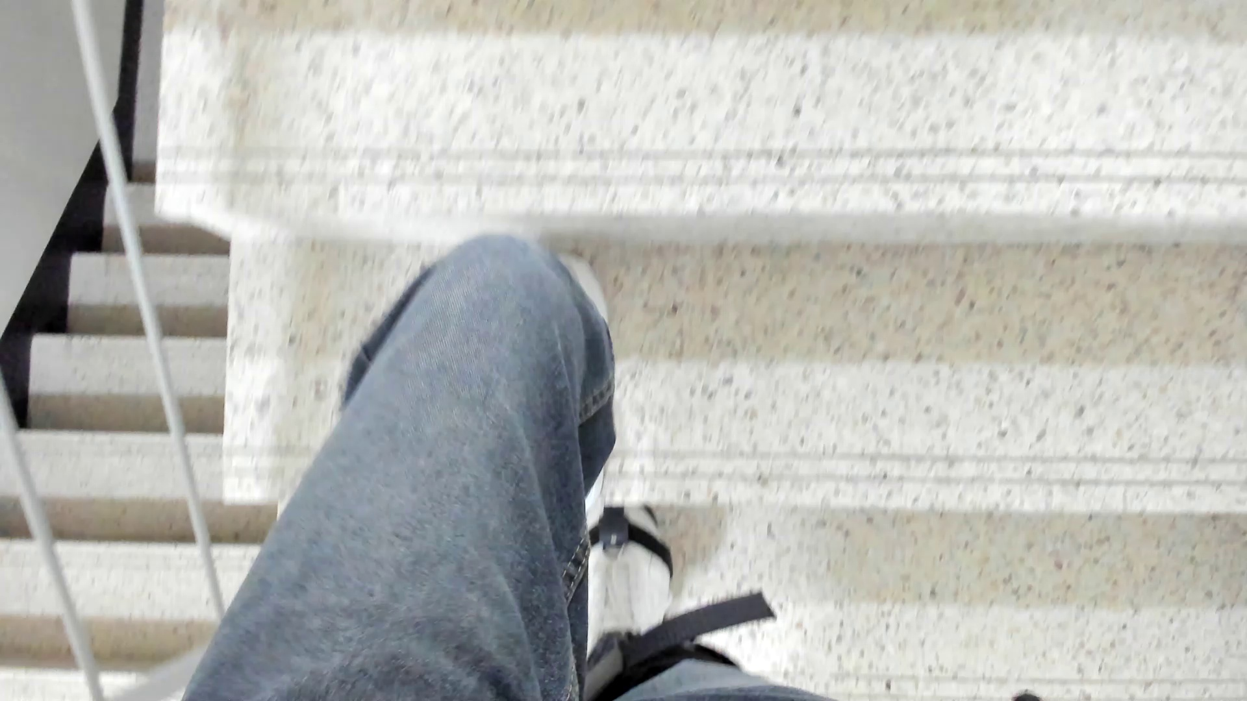
i+10
LG
feature
frame (i)
LSTM
LSTM
softmax
YOLOv8
DC
LSTM
LSTM
IC
input image
frame (i)
environment classification
LSTM1
layer
LSTM2
layer
class
(3)
feature sequence
(10,8)
fully connected layer
(128)
output feature
(8)
[class probability, top 1 class]

Slide 5
input image
frame (i)
environment classification
YOLOv8
output feature (8)
[class probability, top 1 class]
i+10
LG
feature
frame (i)
feature
frame (i)
LSTM
LSTM
softmax
DC
LSTM
LSTM
IC
feature sequence
(10,8)
LSTM1 layer
LSTM2 layer
class
(3)
fully connected layer
(128)

Slide 6
output feature
(8)
[class probability, top 1 class]
input image
frame (i)
environment classification
i+10
feature
frame (i)
YOLOv8
feature sequence
(10,8)
LSTM
LSTM1 layer
LSTM
LSTM
LSTM2 layer
LSTM
fully connected layer
(128)
softmax
LG
DC
IC
class
(3)

Slide 7
feature
frame (i)
LSTM
YOLOv8
input image
frame (i)
environment classification
environment
class
LSTM1 units
output feature
(8)
[class probability, top 1 class]
feature sequence
(10,8)
fully connected layer
(128)

Slide 8
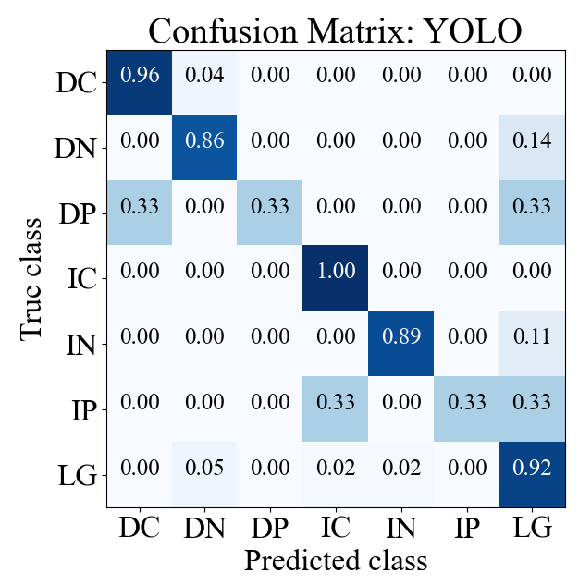
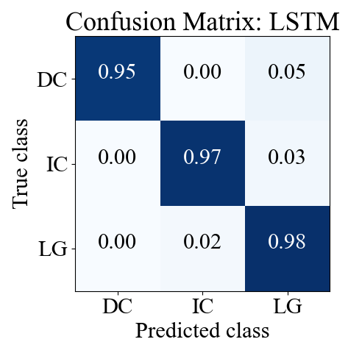
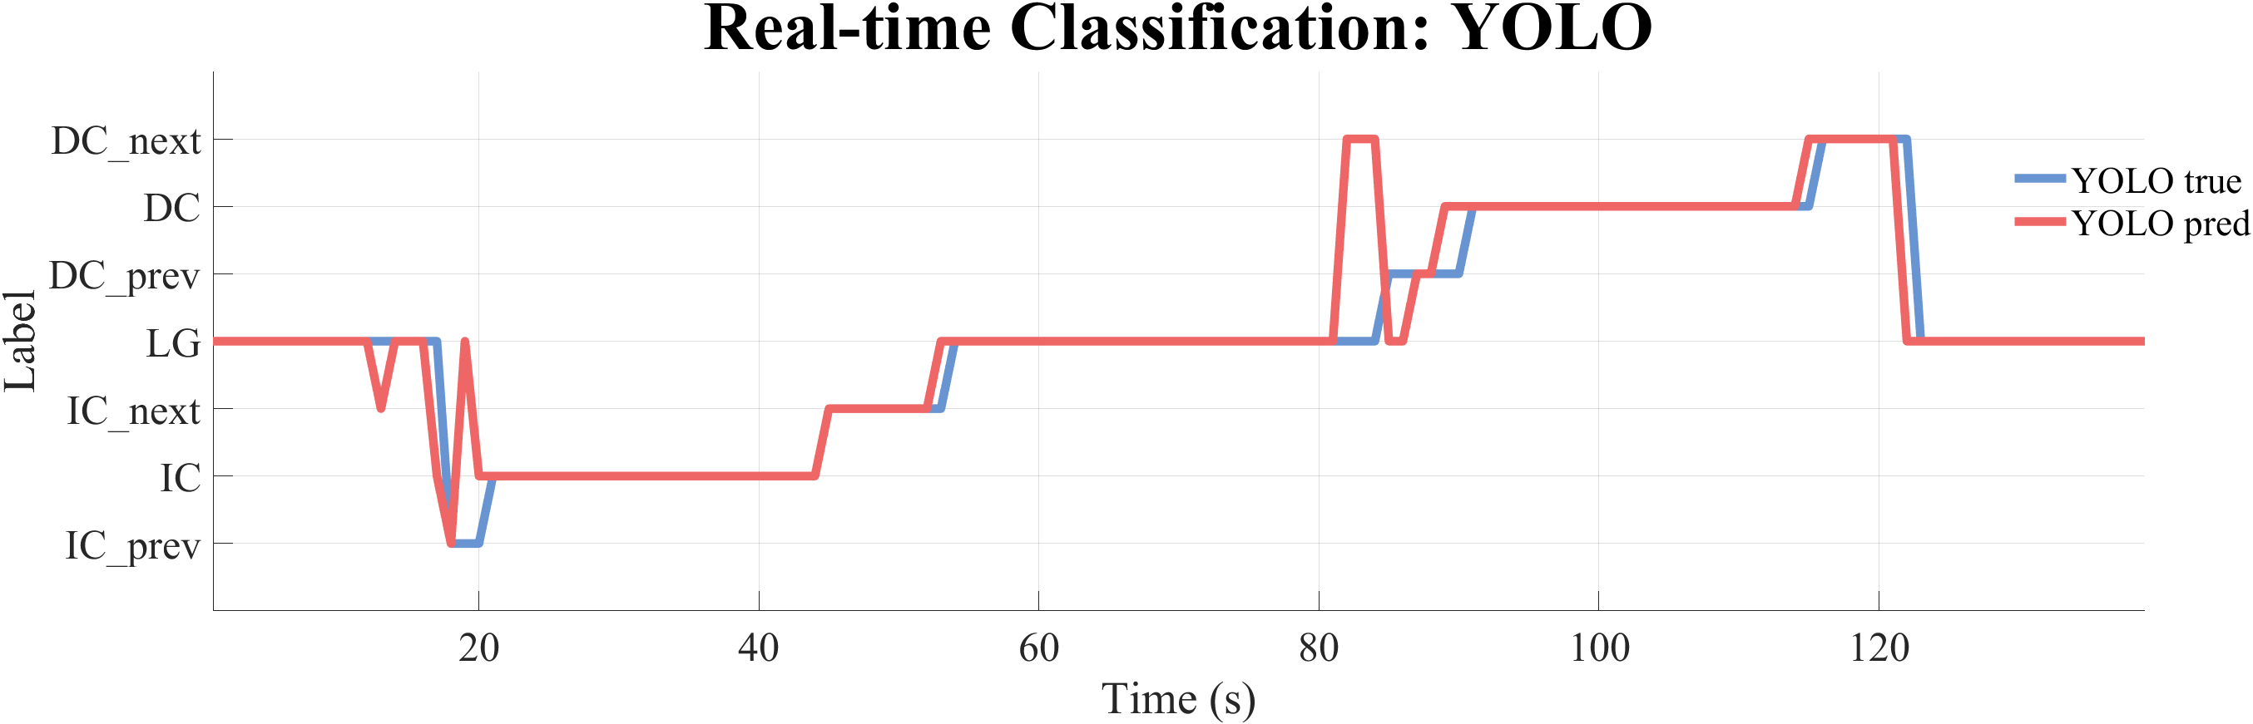
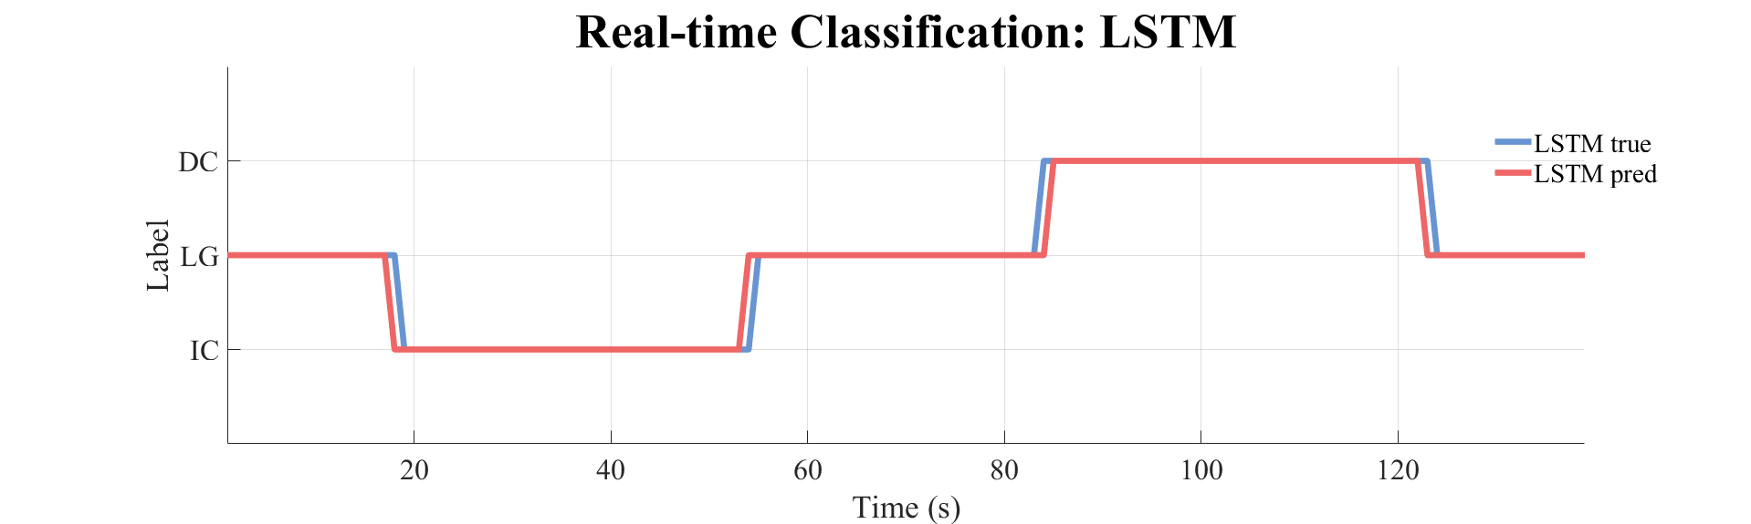
(A)
(B)
(C)
(D)

Slide 9
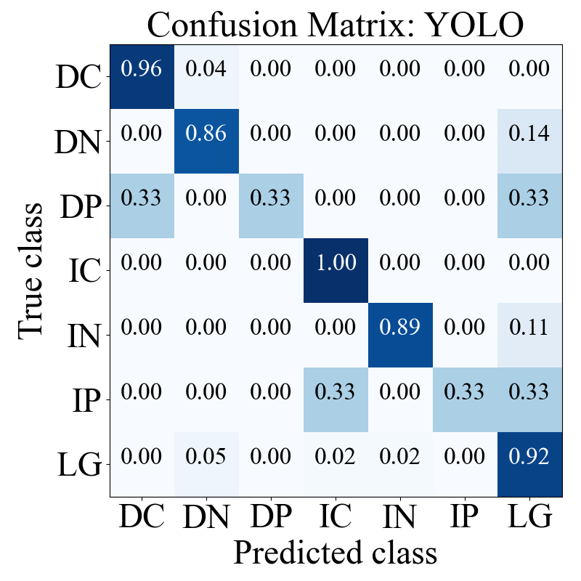
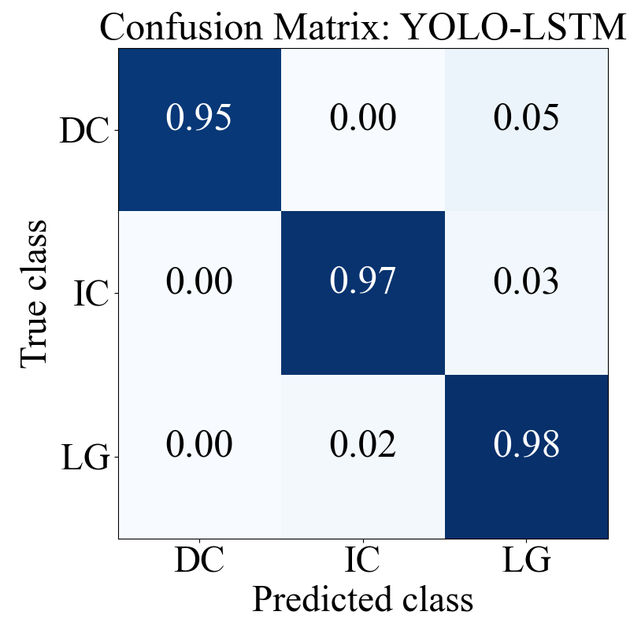
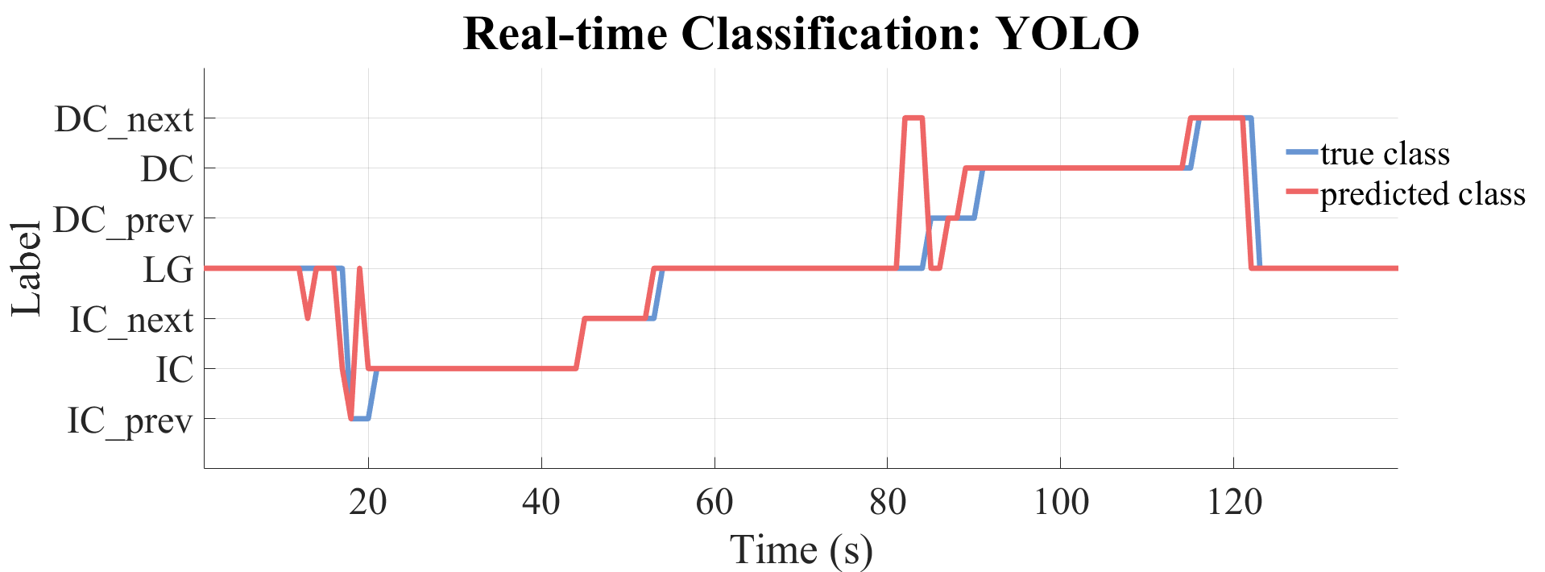
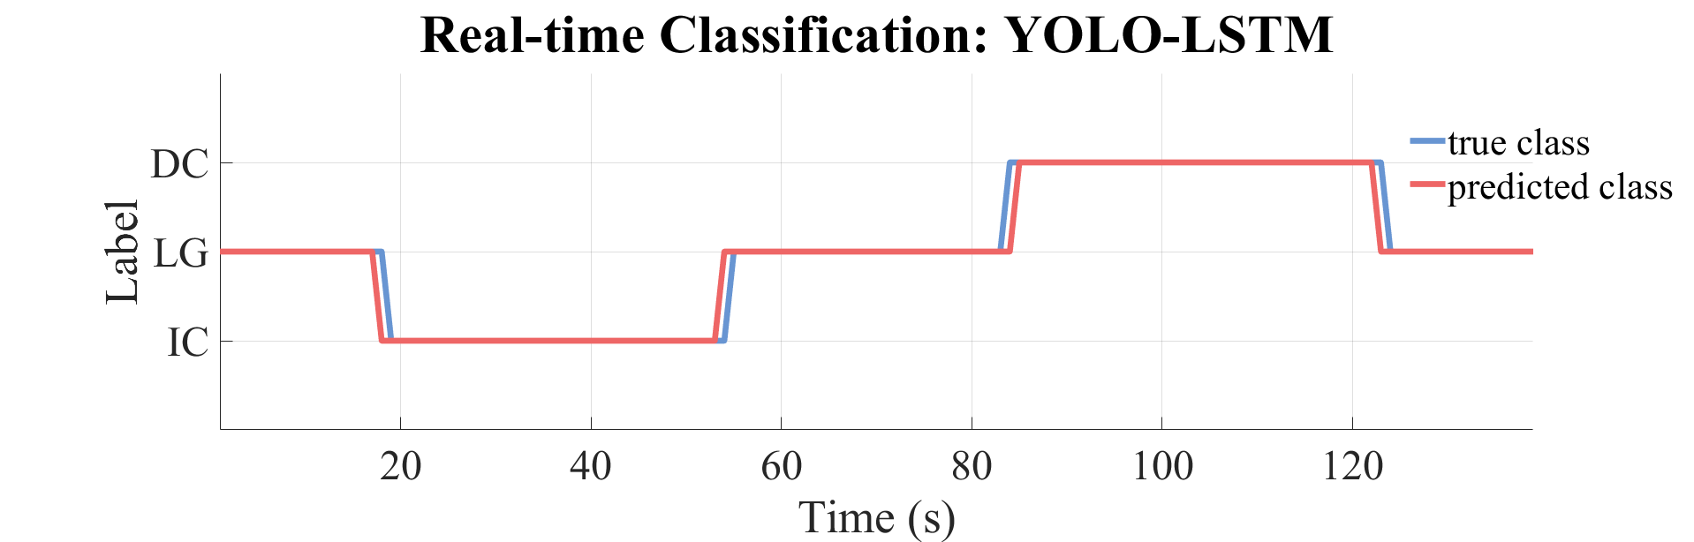
(A)
(B)
(C)
(D)

Slide 10
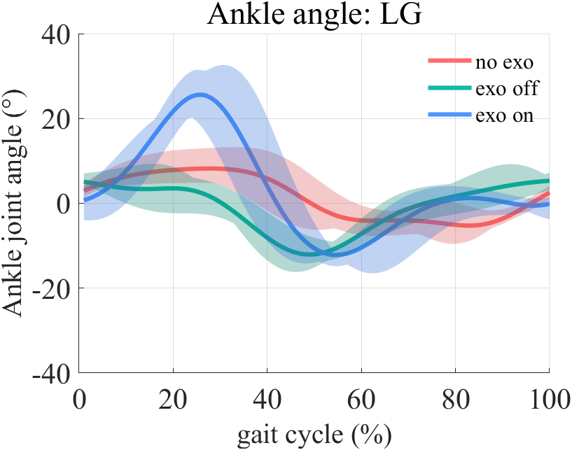
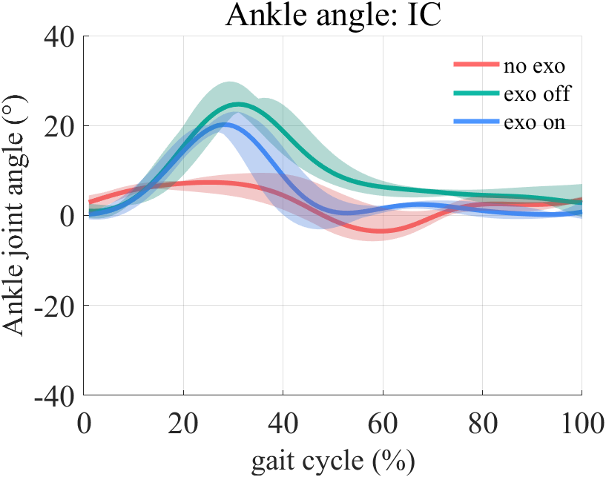
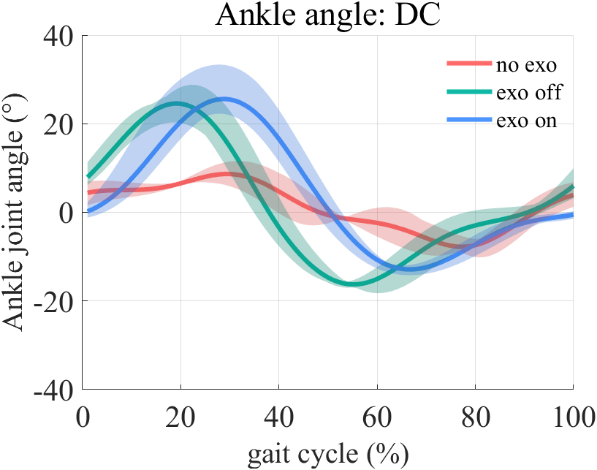
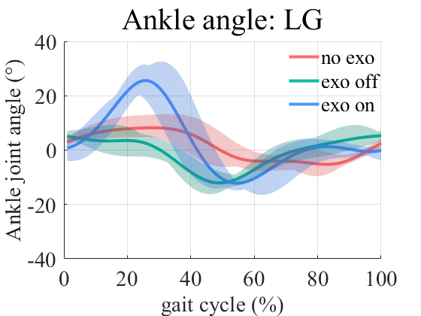
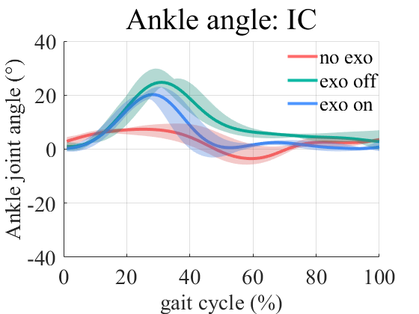
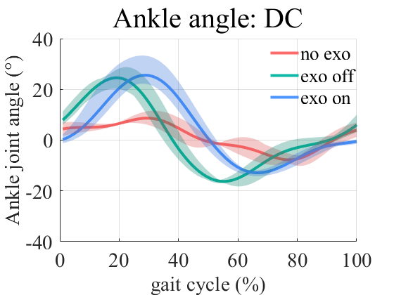
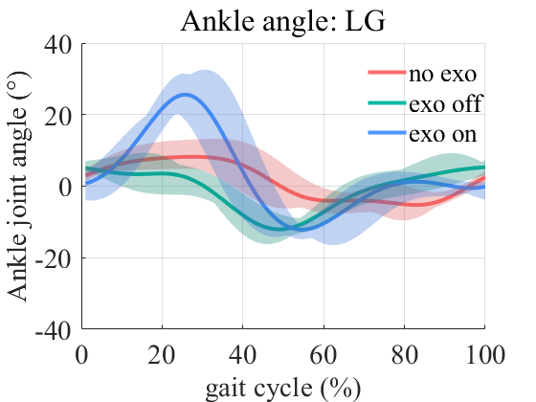
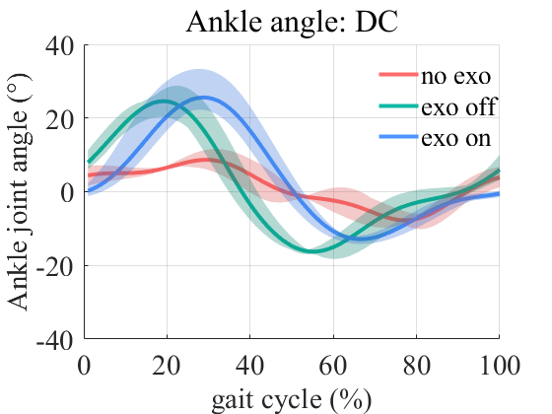
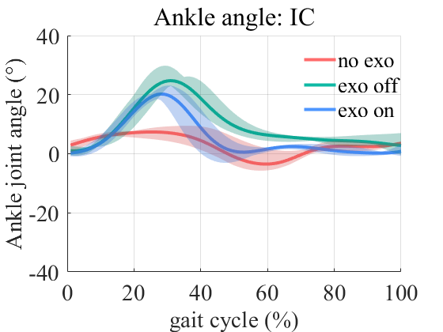
(A)
(B)
(C)
(A)
(B)
(C)
(A)
(B)
(C)

Slide 11
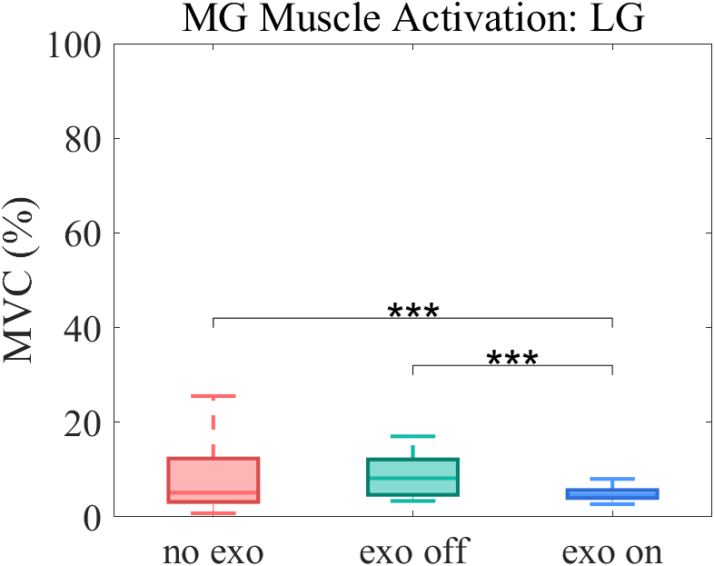
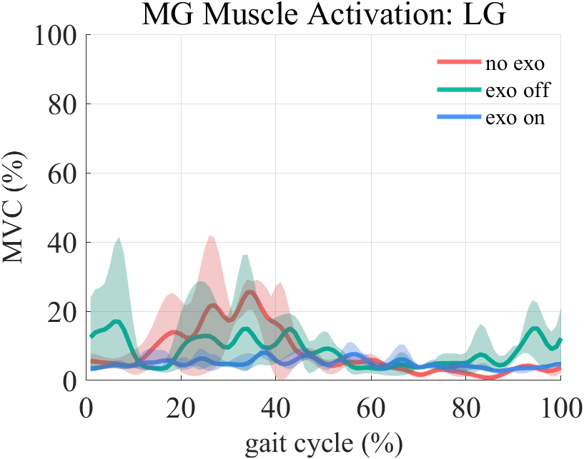
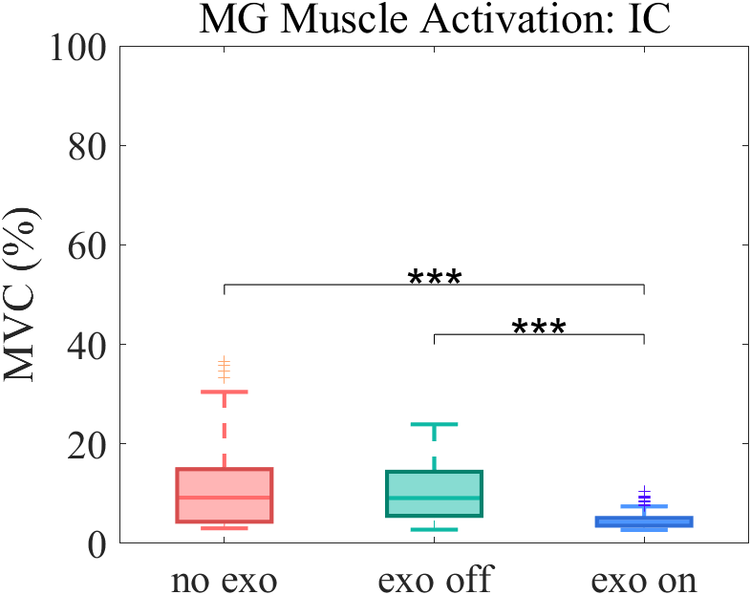
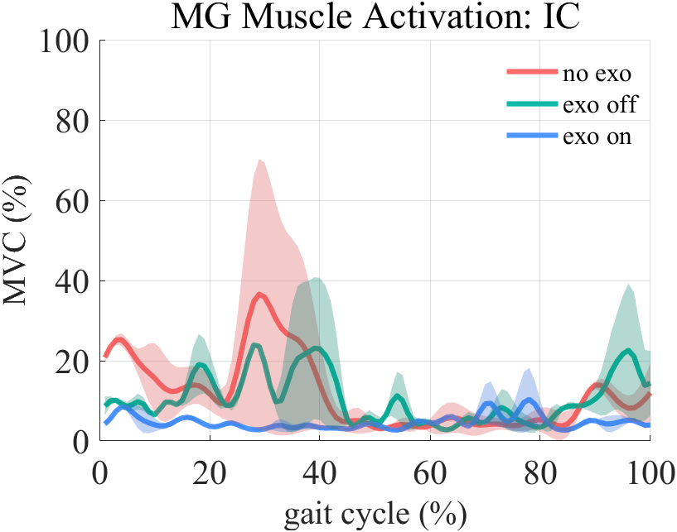
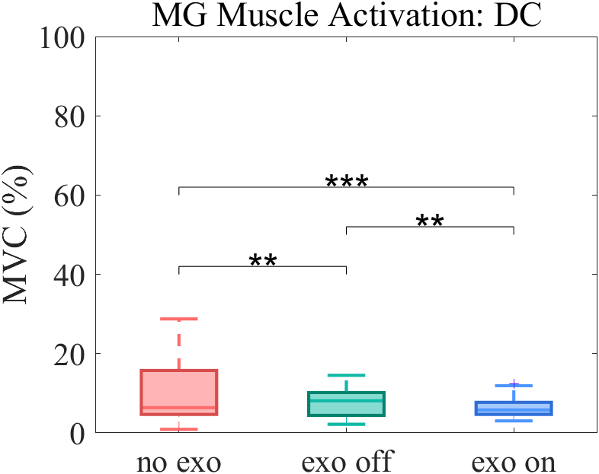
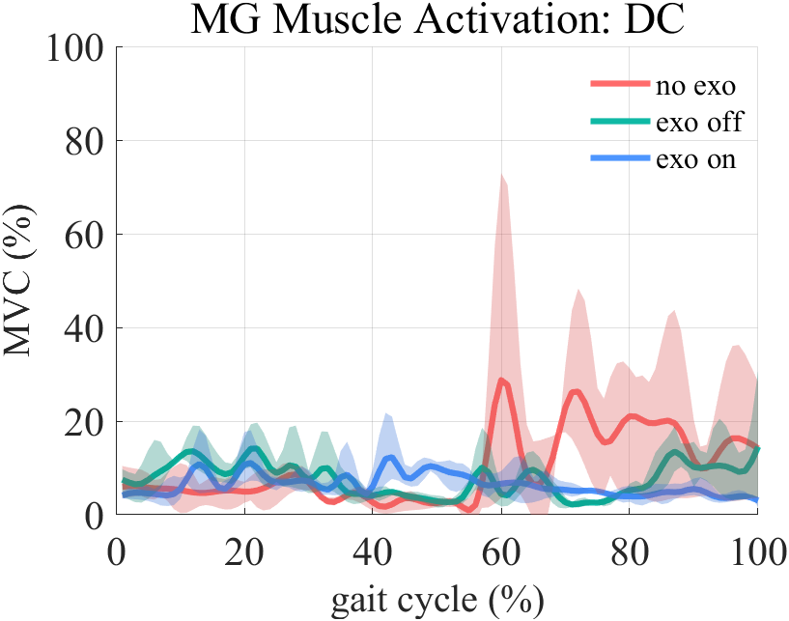
(A)
(B)
(C)
(D)
(E)
(F)

Slide 12
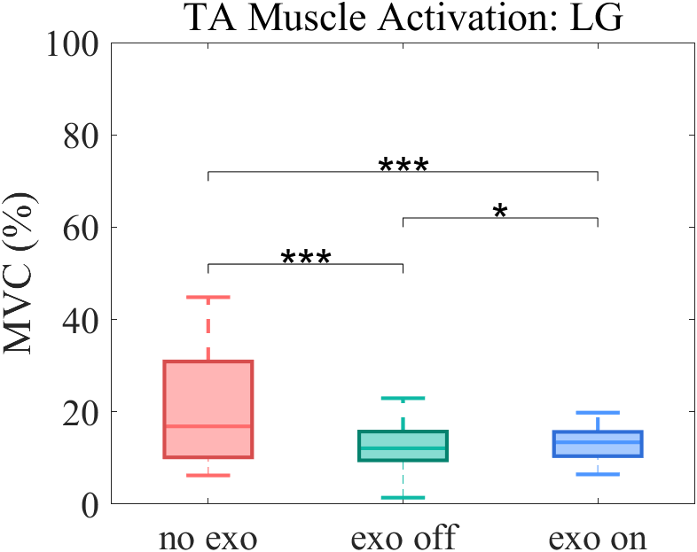
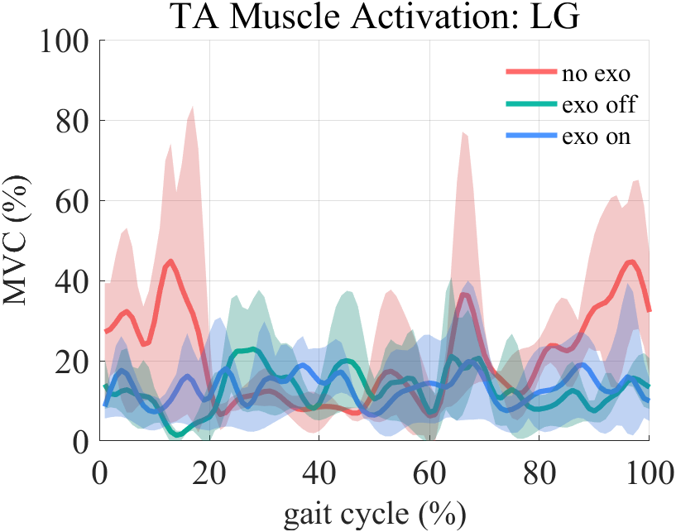
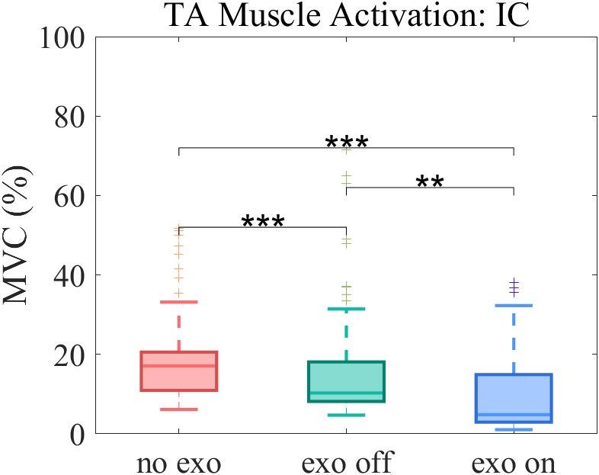
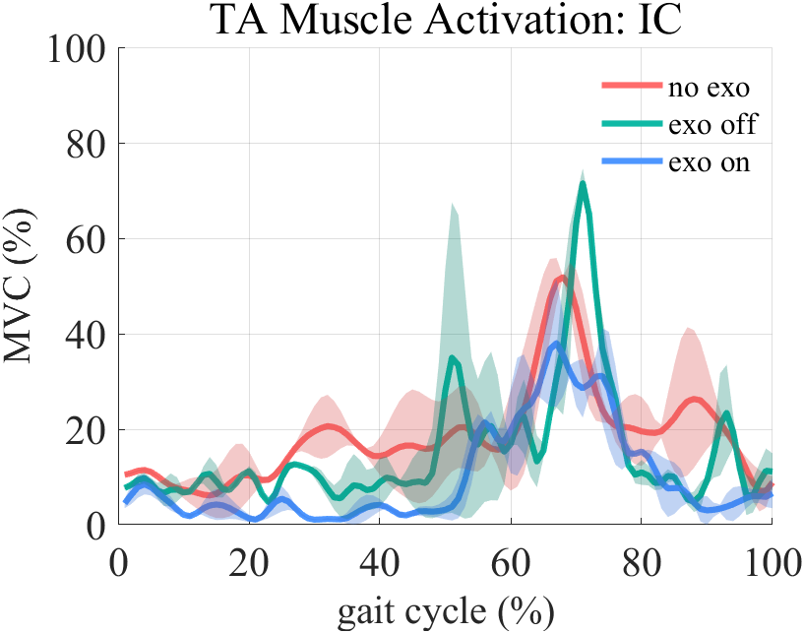
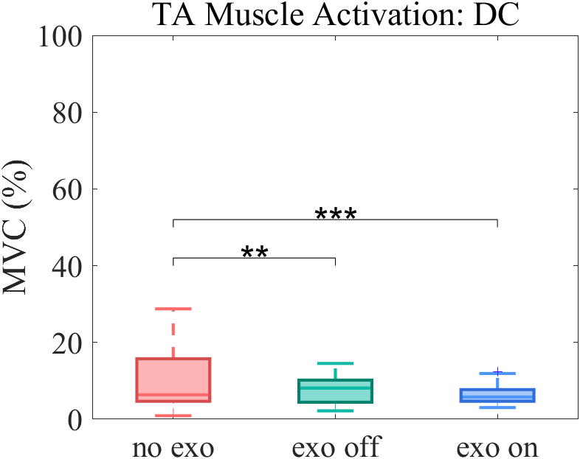
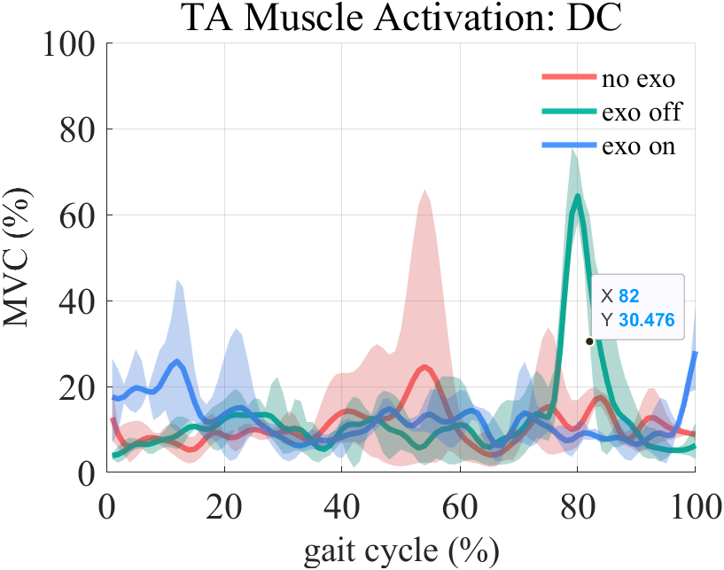
(A)
(B)
(C)
(D)
(E)
(F)

Slide 13
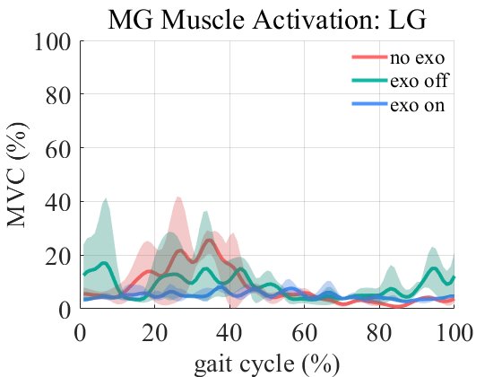
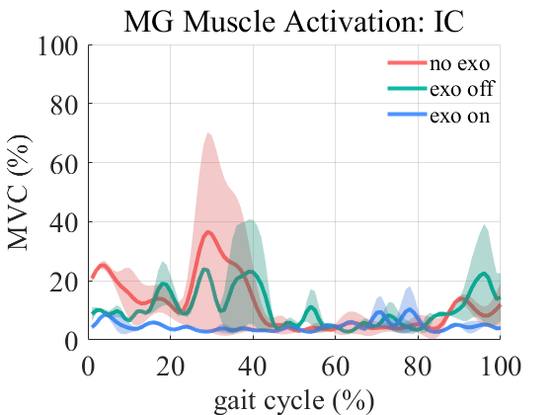
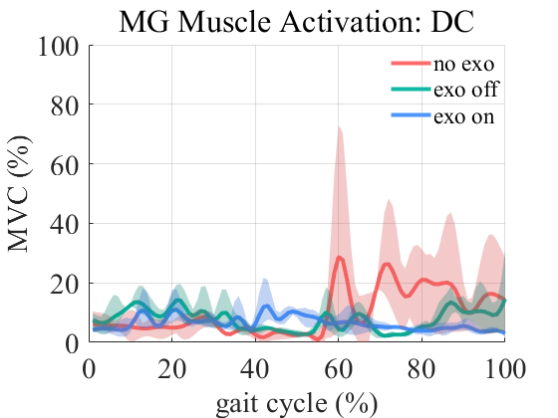
(A)
(B)
(C)
(D)
(E)
(F)

Slide 14
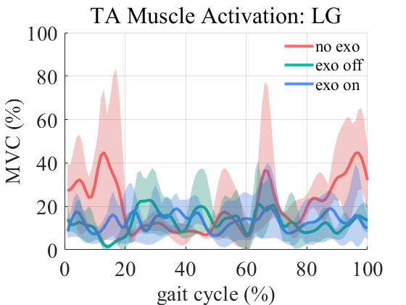
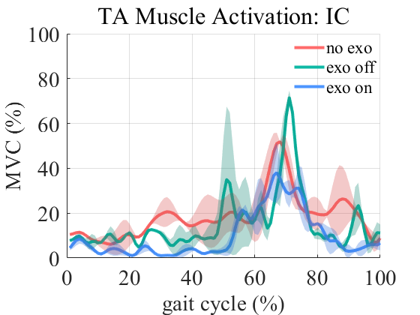
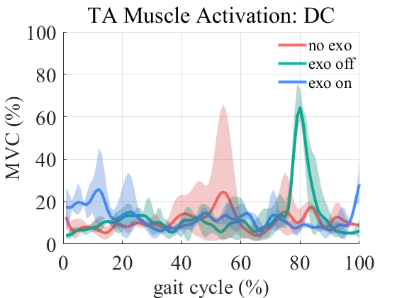
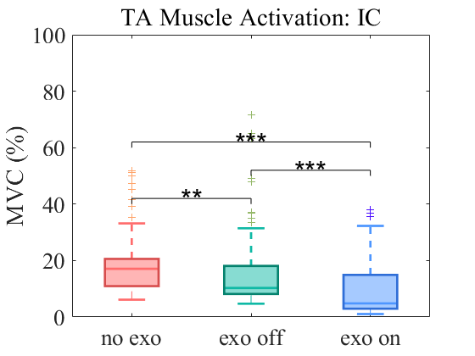
(A)
(B)
(C)
(D)
(E)
(F)

