Slide 1
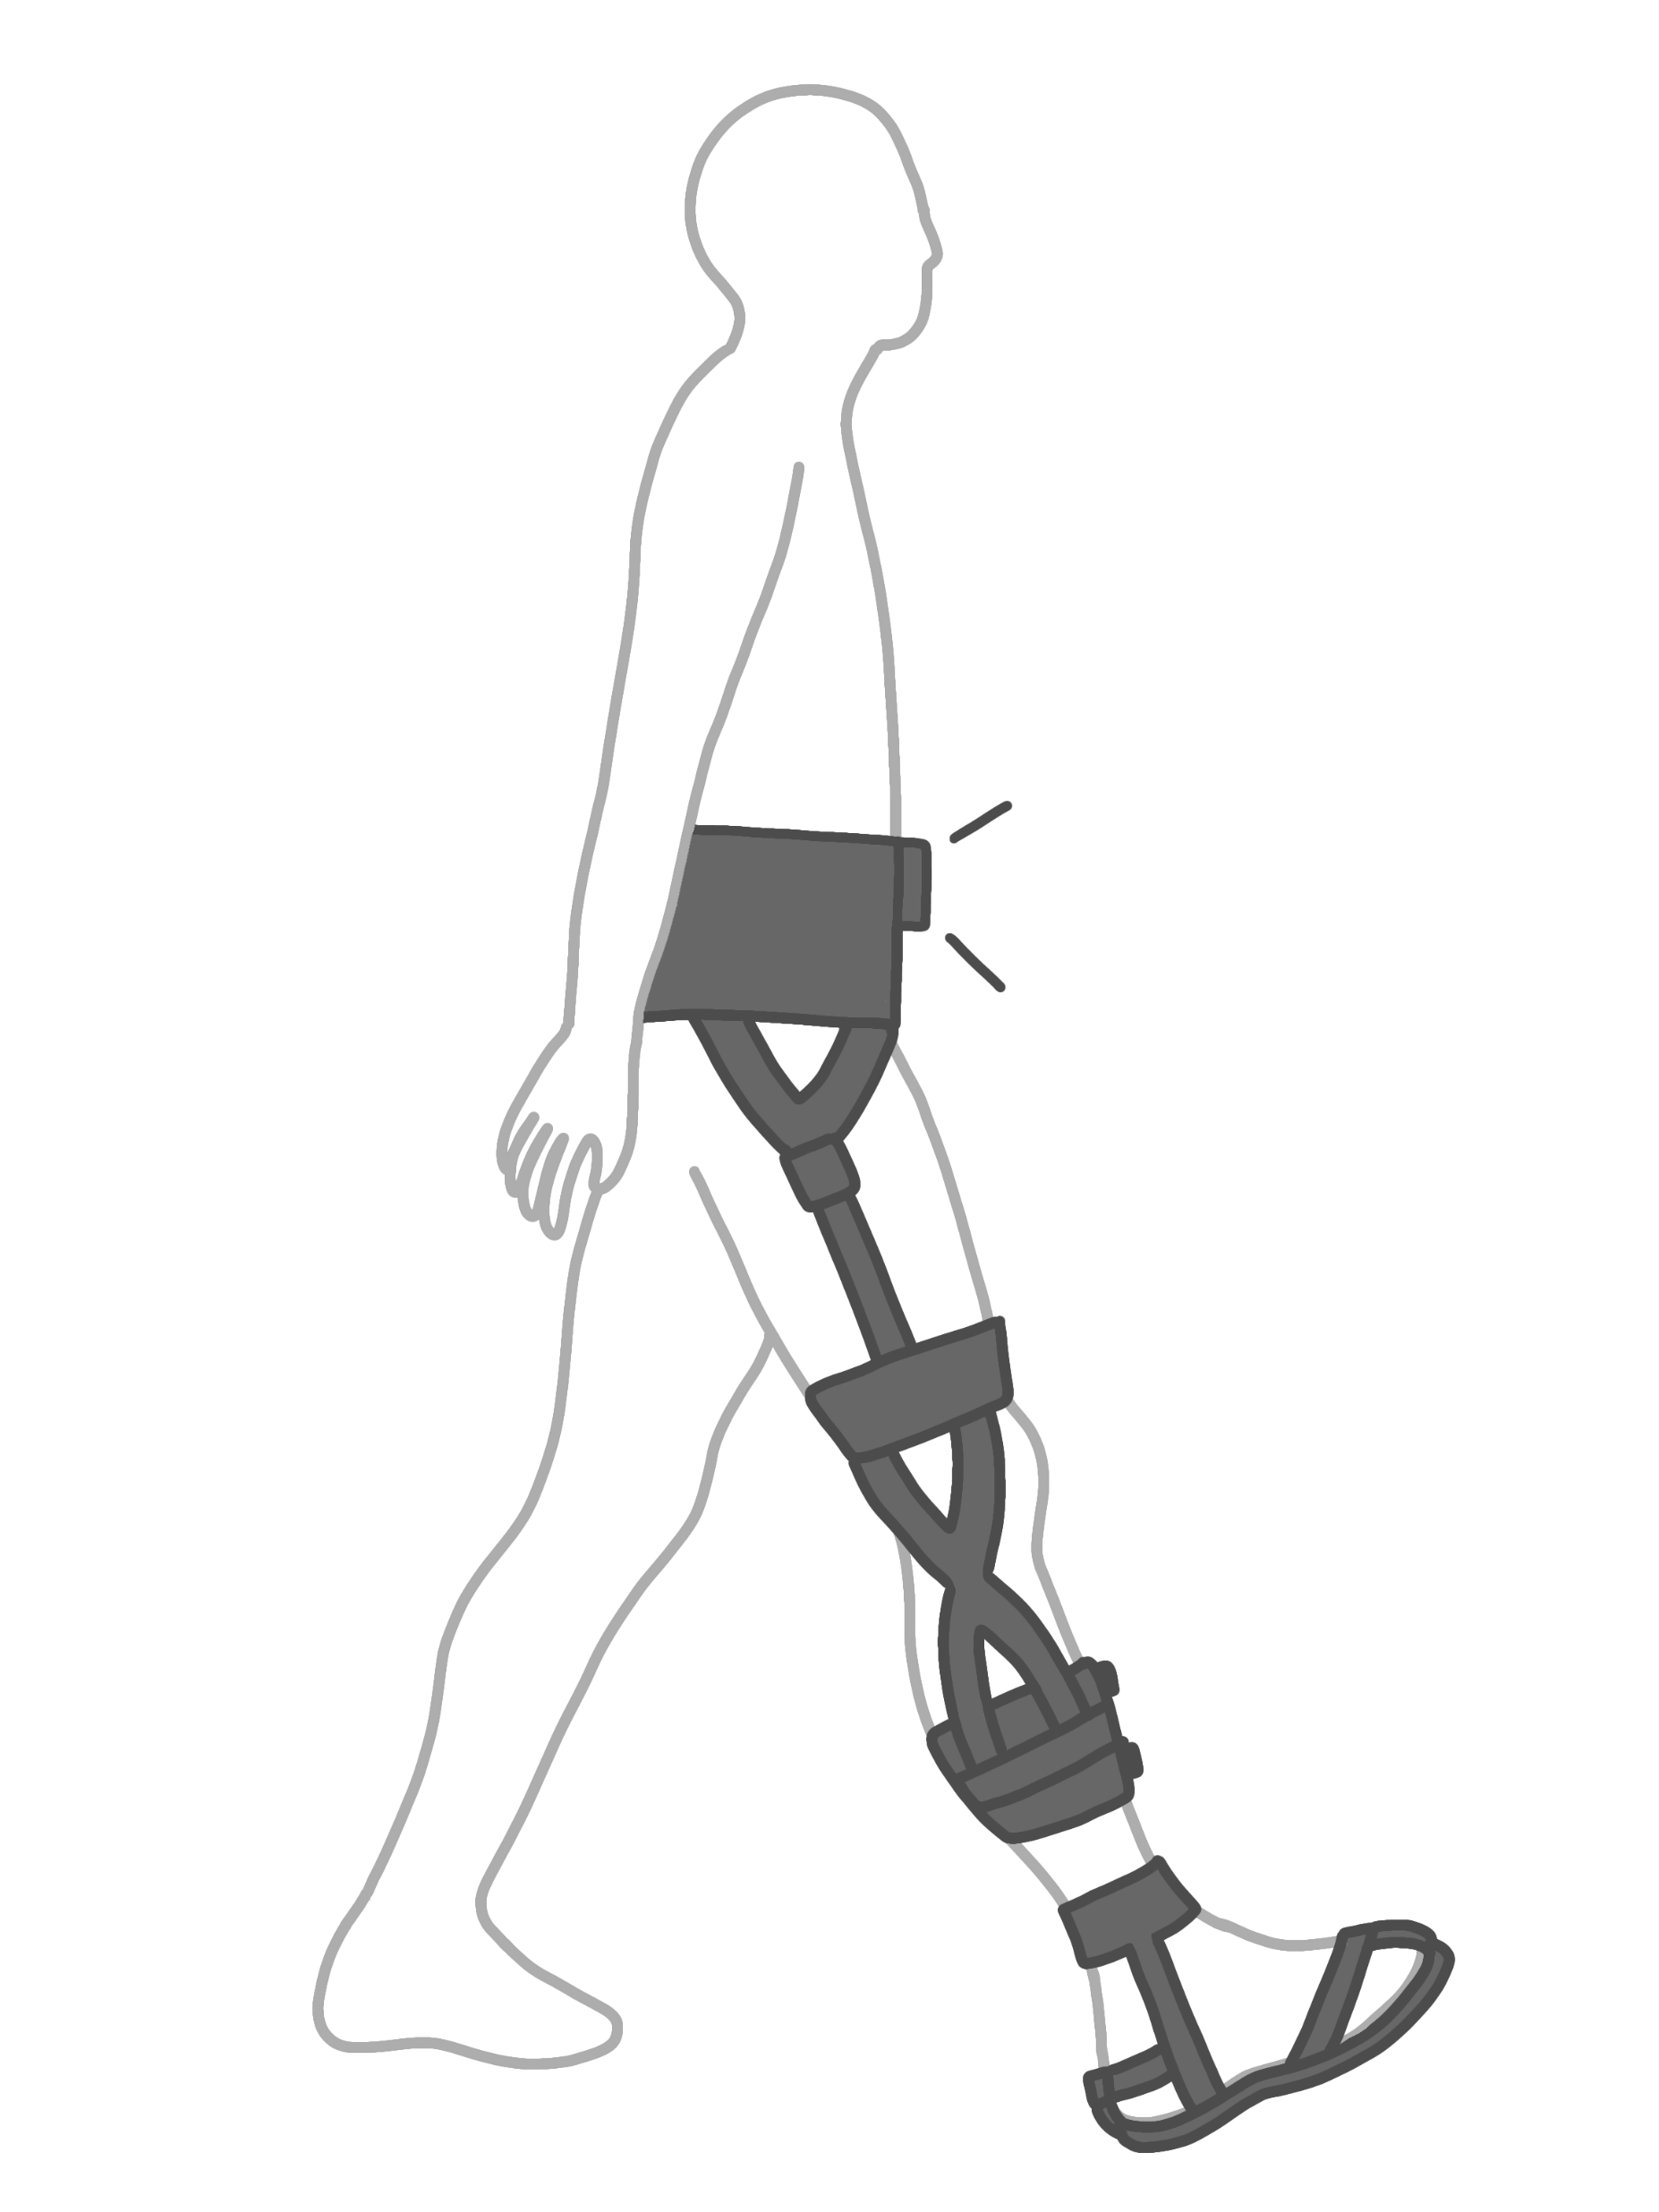
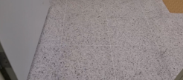
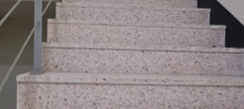




발목 착용형 보조 로봇
비전 인공지능 모델
지능형 보행 환경 감지 알고리즘 개발
데이터 수집
인공지능 모델 개발
데이터 수집
보행 주기 분석
IMU 기반 보행 보조 제어

Slide 2
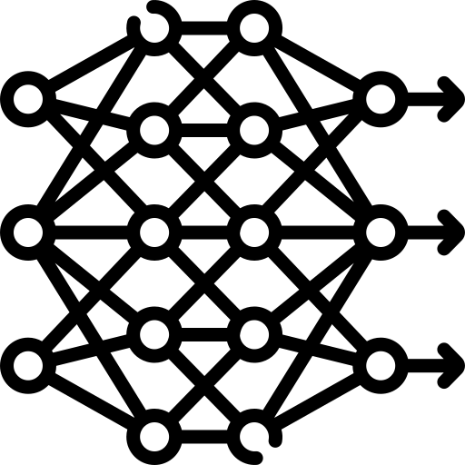
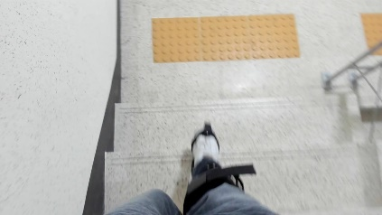
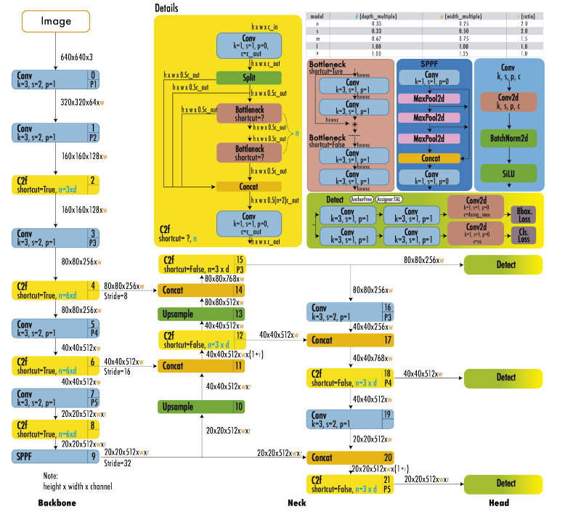
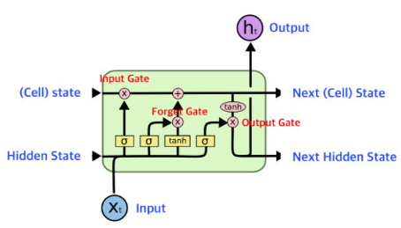
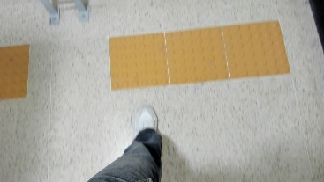
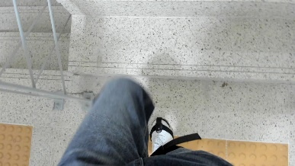

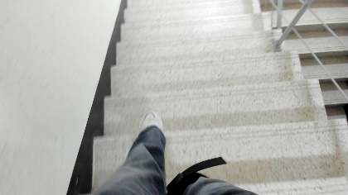
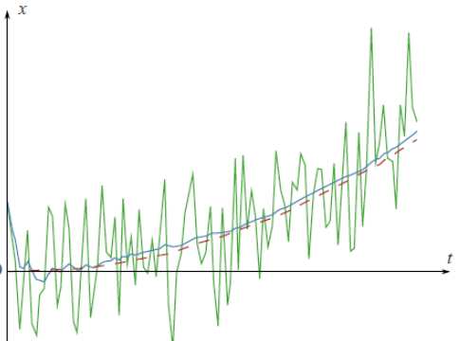
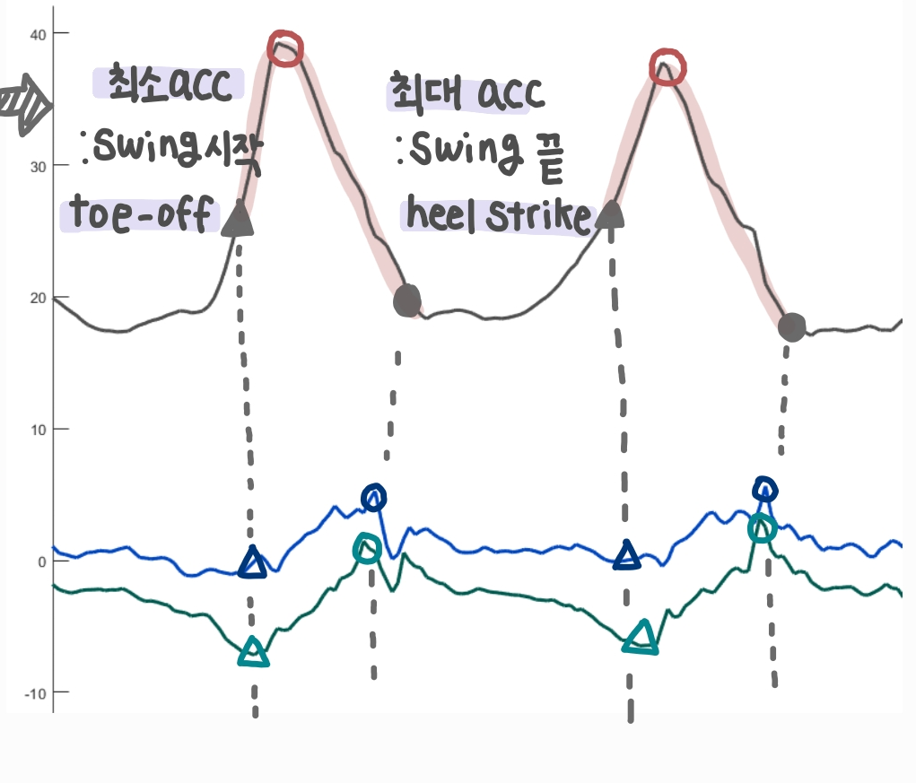

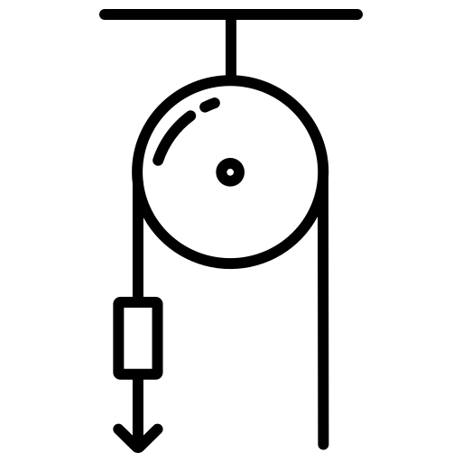
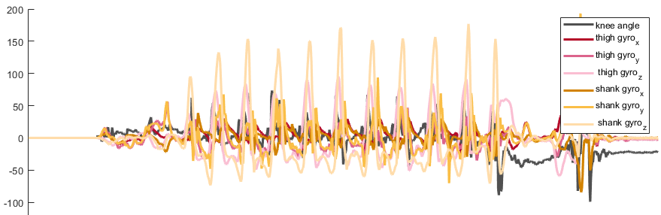
environment recognition
exosuit
scenario class
: [0,1,2,3,4,5,6]
camera
environment class
+ probability
frame
yolo v8
image classification
LSTM
temporal feature extraction
IMU sensor
acc_x, gyro_z
noise filtering
gait phase detection
motor reference trajectory
position-based control
gait phase detection
high-level controller
mid-level controller
low-level controller

Slide 3
environment recognition
exosuit
environment class
:[0,1,2,3,4,5,6]
camera
frame
yolo v8
image classification
LSTM
temporal feature extraction
IMU sensor
motor reference trajectory
position-based control
특정 environmen의 gait cycle (%)
- ex) stair incline의 gait cycle 8%
acc_x, gyro_z
noise filtering
shank & thigh: acc_x, gyro_z
gait phase detection
high-level controller
mid-level controller
low-level controller

