Slide 1
Machine learning introduction
Part I – From neurons to networks
2 - The Formal Neuron
Simon Gay
Github : https://github.com/gaysimon/ARTISAN2022

Slide 2
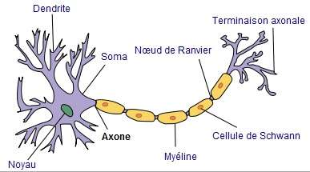

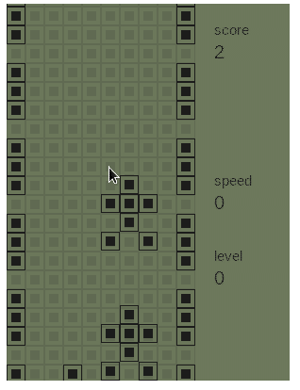
Part I-2 : the formal neuron
A simplified model of the neuron:
  The biological neuron:
    Dendrites collect input signals
    The body processes these signals
    An axon conveys the output signal
    Information is encoded with impulses (frequency)
  The model must be simplified to work on a computer:
    /!\ The model of the formal neuron is a VERY simplified model of the biological neuron
https://github.com/tshiamobhuda/Racing

Slide 3
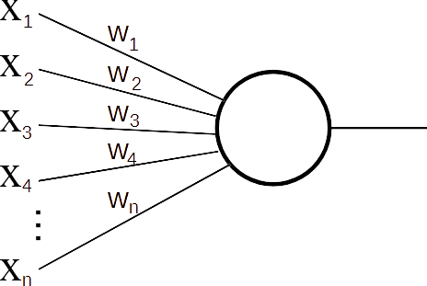
Part I-2 : the formal neuron
A simplified model of the neuron:
  The biological neuron:
    Dendrites collect input signals
    The body processes these signals
    An axon conveys the output signal
    Information is encoded with impulses (frequency)
  The model must be simplified to work on a computer:
    Frequency is replaced with a real value
    Input: a vector of real values
      Vector X = { x1, x2, x3, … , xn }
    A vector of real values replace synapses
      Vector W = { w1, w2, w3, … , wn }

Slide 4
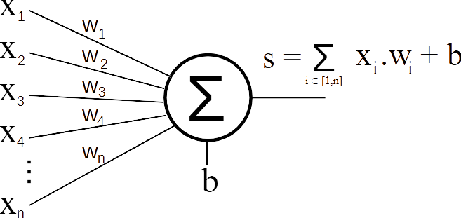
Part I-2 : the formal neuron
A simplified model of the neuron:
  The biological neuron:
    Dendrites collect input signals
    The body processes these signals
    An axon conveys the output signal
    Information is encoded with impulses (frequency)
  The model must be simplified to work on a computer:
    Input processing:
      Sum of inputs weighted by
      synaptic weights
      A bias b

Slide 5
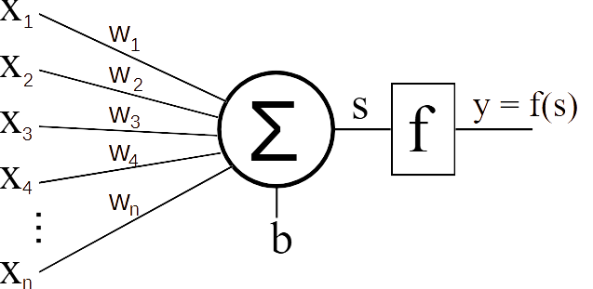
Part I-2 : the formal neuron
A simplified model of the neuron:
  The biological neuron:
    Dendrites collect input signals
    The body processes these signals
    An axon conveys the output signal
    Information is encoded with impulses (frequency)
  The model must be simplified to work on a computer:
    The output pass through an activation function
      Limits the neuron’s output value

Slide 6
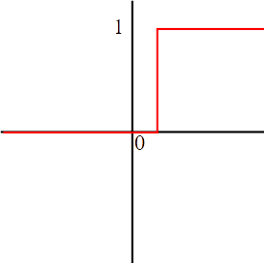
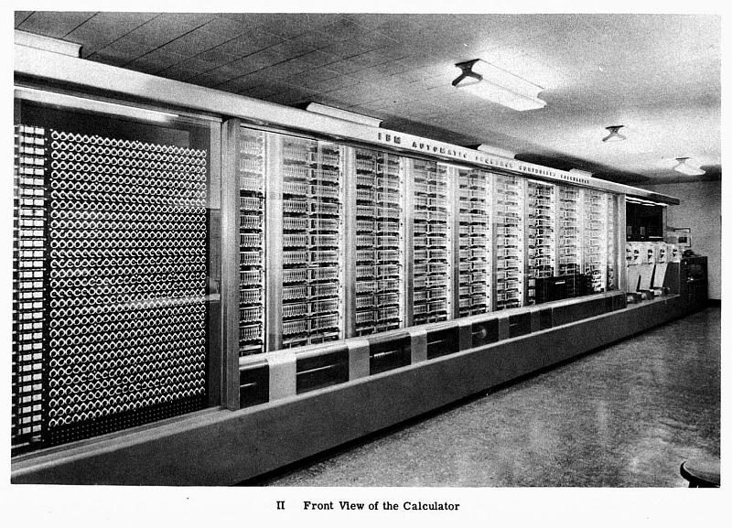
Part I-2 : the formal neuron
The activation function
  Threshold function : S = 1 when y>threshold
  S = 0 otherwise
  (note: The threshold value is not important due to the bias)
  Function used in the first neuron models (proposed by Warren McCulloch and Walter Pitts in 1943)
  Several limitations:
    Neurons’ outputs cannot be compared
    In a network, output “strength” cannot be transmitted to other neurons

Slide 7
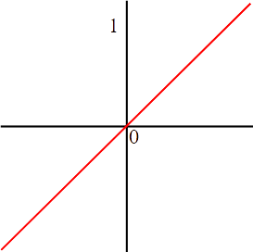
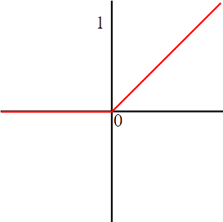
Part I-2 : the formal neuron
The activation function
  Linear functions and ReLU (Rectified Linear Unit)
    y = x
    y = max(0,x)
  Very simple functions
  ReLU allows removing negative values
    Often used in deep learning approaches
  The output value can be greater than 1 (Weighted sum s must approach 1)
  Constant gradient (variations of a weight have the same effect on the output)

Slide 8
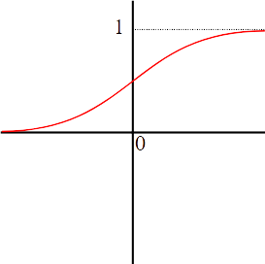
Part I-2 : the formal neuron
The activation function
  Sigmoid function
    (note: the tanh function is also used)
  More complex functions
  High values provide an output close to 1 (or 0 for negative values)
  The gradient tends to 0 for high values
    Stabilization of weights (variations become weaker and weaker)
    But we lose the gradient (can be problematic when using multiple layers)
  Another great advantage (we will see this later)

Slide 9
Part I-2 : the formal neuron
Methods for supervised learning
  Hebb rule (1949) : “cells that fire together, wire together” (biological observations)
    wi^{t+1} = wi^{t} + α . xi . r : if result r and input xi have same sign, weight wi is reinforced
    α Is the learning rate (limiting weights variations)
  Delta rule : weights are modified according to the output error :
  Δ = r – y
    Perceptron rule (Rosenblatt, 1957) : use threshold activation function, thus Δ ∈ { -1 ; 0 ; 1 }
    Widrow-Hoff rule (1960) : continuous activation functions, thus Δ ∈ ℝ
  → Weights are modified to makes the output closer from expected result
    principles: modify each weight wi according to :
      The input value (a higher value will have a greater influence on the output)
      The difference ( Δ ) between output and expected result (the greater the difference, the more the weights must be modified)
    wi^{t+1} = wi^{t} + α . xi . Δ
  Neurons are trained on large number of examples

Slide 10
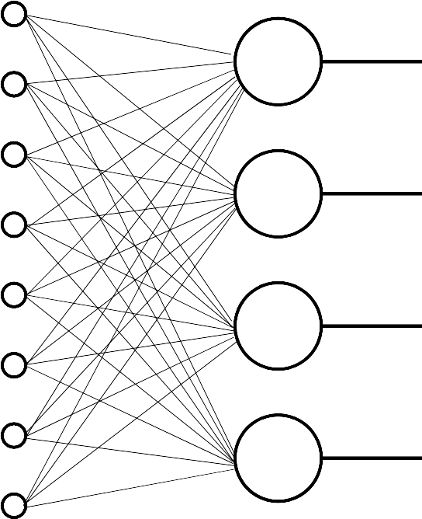
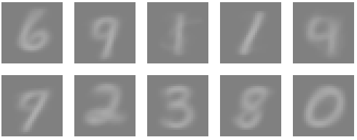
Part I-2 : the formal neuron
...And some for unsupervised learning
  Winner-Takes-All :
    Multiple neurons in competition
    The neuron with highest input inibates others
    Weights are modified until convergence
  Grossberg rule :
    Neuron with highest output update its weights
    to get closer to the input vector
  Progressively, the grooup of neurons
  define classes of input vectors
Xk
Y
Res
0,235
0
0,128
0
0,567
1
0,432
0

Slide 11
Part I-2 : the formal neuron
  Enough with theory, now to practice!
Github : https://github.com/gaysimon/ARTISAN2022

Slide 12
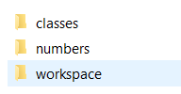
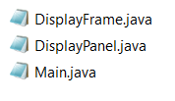
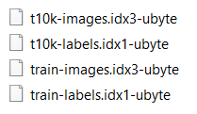
Part I-2 : the formal neuron
The Workspace
  Create a ‘Workspace’ folder somewhere (e.g. in ‘my documents’ or ‘Desktop’)
  Create a folder ‘classes’ and a folder ‘numbers’ beside your workspace folder
  Download the 3 files at https://github.com/gaysimon/ARTISAN2022/tree/main/classes
    Click on green button ‘ Code ’ then ‘Download Zip’
    Unzip the three files in ‘classes’ folder
  Download the 4 dataset files at http://yann.lecun.com/exdb/mnist/ and unzip them in ‘numbers’ (/!\ be sure that the four files have the same name as below)

Slide 13
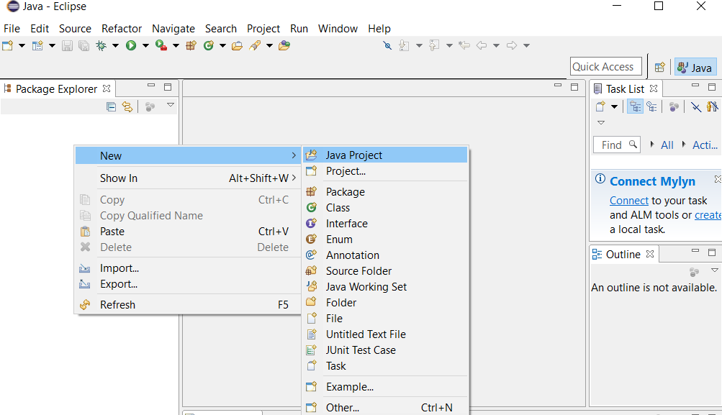
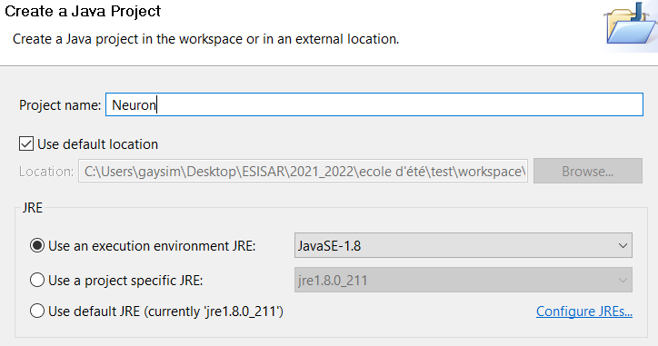
Part I-2 : the formal neuron
The Workspace
  open Eclipse and select your ‘workspace’ folder, then click on ‘Workbench’ (top right corner)
  Create a new project ‘Neuron’
    Right click in the package explorer (left part) → new → Java project
    Name your project ‘Neuron’, then click ‘Finish’

Slide 14

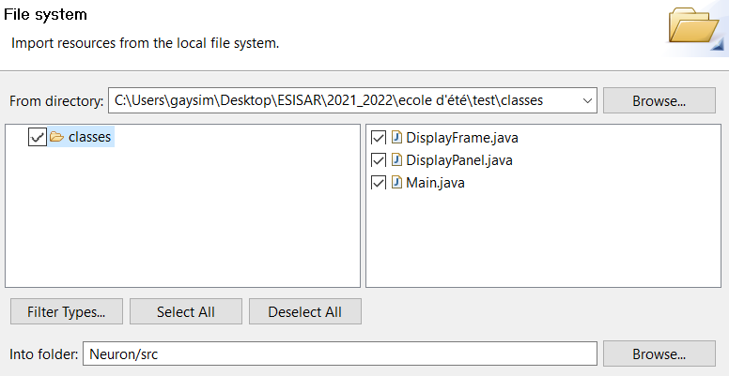
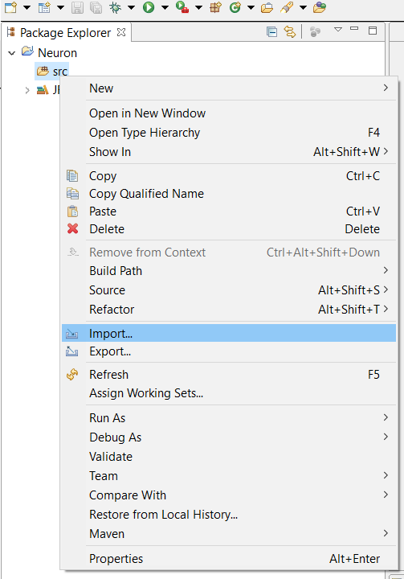

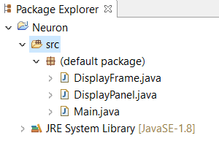
Part I-2 : the formal neuron
The Workspace
  Import the java file from the previously downloaded archive
    Expand the project in package explorer
    Right click on ‘src’ (left part) → import, then ‘general’ → ‘file system’.
    Browse to your ‘classes’ folder and select Main.java, DisplayFrame.java and DisplayPanel.java
    Click on ‘Finish’ to complete the import

Slide 15
Part I-2 : the formal neuron
The Workspace
  3 classes :
    Main.java :
      main function
      A function to load datasets (setData)
      Bases for training and exploiting a neuron
    DisplayFrame.java and DisplayPanel.java :
      Create a window to display properties of the neuron

Slide 16
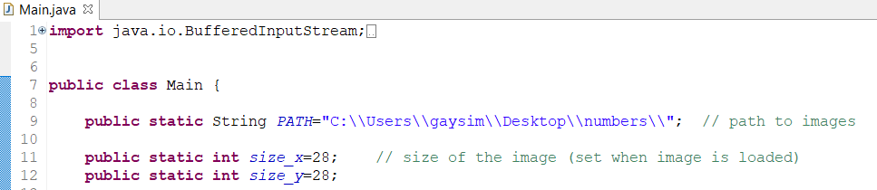

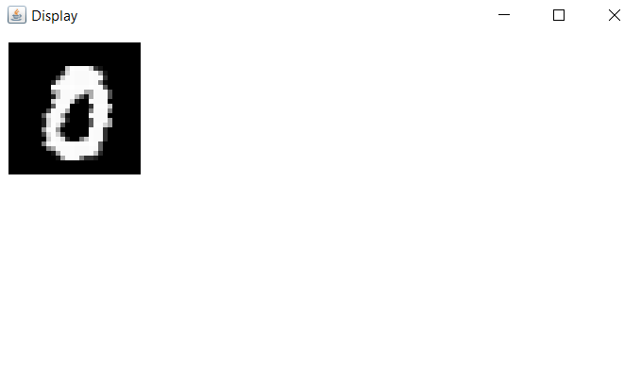
Part I-2 : the formal neuron
The Workspace
  Finally, double-click on the Main class to open it, and change the path value (line 9) to indicate the position of your ‘numbers’ folder.
    /!\ use ‘\\’ folder separator on windows and ‘/’ on Linux/Mac
  Test the application with ‘run’ button to test your installation

Slide 17
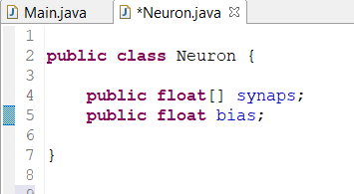
Part I-2 : the formal neuron
Creating an artificial neuron
  We will implement an artificial neuron and add it to our project
  First, create a new class in your project
    Right click on ‘default package’ → new class. Name your class ‘Neuron’
  We first implement weights and a bias

Slide 18
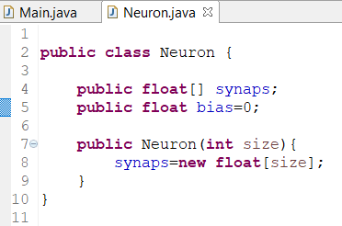
Part I-2 : the formal neuron
Creating an artificial neuron
  We then write the class constructor, and initialize the weight vector and bias
    The parameter size gives the number of weights
synaps

Slide 19
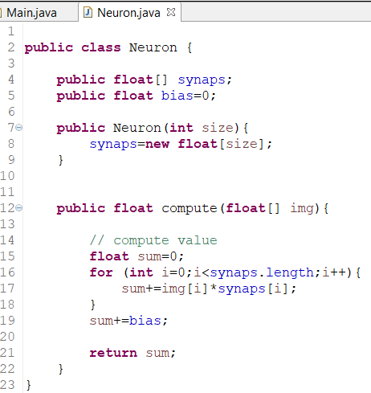
Part I-2 : the formal neuron
Creating an artificial neuron
  We add a function to compute the output of the neuron
    A vector img is used as parameter (input vector)
img
synaps
sum

Slide 20
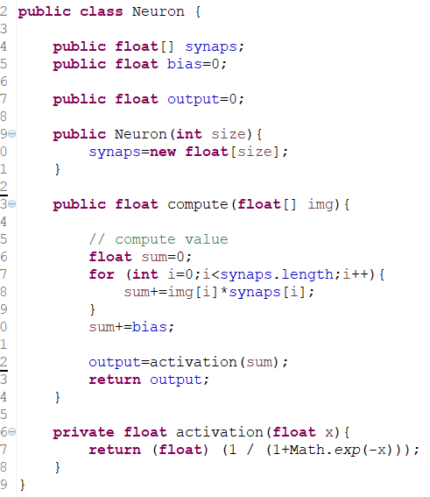
Part I-2 : the formal neuron
Creating an artificial neuron
  We forgot the activation function !
We will also
record the
output value
sum
output

Slide 21
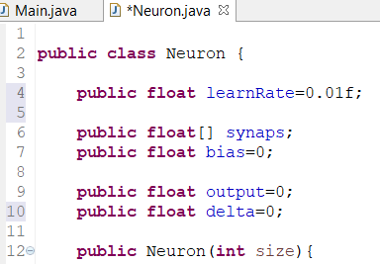
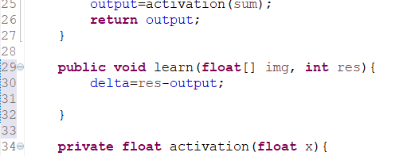
Part I-2 : the formal neuron
Creating an artificial neuron
  We then define a function to train the neuron :
    Widrow-Hoff :
      Δ = r – y → difference between expected result and output
      wi^{t+1} = wi^{t} + α . xi . Δ → each weight is updated in proportion to related input value
    First, we add the delta value and a learning rate with a value of 0,01
    Then, a learning function that computes the delta value, using input vector and expected result

Slide 22
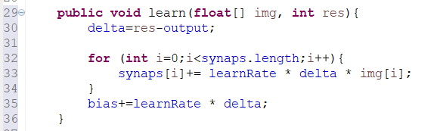
Part I-2 : the formal neuron
Creating an artificial neuron
  We then define a function to train the neuron :
    Widrow-Hoff :
      Δ = r – y → difference between expected result and output
      wi^{t+1} = wi^{t} + α . xi . Δ → each weight is updated in proportion to related input value
    Finally, the learn function update weight according to Widrow-Hoff rule :
      Don’t forget the bias !
Congratulations ! Your neuron is complete !

Slide 23
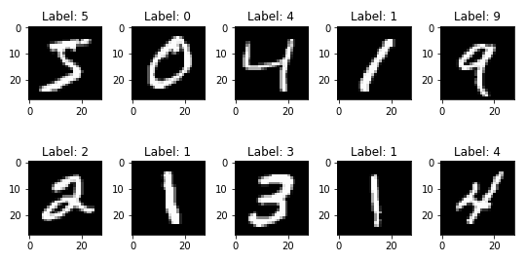
Part I-2 : the formal neuron
Training and exploiting a neuron
  We will use our neuron on a dataset called MNIST number.
    This dataset is composed of two sets of small images of 28x28 pixels of handwritten digits (0 to 9)
    A first dataset of 60 000 samples is used for training
    A second dataset of 10 000 samples is used for testing
    Each dataset is composed of two files : a file containing the pixel values of images, and a file containing the label (number) of images
    A function is provided in main class to read these files and load samples in a matrix and labels in a vector (setData)

Slide 24

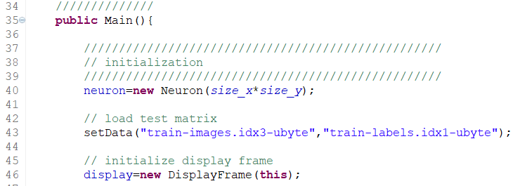
Part I-2 : the formal neuron
Training and exploiting a neuron
  In class main, uncomment the line adding the neuron as a variable
  The neuron must have a weight for each pixel of image. We thus initialize the neuron with 28x28 weights :
  The lines after load the training dataset and initialize the display window
784 inputs

Slide 25
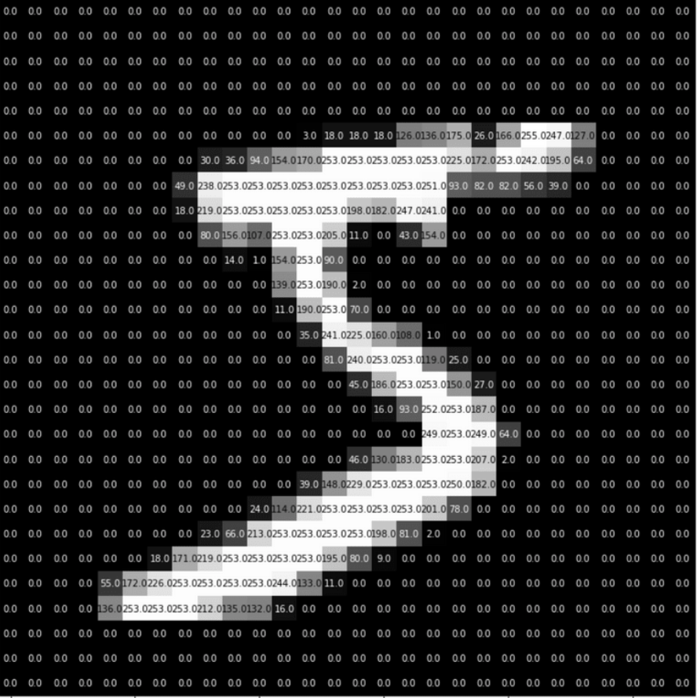
Part I-2 : the formal neuron
Training and exploiting a neuron
  The MNIST training dataset is loaded in a matrix (for the images) and a vector (for the labels)
  We will get sample images by reading the matrix line by line and the label by reading the same line on label vector
    The neuron does not consider the position of pixels on the 2D image : it gets the image as a vector of pixels !
784 pixels
28
‘5’
60000
lines
28

Slide 26
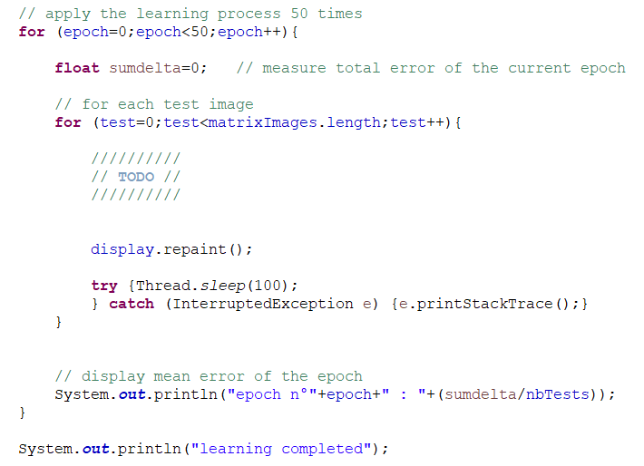
Part I-2 : the formal neuron
Training and exploiting a neuron
  We will train our neuron to recognize a digit. Choose a digit (0-9) for the number variable (you can change later)
  The training cycle works as follow :
    For each sample of the dataset
      Get next sample and its label
      Compute output value of the neuron
      Reinforce the neuron using
      expected result (delta)
  The neuron can be trained on the dataset
  multiple times to improve results. Each
  dataset cycle is called ‘epoch ‘
    We will train the neuron on 50 epoches

Slide 27
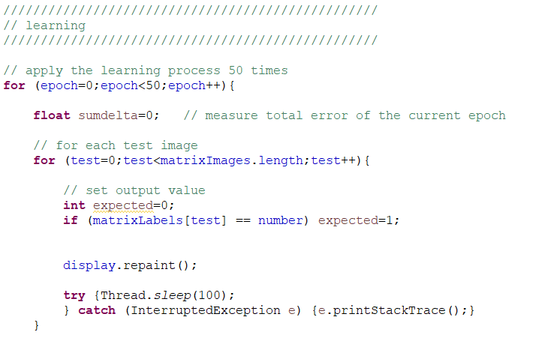
Part I-2 : the formal neuron
Training and exploiting a neuron
  First, we define the expected result : 1 when the digit is the right one, 0 otherwise

Slide 28
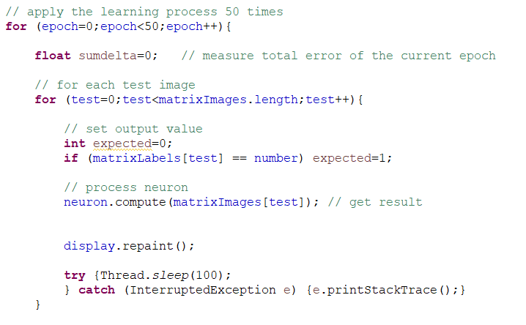
Part I-2 : the formal neuron
Training and exploiting a neuron
  Then, the neuron’s output is computed on sample image(and stored in its output variable)

Slide 29
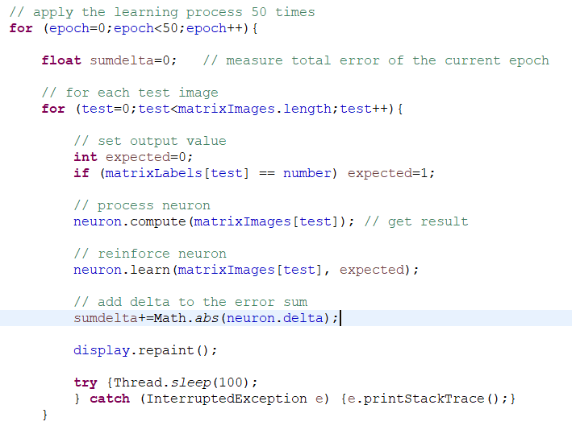
Part I-2 : the formal neuron
Training and exploiting a neuron
  Finally, reinforce the neuron. We also record the delta to observe the evolution of predictions

Slide 30
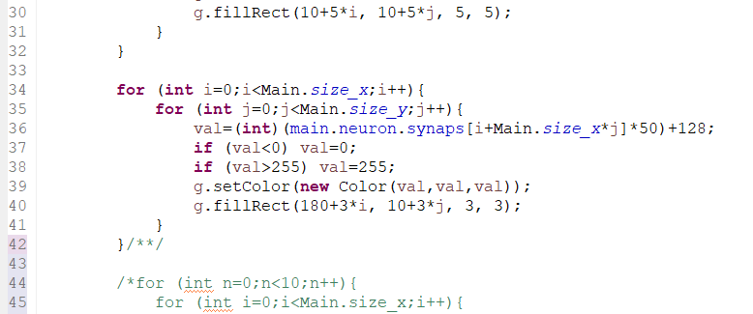
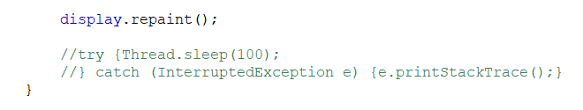
Part I-2 : the formal neuron
Training and exploiting a neuron
  In class DisplayPanel, uncomment the second part in PaintComponent procedure
  (remove ‘/*’ on line 34) to display the neuron’s weights. Then, test your application
  If the program runs correctly, comment or remove the sleep fonction in main class
What do you observe on neuron’s weights and average delta ?

Slide 31

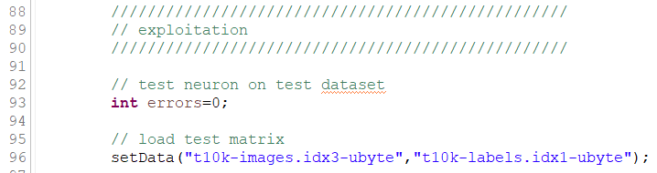
Part I-2 : the formal neuron
Training and exploiting a neuron
  The weights form the ‘average’ shape of the selected digit
  The average delta first decreases quickly but seems to converge
  Now, let’s test our neuron on the test dataset (loaded hereafter)

Slide 32
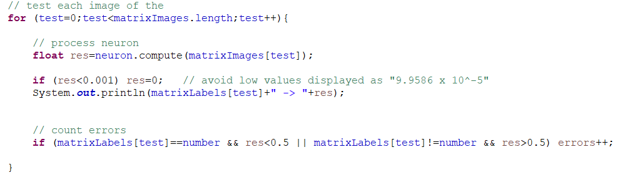
Part I-2 : the formal neuron
Training and exploiting a neuron
  We simply get neuron’s predictions for each sample image :
  We can aslo count the number of prediction errors :
  Not bad for 10 000 samples

Slide 33



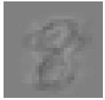
Part I-2 : the formal neuron
The formal neuron
  The formal neuron makes an average of positive and negative results to generate an “average image”, exposing the features of the element to recognize
  This average image allows detecting the presence of the associated element on an unknown input vector.
  But Why does this works ?

Slide 34
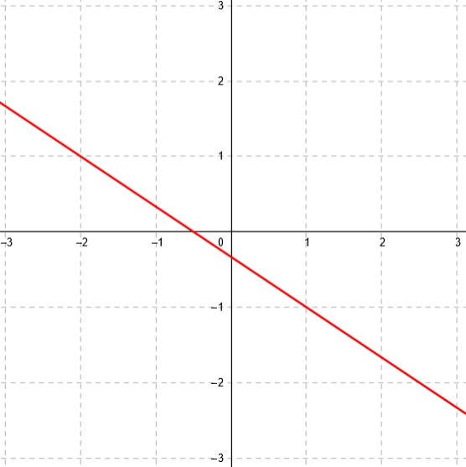
Part I-2 : the formal neuron
Let’s consider a linear function
example :
3.y + 2.x + 1 = 0 ( y = -(2/3).x – 1/3 )
This function separates the plane in 2:
  3.y+2.x+1 > 0
  → area A above the line
  3.y+2.x+1 < 0
  → area B below the line
A
B

Slide 35
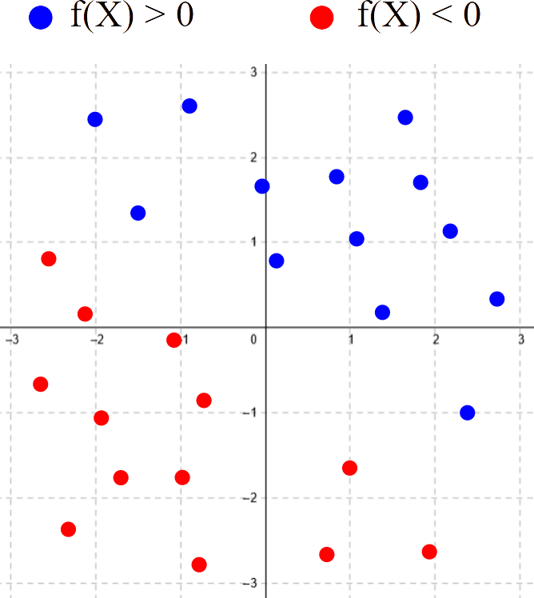
Part I-2 : the formal neuron
And if we do not know the function parameters ?
We start with a function a.x + b.y + c = 0 with unknown parameters (a,b,c)
We have a set of points Xi = [ xi , yi ] which position f(Xi) > 0 or f(Xi) < 0 is known
→ We have to find a triplet (a , b , c) satisfying all point conditions
We get a random triplet
Each point is tested
  If f(Xi)>0 but axi+byi+c<0
    axi+byi+c must be increased
  If f(Xi)<0 but axi+byi+c>0
    axi+byi+c must be decreased
  otherwise, we do not change parameters

Slide 36
Part I-2 : the formal neuron
And if we do not know the function parameters ?
For each parameter a, b and c, we sligtly increase or decrease the value proportionnally to, respectively, x (a), y (b) and 1 (c)
a ← a + α . xi or a ← a – α . xi
b ← b + α . y i or b ← b – α . yi
c ← c + α . 1 or c ← c – α . 1
If we note ri = 1 when f(Xi)>0 and ri = -1 when f(Xi)<0
  then
    a ← a + α . ri . xi
    b ← b + α . ri . yi
    c ← c + α . ri
  Points Xi are tested, until they are all on the right side of the line

Slide 37
Part I-2 : the formal neuron
The parameters will converge until finding a solution
Algorithm :
errors = true
while errors do
  errors = false
  for each Xi do
    if f(Xi) . (a.xi+b.yi+c) < 0 do
      a += α . ri . xi
      b += α . ri . yi
      c += α . ri
      errors = true
    end if
  end for each
end while

Slide 38
Part I-2 : the formal neuron
What has this got to do with the neuron ?
Let’s write:
  a . x + b . y + c = 0 → w1 . x1 + w2 . x2 + b = 0
We generalize to a space with n-dimensions:
Weights of a neuron form the equation of a hyperplane
The reinforcement modifies weights to separate space in two groups of points

Slide 39
Part I-2 : the formal neuron
A neuron can only recognize one type of element
But with multiple neurons, it is possible to categorize multiple elements
With a threshold activation function :
  The output is a binary vector
    Conversion to binary code, ASCII code…
  → Perceptrons
{ 0 , 1 , 0 , 1 }

Slide 40

Part I-2 : the formal neuron
Neurons with continual activation function (linear, ReLU, Sigmoid…)
Each neuron is trained to recognize a category of element (e.g. a number)
  The training process must convert labels into binary vectors
    ‘2’ → {0,0,1,0,0,0,0,0,0,0,0}
    Each neuron needs a binary output for training
  Neurons are in competition : the neuron with the greatest output provide the output of the network, with the confidence of the result
Often used for object recognition
(0: 0.21) (1: 0,01) (2: 0,65) (3: 0,55) (4: 0,35) (5: 0,11) (6: 0,09)...

Slide 41
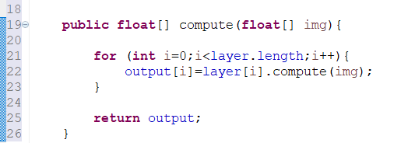
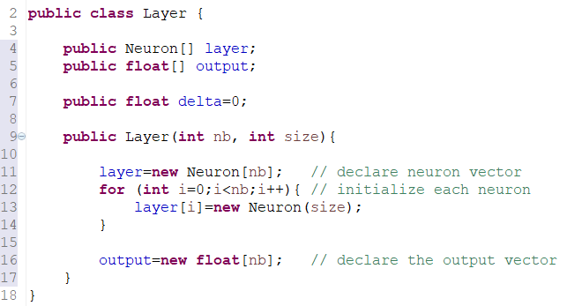
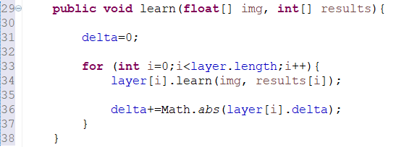
Part I-2 : the formal neuron
Implementing a layer of neuron
  Simple way : create a class that manage a vector of neurons and provide a vector of results as output
Compute output of each neuron
And write their results in output vector
Initialize the vector of neurons
Reinforce neurons individually
Notice that result is a vector (result for each neuron)

Slide 42
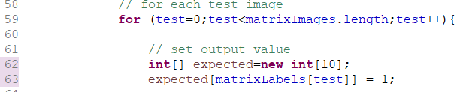
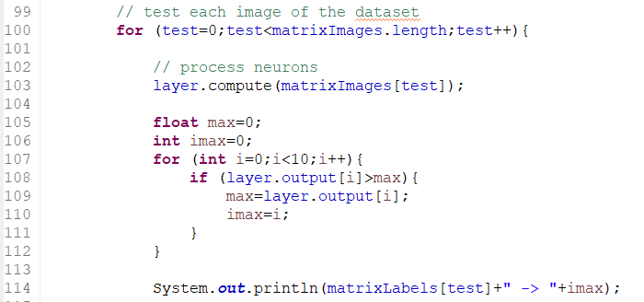
Part I-2 : the formal neuron
Implementing a layer of neuron
  Training : the result vector must be obtained from labels :
  The result is obtained by finding the maximum output :
Expected is a vector of 10 values, with only one value at 1

Slide 43
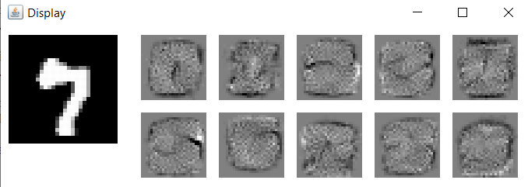
Part I-2 : the formal neuron
Each neuron specializes for a digit, the highest output provide the number
/ 10 000 → 9.04 %
ANNEX 1 provide details of this implementation

