Slide 1
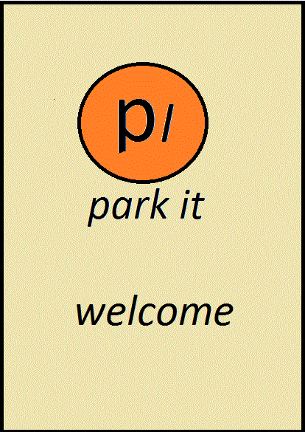
Use your SPARK and PARK☺

Slide 2
The necessity of our product: PARKiT
Our application is linked with the CCTV cameras, by making use of the recent technologies (Artificial Intelligence, IOT).
Since we are dealing with smart cities, CCTV cameras are guarding us everywhere.
It detects the location of the parking lots available around us, using Google Maps.
It senses the vacancy in the parking lot through sensors.
If the area is already occupied, it blocks the path way using blocker.

Slide 3
Option for booking in advance:
This application also provides the user to book the vacant area available in any particular parking lot; gets the user details, the arrival as well as the departure time and the user receives an OTP. Once the user enters the OTP in the device provided which opens up the blocker.
Payment must be done online.
Pre-booking is also available. It displays the time after which the area will be vacant.

Slide 4
Components required:
CCTV cameras
Sensors
Arduino board
Cable wires
Blockers
Approximate cost = Rs. 6000/-

Slide 5
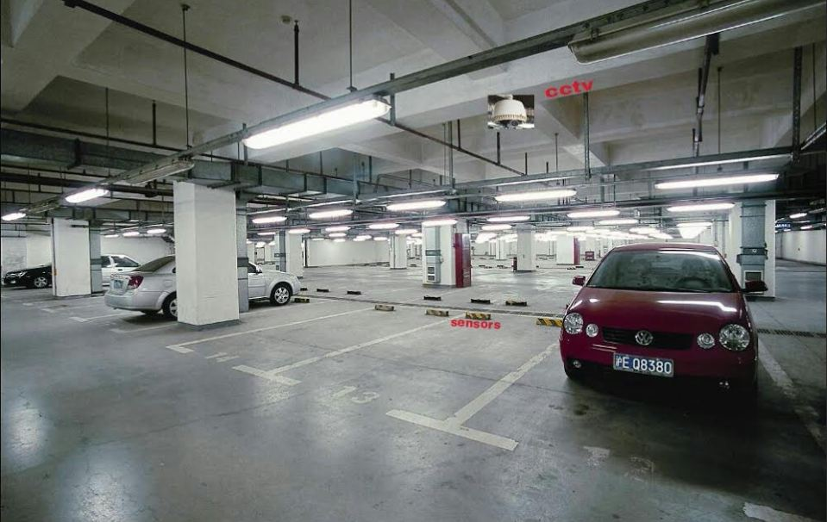

Slide 6
Use your SPARK and PARK☺

Slide 7
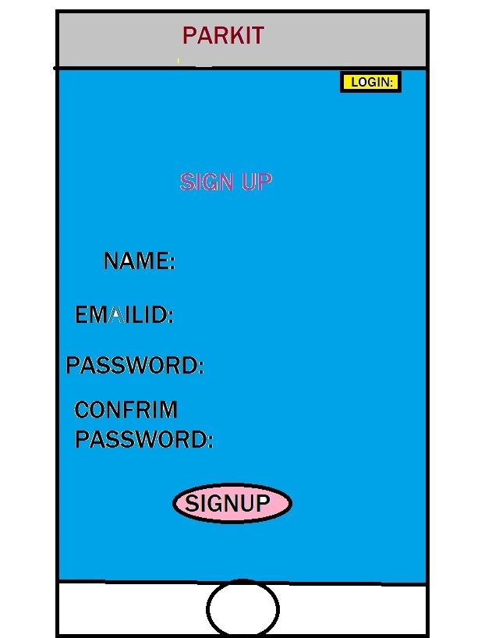

Slide 8
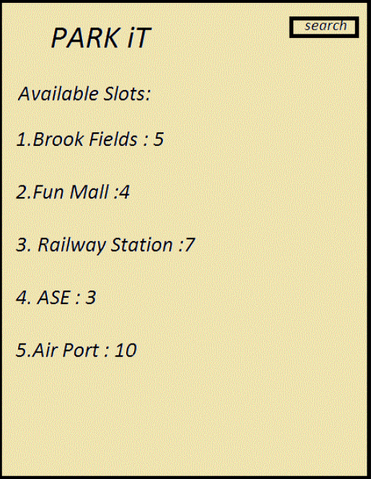

Slide 9
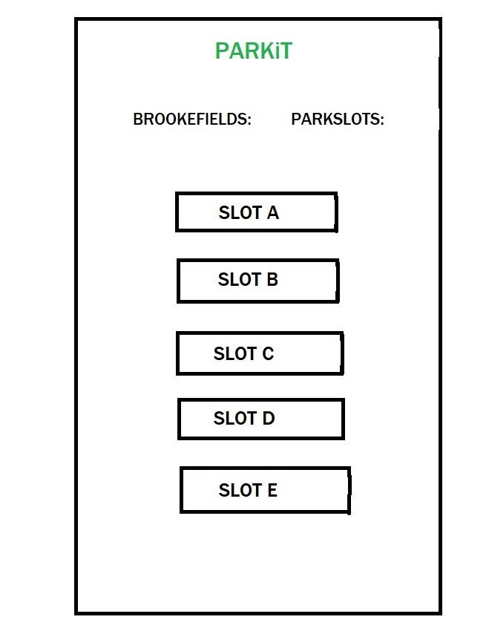

Slide 10
