Slide 1
Basic Relationships Between Pixels
Neighborhood
Adjacency
Connectivity
Paths
Regions and boundaries

Slide 2
Basic Relationships Between Pixels
Neighbors of a pixel p at coordinates (x,y)
4-neighbors of p, denoted by N₄(p):
(x-1, y), (x+1, y), (x,y-1), and (x, y+1).
4 diagonal neighbors of p, denoted by N_{D}(p):
(x-1, y-1), (x+1, y+1), (x+1,y-1), and (x-1, y+1).
8 neighbors of p, denoted N₈(p)
N₈(p) = N₄(p) U N_{D}(p)

Slide 3
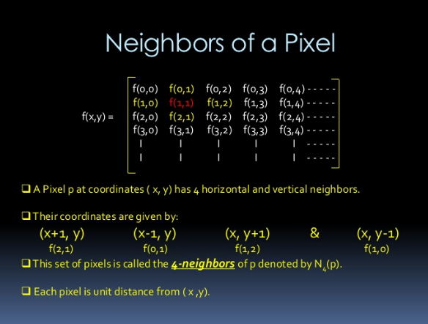

Slide 4
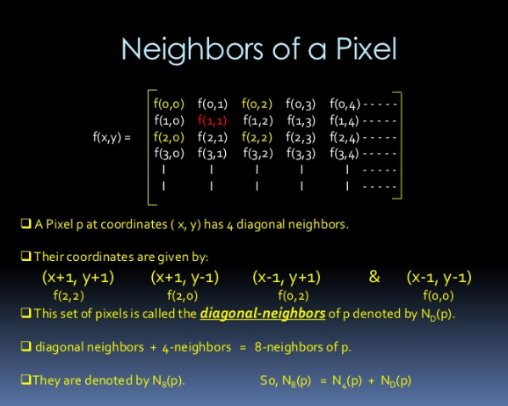

Slide 5
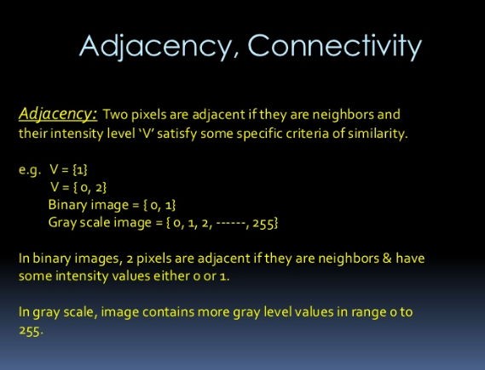

Slide 6
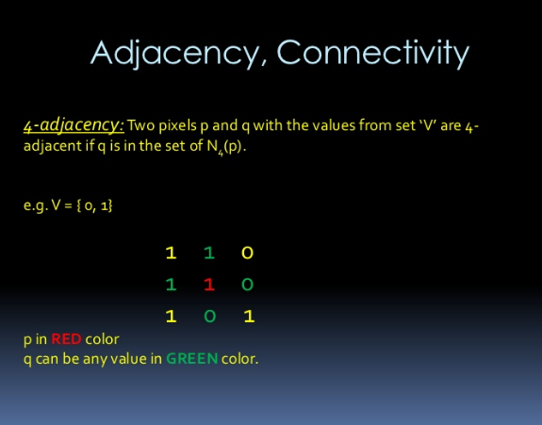

Slide 7
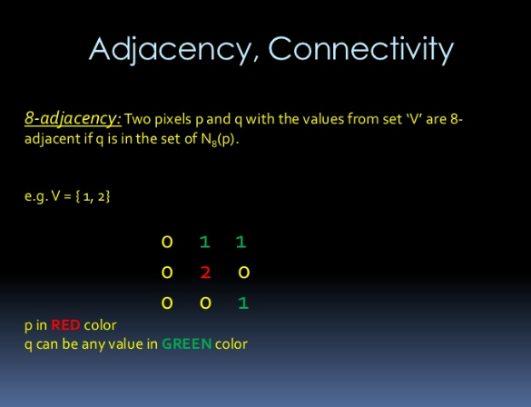

Slide 8


Slide 9
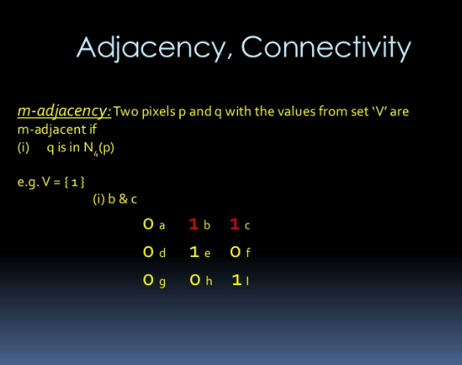

Slide 10
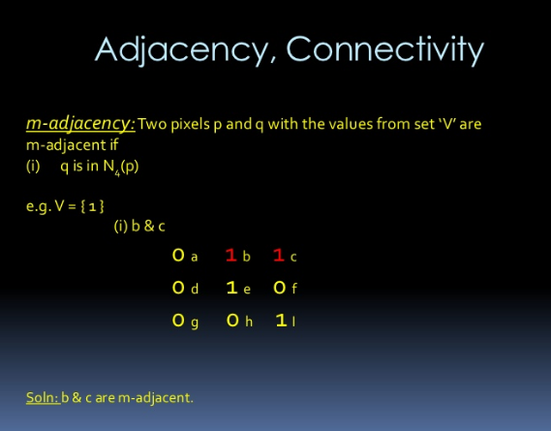

Slide 11
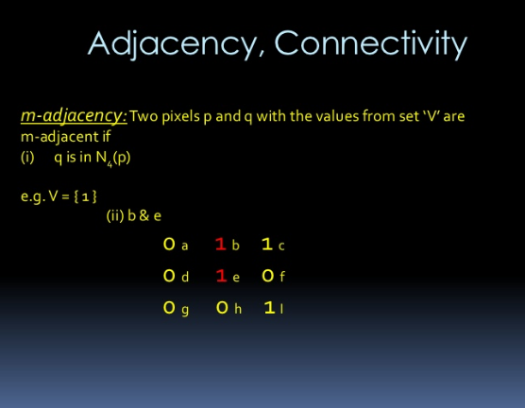

Slide 12
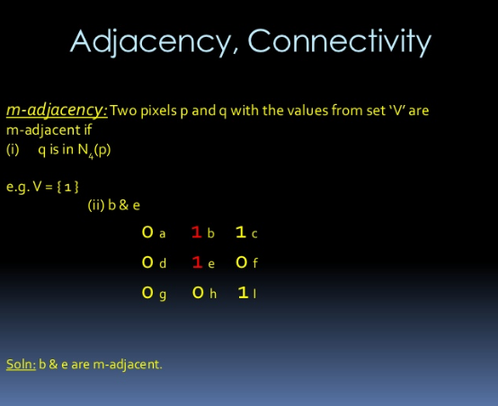

Slide 13
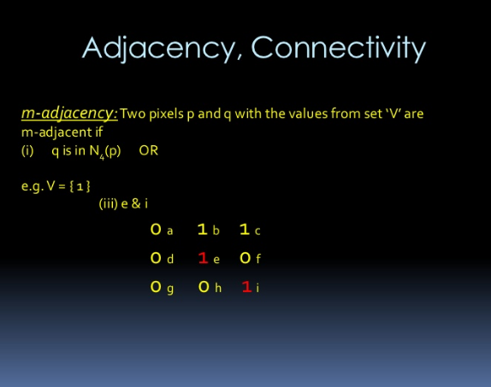

Slide 14
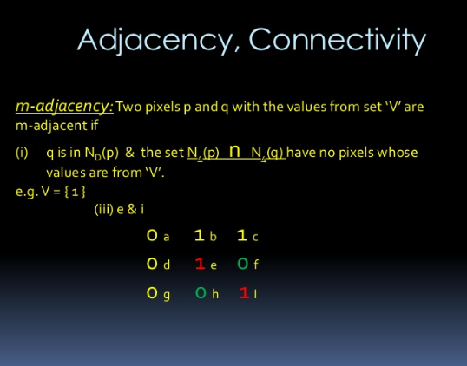

Slide 15
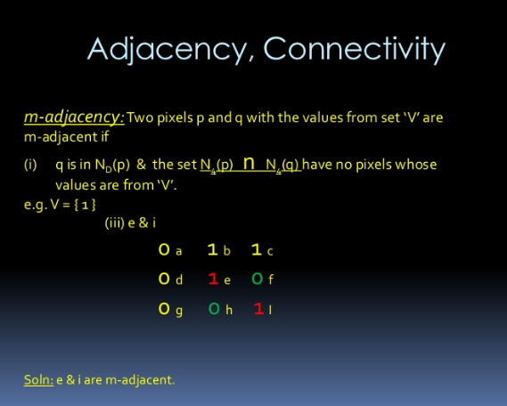

Slide 16
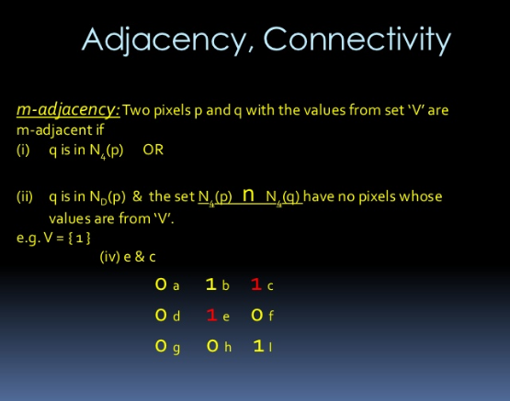

Slide 17
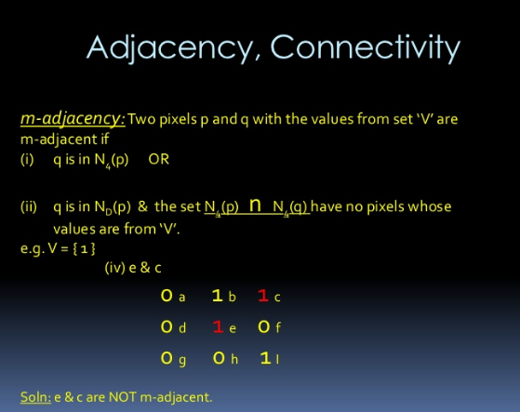

Slide 18


Slide 19
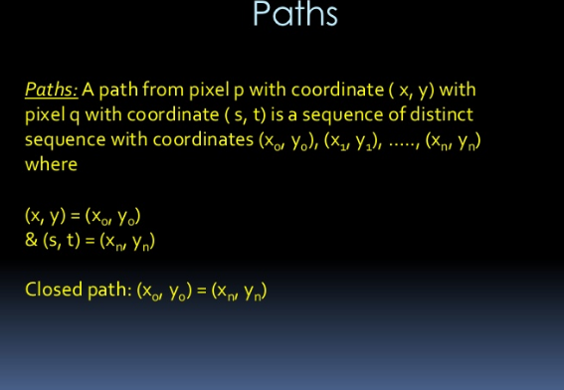

Slide 20
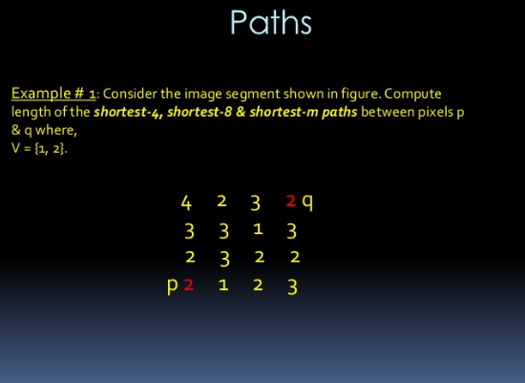

Slide 21
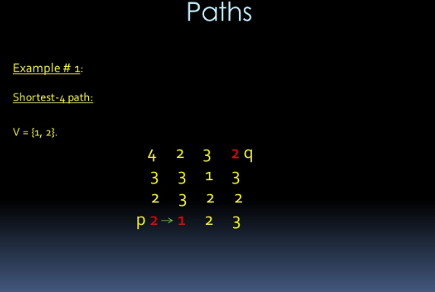

Slide 22
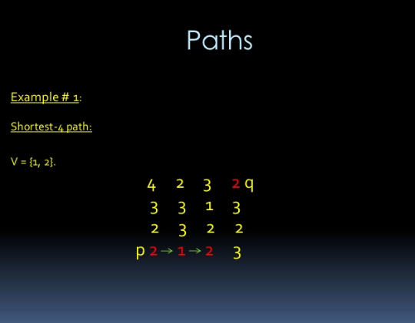

Slide 23
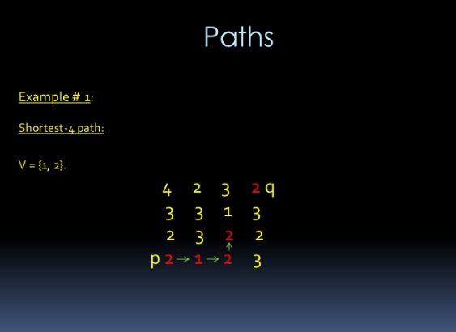

Slide 24
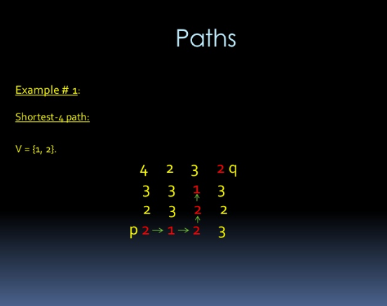

Slide 25
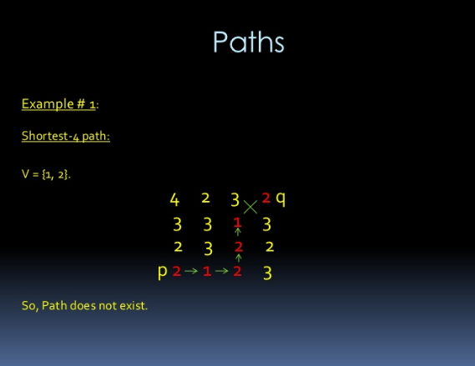

Slide 26
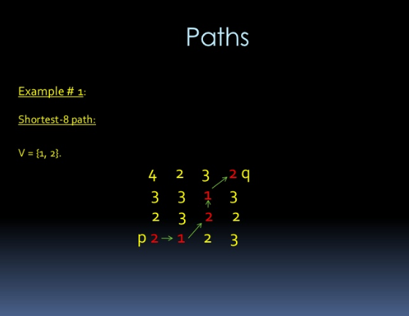

Slide 27
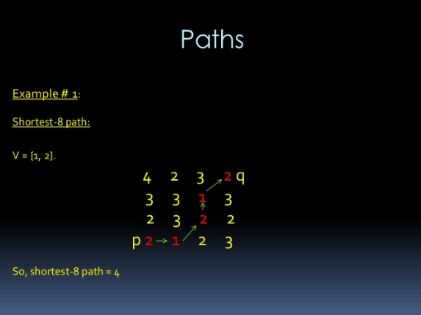

Slide 28
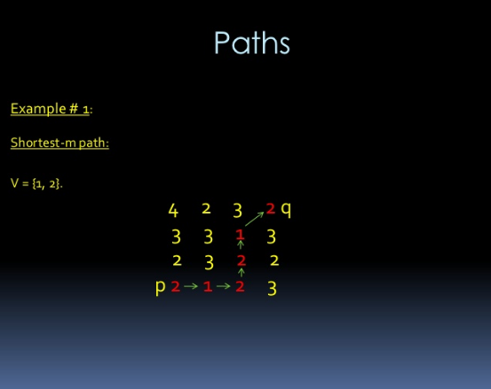

Slide 29
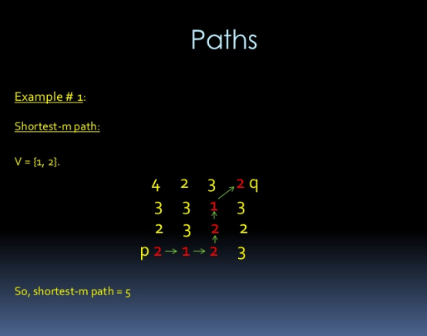

Slide 30
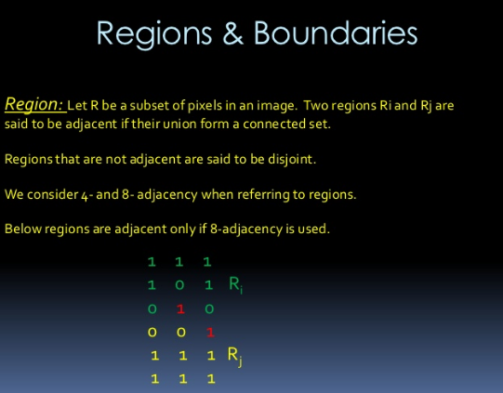

Slide 31


Slide 32
Distance Measures
Given pixels p, q and z with coordinates (x, y), (s, t), (u, v) respectively, the distance function D has following properties:
D(p, q) ≥ 0 [D(p, q) = 0, iff p = q]
D(p, q) = D(q, p)
D(p, z) ≤ D(p, q) + D(q, z)

Slide 33
Distance Measures
The following are the different Distance measures:
a. Euclidean Distance :
D_{e}(p, q) = [(x-s)² + (y-t)²]^{1/2}
b. City Block Distance:
D₄(p, q) = |x-s| + |y-t|
c. Chess Board Distance:
D₈(p, q) = max(|x-s|, |y-t|)

Slide 34
In the following arrangement of pixels, what’s the value of the chessboard distance,City block and euclidean distance between the circled two points?
0 0 0 0 0
0 0 1 1 0
0 1 1 0 0
0 1 0 0 0
0 0 0 0 0
0 0 0 0 0

Slide 35
THANK YOU

