Slide 1
INTENSITY TRANFORMATIONS USING MATLAB

Slide 2
Arithmetic operations on images
imadd() : Add two images or add constant to image.
imsubtract() : Subtract one image from another or subtract constant from image.
immultiply() : Multiply two images or multiply image by constant.
imdivide() : Divide one image into another or divide image by constant.

Slide 3
IMAGE ENHANCEMENT
It is one of the most visually appealing areas of image processing.
Enhancement is the process of manipulating an image so that the result is more suitable than the original for a specific application.
Problem Oriented

Slide 4
BASIC INTENSITY TRANSFORMATION FUNCTIONS
Image Negative
Log Transformation
Gamma/Power Law Transformation

Slide 5
Intensity transformation
General Expression
s=T(r)
where r → pixel before processing.
s → pixel after processing.
T → Transformation Function.

Slide 6
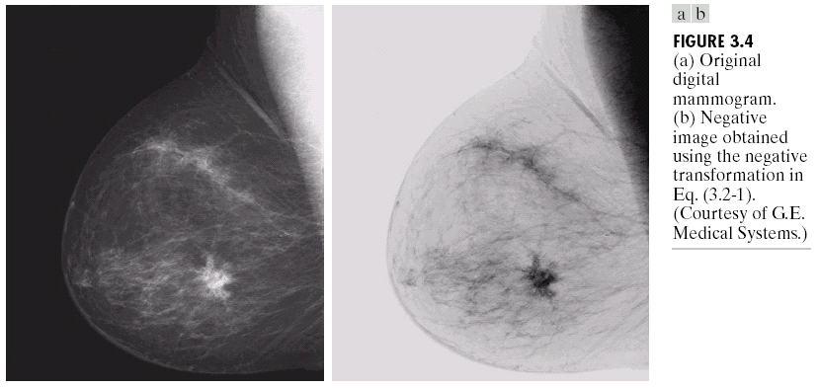
Image Negative
General Expression :
s=L-1-r
Used for enhancing white or gray detail embedded in dark regions of an image.
Original image Negative Image
s = L-1-r

Slide 7
Log Transformations
General Expression:
s = c * log(1+r) ,where c is a constant and r>=0.
The log transformation maps a narrow range of low intensity values in the input into a wider range of output values(i.e.,)expands the dark pixels in an image while compressing the higher level values.
The inverse log transformation performs the opposite transformation

Slide 8
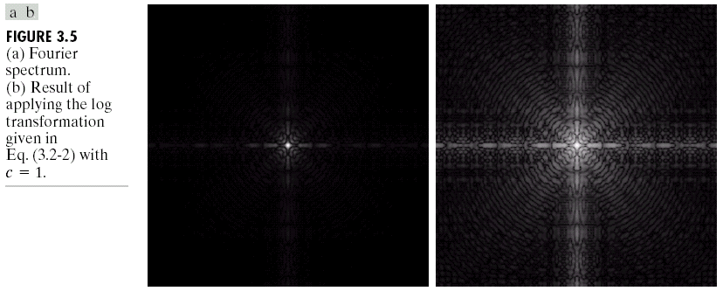
LOG TRANSFORMATIONS(CONTN…)
Log functions are particularly useful when the input grey level values may have an extremely large range of values
In the following example the Fourier transform of an image is put through a log transform to reveal more detail
s = log(1 + r)

Slide 9
Gamma/Power Law Transformation
General Expression:
, Where c and ϒ are positive constant
Map a narrow range of dark input values into a wider range of output values or vice versa.
Gamma correction
ϒ> 1
ϒ < 1
ϒ = 1

Slide 10
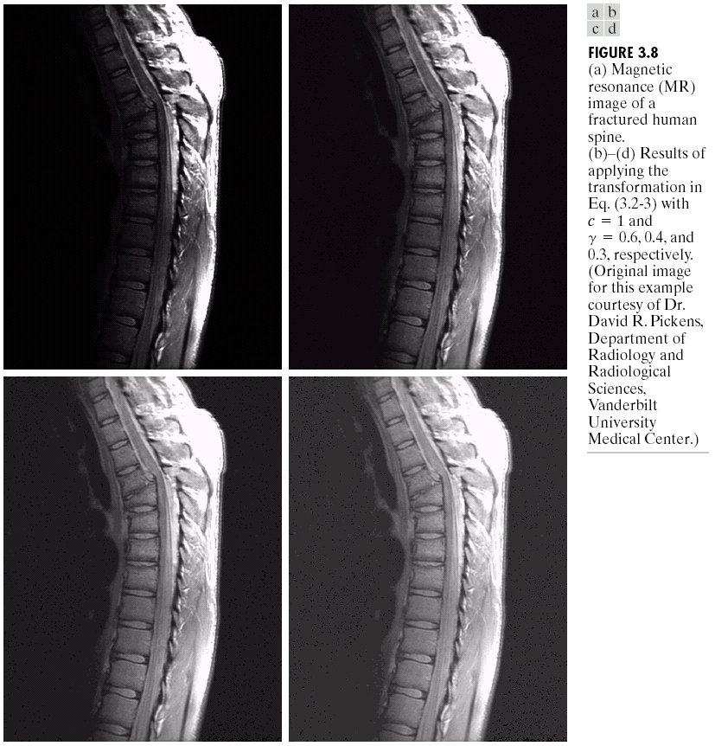
Gamma/Power Law Transformation
For darker images ϒ<1 makes it more visible but very less ϒ value will give a washed out effect
s = r ^{0.6}
s = r ^{0.4}
s = r ^{0.3}

Slide 11
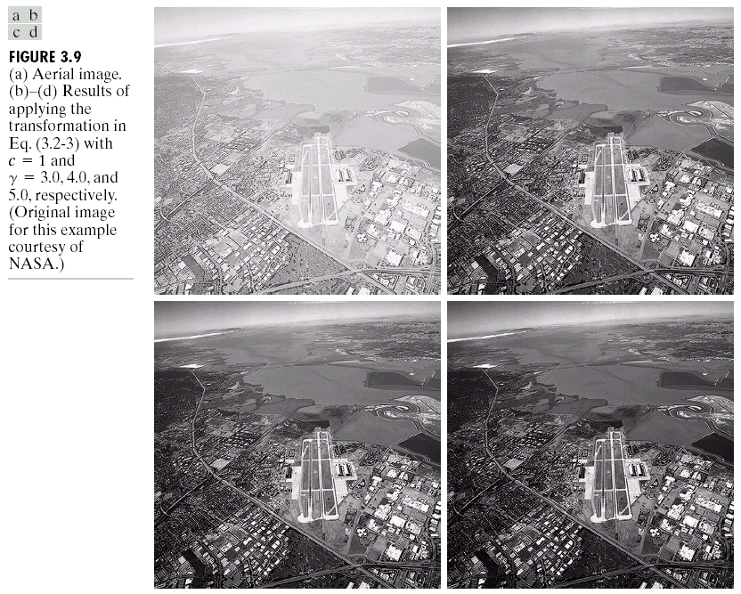
Gamma/Power Law Transformation
To make
The images
Darker ϒ>1
s = r ^{3.0}
s = r ^{4.0}
s = r ^{5.0}

Slide 12
HISTOGRAM
Histogram of an image represents the relative frequency of occurrence of gray level values in an image.
imhist(I) : displays a histogram for the image I.

Slide 13
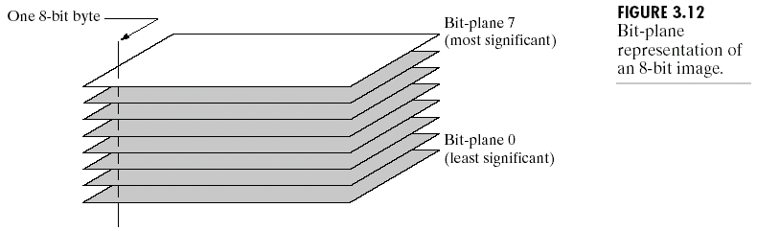
BIT PLANE SLICING
Often by isolating particular bits of the pixel values in an image we can highlight interesting aspects of that image
Higher-order bits usually contain most of the significant visual information
Lower-order bits contain subtle details

Slide 14
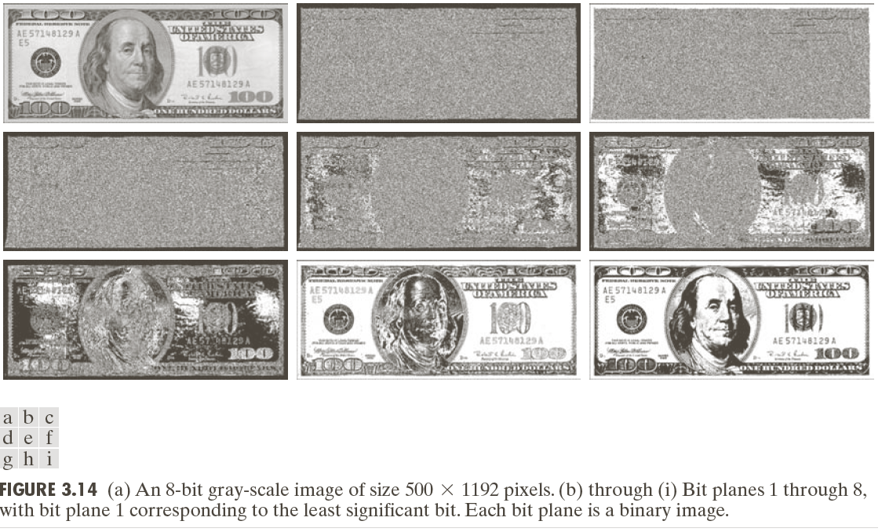
BIT PLANE SLICING(CONTN..)

Slide 15
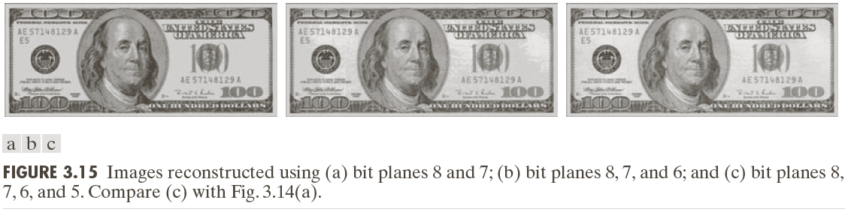
BIT PLANE SLICING (CONTN..)
Reconstructed image using only bit planes 8 and 7
Reconstructed image using only bit planes 8, 7 and 6
Reconstructed image using only bit planes 8,7, 6 and 5

Slide 16
%To illustrate that higher bit planes gives more information than lower bit
%planes of an image
% 1000 0010(1 pixel value of a grey scale 8 bit image)
% MSB LSB
% Bit Position Bit 7 Bit 6 Bit 5 Bit 4 Bit 3 Bit 2 Bit 1 Bit 0

Slide 17
THANK YOU

