Slide 1
MATLAB

Slide 2
Objective
imwrite function
Imfinfo
Logical
Islogical
Figure keyword usage with imshow function( With title option)
subplot function
plot function
Image conversion functions :
  gray2bw
  rgb2gray
  rgb2bw
  im2bw
  imbinarize
Arithmetic operations
Image negative
Finding image intensty profile using .m file
Histogram of an image
Binarize the image

Slide 3
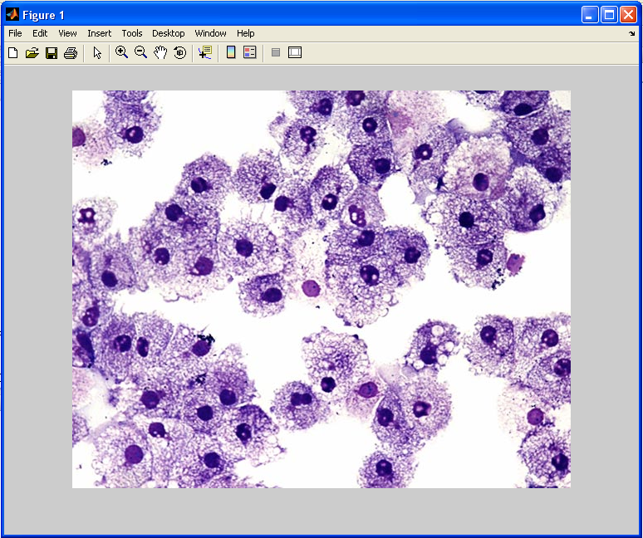
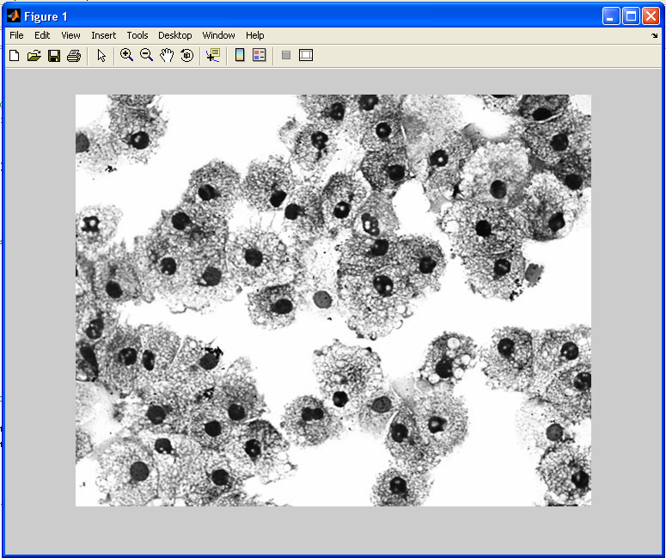
Image import and export
Read and write images in Matlab
>> I=imread('cells.jpg');
>> imshow(I)
>> size(I)
ans = 479 600 3 (RGB image)
>> A=imread(‘pout.tif’);
Imwrite(A, ‘C:\Users\r_manjusha\
Documents\MATLAB\justt.tif‘);
Alternatives to imshow
>>imtool(I)

Slide 4
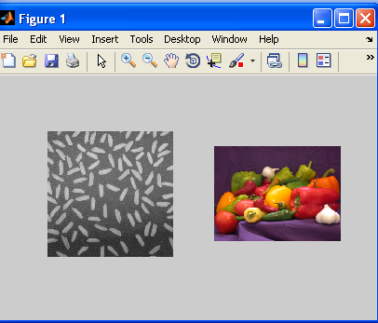
Image import and export-subplot(Row wise)
a= imread('rice.png');
b=imread('peppers.png');
subplot(1,2,1),imshow(a);
subplot(1,2,2),imshow(b);

Slide 5
Figure
a=imread('pout.tif');
b=imread('cameraman.tif');
figure,imshow(a);
figure,imshow(b);

Slide 6
Iminfo and logical
imfinfo(‘pout.tif’);
>>A=[2 3 4; 0 0 2; 0 3 3];
>> B=logical(A);- converts matrix to binary-greater than 0 to 1 and 0 to 0
>>islogical(A);
>>islogical(B);- checks whether the given matrix is binary- if so, returns 1 else 0

Slide 7
Image Conversion
im2bw - image to binary
mat2gray - matrix to intensity image
rgb2gray - RGB image to grayscale
im2unit8

Slide 8
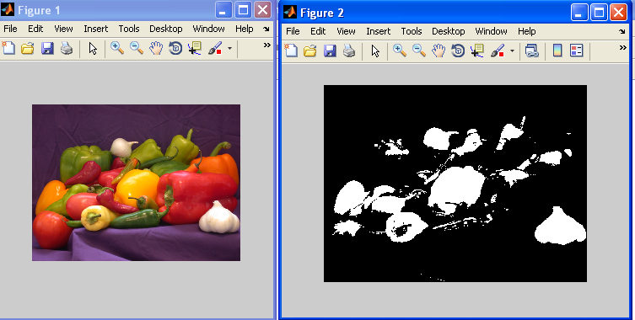
Im2BW- Color
a= imread('peppers.png');
b=im2bw(a);
imshow(a), figure,imshow(b);

Slide 9
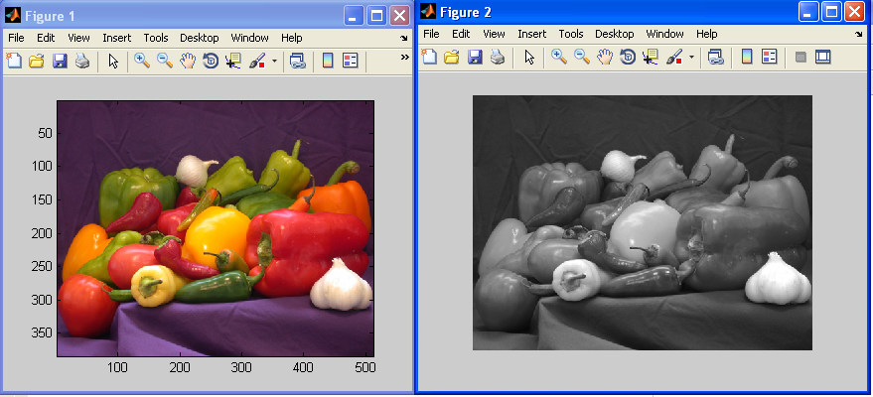
rgb2gray
a= imread('peppers.png');
b=rgb2gray(a);
imagesc(a), figure,imshow(b);

Slide 10
Im2uint8 and mat2gray
f=[1 1.3; 0 .5]
g=im2uint8(f);
G=im2uint16(f)
a=[23 12;45 4];
>> b=mat2gray(a)
b =
0.4634 0.1951
1.0000 0

Slide 11
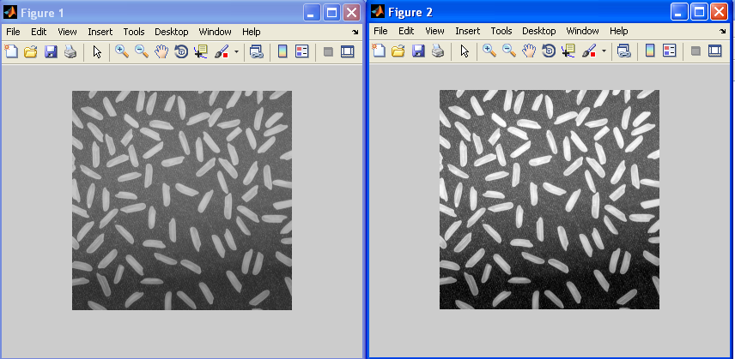
mat2gray
a= imread('rice.png');
b=mat2gray(a);
imshow(a), figure, imshow(b);

Slide 12
Additional functions
Zeros(M,N)
Ones(m,n)
True(m,n)
False(m,n)
Magic(m)-generates an m*m square matrix in which sum along diagona;,row cols all wil be same
Rand(m,n)-uniformly distributed random numbers in interval [ 0 1]

Slide 13
Image Arithmetic operations
Rotate
Crop
Resize
Addition
Subtraction
Multiplication
Division
Complement
Difference

Slide 14
Image Arithmetic operations-Rotate
I = imread('cameraman.tif');
J = imrotate(I,90);
imshow(I),figure, imshow(J);

Slide 15
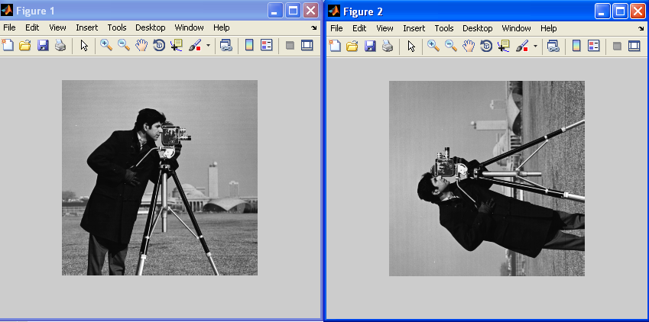
Image Arithmetic operations-Rotate

Slide 16
Image Arithmetic operations-IMCROP
u=imread('cameraman.tif');
i=imcrop(u,[100,120,300,450]);
imshow(i);

Slide 17
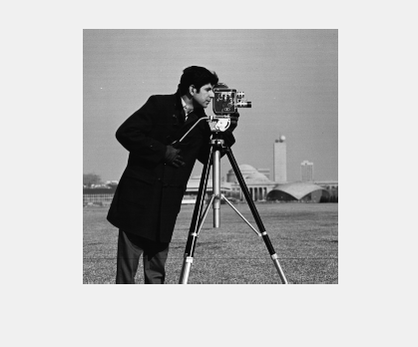
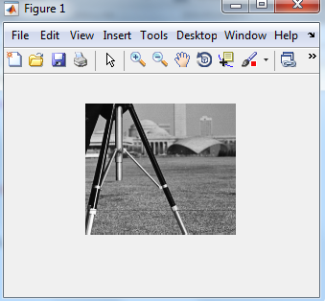
Image Arithmetic operations-IMCROP

Slide 18
Image Arithmetic operations-Resize
I = imread('cameraman.tif');
J = imresize(I, 1.25);
K=imresize(I,.5);
imshow(I),figure, imshow(J), figure,imshow(K);

Slide 19
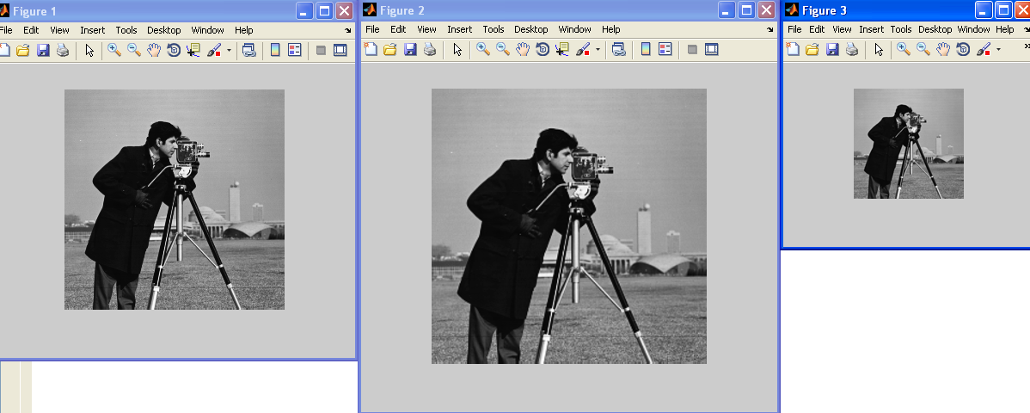
Image Arithmetic operations-Resize

Slide 20
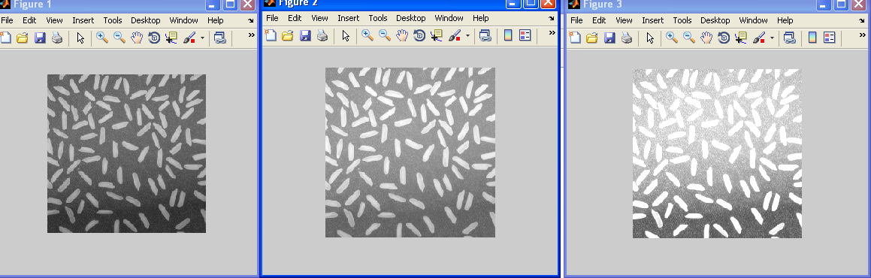
Image Arithmetic operations-Imadd
a= imread('rice.png');
c=imread('rice.png');
d=imadd(a,50);
b=imadd(a,c);
imshow(a), figure,imshow(d),figure,imshow(b);

Slide 21
Image Arithmetic operations-Imsubtraction
a= imread('rice.png');
c=imread('rice.png');
b=imsubtract(a,50);
d=imsubtract(a,c);
subplot(2,2,1), imshow(a),xlabel('original image');
subplot(2,2,2), imshow(c),xlabel('original image');
subplot(2,2,3), imshow(b),xlabel('subtract image');
subplot(2,2,4), imshow(d),xlabel('subtract image');

Slide 22
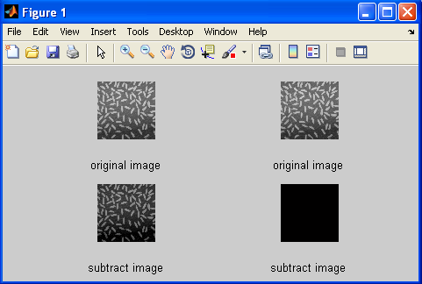
Image Arithmetic operations-Imsubtract

Slide 23
Image Arithmetic operations-Immultiply
a= imread('rice.png');
c=imread('rice.png');
b=immultiply(a,2);
d=immultiply(a,c);
subplot(2,2,1), imshow(a),xlabel('original image');
subplot(2,2,2), imshow(c),xlabel('original image');
subplot(2,2,3), imshow(b),xlabel('Multiplied image');
subplot(2,2,4), imshow(d),xlabel('Multiplied image');

Slide 24
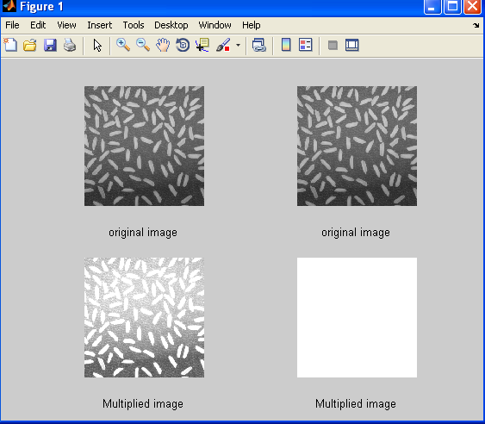
Image Arithmetic operations-Immultiply

Slide 25
Image Arithmetic operations-ImDivide
a= imread('rice.png');
c=imread('rice.png');
b=imdivide(a,3);
d=imdivide(a,c);
subplot(2,2,1), imshow(a),xlabel('original image');
subplot(2,2,2), imshow(c),xlabel('original image');
subplot(2,2,3), imshow(b),xlabel('Divide image');
subplot(2,2,4), imshow(d),xlabel('divide image');

Slide 26
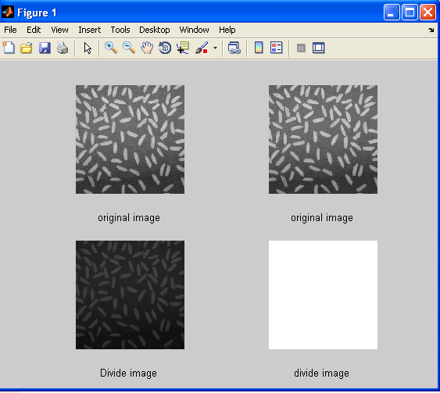

Image Arithmetic operations-ImDivide

Slide 27
Image Arithmetic operations-imcomplement
a= imread('rice.png');
b=imcomplement(a);
subplot(1,2,1), imshow(a), title('original image');
subplot(1,2,2), imshow(b), title('complemented image');

Slide 28
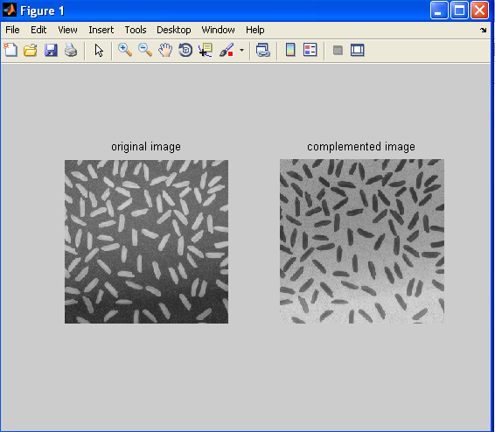
Image Arithmetic operations-imcomplement

Slide 29
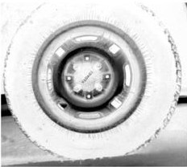
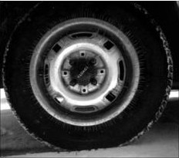
Image Negative
Using complement
I=imread('tire.tif');
imshow(I)
J=imcomplement(I);
figure, imshow(J)

Slide 30
Image Arithmetic operations-imabs diff
a= imread('rice.png');
b=imread('cameraman.tif');
c=imabsdiff(a,b);
subplot(2,2,1), imshow(a), title('original image');
subplot(2,2,2), imshow(b), title('Original image');
subplot(2,2,3), imshow(c), title('Difference image');

Slide 31
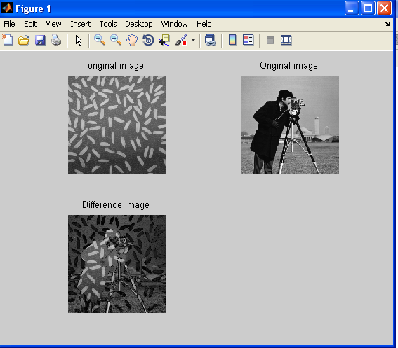
Image Arithmetic operations-imabs diff

Slide 32
Histogram
h=imread('pout.tif');
imhist(h);

Slide 33
AT3_1m4_01.tif AT3_1m4_02.tif
AT3_1m4_03.tif AT3_1m4_04.tif
AT3_1m4_05.tif AT3_1m4_06.tif
AT3_1m4_07.tif AT3_1m4_08.tif
AT3_1m4_09.tif AT3_1m4_10.tif
autumn.tif bag.png
blobs.png board.tif
cameraman.tif canoe.tif
cell.tif circbw.tif
circles.png circuit.tif
coins.png concordaerial.png
concordorthophoto.png eight.tif
fabric.png football.jpg
forest.tif gantrycrane.png
glass.png greens.jpg
hestain.png kids.tif
liftingbody.png logo.tif
m83.tif mandi.tif
moon.tif mri.tif
office_1.jpg office_2.jpg
office_3.jpg office_4.jpg
office_5.jpg office_6.jpg
onion.png paper1.tif
pears.png peppers.png
pillsetc.png pout.tif
rice.png saturn.png
shadow.tif snowflakes.png
spine.tif tape.png
testpat1.png text.png
tire.tif tissue.png
trees.tif westconcordaerial.png
westconcordorthophoto.png

Slide 34
Thank you

