Slide 2

Basic Relationships between Pixels

Slide 4

f(0,0) f(0,1) f(0,2) f(0,3) f(0,4) - - - - -
f(1,0) f(1,1) f(1,2) f(1,3) f(1,4) - - - - -
f(x,y) = f(2,0) f(2,1) f(2,2) f(2,3) f(2,4) - - - - -
f(3,0) f(3,1) f(3,2) f(3,3) f(3,4) - - - - -
I I I I I - - - - -
I I I I I - - - - -

Slide 5
f(0,0) f(0,1) f(0,2) f(0,3) f(0,4) - - - - -
f(1,0) f(1,1) f(1,2) f(1,3) f(1,4) - - - - -
f(x,y) = f(2,0) f(2,1) f(2,2) f(2,3) f(2,4) - - - - -
f(3,0) f(3,1) f(3,2) f(3,3) f(3,4) - - - - -
I I I I I - - - - -
I I I I I - - - - -
A Pixel p at coordinates ( x, y) has 4 horizontal and vertical neighbors.
Their coordinates are given by:
(x+1, y) (x-1, y) (x, y+1) & (x, y-1)
f(2,1) f(0,1) f(1,2) f(1,0)
This set of pixels is called the 4-neighbors of p denoted by N₄(p).
Each pixel is unit distance from ( x ,y).

Slide 6
f(0,0) f(0,1) f(0,2) f(0,3) f(0,4) - - - - -
f(1,0) f(1,1) f(1,2) f(1,3) f(1,4) - - - - -
f(x,y) = f(2,0) f(2,1) f(2,2) f(2,3) f(2,4) - - - - -
f(3,0) f(3,1) f(3,2) f(3,3) f(3,4) - - - - -
I I I I I - - - - -
I I I I I - - - - -
A Pixel p at coordinates ( x, y) has 4 diagonal neighbors.
Their coordinates are given by:
(x+1, y+1) (x+1, y-1) (x-1, y+1) & (x-1, y-1)
f(2,2) f(2,0) f(0,2) f(0,0)
This set of pixels is called the diagonal-neighbors of p denoted by N_{D}(p).
diagonal neighbors + 4-neighbors = 8-neighbors of p.
They are denoted by N₈(p). So, N₈(p) = N₄(p) + N_{D}(p)

Slide 7

Adjacency: Two pixels are adjacent if they are neighbors and their intensity level ‘V’ satisfy some specific criteria of similarity.
e.g. V = {1}
V = { 0, 2}
Binary image = { 0, 1}
Gray scale image = { 0, 1, 2, ------, 255}
In binary images, 2 pixels are adjacent if they are neighbors & have some intensity values either 0 or 1.
In gray scale, image contains more gray level values in range 0 to 255.

Slide 8
4-adjacency: Two pixels p and q with the values from set ‘V’ are 4-adjacent if q is in the set of N₄(p).
e.g. V = { 0, 1}
1 1 2
1 1 0
1 0 1
p in RED color
q can be any value in GREEN color.

Slide 9
8-adjacency: Two pixels p and q with the values from set ‘V’ are 8-adjacent if q is in the set of N₈(p).
e.g. V = { 1, 2}
0 1 1
0 2 0
0 0 1
p in RED color
q can be any value in GREEN color

Slide 10
m-adjacency: Two pixels p and q with the values from set ‘V’ are m-adjacent if
q is in N₄(p) OR
q is in N_{D}(p) & the set N₄(p) n N₄(q) have no pixels whose values are from ‘V’.
e.g. V = { 1 }
0 a 1 b 1 c
0 d 1 e 0 f
0 g 0 h 1 i

Slide 11
m-adjacency: Two pixels p and q with the values from set ‘V’ are m-adjacent if
q is in N₄(p)
e.g. V = { 1 }
(i) b & c
0 a 1 b 1 c
0 d 1 e 0 f
0 g 0 h 1 I

Slide 12
m-adjacency: Two pixels p and q with the values from set ‘V’ are m-adjacent if
q is in N₄(p)
e.g. V = { 1 }
(i) b & c
0 a 1 b 1 c
0 d 1 e 0 f
0 g 0 h 1 I
Soln: b & c are m-adjacent.

Slide 13
m-adjacency: Two pixels p and q with the values from set ‘V’ are m-adjacent if
q is in N₄(p)
e.g. V = { 1 }
(ii) b & e
0 a 1 b 1 c
0 d 1 e 0 f
0 g 0 h 1 I

Slide 14
m-adjacency: Two pixels p and q with the values from set ‘V’ are m-adjacent if
q is in N₄(p)
e.g. V = { 1 }
(ii) b & e
0 a 1 b 1 c
0 d 1 e 0 f
0 g 0 h 1 I
Soln: b & e are m-adjacent.

Slide 15
m-adjacency: Two pixels p and q with the values from set ‘V’ are m-adjacent if
q is in N₄(p) OR
e.g. V = { 1 }
(iii) e & i
0 a 1 b 1 c
0 d 1 e 0 f
0 g 0 h 1 i

Slide 16
m-adjacency: Two pixels p and q with the values from set ‘V’ are m-adjacent if
q is in N_{D}(p) & the set N₄(p) n N₄(q) have no pixels whose values are from ‘V’.
e.g. V = { 1 }
(iii) e & i
0 a 1 b 1 c
0 d 1 e 0 f
0 g 0 h 1 I

Slide 17
m-adjacency: Two pixels p and q with the values from set ‘V’ are m-adjacent if
q is in N_{D}(p) & the set N₄(p) n N₄(q) have no pixels whose values are from ‘V’.
e.g. V = { 1 }
(iii) e & i
0 a 1 b 1 c
0 d 1 e 0 f
0 g 0 h 1 I
Soln: e & i are m-adjacent.

Slide 18
m-adjacency: Two pixels p and q with the values from set ‘V’ are m-adjacent if
q is in N₄(p) OR
q is in N_{D}(p) & the set N₄(p) n N₄(q) have no pixels whose values are from ‘V’.
e.g. V = { 1 }
(iv) e & c
0 a 1 b 1 c
0 d 1 e 0 f
0 g 0 h 1 I

Slide 19
m-adjacency: Two pixels p and q with the values from set ‘V’ are m-adjacent if
q is in N₄(p) OR
q is in N_{D}(p) & the set N₄(p) n N₄(q) have no pixels whose values are from ‘V’.
e.g. V = { 1 }
(iv) e & c
0 a 1 b 1 c
0 d 1 e 0 f
0 g 0 h 1 I
Soln: e & c are NOT m-adjacent.

Slide 20
Connectivity: 2 pixels are said to be connected if their exists a path between them.
Let ‘S’ represent subset of pixels in an image.
Two pixels p & q are said to be connected in ‘S’ if their exists a path between them consisting entirely of pixels in ‘S’.
For any pixel p in S, the set of pixels that are connected to it in S is called a connected component of S.

Slide 21

Paths: A path from pixel p with coordinate ( x, y) with pixel q with coordinate ( s, t) is a sequence of distinct sequence with coordinates (x₀, y₀), (x₁, y₁), ….., (x_{n}, y_{n}) where
(x, y) = (x₀, y₀)
& (s, t) = (x_{n}, y_{n})
Closed path: (x₀, y₀) = (x_{n}, y_{n})

Slide 22
Example # 1: Consider the image segment shown in figure. Compute length of the shortest-4, shortest-8 & shortest-m paths between pixels p & q where,
V = {1, 2}.
4 2 3 2 q
3 3 1 3
2 3 2 2
p 2 1 2 3

Slide 23
Example # 1:
Shortest-4 path:
V = {1, 2}.
4 2 3 2 q
3 3 1 3
2 3 2 2
p 2 1 2 3

Slide 24
Example # 1:
Shortest-4 path:
V = {1, 2}.
4 2 3 2 q
3 3 1 3
2 3 2 2
p 2 1 2 3

Slide 25
Example # 1:
Shortest-4 path:
V = {1, 2}.
4 2 3 2 q
3 3 1 3
2 3 2 2
p 2 1 2 3

Slide 26
Example # 1:
Shortest-4 path:
V = {1, 2}.
4 2 3 2 q
3 3 1 3
2 3 2 2
p 2 1 2 3

Slide 27
Example # 1:
Shortest-4 path:
V = {1, 2}.
4 2 3 2 q
3 3 1 3
2 3 2 2
p 2 1 2 3

Slide 28
Example # 1:
Shortest-4 path:
V = {1, 2}.
4 2 3 2 q
3 3 1 3
2 3 2 2
p 2 1 2 3
So, Path does not exist.

Slide 29
Example # 1:
Shortest-8 path:
V = {1, 2}.
4 2 3 2 q
3 3 1 3
2 3 2 2
p 2 1 2 3

Slide 30
Example # 1:
Shortest-8 path:
V = {1, 2}.
4 2 3 2 q
3 3 1 3
2 3 2 2
p 2 1 2 3

Slide 31
Example # 1:
Shortest-8 path:
V = {1, 2}.
4 2 3 2 q
3 3 1 3
2 3 2 2
p 2 1 2 3

Slide 32
Example # 1:
Shortest-8 path:
V = {1, 2}.
4 2 3 2 q
3 3 1 3
2 3 2 2
p 2 1 2 3

Slide 33
Example # 1:
Shortest-8 path:
V = {1, 2}.
4 2 3 2 q
3 3 1 3
2 3 2 2
p 2 1 2 3

Slide 34
Example # 1:
Shortest-8 path:
V = {1, 2}.
4 2 3 2 q
3 3 1 3
2 3 2 2
p 2 1 2 3
So, shortest-8 path = 4

Slide 35
Example # 1:
Shortest-m path:
V = {1, 2}.
4 2 3 2 q
3 3 1 3
2 3 2 2
p 2 1 2 3

Slide 36
Example # 1:
Shortest-m path:
V = {1, 2}.
4 2 3 2 q
3 3 1 3
2 3 2 2
p 2 1 2 3

Slide 37
Example # 1:
Shortest-m path:
V = {1, 2}.
4 2 3 2 q
3 3 1 3
2 3 2 2
p 2 1 2 3

Slide 38
Example # 1:
Shortest-m path:
V = {1, 2}.
4 2 3 2 q
3 3 1 3
2 3 2 2
p 2 1 2 3

Slide 39
Example # 1:
Shortest-m path:
V = {1, 2}.
4 2 3 2 q
3 3 1 3
2 3 2 2
p 2 1 2 3

Slide 40
Example # 1:
Shortest-m path:
V = {1, 2}.
4 2 3 2 q
3 3 1 3
2 3 2 2
p 2 1 2 3

Slide 41
Example # 1:
Shortest-m path:
V = {1, 2}.
4 2 3 2 q
3 3 1 3
2 3 2 2
p 2 1 2 3
So, shortest-m path = 5

Slide 42

Ch2, lesson3: Some basic Relationships between pixels
A digital path from pixel p with coordinates (x,y) to pixel q with coordinates (s,t) is a sequence of distinct pixels with coordinates (x0,y0), (x1,y1), …, (xn,yn), where (x0,y0)= (x,y) and (xn,yn)=(s,t), and pixels (xi,yi) and (xi-1,yi-1) are adjacent for 1 ≤ i ≤ n.
S: a subset of pixels in an image.
Two pixels p and q are said to be connected in S if there exists a path between them consisting entirely of pixels in S.
For any pixel p in S, the set of pixels that are connected to it in S is called a connected component of S.
If S has only one connected component, it is called a connected set.

Slide 43

Ch2, lesson3: Some basic Relationships between pixels
R: a subset of pixels in an image.
R is a region of the image if R is a connected set.
The boundary of a region R is the set of pixels in the region that have one or more neighbors that are not in R.

Slide 44

Region: Let R be a subset of pixels in an image. Two regions Ri and Rj are said to be adjacent if their union form a connected set.
Regions that are not adjacent are said to be disjoint.
We consider 4- and 8- adjacency when referring to regions.
Below regions are adjacent only if 8-adjacency is used.
1 1 1
1 0 1 R_{i}
0 1 0
0 0 1
1 1 1 R_{j}
1 1 1

Slide 45

Suppose that the image contains K disjoint regions Rk none of which touches the image border .
Ru : the union of all regions .
(Ru)^{c :} is the complement .
so Ru is called foreground , and (Ru)^{c :} is the background .

Slide 46
Boundaries (border or contour): The boundary of a region R is the set of points that are adjacent to points in the compliment of R.
0 0 0 0 0
0 1 1 0 0
0 1 1 0 0
0 1 1 1 0
0 1 1 1 0
0 0 0 0 0
RED colored 1 is NOT a member of border if 4-connectivity is used between region and background. It is if 8-connectivity is used.

Slide 47
Outer border , corresponding border in the background.
Inner border of the1-valued region is the region itself
If R happens to be an entire image, then its boundary is defined as the set of pixels in the first and last rows and columns of the image.
0 0 0
0 1 0
0 1 0
0 1 0
0 1 0
0 0 0

Slide 48

Distance Measures: Distance between pixels p, q & z with co-ordinates ( x, y), ( s, t) & ( v, w) resp. is given by:
D( p, q) ≥ 0 [ D( p, q) = 0 if p = q] …………..called reflexivity
D( p, q) = D( q, p) .………….called symmetry
D( p, z) ≤ D( p, q) + D( q, z) ..………….called transmitivity
Euclidean distance between p & q is defined as-
D_{e}( p, q) = [( x- s)² + (y - t)²]^{1/2}

Slide 49
City Block Distance: The D₄ distance between p & q is defined as
D₄( p, q) = |x - s| + |y - t|
In this case, pixels having D₄ distance from ( x, y) less than or equal to some value r form a diamond centered at ( x, y).
2
2 1 2
2 1 0 1 2
2 1 2
2
Pixels with D₄ distance ≤ 2 forms the following contour of constant distance.

Slide 50
Chess-Board Distance: The D₈ distance between p & q is defined as
D₈( p, q) = max( |x - s| , |y - t| )
In this case, pixels having D₈ distance from ( x, y) less than or equal to some value r form a square centered at ( x, y).
2 2 2 2 2
2 1 1 1 2
2 1 0 1 2
2 1 1 1 2
2 2 2 2 2
Pixels with D₈ distance ≤ 2 forms the following contour of constant distance.

Slide 51

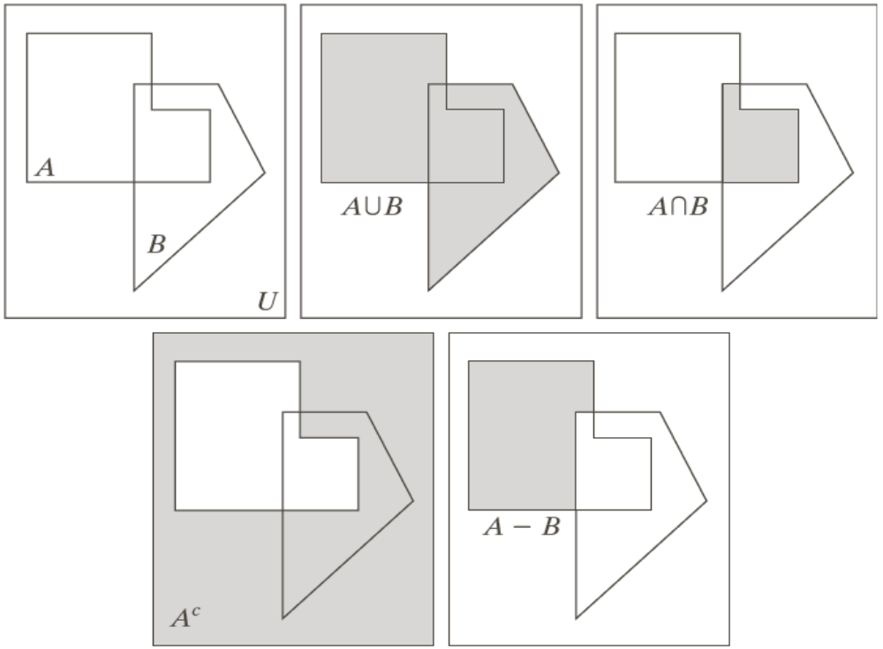

Slide 52

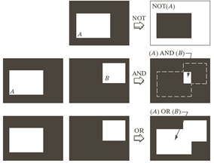

Slide 53
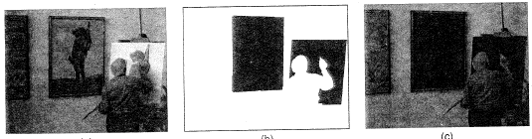
The AND operator is usually used to mask out part of an image.

Slide 54
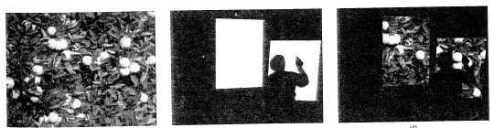
Parts of another image can be added with a logical OR operator.

Slide 55
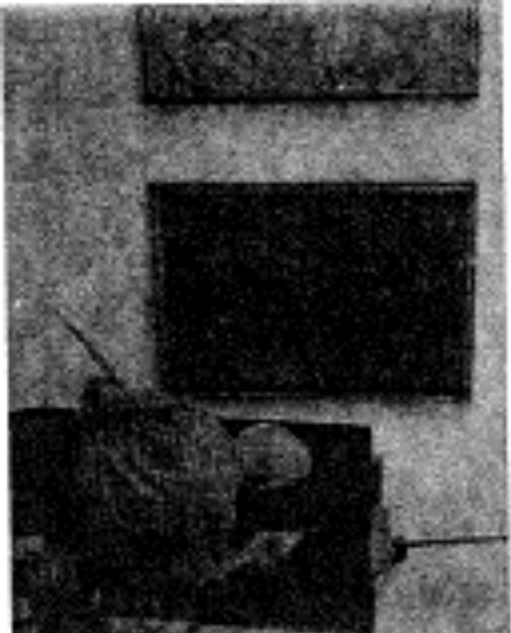
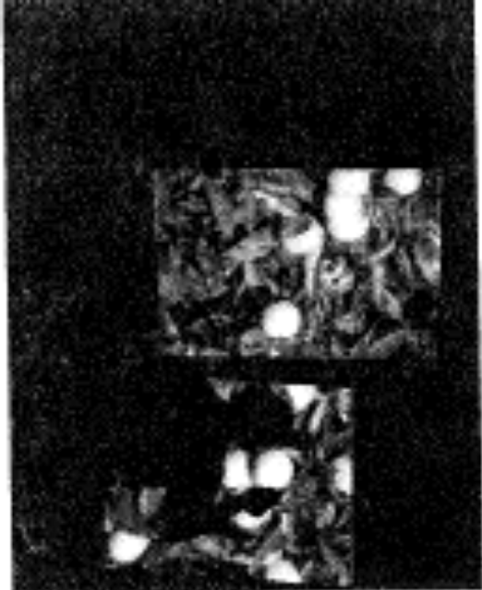
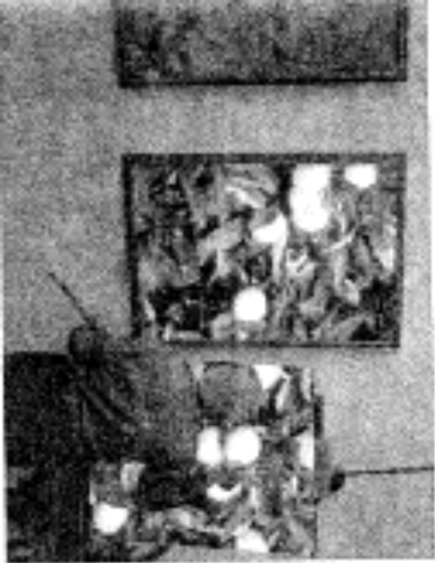
Result of AND
Result of OR
OR

Slide 56
