Slide 1
Spatial Filtering - Basics
Used for image enhancement
Filter → accepting or rejecting certain frequency components
Filter that passes low frequencies → low pass filter → blur (smooth) an image
Smoothing → pixel directly → spatial filtering
a.k.a spatial masks, kernels, templates, windows
Performs non-linear filtering

Slide 2
Components of Spatial filter
A neighborhood (small rectangle)
A predefined operation performed on the neighborhood
Filtering creates a new pixel with coords equal to the coords of center of the neighborhood → value as resultant of the operation
A filtered image is generated, as the center of the filter visits each pixel in the input image
Linear /non-linear filtering

Slide 3
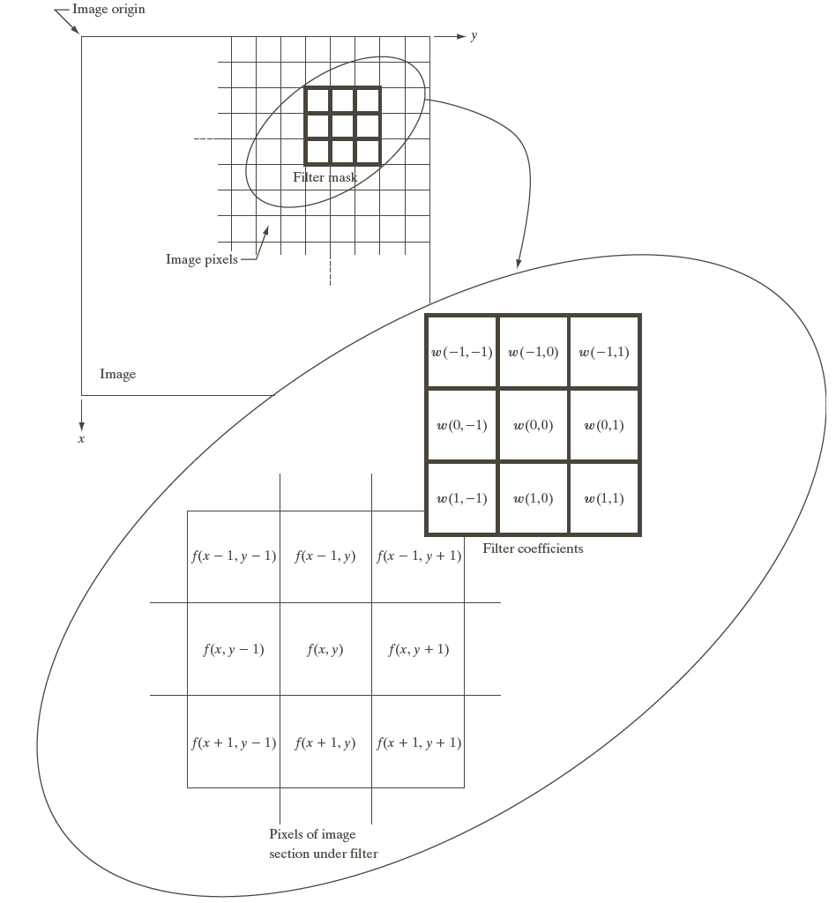
Linear - Spatial Filtering
Mask size m x n , m = 2a +1, n=2b+1 (a,b positive integers)
Filters are always of odd size (min: 3 x 3)
x and y are varied so that each pixel in w visits every pixel in f

Slide 4
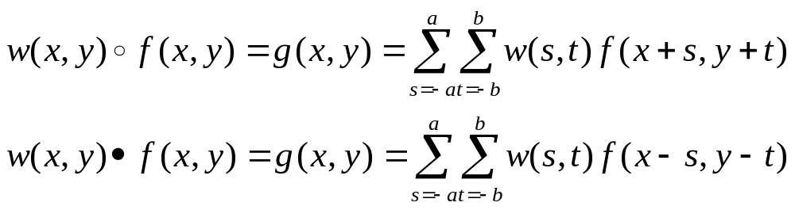
Spatial Correlation and Convolution
Correlation → process of moving a filter mask over the image and computing the sum of products at each location
Convolution → same as correlation but initially the filter is rotated by 180 degrees

Slide 5
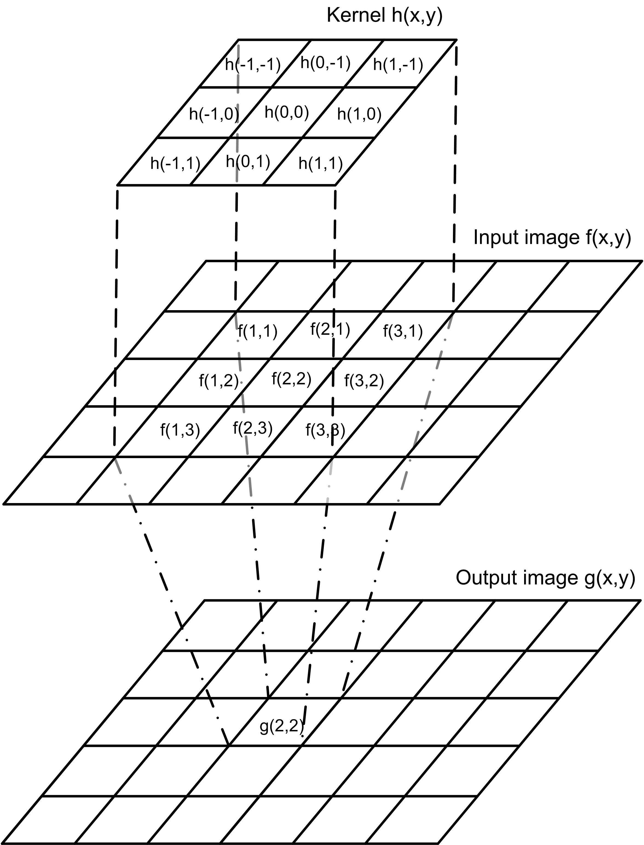
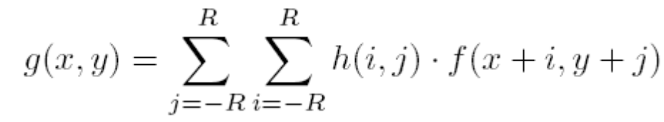
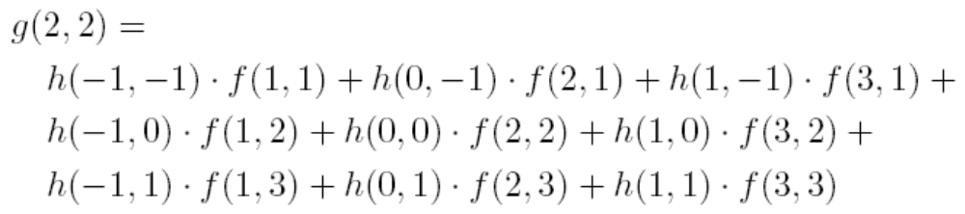
Correlation example
Calculating one value in
the output image

Slide 6
The Spatial Filtering Process
Origin
x
a
b
c
r
s
t
d
e
e
*
u
v
w
f
g
h
x
y
z
Original Image Pixels
Filter
Simple 3*3
Neighbourhood
e
3*3 Filter
e_{processed} = v*e +
r*a + s*b + t*c +
u*d + w*e +
x*f + y*g + z*h
y
Image f (x, y)
The above is repeated for every pixel in the original image to generate the smoothed image

Slide 7
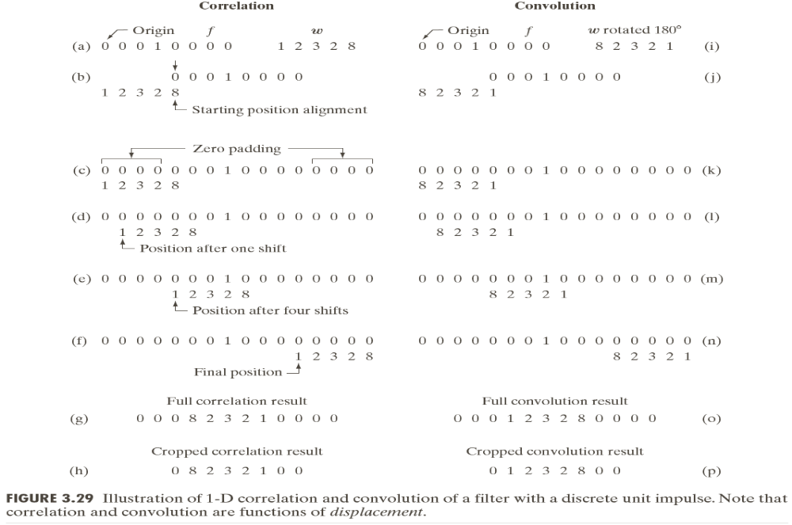

Slide 8

What is point processing?
Only one pixel in the input has an effect on the output
For example:
  Changing the brightness, thresholding, histogram stretching
Input
Output
1 | 2 | 0
2 | 1 | 4
1 | 0 | 1
1 | 3
2 | 2
0 | 1
1 | 2 | 1
2 | 5 | 3
0 | 2
1 | 2

Slide 9
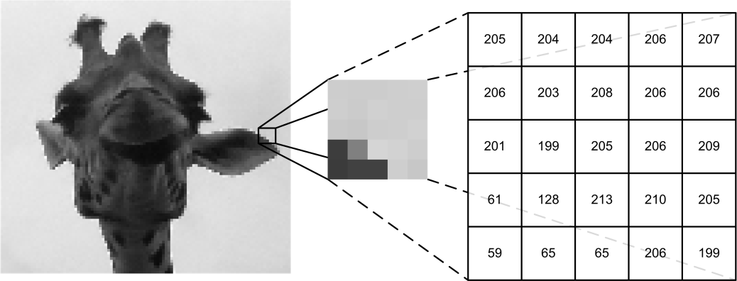
Neighborhood processing
Input
Output
1 | 2 | 0
2 | 1 | 4
1 | 0 | 1
1 | 3
2 | 2
0 | 1
1 | 2 | 1
2 | 5 | 3
0 | 2
1 | 2

Slide 10
Strange Things Happen At The Edges! (cont…)
There are a few approaches to dealing with missing edge pixels:
  Omit missing pixels
    Only works with some filters
    Can add extra code and slow down processing
  Pad the image
    Typically with either all white or all black pixels
  Replicate border pixels
  Truncate the image
  Allow pixels wrap around the image
    Can cause some strange image artefacts

Slide 11
Discussions
Correlation is a displacement function
A function with single 1 and all 0’s → discrete unit impulse
Convolving a function with unit impulse yields a copy of the function at the location of impulse
Correlation and convolution with 2-D
Correlation is used to find matches between images
Correlation / Convolution → based on preference
“Convolving a mask with an image” → convolution filter, convolution mask, convolution kernel → sliding sum-of-products

Slide 12
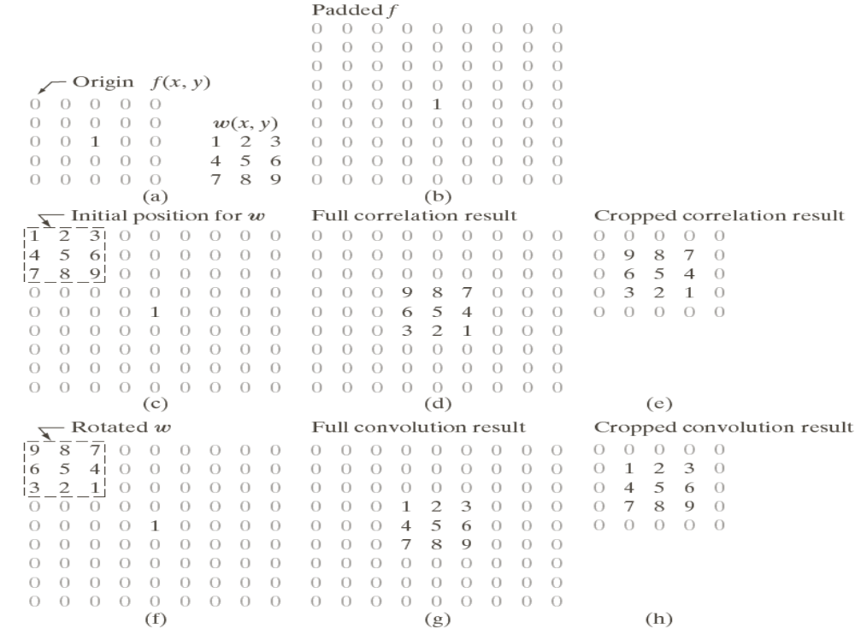

Slide 13
Generating Spatial Filter Masks
An m x n linear filter mask requires mn mask coeffs.
Coeffs. are selected based on what the filter is supposed to do.
Ex: linear filters implement a sum of products.
if we want to replace the pixels in an image by the average intensity of 3x3 neighborhood centered on those pixels → average is computed → results in image smoothing
Non linear filter → needs to specify the neighborhood and the operation. Ex: maximum intensity in filter mask to be assigned to (x,y)

Slide 14
Smoothing spatial filters
Used for blurring → removal of small details from an image prior to object extraction and bridging of small gaps in lines/curves.
Used in noise reduction → can be used with a linear / non-linear filtering
Linear filters are a.k.a averaging filters or lowpass filters
Results in an image with reduced “sharp” transitions in intensities.
As random noise has sharp transitions in intensity levels, smoothing reduces noise.
But in edges lowpass filters reduces sharpness → results in blur edges
Reduces irrelevant details in an image → pixel regions that are small w.r.to size of filter mask.

Slide 15
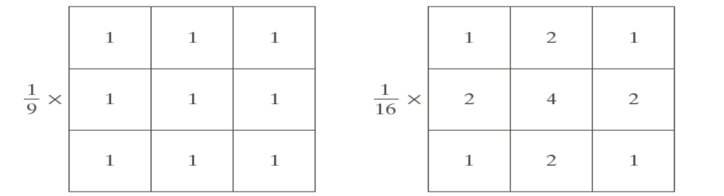
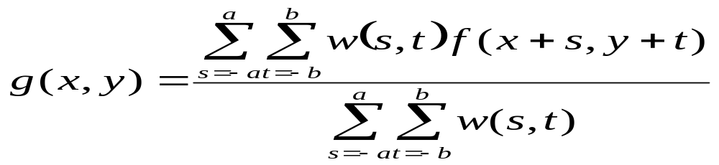
Example of smoothing filters
First filter→ average filter → entire image is divided by 9 → normalized image → a.k.a box filter (all 1’s and divide by 9)
Second filter → weighted average filter → center pixel is multiplied by a higher value than others.
  Other pixels are inversely weighted as a function of their distance from the center
  Diagonal pixels are at distance of sqrt(2) → weighted less
  Attempts to reduce blurring in the smoothing process.

Slide 16
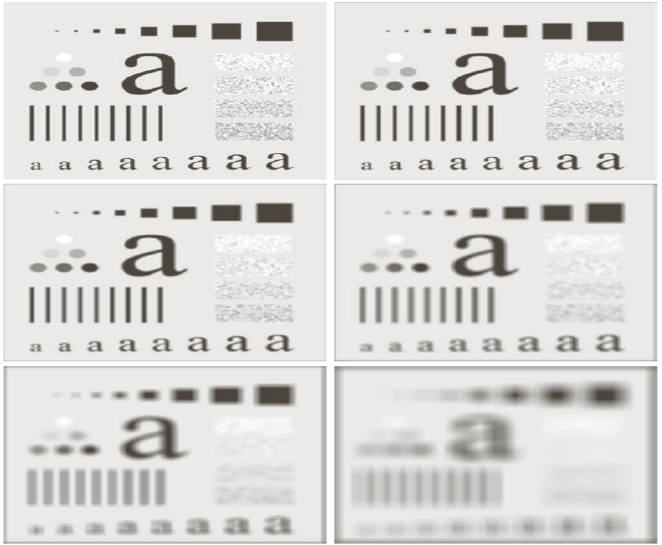
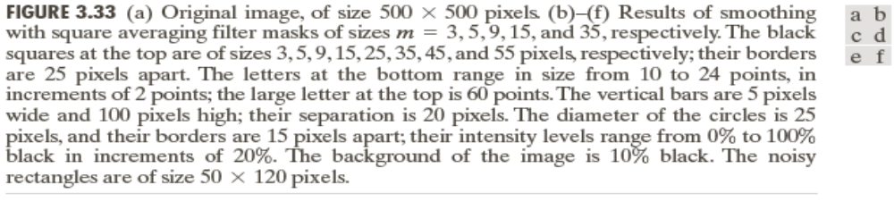
Smoothing functions

Slide 17
Results of Smoothing Filter
Blur image for getting gross representation of objects of interest → intensity of small objects blends with background and larger objects are trivially visible
Size of mask establishes the relative size of objects that blend with background

Slide 18
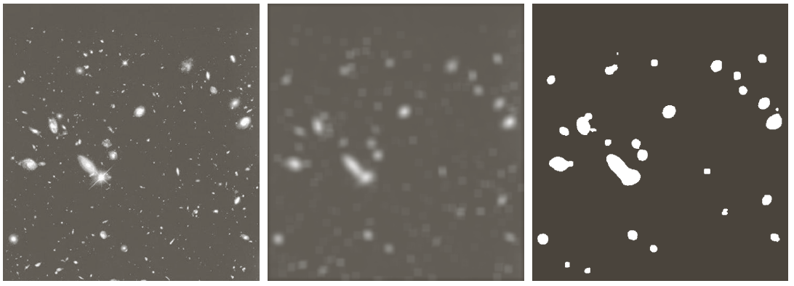
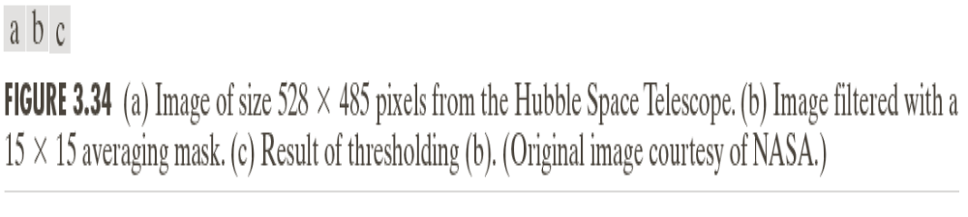
Smooth Filters

Slide 19
Non-linear (order-statistic) filters
Response is based on the ordering (ranking) the pixels contained in the image are encompassed by the filter and then replacing the value of the center pixel with the value determined by the ranking result.
Median filter (50th percentile) →replaces the values of pixel by the median of the intensity values in the neighborhood → provides excellent noise reduction, less blurring → effective in presence of impulse (salt-and-pepper) noise
Forces points with distinct intensity levels to be more like neighbors → isolated clusters of points (light or dark) are eliminated
Max Filter (100th percentile) → finding the brightest points in an image
Min Filter (0th percentile) → finding the lowest contrast points

Slide 20
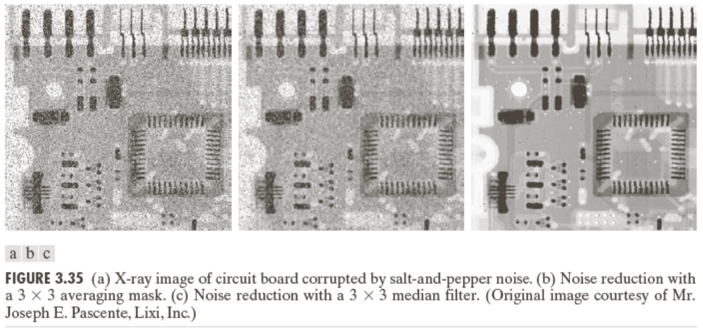
Example of non-linear filter
Median filter has better performance than averaging to reduce impulse noise

Slide 21
Sharpening - using Spatial Filters
Used to highlight transitions in intensity
Applications: Electronic printing, medical imaging, industrial inspection, autonomous guidance in military systems
Can be achieved by spatial differentiation
Operators for sharpening by digital differentiation → enhances edges and discontinuities due to noise

Slide 22
Un sharp Masking and Highboost Filtering
Method used by publishers
To sharpen images by subtracting unsharp version of image from its original
Called Unsharp masking:
  Blur the original image: f’(x,y)
  Subtract blurred from the original → mask: gm(x,y)
  Add mask to original: g(x,y) = f(x,y) +k * gm(x,y)
    k is a weight; k=1 → unsharp masking
    k > 1 → highboost filtering

Slide 23
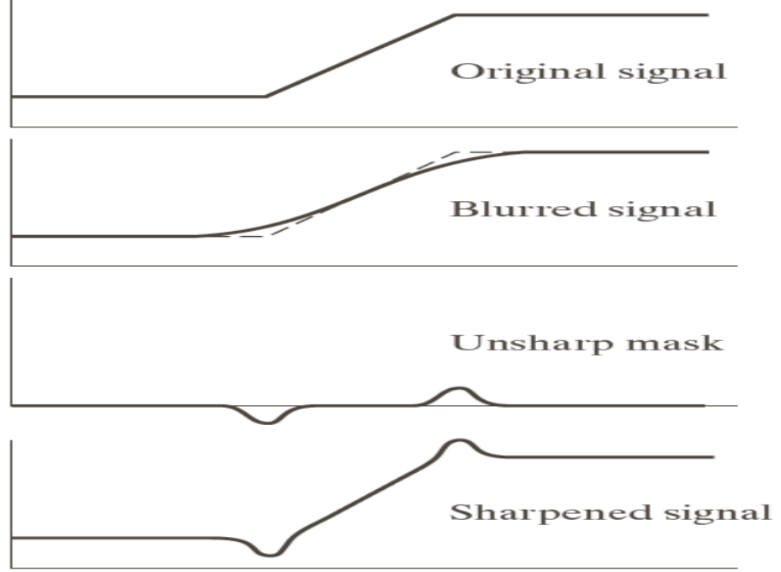
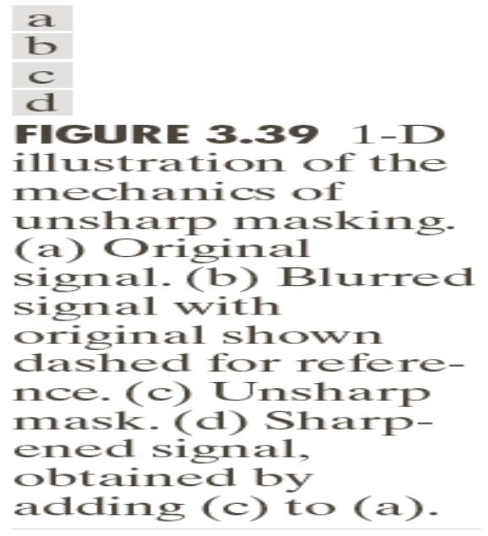
Example
Fig ( c) is the unsharp mask obtained by subtracting blurred from original → similar to 2nd order derivative
Fig (d) is final sharpened result → adding mask to the original

Slide 24
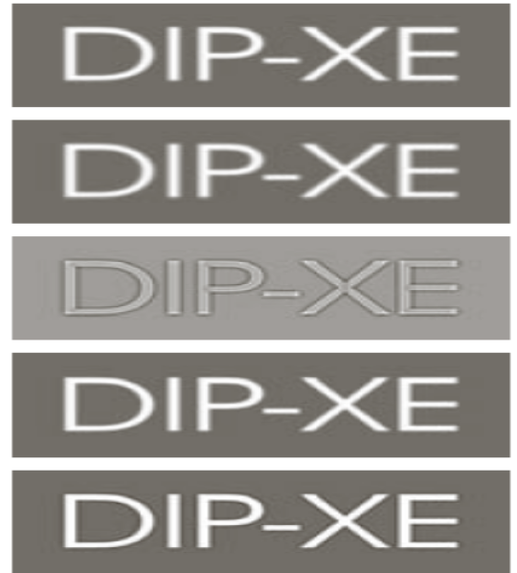
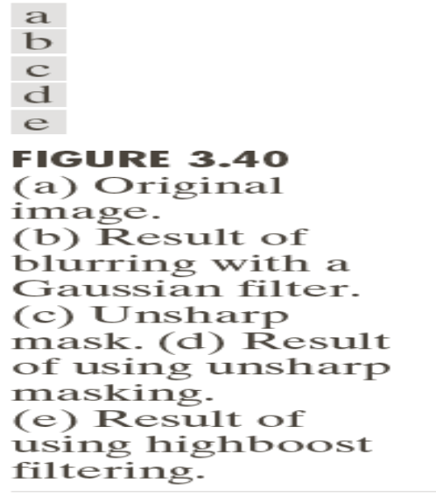
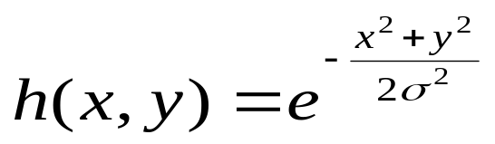
Example
Blurred image of white text on a dark gray b/g
Gaussian smoothing filter with size 5x5 and σ=3.
  Function
  Bell shaped → controlled by standard deviation

Slide 25
Sharpening using derivatives
Based on first and second order derivatives
Derivates are defined in terms of differences.
First derivative should have the following properties:
  Must be zero in areas of constant intensities
  Must be non-zero at the onset of an intensity step or ramp
  Must be nonzero along ramps
Second derivative should have the following properties:
  Must be zero in constant areas
  Must be nonzero at the onset and end of intensity ramp
  Must be zero along the ramps of constant slope

Slide 26
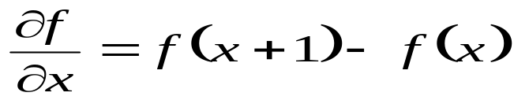
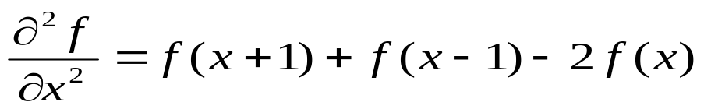
Sharpening using derivatives
First order derivative of a 1-D function is defined as:
Second order derivative is:

Slide 27
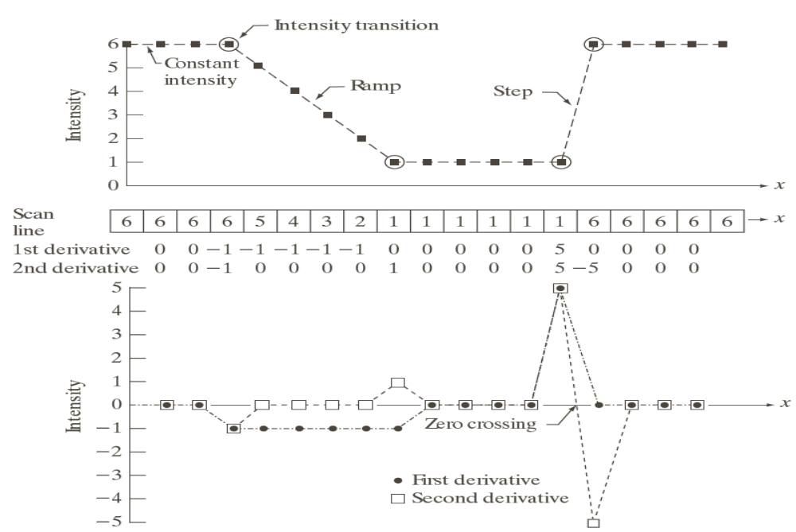
Derivatives - Representation

Slide 28
Discussions - Derivatives
Areas of constant intensity → both derivatives are zero → condition (1) is satisfied
Intensity ramp and Step → first order derivative is non-zero at the onset of the ramp and step, second order derivative is non-zero at the onset and end-of-ramp and step → condition (2) is satisfied
First derivative is non-zero and second derivative is zero along the ramp → condition (3) is satisfied
Sign of second derivative changes at the onset, end of a step or ramp
In a step transition a line joining these two values crosses horizontal axis between two extremes → zero crossing → useful in locating edges

Slide 29
Discussions - Derivatives
Edges are ramp-like transitions in intensity
First derivative of the image results in thick edges because derivative is non-zero along a ramp
Second derivative produces a double edge one pixel thick, separated by zeros → second derivative enhances fine details much better than first derivative → ideally suited for image sharpening

Slide 30
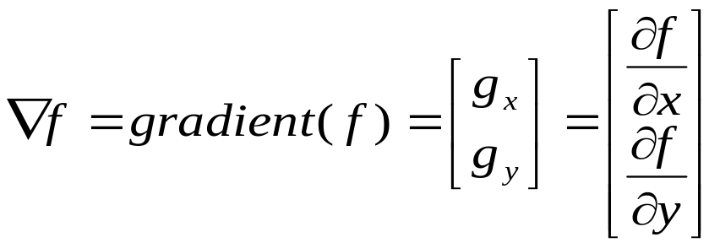
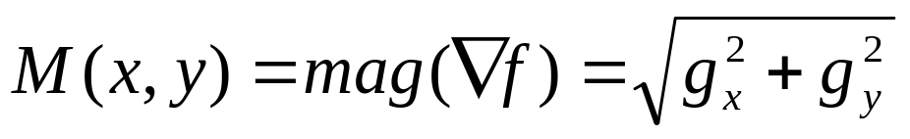
Gradient – Using first order derivative for nonlinear sharpening
First derivatives are implemented using magnitude of the gradient
For a function f(x,y) the gradient of f at (x,y) is defined as a 2-D column vector
This vector points in the direction of the greatest rate of change of f at (x,y)
Magnitude of the vector is the value at (x,y) of the rate of change in the direction of the gradient vector. → same as the size of original image
Called as the gradient image

Slide 31
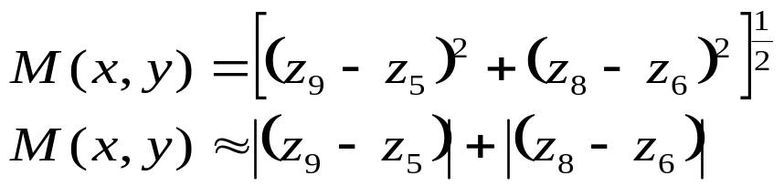
Generating filter masks
z₅ denote f(x,y) ; z₁ denote f(x-1,y-1)…
g_{x} =(z₈ - z₅); g_{y}=(z₆ - z₅) (based on first derivative)
g_{x} =(z₉ - z₅); g_{y}=(z₈ – z₆) (based on cross differences – proposed by Roberts)
x and y vary over the dimensions
Called as Roberts cross-gradient operators
Masks are of always odd sizes, smallest is 3 x 3

Slide 32
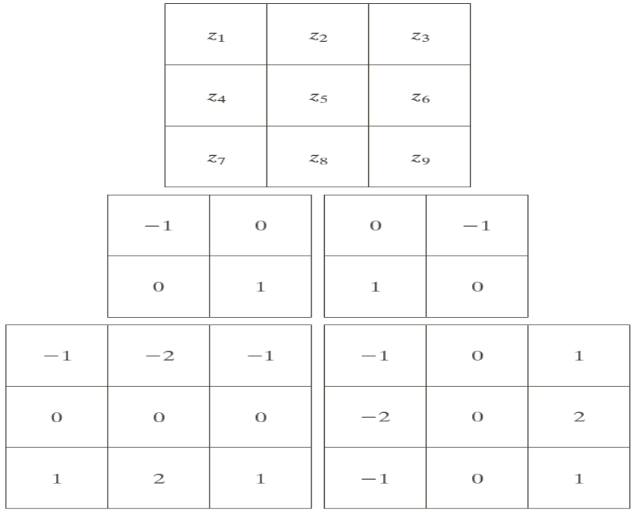
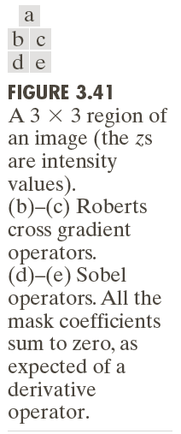
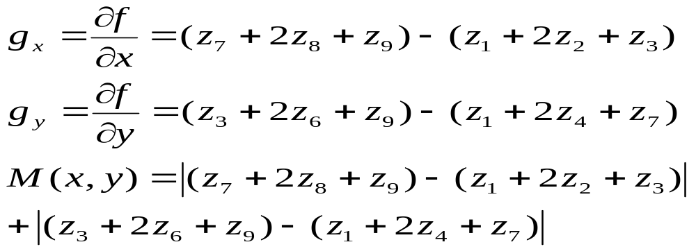
Generating filter masks - Example
Fig (b) and ( c) are results of Roberts
Fig (d) and (e) are Sobel operators

Slide 33
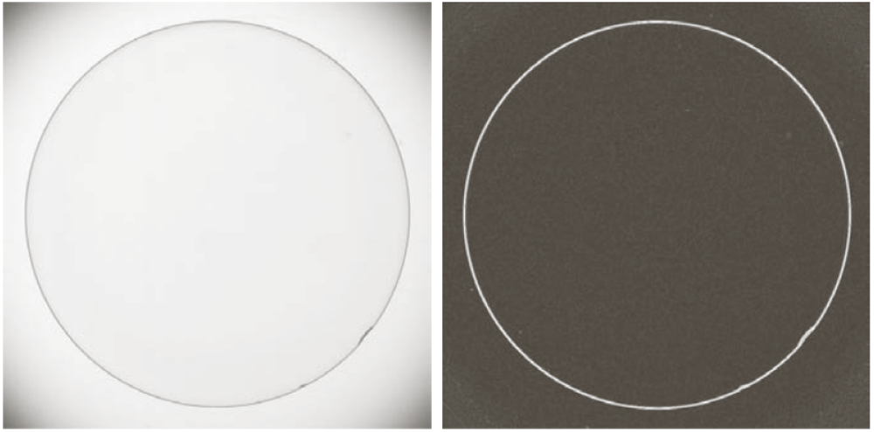
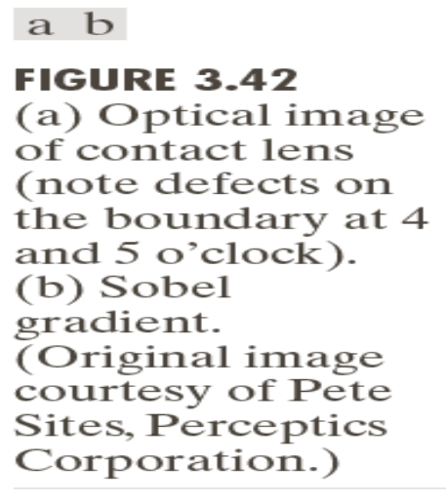
Example: Industrial Inspection
Optical image of a contact lens, illuminated by lighting arrangement to identify anomalies in edges → observations at 4 and 5’o clock
Gradient obtained by the eqns. With two sobel masks

Slide 34
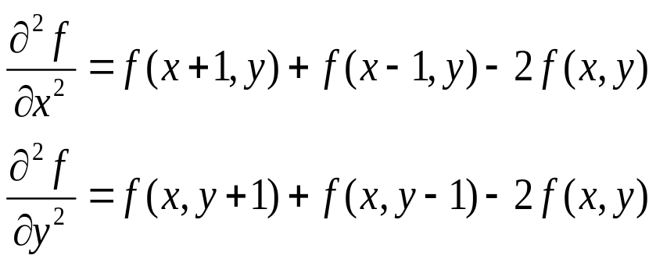
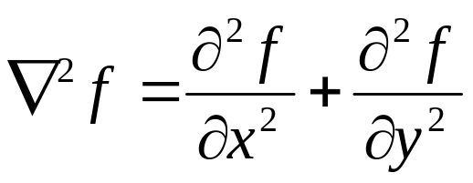
Using Second Order Derivative – for image sharpening
Extensively used in image segmentation
Define a discrete formulation
Construct a filter mask
Construct isotropic filters → response is independent of direction of discontinuities
Invariant to rotation
Laplacian – simple isotropic derivative operator, defined for an image f(x, y) as:

Slide 35
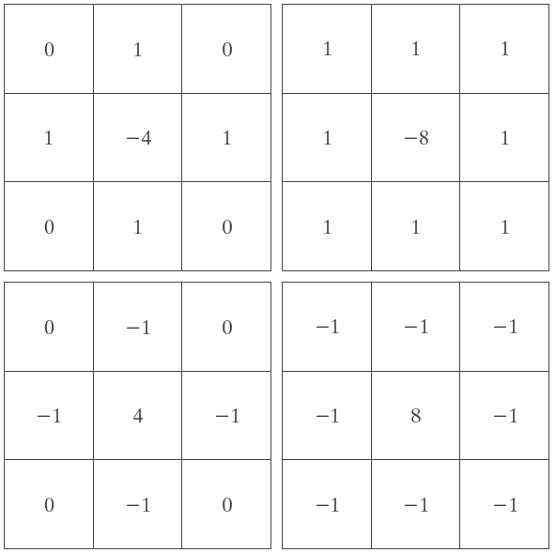
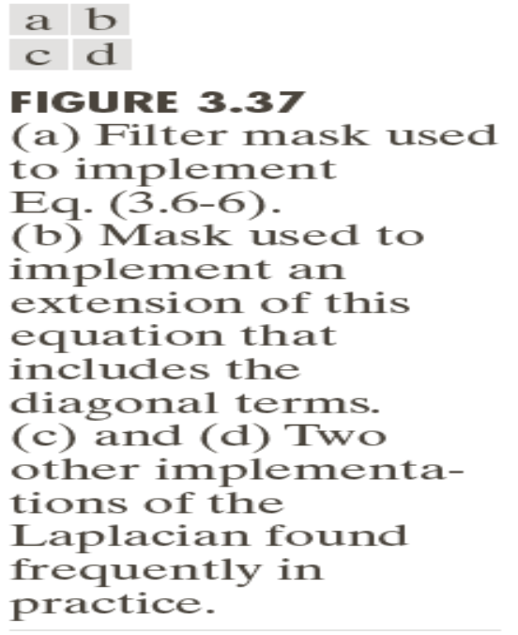
Example Filter mask
Fig (a) → isotropic filter for rotations in increments of 90 degree
Fig (b) – new coords. In diagonal resulting in -8f(x,y) → rotations in increments of 45 degree
Fig (c) and Fig (d) → negatives of (a) and (b)

Slide 36
Discussions - Second Order Derivative
Laplacian is a derivative operator
It highlights intensity discontinuities in an image
De emphasizes regions with slow variations in intensity levels
Produces images that have grayish edge lines → superimposed on a dark, featureless background
Recovers background features still preserving the sharpening effect of Laplacian by adding/ subtracting Laplacian image to the original

Slide 37
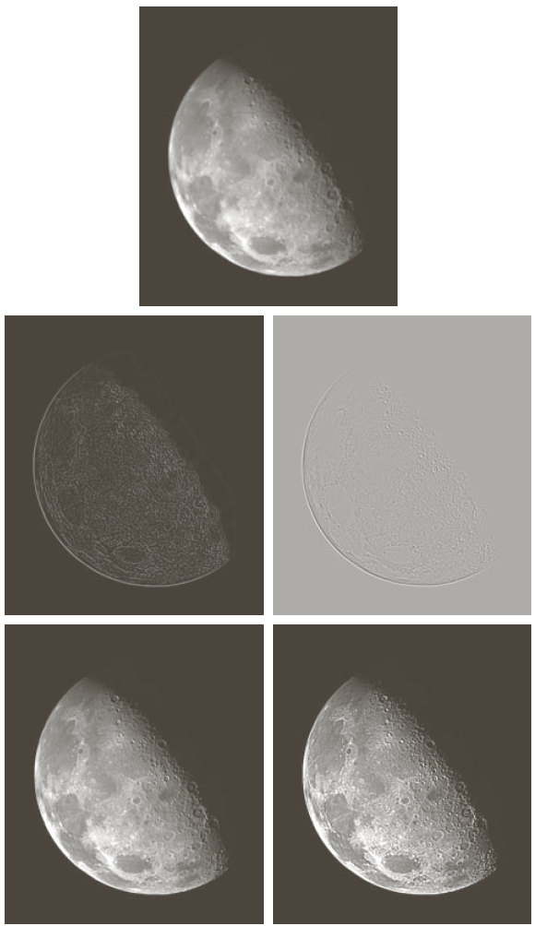
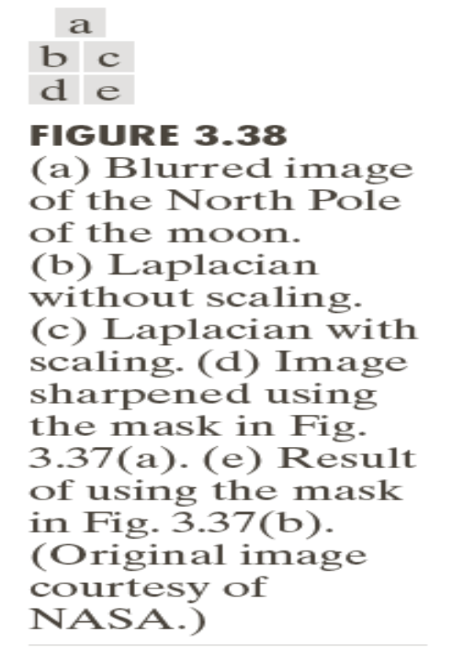
Example - Laplacian
Fig (b) → Laplacian mask → large sections are black due to Laplacian that has both positive and negative values and all negative values are clipped to zero
Fig (c) → Laplacian with scaling to full [0, L-1] → full grayish background (Laplacian property)
Fig (d) → Sharpen with c=-1 (adding original to Fig (b))
Fig (e) → Sharpen with c=-1 (adding original and Fig (c)

Slide 38
End of Spatial Domain ….
Frequency Domain…..

