Slide 1
Sharpening - using Spatial Filters
Used to highlight transitions in intensity
Applications: Electronic printing, medical imaging, industrial inspection, autonomous guidance in military systems
Can be achieved by spatial differentiation
Operators for sharpening by digital differentiation → enhances edges and discontinuities due to noise

Slide 2
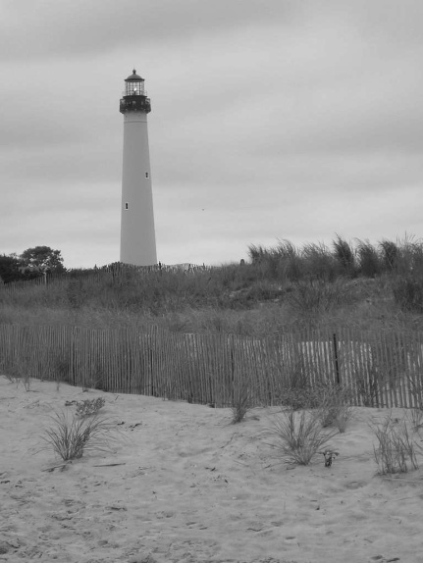
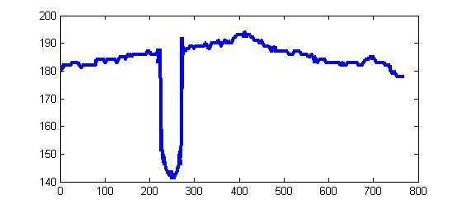
Edge Detection
Edge pixels are pixels at which the intensity of an image function changes abruptly and edges are set of connected edge pixels.

Slide 3
Modeling Intensity Changes
Step edge: The image intensity abruptly changes from one value on one side of the discontinuity to a different value on the opposite side.

Slide 4
Modeling Intensity Changes (cont’d)
Ramp edge: A step edge where the intensity change is not instantaneous but occur over a finite distance.
IDEAL
NOISY

Slide 5
Modeling Intensity Changes (cont’d)
Ridge edge: The image intensity abruptly changes value but then returns to the starting value within some short distance (i.e., usually generated by lines).

Slide 6
Modeling Intensity Changes (cont’d)
Roof edge: A ridge edge where the intensity change is not instantaneous but occur over a finite distance (i.e., usually generated by the intersection of two surfaces).
IDEAL
NOISY

Slide 7
Edge Detection
Edge is normally extracted by computing the derivative of the image function where derivative are defined in terms of differences.
Magnitude of the derivative indicates the strength/contrast of the edge
Direction of the derivative vector is the measure of edge orientation.

Slide 8
Edge Detection(Contd..)
First derivative should have the following properties:
Must be zero in areas of constant intensities
Must be non-zero at the onset of an intensity step or ramp
Must be nonzero along ramps
Second derivative should have the following properties:
Must be zero in constant areas
Must be nonzero at the onset and end of intensity step or ramp
Must be zero along the ramps of constant slope
back
back1

Slide 9
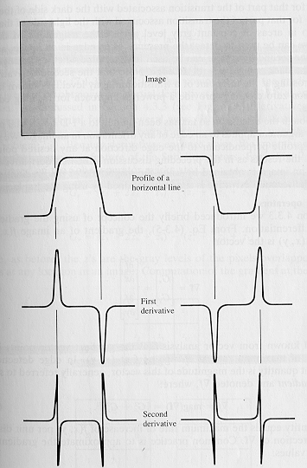
Edge Detection Using Derivatives
Often, points that lie on an edge
are detected by:
(1) Detecting the local maxima or
minima of the first derivative.
(2) Detecting the zero-crossings
of the second derivative.
1st derivative
2nd derivative

Slide 10
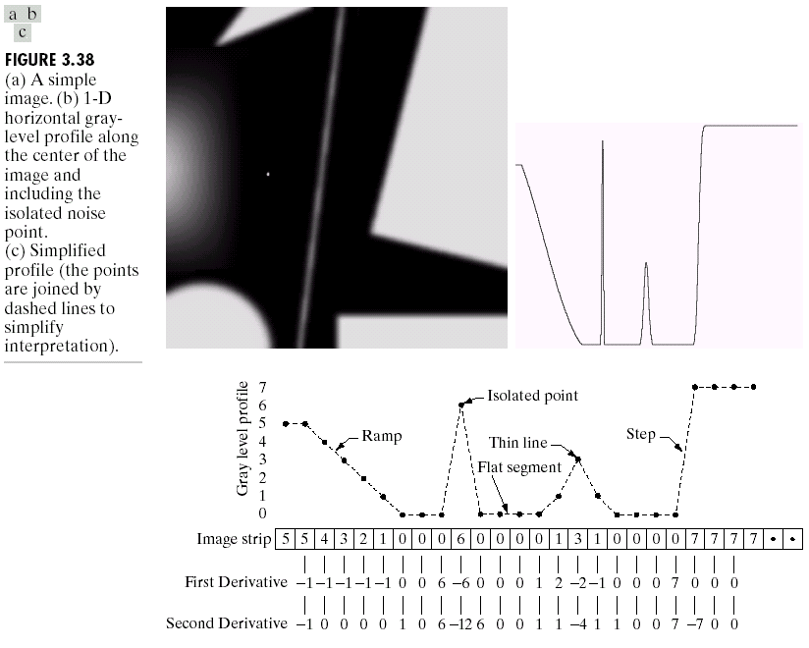
Edge Detection using First Order Derivative
Differentiation measures the rate of change of a function (Gradient)
Let’s consider a simple 1 dimensional example

Slide 11
Edge Detection using First order derivative(1 D Functions)

Slide 12
Edge Detection using First order derivative(1 D Functions)
The first derivative of a function is as follows:
It represents the difference between subsequent values
and measures the rate of change of the function

Slide 13
Edge Detection using First order derivative(1 D Functions)
5 | 5 | 4 | 3 | 2 | 1 | 0 | 0 | 0 | 6 | 0 | 0 | 0 | 0 | 1 | 3 | 1 | 0 | 0 | 0 | 0 | 7 | 7 | 7 | 7
 | 0 | -1 | -1 | -1 | -1 | 0 | 0 | 6 | -6 | 0 | 0 | 0 | 1 | 2 | -2 | -1 | 0 | 0 | 0 | 7 | 0 | 0 | 0

Slide 14
Edge detection using first order derivative (Gradient)- 2 D functions
The first derivative of an image can be computed using the gradient:

Slide 15
Gradient Representation
The gradient is a vector which has magnitude and direction:
Magnitude: indicates edge strength.
Direction: indicates edge direction.

Slide 16
First Order Edge Detection Operators
Prewitt operator
Sobel Operator
Roberts Operator

Slide 17

First Order Edge Detection Operators:
Consider the arrangement of pixels about the pixel (i,j):
3 x 3 neighborhood :
The partial derivatives and can be computed as
The constant c implies the emphasis given to pixels closer to the center of the mask.

Slide 18
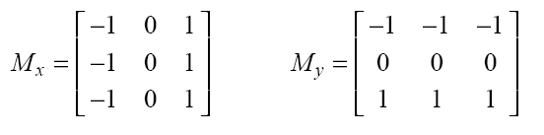
Prewitt Operator
Setting c = 1, we get the Prewitt operator:

Slide 19
Sobel Operator
Setting c = 2, we get the Sobel operator:
To filter an image it is filtered using both operators M_{X} and M_{Y} the results of which are added together

Slide 20
Roberts Operator
Robert kernels are derivative with respect to diagonal elements.
They are based on cross diagonal differences. They are also called cross gradient operators.
and can be implemented using the following mask

Slide 21
Edge Detection using Second order derivative(1 D Functions)
The second derivative of a function is as follows:
It takes into account the values both before and after the current value.

Slide 22
Edge Detection using Second order derivative(1 D Functions)(Contd..)
5 | 5 | 4 | 3 | 2 | 1 | 0 | 0 | 0 | 6 | 0 | 0 | 0 | 0 | 1 | 3 | 1 | 0 | 0 | 0 | 0 | 7 | 7 | 7 | 7
 | -1 | 0 | 0 | 0 | 0 | 1 | 0 | 6 | -12 | 6 | 0 | 0 | 1 | 1 | -4 | 1 | 1 | 0 | 0 | 7 | -7 | 0 | 0

Slide 23
Edge Detection using second order derivative(2D Functions)
Can’t always find discrete pixels where the second derivative is zero – look for zero-crossing instead.
Four cases of zero-crossings:
{+,-}, {+,0,-},{-,+}, {-,0,+}

Slide 24
Second Order Edge detection Operators
Laplacian Operator

Slide 25
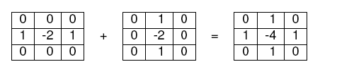
Laplacian Operator

Slide 26


Variations of Laplacian

Slide 27
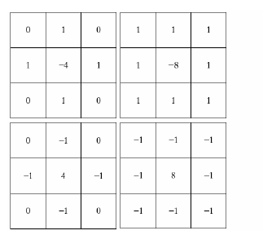
Laplace kernels
Use: for highlighting fine detail or enhancing detail that has been blurred.

Slide 28
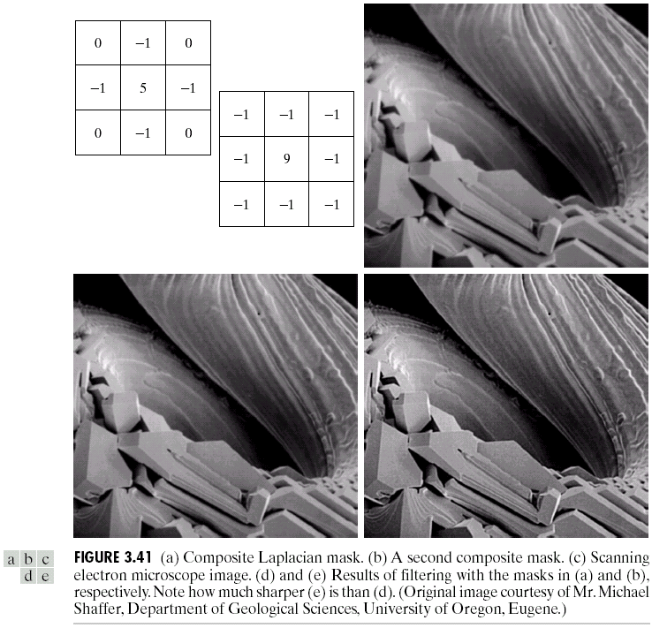
Variants On The Simple Laplacian
0
1
0
Simple Laplacian
1
1
1
Variant of Laplacian
1
-4
1
1
-8
1
0
1
0
1
1
1
-1
-1
-1
-1
8
-1
-1
-1
-1
There are lots of slightly different versions of the Laplacian that can be used:
Notes:
28

Slide 29
Un sharp Masking and Highboost Filtering
Method used by publishers
To sharpen images by subtracting unsharp version of image from its original
Called Unsharp masking:
Blur the original image: f’(x,y)
Subtract blurred from the original → mask: gm(x,y)
Add mask to original: g(x,y) = f(x,y) +k * gm(x,y)
k is a weight; k=1 → unsharp masking
k > 1 → highboost filtering

Slide 30
Example
Fig ( c) is the unsharp mask obtained by subtracting blurred from original → similar to 2nd order derivative
Fig (d) is final sharpened result → adding mask to the original

Slide 31
Example
Blurred image of white text on a dark gray b/g
Gaussian smoothing filter with size 5x5 and σ=3.
Function
Bell shaped → controlled by standard deviation

Slide 32
Discussions - Derivatives
Areas of constant intensity → both derivatives are zero → condition (1) is satisfied
Intensity ramp and Step → first order derivative is non-zero at the onset of the ramp and step, second order derivative is non-zero at the onset and end-of-ramp and step → condition (2) is satisfied
First derivative is non-zero and second derivative is zero along the ramp → condition (3) is satisfied
Sign of second derivative changes at the onset, end of a step or ramp
In a step transition a line joining these two values crosses horizontal axis between two extremes → zero crossing → useful in locating edges

Slide 33
Discussions - Derivatives
Edges are ramp-like transitions in intensity
First derivative of the image results in thick edges because derivative is non-zero along a ramp
Second derivative produces a double edge one pixel thick, separated by zeros → second derivative enhances fine details much better than first derivative → ideally suited for image sharpening

Slide 34
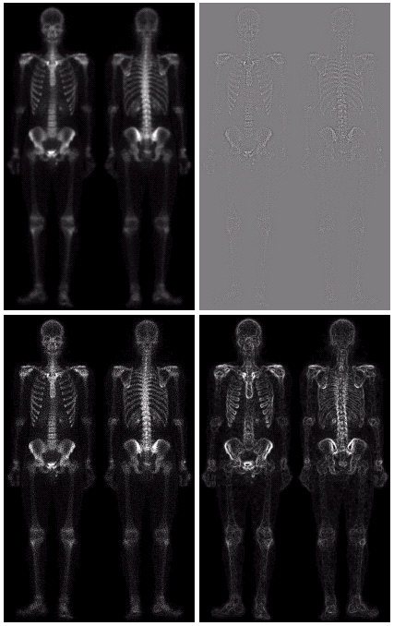
Combining Spatial Enhancement Methods
Successful image enhancement is typically not achieved using a single operation
Rather we combine a range of techniques in order to achieve a final result
This example will focus on enhancing the bone scan to the right
Notes:
34

Slide 35
Combining Spatial Enhancement Methods (cont…)
(a)
Laplacian filter of bone scan (a)
(b)
Sharpened version of bone scan achieved by subtracting (a) and (b)
(c)
Sobel filter of bone scan (a)
(d)
Notes:
35

Slide 36
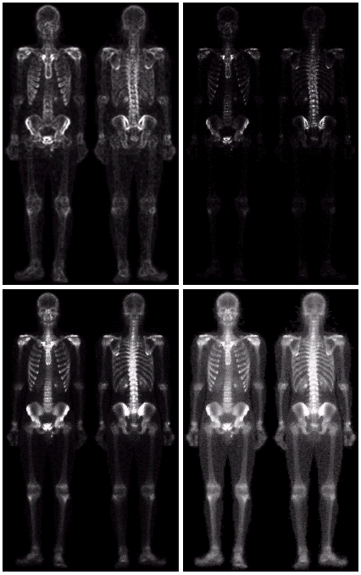
Combining Spatial Enhancement Methods (cont…)
Result of applying a power-law trans. to (g)
(h)
Sharpened image which is sum of (a) and (f)
(g)
The product of (c) and (e) which will be used as a mask
(f)
(e)
Image (d) smoothed with a 5*5 averaging filter
Notes:
36

Slide 37
Combining Spatial Enhancement Methods (cont…)
Compare the original and final images
Notes:
37

