Slide 1
Digital Image Processing
Image Segmentation:
Thresholding

Slide 2
Contents
Today we will continue to look at the problem of segmentation, this time though in terms of thresholding
In particular we will look at:
  What is thresholding?
  Simple thresholding
  Adaptive thresholding

Slide 3
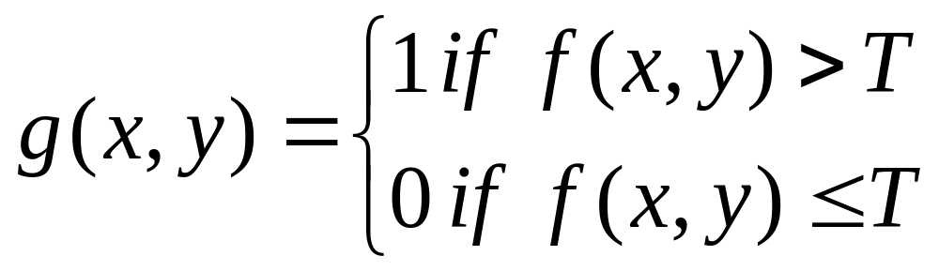
Thresholding
Thresholding is usually the first step in any segmentation approach
We have talked about simple single value thresholding already
Single value thresholding can be given mathematically as follows:

Slide 4


Thresholding Example
Imagine a poker playing robot that needs to visually interpret the cards in its hand
Original Image
Thresholded Image

Slide 5
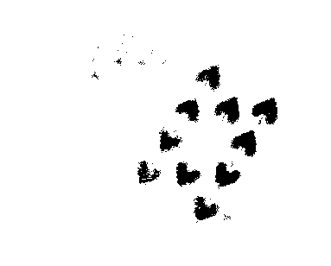

But Be Careful
If you get the threshold wrong the results can be disastrous
Threshold Too Low
Threshold Too High

Slide 6
Basic Global Thresholding
Based on the histogram of an image
Partition the image histogram using a single global threshold
The success of this technique very strongly depends on how well the histogram can be partitioned

Slide 7
Basic Global Thresholding Algorithm
The basic global threshold, T, is calculated
as follows:
  Select an initial estimate for T (typically the average grey level in the image)
  Segment the image using T to produce two groups of pixels: G₁ consisting of pixels with grey levels >T and G₂ consisting pixels with grey levels ≤ T
  Compute the average grey levels of pixels in G₁ to give μ₁ and G₂ to give μ₂

Slide 8
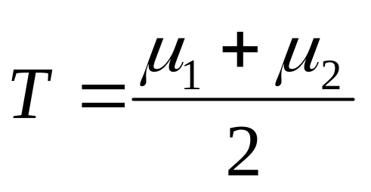
Basic Global Thresholding Algorithm
  Compute a new threshold value:
  Repeat steps 2 – 4 until the difference in T in successive iterations is less than a predefined limit T∞
This algorithm works very well for finding thresholds when the histogram is suitable

Slide 9
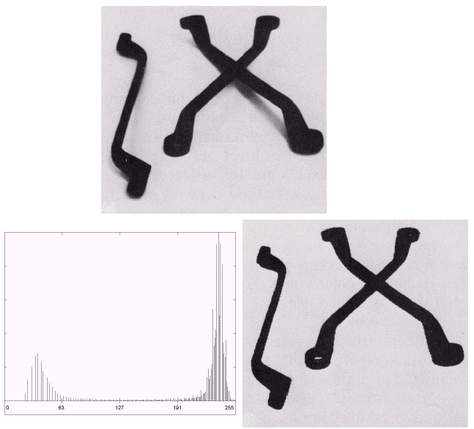

Thresholding Example 1
Images taken from Gonzalez & Woods, Digital Image Processing (2002)

Slide 10
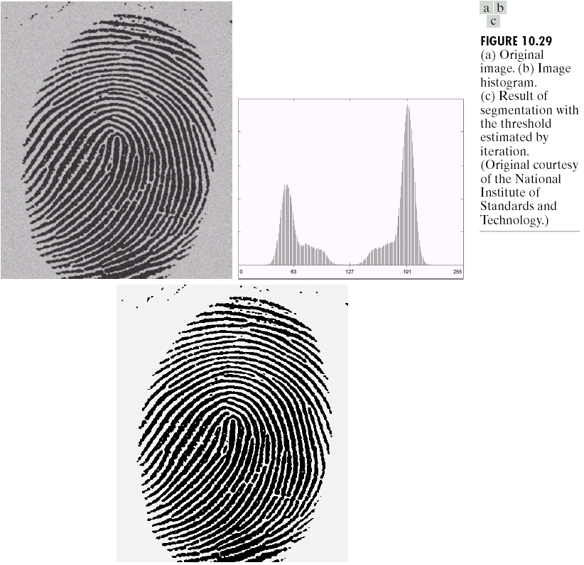
Thresholding Example 2
Images taken from Gonzalez & Woods, Digital Image Processing (2002)

Slide 11
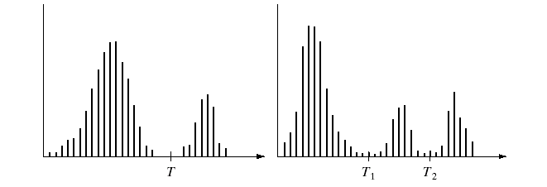
Problems With Single Value Thresholding
Single value thresholding only works for bimodal histograms
Images with other kinds of histograms need more than a single threshold
Images taken from Gonzalez & Woods, Digital Image Processing (2002)

Slide 12
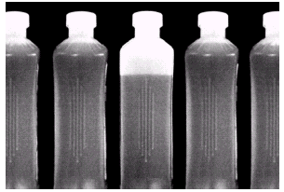
Problems With Single Value Thresholding (cont…)
Let’s say we want to
isolate the contents
of the bottles
Think about what the
histogram for this
image would look like
What would happen if we used a single threshold value?
Images taken from Gonzalez & Woods, Digital Image Processing (2002)

Slide 13
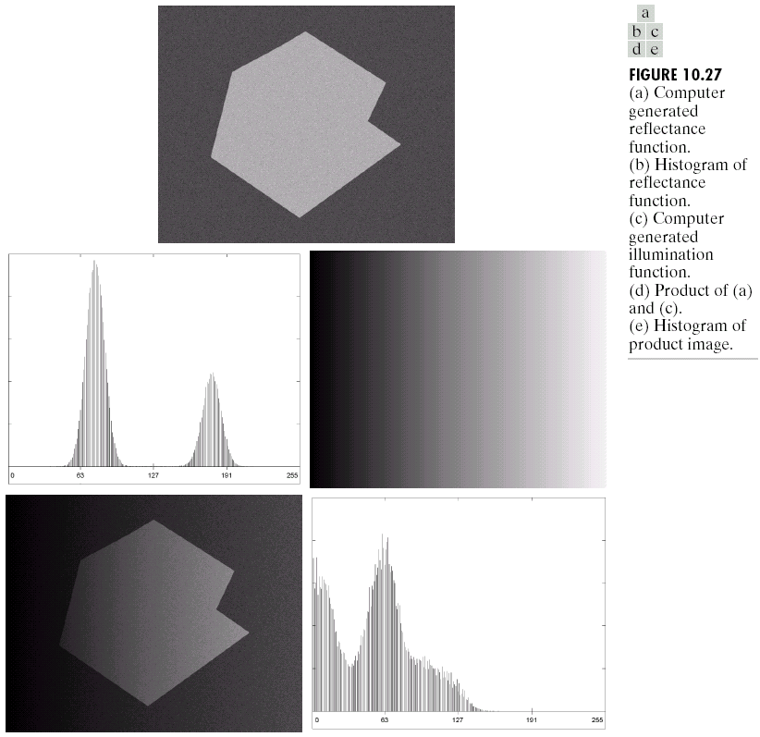
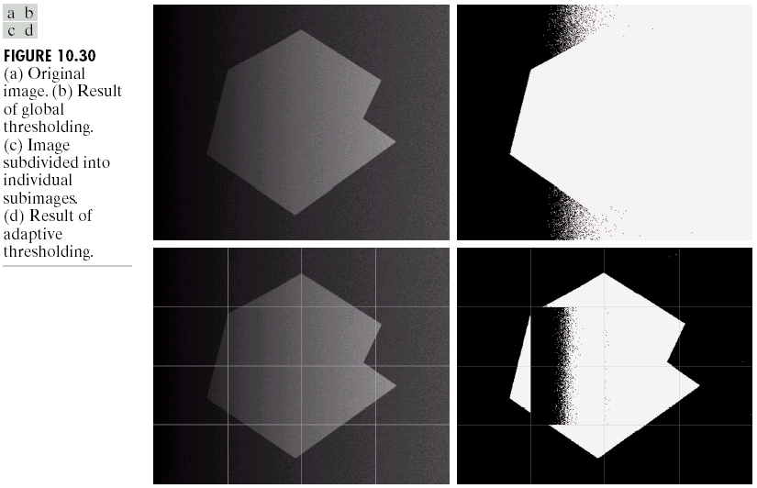
Single Value Thresholding and Illumination
Images taken from Gonzalez & Woods, Digital Image Processing (2002)
Uneven illumination can really upset a single valued thresholding scheme

Slide 14
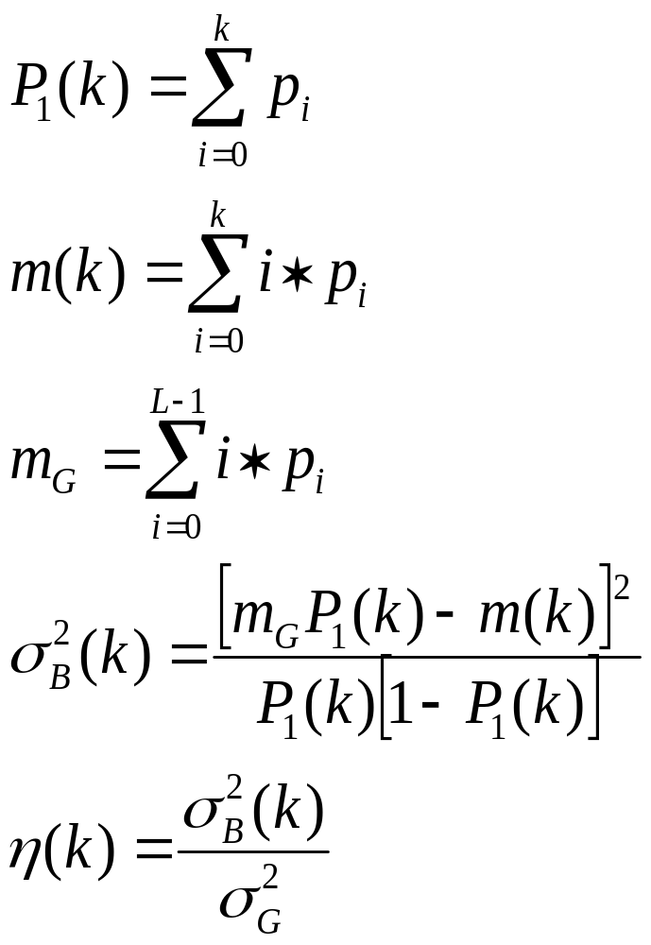
Otsu’s method of Thresholding
Compute the normalized histogram. Denote the components of the histogram by pi, for i=1 to L-1
Compute the cumulative sums, P1(k), for k=1 to L-1 using P1(k)
Compute the cumulative means – average intensity up to level k, m(k) for k=1 to L-1 using m(k)
Compute the global mean intensity mG using mG
Compute the between class variance
Obtain the Otsu threshold k* as the value of k for which the between-class variance is maximum . If the maximum is not unique, obtain k* by averaging the values of k corresponding to the various maxima detected.
Obtain the separability measure at k=k*

Slide 15
Basic Adaptive Thresholding
An approach to handling situations in which single value thresholding will not work is to divide an image into sub images and threshold these individually
Since the threshold for each pixel depends on its location within an image this technique is said to adaptive

Slide 16
Basic Adaptive Thresholding Example
The image below shows an example of using adaptive thresholding with the image shown previously
As can be seen success is mixed
But, we can further subdivide the troublesome sub images for more success

Slide 17

Basic Adaptive Thresholding Example (cont…)
These images show the
troublesome parts of the
previous problem further
subdivided
After this sub division
successful thresholding
can be
achieved

Slide 18
Summary
In this lecture we have begun looking at segmentation, and in particular thresholding
We saw the basic global thresholding algorithm and its shortcomings
We also saw a simple way to overcome some of these limitations using adaptive thresholding

Slide 19
For further reading
Region based segmentation
Morphology based segmentation – watershed segmentation
Dam construction

