Slide 1

BigQuery – Geotab Intersection Congestion Prediction
Group 6
Gayathri Chandrasekaran
Pragya Srivastava
Sharmin Kantharia

Slide 2
Introduction
The dataset is taken from Kaggle Open dataset. It is originally from Geotab – a company that specializes in GPS fleet management and vehicle tracking – telematics industry.
Objective – Multi – target prediction of 2 targets that determine traffic: Distance from first stop to the end of intersection at the 80th percentile and Total time stopped at intersection at the 80th percentile.
Applications of the Project include –
City Planners and Government can organize traffic better
Infrastructure planning to handle high traffic areas
Helps applications like Google Maps predict congestion

Slide 3
Data and its Preparation
The data is generated for the cities of Atlanta, Boston, Chicago and Philadelphia, with 800,000 datapoints
Training set – 28 columns
Selected city – Philadelphia
Most features had categorical values – to reduce dimensionality we created clusters based on longitude and latitude. (10 main clusters)
Same direction function: 1 is EntryStreetName = ExitStreetName, 0 if not same
Direction function based on EntryHeading and ExitHeading to give 4 directions: Right, Left, Straight, U-turn
Road type function categorizes the EntryStreetName and ExitStreeName into 11 different categories.

Slide 4
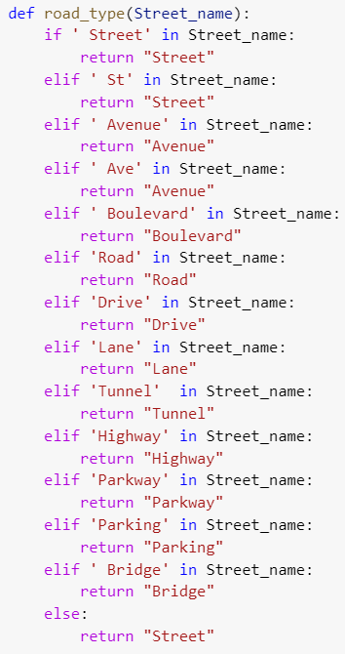
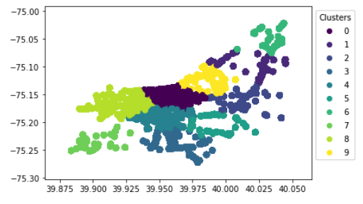
Philadelphia - Clusters

Slide 5
Challenges
Initially the plan was to predict 15 targets – but upon exploring further – to save computational time and complexity – 2 targets were picked.
AWS SageMaker:
Cost
Larger Dataset

Slide 6
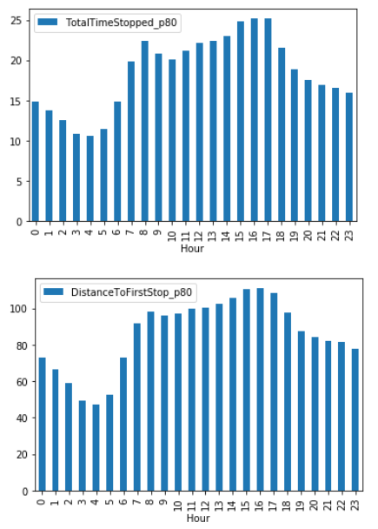
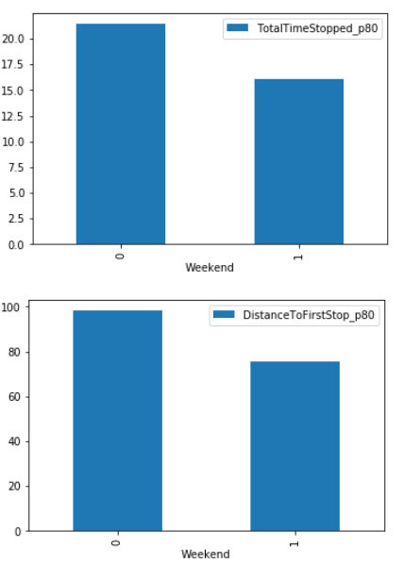
Exploratory Data Analysis – For Total Time Stopped & Distance to First Stop
By Hour
By Weekend/day (1= Weekend)

Slide 7
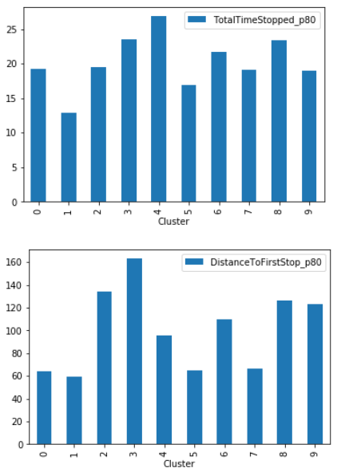
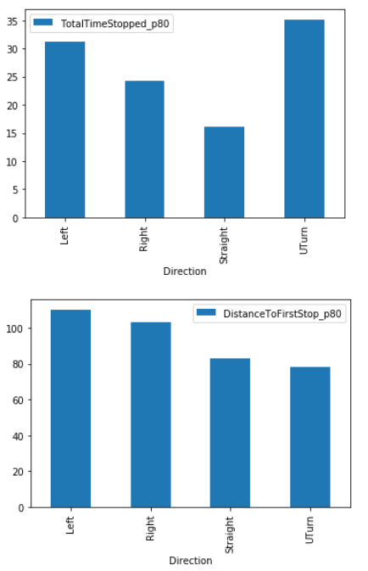
Exploratory Data Analysis – For Total Time Stopped & Distance to First Stop
By Clusters
By Direction

Slide 8
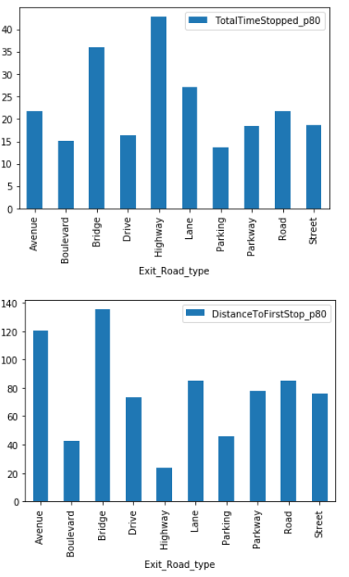
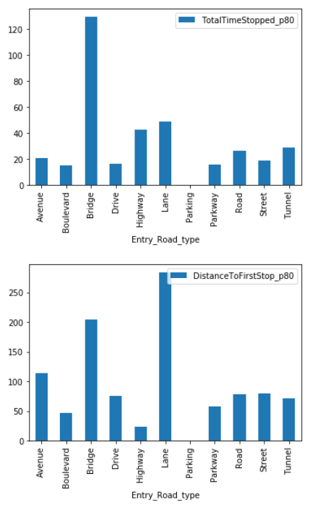
Exploratory Data Analysis – For Total Time Stopped & Distance to First Stop
By Entry Road Type
By Exit Road Type
By Entry Road Type

Slide 9
Modelling
Regression Algorithms:
Linear Regression
Lasso & ridge regression
Elastic Net
Decision tree
Random Forest
Multi Output Regressor:
Important features:
Intersections
Clusters
Traffic Heading Direction
R2 Score – less than 30%
Model | DistanceToFirstStop_p80 | TotalTimeStopped_p80 | Hyper Parameters
Random Forest | ~77% | ~62% | min_samples_split- 20 min_samples_leaf - 1

Slide 10
Findings & Results
Exploratory Data Analysis:
Clusters with high average total time stopped also have higher distance from the first stop which implies high traffic
U-Turns and Left Turns have high total time and distance stopped
Modelling:
Random Forest best model followed by Decision tree
Dataset is not linearly separable
Intersection Section & Cluster plays vital role in congestion
Future Goals:
Analysis on other infrastructure aspects – zonal information, etc
Extend Model to accommodate multiple cities
In terms of AWS services, Lambda Function
GUI for better accessibility

Slide 11







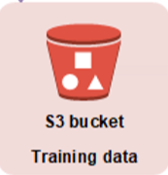
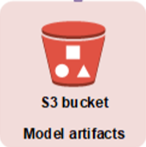
AWS Pipeline - Project Architecture & Data Flow
Data Source:
Kaggle dataset :
train.csv
test.csv
IAM Role :
Role Permission : Access any s3 Buckets
Policy : AmazonSageMakerFullAccess
S3FullAccess
Amazon S3:
Role: Data Storage
Region : US East (N. Virginia)
Files : train.csv, test.csv, Trained_Model,
Predicted_Results.
Amazon SageMaker:
Role: Create, train and deploy ML model in cloud.
Assign Full access S3 IAM role
Instances : Notebook Instances
Instance Type: ml.t2.medium
CPU : 2 Mem: 4 GB
Data – cleanup/Processing – Python libraries
Code Commit:
To securely collaborate and ensure version-control with Jupyter Notebooks.
AWS Cloud
Comma separated files
Model Training on Notebook Instance
Data Source
Kaggle Dataset – Train.csv & Test.csv
Deployment/Prediction on Notebook Instance
Amazon SageMaker

Slide 12
AWS Services
Amazon SageMaker:
Notebook instance:
Instance Type - ml.t2.medium
IAM Role & Policy – S3 Access to associated S3 bucket
AWS CodeCommitPower Access
VPC – default VPC & Subnet
CodeCommit repo - AmazonSagemaker-Geotab-pred-CodeCommitRepo
K Means Clustering:
Training & Deploying model:
Instance Type - ml.m4.xlarge
Train Seconds – 112 seconds
Random Forest :
Training & Deploying model:
Instance Type - ml.m4.xlarge
Train Seconds – 83 seconds

Slide 13
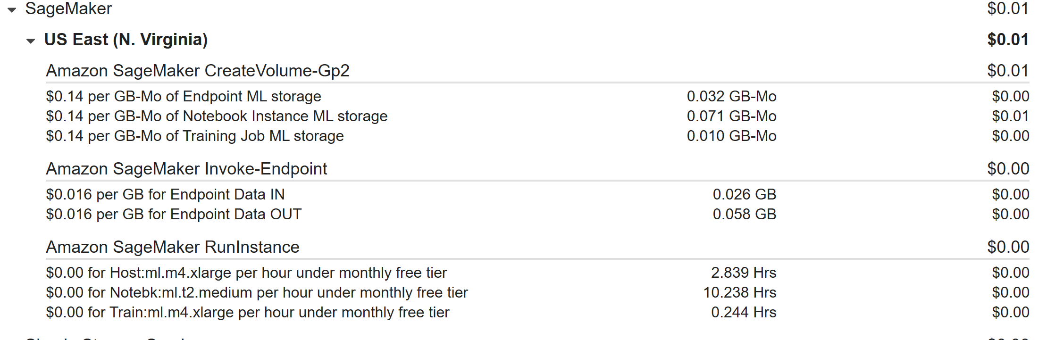
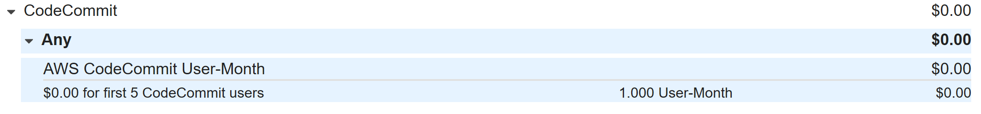
SageMaker Service Pricing Used

Slide 14
Demo

