Slide 1

SMART INDIA HACKATHON 2026
TITLE PAGE
Problem Statement ID –SIH26112
Problem Statement Title- Design and Develop a Modular Autonomous Mobile Robot (AMR) Platform for Smart Warehouse Automation
Theme-Robotics and Drones
PS Category- Hardware
Team ID-SIH26-A0H-T284
Team Name (Registered on portal)-Krayons

Slide 2
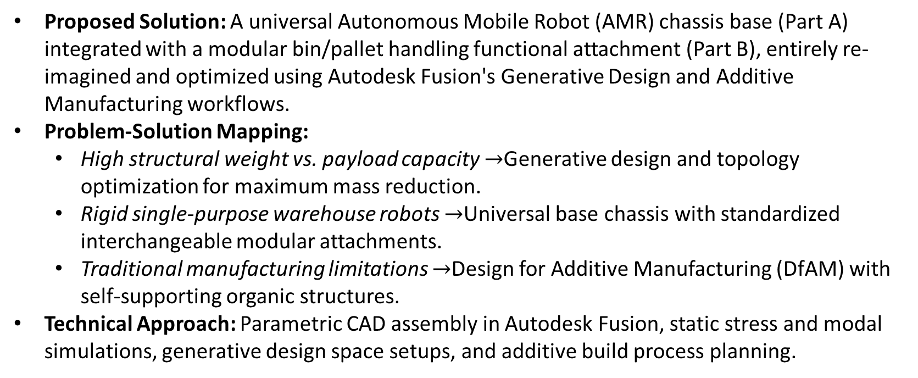
Krayons
Proposed Solution & Innovation
Proposed Solution: A universal Autonomous Mobile Robot (AMR) chassis base (Part A) integrated with a modular bin/pallet handling functional attachment (Part B), entirely re-imagined and optimized using Autodesk Fusion's Generative Design and Additive Manufacturing workflows.
Problem-Solution Mapping:
  High structural weight vs. payload capacity $→$Generative design and topology optimization for maximum mass reduction.
  Rigid single-purpose warehouse robots $→$Universal base chassis with standardized interchangeable modular attachments.
  Traditional manufacturing limitations $→$Design for Additive Manufacturing (DfAM) with self-supporting organic structures.
Technical Approach: Parametric CAD assembly in Autodesk Fusion, static stress and modal simulations, generative design space setups, and additive build process planning.

Slide 3
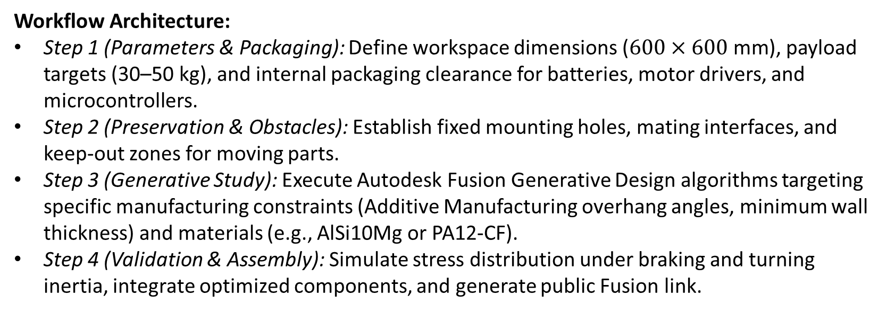
TECHNICAL APPROACH
Krayons
Workflow Architecture:
Step 1 (Parameters & Packaging): Define workspace dimensions ($600×600\text{ mm}$), payload targets (30–50 kg), and internal packaging clearance for batteries, motor drivers, and microcontrollers.
Step 2 (Preservation & Obstacles): Establish fixed mounting holes, mating interfaces, and keep-out zones for moving parts.
Step 3 (Generative Study): Execute Autodesk Fusion Generative Design algorithms targeting specific manufacturing constraints (Additive Manufacturing overhang angles, minimum wall thickness) and materials (e.g., AlSi10Mg or PA12-CF).
Step 4 (Validation & Assembly): Simulate stress distribution under braking and turning inertia, integrate optimized components, and generate public Fusion link.

Slide 4
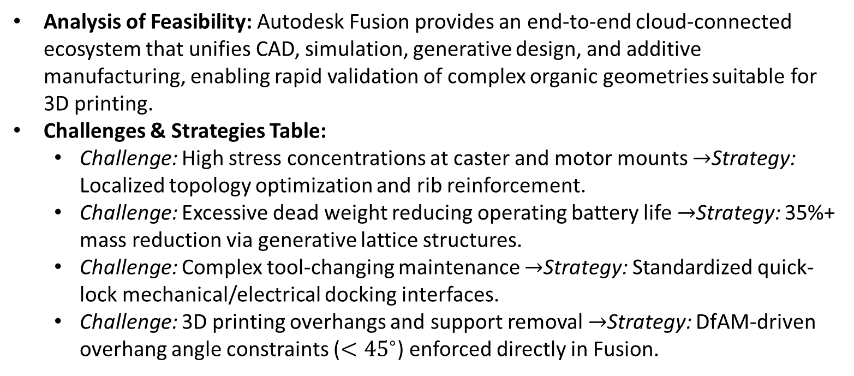
FEASIBILITY AND VIABILITY
Krayons
Analysis of Feasibility: Autodesk Fusion provides an end-to-end cloud-connected ecosystem that unifies CAD, simulation, generative design, and additive manufacturing, enabling rapid validation of complex organic geometries suitable for 3D printing.
Challenges & Strategies Table:
  Challenge: High stress concentrations at caster and motor mounts $→$Strategy: Localized topology optimization and rib reinforcement.
  Challenge: Excessive dead weight reducing operating battery life $→$Strategy: 35%+ mass reduction via generative lattice structures.
  Challenge: Complex tool-changing maintenance $→$Strategy: Standardized quick-lock mechanical/electrical docking interfaces.
  Challenge: 3D printing overhangs and support removal $→$Strategy: DfAM-driven overhang angle constraints ($<{45}^{∘}$) enforced directly in Fusion.

Slide 5
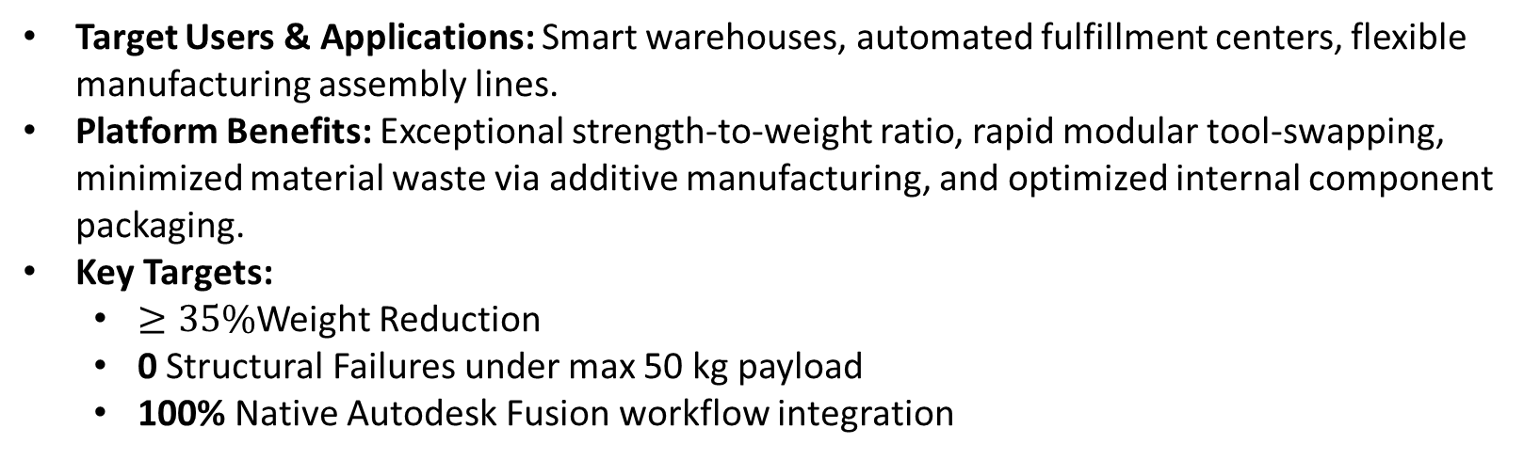
IMPACT AND BENEFITS
Krayons
Target Users & Applications: Smart warehouses, automated fulfillment centers, flexible manufacturing assembly lines.
Platform Benefits: Exceptional strength-to-weight ratio, rapid modular tool-swapping, minimized material waste via additive manufacturing, and optimized internal component packaging.
Key Targets:
  $≥35\%$Weight Reduction
  0 Structural Failures under max 50 kg payload
  100% Native Autodesk Fusion workflow integration

Slide 6
RESEARCH AND REFERENCES
Krayons
Research topics:
References:
Design for Additive Manufacturing (DfAM), Topology Optimization in Mobile Robotics, Kinematic Modular Interfaces for AGVs/AMRs, Generative Design Methodologies.
[1] Autodesk Fusion Official Documentation: Generative Design and Additive Manufacturing Workflows.
[2] Gibson, I., Rosen, D., & Stucker, B. Additive Manufacturing Technologies: 3D Printing, Rapid Prototyping, and Direct Digital Manufacturing. Springer.
[3] Sigmund, O., & Maute, K. Topology optimization approaches: A comparative review. Structural and Multidisciplinary Optimization.

