Slide 1

SMART INDIA HACKATHON 2026
TITLE PAGE
Problem Statement ID –SIH26123
Problem Statement Title-Edge-AI Based Distributed Fleet Coordination for Autonomous Mobile Robots (AMRs) in Smart Warehouses
Theme-Smart Automation
PS Category- Software
Team ID-SIH26-A0H-T284
Team Name (Registered on portal)-Krayons

Slide 2
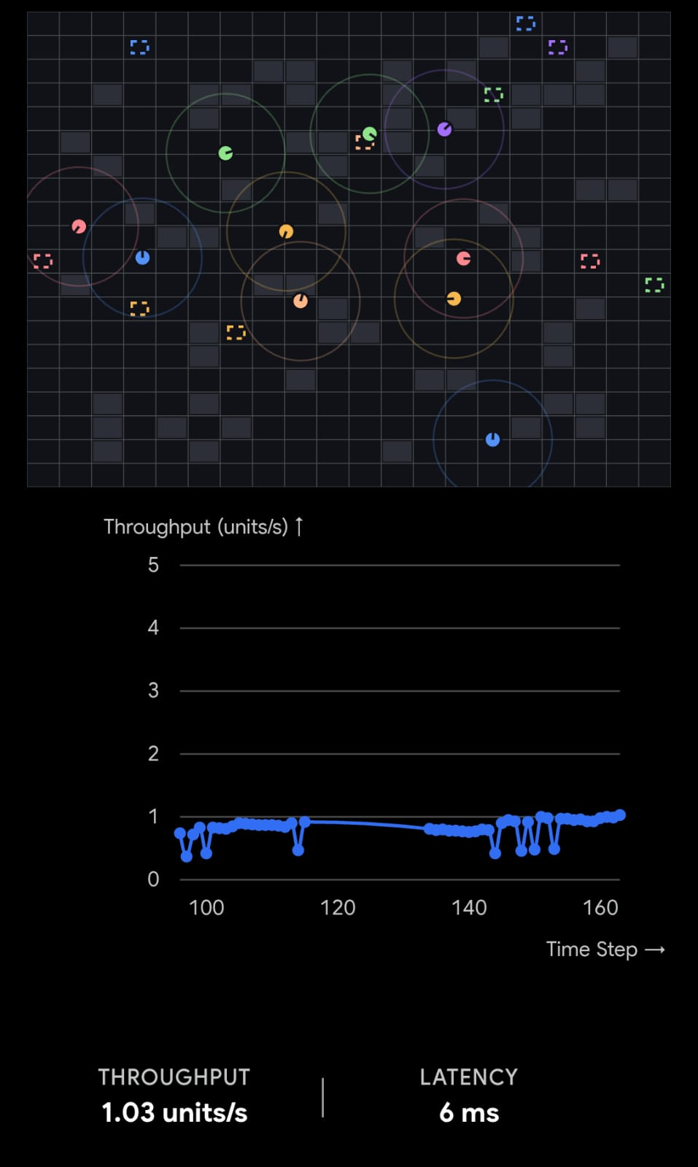
Krayons
Collaborative AMR Intelligence
How we address the Problem:
Innovation & Uniqueness:
Proposed Solution:
3+ AMRs operate collaboratively in a dynamic warehouse.
Each robot makes local decisions on edge hardware.
Robots communicate position, velocity & intent directly.
Ego-radius filters only nearby robots for efficient processing.
VO prediction identifies potential collision risks.
Priority-based yielding resolves conflicts and deadlocks.
Dynamic re-routing handles blocked aisles.
Task reassignment keeps operations running if a robot becomes unavailable.
Problem | Solutions
Network latency | Local edge decisions
Wi-fi dead zones | Peer-to-peer communication
Central failure | Decentralized coordination
Collision at intersection | VO + priority-based yielding
Blocked aisle | Dynamic A* re-routing
Robot/task failure | Dynamic task reassignment
Narrow-aisle deadlock | Conflict resolution
Predictive
Distributed
Local
Adaptive

Slide 3
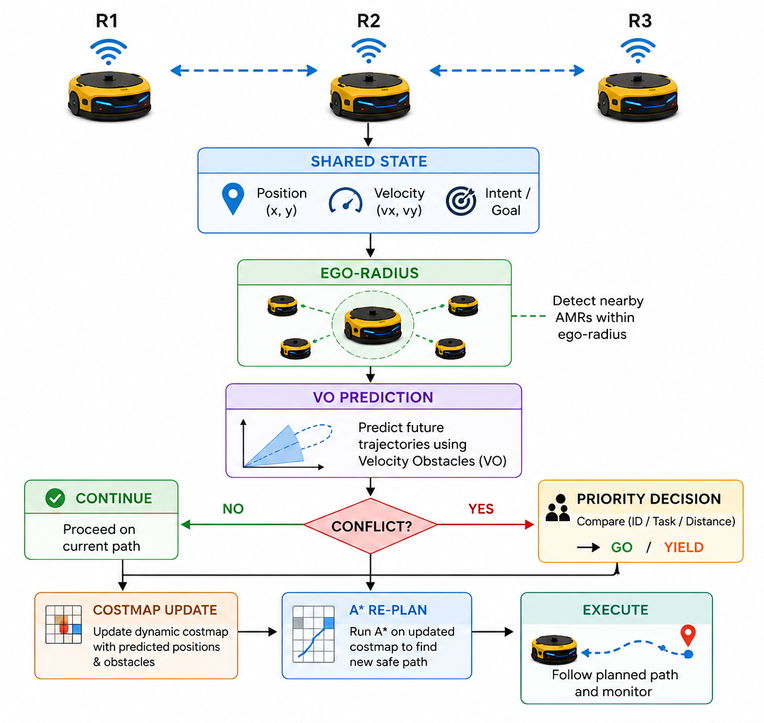
TECHNICAL APPROACH
Krayons
How the Fleet Coordinates
Technology:
Simulation: Isaac Sim / Gazebo
Development: Python
Communication: UDP / WebSocket
Path Planning: A*
Collision Avoidance: Velocity Obstacle
Coordination: Priority Matrix
Dashboard: Streamlit + Plotly
Edge Deployment: Raspberry Pi / Jetson-class hardware

Slide 4
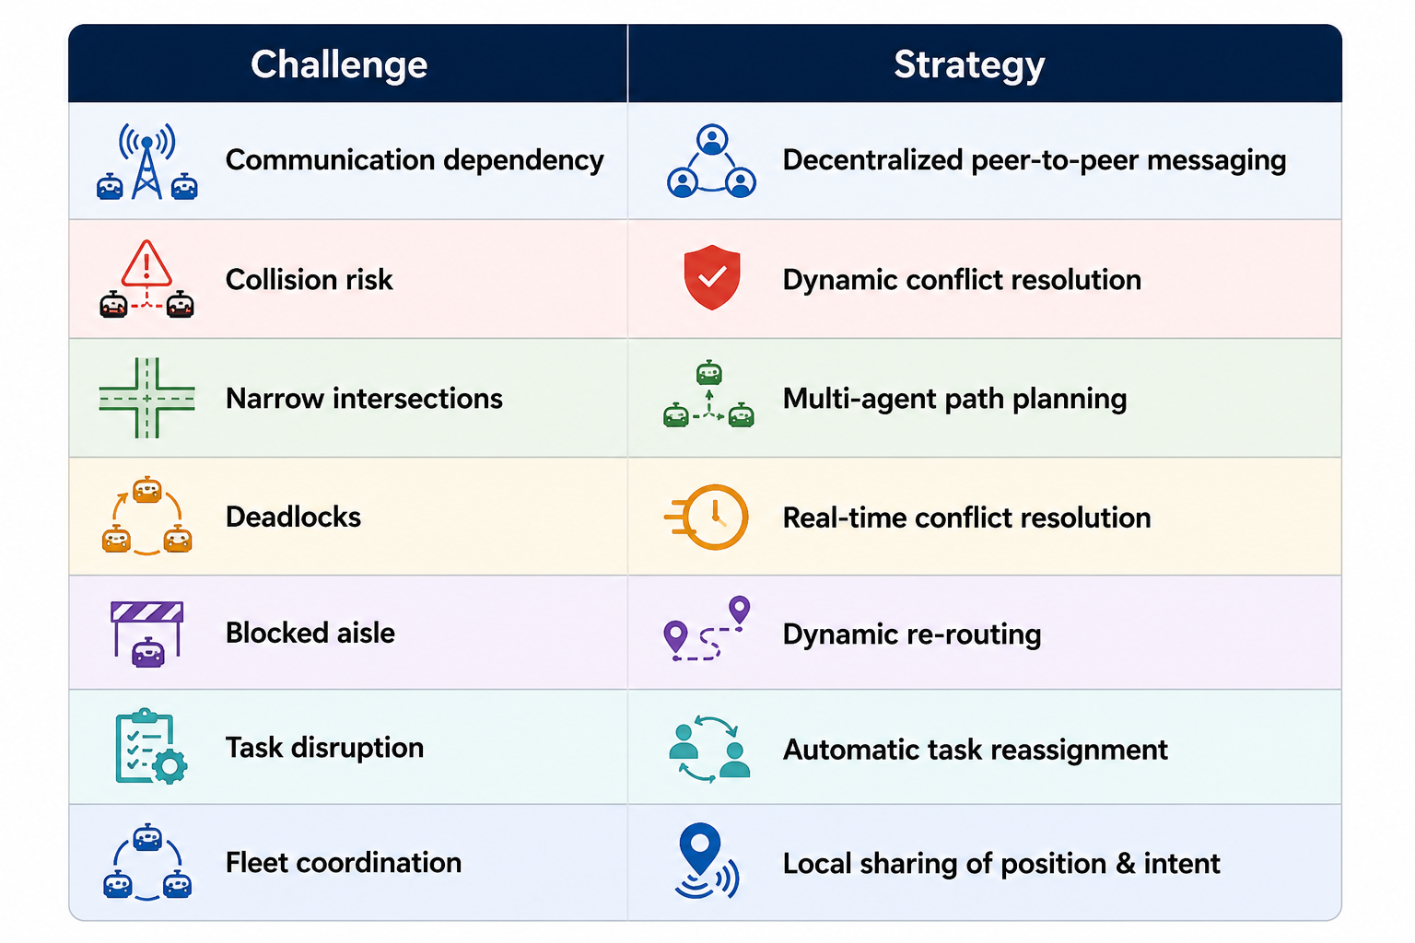
FEASIBILITY AND VIABILITY
Krayons
Analysis of Feasibility:
Software-based multi-robot simulation supports 3+ AMRs in a dynamic warehouse.
Peer-to-peer communication enables robots to share position and intent without a central server.
Multi-agent path planning enables coordinated movement through shared warehouse paths.
Dynamic re-routing allows robots to respond to blocked aisles.
A fleet dashboard provides real-time visualization of robot positions and battery status.
Performance can be validated against traditional stop-and-wait coordination.
Potential Challenges & Risks:
Communication challenges between nearby robots.
Collision risks at narrow intersections and choke points.
Deadlocks when multiple robots compete for the same space.
Blocked aisles making planned paths unavailable.
Overlapping paths increasing waiting and task completion time.
Maintaining coordination as the fleet size increases.
Strategies to Overcome Challenges:

Slide 5
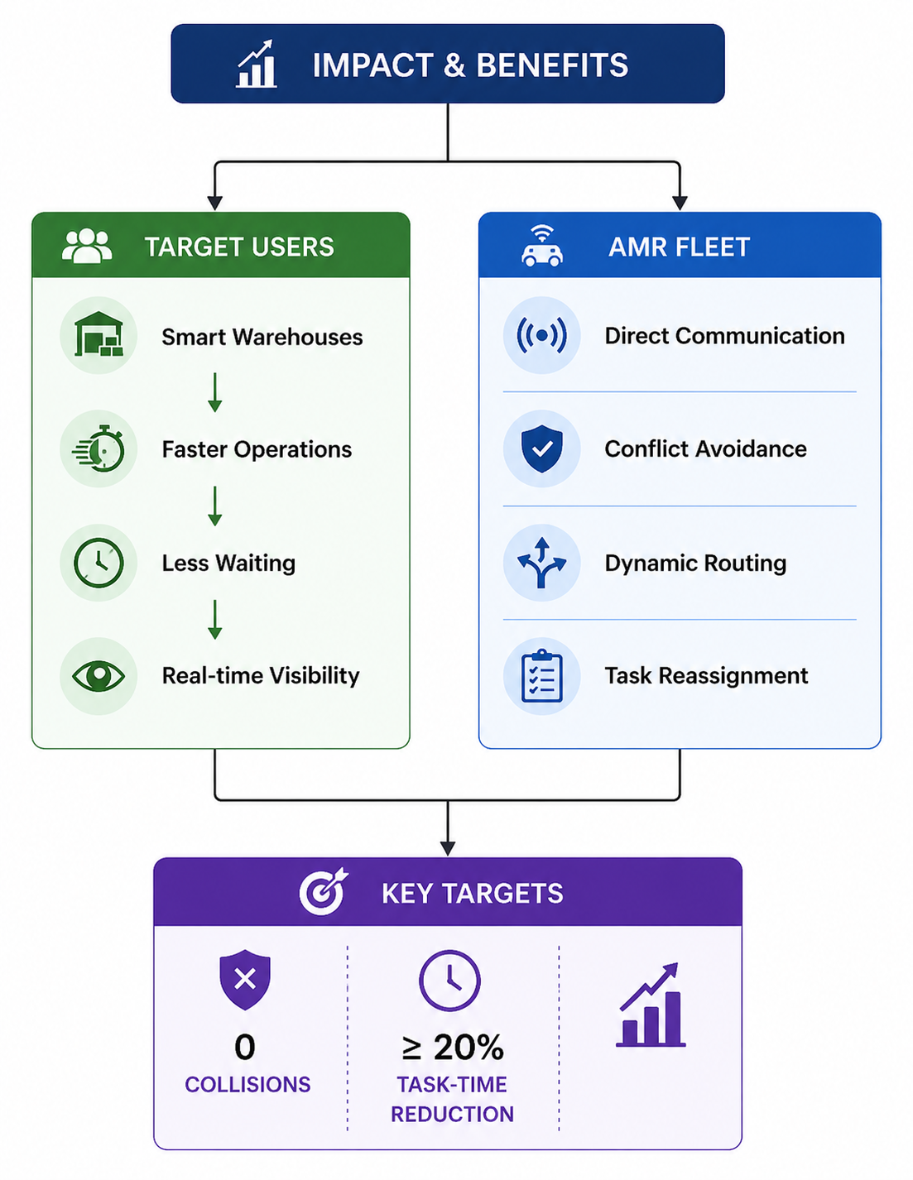
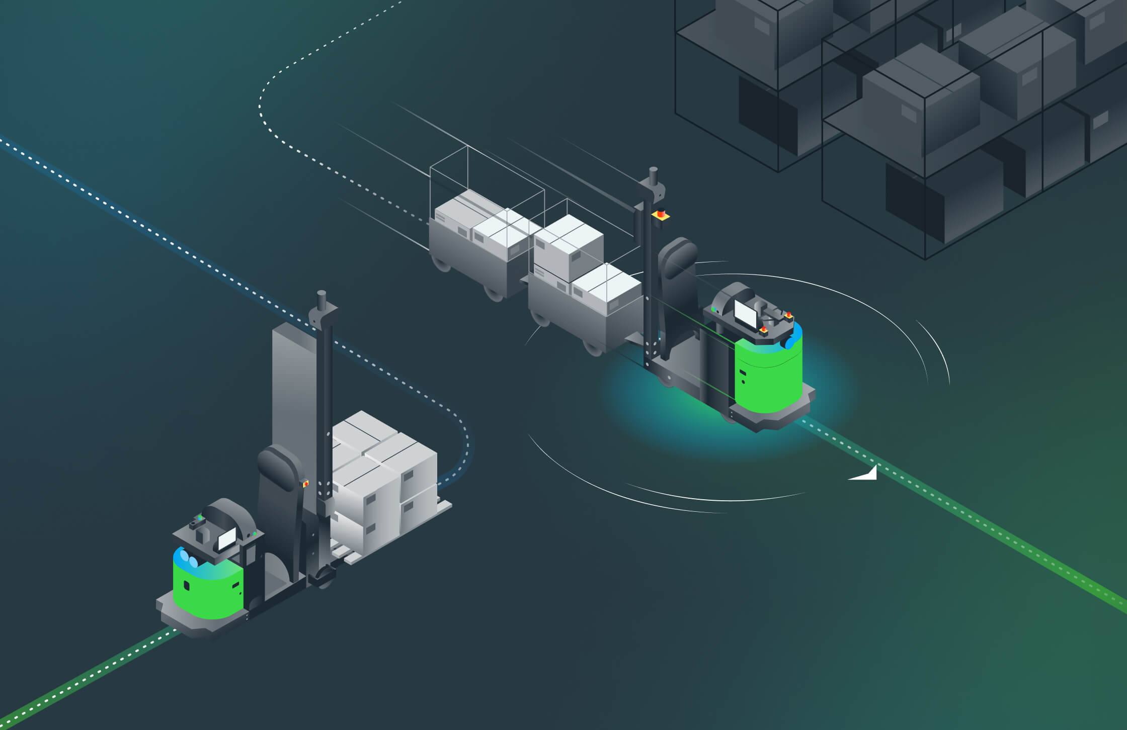
IMPACT AND BENEFITS
Krayons
Potential Impact:
Improves warehouse throughput through coordinated AMR movement.
Reduces unnecessary waiting at shared paths and intersections.
Enables continuous fleet operation in dynamic conditions.
Provides real-time fleet visibility to warehouse operators.

Slide 6
RESEARCH AND REFERENCES
Krayons
Research topics:
References:
Velocity Obstacles (VO) → Collision prediction
Multi-Agent Path Planning → Coordinated robot navigation
Decentralized Multi-Robot Coordination → Robot-to-robot decision making
Robotics Simulation → Virtual testing of 3+ AMRs
[1] Motion Planning in Dynamic Environments Using Velocity Obstacles Publisher: SAGE Publications — The International Journal of Robotics Research [2] Multi Robot Collision Avoidance in a Shared Workspace Publisher: Springer — Autonomous Robots
[3] Reciprocal n-Body Collision Avoidance Publisher: Springer — Robotics Research / Springer Tracts in Advanced Robotics

