Slide 1

Xilinx Tool Flow

Slide 2

Foundation Series ISE
Foundation Series ISE (Integrated Software Environment)
For PC platforms:
Win98, Win2000,
and NT4.0
For UNIX platforms:
HP and Solaris

Slide 3
Xilinx Design Flow
Plan & Budget
Create Code/
Schematic
HDL RTL
Simulation
Implement
Functional
Simulation
Synthesize
to create netlist
Translate
Map
Place & Route
Attain Timing
Closure
Timing
Simulation
Create
BIT File
Notes:
This slide lists the major stages of implementing a design into a Xilinx device.
The implementation stage consists of three steps, which will be discussed later in this presentation.
Although simulation points can happen in other parts of the design cycle, the three simulation points in the above diagram are the Xilinx-recommended simulation points.
More details on Timing Closure in a coming slide.
For more detailed flow diagrams, refer to Chapter 2 (Design Flow) of the Development System Reference Guide at www.xilinx.com/literature/index.htm

Slide 4
Design Entry
Plan and budget
Two design-entry methods: HDL or schematic
  Architecture Wizard, CORE Generator™ system, and StateCAD tools are available to assist in design entry
Whichever method you use, you will need a tool to generate an EDIF or NGC netlist to bring into the Xilinx implementation tools
  Popular synthesis tools include: Synplify, Precision, FPGA Compiler II, and XST
Simulate the design to ensure that it works as expected!
Plan & Budget
Create Code/
Schematic
HDL RTL
Simulation
. . .
Functional
Simulation
Synthesize
to create netlist

Slide 5
HDL Source File
Types of HDL source files
  VHDL logic description (.vhd extension)
  Verilog logic description (.v extension)
  ABEL-HDL logic description (.abl extension)
Selecting these source types will open a text editor for you to enter the design code

Slide 6



5.1i Synthesis Solutions
ISE provides integrated interfaces to:
  Mentor Leonardo Spectrum
  Synplicity Synplify/Pro
  Both with cross-probing and synthesis launching
FPGA Compiler II supported through Alliance flow
ISE Foundation includes basic
synthesis with
  Xilinx Synthesis Technology (XST)
Notes:
all the leading synthesis vendors are supported in ISE 5.1i including Synopsys FPGA Express and FPGA Compiler, Xilinx Synthesis Technology (XST), Leonardo Spectrum, and Synplicity Synplify and Synplify Pro.
Your chosen vendor shows up in all ISE windows and menus, and can also be driven from batch script if desired.

Slide 7


XST Flow
VHDL
Verilog
ISE 5.1i
PC & WS
Supported Families:
Virtex XC9500
Virtex-E XC9500XL
Virtex-II XC9500XV
Virtex-IIPro CoolRunner
Spartan-II CoolRunner-II
Spartan-IIE
Constraints
Synthesis
Technology Specific Optimization
To Implementation
Tools
Synthesis
Report File
.NGC
.LOG

Slide 8
Xilinx Implementation
Once you generate a netlist,
you can implement the design
There are several outputs of implementation
  Reports
  Timing simulation netlists
  Floorplan files
  FPGA Editor files
  and more!
Implement
. . .
Translate
Map
Place & Route
.
.
.

Slide 9
What is Implementation?
More than just Place & Route
Implementation includes many phases
  Translate: Merge multiple design files into a single netlist
  Map: Group logical symbols from the netlist (gates) into physical components (slices and IOBs)
  Place & Route: Place components onto the chip, connect the components, and extract timing data into reports
Each phase generates files that allow you to use other Xilinx tools
  Floorplanner, FPGA Editor, XPower

Slide 10
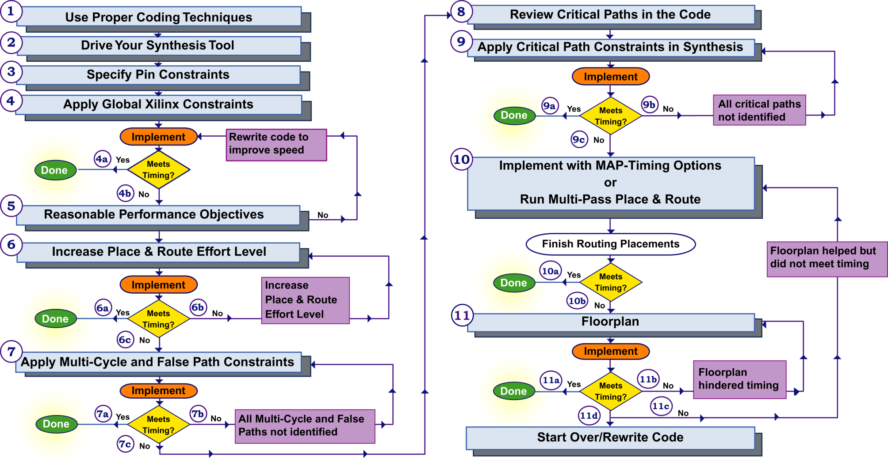
Timing Closure
Notes:
Where to find details on each numbered step:
1. “Synthesis Techniques” module in the Designing for Performance course.
2. “Synthesis Techniques” module in the Designing for Performance course.
3. “Architecture Wizard and PACE” module in this course.
4. “Global Timing Constraints” module in this course.
5. “Reading Reports” module in this course. More details in the “Achieving Timing Closure” module in the Designing for Performance course.
6. “Implementation Options” module in this course.
7. “Timing Groups and OFFSET Constraints” and “Path-Specific Timing Constraints” modules in the Designing for Performance course.
8. “Synthesis Techniques” module in the Designing for Performance course. Third-party synthesis vendors also offer training.
9. “Synthesis Techniques” module in the Designing for Performance course. Third-party synthesis vendors also offer training.
10. “Advanced Implementation Options” module in the Designing for Performance course.
11. “Floorplanner: Effective Layout” module in the Advanced FPGA Implementation course.

Slide 11
Download
Once a design is implemented, you must create a file that the FPGA
can understand
  This file is called a bitstream: a BIT file (.bit extension)
The BIT file can be downloaded directly into the FPGA, or the BIT file can be converted into a PROM file, which stores the programming information
Notes:
To learn more and to debug configuration problems, refer to the Configuration Problem Solver on the Web: www.xilinx.com → Support → Problem Solvers → Configuration Problem Solver

Slide 12
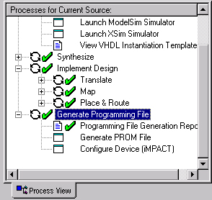
Program the FPGA
There are two ways to program an FPGA
  Through a PROM device
    You will need to generate a file that the PROM programmer will understand
  Directly from the computer
    Use the iMPACT configuration tool

Slide 13
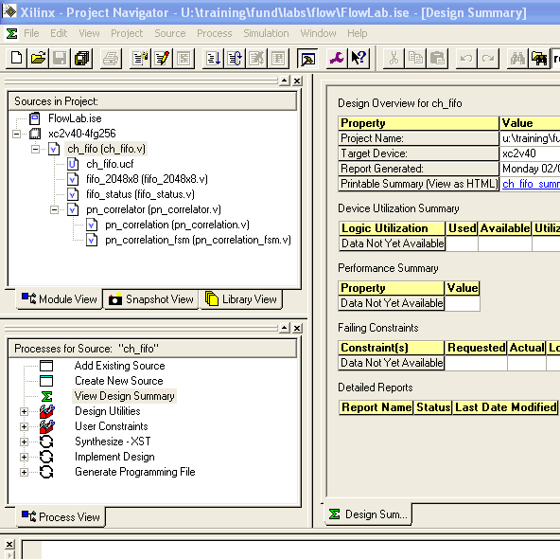
ISE Project Navigator
Built around the Xilinx design flow
  Access to synthesis
  and schematic tools
    Including third-party synthesis tools
  Implement your design with a simple double-click
    Fine-tune with
    easy-to-access software options
Notes:
ISE = Integrated Synthesis Environment.
The ISE™ software is the Xilinx tool suite that includes design entry tools (PC only), implementation tools, and timing analysis tools. The ISE software also interfaces with third-party tools for synthesis and simulation.
The ISE software includes the following tools: XST synthesis, CORE Generator™ tool, Architecture Wizard, ECS schematic editor, StateCAD state diagram editor, and HDL Bencher waveform editor (for testbench creation).
The ISE software runs on Windows, UNIX, and Linux operating systems.
The Project Navigator is the name of the main GUI in the ISE tool suite. There are four main windows in the Project Navigator. In the upper-left corner is the Sources in Project window. Directly below that window is the Processes for Current Source window. To the right is the main working window, and below is the Message (or Console) window.

Slide 14
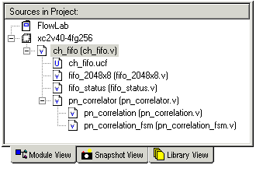
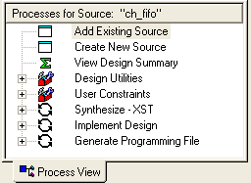
Implementing a Design
Implement a design:
  Select the top-level source file in the Sources in Project window
    HDL, schematic, or EDIF,
    depending on your design flow
  Double-click Implement Design in the Processes for Source window
Notes:
You can select a lower-level file in the Sources in Project window to perform resource estimation.

Slide 15
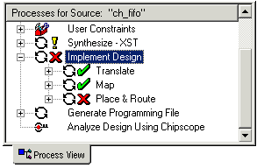
Implementation Status
The ISE™ software will run all of the necessary steps to implement the design
  Synthesize HDL code
  Translate
  Map
  Place & Route
Progress and status are indicated by icons
  Green check mark ( ) indicates that the process was completed successfully
  Yellow exclamation point ( ! ) indicates warnings
  Yellow question mark ( ? ) indicates a file that is out of date
  Red X indicates errors

Slide 16
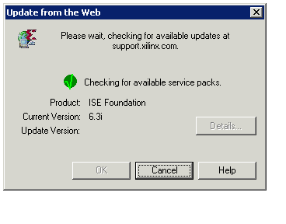
Software Update Center
Automatically checks for Service Packs on the Web
Alerts you when an update is available
Supports Windows platforms only
Notes:
Click Edit → Preferences → Updates to control the frequency of automatic notification of updates.

Slide 17
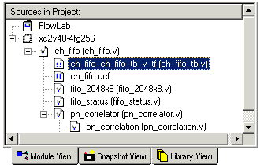
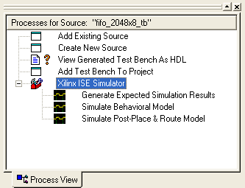
Simulating a Design
Simulate a design:
  Select a testbench file in the Sources in Project window
  Expand Xilinx ISE Simulator in the Processes for Source window
  Double-click Simulate
  Behavioral Model or
  Simulate Post-Place & Route
  Model
    You can also simulate after Translate or after Map
Notes:
The ISE™ Project Navigator can also be integrated with ModelSim.

Slide 18
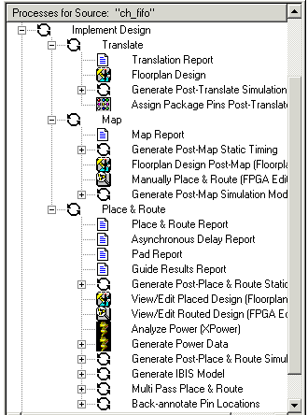
Subprocesses
Expand each process to view subtools and subprocesses
  Translate
    Floorplan
    Assign package pins
  Map
    Analyze timing
  Place & Route
    Analyze timing
    Floorplan
    FPGA Editor
    Analyze power
    Create simulation model
Notes:
There are many subprocesses for each main process. Not all of these subprocesses are necessary for a successful design implementation. Some of the more popular subprocesses include the Floorplanner, FPGA Editor, and Timing Analyzer.
The Floorplanner physically constrains or places parts of your design. This tool can be accessed after MAP or after PAR. More information is available in the Advanced FPGA Implementation course.
The FPGA Editor is used after PAR. This tool displays the actual placement and routing of a completed design. One popular use for the FPGA Editor is to route internal signals out to a pin for testing. More information on this feature is available at www.xilinx.com and in the Advanced FPGA Implementation course.
The Timing Analyzer is also available after MAP and PAR. The MAP and PAR static timing reports can be viewed by using the Timing Analyzer. The Timing Analyzer performs static timing analysis. Various reports can be generated, including customized reports. More information on the Timing Analyzer is available in the Designing for Performance course.

Slide 19
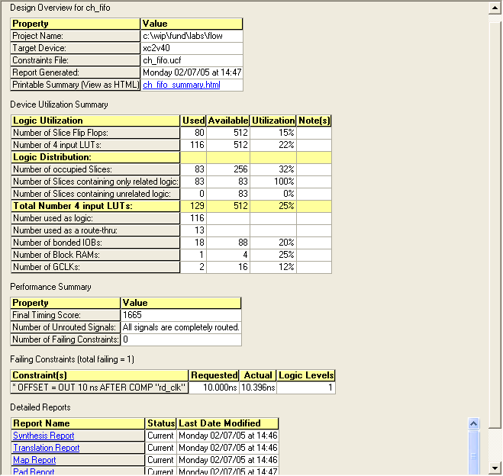
Project Summary
Design Overview
Device Utilization
Performance and Constraints
Reports
Notes:
The new Project Summary screen displays important design data in a single page, easy-to-read format. Information from the Map and Timing reports are displayed, as well as links to all software reports.

Slide 20
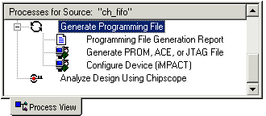
Programming the FPGA
There are two ways to program an FPGA
  Through a PROM device
    You must generate a file that the PROM programmer can understand
  Directly from the computer
    Use the iMPACT configuration tool

Slide 21
Summary
Implementation means more than Place & Route
Xilinx provides a simple pushbutton tool to guide you through the Xilinx design process

Slide 22
References
Complete design flow tutorials
  www.xilinx.com → Documentation → Tutorials
On implementation: Development System Reference Guide
  www.xilinx.com → Documentation → Software Manuals
  Documentation may also be installed on your local computer
On simulation: ISIM Online Help
Configuration Problem Solver
  www.xilinx.com → Support → Problem Solvers → Configuration Problem Solver

