Slide 1
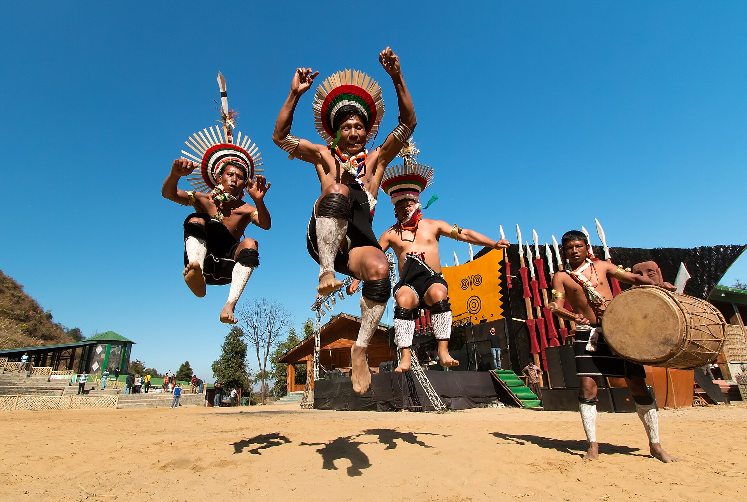
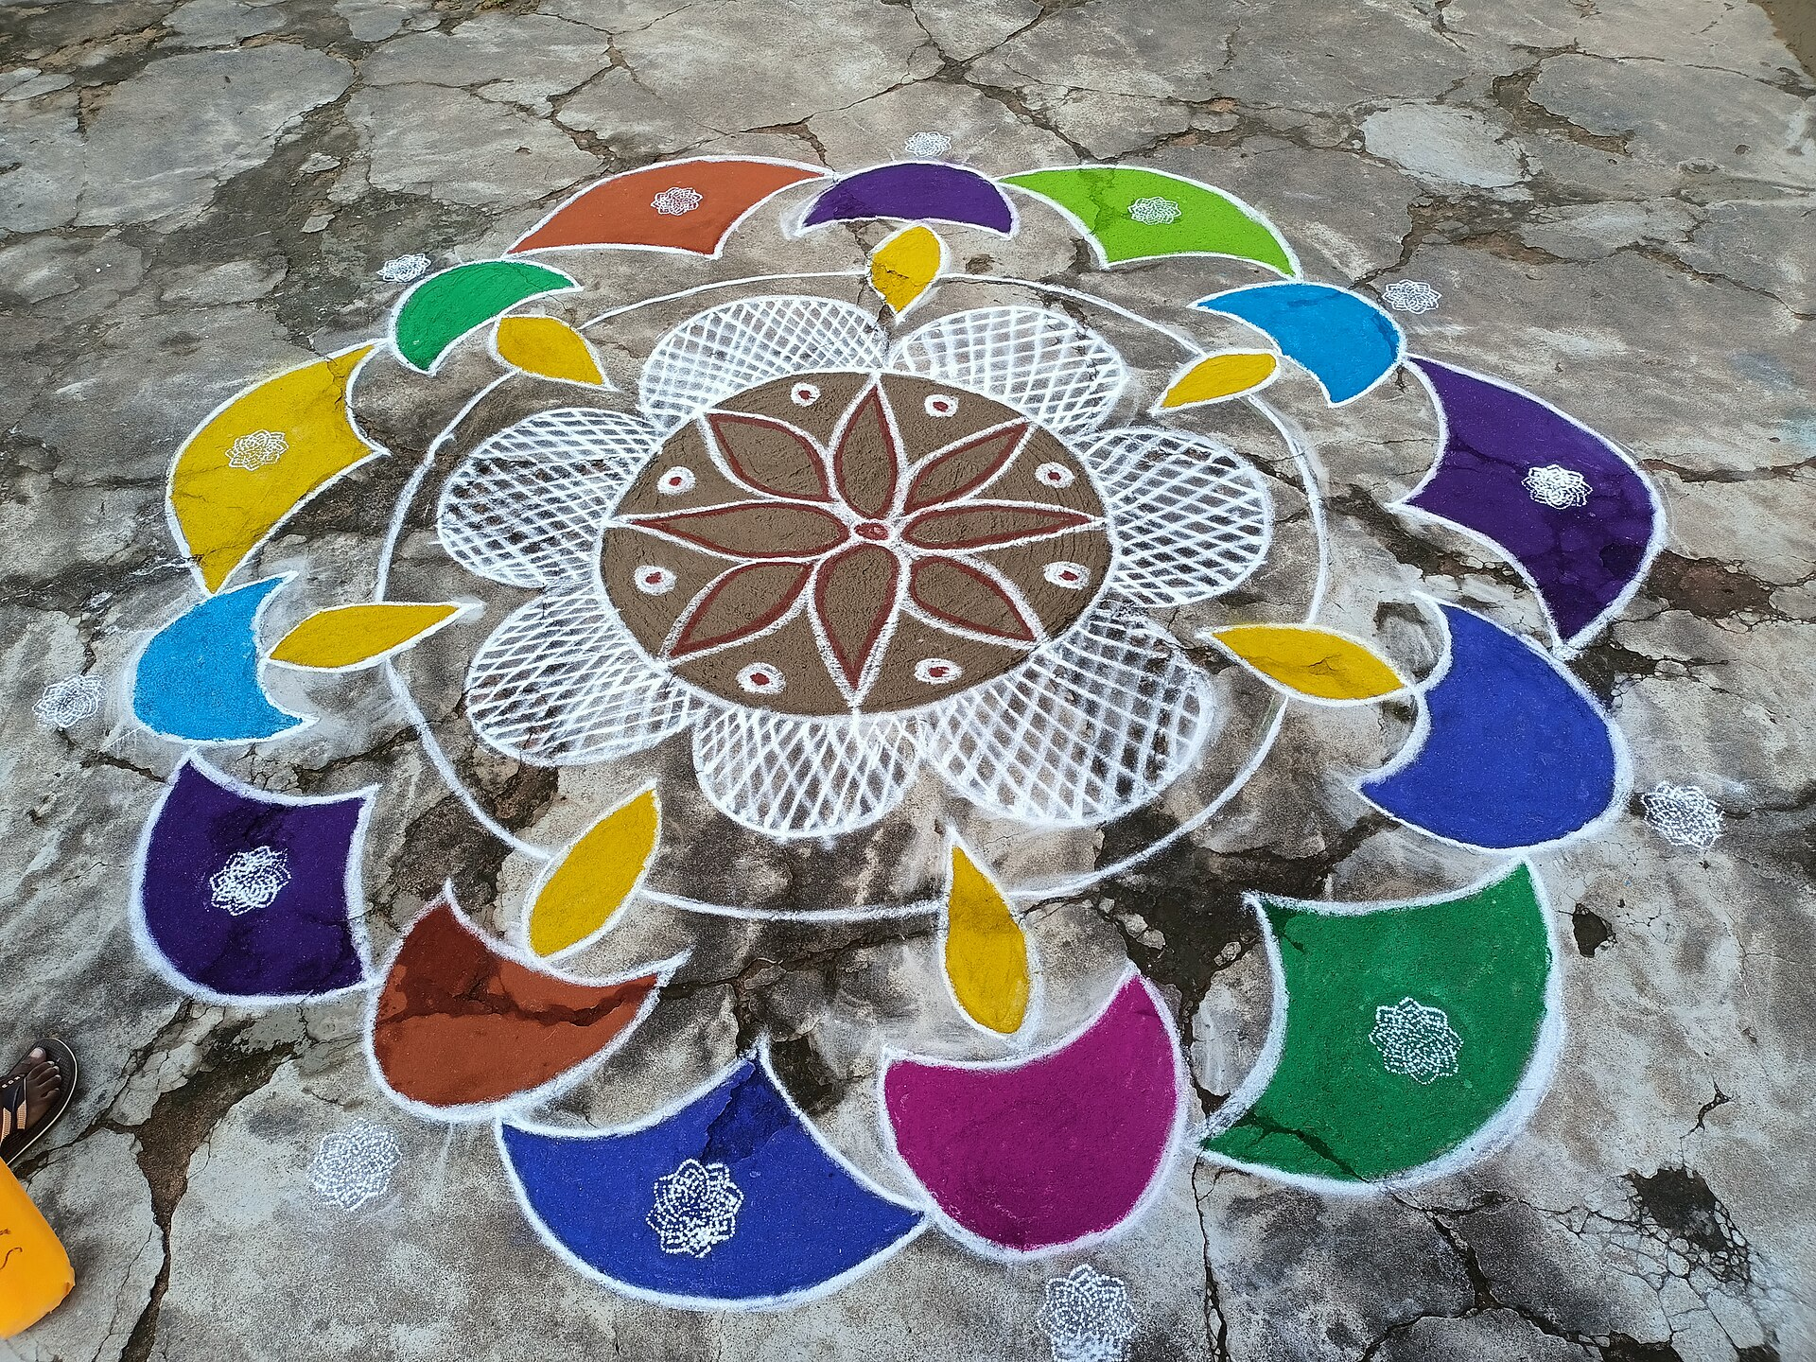
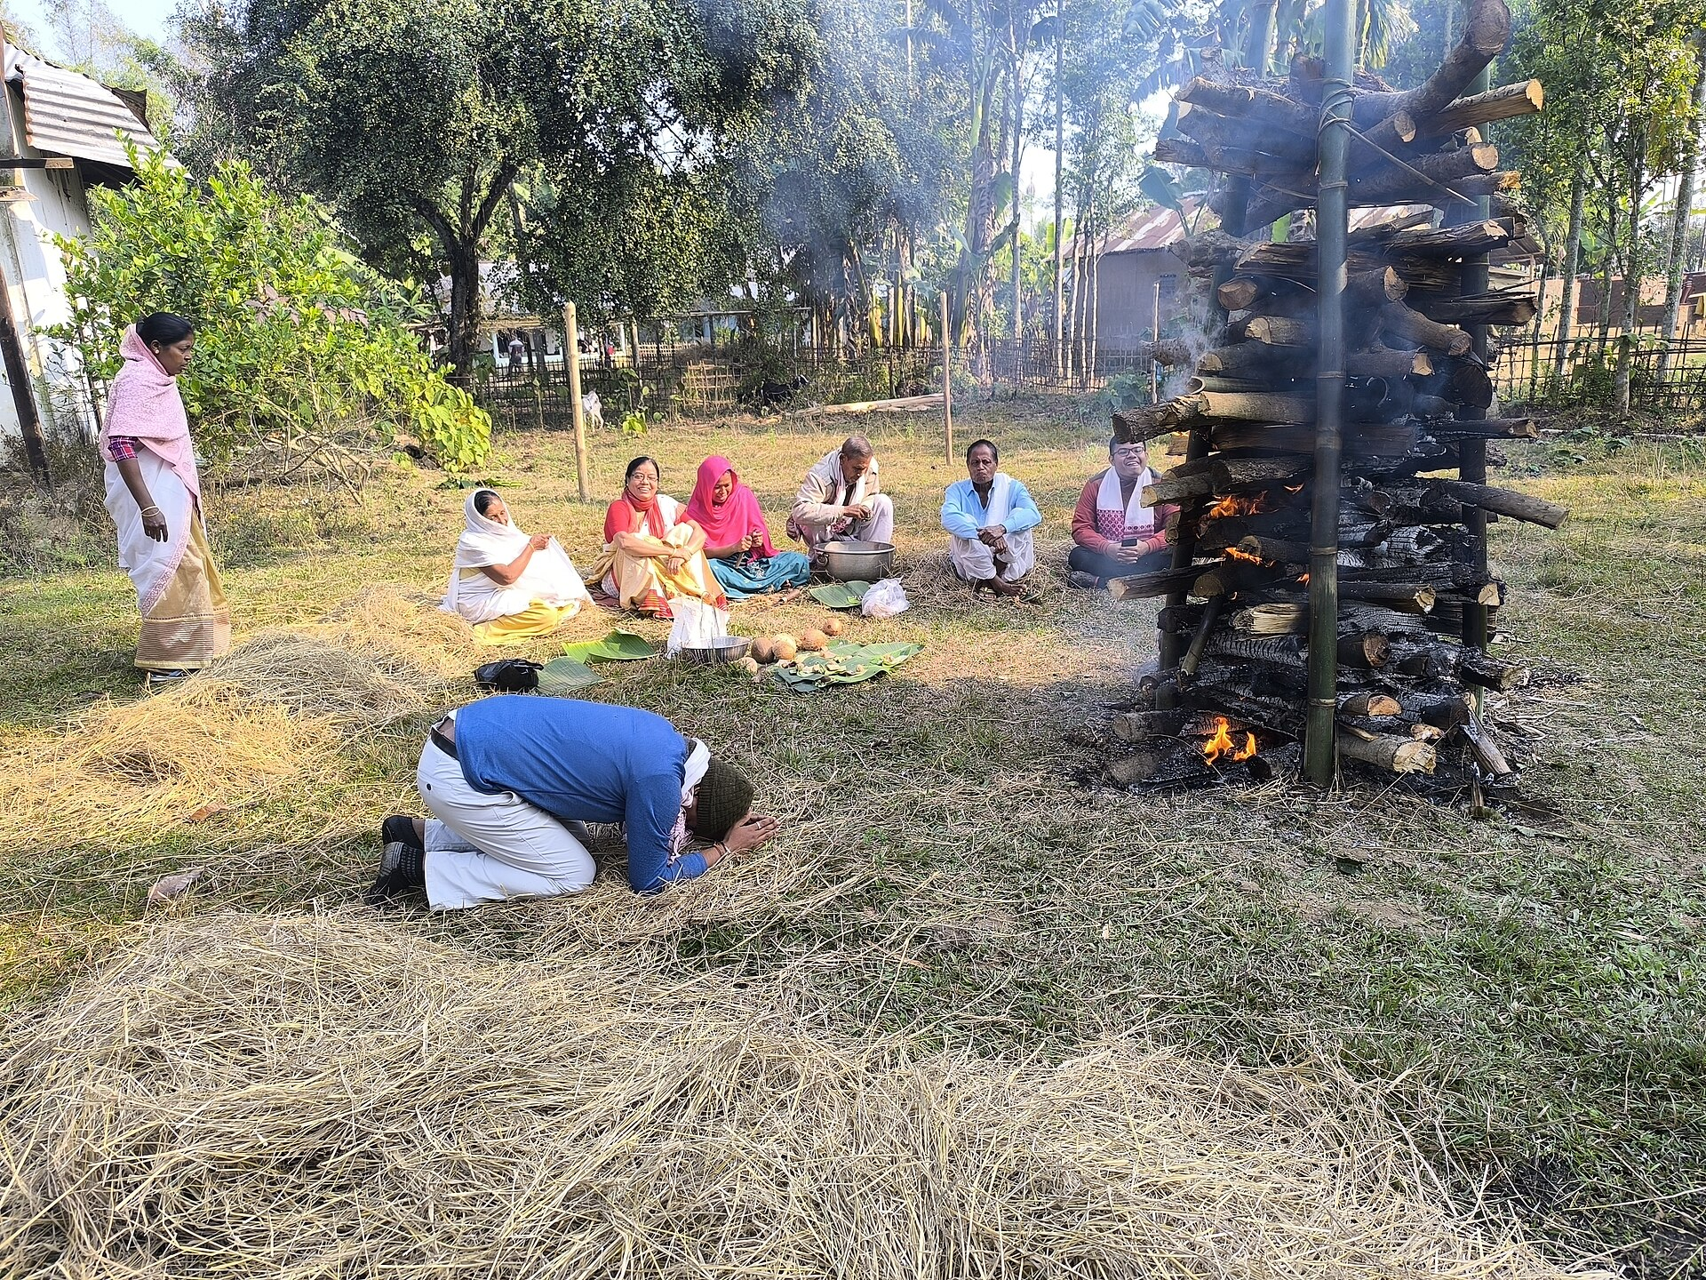
Diversity
UNIT IV · CONTEMPORARY DEBATES
Understanding India's Social and Cultural Plurality
Aliza Khan
Roll Number: 25501012
BA Programme — Economics and Political Science
Presentation topic: Diversity
Photos (Wikimedia Commons): Hornbill Festival, Nagaland — Vikramjit Kakati, CC BY-SA 4.0; Pongal kolam — Priyadharshini Mohanraj, CC BY-SA 4.0; Magh Bihu, Assam — Nilotpal Hazarika, CC BY-SA 4.0
Notes:
Opening (about 1 minute).
Good morning. My topic is Diversity, from Unit IV (Contemporary Debates) of our textbook, Theory and Practice of Democracy, Lesson 4, printed pages 72 to 77.
I will cover four things the textbook discusses: what diversity means and why it matters in a democracy; India as a case study and the reasons for its diversity; the factors that hold a diverse India together; and the contemporary debates on diversity in India and the world.
The photos show three regions of India: the Hornbill Festival of the Naga tribes in Nagaland, a kolam drawn for Pongal in Tamil Nadu, and the meji bonfire of Magh Bihu in Assam.
Primary source: Batham, M. (2023). Diversity, representation, and globalisation and global issues (Unit IV, Lesson 4). In Theory and Practice of Democracy (B.A. Programme Political Science, Semester III). Department of Distance and Continuing Education, Campus of Open Learning, School of Open Learning, University of Delhi, pp. 72-77.
Photos: "Hornbill Festival, Pix by Vikramjit Kakati" (CC BY-SA 4.0); "Pongal celebration kolam" by Priyadharshini Mohanraj (CC BY-SA 4.0); "Magh Bihu Celebration with Meji in Sivasagar, Assam" by Nilotpal Hazarika (CC BY-SA 4.0), all via Wikimedia Commons.

Slide 2
What is diversity?
Socio-economic class
“The existence of a broad variety of unique individuals, objects, or social constructs within a given group or civilisation.”
Culture & region
Gender & gender identity
— Textbook definition, p. 72
Language
Dimensions of diversity
Sexual orientation
Recognising diversity
Noticing that people differ.
Including diversity
Making sure people from every background can take part, be heard and reach opportunities.
Race & ethnicity
Age
Religion
Source: Textbook (Batham, 2023), pp. 72–74. The dimensions shown are those the textbook names.
Notes:
Meaning: The textbook defines diversity as "the existence of a broad variety of unique individuals, objects, or social constructs within a given group or civilisation" (p. 72). In a social setting, it refers to differences between people based on socio-economic class, gender, sexual orientation, age, race and ethnicity, among other traits (pp. 72-73). Later (p. 74) it adds culture, language and gender identity, and says diversity can exist anywhere people come from different settings - a workplace, a state, or a country.
The textbook also points out that the term diversity "stresses differences rather than inequalities" (pp. 73-74). This is an important distinction: being different is not the same as being unequal. But in real life, differences can turn into inequality when some groups are excluded - which is why democracies care about inclusion.
Recognising vs including: recognising diversity just means accepting that people differ. Inclusion goes further - it means people from every background can actually participate, be represented and access opportunities. This is my own framing to connect the definition with the next slide on democracy.

Slide 3




Why diversity matters in a democracy
Representation
Equity
Dialogue and understanding
Innovation and progress
A diverse society can reflect the views and interests of all its people, not just a small segment.
People of every background are more likely to get equal access to resources and opportunities.
Contact across differences can build tolerance and reduce discrimination.
Different experiences bring original ideas for solving complex problems.
Key point: the textbook says diverse societies are “more likely” to gain these benefits. They follow only when institutions make room for everyone — being present is not the same as being heard.
Source: Textbook (Batham, 2023), p. 73 — the four reasons are the textbook's own.
Notes:
The textbook (p. 73) calls diversity "a key virtue" in democratic societies because it fosters inclusivity, equity and respect for all viewpoints. It gives four reasons:
1. Representation - a diverse society can reflect the views and interests of all its inhabitants, instead of only a small segment.
2. Equity - all members are more likely to have equal access to resources and opportunities, regardless of background.
3. Dialogue and understanding - people from different backgrounds can communicate and understand one another better, which encourages tolerance and lessens discrimination.
4. Innovation and progress - people with different experiences offer original thoughts and solutions to complicated problems.
Note the careful wording in the textbook: "more likely", "may", "can". These are potential benefits, not automatic results. A society can be very diverse and still exclude some groups. So the democratic question is not only "are we diverse?" but "can everyone participate meaningfully?" This links to the textbook's conclusion that the problem lies in how diversity is handled.

Slide 4
India: a land of diversity
कोस-कोस पर बदले पानी, चार कोस पर वाणी
Kos-kos par badle paani, chaar kos par vaani
“The water changes every kos; the way people speak changes every four kos.”
A kos is an old unit of distance (about 2–4 km; it varied by region). The textbook calls it a unit of area.
Hornbill Festival, Nagaland. Photo: Vikramjit Kakati, CC BY-SA 4.0
28 + 8
22
121
States and Union Territories (since 2020)
languages in the Eighth Schedule of the Constitution
languages, grouped from 19,569 mother-tongue names (Census 2011)
Sources: Textbook, p. 73 (saying; 28 states, 8 UTs; 22 languages; “19,500 dialects”); Census of India 2011, Language Paper 1 of 2018 and religion data (C-1). Census 2027 figures are not yet published.
Notes:
The textbook (p. 73) describes India as "the land of diversity" and quotes a famous Hindi saying:
"Kos-kos par badle paani, chaar kos par vaani" - every kos the water (its taste) changes, and every four kos the speech or dialect (vaani) changes. In simple words: travel a short distance in India and even everyday things like water and language change.
Small correction: the textbook calls the kos "an old Indian unit of area", but a kos is actually a traditional unit of distance. Its length varied - roughly 2 to 4 km; the Mughal standard under Akbar was about 4 km.
Figures, with their dates:
- 28 states and 8 Union Territories: this has been the position since January 2020, when Dadra and Nagar Haveli and Daman and Diu were merged. It is still current.
- 22 languages in the Eighth Schedule of the Constitution: the list reached 22 in 2003 (92nd Amendment).
- The textbook says India has "more than 19500 spoken dialects" according to 2011 data. More precisely, Census 2011 recorded 19,569 raw mother-tongue names. After linguistic scrutiny these were rationalised into 1,369 mother tongues, which were grouped into 121 languages (22 scheduled and 99 non-scheduled). So the 19,500+ figure counts names people reported, not separate dialects. These are 2011 figures; the next census (2027) has not yet published language data.
- Religion (chart): Census 2011 - Hindus 79.8%, Muslims 14.2%, Christians 2.3%, Sikhs 1.7%, Buddhists 0.7%, Jains 0.4%; other religions 0.7% and not stated 0.2% (shown together as 0.9%).
The textbook also calls India "a synthesis of cultures, languages and religions belonging to various castes and communities" (p. 73).
References:
- Office of the Registrar General and Census Commissioner, India (2018). Census of India 2011 - Language: India, States and Union Territories (Paper 1 of 2018).
- Office of the Registrar General and Census Commissioner, India (2015). Census of India 2011 - Population by religious community (Table C-1).
Photo: "Hornbill Festival, Pix by Vikramjit Kakati", CC BY-SA 4.0, Wikimedia Commons.

Slide 5






Six reasons for India's diversity
1. Ancestry and migration
2. Religion
3. Language
Many waves of settlement over thousands of years. The textbook's ‘racial groups’ come from the 1931 Census, a colonial typology; genetics shows mixed ancestry, not separate races.
Birthplace of Hinduism, Buddhism, Jainism and Sikhism; home to Islam, Christianity and other faiths, each with many sects.
Indo-Aryan (about 78%) and Dravidian (about 19.6%) families, plus Austroasiatic, Tibeto-Burman and others (Census 2011).
4. Caste and jati
5. Geography
6. Culture
Four varnas but thousands of jatis, traditionally tied to occupation. Education and inter-caste marriage are making jati more flexible.
Seventh-largest country: young Himalayas, old Aravallis, cold desert (Ladakh), hot desert (Thar), long coasts and fertile plains.
Hills, plains, coasts and deserts shape different ways of life, architecture, dance forms and folk songs.
Sources: Textbook, pp. 74–75; Guha (1935), Census of India 1931; Reich et al. (2009); Narasimhan et al. (2019); AAPA (2019); Census 2011 language data; Dirks (2001).
Notes:
The textbook (pp. 74-75) gives six reasons for India's diversity:
1. Racial groups / ancestry: The textbook lists "Negrito, Proto-Australoid, Mongoloid, Mediterranean, Western Brachycephals and Nordic" groups "according to the 1931 census", and says the three "major races" are found in India. Context: this list comes from the anthropologist B.S. Guha's study "The Racial Affinities of the People of India", published as part of the Census of India 1931. It was based on measuring skulls, noses and height - methods that modern science no longer accepts. Today biological anthropologists agree that "race" is not an accurate description of human biological variation (AAPA statement, 2019). Genetic studies instead show that most Indians descend from a mixture of ancient populations (Reich et al., 2009, Nature; Narasimhan et al., 2019, Science). So the safe point to make is: India's population was formed by many migrations and much mixing over thousands of years.
2. Religion: Hinduism, Buddhism, Sikhism and Jainism originated in India; Islam and Christianity are also practised, and each has many sub-sects. Religion has shaped Indian culture throughout history.
3. Language: The textbook says Indo-Aryan languages are spoken by 78.05% and Dravidian languages by 19.64% of Indians. Census 2011 data give about 78% for the Indo-European family and 19.64% for Dravidian. Smaller families include Austroasiatic, Sino-Tibetan (Tibeto-Burman), Tai-Kadai and some isolates.
4. Caste or jati: The textbook distinguishes the four varnas (Brahmins, Kshatriyas, Vaishyas, Shudras, with Dalits outside this scheme) from the many jatis, which were traditionally linked to occupation. It says the varna scheme was "mainly popularised by Britishers in their first Caste Census in 1872". Historians such as Nicholas Dirks (Castes of Mind, 2001) argue that colonial census-taking made caste categories more rigid - though caste itself is much older. The textbook notes that education, empowerment, inter-caste marriage and inter-dining are making the jati system more flexible.
5. Geography: India is the seventh-largest country by area, with the young Himalayas and the old Aravallis, a cold desert in Ladakh and a hot desert in the Thar, perennial and non-perennial rivers, long coasts, forests and fertile plains.
6. Culture: Because of all the above, culture varies by region - life in the hills differs from the plains, coasts and deserts - and each religion, caste and region has its own traditions in architecture, dance and folk song.
References:
- Guha, B.S. (1935). The Racial Affinities of the People of India. Census of India 1931, Vol. I, Part III. Simla: Government of India Press.
- Reich, D., Thangaraj, K., Patterson, N., Price, A.L. and Singh, L. (2009). Reconstructing Indian population history. Nature, 461, 489-494.
- Narasimhan, V.M. et al. (2019). The formation of human populations in South and Central Asia. Science, 365(6457), eaat7487.
- American Association of Physical Anthropologists (2019). AAPA Statement on Race and Racism.
- Dirks, N.B. (2001). Castes of Mind: Colonialism and the Making of Modern India. Princeton University Press.

Slide 6
Unity in diversity: the constitutional foundations
The Constitution of India — one framework for a diverse nation
Fundamental rights
Freedom of movement
Secularism
Economic integration
Arts. 14–15
Art. 19(1)(d)
Arts. 25–28
GST, 1 July 2017
Equality before law; no discrimination on grounds of religion, race, caste, sex or place of birth.
Every citizen may move freely throughout India — and settle anywhere (Art. 19(1)(e)).
No state religion; freedom of conscience and worship for all. ‘Secular’ added to the Preamble in 1976.
The same trade rules across states; GST created one national tax on goods and services.
Base: one government framework in three tiers — Union, States and local bodies. Common rules create shared ground; they do not erase regional or social inequality.
Sources: Textbook, p. 75–76 (factors 1–4); Constitution of India, Arts. 14–15, 19, 25–28; 42nd Amendment (1976); 101st Amendment (2016) and GST rollout (2017).
Notes:
The textbook (pp. 75-76) lists factors responsible for unity in diversity. The first four are institutional:
1. Indian Constitution: it provides a "solid backbone" to run a huge country. One national framework and a "three-tier government structure" (Union, States, and local bodies - panchayats and municipalities, constitutionally recognised by the 73rd and 74th Amendments, 1992) give uniformity in governance. Fundamental rights are guaranteed to all citizens regardless of class, caste, gender, age or religion - for example Article 14 (equality before law) and Article 15 (no discrimination on grounds of religion, race, caste, sex or place of birth).
2. Inter-state mobility: Article 19(1)(d) gives every citizen the freedom to move freely throughout India; Article 19(1)(e) adds the right to reside and settle anywhere. Moving and living together builds a shared sense of belonging.
3. Secularism: there is no state religion; Articles 25-28 guarantee freedom of conscience and the right to practise and propagate religion. The word "secular" was added to the Preamble by the 42nd Amendment in 1976. The textbook describes religious co-existence with tolerance as a unique feature of India.
4. Economic incorporation: the Constitution gives the same rules for trade and commerce across the country, and the Goods and Services Tax (introduced on 1 July 2017 after the 101st Amendment, 2016) made indirect taxation more uniform.
Balance: these features give all Indians common rights and rules, but they do not make every region or community equal in practice. Inequalities of class, caste, gender and region continue - which is why the debates on later slides exist.

Slide 7
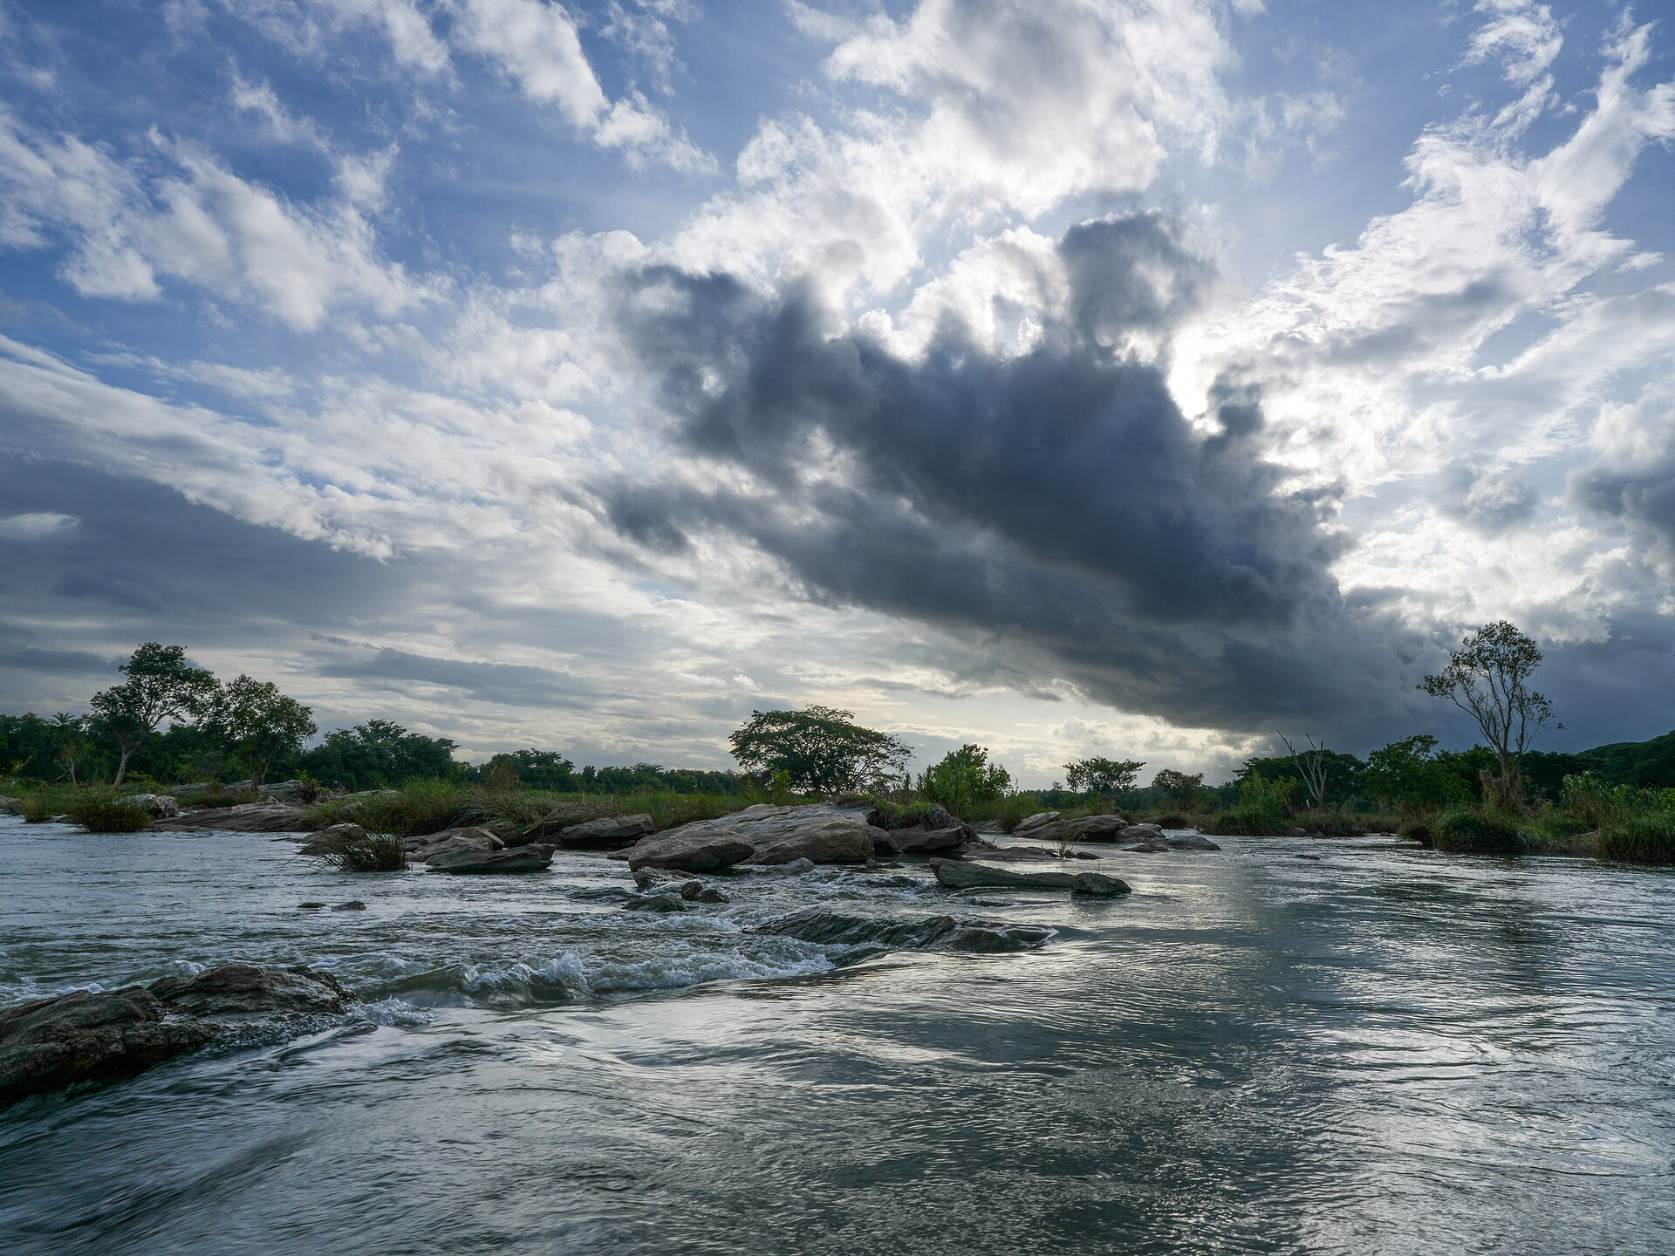
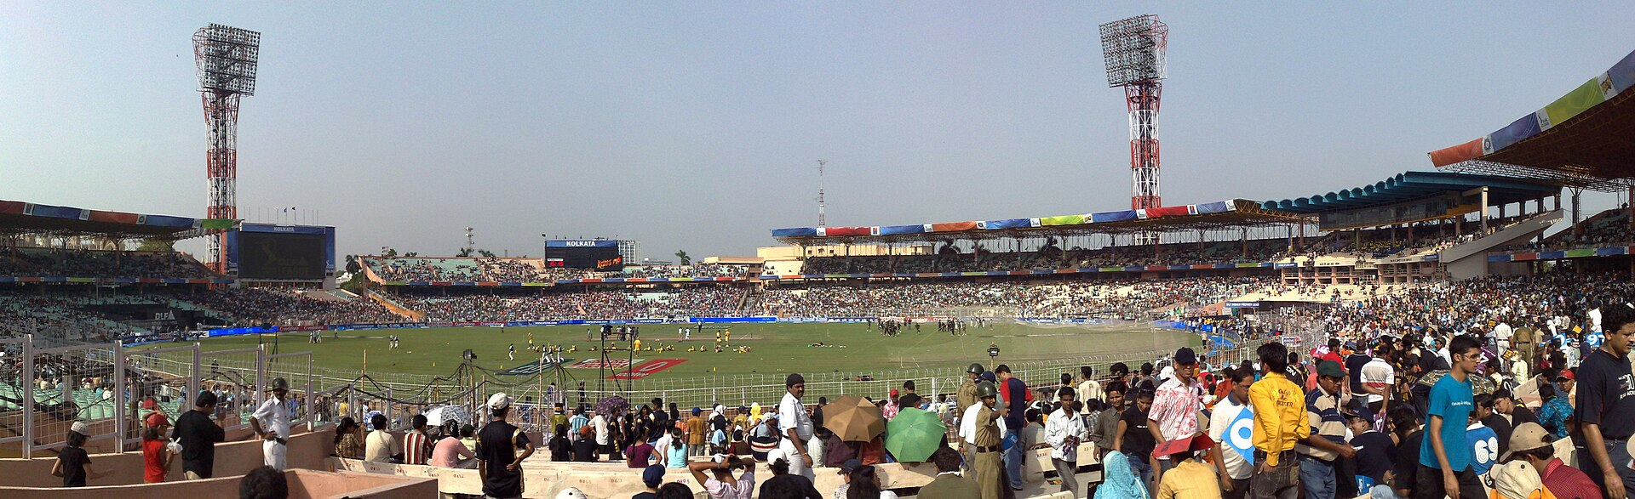
Shared experiences across a diverse country
Festivals
The monsoon
Language, cinema and cricket
Festivals of many faiths are celebrated widely. The textbook links them to the lunar calendar; Makar Sankranti actually follows the solar one, so its date stays fixed.
June–September rains bring about three-quarters of India's yearly rainfall (IMD), shaping farming, food, festivals and daily life.
Hindi and English are the Union's official languages; Bollywood spreads Hindi and cricket draws fans nationwide. Yet Hindi is the mother tongue of 43.6% (Census 2011).
Around 14 January — one harvest festival, many names (textbook, p. 76):
Makar Sankranti · UP, Bihar, MP, Delhi
Uttarayan · Gujarat
Magh Bihu · Assam
Lohri · Punjab
Thai Pongal · Tamil Nadu
Suggi Habba · Karnataka
Shishur Saenkrant · Kashmir
Poush Sankranti · West Bengal
Sources: Textbook, p. 76; India Meteorological Department (2022); Census 2011 language tables (C-16, C-17); Constitution of India, Art. 343.
Notes:
The textbook's remaining unity factors (p. 76) are about shared everyday experience:
5. Festivals: Around 14 January, the same harvest festival is celebrated across India under different names - Makar Sankranti (MP, UP, Bihar, Delhi, Chhattisgarh, Haryana), Uttarayan (Gujarat), Magh Bihu (Assam), Shishur Saenkrant (Kashmir Valley), Poush Sankranti (West Bengal), Lohri (Punjab), Thai Pongal (Tamil Nadu) and Suggi Habba (Karnataka). The textbook also says major festivals of different religions are celebrated "with great harmony".
Correction: the textbook says Indian festivals "follow the lunar calendar". Most do, but Makar Sankranti is a solar festival - it marks the Sun entering Capricorn (Makara) - which is exactly why it falls on 14 or 15 January every year.
6. Monsoon climate: the monsoon shapes agriculture, ways of life, plants and animals, and festivals across the subcontinent. According to the India Meteorological Department, the June-September south-west monsoon gives about 75% of India's annual rainfall (all-India normal: 87 cm, based on 1971-2020).
7. Common language and sports: The textbook says Hindi is spoken by "the majority" and that Indians typically speak "more than two languages". Hindi (in Devanagari) is the official language of the Union under Article 343, and English continues to be used officially under the Official Languages Act, 1963. India has no single "national language". Census 2011 data qualify the textbook's claim: Hindi was the mother tongue of 43.63% of people, and about 26% reported being bilingual. Bollywood films spread Hindi in India and abroad, and cricket brings people together across regions.
Balance: these shared experiences connect people, but they do not affect every community in the same way - for example, many states have their own dominant language and festivals, and the monsoon's effect depends on where you live and how you earn a living.
References: India Meteorological Department (2022), revision of the all-India rainfall normal; Census of India 2011, language tables (C-16, C-17); Constitution of India, Art. 343; Official Languages Act, 1963.
Photos: "Magh Bihu Celebration with Meji in Sivasagar, Assam" (Nilotpal Hazarika, CC BY-SA 4.0); "Monsoon Kaveri Doddegaudana Koppalu Mandya" (Timothy A. Gonsalves, CC BY-SA 4.0); "Eden Gardens Kolkata" (Partha Bhaumik, CC BY-SA 2.0) - Wikimedia Commons.

Slide 8


Debates: representation and affirmative action
One view
Another view
Indian context
Parties and institutions should mirror the diverse people they serve.
Representatives should be chosen for ability, not identity.
Lok Sabha reserves 84 seats for SCs and 47 for STs (Arts. 330, 332). One-third of seats for women (106th Amendment, 2023) begins only after the next census and delimitation.
Political representation
Reservation corrects historical prejudice against groups such as Dalits and Adivasis and secures real equality.
Critics, mostly from dominant groups, call it discriminatory and say it replaces individual merit.
Arts. 15(4), 16(4) allow quotas; Indra Sawhney (1992) set a 50% ceiling; the 10% EWS quota (2019) was upheld in 2022. Census 2027 will record caste.
Affirmative action
Sources: Textbook, pp. 76–77 (both views); Constitution of India; Indra Sawhney v. Union of India (1992); Janhit Abhiyan v. Union of India (2022); 106th Amendment Act, 2023.
Notes:
The textbook (pp. 76-77) presents these as live debates, both in India and globally. I present both sides as the textbook describes them; the "Indian context" column adds verified facts.
Political representation: some argue that political parties and organisations should represent the various populations they work with more accurately (sometimes called "mirror" or descriptive representation). Others argue representation should be decided by ability rather than identity. In India, the Constitution reserves Lok Sabha seats for Scheduled Castes and Scheduled Tribes (Articles 330 and 332): currently 84 SC and 47 ST seats out of 543. The 106th Constitutional Amendment (2023) reserves one-third of seats in the Lok Sabha and state assemblies for women, but it takes effect only after the next census and the delimitation that follows it.
Affirmative action: the textbook calls this "the most debatable topic in India and elsewhere". It aims to remove historical prejudice against marginalised groups like Dalits and Adivasis. For supporters, it guarantees equality and representation for underprivileged groups. The textbook says that, for dominant groups, it is seen as discriminatory and not based on individual merit.
Indian context: Articles 15(4) and 16(4) permit special provisions and reservations. In Indra Sawhney v. Union of India (1992) the Supreme Court upheld 27% OBC reservation, excluded the "creamy layer" and set a general 50% ceiling. The 103rd Amendment (2019) created a 10% quota for economically weaker sections, upheld in Janhit Abhiyan v. Union of India (2022). The Census 2027 schedule includes a caste question for the first time since independence (beyond SC/ST).
This is not a simple two-sided debate: many positions lie in between - for example, excluding the better-off within reserved groups (creamy layer), sub-classification within reserved categories (allowed by the Supreme Court in 2024 for SCs and STs), or combining reservation with better schooling.

Slide 9



Debates: culture, work and migration
Cultural appropriation
Diversity at work
Immigration and nationalism
Exchange: food, dress and ideas have always travelled; sharing connects people.
Appropriation: taking a marginalised culture's traditions without credit can exploit or erase it.
For: diverse teams aid creativity; firms should promote diversity in hiring and promotion.
Against: the most qualified applicant should come first.
For: migration drives economic development.
Concern: some fear it weakens national identity and security — a contested view.
Example: Prada's 2025 sandals resembled GI-tagged Kolhapuri chappals; after protests it acknowledged the Indian inspiration.
Example: large and listed companies must have a woman director (Companies Act, 2013). Haryana's 75% local-jobs quota was struck down by the High Court (2023).
Example: 45.6 crore internal migrants (Census 2011); debates over the CAA (2019) and Assam's NRC (2019); immigration debates in the USA.
Common thread: each debate asks how to combine equal rights and openness with respect for difference. The answers depend on fair rules and institutions.
Sources: Textbook, p. 77; Companies Act 2013, s. 149(1); P&H High Court, Nov 2023; Census 2011 migration tables (D-series); news reports on Prada (June–July 2025).
Notes:
The textbook (p. 77) discusses three more debates.
Cultural appropriation: The textbook describes a global trend of following developed countries' lifestyles and food habits "without appreciating or recognising their value", giving the examples of Chinese food becoming "fast food" and McDonald's burgers being popular worldwide. It says cultural interchange is a crucial part of human connection in a globalised era, while for others cultural appropriation is "a kind of exploitation and erasure of marginalised cultures".
Clarification: in academic use, cultural appropriation usually means a more powerful group taking elements of a marginalised group's culture without credit, understanding or benefit to that community. The textbook's examples are closer to cultural globalisation. A clearer Indian example: in June 2025, Prada showed "leather sandals" in Milan that closely resembled Kolhapuri chappals, which hold a Geographical Indication (GI) tag. After protests by artisans and Maharashtra bodies, Prada acknowledged that the design was inspired by traditional Indian footwear.
Diversity in the workplace: freedom of movement brings diverse groups to big cities and workplaces. "Progressive theories" say diversity is necessary for creativity and progress, so firms should promote it in hiring and promotion; others, including locals, think the most qualified applicants should be preferred. Indian context: Section 149(1) of the Companies Act, 2013 requires listed and large public companies to have at least one woman director. Haryana's 2020 law reserving 75% of lower-paid private jobs for local residents was struck down by the Punjab and Haryana High Court in November 2023 as unconstitutional; the state has challenged this in the Supreme Court.
Immigration and nationalism: the textbook says immigration is essential for economic development, "but it endangers national security and weakens national identity too", and mentions India and the United States. This is the textbook's description of one side of a heated debate, not a settled fact - research on migration's effects is mixed. Indian context: Census 2011 counted about 45.6 crore people as migrants (mostly within India, often for marriage or work). Debates over the Citizenship (Amendment) Act, 2019 (rules notified in March 2024) and Assam's National Register of Citizens (final list in August 2019) show how migration, identity and citizenship are linked.
References: Companies Act, 2013, s. 149(1); Punjab and Haryana High Court, Faridabad Industries Association v. State of Haryana (17 November 2023), as reported by Bar and Bench; Census of India 2011 migration tables (D-series); exchange4media and Deccan Herald reports on Prada and Kolhapuri chappals (June-July 2025).

Slide 10
Conclusion and references
“The problem does not lie in diversity but in the handling of diversity in any society.”
References (APA 7th)
Batham, M. (2023). Diversity, representation, and globalisation and global issues. In Theory and practice of democracy (Unit IV, pp. 72–77). DDCE, School of Open Learning, University of Delhi. [Primary source]
Constitution of India (as amended). Arts. 14–16, 19, 25–28, 330, 332, 343; Eighth Schedule.
Office of the Registrar General & Census Commissioner, India. (2018). Census of India 2011: Language (Paper 1 of 2018); religion (C-1) and migration (D-series) tables.
Guha, B. S. (1935). The racial affinities of the people of India. Census of India 1931, Vol. I, Part III.
Reich, D., et al. (2009). Reconstructing Indian population history. Nature, 461, 489–494.
Narasimhan, V. M., et al. (2019). The formation of human populations in South and Central Asia. Science, 365(6457).
American Association of Physical Anthropologists. (2019). AAPA statement on race and racism.
Dirks, N. B. (2001). Castes of mind. Princeton University Press.
India Meteorological Department. (2022). All-India rainfall normal revised to 87 cm (1971–2020).
Indra Sawhney v. Union of India (1992); Janhit Abhiyan v. Union of India (2022). Supreme Court of India.
— Textbook, p. 77
1
Diversity is multidimensional: religion, language, caste, region, class, gender and more.
2
Unity rests on constitutional values (equality, rights, secularism) and shared everyday life, not on sameness.
3
Debates on quotas, culture, work and migration are about including everyone fairly. Diversity is neither automatic harmony nor the problem itself.
Notes:
Conclusion: The textbook ends its section on diversity (pp. 77-78) by saying diversity is "a complicated and multidimensional concept", that challenges arise when inclusivity and equity are applied in varied cultures, and that "our constitutional structure has given us a strong foundation". Its key line is: "The problem does not lie in diversity but in the handling of diversity in any society." It describes India as "a unique mosaic" where people have developed "a composite way of living".
My three takeaways:
1. Diversity has many dimensions, and in India they overlap - religion, language, caste, region, class and gender.
2. India's unity comes from constitutional values like equality, fundamental rights and secularism, and from shared experiences - not from everyone being the same.
3. The contemporary debates are really about how to include everyone fairly. Diversity does not automatically produce harmony, but it is not the problem either; what matters is how institutions and society handle it.
Thank you. I am happy to take questions.
Full references (APA 7th):
- Batham, M. (2023). Diversity, representation, and globalisation and global issues (Unit IV, Lesson 4). In Theory and practice of democracy (B.A. Programme Political Science, Semester III, pp. 71-78; prescribed reading pp. 72-77). Department of Distance and Continuing Education, Campus of Open Learning, School of Open Learning, University of Delhi.
- Constitution of India (as amended). Articles 14-16, 19, 25-28, 330, 332, 343; Eighth Schedule; 42nd (1976), 101st (2016), 103rd (2019) and 106th (2023) Amendments.
- Office of the Registrar General & Census Commissioner, India. (2018). Census of India 2011 - Language: India, States and Union Territories (Paper 1 of 2018). Also Census 2011 Table C-1 (religion), C-16/C-17 (language) and D-series (migration).
- Guha, B. S. (1935). The racial affinities of the people of India (Census of India 1931, Vol. I, Part III). Government of India Press.
- Reich, D., Thangaraj, K., Patterson, N., Price, A. L., & Singh, L. (2009). Reconstructing Indian population history. Nature, 461, 489-494.
- Narasimhan, V. M., et al. (2019). The formation of human populations in South and Central Asia. Science, 365(6457), eaat7487.
- American Association of Physical Anthropologists. (2019). AAPA statement on race and racism.
- Dirks, N. B. (2001). Castes of mind: Colonialism and the making of modern India. Princeton University Press.
- India Meteorological Department. (2022). Revision of the all-India rainfall normal to 87 cm (based on 1971-2020).
- Indra Sawhney v. Union of India, AIR 1993 SC 477 (decided 16 November 1992); Janhit Abhiyan v. Union of India (decided 7 November 2022).
- News context: exchange4media and Deccan Herald (June-July 2025) on Prada and Kolhapuri chappals; Bar and Bench (2024) on the Haryana local-jobs quota appeal.

