Slide 1
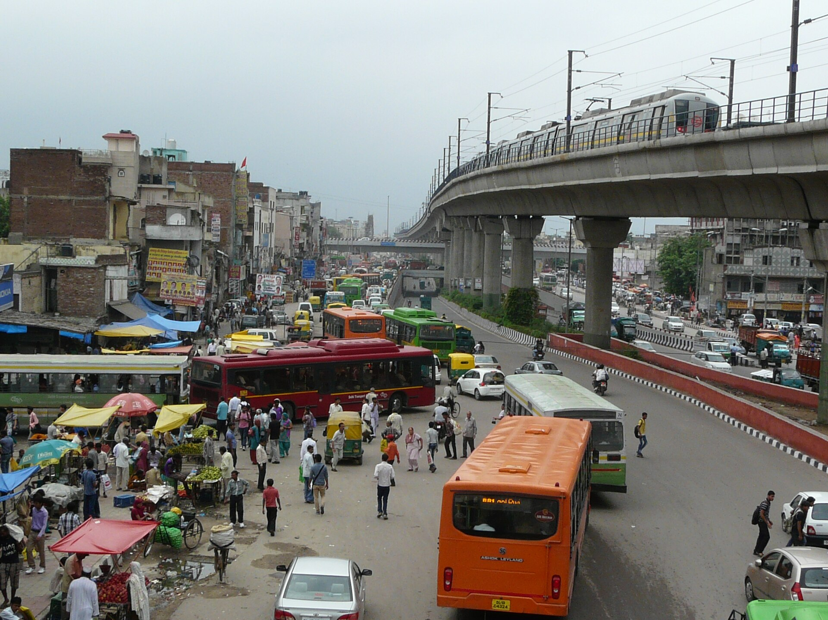

CNG Vehicles in Delhi and Swachh Bharat Abhiyan
Cleaner fuel, cleaner streets: two public policies and the goal of a healthier city
Aliza Khan
Roll Number: 25501012
BA Programme — Economics and Political Science
Delhi Metro and CNG buses, Azadpur. Photo: Varun Shiv Kapur, CC BY 2.0, Wikimedia Commons
Notes:
Opening (about 1 minute).
Good morning. My presentation looks at two well-known Indian public policies: Delhi's move to CNG for public transport, and the Swachh Bharat Abhiyan, the national cleanliness and sanitation mission.
They are separate policies. CNG came mainly from Supreme Court orders on air pollution from 1998 onwards. Swachh Bharat is a Central Government mission launched in 2014. I will explain each one, look at evidence on what worked and what did not, and then show where they meet: both try to make a crowded city like Delhi healthier.
Photo: "Delhi Metro and CNG Buses in Azadpur Neighborhood" by Varun Shiv Kapur, CC BY 2.0, via Wikimedia Commons.

Slide 2



Why Delhi needs cleaner air and cleaner streets
Air pollution
In winter, Delhi's air carries high levels of PM2.5, fine particles that reach deep into the lungs. Vehicles are one of the largest sources.
Waste and sanitation
Open dumps, burnt garbage and poor sanitation spread disease, and burning waste also adds smoke to the air.
What this presentation covers
Two separate responses: Delhi's switch to CNG (from 1998) and Swachh Bharat Abhiyan (from 2014), their results, limits, and where they meet.
Vehicles link to the CNG story; waste burning links to Swachh Bharat. The remaining share is road dust, industry and other sources.
Source: IIT Kanpur (2016), Comprehensive Study on Air Pollution and GHGs in Delhi, report to the Govt. of NCT of Delhi (winter PM2.5 shares, as reported by Governance Now, 7 Nov 2016).
Notes:
Key idea: Delhi's health problem is both "dirty air" and "dirty surroundings".
- PM2.5 means particles smaller than 2.5 micrometres. They are small enough to enter the bloodstream, which is why they matter for health.
- The chart uses the 2016 IIT Kanpur source-apportionment study done for the Delhi Government. In winter, vehicles were about a quarter of PM2.5. Burning of municipal solid waste was about 8 percent. Secondary particles are formed in the air from gases such as SO2 and NOx, which come partly from vehicles and industry.
- Note: different summaries of this study give slightly different numbers (for example 20 to 25 percent for vehicles), so I present these as approximate shares for winter only. In summer, road dust dominates.
- This is why I have highlighted two bars: vehicles connect to the CNG policy, and waste burning connects to cleanliness and waste management.
Reference: IIT Kanpur (2016). Comprehensive Study on Air Pollution and Green House Gases (GHGs) in Delhi. Report submitted to the Government of NCT of Delhi, January 2016. Figures as reported in Governance Now, "IIT study has all answers to Delhi pollution woes", 7 November 2016, https://governancenow.com/news/regular-story/iit-study-has-all-answers-delhi-pollution-woes

Slide 3

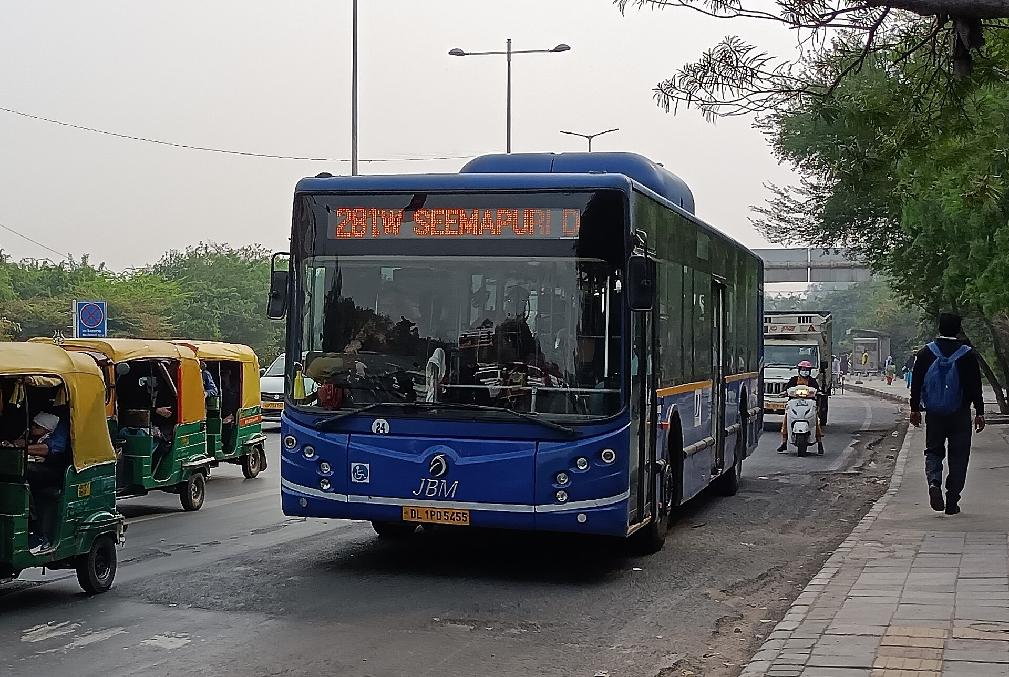
CNG in Delhi: from a court case to the roads
1985
M.C. Mehta files a public interest petition on vehicle pollution in Delhi (WP(C) 13029/1985)
What is CNG?
Jan 1998
EPCA (Bhure Lal Committee) set up under Section 3 of the Environment (Protection) Act, 1986
Natural gas (mostly methane) squeezed to about 200–250 bar and stored in strong cylinders
Burns in a spark-ignition engine, like petrol; diesel buses had to be replaced or re-engined
Produces far less soot than diesel
28 Jul 1998
Supreme Court accepts EPCA's plan: Delhi's whole city-bus fleet to run on CNG by 31 March 2001
2001
Deadline largely missed — too few CNG buses were ready; Court allows only conditional extensions
5 Apr 2002
Court calls CNG a clean fuel; diesel buses fined ₹500 a day, rising to ₹1,000
2021
CAQM Act replaces EPCA with a statutory Commission for Air Quality Management
2025–26
Delhi shifts to electric buses; CNG cluster buses to be phased out by 2031
CNG bus, Delhi. Photo: Kool Nerd 123, CC BY 4.0
Sources: Supreme Court, M.C. Mehta v. Union of India (orders of 28 Jul 1998, 5 Apr 2002); MoEF S.O. 93(E), 29 Jan 1998; CSE (2011); CAQM Act, 2021; Rajya Sabha reply (Aug 2025).
Notes:
What CNG is: natural gas, mainly methane, compressed to roughly 200 to 250 bar so enough fuel fits in a vehicle. The engine works on the same spark-ignition principle as a petrol engine, which is why petrol autos could be converted, while diesel buses needed new CNG buses or new engines.
The timeline - this is the "which law, which policy, and when" part:
- 1985: Environmental lawyer M.C. Mehta filed a public interest litigation (PIL) on vehicular pollution. The Supreme Court used this case for decades to issue orders on Delhi's air.
- 29 January 1998: Using its powers under Section 3 of the Environment (Protection) Act, 1986, the Ministry of Environment set up the Environment Pollution (Prevention and Control) Authority, EPCA, chaired by Bhure Lal (Notification S.O. 93(E)).
- 28 July 1998: The Supreme Court accepted EPCA's recommendations and ordered the entire city bus fleet to move to CNG by 31 March 2001. Commercial vehicles such as autos and taxis also moved to CNG under the same case.
- 2001: The deadline was largely missed. CSE reported "mayhem" in April 2001 with few buses running, and a market with only two bus makers and one conversion agency. The Court allowed only conditional extensions.
- 5 April 2002: The Court refused the Centre's request to allow any low-sulphur fuel, said CNG supply to transport must be a priority, and fined diesel buses Rs 500 per day, rising to Rs 1,000 per day after 30 days.
- 2021: Parliament passed the Commission for Air Quality Management in NCR and Adjoining Areas Act, 2021, and EPCA was replaced by a permanent statutory body.
- Today: Delhi is replacing CNG buses with electric ones. In a Rajya Sabha reply in August 2025, the government said older DTC CNG buses would be retired and about 1,750 CNG cluster buses phased out by 2031.
Political science point: this was policy made largely by the judiciary through a PIL, not by the legislature - an example of judicial activism in environmental governance.
References:
- Supreme Court of India, M.C. Mehta v. Union of India, Writ Petition (Civil) 13029 of 1985: orders dated 28 July 1998, 26 March 2001 and 5 April 2002.
- Ministry of Environment and Forests, Notification S.O. 93(E), 29 January 1998 (constitution of EPCA).
- Centre for Science and Environment (2011). Status of implementation of CNG as a fuel for urban buses in Delhi. https://www.cseindia.org/status-of-implementation-of-cng-as-a-fuel-for-urban-buses-in-delhi-2024
- Jojan, A. (2019). Supreme Court and Air Pollution: An overview of the vehicular pollution case (1985-2019). LiveLaw, 25 June 2019.
- The Commission for Air Quality Management in National Capital Region and Adjoining Areas Act, 2021.
- Rajya Sabha reply on Delhi CNG buses, as reported by PTI/The Week, 18 August 2025.
Photo: "A JBM CityLife CNG AC Bus on Delhi's Outer Ring Road" by Kool Nerd 123, CC BY 4.0, Wikimedia Commons.

Slide 4


What CNG achieved — and where it falls short
Benefits
Limitations
Cleaner air from buses: replacing diesel buses with CNG helped lower PM10, carbon monoxide and SO2 levels
No fuel vapour: CNG systems are sealed, so there are no evaporative emissions
Fast, large-scale change: most of Delhi's public transport moved to CNG within about two years of April 2001
Health: less exposure to diesel exhaust, which WHO's cancer agency (IARC) lists as a known carcinogen
Still a fossil fuel: burning gas releases CO2, and leaked methane is a strong greenhouse gas
Gains eroded: more vehicles and more diesel cars cancelled part of the benefit
Mixed evidence: one study found NOx levels rose after the switch
Price risk: Delhi CNG rose from ₹77.09/kg (Jan 2026) to ₹86.98/kg (29 Aug 2026) as imported LNG costs climbed
CNG is now a transition fuel: Delhi's newest buses are electric, and its 1,750 CNG buses are due to retire.
Sources: Narain & Krupnick (2007); Ravindra et al. (2006); US DOE AFDC; IARC (2012); IGL prices via AIR News (29 Aug 2026), Deccan Herald; fleet as reported 13 Oct 2026.
Notes:
Benefits (evidence):
- The best-known study is Narain and Krupnick (2007) for Resources for the Future. Using monthly data from 1990 to 2005, they found that converting buses from diesel to CNG helped reduce PM10, carbon monoxide and sulphur dioxide, and did not cause the rise in NO2. Converting three-wheelers from petrol to CNG showed less benefit, possibly because of poor technology.
- Health: in 2012 the International Agency for Research on Cancer (IARC, part of WHO) classified diesel engine exhaust as carcinogenic to humans (Group 1), so moving buses off diesel reduces a known health risk.
- The US Department of Energy's Alternative Fuels Data Center notes that CNG fuel systems are sealed, so there are no evaporative emissions.
- Narain and Krupnick also note that Delhi had the highest share of CNG-run public vehicles in the world, most introduced within about 20 months after April 2001.
Limitations:
- CNG is still a fossil fuel. Its tailpipe produces CO2, and methane that leaks during production, transport or from the vehicle is a powerful greenhouse gas. The AFDC says life-cycle climate benefits over diesel are only small to moderate. So CNG is cleaner, not clean, and certainly not zero-emission.
- Mixed findings: another study (Ravindra et al., 2006) at a single traffic junction found NOx rose after CNG, and PM10 showed no significant change. The overall growth in vehicle numbers and diesel cars offset part of the gains.
- Tailpipe versus wider impact: CNG mainly reduces tailpipe soot. It does nothing about road dust, crop burning or industrial emissions.
Economics:
- Price: IGL raised Delhi's CNG price to Rs 86.98 per kg from 29 August 2026, compared with Rs 77.09 at the start of 2026, citing higher international LNG prices. India imports a large share of its gas, so consumers face global price shocks.
- Costs of switching fell on bus operators, auto and taxi owners. In 2001 the supply side was a bottleneck: only two bus makers, one conversion agency and too few stations.
- Fleet change: As reported in October 2026, Delhi had 6,988 buses: 5,238 electric and 1,750 CNG. Exact counts vary between reports and dates.
References:
- Narain, U. and Krupnick, A. (2007). The Impact of Delhi's CNG Program on Air Quality. Resources for the Future Discussion Paper 07-06. https://www.rff.org/publications/working-papers/the-impact-of-delhi039s-cng-program-on-air-quality/
- Ravindra, K. et al. (2006). Assessment of air quality after the implementation of CNG as fuel in public transport in Delhi, India. Environmental Monitoring and Assessment, 115, 405-417.
- U.S. Department of Energy, Alternative Fuels Data Center. Natural Gas Vehicle Emissions. https://afdc.energy.gov/vehicles/natural-gas-emissions
- IARC (12 June 2012). Diesel engine exhaust carcinogenic. Press Release No. 213, World Health Organization. https://www.iarc.who.int/wp-content/uploads/2018/07/pr213_E.pdf
- All India Radio News (29 August 2026). CNG price hiked by Rs 3.89/kg in Delhi-NCR. https://newsonair.gov.in/cng-price-hiked-by-rs-3-89-kg-in-delhi-ncr/
- Deccan Herald (August 2026). CNG price hiked Rs 3.89 per kg in Delhi as global LNG costs surge (start-of-year price Rs 77.09/kg).
- Angel One News (13 October 2026). Delhi EV push: CM unveils 150 e-buses (fleet figures).

Slide 5
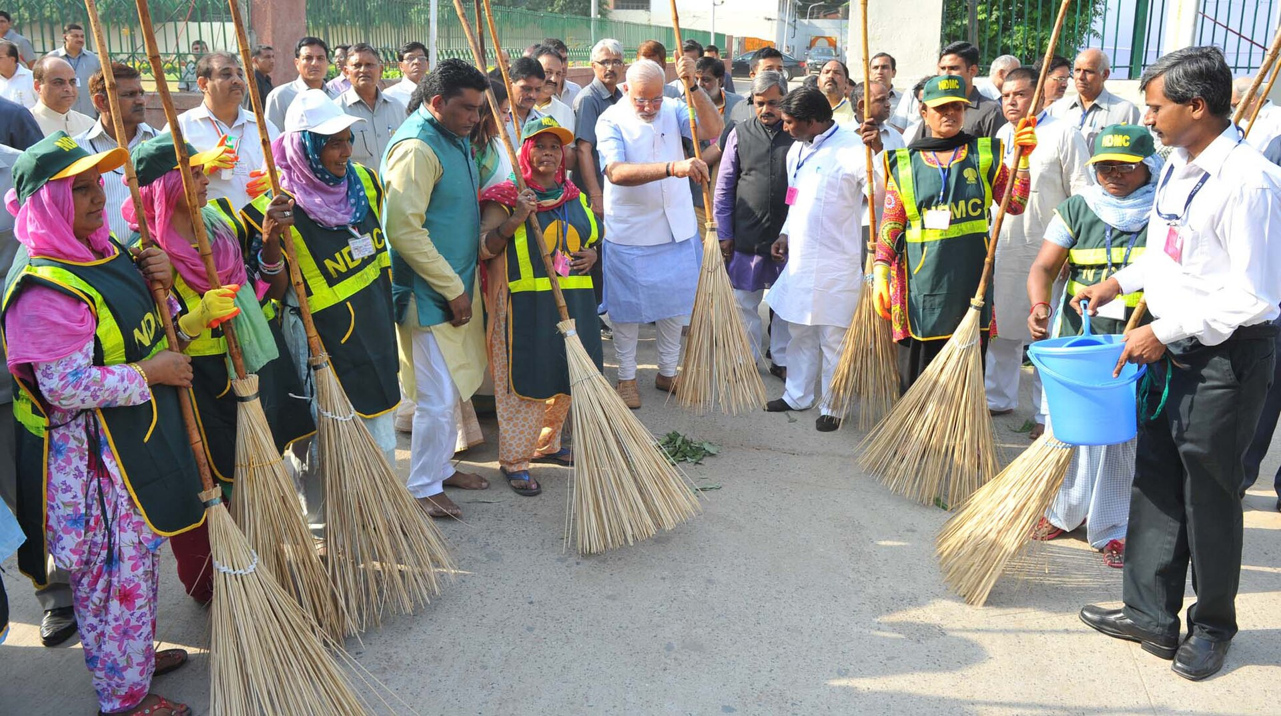




Swachh Bharat Abhiyan at a glance
Launched 2 October 2014. Goal: an open-defecation-free (ODF) India by 2 October 2019, Mahatma Gandhi's 150th birth anniversary.
SBM-Grameen (rural)
Ministry of Jal Shakti
SBM-Urban
Ministry of Housing & Urban Affairs
Phase I: household toilets; villages declared ODF
Phase II (2020–26): ODF Plus — solid & liquid waste management, visible cleanliness
Toilets and door-to-door waste collection in towns
SBM-U 2.0 (from 1 Oct 2021): "Garbage Free Cities" — segregation, 3Rs, clearing old dumpsites
Government
funds, targets, monitoring
Local bodies
collection, processing, toilets
Citizens
use toilets, segregate waste
Sources: DDWS, Ministry of Jal Shakti, SBM(G) Year End Review (PIB, Jan 2026); MoHUA on SBM-U 2.0 (PIB).
Launch of the cleanliness drive, Valmiki Basti, New Delhi, 2 Oct 2014. Photo: PMO, GODL-India
Notes:
Swachh Bharat Abhiyan (Swachh Bharat Mission, SBM) was launched by Prime Minister Narendra Modi on 2 October 2014. The first target was to make India open-defecation free by 2 October 2019, the 150th birth anniversary of Mahatma Gandhi, who strongly linked cleanliness with public life.
It has two arms:
- SBM-Grameen, run by the Department of Drinking Water and Sanitation in the Ministry of Jal Shakti. Phase I focused on building household toilets. Phase II, from 2020 to 2025-26, aims at "ODF Plus" villages: keeping ODF status and managing solid and liquid waste, with visible cleanliness. The Phase II outlay is over Rs 1.40 lakh crore.
- SBM-Urban, run by the Ministry of Housing and Urban Affairs. SBM-U 2.0 was launched on 1 October 2021 with the vision of "Garbage Free Cities": source segregation of waste, the 3Rs (reduce, reuse, recycle), scientific processing of all municipal waste, and remediation of legacy dumpsites.
Why it matters: unsafe sanitation spreads diarrhoea and other diseases, especially among children; uncollected waste blocks drains, breeds mosquitoes, and is often burnt.
Roles: the Centre funds and sets targets with the states; municipal bodies and gram panchayats deliver services; citizens are expected to use toilets, segregate waste and join drives such as Swachhata Hi Seva. The government reported participation of over 18 crore people in Swachhata Hi Seva 2025 (17 September to 2 October 2025).
Political science point: this is an executive-led, centrally sponsored scheme that relies on "Jan Andolan" (mass participation) and on cooperative federalism between the Centre, states and local governments.
References:
- Department of Drinking Water and Sanitation, Ministry of Jal Shakti. Year End Review 2025: Swachh Bharat Mission (Grameen) Phase II. Press Information Bureau, January 2026. https://static.pib.gov.in/WriteReadData/specificdocs/documents/2026/jan/doc202611750301.pdf
- Ministry of Housing and Urban Affairs. Swachh Bharat Mission-Urban 2.0, PIB release. https://pib.gov.in/PressReleasePage.aspx?PRID=1799410
Photo: "The Prime Minister, Shri Narendra Modi launching the cleanliness drive for Swachh Bharat Mission from Valmiki Basti, in New Delhi on October 02, 2014", Prime Minister's Office, GODL-India, Wikimedia Commons.

Slide 6
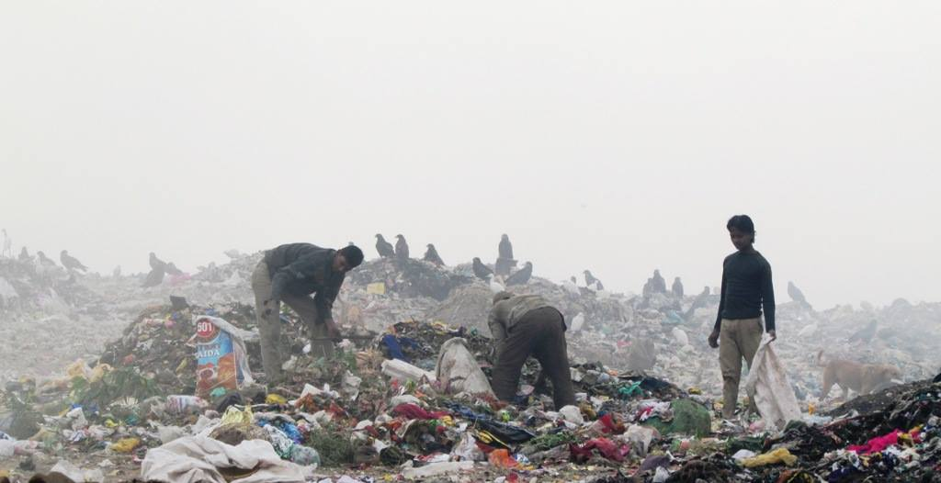

Progress so far — and what remains
Official figures
Independent checks
12 crore+
NSS 76th round (Jul–Dec 2018): 71.3% of rural households had access to a latrine — a survey taken before the 2019 ODF declaration. Access does not always mean use.
WHO (2018): modelled 300,000+ deaths avoided (2014–19) if full coverage was reached — an estimate, not a count.
WHO/UNICEF JMP: 676 million Indians stopped open defecation over two decades (as cited by the government).
Declared vs verified: 4.89 lakh villages declared ODF Plus, 4.15 lakh verified (Dec 2025).
household toilets built in rural India since 2014 (Dec 2025)
83%+
Ghazipur landfill, 2013. Photo: FacetsOfNonStickPans, CC BY-SA 4.0
of villages declared ODF Plus (Model): about 4.89 lakh (Dec 2025)
Delhi's challenge: Ghazipur still held about 67–69 lakh tonnes of waste in 2026; the clearance target is December 2027.
Still to solve: segregation at source, processing capacity, toilet upkeep, and keeping people involved.
80%
of urban solid waste processed, out of 1.62 lakh tonnes a day (Feb 2025)
Sources: SBM(G) IMIS via PIB (Jan 2026); Rajya Sabha reply, MoHUA (10 Feb 2025); NSO, NSS 76th round (2019); WHO India (27 Jul 2018); MCD affidavit to NGT, OA 481/2024 and 2026 reports.
Notes:
Here I separate what the government reports from what independent sources show.
Official figures:
- According to the SBM(G) IMIS portal (16 December 2025), more than 12 crore household latrines and 2.67 lakh community sanitary complexes have been built since 2 October 2014.
- 4,89,526 villages had declared themselves ODF Plus (Model), described as over 83 percent of villages; 4,15,915 were verified.
- For cities, a Rajya Sabha reply by the Ministry of Housing and Urban Affairs on 10 February 2025 said about 80.39 percent of roughly 1.62 lakh tonnes per day of urban waste is processed, based on data reported by states.
- These are self-reported, administrative figures. "Declared" ODF is not the same as independently verified.
Independent checks:
- The NSO's NSS 76th round (July to December 2018) found 71.3 percent of rural households had access to a latrine. This was a year before the 2019 ODF declaration, so it does not directly disprove it, but it shows the gap between building toilets and universal access at that time. NSS also counted access, not actual use.
- WHO (2018) estimated that SBM-Grameen could avert more than 300,000 deaths from diarrhoea and protein-energy malnutrition between 2014 and October 2019, assuming full coverage. It is a model-based estimate.
- The WHO/UNICEF Joint Monitoring Programme report (2000-2024), as cited by the government, says 676 million people in India moved away from open defecation over two decades.
Delhi example: Ghazipur, Delhi's oldest landfill, still held roughly 67 to 69 lakh tonnes of waste in 2026 (different official sources and dates give slightly different totals). Delhi's target is December 2027. A fire at Ghazipur in April 2024 led to a case before the National Green Tribunal.
Remaining challenges: separating wet and dry waste at home, enough processing plants, maintaining toilets and water supply, and keeping public participation alive after the campaign phase.
References:
- DDWS, Ministry of Jal Shakti, Year End Review 2025 (PIB, January 2026). https://static.pib.gov.in/WriteReadData/specificdocs/documents/2026/jan/doc202611750301.pdf
- Rajya Sabha, Unstarred Question 698, answered 10 February 2025, Ministry of Housing and Urban Affairs. https://rsdebate.nic.in/bitstream/123456789/758413/1/PQ_267_10022025_U698_p241_p245.pdf
- National Statistical Office (2019). Drinking Water, Sanitation, Hygiene and Housing Condition in India, NSS 76th Round (July-December 2018), Report No. 584. MoSPI.
- WHO India (27 July 2018). Health gains from the Swachh Bharat initiative. https://www.who.int/india/news/item/27-07-2018-health-gains-from-the-swachh-bharat-initiative
- WHO/UNICEF JMP (2025). Progress on household drinking water, sanitation and hygiene 2000-2024 (as cited in the DDWS Year End Review).
- MCD affidavit before the National Green Tribunal, O.A. No. 481 of 2024 (Ghazipur landfill fire); The Daily Guardian (2026) on Ghazipur legacy waste.
Photo: "Workers on top of Ghazipur landfill 2013" by FacetsOfNonStickPans, CC BY-SA 4.0, Wikimedia Commons.

Slide 7

Two different policies, one shared goal
 | CNG transition in Delhi | Swachh Bharat Abhiyan
Led by | Supreme Court, through a PIL (M.C. Mehta case) | Central Government with states and local bodies
Main tools | Fuel mandate, deadlines and fines | Funding, targets, campaigns, city rankings
Targets | Tailpipe emissions from public transport | Open defecation, solid and liquid waste
Economic idea | Correcting a negative externality (air pollution) | Providing public goods (sanitation, clean spaces)
Main limit | Still a fossil fuel; traffic keeps growing | Keeping toilets used and waste segregated
Where they meet
Burning waste and landfill fires pollute the air: waste burning was about 8% of winter PM2.5.
The national clean-air ranking (Swachh Vayu Sarvekshan, NCAP) scores cities on both waste management and vehicle emissions.
Both need strong institutions and daily citizen action.
Note: CNG is not part of Swachh Bharat Abhiyan. They are separate initiatives with overlapping health goals.
Sources: IIT Kanpur (2016); MoEFCC, Swachh Vayu Sarvekshan guidelines (PIB, 24 Sep 2022) and awards (PIB, 9 Sep 2025); slides 3–6.
Notes:
This slide brings the two topics together without pretending they are one programme.
Comparison:
- Origin: CNG in Delhi was driven mainly by the Supreme Court in a public interest case. Swachh Bharat is an executive programme of the Central Government, delivered with states, municipal bodies and panchayats.
- Tools: the CNG policy used a hard mandate (a fuel rule with deadlines and fines). Swachh Bharat uses money, targets, mass campaigns and competitions such as Swachh Survekshan.
- Economics: air pollution is a classic negative externality - the person driving a diesel bus does not pay for the harm to others' lungs, so the state steps in. Sanitation and clean public spaces have public-good features: everyone benefits, so markets alone under-provide them.
- Limits: CNG is still a fossil fuel and its gains can be cancelled by traffic growth. Swachh Bharat's challenge is to keep toilets in use and make waste segregation and processing permanent.
Where they genuinely meet (evidence-based):
- In the IIT Kanpur study, municipal solid waste burning was about 8 percent of winter PM2.5. Landfill fires, like the April 2024 Ghazipur fire, also release smoke. So better waste management also helps air quality.
- Swachh Vayu Sarvekshan, launched by the Ministry of Environment under the National Clean Air Programme (NCAP), ranks around 130 cities on actions in solid waste management, road dust, construction waste, vehicular emissions and industrial pollution. It ranks actions, not measured air quality. This is an official framework where both kinds of action are assessed together - but it is part of NCAP, not of Swachh Bharat Mission.
Important: CNG vehicles are not a component of Swachh Bharat Abhiyan. They are distinct initiatives that contribute to the broader goal of a healthier city.
References:
- MoEFCC (24 September 2022). Swachh Vayu Sarvekshan - Ranking of Cities under NCAP. PIB. https://www.pib.gov.in/PressReleasePage.aspx?PRID=1861932
- MoEFCC (9 September 2025). Swachh Vayu Sarvekshan Awards 2025. PIB. https://www.pib.gov.in/PressReleasePage.aspx?PRID=2164956
- IIT Kanpur (2016), as cited on slide 2.

Slide 8
Conclusion and key references
1
Delhi's CNG switch shows a court-led fuel mandate can cut harmful pollutants quickly, but CNG is a transition fuel, not a final answer.
Supreme Court of India. M.C. Mehta v. Union of India, WP(C) 13029/1985 (orders: 28 Jul 1998; 5 Apr 2002).
MoEF (1998). Notification S.O. 93(E), 29 Jan 1998 (EPCA).
Narain, U. & Krupnick, A. (2007). The Impact of Delhi's CNG Program on Air Quality. RFF DP 07-06.
US DOE AFDC. Natural Gas Vehicle Emissions. afdc.energy.gov
IIT Kanpur (2016). Comprehensive Study on Air Pollution and GHGs in Delhi.
DDWS, Ministry of Jal Shakti (2026). SBM(G) Year End Review 2025. PIB.
MoHUA. SBM-Urban 2.0 (PIB); Rajya Sabha Unstarred Q. 698, 10 Feb 2025.
NSO (2019). NSS 76th Round: Drinking Water, Sanitation, Hygiene and Housing Condition.
WHO India (2018). Health gains from the Swachh Bharat initiative.
MoEFCC (2022, 2025). Swachh Vayu Sarvekshan. PIB.
2
Swachh Bharat changed sanitation at national scale; official claims and independent surveys should be read together.
3
Clean air needs both cleaner vehicles and an end to open dumping and burning of waste.
4
Lasting results depend on institutions and on everyday citizen behaviour.
Full citations with links are in the speaker notes of each slide.
Notes:
Conclusion (about 1 minute):
1. CNG in Delhi is a strong example of how a court-driven mandate changed a whole public transport system within a few years and improved some pollutant levels. But it is still a fossil fuel, and Delhi is now moving to electric buses.
2. Swachh Bharat achieved a huge scale of toilet construction and waste programmes. As students of economics and political science, we should read official achievements together with independent surveys like the NSS and WHO estimates.
3. Clean air and clean streets are connected: burning waste adds to air pollution, so transport and waste policy both matter.
4. In both cases, success depends on institutions (courts, ministries, municipal bodies) and on citizens' daily choices.
Thank you. I am happy to take questions.
Full references:
1. Supreme Court of India. M.C. Mehta v. Union of India, Writ Petition (Civil) No. 13029 of 1985. Orders dated 28 July 1998, 26 March 2001 and 5 April 2002.
2. Ministry of Environment and Forests (1998). Notification S.O. 93(E), 29 January 1998, constituting the Environment Pollution (Prevention and Control) Authority for the NCR.
3. Narain, U. and Krupnick, A. (2007). The Impact of Delhi's CNG Program on Air Quality. Resources for the Future, Discussion Paper 07-06. https://www.rff.org/publications/working-papers/the-impact-of-delhi039s-cng-program-on-air-quality/
4. U.S. Department of Energy, Alternative Fuels Data Center. Natural Gas Vehicle Emissions. https://afdc.energy.gov/vehicles/natural-gas-emissions
5. IIT Kanpur (2016). Comprehensive Study on Air Pollution and Green House Gases (GHGs) in Delhi. Report to the Government of NCT of Delhi, January 2016. (Figures as reported by Governance Now, 7 November 2016.)
6. Department of Drinking Water and Sanitation, Ministry of Jal Shakti (2026). Year End Review 2025: Swachh Bharat Mission (Grameen). Press Information Bureau. https://static.pib.gov.in/WriteReadData/specificdocs/documents/2026/jan/doc202611750301.pdf
7. Ministry of Housing and Urban Affairs. Swachh Bharat Mission-Urban 2.0, PIB, https://pib.gov.in/PressReleasePage.aspx?PRID=1799410 ; Rajya Sabha Unstarred Question No. 698, 10 February 2025.
8. National Statistical Office (2019). Drinking Water, Sanitation, Hygiene and Housing Condition in India: NSS 76th Round (July-December 2018). Ministry of Statistics and Programme Implementation.
9. World Health Organization, India (27 July 2018). Health gains from the Swachh Bharat initiative. https://www.who.int/india/news/item/27-07-2018-health-gains-from-the-swachh-bharat-initiative
10. Ministry of Environment, Forest and Climate Change. Swachh Vayu Sarvekshan - Ranking of Cities under NCAP (PIB, 24 September 2022), https://www.pib.gov.in/PressReleasePage.aspx?PRID=1861932 ; Swachh Vayu Sarvekshan Awards 2025 (PIB, 9 September 2025), https://www.pib.gov.in/PressReleasePage.aspx?PRID=2164956
Additional sources used: Centre for Science and Environment (2011); Ravindra et al. (2006), Environmental Monitoring and Assessment 115; CAQM Act, 2021; All India Radio News (29 Aug 2026) on CNG prices; Angel One News (13 Oct 2026) on Delhi's bus fleet; MCD affidavit to NGT in O.A. 481/2024 on Ghazipur landfill.

