Slide 1
Research Meeting
Nate
10/20/2011

Slide 2
My Summer and Fall

Slide 3
Home Automation

Slide 4
Prototyping

Slide 5
Learning from Demonstration

Slide 6
Gazebo

Slide 7
Gazebo
User Stories

Slide 8
Gazebo
User Stories
As a user...
I want a faster simulation
I want to run a simulator on laptops
I want to be able to design environments easier
I want to prototype new robots easier

Slide 9
Faster Simulation
Physics Update
GPU solvers, SSE optimizations
Collision Checking
FCL integration
Threading & Multiprocess
Improved threading model
Split physics and sensor generation

Slide 10
Current Gazebo
Gazebo 1.0
CPU
CPU 1
CPU 1
GPU 1
Controller
Update
Plugin
Update
Collision
Check
Collision
Check
CPU 2
GPU 2
Physics
Solver
Physics
Solver
GPU
Sensor Generation
CPU 3
GPU 3
Sensor Generation

Slide 11
Laptops
Cluster Computing
TCP Transport
Distributed architecture
Lightweight GUI
Future
Adjustable simulation fidelity

Slide 12
Design Environments
Graphical World Creation
Stop manual XML editing
Create simple shapes
Import meshes
Near Future
Support prototyping: home oriented design
stairs, doors, and household items

Slide 13
Design New Robots
Missing GUI Tool
Must still edit XML, unfortunately
Scene Description Format
Gazebo XML spec – closely matches URDF
Sharing Robots
Online repository of models and environments

Slide 14
Other Enhancements
Plugins
Flexible plugins for sensors, robots, world, gui
Complete control over simulation
Customizable GUI
Design your own GUI overlay
Create custom interactions
Command Line Tools
System introspection

Slide 15
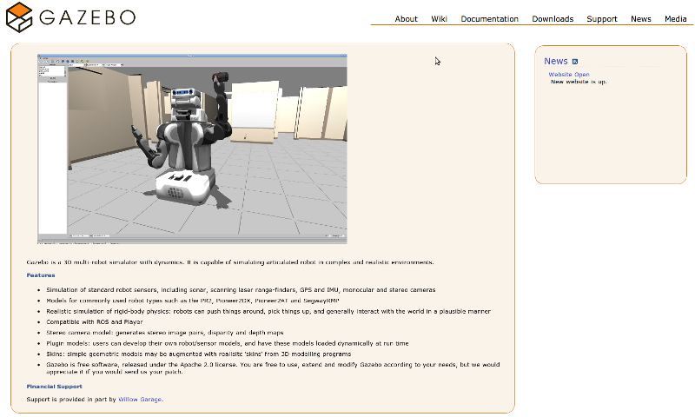
Gazebo 1.0 and You
Find out more
gazebo.willowgarage.com
More user needs
What do you want?

Slide 16
Gazebo
  Needs that we're addressing:
    As a user I want a faster simulation
      Individual libraries for each component (physics, rendering, gui)
        Take advantage of multi-core systems
        Potential for distributed computing
    As a user I want to run a simulator on laptops and other low power PCs
        Run gazebo in the cloud, or make use of nearby Desktops
    As a user I want to be able to design world easier
      GUI tools for simple shapes
      Load meshes from external sources.
      Show demo
    As a user I want to prototype new robots and models easier
      The is mostly in the future.
      We've redesigned the gazebo XML spec to bring it inline with URDF
      Redesigned plugin architecture (world, model, sensor, gui)
Future
  Shared memory communiction
  Run gazebo in the cloud

