Slide 1

GAZİ UNIVERSITY FACULTY OF ENGINEERING DEPARTMENT OF INDUSTRIAL ENGINEERING
IE104-COMPUTER PROGRAMMING I
Lecturer : Dr Ercan Ezin
WEEK 12: FILE AND EXCEPTION HANDLING

Slide 2

Attendance
Please do not share the link to anyone!

Slide 3
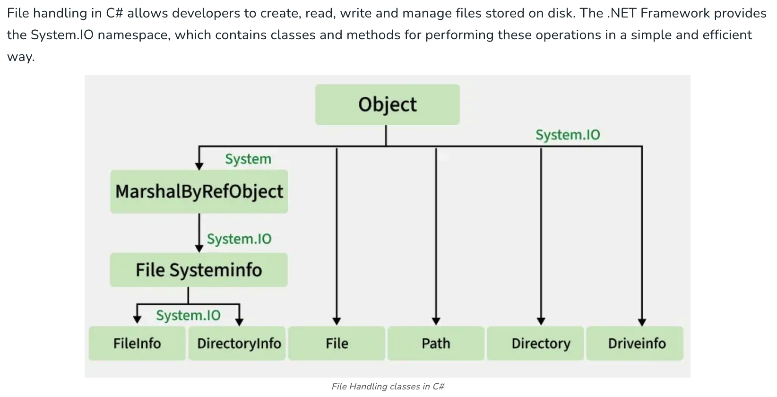
FILE HANDLING

Slide 4
FILE HANDLING CLASSES
C# uses the System.IO namespace for file and directory operations. Commonly used classes include:
File: Provides static methods for creating, copying, deleting, moving and opening files.
FileInfo: Provides instance methods for file operations with additional objec t-oriented features.
Directory: Provides static methods for creating, moving and enumerating directories.
DirectoryInfo: Provides instance methods for directory operations.
StreamReader / StreamWriter: For reading and writing text files.
BinaryReader / BinaryWriter: For reading and writing binary files.
FileStream: For reading and writing to files at a lower level.

Slide 5
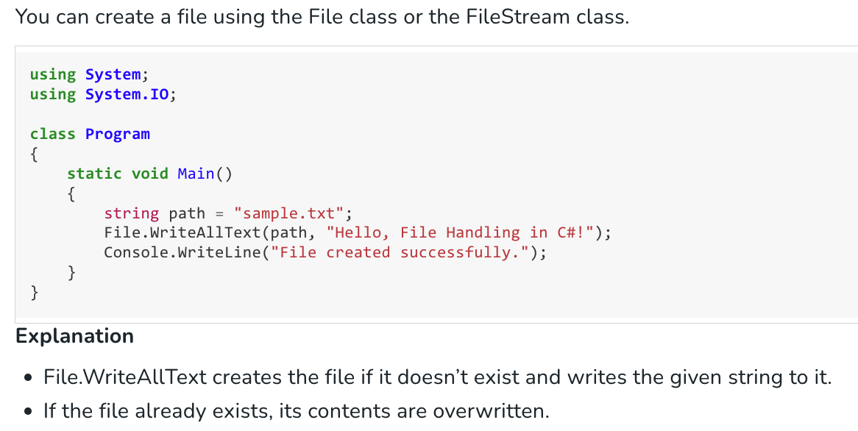
CREATING A FILE
Another method, File.WriteAllLines, is used to write an array of strings as individual lines. In contrast, File.WriteAllText writes a single string exactly as provided, without adding any extra formatting or line breaks.

Slide 6
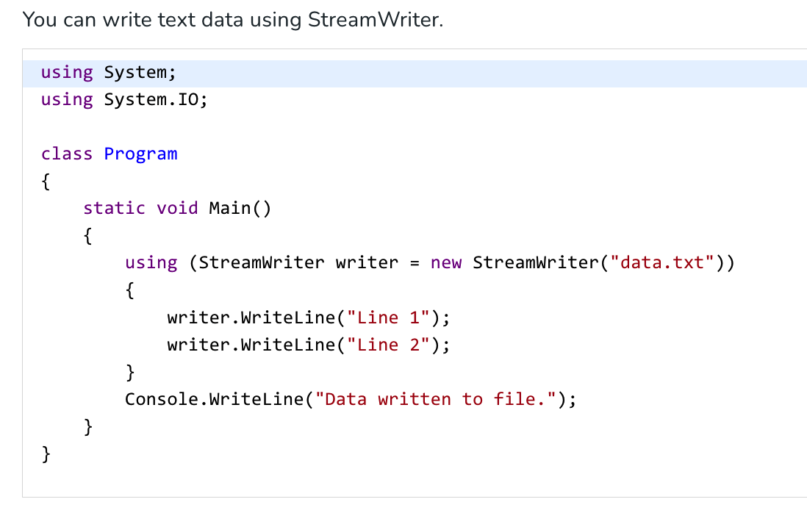
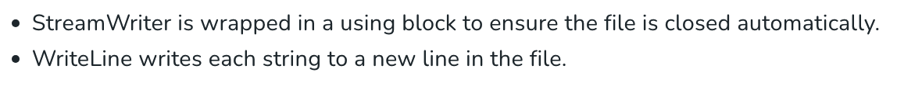
WRITING LINES TO A FILE
The using keyword creates an object within a specific block of code, assigns it to a variable, and ensures it is automatically closed once the block finishes.

Slide 7
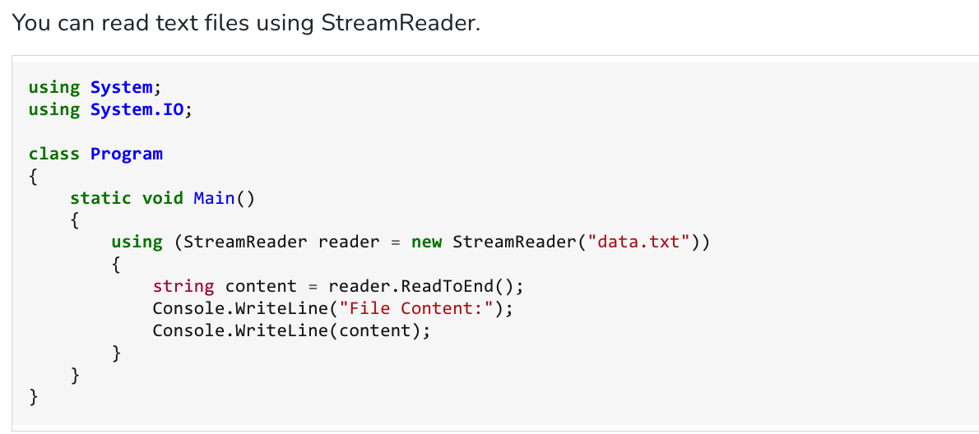
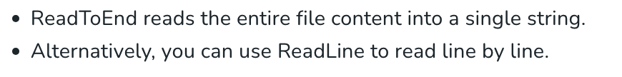
READING LINES FROM A FILE
Now try to write this example with ReadLine!

Slide 8
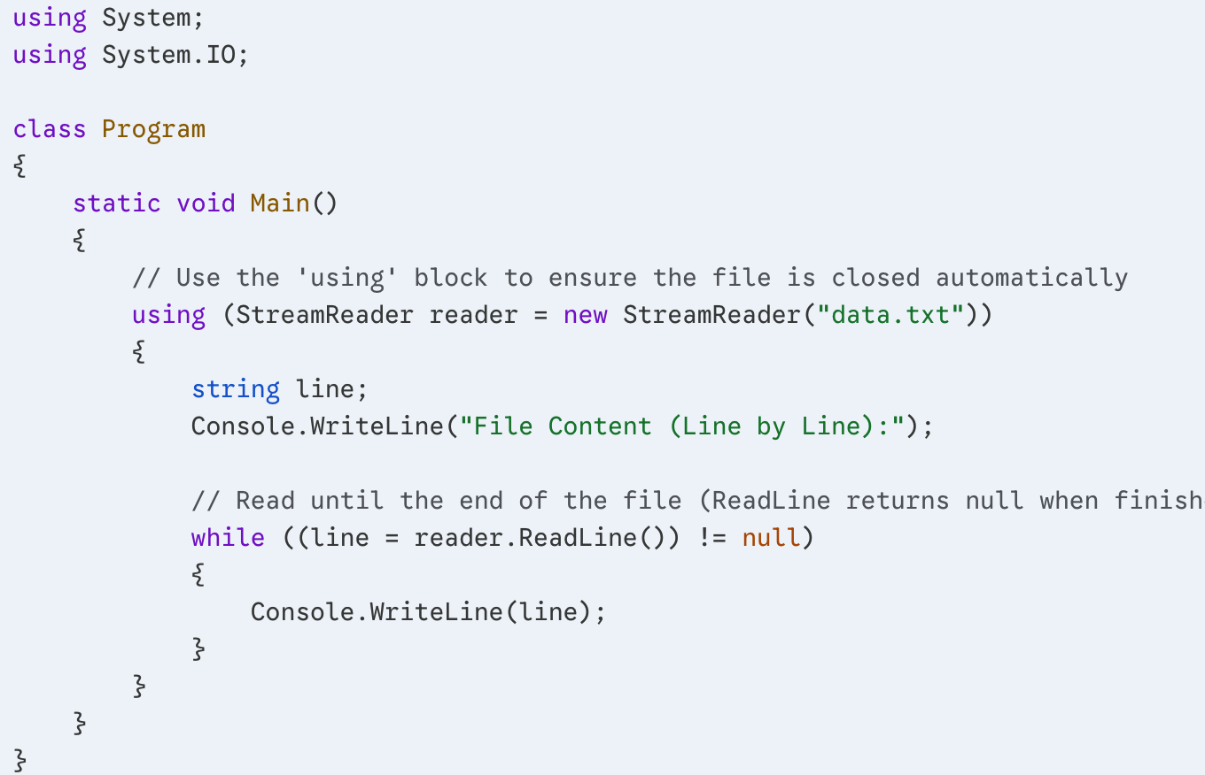
Solution

Slide 9
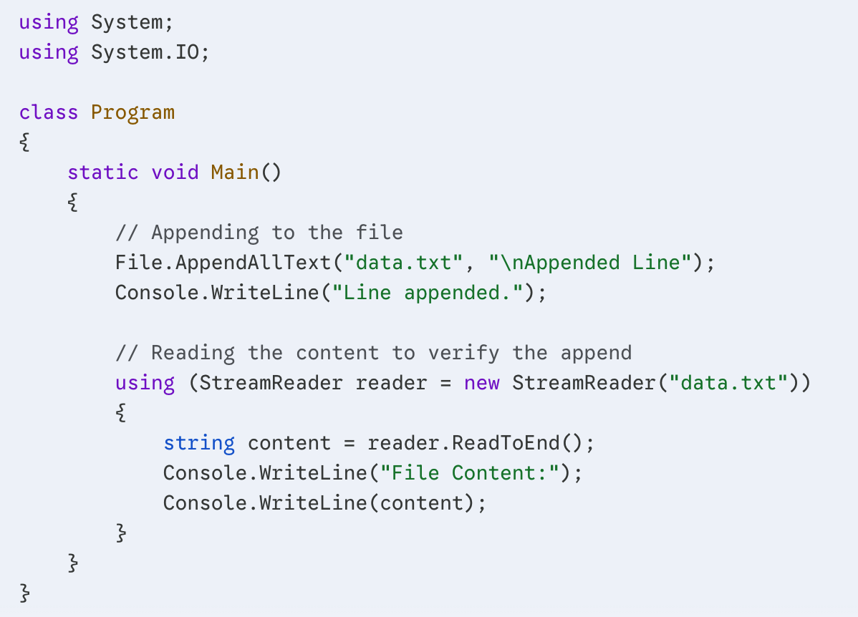
APPENDING NEW LINE TO FILE
Appending adds data without deleting existing content.
What is the output of this code?

Slide 10
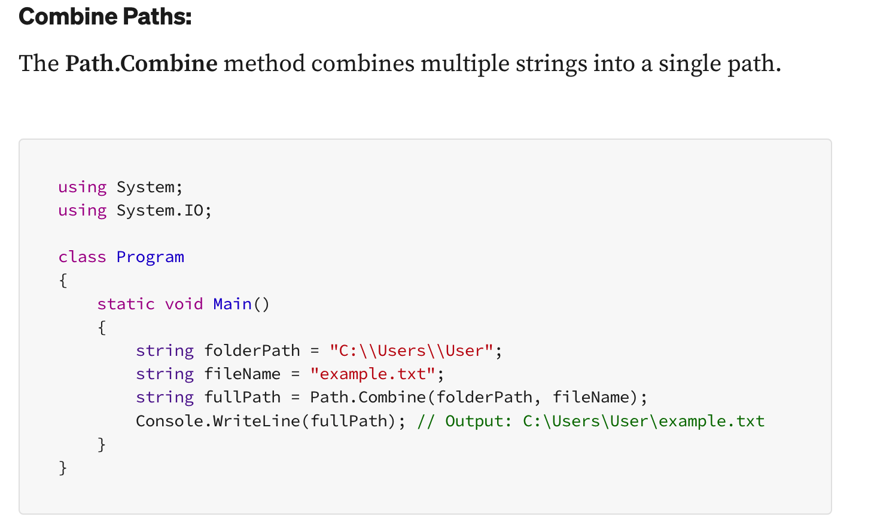
MANAGING FILE PATHS
It is crucial to manage paths to ensure that your application can locate and access files accurately. The .NET framework provides useful methods in the System.IO.Path class for manipulating file and directory paths.

Slide 11
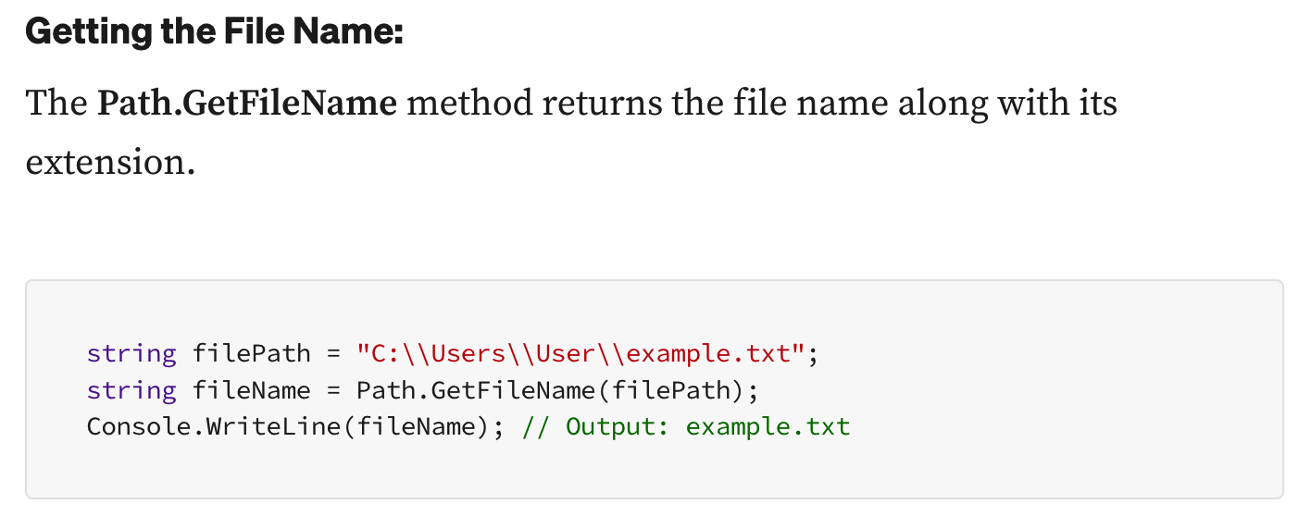
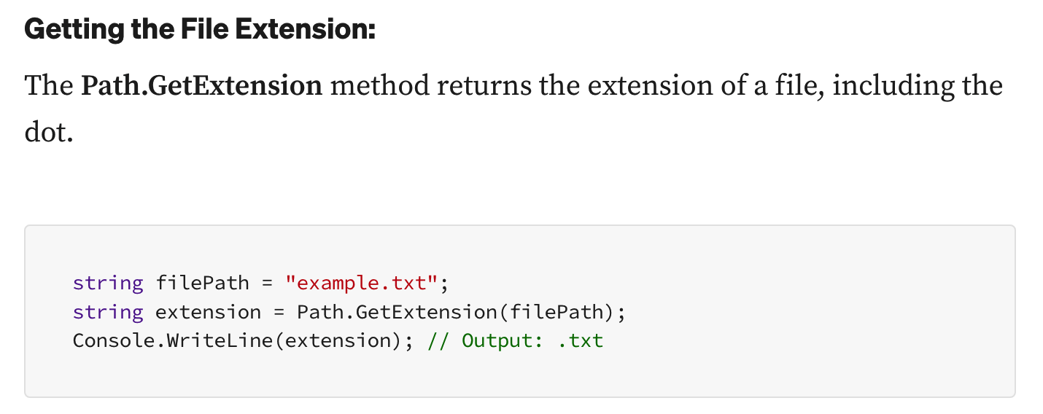
GET FILE NAME AND EXTENSION

Slide 12
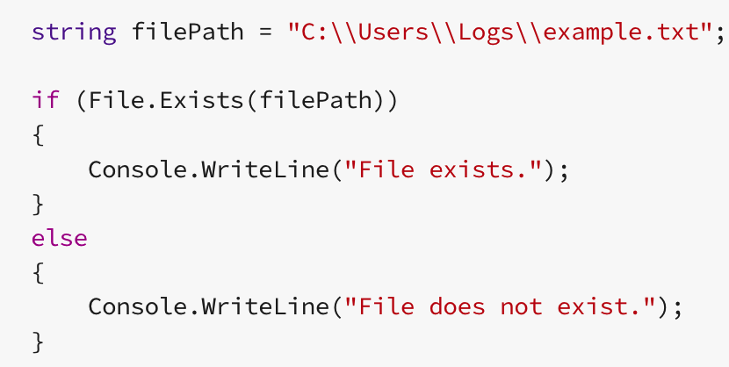
Checking the Existence of Files and Directories
When working with files or directories in C#, it’s always a good practice to check if they exist beforehand.
.NET framework offers built-in methods to perform these checks efficiently.
Check Whether a File Exists:
The Sytem.IO.File.Exists method checks if a file exists at a specified path. Consider that we have using Sytem.IO added above the class for the following code:

Slide 13
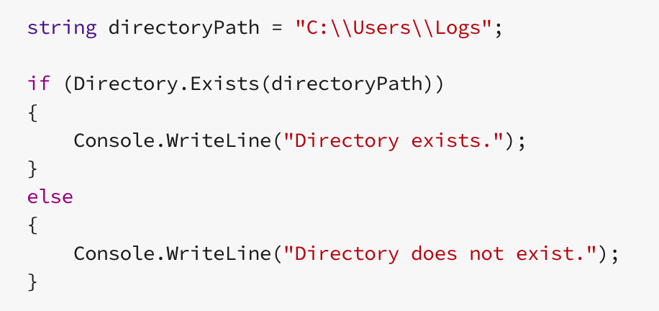
Checking the Existence of Files and Directories
Check Whether a Directory Exists:
The System.IO.Directory.Exists method checks if a directory exists at a specified path. Again, consider that we added System.IO at the beginning:

Slide 14
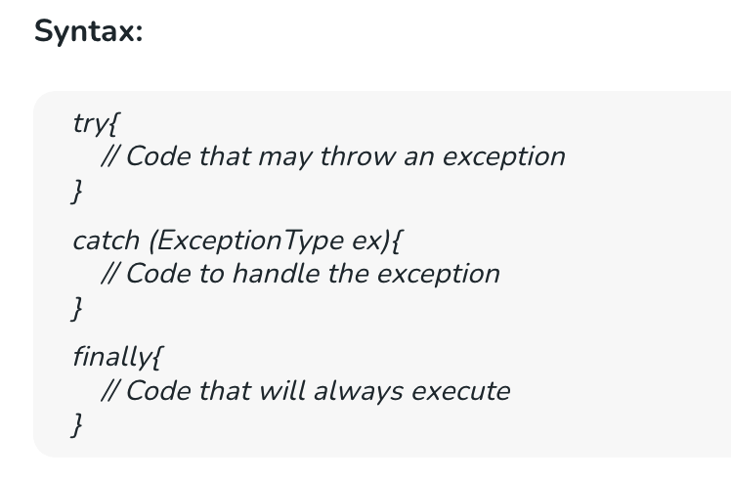
EXCEPTION HANDLING
It is the process of responding to runtime anomalies, known as exceptions, in a controlled way. Proper handling ensures that a program continues to run or exits gracefully instead of crashing unexpectedly. C# provides structured exception handling using the keywords try, catch, finally, and throw.

Slide 15
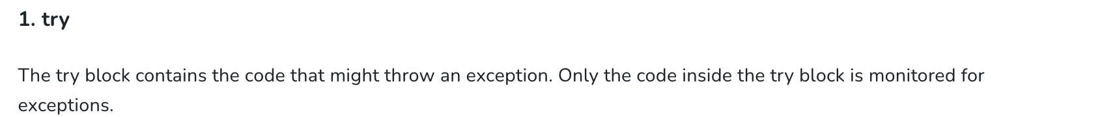
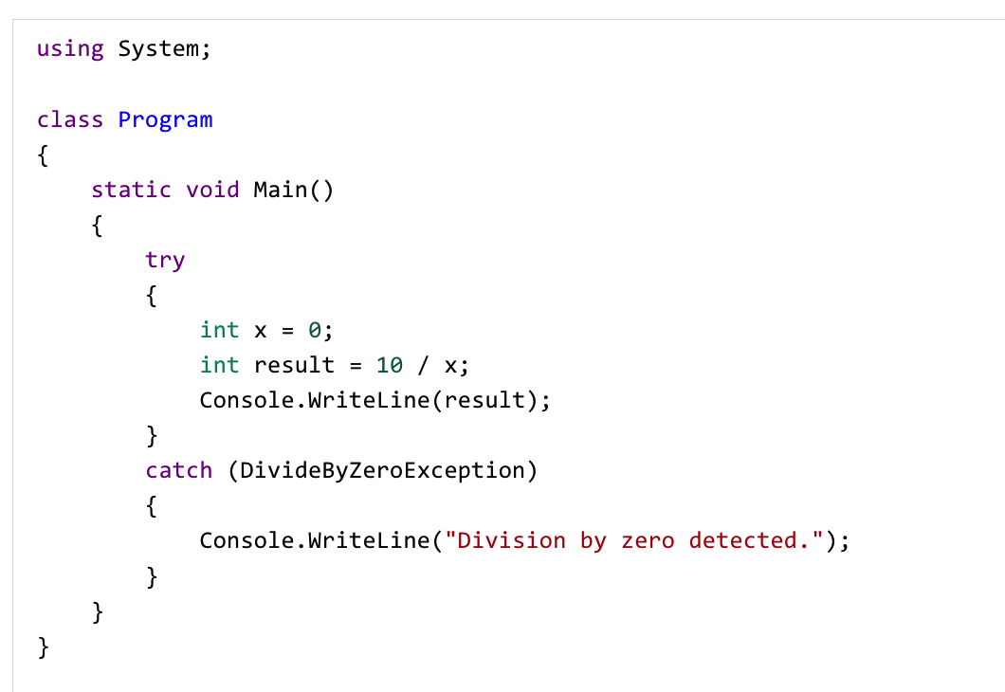
Keywords for Exception Handling
The division uses a variable (x), so the error occurs at runtime, allowing the try-catch block to handle the DivideByZeroException. By using try and catch, program will be controlled against crashes.

Slide 16
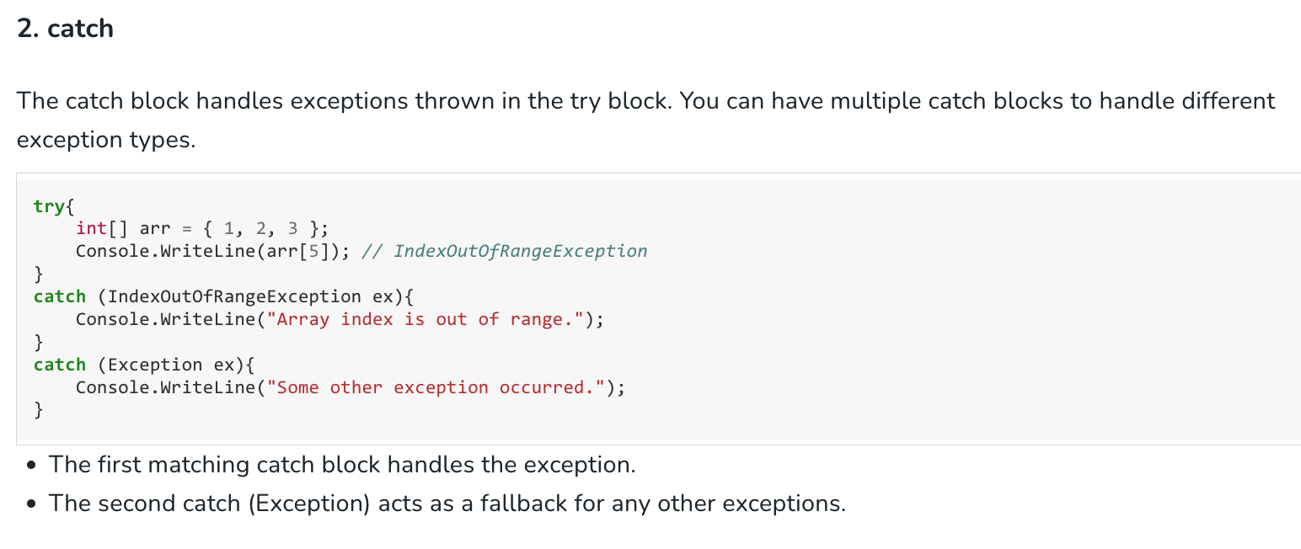
Keywords for Exception Handling

Slide 17
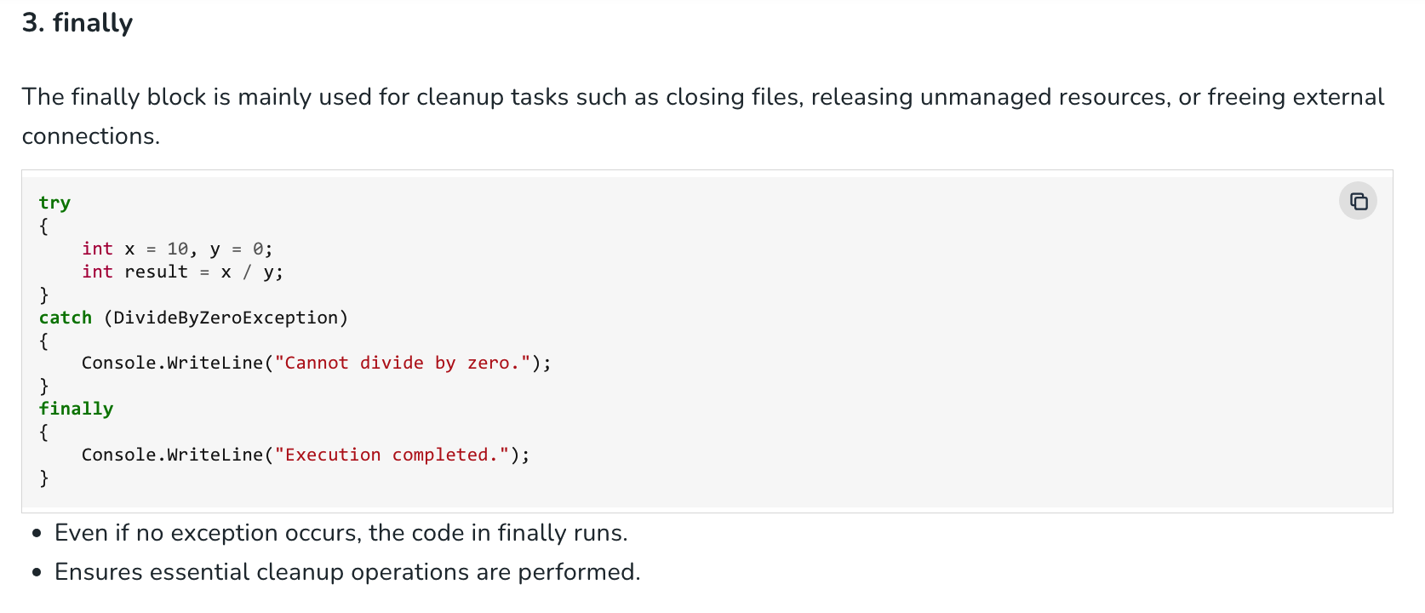
Keywords for Exception Handling

Slide 18
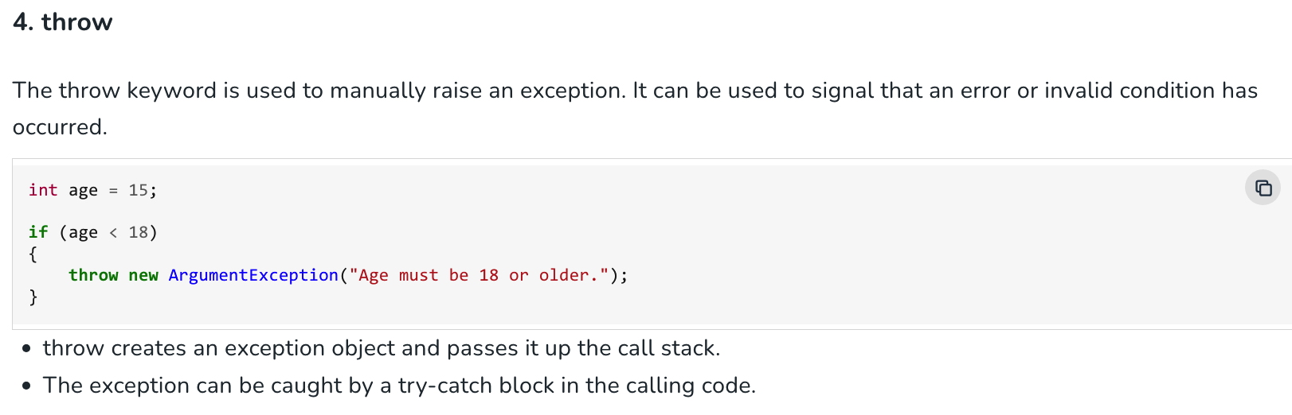
Keywords for Exception Handling

Slide 19
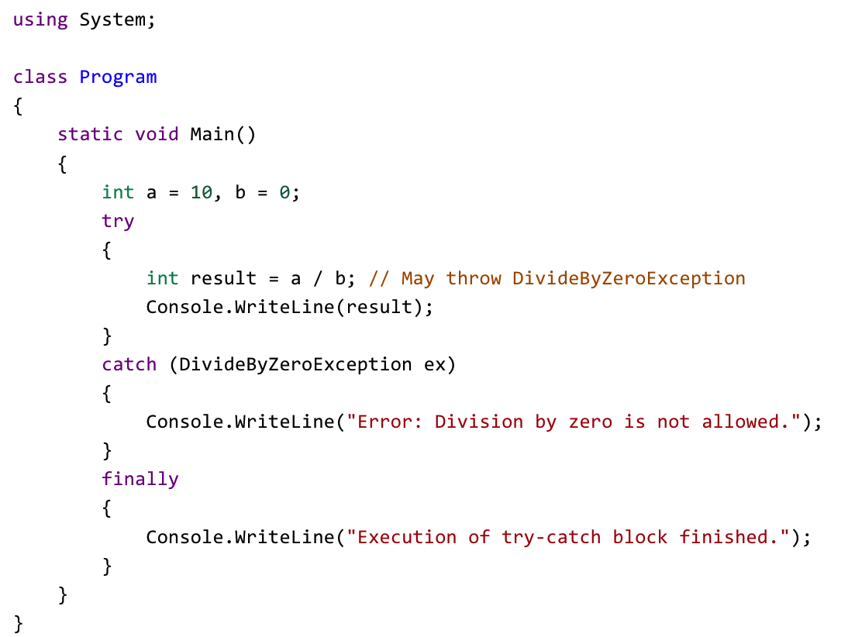
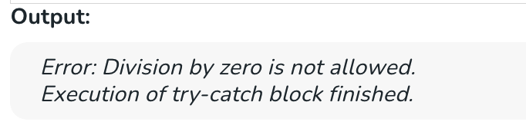
Example-1: Handling Division by Zero

Slide 20
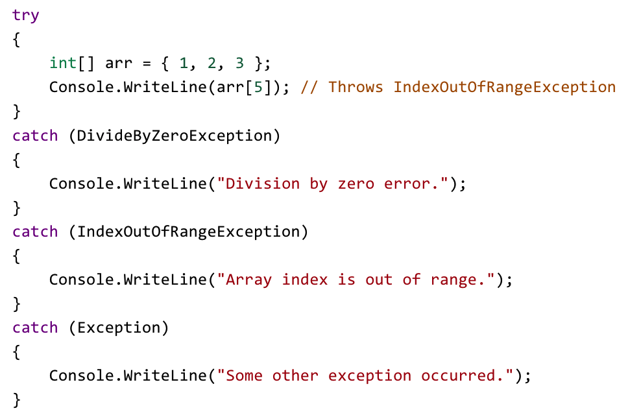
Example 2: Multiple Catch Blocks
OUTPUT: Array index is out of range.

Slide 21
Example: Exercise
Now your turn to create the following program:
Initialize Environment: Define a constant string for your file path.
Input Collection: Create a method that initializes an array of a specific size, loops through that size to collect user strings via Console.ReadLine(), and returns the filled array.
Start Safety Block: Open a try block to protect your code from crashes during disk access.
Write Data: Use a built-in method to write the entire array to the file path at once.
Read Data (Resource Management): Open a using block with a StreamReader to ensure the file handle is released even if an error occurs.
Iteration: Inside a loop, check if the "end of stream" has been reached; if not, read one line at a time and print it to the console with a prefix.
Error Handling: Add a catch block specifically for IOException to display a clean message to the user if the file is locked or the disk is full.

Slide 22
using System;
using System.IO;
class Program
{
static void Main()
{
string path = "data.txt";
string[] inputs = ........... (3)
....
{
File. ........ (path, inputs);
Console.WriteLine("File saved. Reading back contents:");
using (StreamReader reader = new StreamReader(path))
{
while (!reader. ............ )
{
Console.WriteLine($"Row: {reader.ReadLine()}");
}
}
}
..... (IOException ex)
{
Console.WriteLine($"Error accessing file: {ex.Message}");
}
}
static ................... (int count)
{
string[] strArray = new string[count];
for ( .............. )
{
Console.Write($"Enter item {i + 1}: ");
strArray[i] = Console. ............ ();
}
return strArray;
}
}
Use this optional scaffolding to begin
with coding.

Slide 23
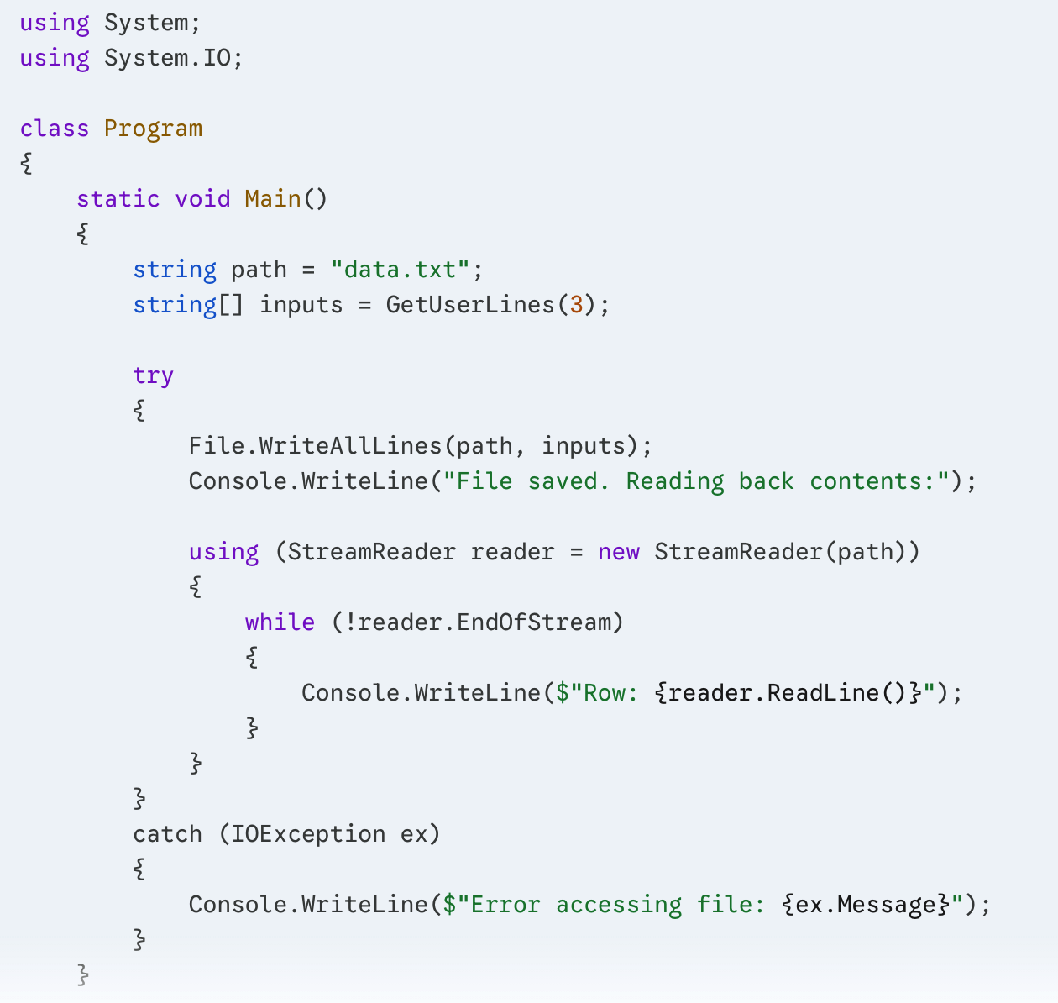
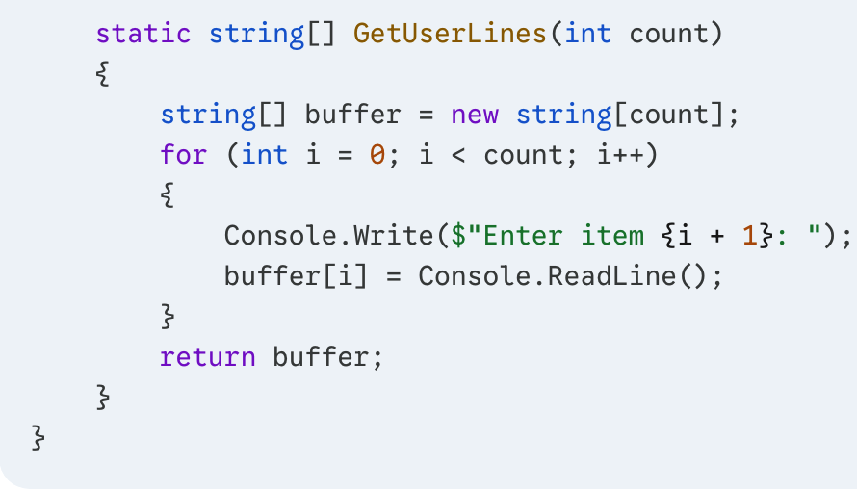
Solution
Continues above

Slide 24
THE END
Check out course website: https://gazi-end-muh.github.io
Got any questions later?
Send me an email: dr.ercan.ezin@gmail.com

