Slide 1

GAZİ UNIVERSITY FACULTY OF ENGINEERING DEPARTMENT OF INDUSTRIAL ENGINEERING
IE104-COMPUTER PROGRAMMING I
Lecturer : Dr Ercan Ezin
WEEK 7: CONDITIONAL STATEMENTS

Slide 2
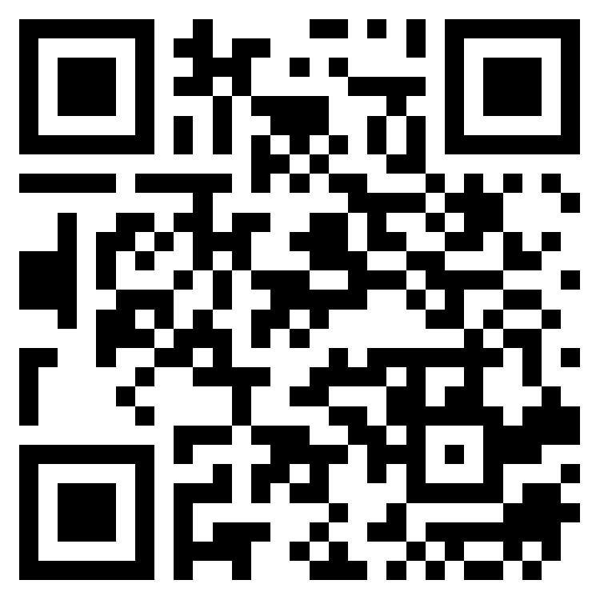
Attandance
Please do not share the link to anyone!

Slide 3
Conditional Statements
In some cases, it may be necessary to change the flow of the program or perform different operations. Sometimes making choices or repeating actions are needs for a program in a certain number of times.
Condition statements and loop structures are used to perform such
operations.
Two different statements can be used to perform conditional
operations in C#:
if statement
switch statement

Slide 4
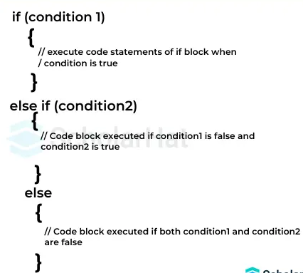
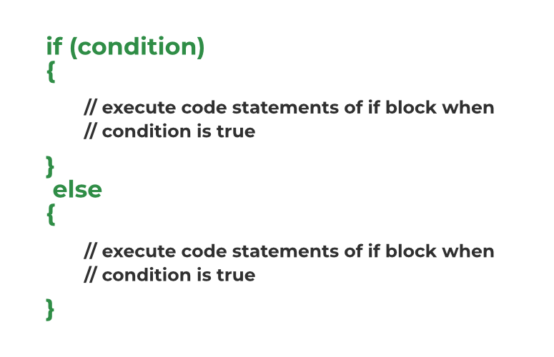
IF Statement
The main statement of flow controls .
Allows different operations according to the condition.
Simple to use:
OR
If there is more than 1 line in the statement region, it is mandatory to use Curly Brackets ({ }) in a program block.

Slide 5
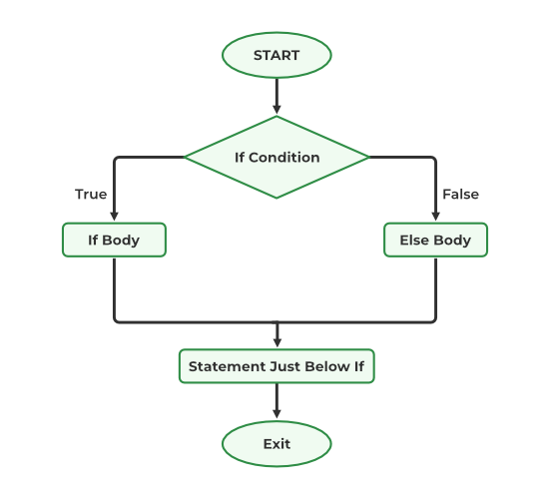
IF Flow Chart

Slide 6
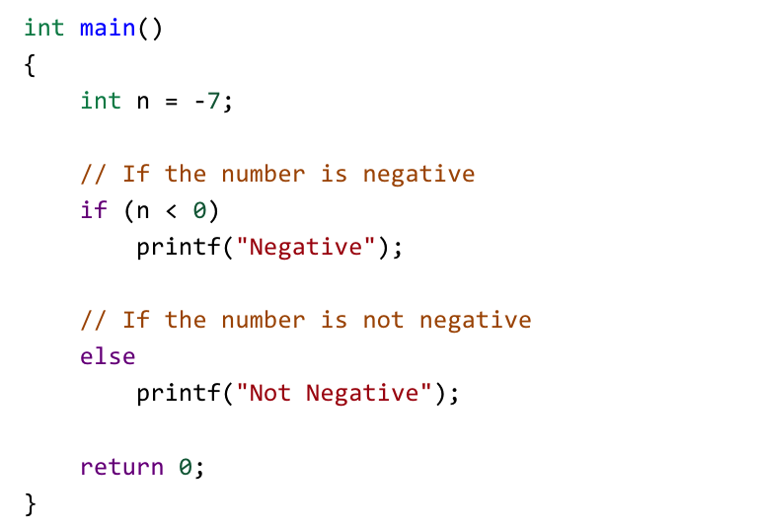
Example program for IF statement
Work on your own
Given else if statement, Now try to print if number is exactly zero.

Slide 7
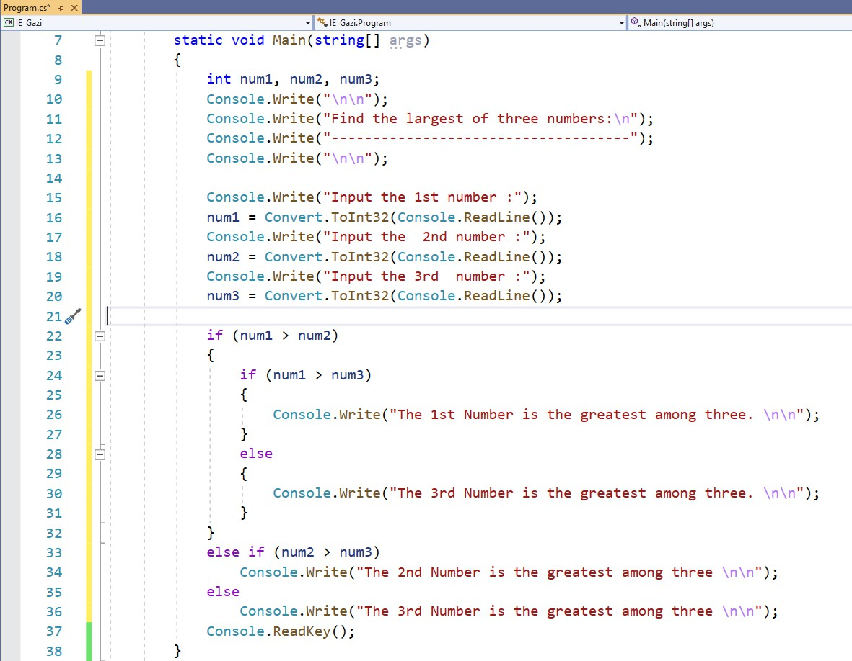
IF Statement
Write a C# program to find the largest number among 3 numbers which are entered through keyboard as inputs.

Slide 8
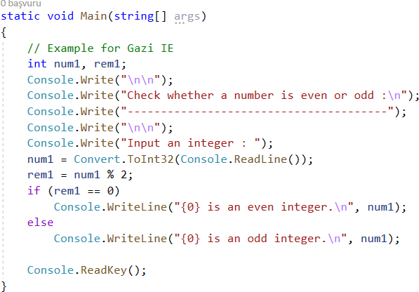
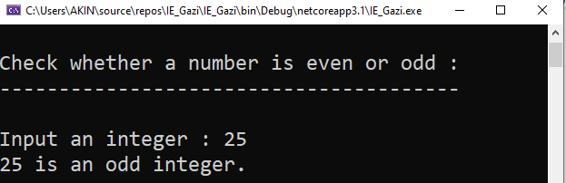
IF Statement
Write a C# program to check whether a given number is even or odd.
Expected screen has shown below:

Slide 9
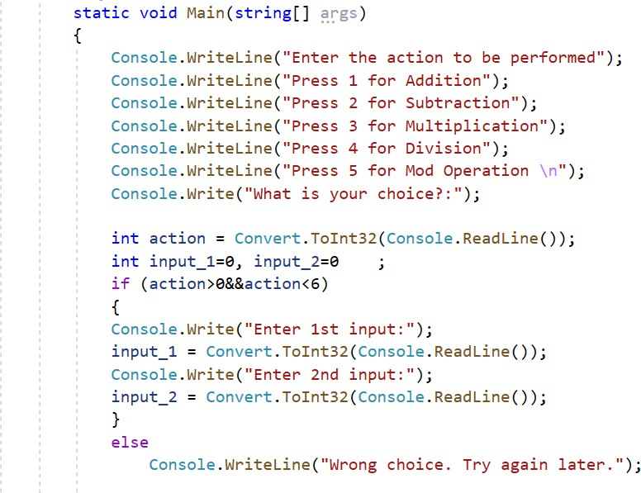
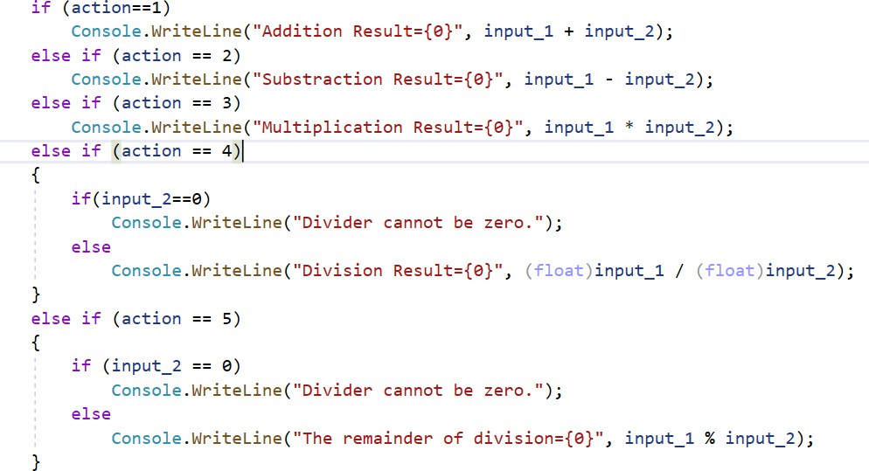
IF Statement
Writing a simple calculator program in C#
CONTINUE TO WRITE HERE

Slide 10
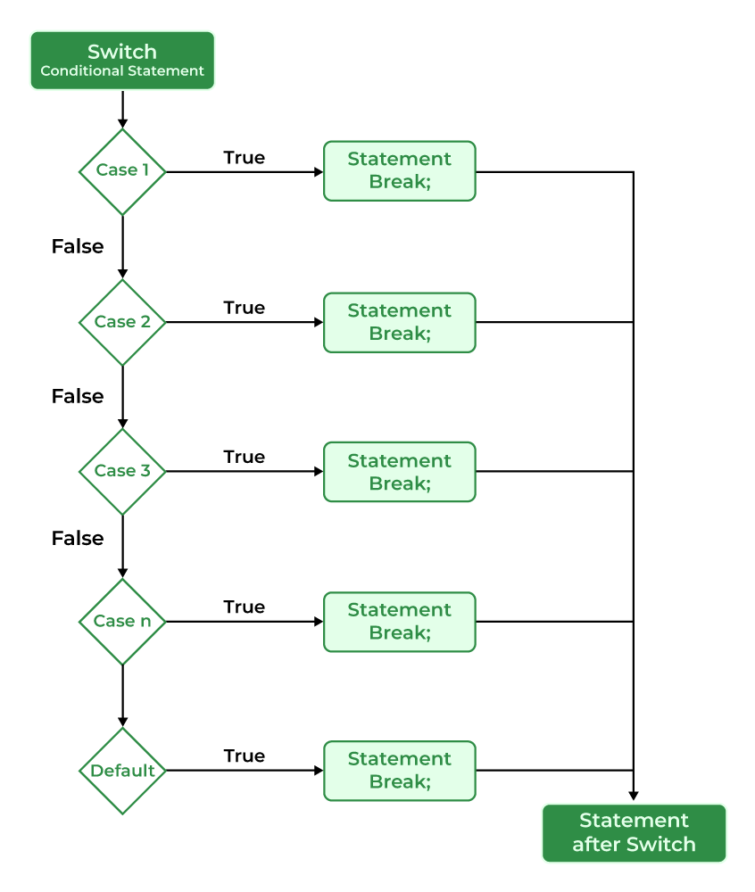
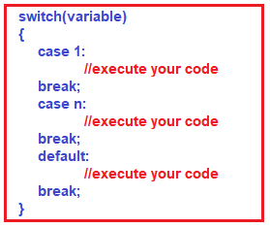
Switch-Case Statement
Used to perform operations
due to the different values
that an expression can take.
It can also make if statements
simpler.

Slide 11
Switch-Case Statement
You must terminate each case statement with a skip (break, goto, return, continue) statement.
The Continue statement can be used if the switch statement is in the body of a loop.
A skip statement is not required if no statement is given in a case
Case 2: // no statement
Case 3:
Case 4: expression….;break,;
Case 5: expression…; goto case 4;

Slide 12
Switch-Case Statement
There are some rules to be aware of when using a switch statement:
Statements after the ‘‘case’’ word must be constants.
‘‘case’’ expressions can be integer, character, or string constants.
‘‘default’’ and ‘‘case’’ statements can be written in any order.
There cannot be more than one same ‘‘case’’ statement in the same switch block.
It is not mandatory to use ‘‘default’’.
To redirect the flow from one ‘‘case’’ statement to another ‘‘case’’
statement, the ‘‘goto’’ keyword is used.

Slide 13
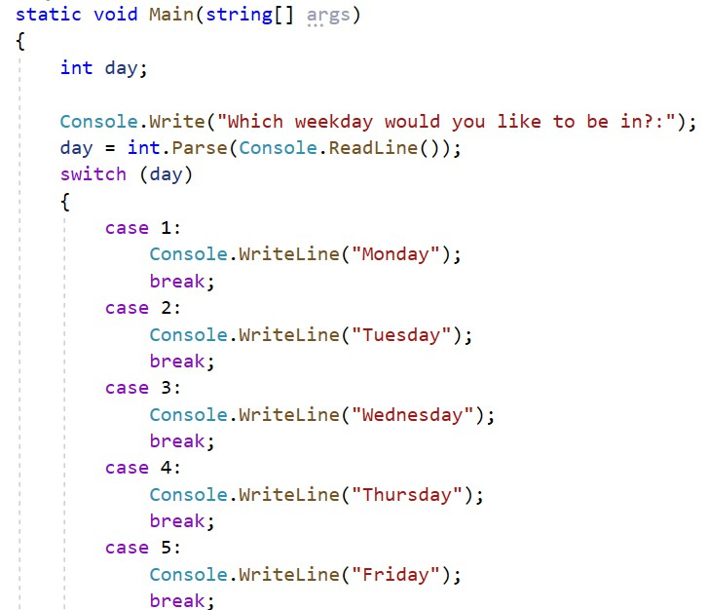
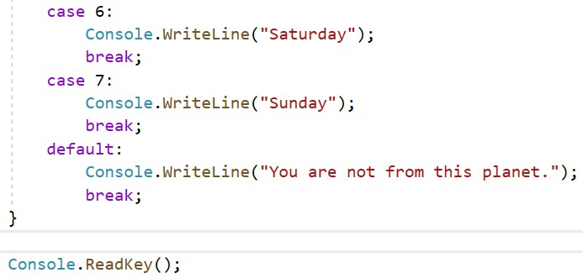
Switch-Case Statement

Slide 14
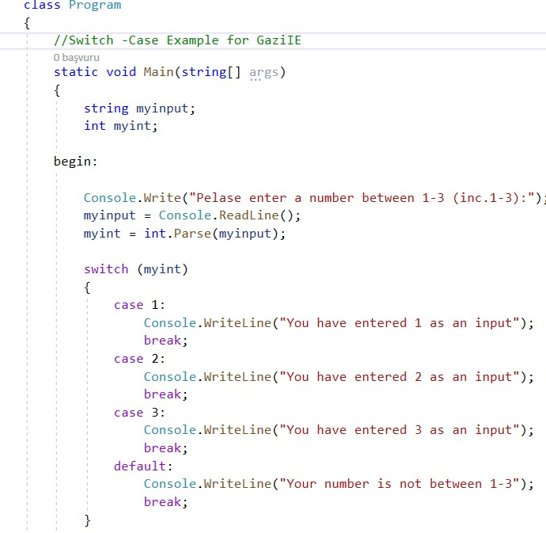
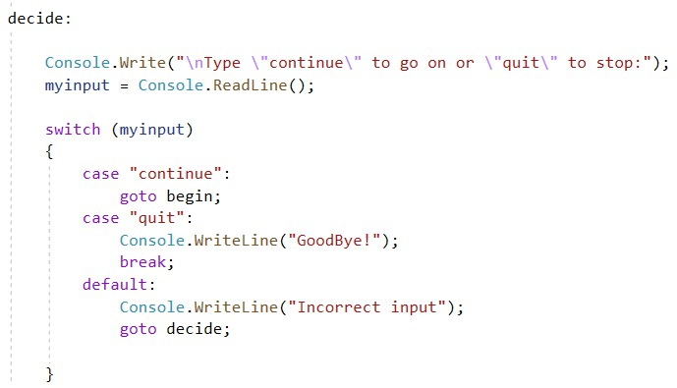
Switch-Case Statement

Slide 15
THE END
Check out course website: https://gazi-end-muh.github.io
Got any questions later?
Send me an email: dr.ercan.ezin@gmail.com

