Slide 1


Optimizimi i Trafikut Urban
Members:
Gazmend Halili
Donesa Shala
Rona Beqiri
Shkurte Rexhepi
Viola Bajrami
Team: Infinite Loopers

Slide 2
The Problem
Static traffic lights
Long waiting times
Stressful driving experience
Existing systems lack real-time adaptability.

Slide 3
Our Solution
From Red Lights to Green Cities
(Dynamic traffic signal optimization)
(A Virtual City for Smarter Decisions)
(Smart Signals That Think)
(City-specific simulation for urban planning)

Slide 4
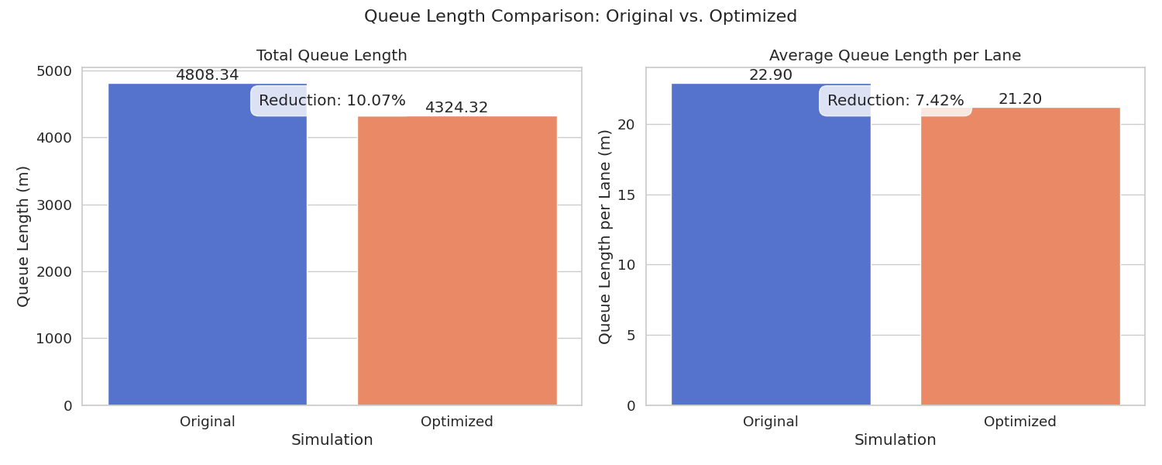
Results & Traction
CO₂ emissions reduced by up to 1.3%
Average waiting time reduced by 7%
Queue length reduced by over 10%
7,000+ vehicles simulated in Gjilan network

Slide 5
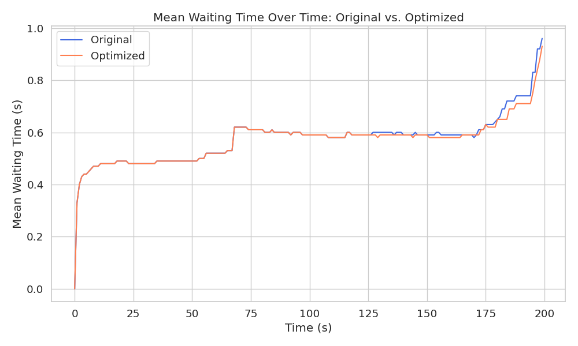
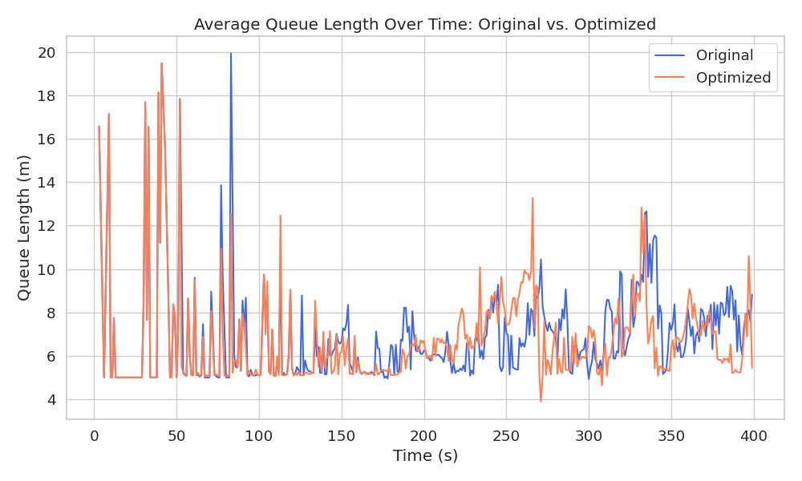

Slide 6
Business Model & Users
Target Users:
Municipalities (e.g., Gjilan)
Transport planners
Smart city startups
Public transit & logistics companies
Potential business models:
Platform for real-time traffic control
Integration with municipal or regional planning systems
Environmental data licensing

