Slide 1

Internet of Things
Paul DeBeasi
© 2022 Gartner, Inc. and/or its affiliates. All rights reserved. Gartner is a registered trademark of Gartner, Inc. and its affiliates. This publication may not be reproduced or distributed in any form without Gartner’s prior written permission. It consists of the opinions of Gartner’s research organization, which should not be construed as statements of fact. While the information contained in this publication has been obtained from sources believed to be reliable, Gartner disclaims all warranties as to the accuracy, completeness or adequacy of such information. Although Gartner research may address legal and financial issues, Gartner does not provide legal or investment advice and its research should not be construed or used as such. Your access and use of this publication are governed by G artner’s Usage Policy. Gartner prides itself on its reputation for independence and objectivity. Its research is produced independently by its research organization without input or influence from any third party. For further information, see “Guiding Principles on Independence and Objectivity.”

Slide 2



























































IoT Fragmentation Continues. Will NoT Abate by 2028
Software
IoT
Communications
Services
Hardware
RESTRICTED DISTRIBUTION
1 © 2022 Gartner, Inc. and/or its affiliates. All rights reserved.
Representative Vendors: No Referenceable Report

Slide 3


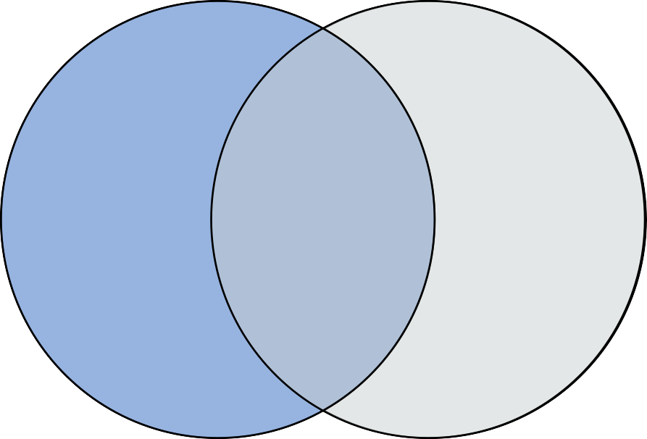









Market Trend: Slow IT/OT Convergence Over Time
OT Vendors IT Vendors
OT IoT IT
Representative Vendors Only
2
© 2022 Gartner, Inc. and/or its affiliates. All rights reserved. Gartner is a registered trademark of Gartner, Inc. and its affiliates.

Slide 4

Common Design Patterns
3
© 2022 Gartner, Inc. and/or its affiliates. All rights reserved. Gartner is a registered trademark of Gartner, Inc. and its affiliates.

Slide 5
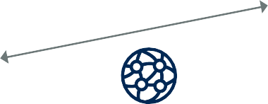
Platform-Centric Pattern
Edge
Platform
Drone
Platform Workloads
Data Analytics
Dashboard
Wind Sensor
Platform Hub
Trash Compactor
WAN
Stream Processing
Digital Twin
API
Gateway
Source: Gartner 756001_C

Slide 6

Hybrid Edge-Platform Pattern
Edge
Platform
Data Historian
Edge Workloads
Data Analytics
Platform Workloads
Data Analytics
Dashboard
Medical
Device
Local Comms
Gateway
Hub
Platform
Stack
Platform Hub
WAN
Security Camera
Stream Digital Processing Twin
Edge Gateway
Stream Processing
Digital Twin
API
Gateway
Source: Gartner 756001_C

Slide 7
















OT – IoT Reference Architecture
Industrial Edge
Azure ML
Amazon SageMaker
Software AG Workbench
Platform (Cloud or Data Center)
Stream Analytics, Machine Learning, Containers
Sensors
PLCs
Industrial
Devices
Controller
MES
SCADA
Kepware Server
OPC UA
Server
OT
Gateway
Data Historian
Hadoop Cluster
ML Inference Engine
Data Store
Integration
“connectors”
_{Web} Litmus Edge App
Data Visualization
Event Broker
Edge
Processing
Platform Stack
Event Broker
Event Stream Processing
Gateway SDK
Azure Stream Analytics
Amazon Kinesis
SAG Apama SmartRules
PTC ThingWorx Analytics Sever
OT
Devices
IoT Edge Gateway
WAN
OT
Control Systems
OT
Access
Systems
Event Broker
Azure IoT Hub
AWS IoT Core
Software AG Cumulocity IoT
PTC ThingWorx
Microsoft PowerBI
Amazon QuickSight
Grafana
Azure IoT Edge Runtime
AWS Greengrass
PTC ThingWorx
Litmus Edge
6
© 2022 Gartner, Inc. and/or its affiliates. All rights reserved. Gartner is a registered trademark of Gartner, Inc. and its affiliates.

Slide 8

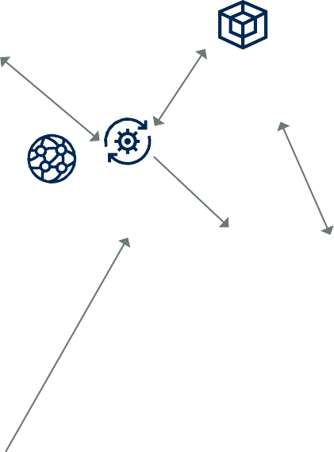


Platform of Platforms Pattern
Edge 1
Industrial Device
Local Edge Comms Gateway
Industrial
Device
Platform 1
Platform Data Dashboard
Workloads Analytics
System 1
Platform Hub
Platform of Platforms
WAN
Platform Workloads
Data Analytics
Stream
Processing
Digital Twin
API
Gateway
Dashboard
Edge N
Platform N
WAN
Platform Hub
Wind Sensor
Platform Workloads
Data
Analytics
Dashboard
Stream
Processing
System N
Digital Twin
API
Gateway
Platform Hub
Drone
WAN
Stream Data
API
Gateway
Processing Storage
Source: Gartner 756001_C

Slide 9
Endpoint Security
8
© 2022 Gartner, Inc. and/or its affiliates. All rights reserved. Gartner is a registered trademark of Gartner, Inc. and its affiliates.

Slide 10
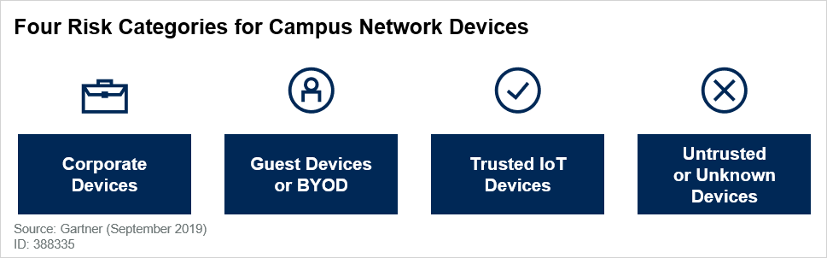
Categorize Devices Prior to Network Connection
Corporate devices are owned, managed and deployed by IT.
Guest devices or BYOD policies will connect to the guest SSID for wireless connectivity
Trusted or known IoT devices are devices the IT organization is aware of and has approved for use but don’t match the standard user endpoint profile.
An untrusted or unknown device is one that does not fit into any of the categories already
identified
Source: Segmentation or Isolation: Implementing Best Practices for Connecting ‘All’ Device
© 2022 Gartner, Inc. and/or its affiliates. All rights reserved. Gartner is a registered trademark of Gartner, Inc. and its affiliates.
9

Slide 11
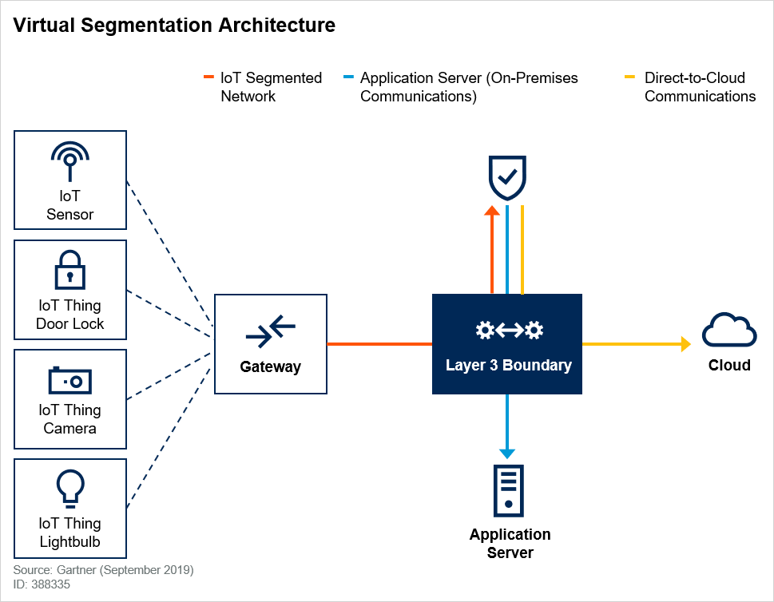
Architect Virtual Segmentation and Isolation
Virtual segmentation is the ability to set up a tunnel from a device to a target application across an L3 (switch or router) boundary, usually by tagging.
Each vendor has a different implementation that is not supported by other vendors (e.g., Cisco Aruba’s GRE tunnels).
Ensure that the same vendor’s equipment is on the end generating and terminating the tunnel.
Isolation may be needed in addition to segmentation. If required, then the packet must be encrypted in the tunnel.
Source: Segmentation or Isolation: Implementing Best Practices for Connecting ‘All’ Device
10 © 2022 Gartner, Inc. and/or its affiliates. All rights reserved. Gartner is a registered trademark of Gartner, Inc. and its affiliates.

Slide 12


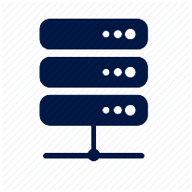
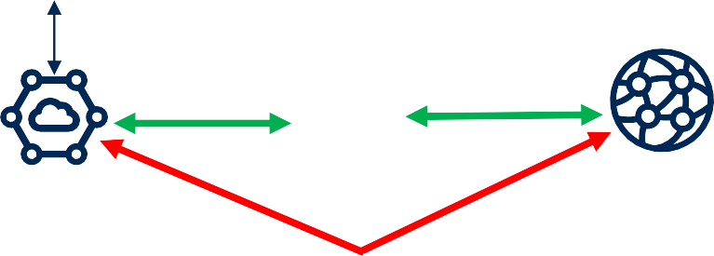


IoT Device Security “Cookbook”
IoT security appliance
Asset discovery, risk analysis
Event detection, device analysis
Endpoint vulnerability assessment
Tampering, intrusion, destruction, monitor/audit
Certificates, encryption, HW root of trust, secure comms.
Operations
Failsafe controls, power management
Endpoint management
Data and algorithms
Configuration, problem diagnosis, firmware updates
Help desk, service level agreements, IT involvement
Usage, ownership, confidentiality
Data “freshness” (i.e., how frequently updated?)
Will you share your data with 3rd parties (partners)?
Endpoint traffic management
Network discovery, traffic segmentation
Bandwidth management, RF management
De-commissioning
Destroy devices. Delete data. Delete algorithms
Power
Platform
Local power? Battery life, replacement?
Edge
Platform Workloads
Data Analytics
Dashboard
IoT security
Appliance
Platform Hub
API
Gateway
Facilities (Heating)
Stream Processing
Data storage
Local
Comms
(traffic isolation)
Edge
Gateway
SD-WAN
Platform Workloads
Data
Analytics
Dashboard
Medical Devices
Platform
Hub
API
Gateway
11 © 2022 Gartner, Inc. and/or its affiliates. All rights reserved. Gartner is a registered trademark of Gartner, Inc. and its affiliates.
Stream
Processing
Data storage

Slide 13
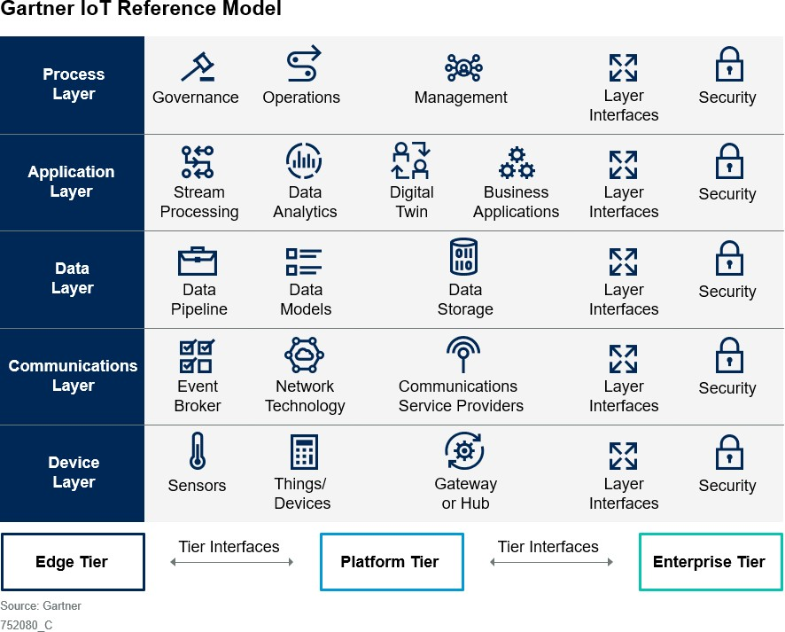
The IoT Challenge: Integrating All The Pieces
Tiers define where a component, function or process operates in the IoT architecture.
Layers define what behavior an IoT component, function or process must possess.
Interfaces define how data and control flow into, out of and through the system.
12 © 2022 Gartner, Inc. and/or its affiliates. All rights reserved. Gartner is a registered trademark of Gartner, Inc. and its affiliates.

Slide 14

© 2022 Gartner, Inc. and/or its affiliates. All rights reserved.

