Slide 1
A multi-model Mental Emotion Prediction of EEG-based Brain Signal Data
Report Presentation on
Supervised By
Dr. Tania Islam
Assistant Professor
Dept. of Computer Science and Engineering
University of Barishal
Submitted By
Gazi Mazharul Islam
EDGE Roll:
Dept. of Computer Science and Engineering
University of Barishal

Slide 2
Outline
What is EEG Signal?
Background
Statement of the problem
Research questions
Objectives of the study
Significance of the study
Scope of the study
Framework
Methodology
EEG Emotion Signal Data
Model’s Confusion Matrix
Result
Conclusion

Slide 3
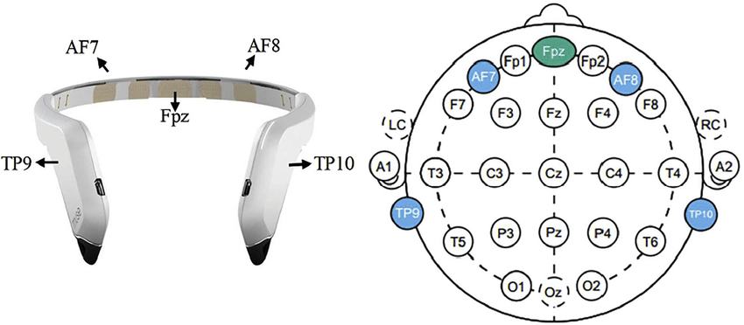
What is EEG Signal
Muse
An electroencephalogram (EEG) signal is a recording of the electrical activity of the brain, which is captured by sensors attached to the scalp.

Slide 4
Background
Electroencephalography (EEG) and Emotion Detection
-EEG data is highly complex, random, and non-stationary, making raw data difficult to classify.
-Brainwave data enables potential applications in mental health, human-computer interaction, and autonomous emotional detection.
2. Emotion Categorization and Challenges
-Emotions are broadly divided into positive, negative, and neutral categories, with overlapping subcategories..
-Accurate emotion classification requires accounting for subtle signals and distinguishing between overlapping emotions.

Slide 5
Background
3. Machine Learning for EEG Emotion Classification
-Feature extraction and selection from EEG data are crucial to reduce data complexity and computational load.
-Various machine learning methods, including deep learning, SVM, Decision Trees, and ensemble methods, are commonly applied to classify emotional states.

Slide 6
Statement of the Problem
Complexity of EEG Emotion Classification: Brainwave (EEG) data is inherently complex, random, and non-stationary, making emotion classification challenging without advanced processing and feature extraction techniques.
Need for Real-Time, Low-Cost Emotion Detection: There is a need for an autonomous, low-cost solution to classify emotional states in real-time, especially for applications in mental health, human-computer interaction, and wearable devices. Current methods often require expert input or high-cost equipment.

Slide 7
Research Questions
How can EEG signals be effectively processed and simplified to classify emotional states accurately?
Which machine learning models (single and ensemble) provide the highest accuracy for classifying emotional states from EEG data?
Can low-cost, commercially available EEG devices provide sufficient accuracy for practical emotion classification applications?
What impact do feature selection techniques have on the performance of different classification models?

Slide 8
Objectives of the study
To develop effective machine learning models for classifying emotional states using EEG data.
To evaluate the effectiveness of feature selection methods in enhancing classification performance.
To validate the feasibility of using a low-cost, commercially available EEG device for emotion classification.

Slide 9
Significance of the study
Advancement in Emotion Classification
Potential Applications in Mental Health and Human-Computer Interaction
Accessibility of Emotion Detection Technology

Slide 10
Scope of the study
Data Collection using MUSE EEG Headband
Classification of Three Emotional States
Feature Selection and Machine Learning Techniques
Limited Dataset

Slide 11
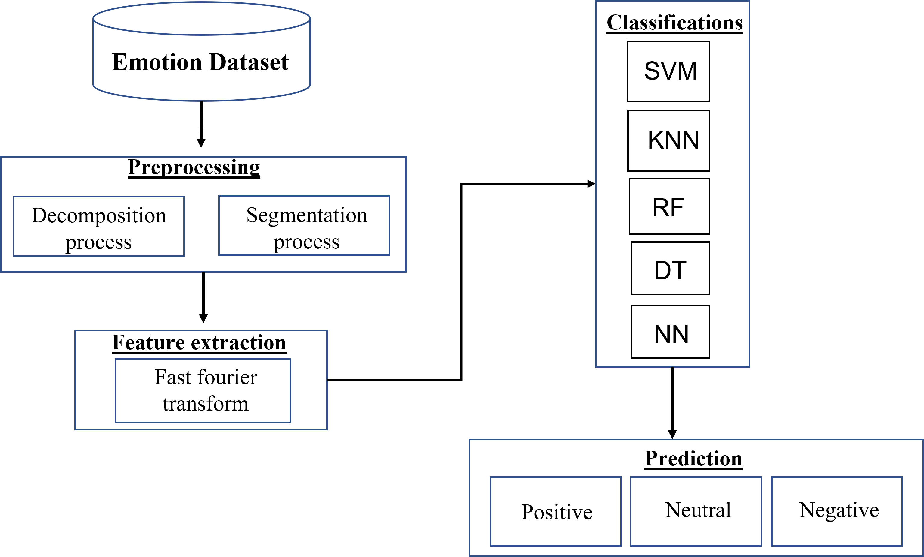
Framework

Slide 12
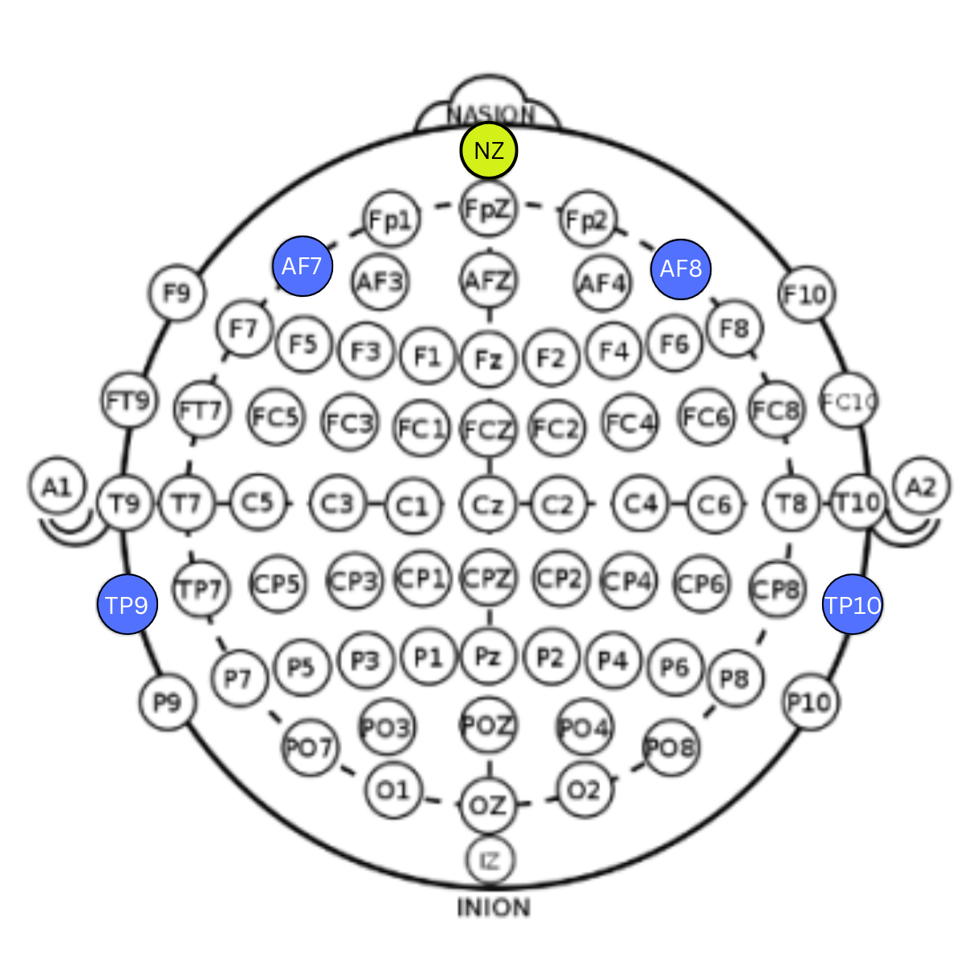
Methodology
Data Collection
EEG data was collected using a low-cost MUSE EEG headband with four electrodes (TP9, AF7, AF8, TP10) to record brain activity.
Three emotional states (positive, negative, and neutral) were induced in participants using specific film clips, each representing a distinct valence.

Slide 13
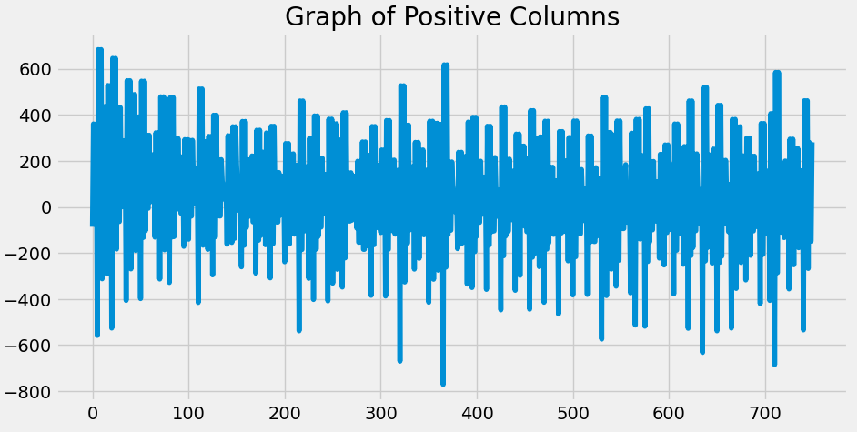
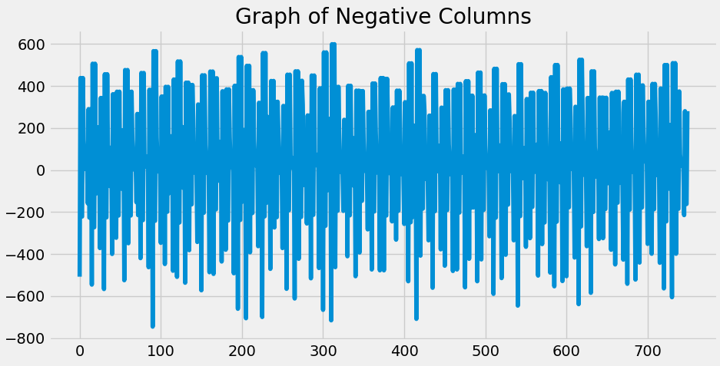
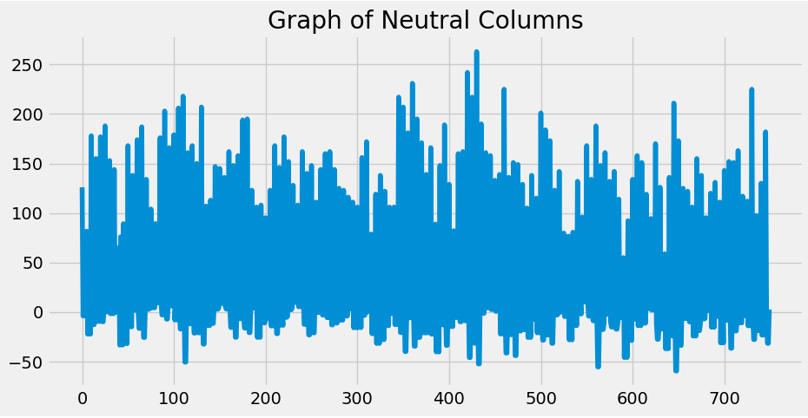
Methodology
Feature Extraction
Fast Fourier Transform is used for feature extraction

Slide 14
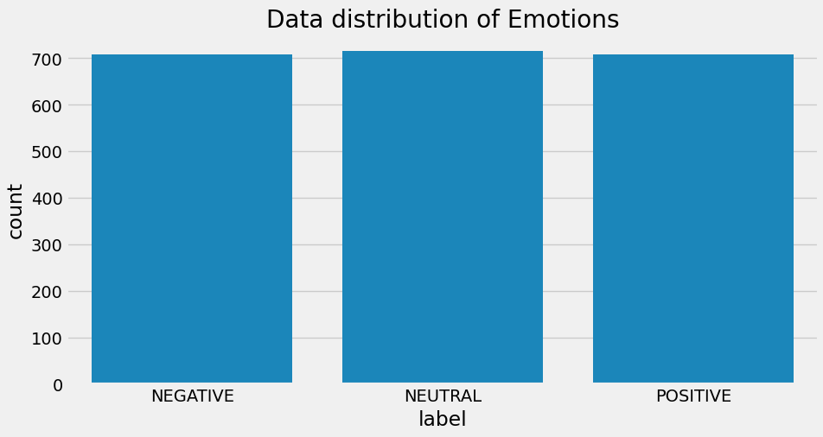
EEG Emotion Signal Data

Slide 15
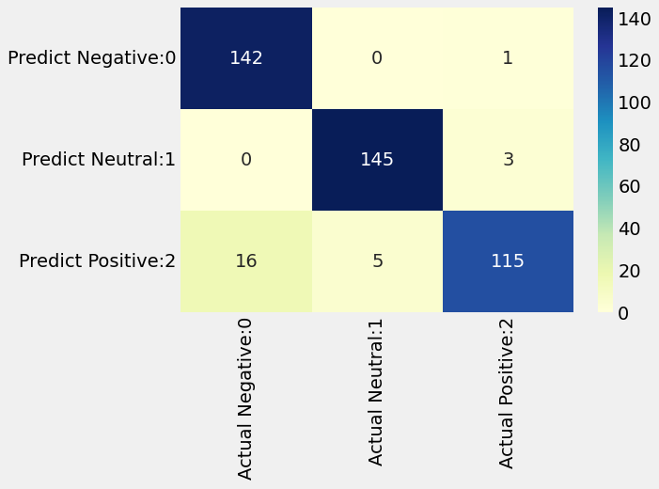
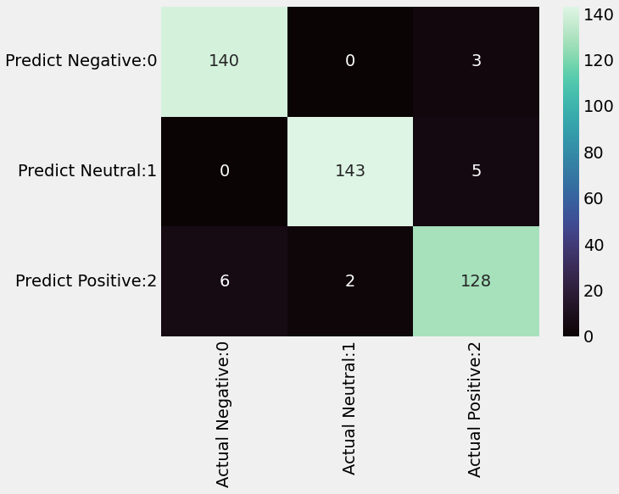
Model’s Confusion Matrix
K-Nearest Neighbor
Support Vector Machine

Slide 16
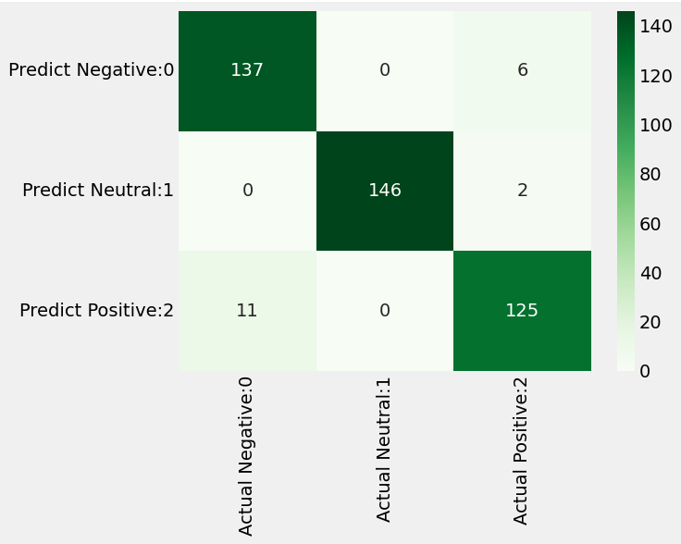
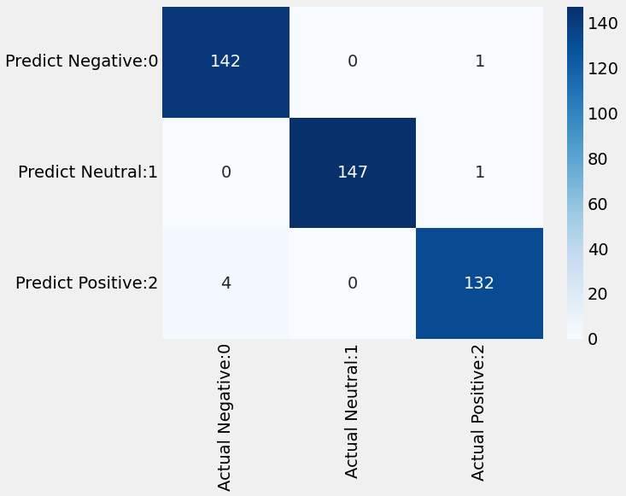
Model’s Confusion Matrix
Decision Tree
Random Forest

Slide 17
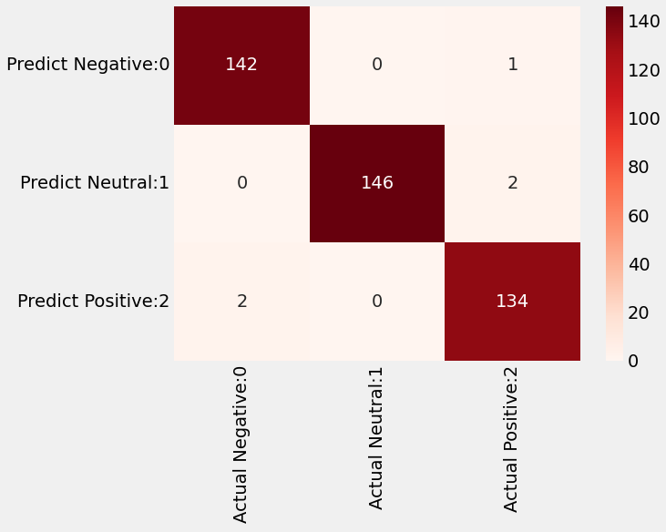
Model’s Confusion Matrix
Neural Network

Slide 18
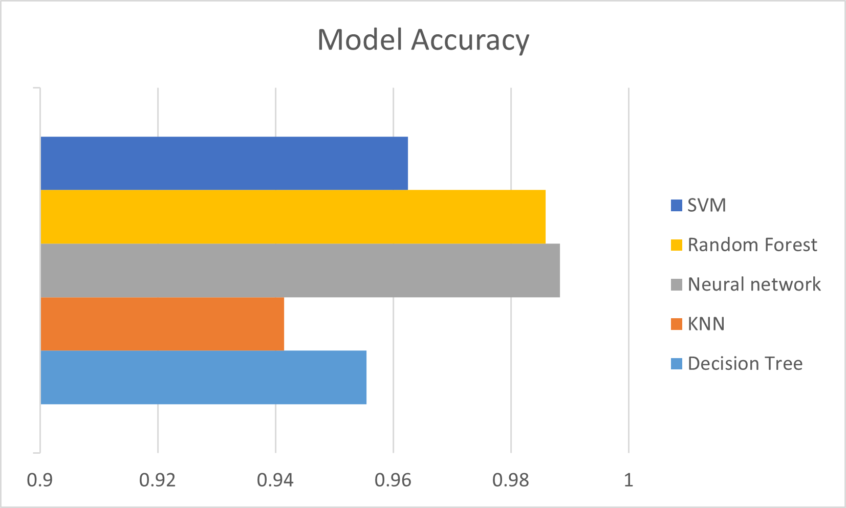
Result
Model Name | Accuracy
KNN | 0.9415
SVM | 0.9625
Decision Tree | 0.9555
Random Forest | 0.9859
Neural network | 0.9883
Neural network and Random Forest performs almost 99.00% accuracy

Slide 19
Conclusion
This study shows that low-cost, widely available EEG devices can effectively and accurately classify emotional states.
Impressive levels of accuracy have been achieved using advanced machine learning techniques, especially ensemble methods like Random Forest and single methods like Neural Networks.
Further research should focus on the feature selection of huge EEG data, which can reduce the dimension of the data as well as the computation cost.

Slide 20
Thank You

