Slide 1
      Welcome To
              OuR
    Presentation

Slide 2
OUR PRESENTERS
SHAWON GAZI
241400031
MD. SIAM 241400032
PROMA BASAK
241400058
AFROZA BINTE ANSARUL
241400042
TAMANNA AHMED TASIN
241400033

Slide 3
Who will explain Which parts
Name of Experiment, Objective & learning Outcomes By- SHAWON
Theory By- TAMANNA
Apparatus, Procedure(1-3) By- AFROZA
Procedure(4-8), Result By- SIAM
Precautions and Discussion By- PROMA

Slide 4
CONTENTS
1. Learning Objective & Outcomes
2. THEORY
3. Apparatus & PROCEDURES
4. RESULTS
5. PRECAUTIONS & DISCUSSIONS

Slide 5
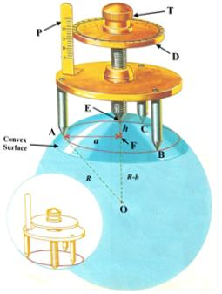
NAME OF THE EXPERIMENT
To determine the Thickness and radius of curvature of a Spherical surface with a Spherometer.

Slide 6


Slide 7
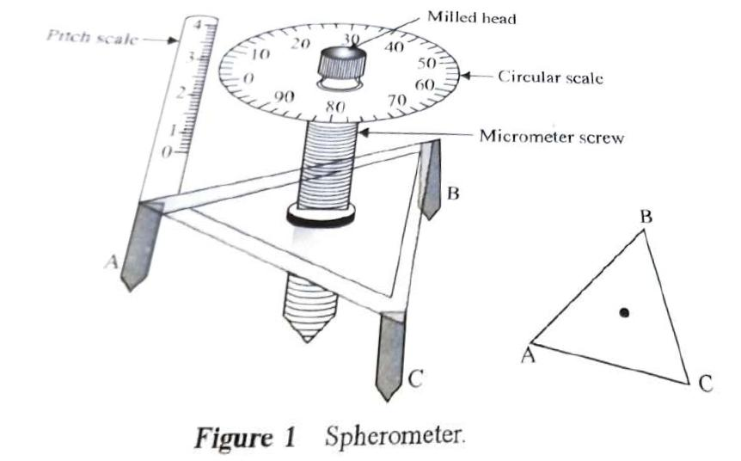
Objective
How to use a spherometer to determine the thickness and radius of Curvature of a spherical surface.

Slide 8

Learning outcomes
Students will be able to know
  How a spherometer can be used and for what purpose.
  How the thickness of a spherical surface is calculated.

Slide 9


Slide 10
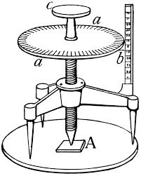
Theory
Spherometer is a measuring device that works on the principle of micrometre screw.
It has a metallic triangular frame supported on three legs. The tips of the three legs form an equilateral triangle and lie on the radius. There is a central leg which can be moved in a perpendicular direction.

Slide 11
Theory
It is used to measure either very small thickness or the radius of curvature of a spherical surface that is why it is called a spherometer.

Slide 12
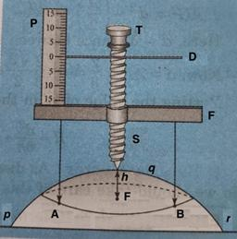
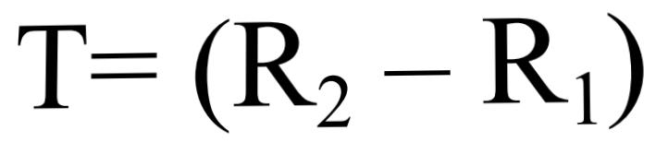
Theory
Now, thickness of the glass plate by a spherometer is determined by the formula:-
Where,
R₂= Reading on the test plate + base plate,
R₁= Reading on the base plate .

Slide 13
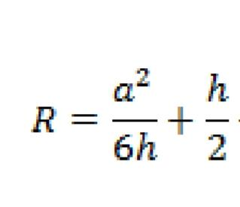
Theory
Radius of curvature of the spherical surface is determined by using the formula:-
Where,
h — thickness of the glass plate.
a — average distance between three legs of the spherometer.

Slide 14
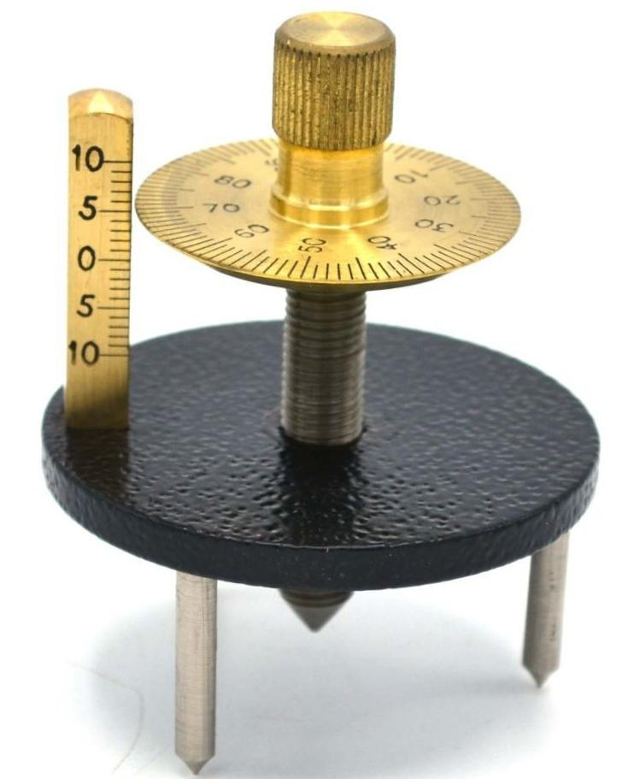
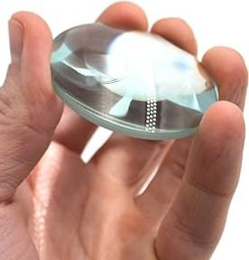
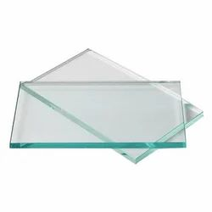
Apparatus
A Spherometer
A convex lens
A Plane glass plate

Slide 15
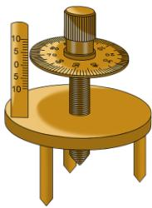
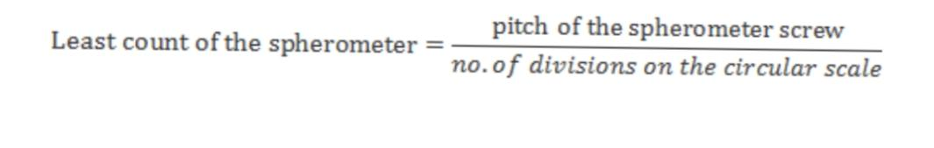
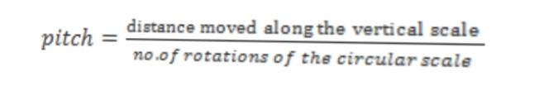
Procedures
Determine the pitch and the least count of the Spherometer by using the formula given below:-

Slide 16
Procedures
2. Place the Spherometer on the glass plate to be called the base plate and see that all the legs including the central leg touch the plate.
3. Tilt the screw-head and make sure that all the legs touch the plate.

Slide 17
Procedures
4. Take reading both on the pitch-scale and on the C scale where the sharp-edge of the C -scale is against any particular reading on the pitch-scale.
5. Now screw-up the central leg and introduce the test plate under it. Take reading both on the pitch-scale and on the C-scale. Enter the result in the table -1 and then find T = (R2 –R1)

Slide 18
Procedures
6. Now, to measure the distance between two legs of the spherometer, place the spherometer on a piece of paper and press it lightly so that an imprint of the three legs is made on the paper.
7. Measure each side of the triangle AB, BC, and CA formed by the points (A, B, C).

Slide 19
Procedures
8. Take mean of the readings that will give the value of `a’ in your formula to calculate the radius of curvature of the spherical surface.

Slide 20

                Experimental Data
Reading on | No. Of objects (O) | Pitch scale reading (M) (cm) | Circular scale reading (N) div | Least Count (L_{c}) (cm) | Fractional reading (F=N×L_{c}) (cm) | Total reading (T=M+F) (cm) | Mean reading (cm) | T=(R_{t} - R_{b}) Thickness (cm)
Base plate | 1 | 0 | 8 | 0.001 | 0.008 | 0.008 | R_{b} 0.00933 | 0.1037
 | 2 | 0 | 11 |  | 0.011 | 0.011
 | 3 | 0 | 9 |  | 0.009 | 0.009
Test plate | 1 | 1 | 15 | 0.001 | 0.015 | 1.015 | R_{t} 0.113
 | 2 | 1 | 13 |  | 0.013 | 1.013
 | 3 | 1 | 11 |  | 0.011 | 1.011

Slide 21

Result
&
Other Discussions

Slide 22

RESULT
The Thickness of the spherical surface is T=0.104 cm and it’s radius of curvature is R=31.177 cm

Slide 23
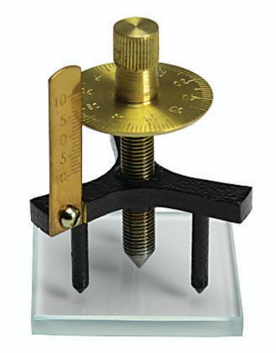
Precautions and Discussions
Care must be taken to see that the central screw just touches the plate.
(ii) Since a occurs as a square in the formula, its value must be determined very accurately.
(iii) To avoid back-lash error, the screw must always be turned in the same direction while taking different readings.

Slide 24
Precautions and Discussions
(iv) If the pitch of the screw is half the linear scale division, care should be taken in noting the linear scale reading. When the upper edge of the circular disc is more than half way above a particular linear scale division, the linear scale reading is obtained by adding half a linear scale division to the linear scale mark just below the upper edge of the disc.

Slide 25
THANK YOU
FOR
WATCHING

