Slide 1


Welcome to depth first search (DFS) presentation
1

Slide 2

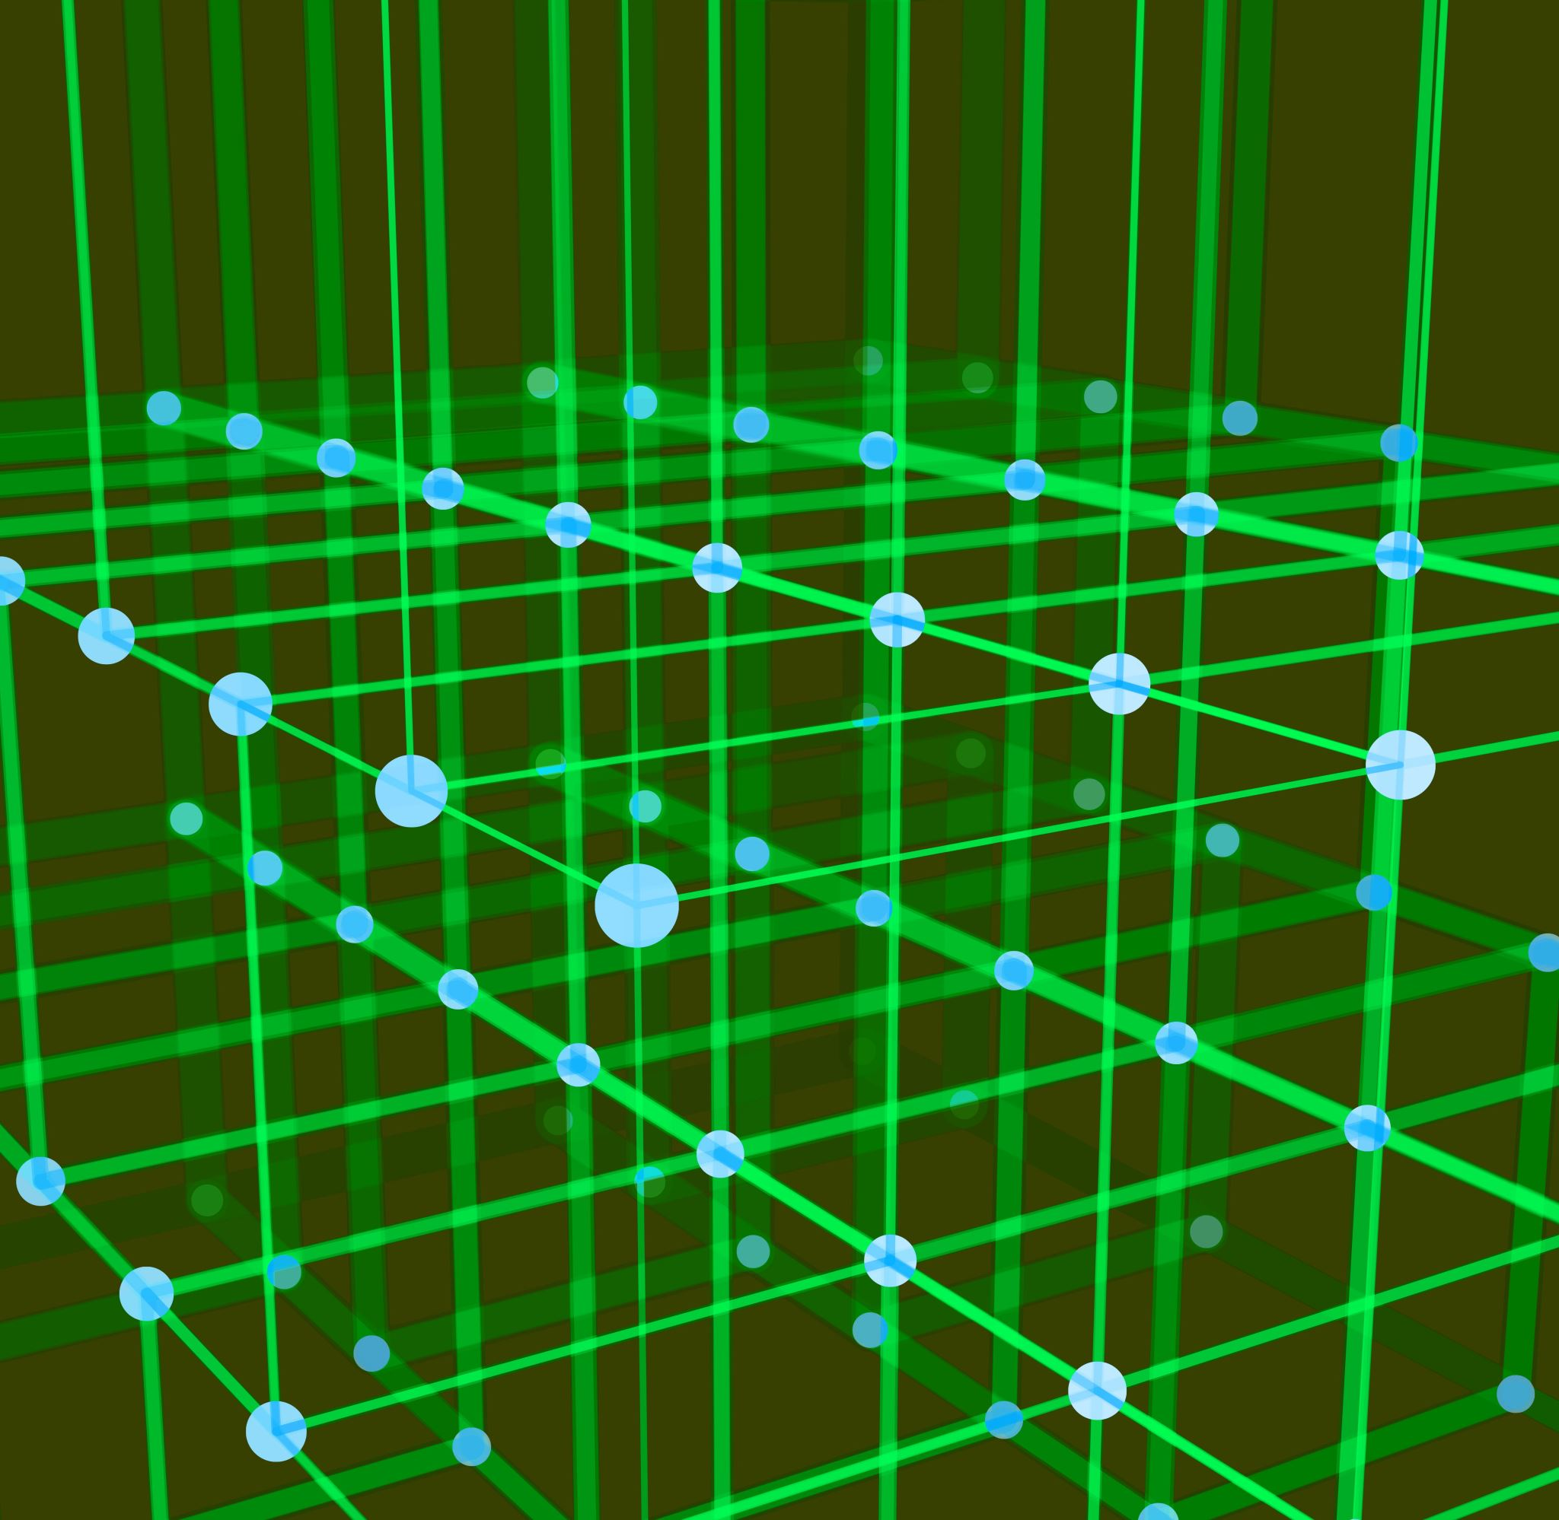

Presented By:
Name: Shawon Gazi
Id: 241400031
Name: Tamanna Ahmed Tasin
Id: 241400033
Name: Al- Sharif
Id: 241400037
2

Slide 3
Table of contents
Introduction
Pros & Cons
Basic idea of DFS
Time & Space Complexity Analysis
DFS Simulation
DFS vs BFS
DFS Algorithm (Pseudo Code)
Conclusion
Application of DFS
Running a Sample Code(Python)
3

Slide 4

introduction
What is Depth First Search(DFS).?
Depth First Search (DFS) is a fundamental graph traversal algorithm.
It explores a graph by going as deep as possible along one branch before backtracking.
DFS works on both directed and undirected graphs.
It is commonly implemented using recursion or an explicit stack.
4

Slide 5

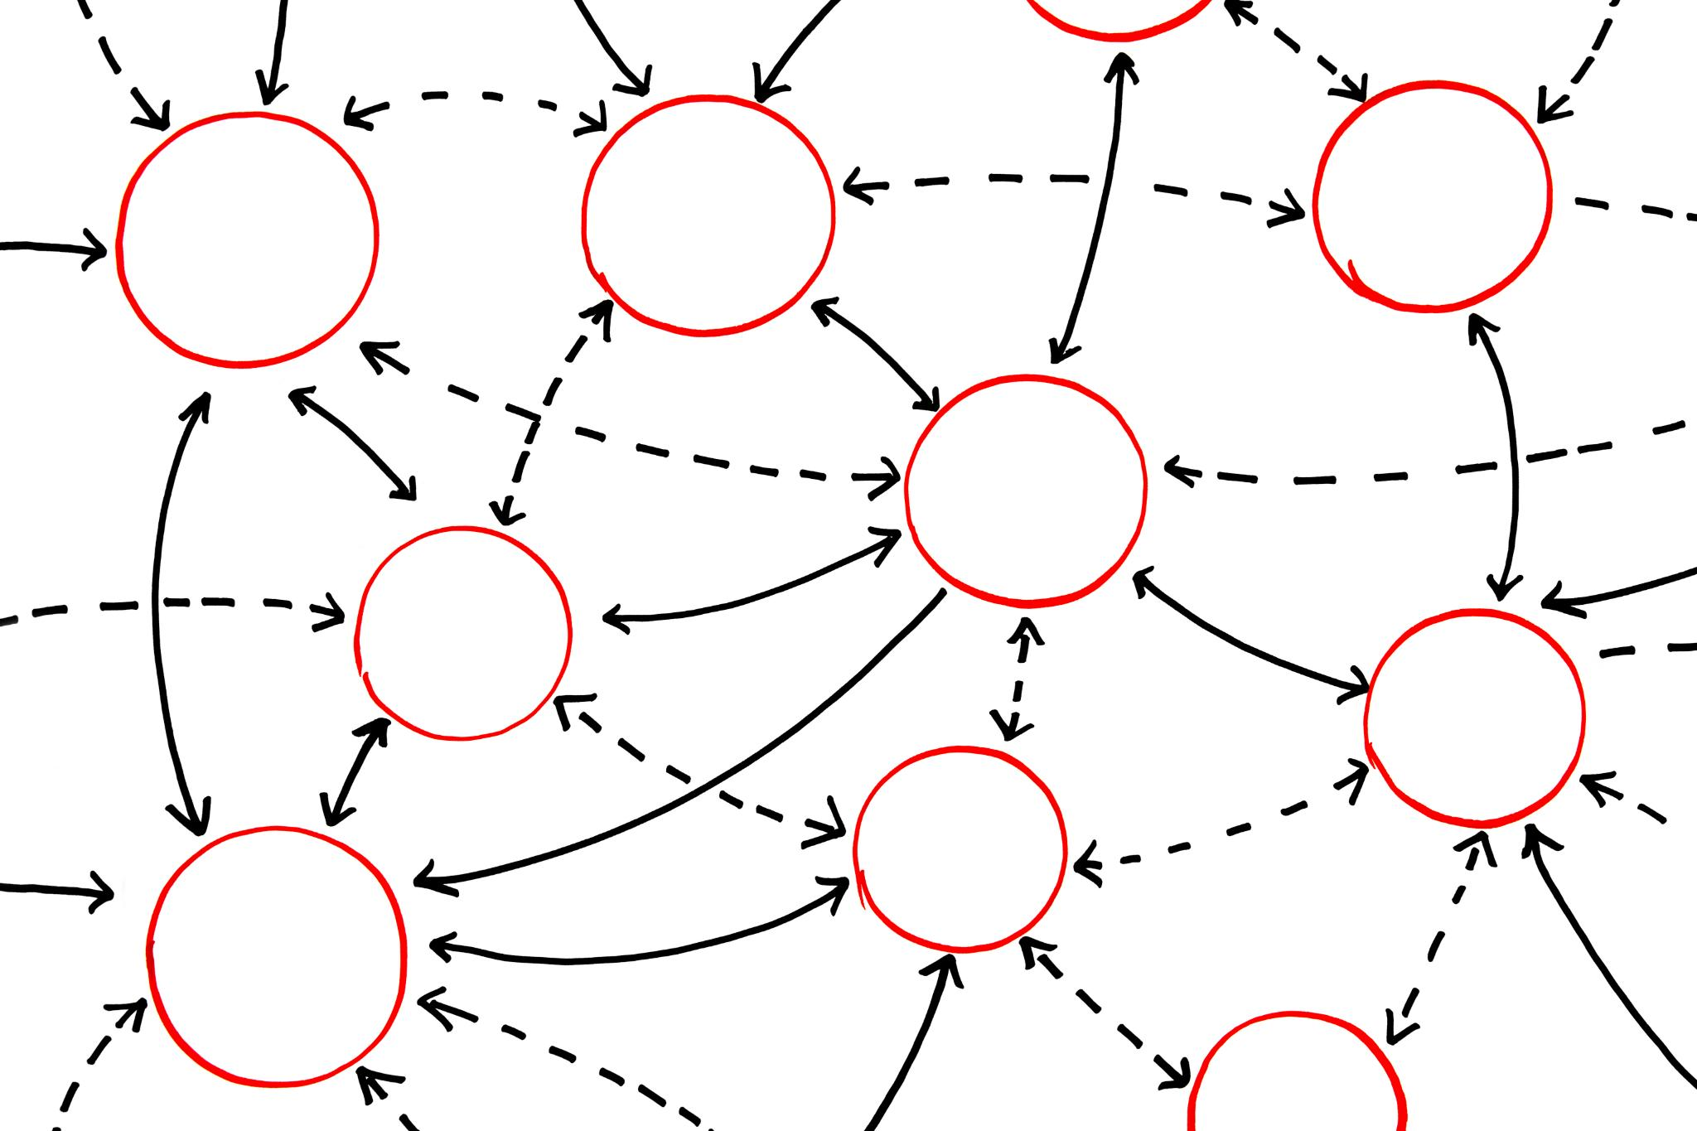

Basic idea of dfs
Start from a source (root) node.
Visit the node and mark it as visited.
Recursively visit an unvisited adjacent node.
If no unvisited adjacent nodes exist, backtrack.
Continue until all reachable nodes are visited.
5

Slide 6
Simulation
DFS Graph:
0
1
7
6
8
3
2
5
4
6

Slide 7
Simulation
Initial state: node 0 is pushed
0
1
=Pushed
7
6
8
3
2
=Visited
5
4
Stack
7

Slide 8
Simulation
Initial state: node 0 is pushed
0
1
=Pushed
7
6
8
3
2
=Visited
5
4
0
Stack
8

Slide 9
Simulation
State: after visiting 0
Push the unvisited neighbour nodes: 8,3,1
Next, visit the top node in the stack: 1
0
1
=Pushed
7
6
8
3
2
=Visited
5
1
3
4
8
Stack
9

Slide 10
Simulation
State: after visiting 1
Push the unvisited neighbour nodes:7
Next, visit the top node in the stack: 7
0
1
1
=Pushed
7
6
8
3
2
=Visited
5
7
3
4
8
Stack
10

Slide 11
Simulation
State: after visiting 7
Push the unvisited neighbour nodes:2
Next, visit the top node in the stack: 2
0
1
1
=Pushed
7
6
8
3
2
=Visited
5
2
3
4
8
Stack
11

Slide 12
Simulation
State: after visiting 2
Push the unvisited neighbour nodes: 5,3
Next, visit the top node in the stack: 3
0
1
1
=Pushed
7
6
8
3
2
3
=Visited
5
5
3
4
8
Stack
12

Slide 13
Simulation
State: after visiting 3, node 0 already visited.
Push the unvisited neighbour nodes: 4
Next, visit the top node in the stack: 4
0
1
1
=Pushed
7
6
8
3
2
4
=Visited
5
5
3
4
8
Stack
13

Slide 14
Simulation
State: after visiting 4
Push the unvisited neighbour nodes: 8
Next, visit the top node in the stack: 8
0
1
1
=Pushed
7
6
8
3
2
8
=Visited
5
5
3
4
8
Stack
14

Slide 15
Simulation
State: after visiting 8
Push the unvisited neighbour nodes: None
Next, visit the top node in the stack: 5
0
1
1
=Pushed
7
6
8
3
2
=Visited
5
5
3
4
8
Stack
15

Slide 16
Simulation
State: after visiting 5
Push the unvisited neighbour nodes: 6
Next, visit the top node in the stack: 6
0
1
1
=Pushed
7
6
8
3
2
=Visited
5
6
3
4
8
Stack
16

Slide 17
Simulation
State: after visiting 6
Push the unvisited neighbour nodes: None
Next, visit the top node in the stack: 3
3 is visited, skip.
0
1
1
=Pushed
7
6
8
3
2
=Visited
5
3
4
8
Stack
17

Slide 18
Simulation
Next, visit the top node in the stack: 8
8 is visited, skip.
0
1
1
=Pushed
7
6
8
3
2
=Visited
5
4
8
Stack
18

Slide 19
Simulation
Result: DONE
The Stack has become empty.
and all the nodes of the graph have been traversed
0
1
1
=Pushed
7
6
8
3
2
=Visited
5
4
Stack
19

Slide 20

Simulation
Result:
The printing sequence of the graph will be:
Final Path:-
0
1
7
2
3
4
8
5
6
All nodes are converted by DFS algorithm.
20

Slide 21


DFS algorithm (pseudo code)
DFS(Graph, start):
mark all nodes as unvisited
call DFS_Visit(start)
DFS_Visit(node):
mark node as visited
print node
for each adjacent node x:
if x is not visited:
DFS_Visit(x)
}
21

Slide 22

Application of dfs
For finding the path.
To test if the graph is bipartite.
For finding the strongly connected components of a graph.
For detecting cycles in a graph.
22

Slide 23
Pros & cons
Pros
Cons
Simple and easy to implement.
Requires less memory compared to BFS.
Useful for deep exploration problems.
Helps in solving recursive problems efficiently.
May go deep into infinite paths if not handled properly.
Does not guarantee the shortest path.
Recursive DFS may cause stack overflow for very large graphs.
25

Slide 24
Time complexity analysis
Let V = number of vertices
Let E = number of edges
Time Complexity:
Using Adjacency List: O(V + E)
Using Adjacency Matrix: O(V²)
23

Slide 25
Space complexity analysis
Space required for visited array: O(V)
Recursive call stack (worst case): O(V)
Total Space Complexity: O(V)
24

Slide 26
Dfs vs bfs
DFS
BFS
Uses stack / recursion
Goes deep first
Less memory usage
Not shortest path
Uses queue
Explores level by level
More memory usage
Finds shortest path
26

Slide 27
Running a Sample Code (python)
# DFS using Adjacency List
def dfs(graph, visited, node):
# Mark the current node as visited
visited.add(node)
print(node, end=“ “)
# Visit all adjacent unvisited nodes
for neighbor in graph[node]:
if neighbor not in visited:
dfs(graph, visited, neighbour)
# Main program
vertices = int(input(“Enter number of vertices: “))
edges = int(input(“Enter number of edges: “))
# Create adjacency list
graph = {}
for i in range(vertices):
graph[i] = []
print(“Enter edges (source destination):”)
for _ in range(edges):
u, v = map(int, input().split())
graph[u].append(v)
graph[v].append(u) # undirected graph
start = int(input(“Enter starting vertex: “))
visited = set()
print(“DFS Traversal:”)
dfs(graph, visited, start)
Sample Input:
Enter number of vertices: 5
Enter number of edges: 4
Enter edges:
0 1
0 2
1 3
1 4
Enter starting vertex: 0
Output:
DFS Traversal:
0 1 3 4 2
28

Slide 28
Conclusion
DFS is a powerful graph traversal technique.
Best suited for problems requiring deep exploration.
Plays a vital role in graph algorithms and real-life applications.
Understanding DFS helps in mastering advanced algorithms.
27

Slide 29

#JusticeForHadi
#WeAreOsmanHadi
29

Slide 30
Thank You!!!
Any Questions???
30

