Slide 1

Best Location to Open a Restaurant In Toronto
YAKOV GAZMAN

Slide 2
Introduction/Business Problem
The city of Toronto is a vibrant and an extremely diverse city. As a results it has one of the best restaurant cultures in the world that includes all the international cooking styles in addition to a range of fusion styles as well. Due to this variety its hard to decide where to locate a new restaurant as the competition is tough. The proposed project will address this issue by providing an intelligent approach for selecting a location and helping potential restaurant owner to select a neighborhood in the city where they have the most chance to success.
The project will leverage the foursquare data to cluster the city neighborhoods based on density of restaurant locations and help to predict a location where competition will be less impactful

Slide 3
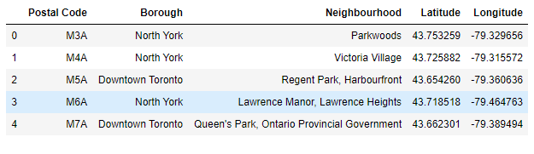
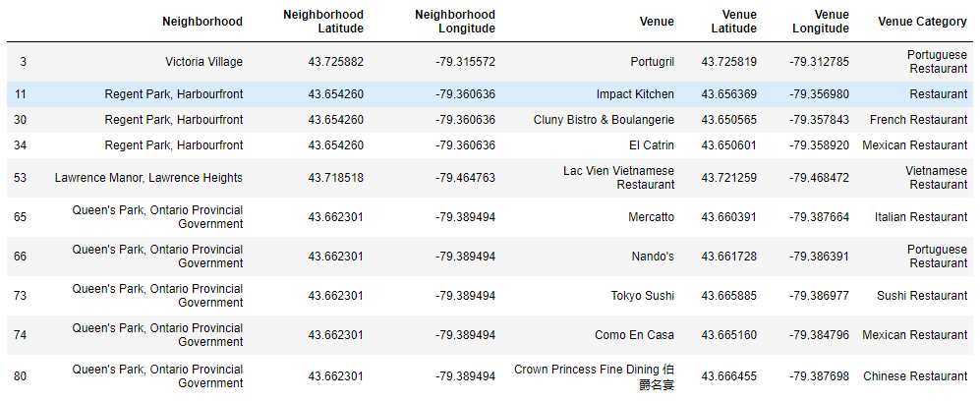
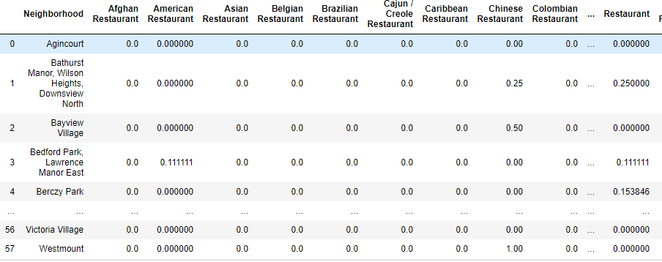
Data
The project will utilize the foursquare data to cluster the areas where restaurants are most likely to encounter competition. Initially we will use the neighborhoods table. Then the data will setup to show the restaurants data per neighborhood. And finally we will create the data required for classification

Slide 4
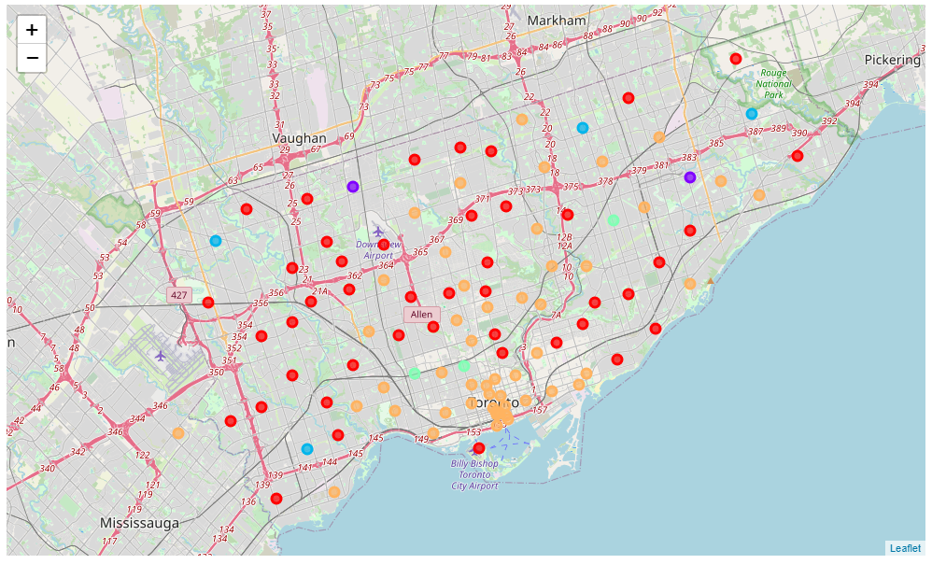
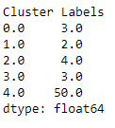
Methodology
K mean clustering model to identify the nationhood with lower restaurant density
cluster 0- red, 1-purpule, 2-blue, 3-green, orange-4

Slide 5
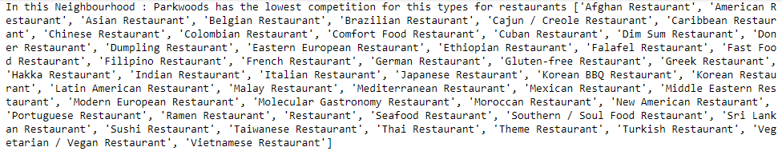
List of restaurant types
For each neighborhood we are able to generate a list of restaurant types that will be most successful in the selected area. Overall potential business owners should avoid the orange areas as they have the highest restaurant density

