Slide 1
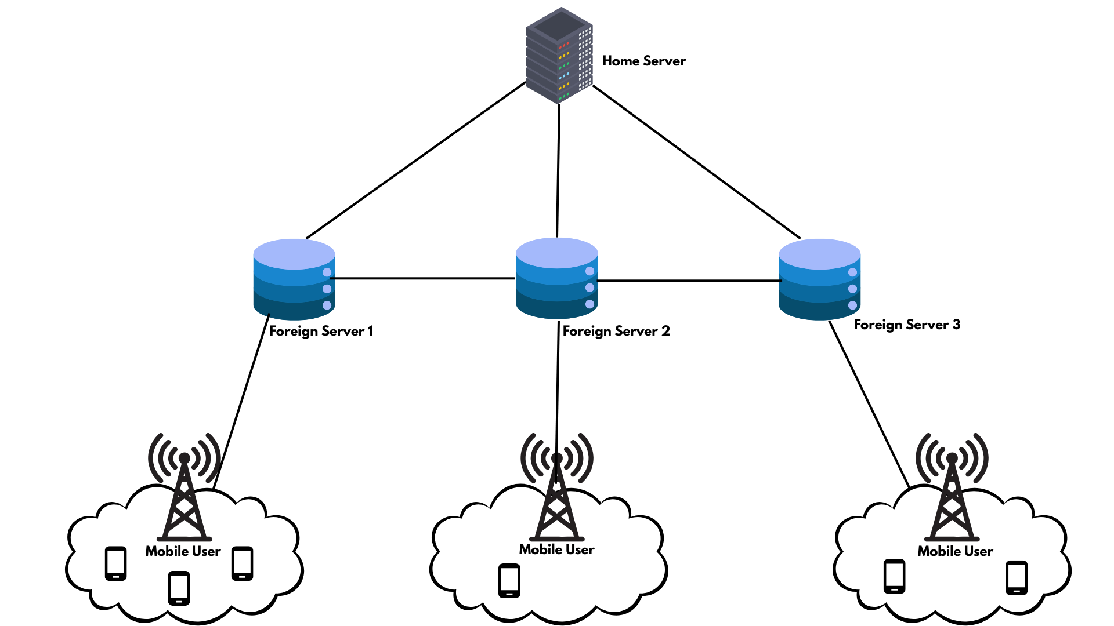
Username: Pushan
Key: 111
Pushan: { (1,129), (2,243), (3,567) }
(1,129)
(3,567)
(2, 243)
Reconstruction using any t shares to form Key’= 111
Key = key’ = 111
(1,129)
(3,567)
Get share
Get share
AUTHENTICATION REQUEST
Username: Pushan key: 111
AUTHENTICATION SUCCESSFUL

