Slide 1
The next generation is there…
…they’re ready to replace us…
…we have tough times before us!

Slide 2
They are precocious

Slide 3
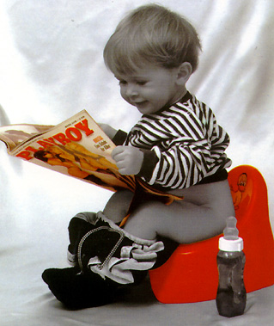

Slide 4
They’re not waiting to learn

Slide 5


Slide 6
They know how to have fun

Slide 7
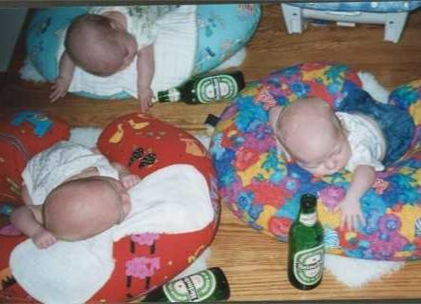

Slide 8
They know how to fight

Slide 9
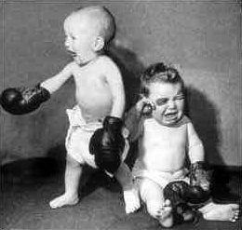

Slide 10
They aim high and far

Slide 11
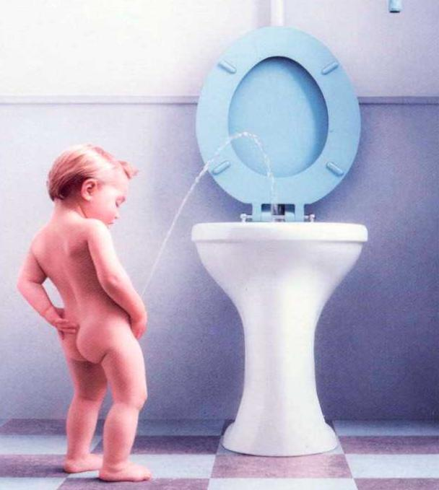

Slide 12
And you know what they’re telling us?

Slide 13


