Slide 1
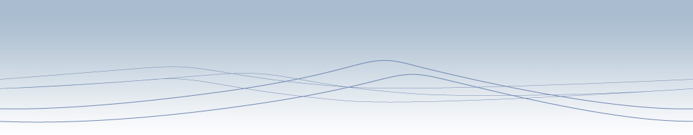



Attribution: University of Michigan Medical School, Department of Microbiology and Immunology
License: Unless otherwise noted, this material is made available under the terms of the Creative Commons Attribution–Noncommercial–Share Alike 3.0 License: http://creativecommons.org/licenses/by-nc-sa/3.0/
We have reviewed this material in accordance with U.S. Copyright Law and have tried to maximize your ability to use, share, and adapt it. The citation key on the following slide provides information about how you may share and adapt this material.
Copyright holders of content included in this material should contact open.michigan@umich.edu with any questions, corrections, or clarification regarding the use of content.
For more information about how to cite these materials visit http://open.umich.edu/education/about/terms-of-use.
Any medical information in this material is intended to inform and educate and is not a tool for self-diagnosis or a replacement for medical evaluation, advice, diagnosis or treatment by a healthcare professional. Please speak to your physician if you have questions about your medical condition.
Viewer discretion is advised: Some medical content is graphic and may not be suitable for all viewers.

Slide 2





Citation Key
for more information see: http://open.umich.edu/wiki/CitationPolicy
Use + Share + Adapt
{ Content the copyright holder, author, or law permits you to use, share and adapt. }
Public Domain – Government: Works that are produced by the U.S. Government. (USC 17 § 105)
Public Domain – Expired: Works that are no longer protected due to an expired copyright term.
Public Domain – Self Dedicated: Works that a copyright holder has dedicated to the public domain.
Creative Commons – Zero Waiver
Creative Commons – Attribution License
Creative Commons – Attribution Share Alike License
Creative Commons – Attribution Noncommercial License
Creative Commons – Attribution Noncommercial Share Alike License
GNU – Free Documentation License
Make Your Own Assessment
{ Content Open.Michigan believes can be used, shared, and adapted because it is ineligible for copyright. }
Public Domain – Ineligible: Works that are ineligible for copyright protection in the U.S. (USC 17 § 102(b)) *laws in your jurisdiction may differ
{ Content Open.Michigan has used under a Fair Use determination. }
Fair Use: Use of works that is determined to be Fair consistent with the U.S. Copyright Act. (USC 17 § 107) *laws in your jurisdiction may differ
Our determination DOES NOT mean that all uses of this 3rd-party content are Fair Uses and we DO NOT guarantee that your use of the content is Fair.
To use this content you should do your own independent analysis to determine whether or not your use will be Fair.

Slide 3

{ Presentation Title }
{ Course Title }
{ Author(s),
Creator(s) }
{ Date / Term }

