Slide 1


Slide 2
Welcome to the session on
“ SOFT SKILLS “
By :
Y N Jagadeesh
Trainer – Soft skills
Blue HR Solutions

Slide 3
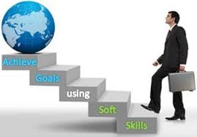
Soft Skills:
CONNECTING TODAY…
SHAPING TOMORROW..

Slide 4
What is Soft Skills ?
“soft skills,” which are defined as skills, abilities, and traits that pertain to personality, attitude, and behavior rather than to formal or technical knowledge” - (Moss and Tilly 2001, p. 44).

Slide 5
What is Hard Skills ?
Hard Skills - the technical requirements of a job (assembly, labor, etc)

Slide 6
What Industry / Organization says…
Technical skill ALONE does not make someone competitive in the job market
In fact, computer literacy skills are assumed!
Today’s our Human resource / workers demonstrate GAPS in:
Communication skills
Team Work
Interpersonal skills
Problem solving,
Project/ Time management etc.,

Slide 7

Communication skills

Slide 8
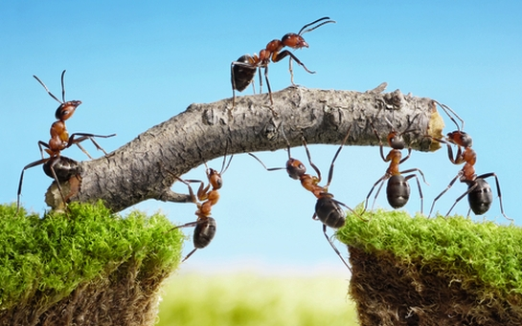
Team Work

Slide 9

Interpersonal skills

Slide 10

Problem solving

Slide 11

Time Management

Slide 12
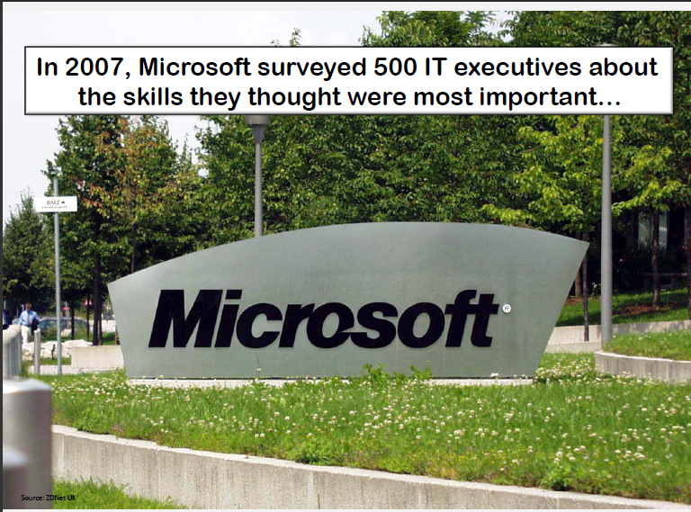

Slide 13
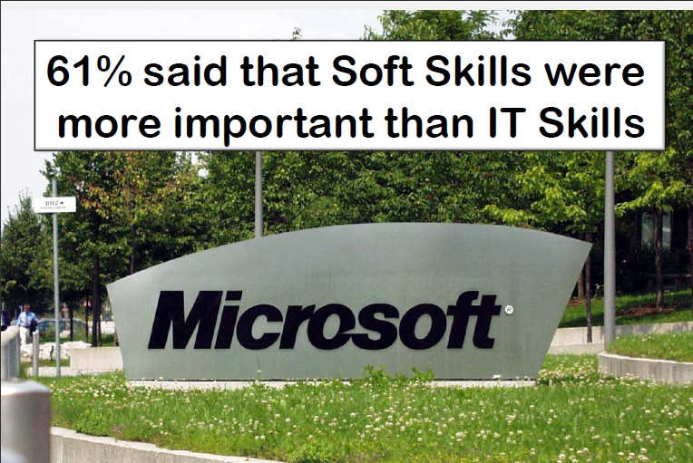

Slide 14

Importance of Soft Skills
To handle interpersonal relations.
To take appropriate decisions .
To communicate effectively.
To have good impression and impact to gain professional development, etc..,

Slide 15

Important Soft skills are..
Strong work ethic.
Positive attitude.
Good Communication skills.
Time management abilities.
Problem – Solving skills.
Acting as a team player.
Interpersonal relations & Self Confidence.
Ability to accept and learn.
Flexibility / Adaptability.
Working well under pressure. Etc..,

Slide 16
What do we really want..
Business and Education should be on the same page…
"There is only one valid definition of business purpose: to create a customer. “
- Peter Drucker
“Technical Skills will get you the interview, but it’s the soft skills that get you the job”
- Heard repeatedly in
Industry Focus Groups

Slide 17
Think about this..
You could have great technical skills, but if you cannot communicate those skills, what good are they?
Life skills..
Soft Skills compliment hard skills, which are the technical requirements of a job”

Slide 18

Soft skill for successful career..
Soft skills with special focus in present scenario is very important because….
“Soft skill is the ability required and expected from persons for finding a suitable job, its maintenance and promotion”

Slide 19
Career Limiting
Moves

Slide 20
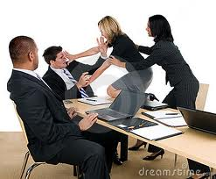
Fighting with others in meetings

Slide 21
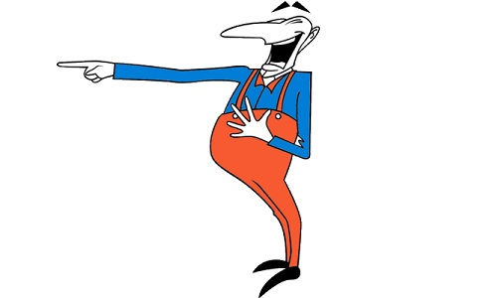
Off - Colour jokes

Slide 22

Bad mouthing – projects or people

Slide 23

Unwillingness to listen to others

Slide 24

Disrespect for authority

Slide 25

Negative Attitude

Slide 26
How can you
improve your
Soft skills..

Slide 27

Look for opportunities
to interact with others

Slide 28

Learn to adapt the way you explain things to people of different ability levels

Slide 29
Conclusion
More and more businesses are considering soft skills as an important job criteria
An increase in all type of industries / Organizations , emphasizes the need for soft skills
Soft skills are used in personal and professional life

Slide 30


