Slide 1
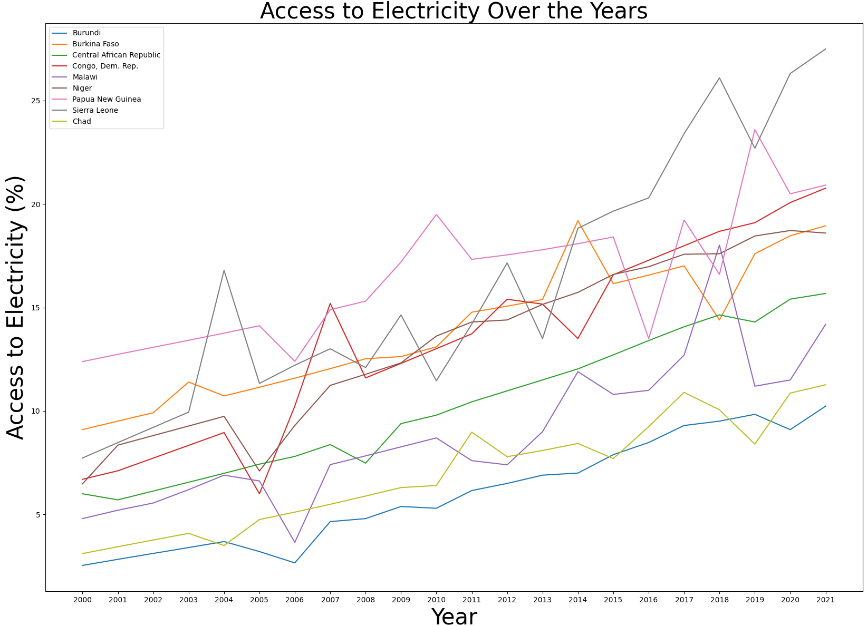
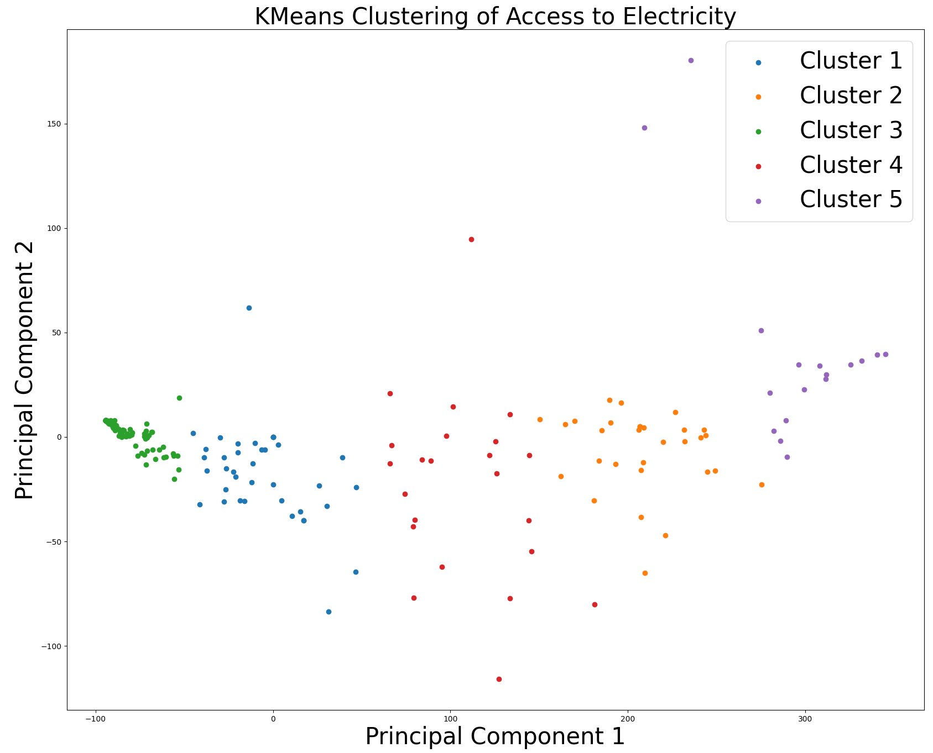
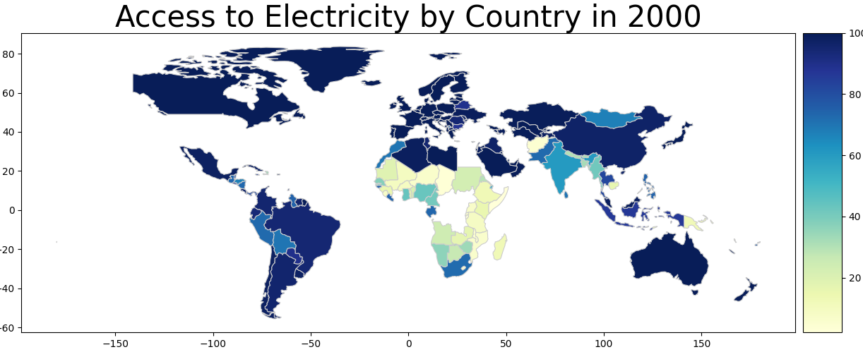
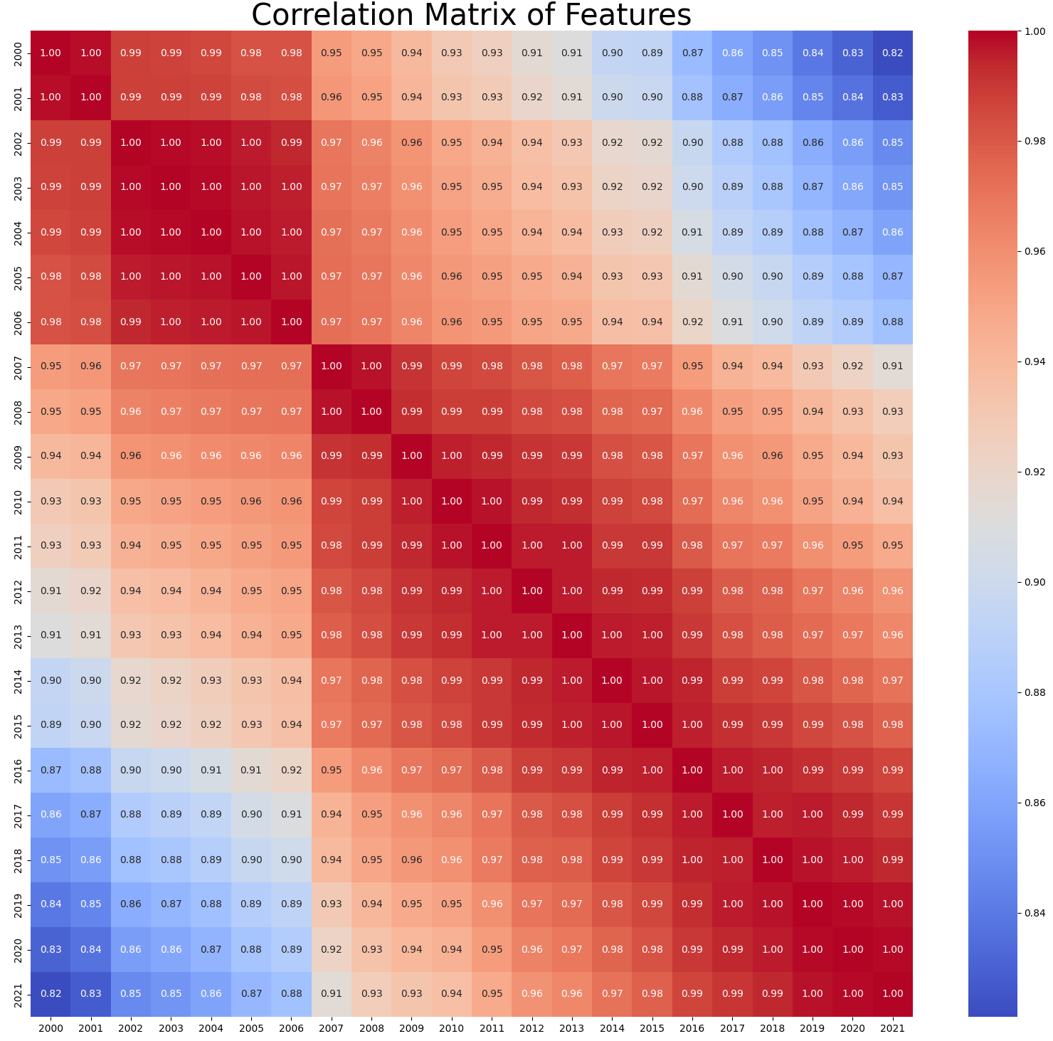
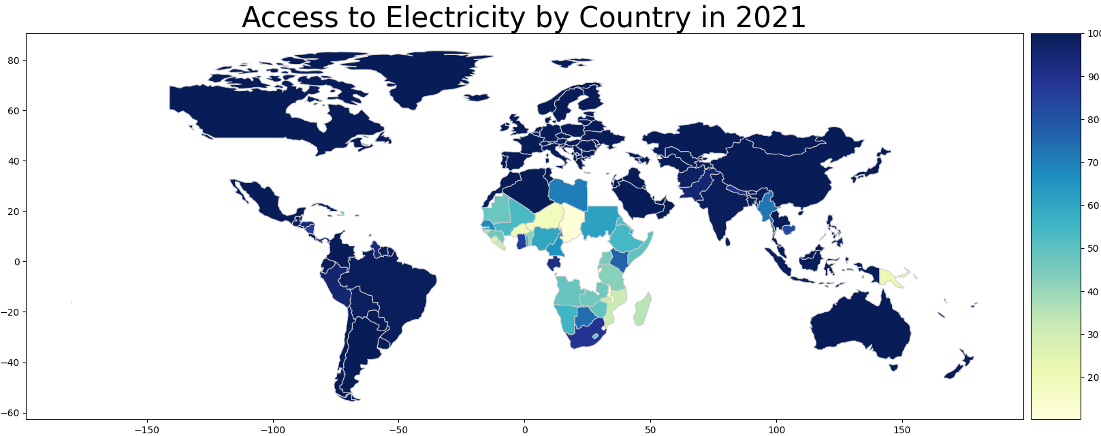
Analysis of Access to Electricity Worldwide
Abstract
Introduction
This study explores global access to electricity from 2000 to 2021, employing K-Means clustering and PCA to identify patterns among countries. The analysis includes a correlation matrix, line plots for historical trends, and a choropleth map illustrating access disparities. The study highlights top performers and offers insights into countries with less than 50% access, guiding targeted interventions for socio-economic development.
Access to electricity is an essential indicator of socio-economic development, reflects a nation's progress and the well-being of its citizens. Through an exploration of key metrics and clustering techniques, we aim to uncover distinct patterns and trends in electrification across diverse countries. Our study not only identifies top performers in providing widespread access but also sheds light on those facing challenges with less than 50% access, offering valuable insights for targeted interventions.
.This study explores global access to electricity from 2000 to 2021, employing K-Means clustering and PCA to identify patterns among countries. The analysis includes a correlation matrix, line plots for historical trends, and a choropleth map illustrating access disparities. The study highlights top performers and offers insights into countries with less than 50% access, guiding targeted interventions for socio-economic development.
Methodology
Line plot:
The plot represents the historical trends in access to electricity for selected countries that meet specific criteria. It allows for a comparison of how access has changed over the years for these countries.
The analysis of global access to electricity from 2000 to 2021 involved a systematic and multi-faceted approach.
K-Means clustering algorithm with five clusters used to identify distinct patterns and groupings among countries based on their access to electricity metrics.
Principal Component Analysis (PCA) was utilized for dimensionality reduction, enabling effective visualization of clustering results.
Geospatial Visualization:
A choropleth map is created using GeoPandas to visualize the access to electricity by country in the year 2000 and 2021. Each country is shaded according to its access value, with a legend for interpretation.
Correlation Matrix
The correlation matrix contains correlation coefficients between each pair of features in the dataset. Correlation coefficients measure the strength and direction of the linear relationship between two variables.
The values range from -1 to 1,
1 indicates a perfect positive correlation
-1 indicates a perfect negative correlation
0 indicates no correlation.
References
Conclusion
Evergreen, S., & Metzner, C. (2013). Design Principles for Data Visualization in Evaluation. In T. Azzam & S. Evergreen (Eds.), Data Visualization, part 2. New Directions for Evaluation, 140, 5–20.
K. Singh and R. Wajgi, "Data analysis and visualization of sales data," 2016 World Conference on Futuristic Trends in Research and Innovation for Social Welfare (Startup Conclave), Coimbatore, India, 2016, pp. 1-6.
Our analysis reveals diverse access to electricity patterns globally. Clustering techniques identify distinct groups, visualizations portray temporal and spatial trends, and a focus on countries with limited access informs targeted interventions.
Name: Geetha Babu STUDENT ID: 22073072 GITHUB LINK: https://github.com/gb23aam/ADS-3.git

