Slide 1
LOAD CELL
2X MOTOR DRIVER
2X ANALOG VOLTAGE
CAN_H
CAN_L
PCBA
2X CAN TRANSCEIVER
IMU
SPI
MCU
SPI
SSI
2X MAG ENCODER
Power
Debug
Power
3.7 V LiPo BATTERY
COMPUTER
USB
ST-LINK
(NUCLEO)
Early Stance
Mid Stance
Heel Strike (Load Cell < TH)
Body Over Ankle (Ankle Speed < 0)
Foot Flat (Foot Speed > 0)
Swing Descension
Late Stance
Foot Descent (Foot Speed < 0)
Knee Extension (Knee Speed < 0)
Toe Off (Load Cell > TH)
Swing Extension
Swing Flexion

Slide 2
Color Key
Start
A
CubeMonitor
Firmware
Initialize Devices
Shutdown Motors
Error?
Yes
A
Red LED
Display Error Messages
No
Set Test Program
while(1);
Get Inputs:
Encoders
Load Cell IMU
Process Inputs:
Differentiate Encoder
Filter Load Cell IMU Orientation Adjustment
Calculate Foot Speed
Run State Machine
Test Program != Impedance Control
No
Assign Control Parameters regardless of State
Yes
Assign Control Parameters per State
No
Test Program = None
Yes
Apply Motor Torque
No
EPOS4 Error?
Yes
A

Slide 3
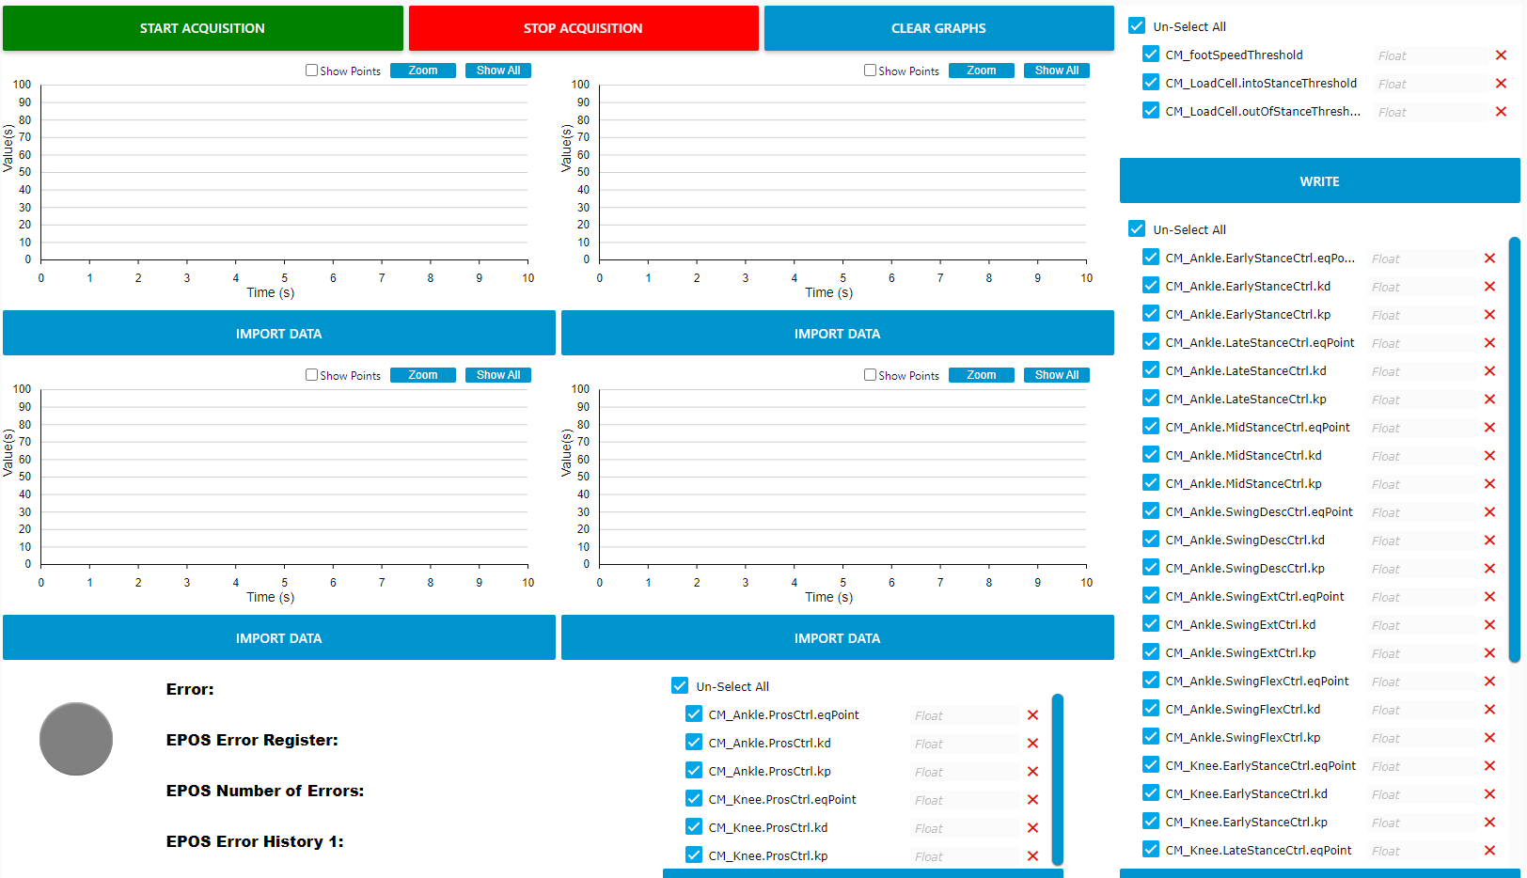
Thresholds
Joint Angles
Load Cell
Joint Torques
Joint & Foot Speeds
State Machine Control
LED & Errors
Impedance Control

Slide 4
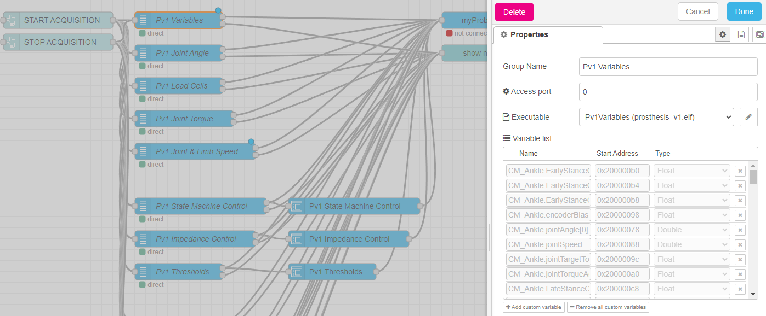
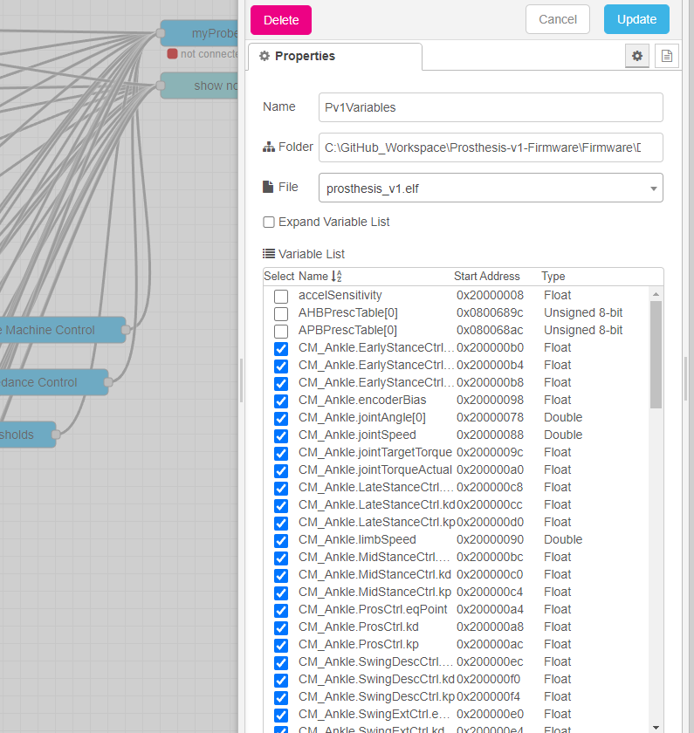
1
5
4
6
2
3

