Slide 1
WEEK 12 CRYPTOGRAPHY
VIC Cipher
PLAINTEXT
MEET AT NOON
Cold War spy cryptography and a Python spy-app demo
SECRET KEY
secret-1970
CIPHERTEXT
04 09 03 22
99 18 00 99
25 22 17 22
Individual Team 6 Work

Slide 2
CORE IDEA
What Is The VIC Cipher?
A hand cipher associated with Cold War espionage.
Connected to Soviet spy Reino Hayhanen.
Used numbers, secret key material, substitution, and transposition.
Important because it was unusually strong for a paper-and-pencil cipher.
Presenter reminder
Say the idea simply first, then show how the demo proves it.
Week 12 Cryptography | VIC Cipher / Spy App
2

Slide 3
CORE IDEA
Why Spies Used Ciphers
Messages could be protected without computers.
Intercepted messages looked like random number groups.
The receiver needed the same secret key to decrypt.
The purpose was to hide both the words and the patterns.
Presenter reminder
Say the idea simply first, then show how the demo proves it.
Week 12 Cryptography | VIC Cipher / Spy App
3

Slide 4
CORE IDEA
Cryptography Terms I Use
Plaintext: the original readable message.
Ciphertext: the encrypted message.
Key: secret information used to encrypt and decrypt.
Substitution and transposition: changing values and order to hide meaning.
Presenter reminder
Say the idea simply first, then show how the demo proves it.
Week 12 Cryptography | VIC Cipher / Spy App
4

Slide 5
PROCESS
How The VIC Cipher Works At A High Level
1
2
3
4
Secret key material
Generate numbers
Convert message
Mix and send
→
→
→
A phrase, date, or other shared secret starts the process.
The key creates number sequences used to transform the message.
The readable message is converted into letters or number groups.
Substitution and transposition make the final message hard to read.
My demo simplifies this into: message + key → encrypted number groups → same key recovers the message.
Week 12 Cryptography | VIC Cipher / Spy App
5

Slide 6
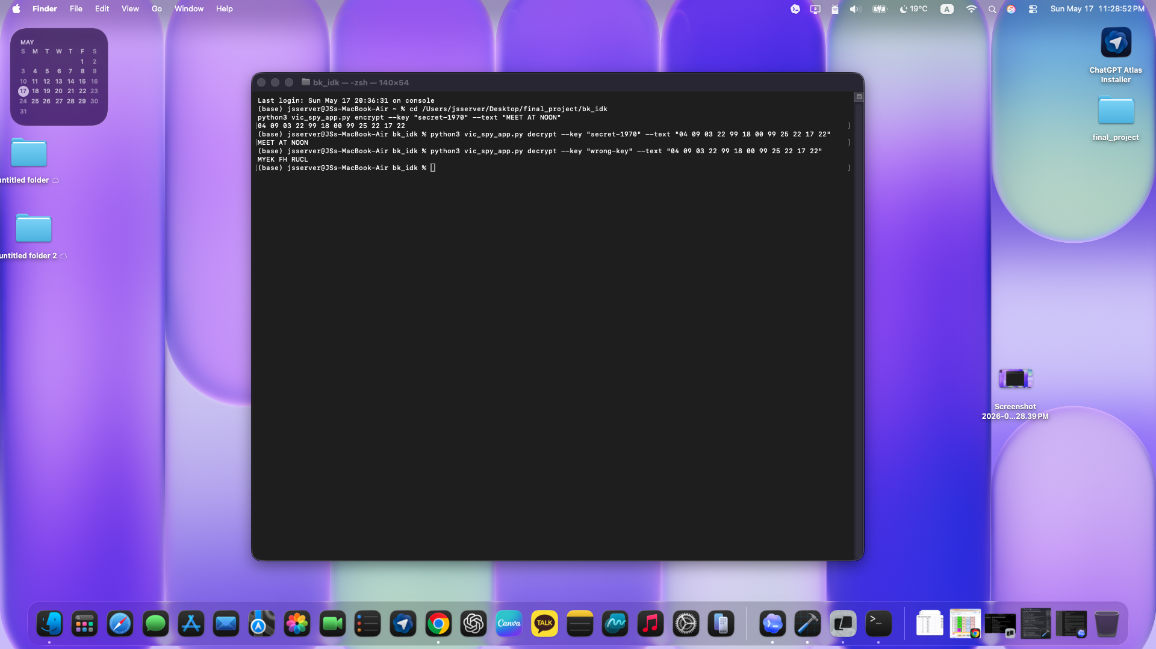
PROOF
Python Demo: Correct Key vs Wrong Key
Encrypt
The message becomes number groups.
Correct key
Decrypts back to MEET AT NOON.
Wrong key
Produces unreadable text.
This proves the central cryptography idea: the secret key controls whether the ciphertext can be read.
Week 12 Cryptography | VIC Cipher / Spy App
6

Slide 7
CORE IDEA
What My Spy App Shows
The user enters a message and a secret key.
The app converts the message into encrypted number groups.
The same key recovers the original message.
A wrong key gives wrong text, proving why the secret matters.
Presenter reminder
Say the idea simply first, then show how the demo proves it.
Week 12 Cryptography | VIC Cipher / Spy App
7

Slide 8
Conclusion
The VIC cipher shows that strong cryptography existed before modern computers.
A secret key is the heart of encryption and decryption.
My Python app demonstrates the core idea safely for education.
Ethics
Cryptography protects privacy and security. Demonstrations should stay educational and authorized.
Thank you

