Slide 1
WEEK 12 CRYPTOGRAPHY
VIC Cipher
PLAINTEXT
MEET AT NOON
Cold War spy cryptography
with a Python spy-app demo
SECRET KEY
secret-1970
CIPHERTEXT
04 09 03 22 99 18
00 99 25 22 17 22
Name / Student ID: ____________________

Slide 2
HISTORICAL CONTEXT
What Is The VIC Cipher?
A strong paper-and-pencil cipher used in Cold War espionage.
1
2
3
Cold War
Hand Cipher
Advanced
Secret communication mattered because messages could be intercepted.
It could be done without a computer, using numbers and written steps.
It combined multiple transformations, making analysis much harder.
VIC Cipher / Spy App | Week 12 Cryptography
02

Slide 3
WHY IT MATTERS
Why Spies Used Ciphers
The ciphertext should be useless to someone who does not have the key.
Protect secret messages during transmission.
Make intercepted communication look like random number groups.
Allow the receiver to recover the original message with shared secret information.
Hide patterns so the message is harder to analyze.
Intercepted message
04 09 03 22
99 18 00 99
25 22 17 22
Without the key, these numbers should not reveal the message.
VIC Cipher / Spy App | Week 12 Cryptography
03

Slide 4
VOCABULARY
Cryptography Terms
These are the words I use during the demo.
Plaintext
Ciphertext
Readable original message
Encrypted protected message
Key
Decryption
Secret needed to decrypt
Turning ciphertext back into plaintext
VIC Cipher / Spy App | Week 12 Cryptography
04

Slide 5
PROCESS
VIC Cipher At A High Level
The historical cipher is complex; this is the understandable class version.
1
2
3
4
5
Secret key material
→
Generate number sequences
→
Convert message into numbers
→
Substitute + transpose
→
Send encrypted groups
Simple explanation: the key controls how the message is changed, and the same key is required to reverse it.
VIC Cipher / Spy App | Week 12 Cryptography
05

Slide 6
MY BUILD
Python Spy App Demo
A simplified VIC-inspired demo, made for education.
Message + Secret Key
Cleans the message into uppercase letters.
Creates repeatable key-based number shifts.
Outputs two-digit encrypted number groups.
Uses the same key to decrypt the message.
encrypt(message, key)
MEET AT NOON
secret-1970
→ 04 09 03 22 99 18 00 99 25 22 17 22
VIC Cipher / Spy App | Week 12 Cryptography
06

Slide 7
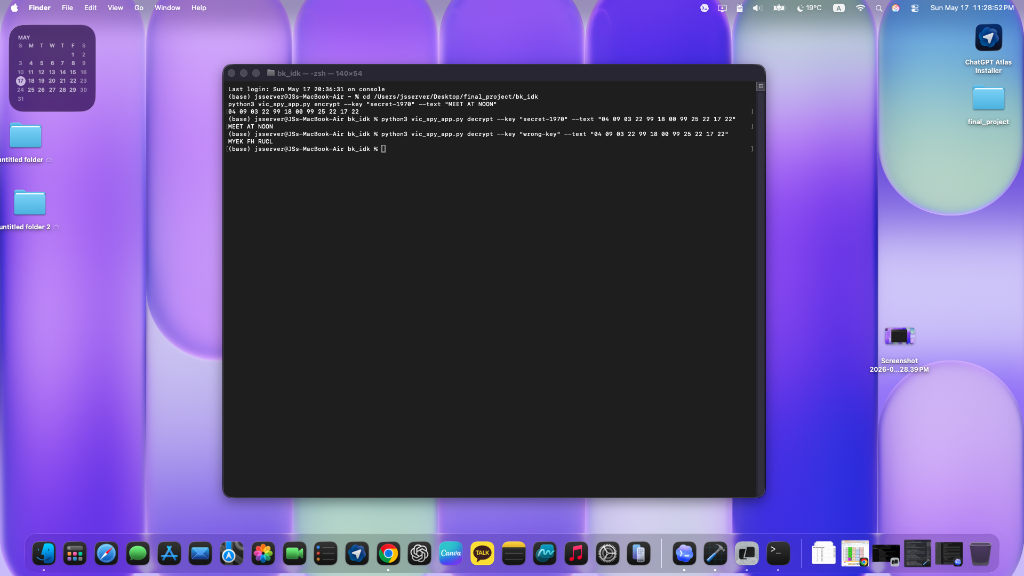
LIVE PROOF
Correct Key vs Wrong Key
Your terminal output shows that the demo actually works.
Encrypt
Message becomes number groups.
Correct key
Returns MEET AT NOON.
Wrong key
Returns unreadable text.
VIC Cipher / Spy App | Week 12 Cryptography
07

Slide 8
SECURITY ANALYSIS
What The Demo Proves
The most important lesson is key dependency.
Confidentiality
Key dependency
The output hides the original words.
Correct key works; wrong key fails.
Pattern hiding
Education only
The message becomes number groups.
Not for real-world secure messaging.
VIC Cipher / Spy App | Week 12 Cryptography
08

Slide 9
ETHICS AND LIMITS
What This Is Not
A good security presentation also explains boundaries.
Limitations
Ethics
Not the full historical VIC cipher.
Not secure enough for real private messages.
Modern systems use reviewed algorithms like AES, RSA, and ECC.
Use cryptography to protect privacy and security.
Keep demos educational and authorized.
Explain risks honestly instead of overstating claims.
VIC Cipher / Spy App | Week 12 Cryptography
09

Slide 10
Conclusion
The VIC cipher shows that cryptography was powerful before modern computers.
Historical ciphers used secret keys and layered transformations.
My Python app demonstrates the core idea safely.
The correct key recovers the message; the wrong key does not.
Final line to say
Without the correct key, ciphertext should not reveal the original message.
Thank you

